Slide 1
ANR Office of
Risk Services
Linda (Oristine) Harris
olharris@ucanr.edu
http://ucanr.edu/sites/anrstaff/Administration/Business_Services/Controller/Risk_Services/

Slide 2
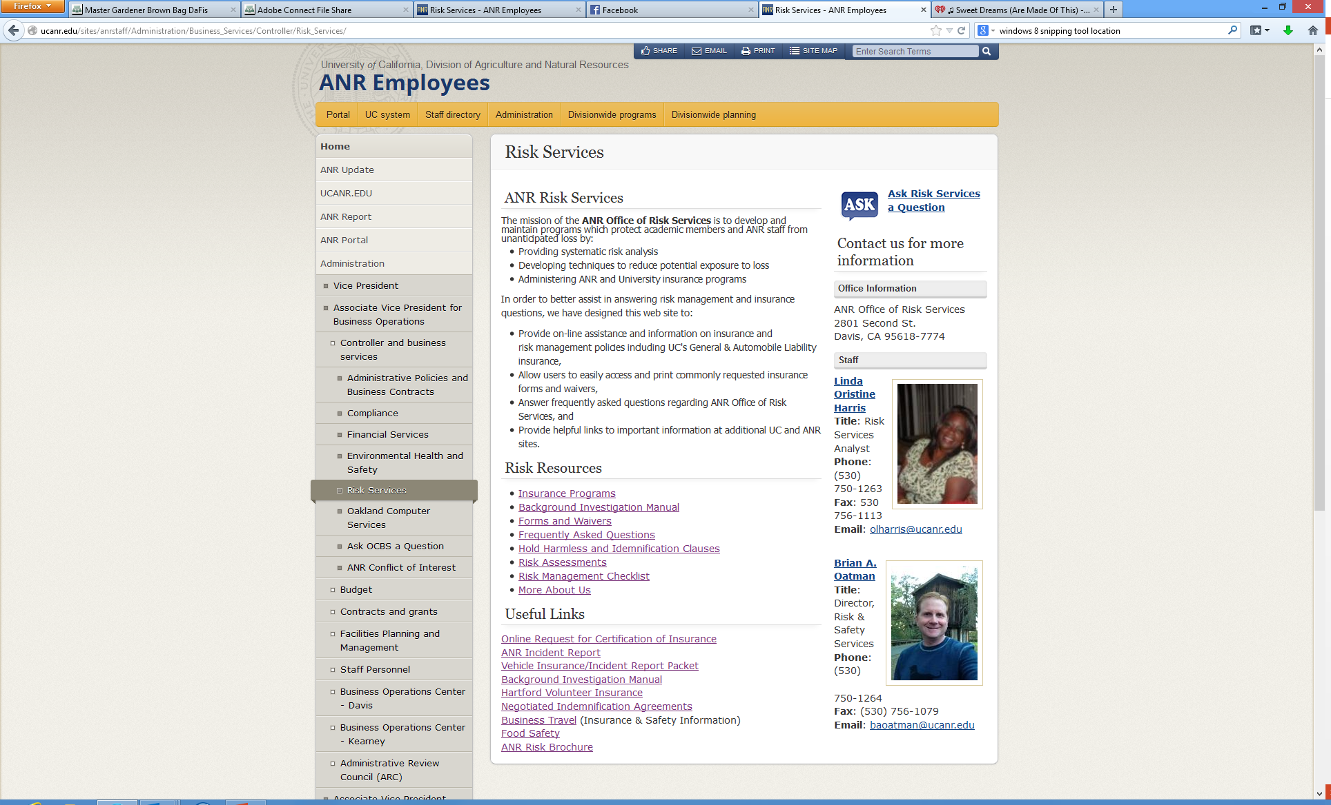

Slide 3
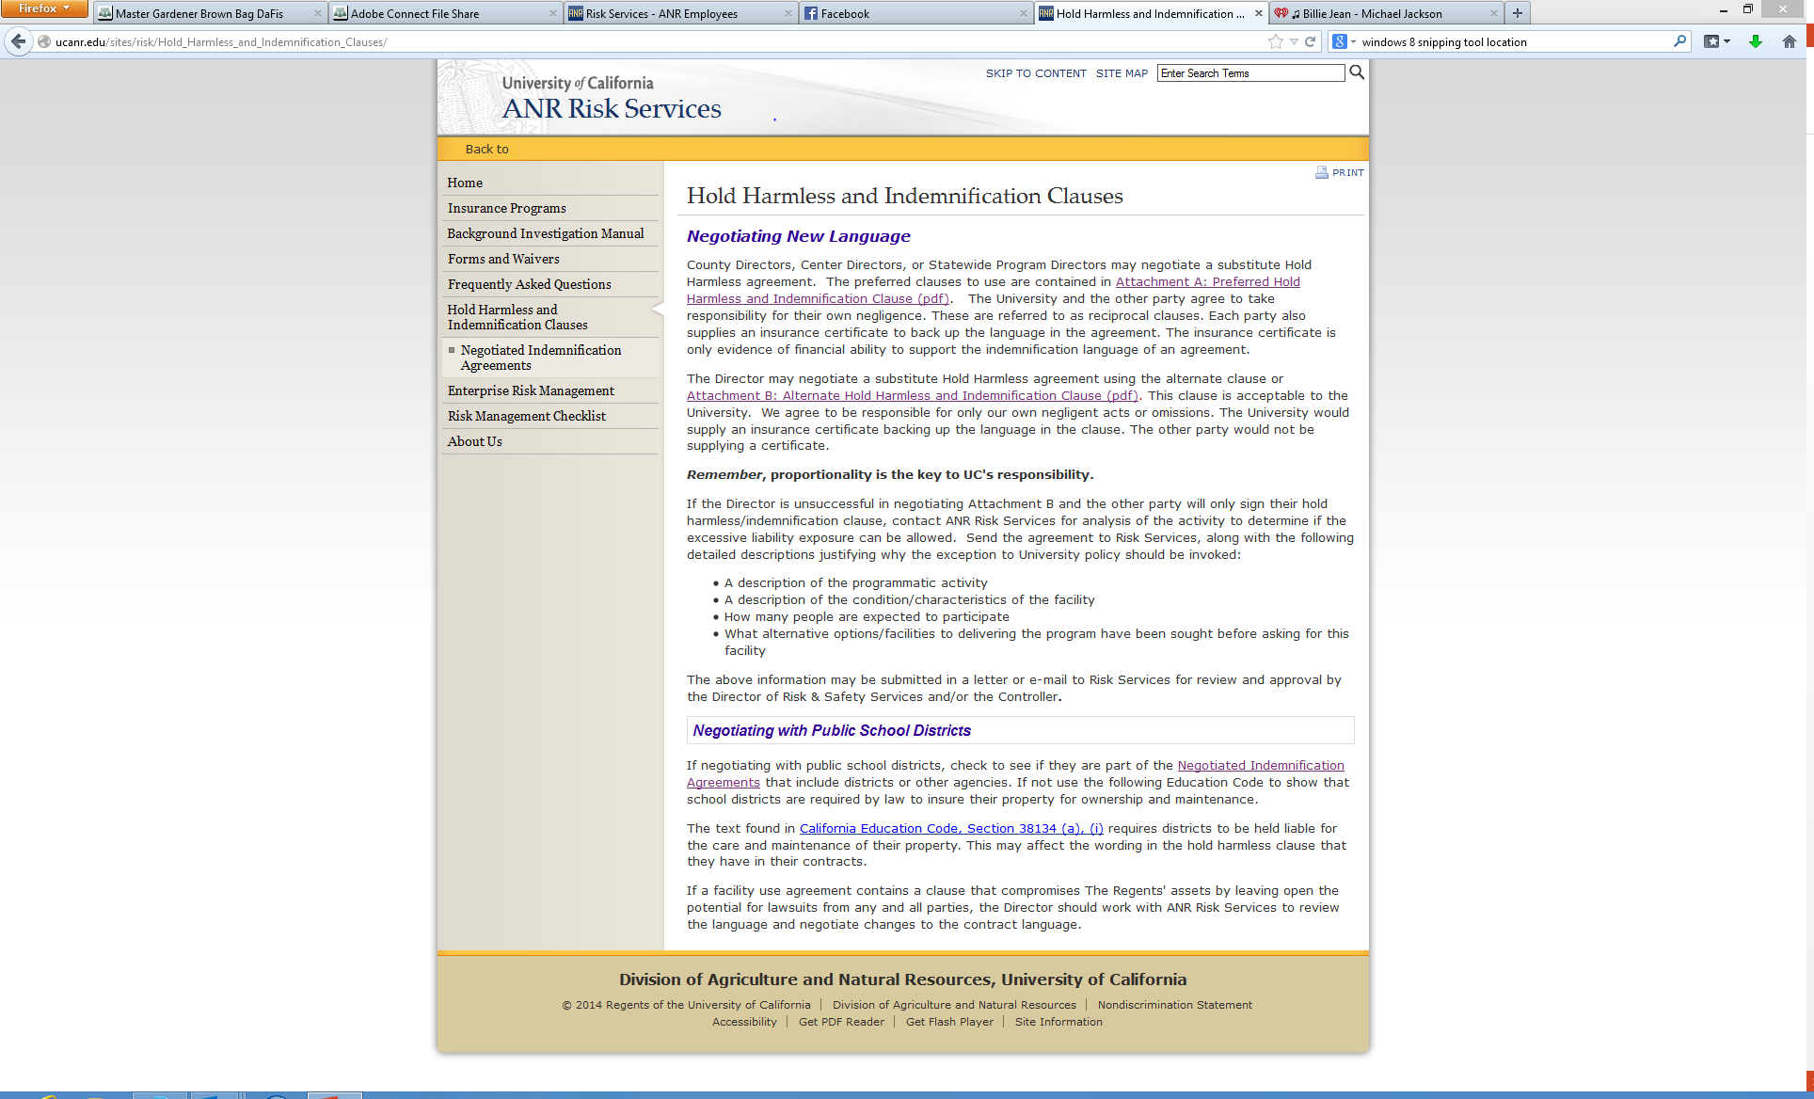

Slide 4
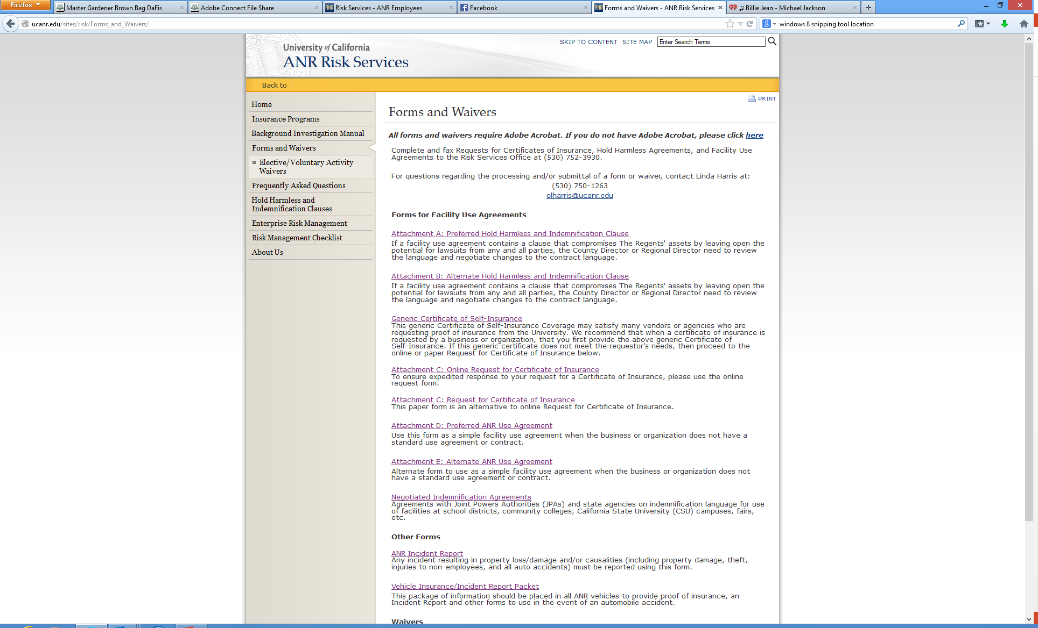

Slide 5
Understanding Facility Use Agreements
What Forms Do I Need to Reserve a Room/Facility for a Meeting or Activity?
What Forms Do I Need to Prepare for Garden Tours?
What Forms Do I Need for Pruning Demonstrations/Meetings on Private Property?
What Do I Need for Booths in Farmers Markets/Fairs, etc.?
What Do I Need for Bus Trips and Tours?

Slide 6
What Forms Do I Need to Reserve a Room/Facility for a Meeting or Activity?
If the facility has an agreement which has language that is not favorable to UC’s responsibility of proportionality the Attachment B should be used to modify the hold harmless language. In some instances the Attachment A should be used which has reciprocal language where both parties agree to be responsible for their negligent or intentional acts. Cross out the language and write “See Attachment B or A”.
The county director or program director is the only person authorized to sign these agreements and attachments. If the facility requires proof of insurance you may provide the generic certificate of insurance, however if they want to be named as an additional insured you will need to complete the Online Request for Certificate of Insurance.
If the facility does not have an agreement in most instances the Attachment D which has reciprocal language should be used as the agreement, as well as obtain proof of the facility’s liability insurance (declaration page). In some instances, facilities i.e., (city, county, school districts, fire and police departments) an Attachment E should be used which usually does not require proof of insurance since these entities are typically self-insured. If the facility requires proof of insurance you may provide our Generic Certificate of Insurance, however if they want to be named as an additional insured you will need to complete the Online Request for Certificate of Insurance.

Slide 7
What Forms Do I Need to Prepare for Garden Tours?
An Attachment D should be prepared and proof of liability insurance (declaration page) obtained from the homeowner. You will also need to complete the Online Request for Certificate of Insurance to provide UC’s insurance coverage to the homeowner.
There are instances where a homeowner may object to completing the Attachment D because it states that they agree to indemnify UC. In this situation you should use the Attachment E and obtain the proof of liability insurance and complete the Online Request for Certificate of Insurance to provide UC’s insurance coverage to the homeowner.

Slide 8
What Forms Do I Need for Pruning Demonstrations/Meetings on Private Property?
Typically, you will complete the Attachment D the same as for a garden tour and obtain proof of liability insurance (declaration page) from the homeowner/landowner. You will also need to complete the Online Request for Certificate of Insurance to provide UC’s insurance coverage to the homeowner/landowner.

Slide 9
What Forms Do I Need for Booths in Farmers Markets/Fairs, etc.?
Typically Farmers Markets have an agreement to complete which may have language that is not favorable to UC. If this is the case, the Attachment B should be used to modify the hold harmless language in the agreement. Cross out the language and write “See Attachment B”. If the facility requires proof of insurance you may provide our generic certificate of insurance, however if they want to be named as an additional insured you will need to complete the Online Request for Certificate of Insurance.
District Agricultural Associations and most of the Fair Authorities have agreements to complete, however they have agreed upon indemnification language, which is the Attachment A language. There is also a fair letter that you may attach to the agreement after you cross out the unfavorable language and write “See Attachment A or See Fair Letter”. You will also need to complete the Online Request for Certificate of Insurance to provide UC’s insurance coverage.

Slide 10
What Do I Need for Bus Trips and Tours?
You may go through purchasing to enter into a contract with a bus company for transportation that is on UC ‘s approved vendor list, or you may contract with a company directly that you have a relationship with. In either case you will need to make sure that the bus company has adequate levels of liability insurance and obtain their proof of insurance.
If the bus company will be transporting up to 20 persons they will need a minimum of $5 million dollars of combined general aggregate insurance. If they will be transporting over 20 persons, the combined general aggregate limit should be $15 million. If you are not sure of their limits you may forward the proof of insurance to Risk Services for review.

Slide 11
What Forms Do I Complete When
There is an Injury or Accident?
Injuries to Master Gardener volunteers should be reported on the ANR Incident Report and sent to Risk Services. You may also need to complete and submit the Hartford Insurance form for payment/reimbursement of medical treatment for the volunteer when they have all their receipts, etc. to the Hartford. (See Hartford Volunteer Insurance link below) Please provide Risk Services a copy of these documents to be placed with the incident report.
Injuries to Employees should be reported on the Workers’ Compensation forms.
Auto accidents involving UC Owned/County Owned vehicles should be reported using the ANR Incident Report and/or a copy of the County incident report along with the police report if applicable.
http://safety.ucanr.org/Guidelines/Reporting_an_Injury/
http://ucanr.edu/sites/risk/Insurance/Hartford_Volunteer_Insurance/

