Slide 1


Welcome to Zoom Training
Notes:
(Question to Audience)
1. Who has heard of zoom? Raise of Hands
2. Who here has used it?
We are really excited about this product and we are excited to share this with you and our division. EVERYONE within UCANR has a zoom account and we are going to walk you through the process of activating your zoom account, the basics of hosting, joining and scheduling zoom meetings.

Slide 2




Current Applications in Use
Zoom combines chat, video conferencing, online meetings, and mobile collaboration into one unified platform.
Notes:
Zoom is a one stop shop it unifies video conferencing, simple online meetings and mobile collaboration into one single platform. We are really excited about this product and we are excited to share this with you and our division. EVERYONE within UCANR has a zoom account and we are going to walk you through the process of logging into your account and walk you through the basics of hosting, joining and scheduling meetings we’re going to present to you this new product and show you how to incorporate it into your workflow.

Slide 3
Today’s Agenda
HW-SW requirements
Downloading and Logging In
Host a Meeting
Schedule a Meeting
Join a Meeting
Desktop Controls
Meeting Controls
Profile Management
Large Meetings & Webinars
Q&A

Slide 4
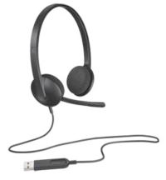
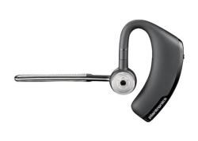
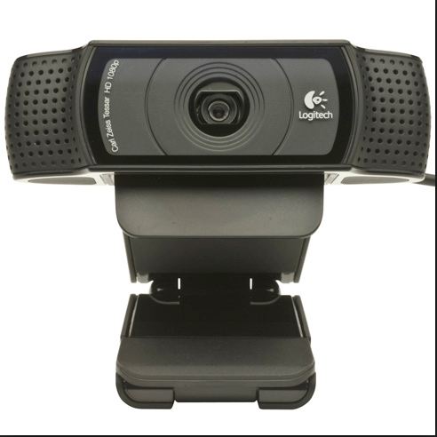
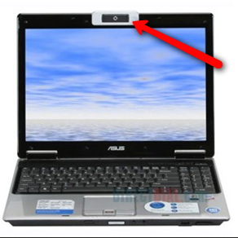
Hardware Requirements
An internet connection - wired or wireless
Webcam - Built in Camera or USB Camera
Speakers/Microphones- Built in or External USB and Bluetooth
Phone
ucanr.edu/sites/zoom

Slide 5
Software Requirements
Supported Operating Systems
MacOS 10.6.8 or later
Windows 10
Windows 8 or 8.1
Windows 7
iOS and Android

Slide 6
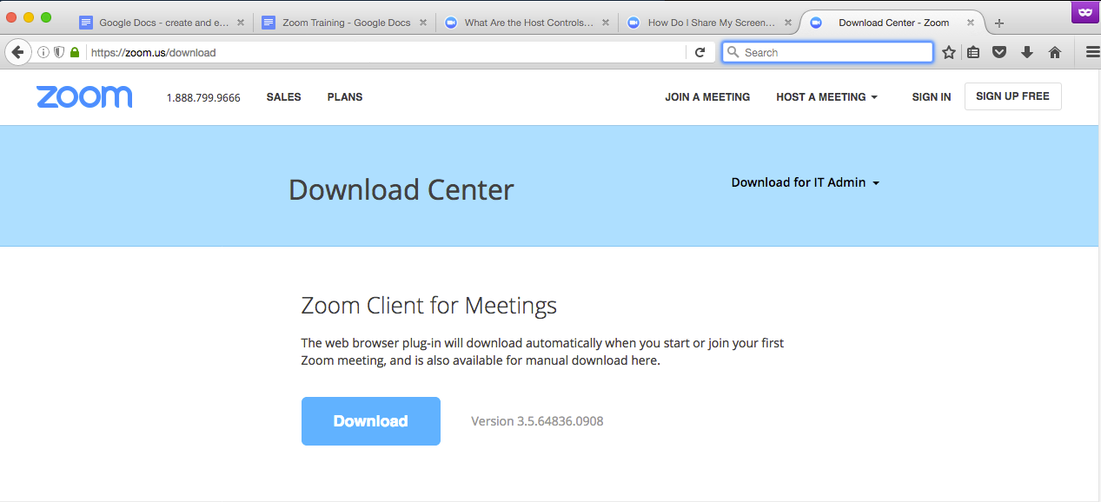
Zoom Application Download
Logging in.
Desktop Application - https://zoom.us/download
Download and install the desktop application.

Slide 7
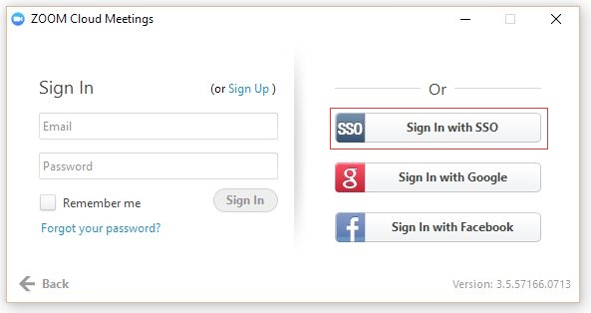
Logging in with portal credentials
Zoom Application Download
In this window select the option for “Sign in with SSO”.

Slide 8
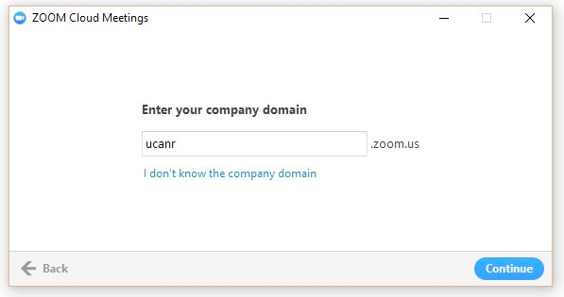
Logging in with portal credentials
Zoom Application Download
After downloading and installing the application in the zoom cloud meetings window enter your company domain “ucanr”.

Slide 9
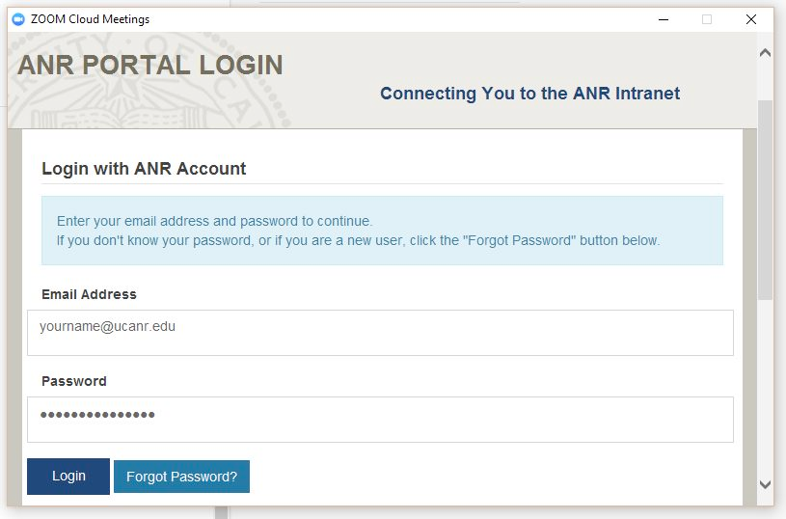
Logging in with portal credentials
Zoom Application Download
The portal log in window should appear. Log in with your ucanr email and portal password.

Slide 10
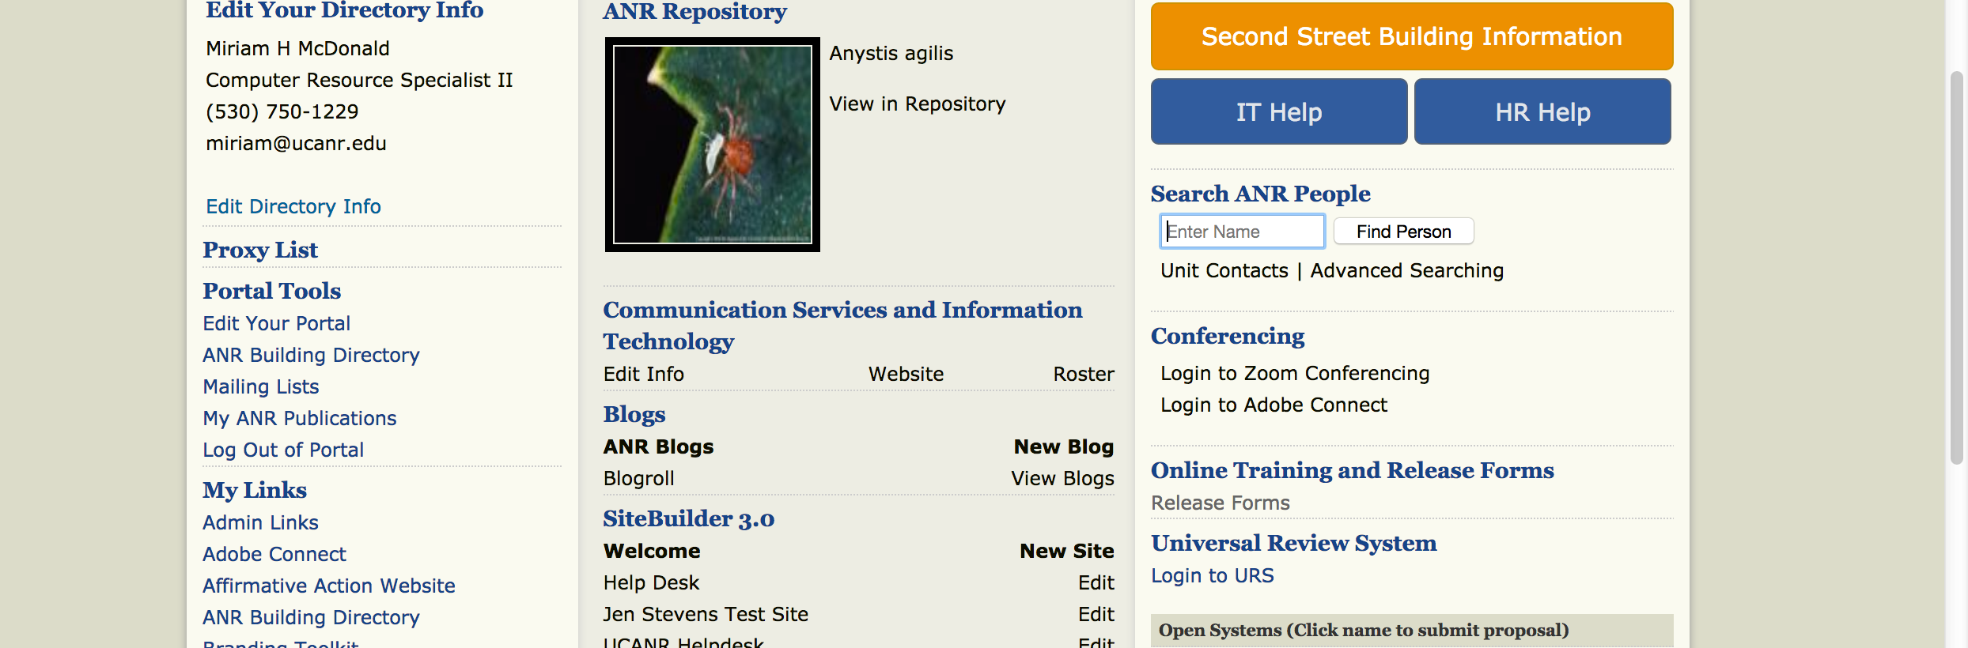
Logging In Via Portal Credentials
From the portal— ucanr.edu/portal
Click on the “Login to Zoom Conferencing” link.

Slide 11
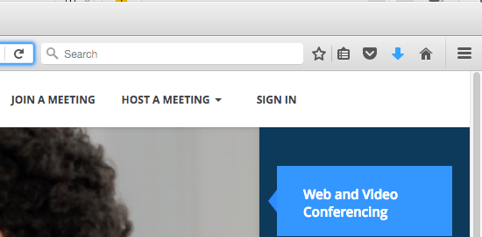
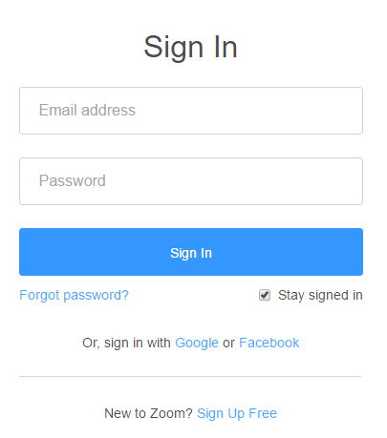
Logging in without ANR credentials
If you are an ANR affiliate and you don’t have an at ucanr.edu email address this is how to log into zoom.
https://zoom.us/ -“sign in” on the upper right.
Enter your email and password.
Notes:
We have provided ANR affiliates with Zoom accounts but their sign in method differs from ANR staff with @ucanr emails.

Slide 12
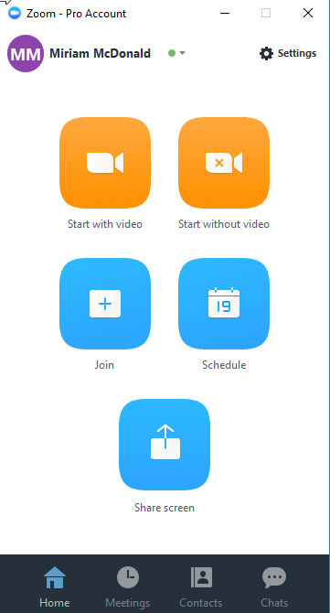
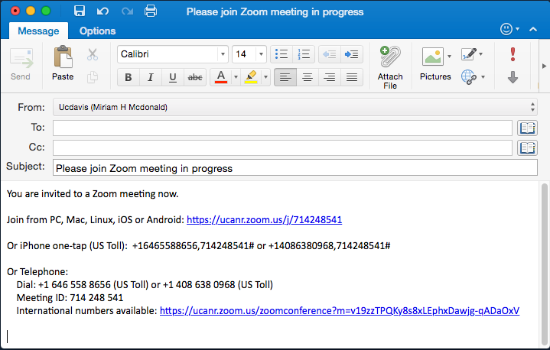
Hosting a Meeting
Instant Meeting with video
Instant Meeting without video
Invite by email
Invite by meeting ID
Via website ucanr.zoom.us
Notes:
Instant Meeting without video
Invite by meeting ID
Invite by email

Slide 13
Schedule a meeting
On the Home menu select the schedule button.

Slide 14
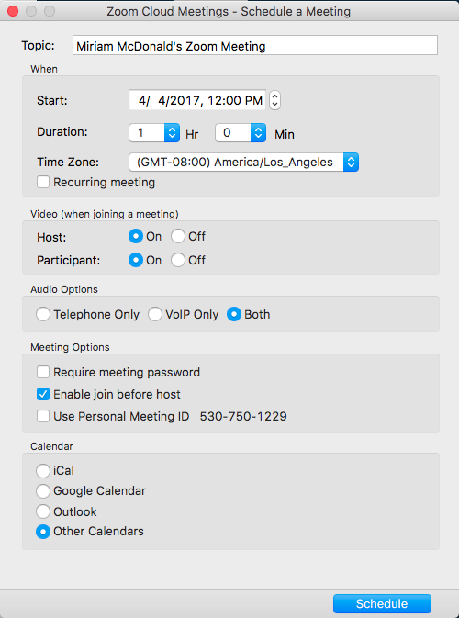
Schedule a meeting
In the schedule panel you can set the following:
Topic, Start, Duration and time zone
Recurring meetings
Allow hosts and participants to join
Audio options (always select both)
Meeting password, enable join before host and PMI
When you click on schedule the meeting will default to your calendar. Outlook will open with a drafted email ready for you to invite others and send.

Slide 15
Joining a meeting
There are several ways to join a meeting.
Email invite
Instant Meeting ID (desktop client must be running)
Join by Phone (dial in)
By Website ucanr.zoom.us via the meeting ID

Slide 16
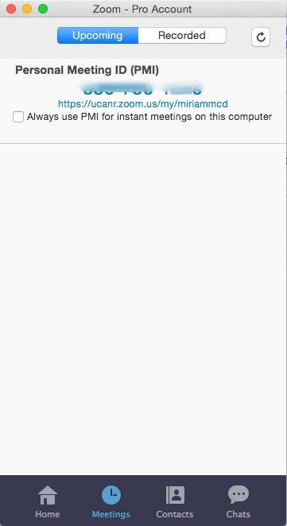
Desktop Controls
~ Home Button ~
This will always take you to your “Home” screen.
Click on Start without video to start a meeting sharing your "desktop" or “application".
Click on Start with video to start a video meeting.
Click on Schedule to set up a future meeting.
Click on Join to join a meeting that is already in progress.
Notes:
screenshots and language of what they do,

Slide 17
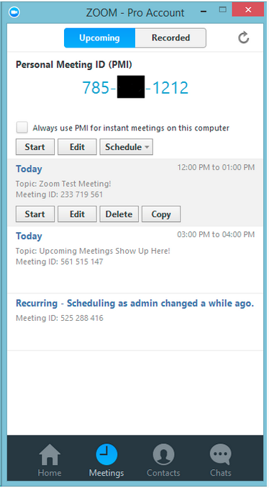
Desktop Controls
~ Meeting Button ~
Start: Selecting start will start the pre-scheduled meeting that you have listed in your upcoming meetings.
Edit: You can edit or update your scheduled meeting.
Delete: Selecting delete will permanently delete your scheduled meeting.
Copy: Here you can copy your scheduled meeting(s) invitation text and manually paste into an email, IM, SMS etc.
Notes:
screenshots and language of what they do,

Slide 18
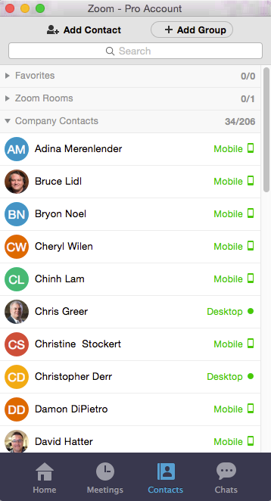
Desktop Controls
~ Contacts Button ~
Allows you to see who is available on zoom via desktop or mobile app.
You can create groups or manually add a contact.
When you select a name you can chat them or start an instant meeting.
Notes:
screenshots and language of what they do,

Slide 19
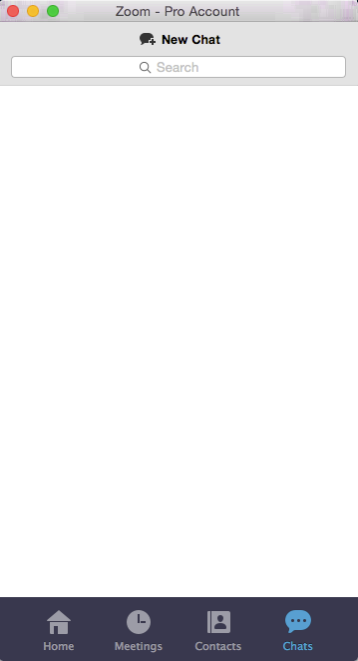
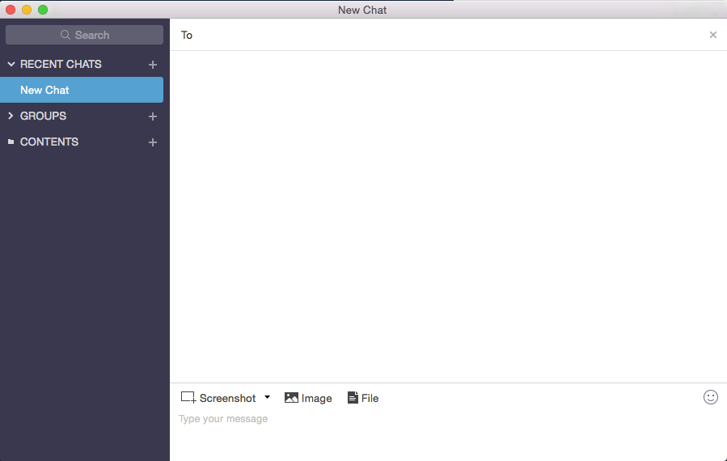
Desktop Controls
~ Chat Button ~
Allows you to start a new chat with other zoom users. You can chat with groups and you can upload files, images and screenshots to one another.
Notes:
screenshots and language of what they do,

Slide 20
Meeting Controls
Attendee Controls Toolbar
Mute/Unmute your microphone
Turn on/off camera
Invite other participants
View Participant list
Share Screen
Chat - with individuals or all.
Record - if host gives you permission.
Leave Meeting

Slide 21
Meeting Controls
Host Controls Toolbar
Mute/Unmute your microphone
Turn on/off camera
Invite other participants
Manage Participant list
Share Screen
Chat - with individuals or all.
Record - if host gives you permission.
Breakout Sessions
End Meeting

Slide 22
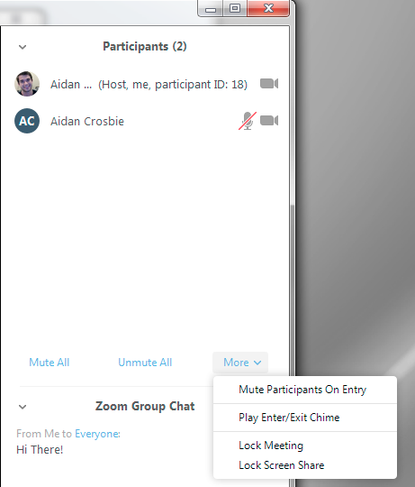
Meeting Controls
Host Controls
The Host of the meeting will have control over all functions and features in the meeting. To access these controls select manage participants in the toolbar.
Mute/Un mute all
Mute participants on entry
Play Enter Exit Chime
Lock Meeting - so no other participants can join
Lock Screen share - attendees will not be allowed to screen share

Slide 23
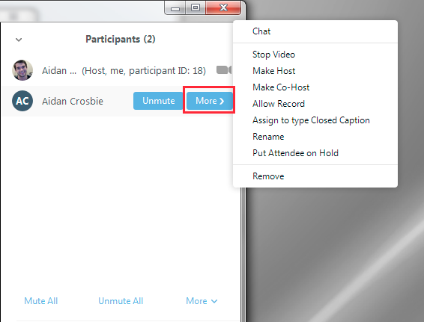
Meeting Controls
Host Controls
Stop/Start video
Make Host - As a Host you can ask another participant to be a host, you can always “reclaim host” and take it back.
Remove - remove a person from the meeting.
Allow Record - Allow an attendee to record the meeting.
Rename
Put Attendee on hold

Slide 24
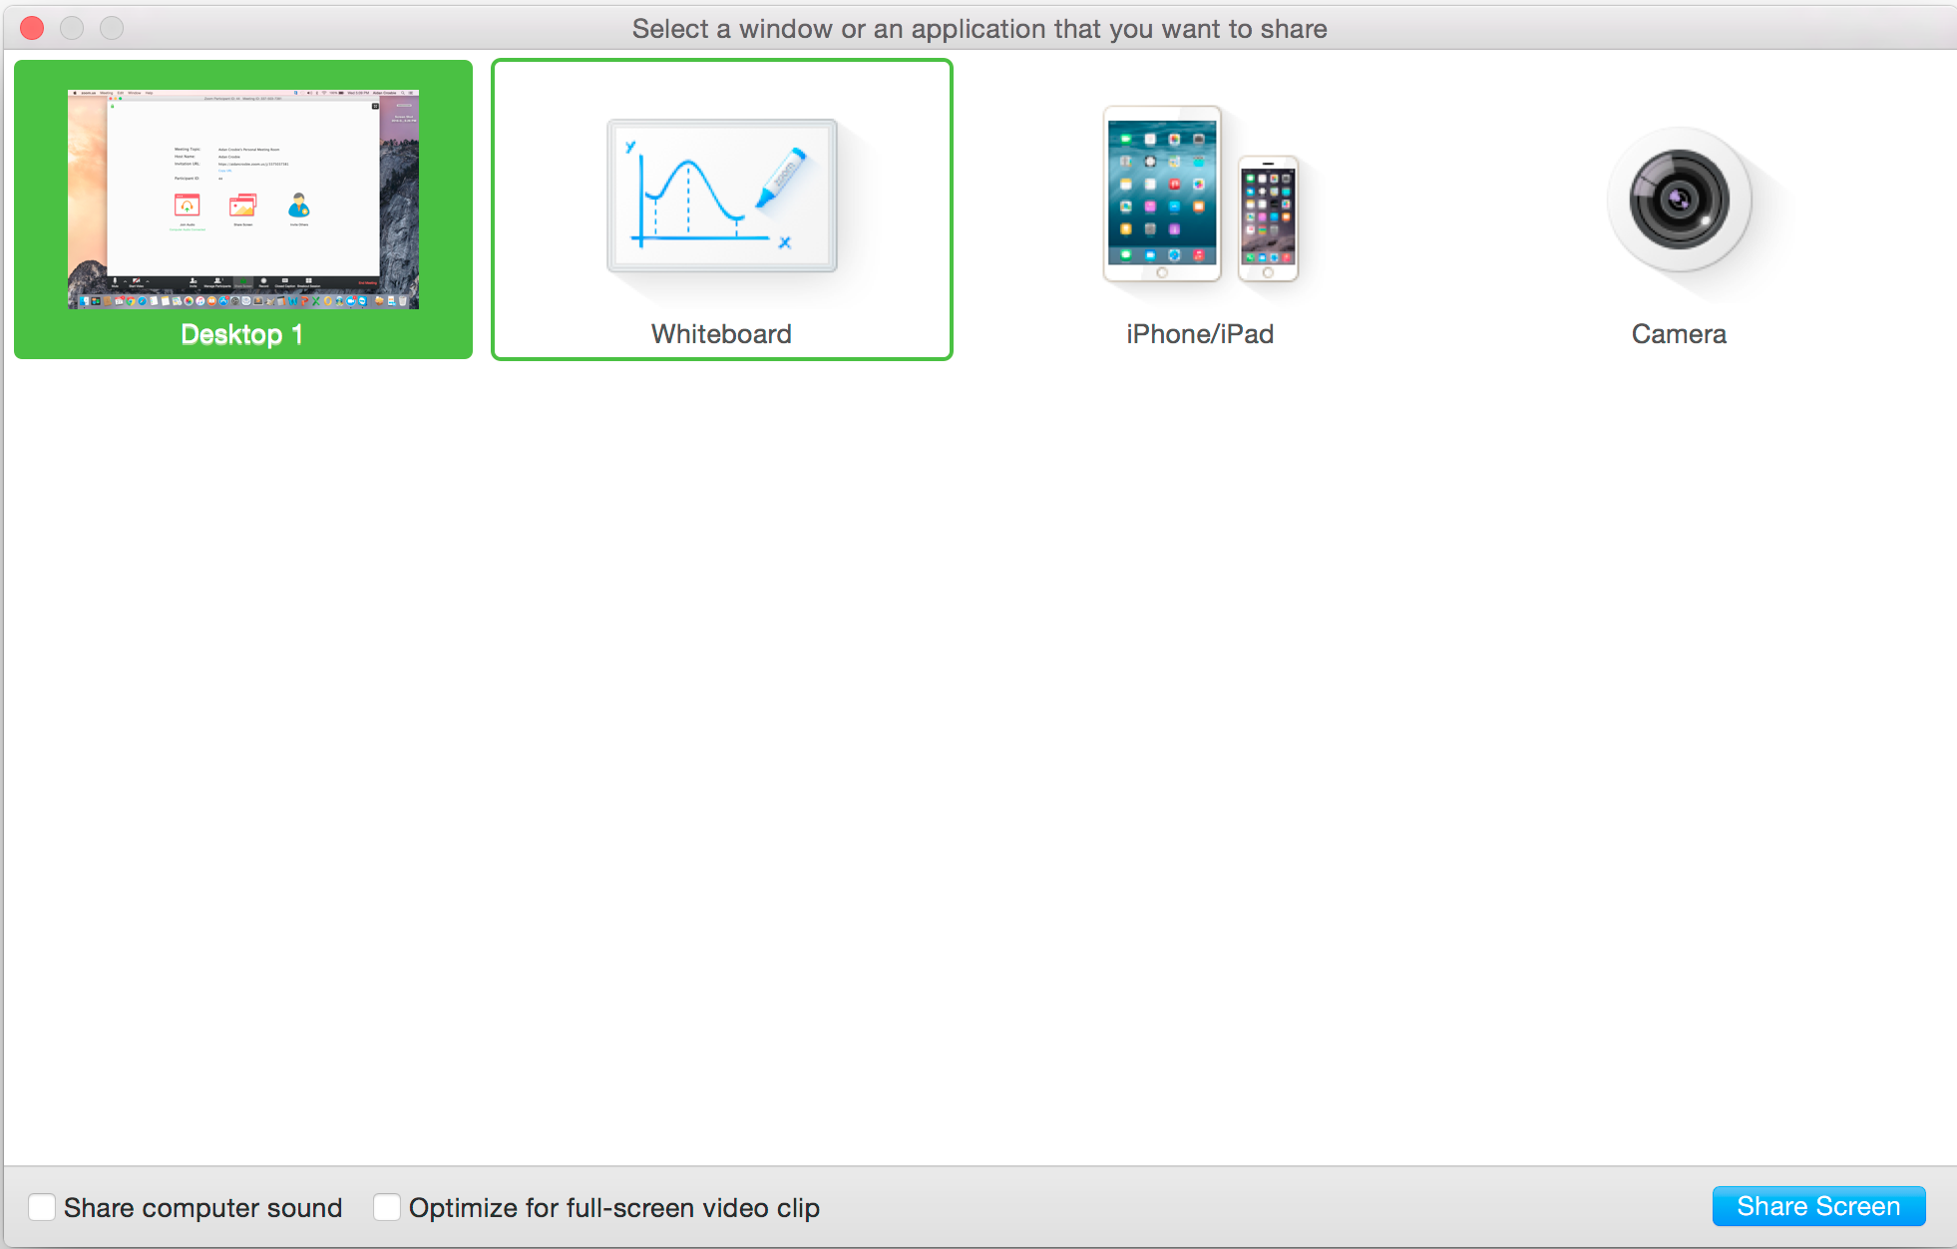
Screen Share Controls
To start “Screen Sharing” select “Screen Share” in the toolbar
After selecting “Screen Share” in the meeting toolbar. You can then choose to share your desktop, whiteboard or an application.
You can also share your “computer audio”. If you share a video clip or a YouTube video it will play with audio.

Slide 25
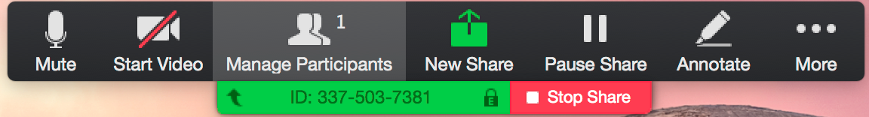
Screen Share Menu
New Share - Allows you to select a new window to share. You can choose another application or window.
Pause - Allows you to pause your current screen share.
Annotate: Allows you to use tools to draw point etc.
More - opens up the meeting controls tool bar options.

Slide 26
Screen Share Annotation
Menu
During your screen share if you select the annotate menu you will open the annotation tools:
Mouse, Draw, Spotlight, Eraser, Color Undo, Redo, Clear and Save.
The save feature allows you to save the annotations on your screen as a screen shot. It will be saved to the default folder where your recordings are saved.

Slide 27
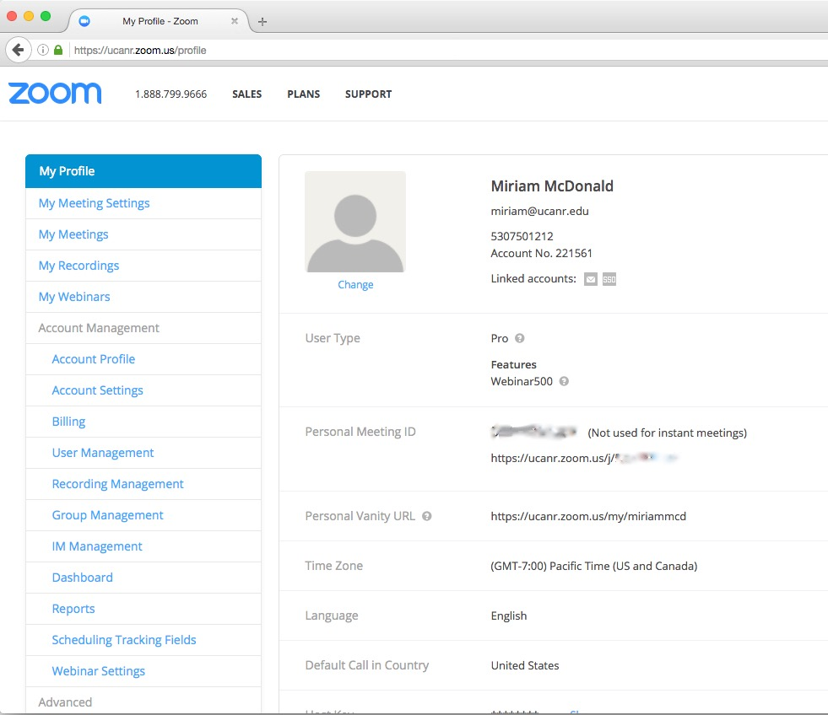
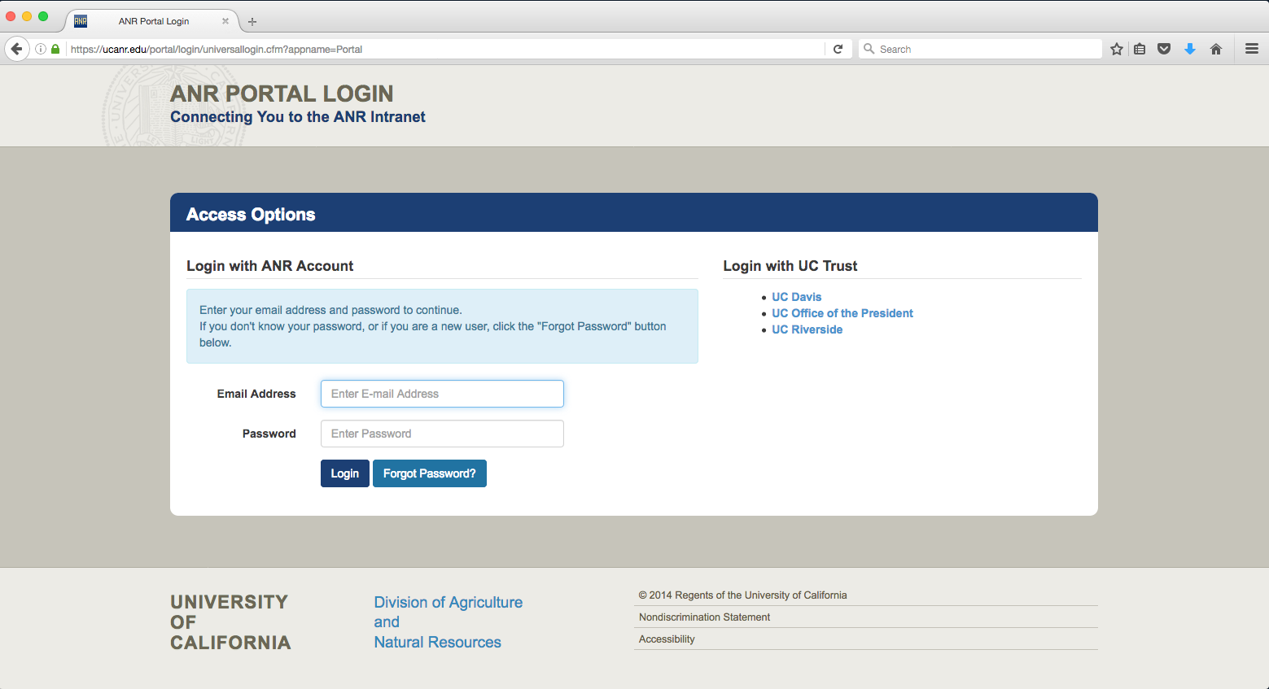
Logging into your Zoom profile.
1. https://ucanr.zoom.us/ -“sign in” on the upper right.
2. Log into the portal.
3. You will be automatically logged into your zoom profile.

Slide 28
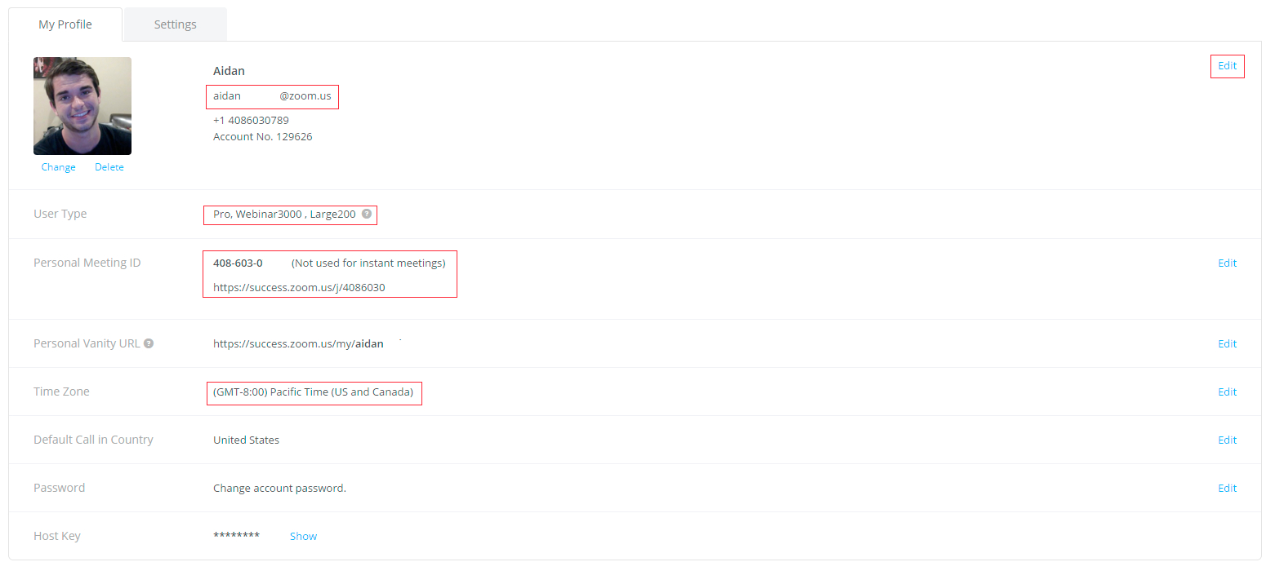
Profile Management
In “My Profile” under the edit menu you can change your personal information such as:
Profile Picture, First name, Last name, Phone number, Company/organization, Personal Meeting ID, Personal Vanity URL , Time Zone, Change Password, Host Key

Slide 29
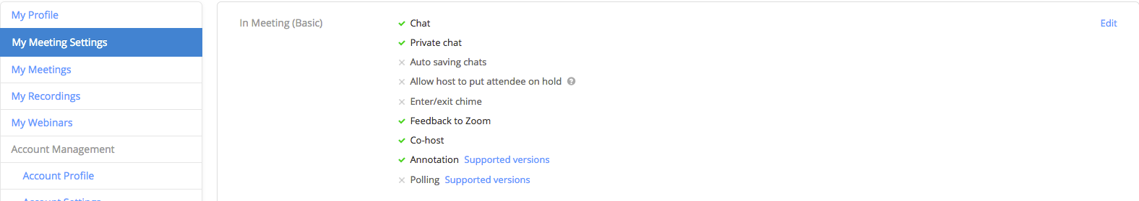
Profile Management
On the left under “My Meeting Settings” is where you can enable/disable “in meeting” features:
Here is a list of the basic settings
You can enable/disable them by clicking on the edit button on the upper right hand corner.

Slide 30
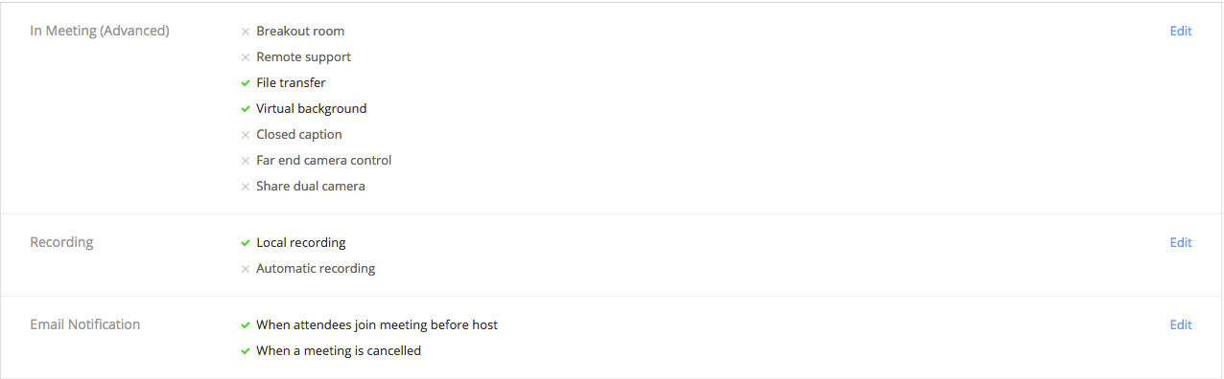
Profile Management
Here is a list of the Advanced/Recording and email notification settings
You can enable/disable all of them by clicking on the edit button on the upper right hand corner.

Slide 31
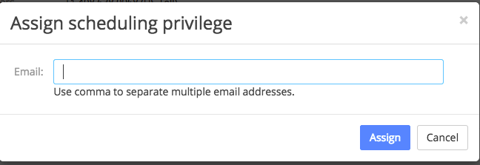
Profile Management
For our administrative staff there is an option for your your manager to add you so you can schedule meetings on their behalf.
On their profile they can click on the add button and add you so you can schedule their meetings.

Slide 32
Large Meetings and Webinars
Large meetings and webinars need to be assigned by contacting ANR IT.
If your account has large meeting enabled you can host 100 participants.

Slide 33
Q&A

Slide 34
Important Information
ucanr.edu/sites/zoom
zoom.us/download
ucanr.zoom.us
For Technical Assistance
IT Helpdesk
(530)750-1212
help@ucanr.edu

