Slide 1

Pruning
A short course
MG Final Presentation
Sheila Rodriguez and Wendy Ernst

Slide 2
What we will cover
Basics of pruning - Sheila and Wendy
Tools used to prune and how to sharpen them - Wendy
Pruning broadleaf shrubs - Sheila
Pruning before a storm season; what to do after a storm - Sheila
Pruning citrus trees - Wendy
Good resources – Sheila and Wendy
Notes:
Why we chose out topic.
Full disclosure; novice.
Shrubs
Not covering conifers & other narrowleaf evergreens or hedges
Not covering topiary pruning (pollarding, stooling).
Tree Law – not up there, but . . .

Slide 3
Definition
Pruning – The selective removal of plant parts to meet specific goals.” Edward F. Gilman, An Illustrated Guide to Pruning (3rd ed. 2012).
Why prune? Trees in the forest grow just fine without pruning!
Notes:
We all know what pruning is because it’s been covered in class. Wendy and I aren’t giving a talk on advanced pruning. We are approaching this topic from a more practical and hands-on perspective. Similar to what advice we might give to the public.
Why prune? Trees in the forest grow just fine without pruning! But only 1 in a billion seeds in the forest grows into a mature tree.

Slide 4
A Tale of Two Cities by Charles Dickens
“Proper pruning is one of the best things that can be done for a tree; improper pruning is one of the worst things that can be done to a tree.” Alex Shigo.
Notes:
Charles Dickens? I put that in there to see if you were paying attention. Allusion to the opening line of A Tale of Two Cities: “It was the best of times, it was the worst of times.”
Trivia: Does anyone remember who Alex Shigo was? “Tree wounds never heal.”

Slide 5
The 10 basics of when and how to prune fruit trees
Prune fruit trees when the leaves are off (dormant).
Right after planting a new tree, cut it off to a short stick.
Low vigor young trees should be pruned fairly heavily and encouraged to grow for the first 3 years without fruit.
Topping a vertical branch encourages vegetative growth necessary for development.
A good combination of horizontal and vertical branches is necessary for fruiting now and in the future.
Notes:
Its easier to see and removal of dormant buds invigorates the remaining buds. Summer pruning removes leaves and slows fruit ripening and exposes fruit to sunburn. Summer pruning can be used, however, to slow down overly vigorous trees or trees that are too large. Most effective in early summer.
Approximately 24 to 30 inches high and cut any side shoots remaining below that to 1-2 buds. This encourages low branching and equalizes the top and root system. Paint the tree with white latex paint to protect it from sunburn and borer attack.
Leave off most of the small horizontal branches untouched for later fruiting. Vigorous growing, young trees can be pruned much less or not at all and encouraged to fruit earlier with branch bending.
It creates a bushing effect. Topping horizontal branches is done to renew fruiting wood and to thin off excessive fruit. Thinning horizontal branches removes fruit. Horizontal branches left uncut will bear earlier and heavier crops.
Upright branches generally remain vegetative and vigorous. Horizontal branches are more fruitful. Branches bent to 45 to 60 degree angles achieve this balance.

Slide 6
The 10 basics, cont’d.
6. Remove diseased or broken branches, and remove suckers, water sprouts, and competing branches
7. New growth occurs right where you make the cut. The more buds cut off, the more vigorous the tree.
8. Sun-exposed wood remains fruitful and produces the largest fruit.
9. Make clean cuts (within ¼” of a bud) don’t leave stubs.
10. Different fruit and nut trees have specific pruning needs.
Paul Vossen, UC ANR Extension.
Notes:
Downward bending branches eventually lose vigor and produce only a few small fruit; cut off the part hanging down.
The influence of the cut only affects the buds within 1 to 8 inches of the cut surface, not 3 to 4 feet down into the tree.
Shaded branches eventually stop fruiting and will never produce again without drastic topping and renewal of the entire tree. Do most of the pruning in the top of the tree so that the lower branches are exposed to sunlight.
10.
10. Peach, nectarine, grape & kiwi bear on last year’s shoot growth – so remove 50% of last year’s growth. Fig, olive, walnut, chestnut, pecan, almond, cherry, feijoa, persimmon, apple, pear, plum, plumcot, and apricot which bean on spurs or less vigorous shoots, so remove 20% of last years growth. For citrus, just keep the skirts pruned up off the ground.

Slide 7
Types of cuts
  Thinning cut – removing a lateral branch at its origin or shortening a branch’s length by cutting to a lateral large enough to assume the terminal role. Dennis R. Pittenger, California Master Gardener Handbook (2nd ed. 2015).
  Heading cut – cutting the plant back to a stub, lateral bud, or small lateral branch. Id.
  Removal cut – removes a branch from the trunk or parent branch just outside the collar. Edward F. Gilman, An Illustrated Guide to Pruning (3rd ed. 2012).
Notes:
3 basic kinds of cuts – Although different books say different things (show Gilman & Elis books—Most books (Ellis) say only 2 types of cuts: thinning & heading cuts. Gilman says the terminology thinning cut went out of use in 1995, and is now officially known as a reduction cut.
But we are educating the public, and that official terminology gets confusing, particularly when most books still refer to thinning cuts. So, we are sticking with thinning cuts and heading cuts. However, there is a third type of cut known as: a removal cut, which means pruning a branch back to the collar.
Thinning cuts are appropriate for removing dead or diseased branches and for eliminating branches that rub one another or that cross the center of a plant. Demo on limb: a thinning cut is made back to a branch no smaller than about 1/3 (minimum) to 1/2 (preferred) the diameter of the cut stem, making the cut from a to b rather than from b to a (to reduce the likelihood of the union splitting).
Heading cuts cause shoots to branch, so they are ideal for encouraging bushy growth. Demo on limb: a heading cut is made across a stem or small branch, above a bud or buds (nodes)..

Slide 8
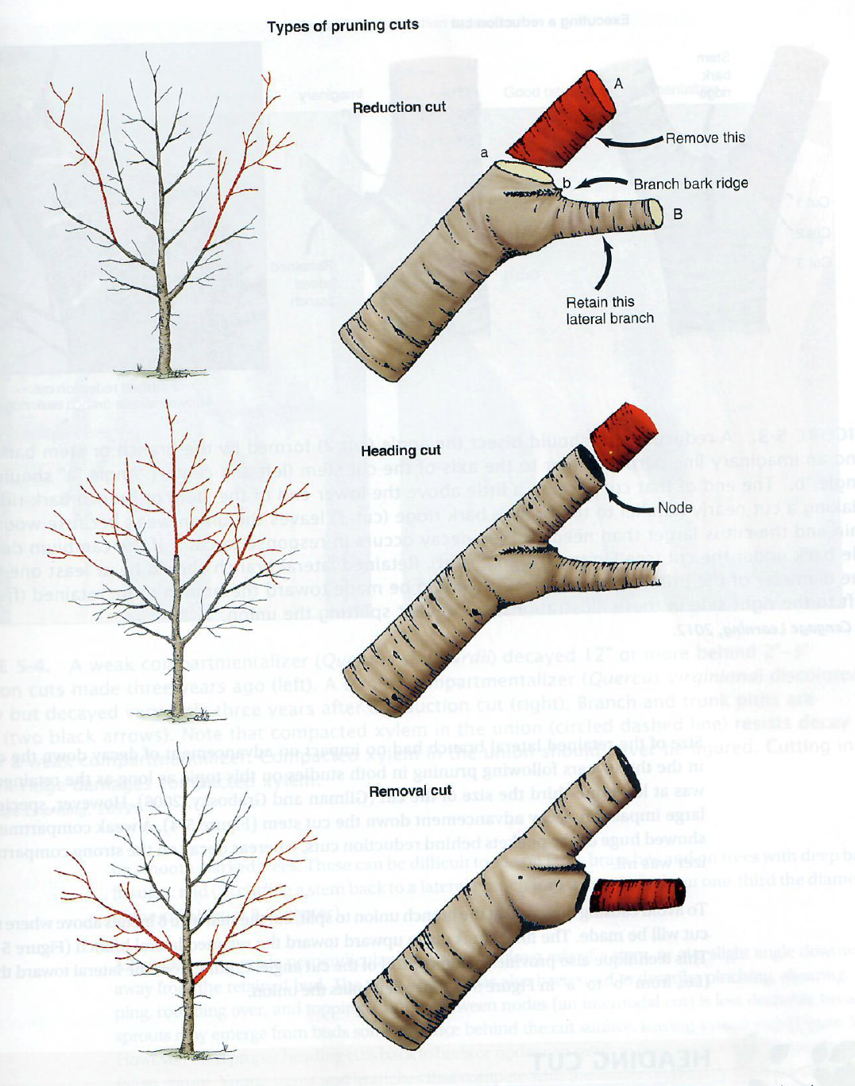
Types of cuts
Notes:
Plug Gilman book. Great because all illustrations show removed parts in red.

Slide 9
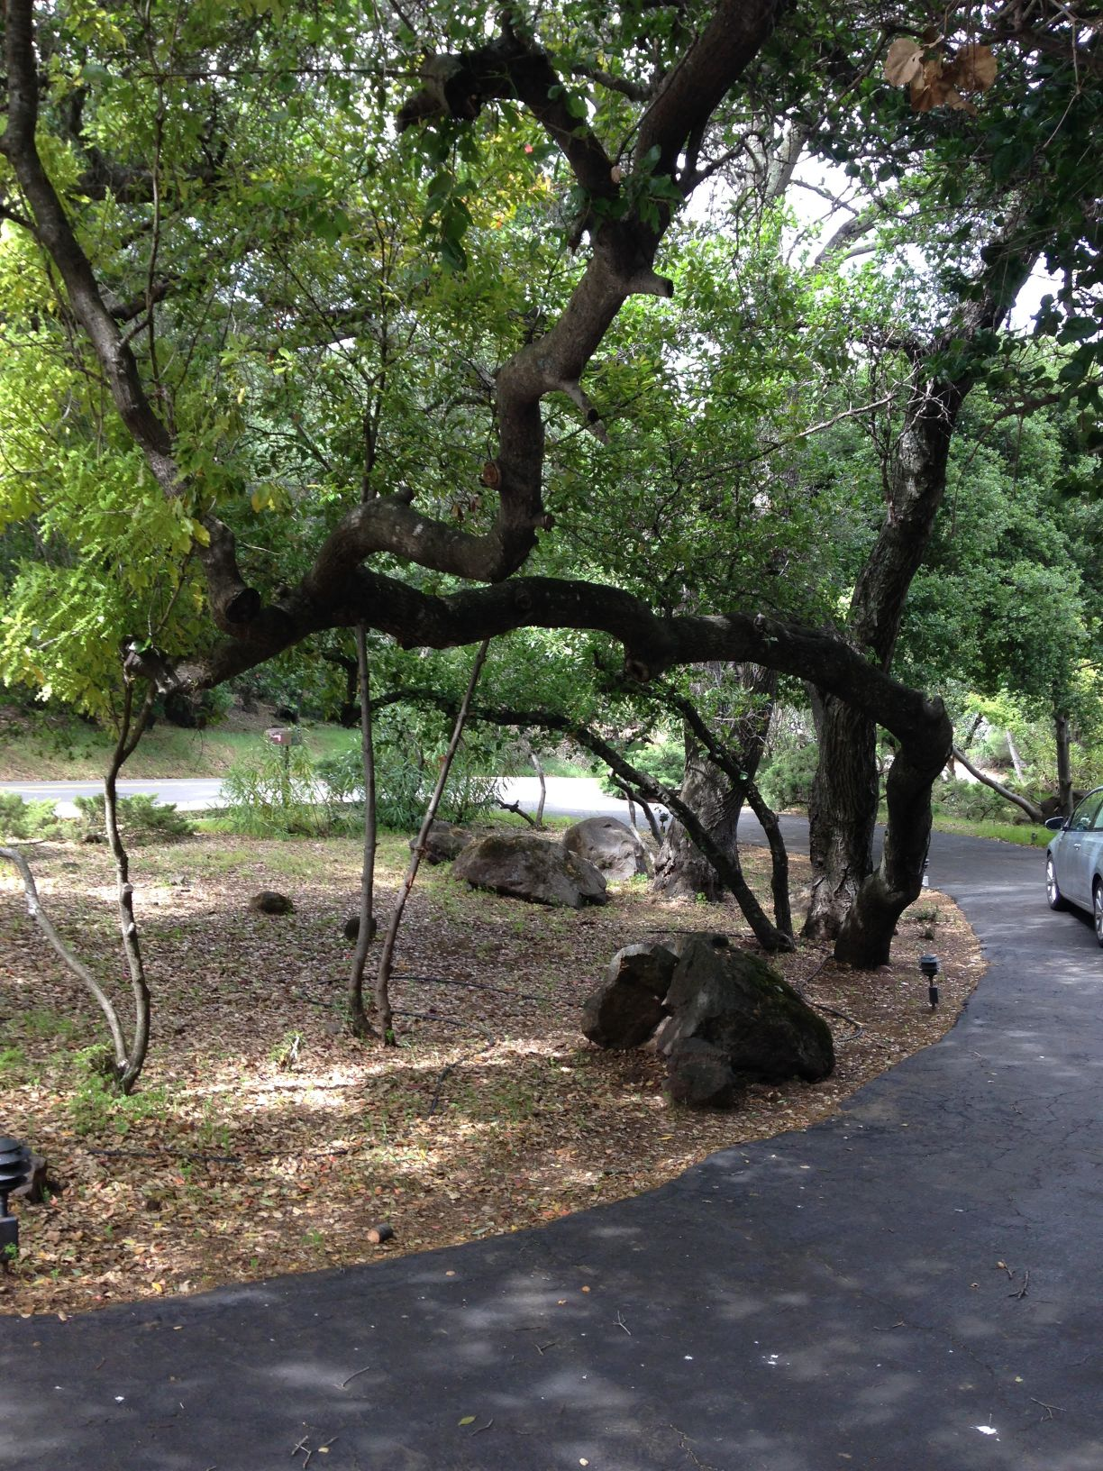
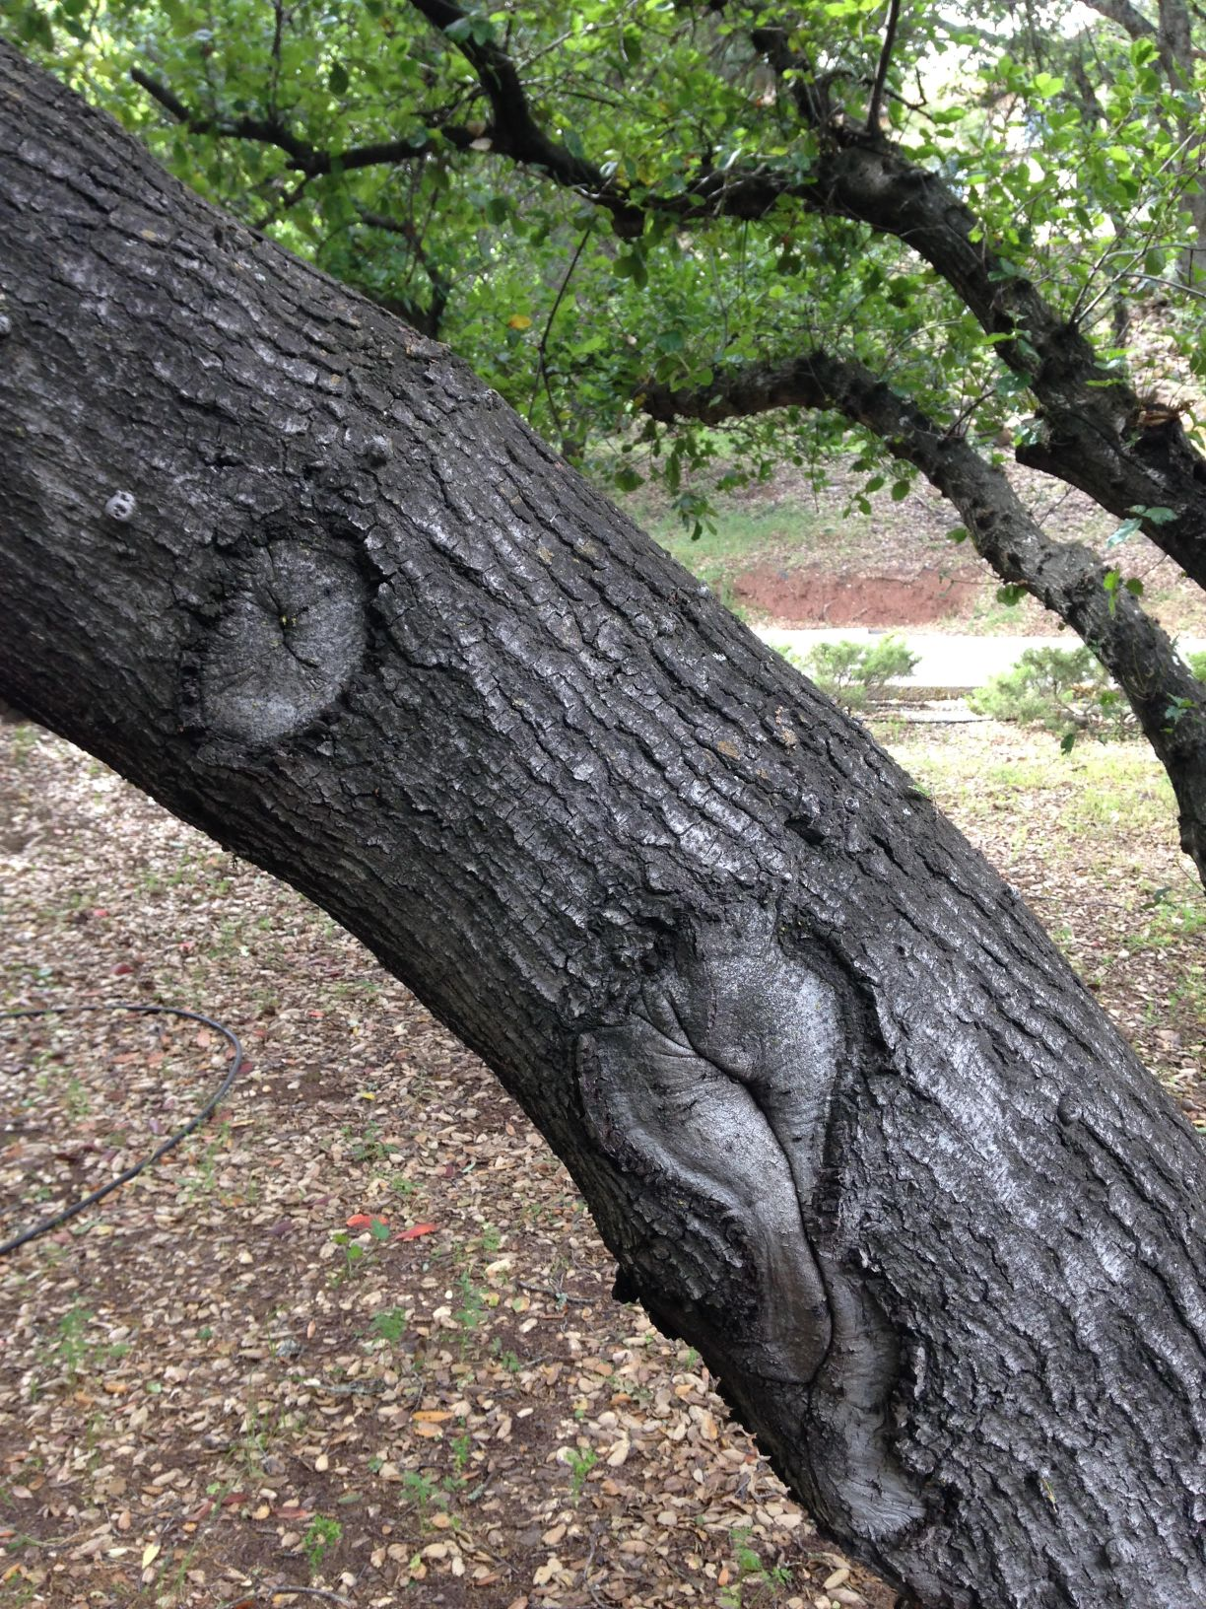
What’s wrong with this picture?
Notes:
We all want trees to grow old gracefully. Reducing the risk of failure is an important goal in pruning.
Remember the Charles Dickens slide? The best/the worse thing you can do to a tree.
This is an oak tree in front of my house. I worry . . . Fortunately . . .
What kind of cuts were these?
What’s wrong with these removal cut wounds?
Flush cuts remove bark ridge—damage the branch protection zone.
Alex Shigo: “tree wounds never heal.”

Slide 10
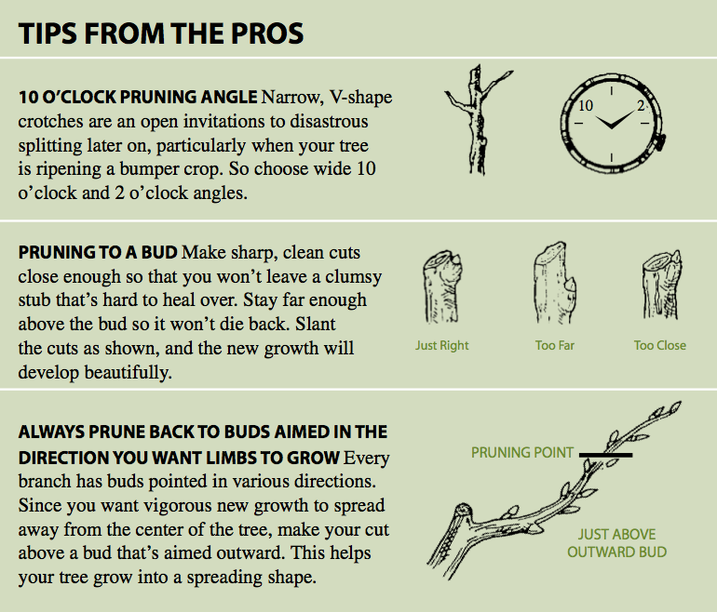
Notes:
Of course, none of us will make those pruning mistakes, but here are 3 tips to help you improve your technique.
Read on own time.

Slide 11

Pruning dose
The amount of foliage removed.
  Pruning dose depends on tree age. Maximum pruning dose:
      Young – 50%
      Medium age – 25%
      Mature – 10%
Notes:
Pruning dose aka pruning severity, pruning amount, pruning budget.
As a pruning novice, this recommended dose seemed counterintuitive, i.e., old tree = tough tree.
But old trees require large amounts of sugars (generated in green leaves) to keep wood functional.

Slide 12
Sharpening Pruners
In Three Easy Steps, really….
Notes:
From Article Sharpening Pruners by Melissa Levangle, Fine Gardening issue 95

Slide 13
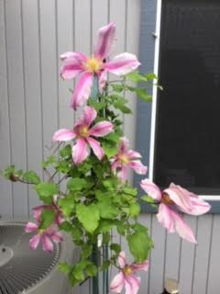
Basic Logic
Pruning tools must be in good condition and to ensure an efficient job, you must keep them sharp.
Sharp pruners make cleaner cuts that heal quickly, which ensure a healthier plant able to fight diseases, pests and stresses.

Slide 14
Process of sharpening
Well maintained pruners need sharpening only every six weeks
It takes about 10 minutes to sharpen hand pruners in good shape.
Regular maintenance cuts down the sharpening time.
Notes:
For those who spend less than 4 hours a week pruning, one good sharpening a year is adequate.

Slide 15
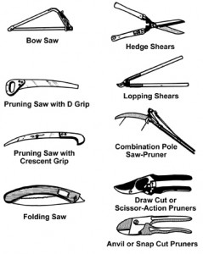
Examples of Pruning implements
Common tools
Notes:
For today’s demonstration we are using the draw cut or scissor action pruners

Slide 16
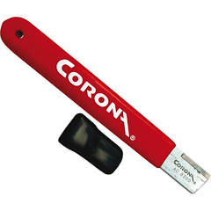
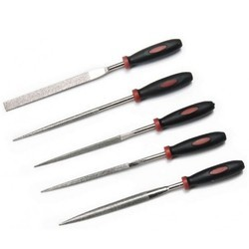
Types of Files
Diamond
Carbide Steel
Notes:
Examples of diamond files from coarse to extra fine, and an example of a carbide steel file.

Slide 17
Supplies
Diamond file
Carbide steel file
A dry or silicone-based lubricant
Twigs for testing your progress
To get started you will need:
Kitchen Scouring pad
Soap and warm water
Clean rag and towel
Gloves
#3 and #1 steel wool,
or a steel bristle brush
Notes:
Show bucket with cleaning supplies

Slide 18
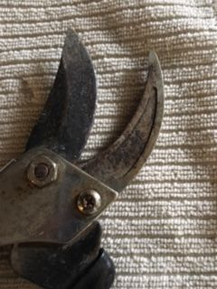
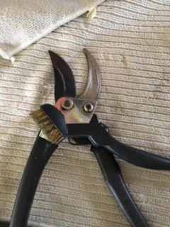
1. Start with a good cleaning
Clean – with soap and water and wipe dry
Remove rust with steel wool or wire brush
Use finer steel wool to restore sheen of metal
Notes:
*If the cutting surface is grimy it will not cut cleanly even if the blade is sharp

Slide 19
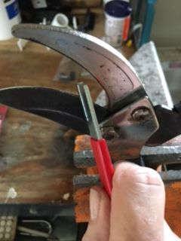
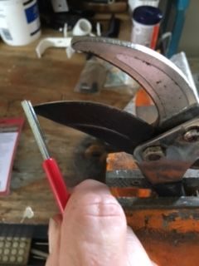
2. Get the angle and motion right
Start with the coarse file or use a carbide steel sharpener
Switch to finer grits to sharpen the beveled edge.
Finish by removing burrs
Notes:
I place my pruners in a vise in order to make it easier to sharpen, but you can sharpen without one; just be careful that you hold them safely. You start your file from the pivot and in one long straight sweep angle it along the blade to the tip. Do this 4 or 5 times. Then flip the pruner over and use the file to take off any metal burrs that result of the sharpening.

Slide 20
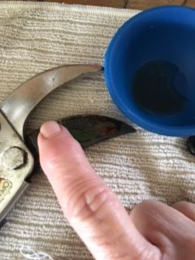
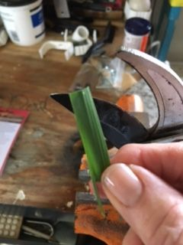
3. Finish with lubricant
Apply a dry or silicone-based lubricant to repel water and hinder rust.
Check for sharpness – Pruners are ready to go to work!
Notes:
Throughout the year you can lightly coat the blades with olive oil – keeps dirt and other materials from harming the pruners without drying or becoming sticky – and it’s natural

Slide 21
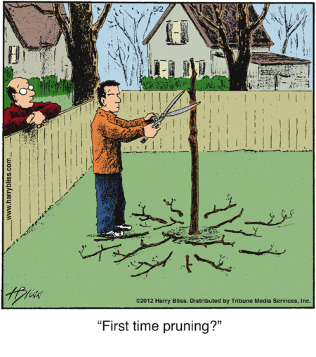
Pruning Broadleaf Shrubs

Slide 22
Easier than Pruning Trees!
  Using similar (tree) pruning methods will lead to a natural shape.
  Prune broadleaf shrubs using mostly thinning cuts.
Notes:
Full disclosure again: why I chose this subtopic.
Pruning shrubs = mostly about thinning.
Avoid making heading cuts or shearing the whole plant.

Slide 23
Thinning shrubs/thinning & reducing shrubs
Notes:
Plug Gilman book (illustrations).
Cut about 1/3 of stems back down to near ground level.

Slide 24
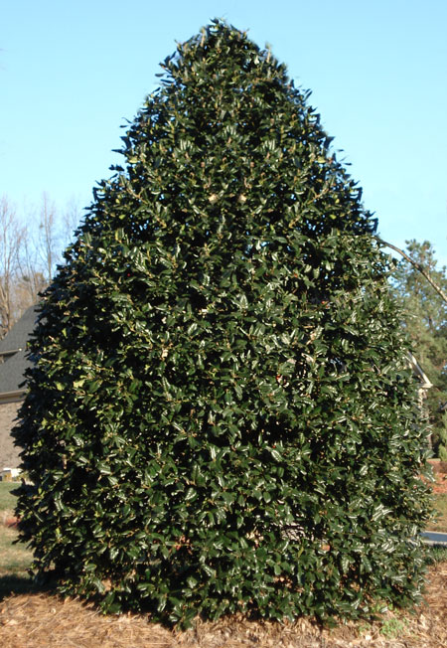
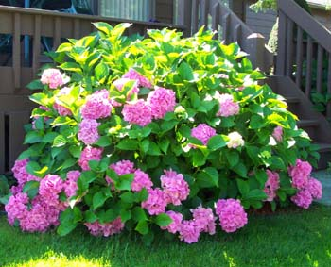
Maintaining Size
    [insert split-screen photo of Hydrangea/Holly]
Notes:
Cane-type plants (e.g., hydrangea) can be pruned to maintain size by cutting to the ground, every year, 1/3 of tallest canes.
Round-headed shrubs (e.g., holly) cut only longest shoots 6-24 inches back inside outer edge of plant.

Slide 25
Reducing Size
    Thinning cuts
    Heading cuts
    To make a substantial size reduction:
      Prune plants that bloom on current year’s growth in late winter/early spring.
      Prune plants that bloom on the previous season’s growth immediately after flowering.
Notes:
Most shrubs grow wider at the top.
Use thinning cuts to narrow the top by cutting back into the center, shortening longest branches.
Use heading cuts to substantially reduce the size of a shrub, cutting longest stems back deep into the crown.

Slide 26
Rejuvenating
      Severe rejuvenating pruning
      First spring – cut oldest half close to the ground.
      Second spring – cut remaining stems close to the ground.
Notes:
Most shrubs—not conifers—can be cut nearly to the ground in the spring to rejuvenate them.
Severe rejuvenating should be done every 2 years.
For the first spring, allow sprouts to grow all year.
Note - spring flowering shrubs will not flower well the first growing season after pruning.

Slide 27
When to prune shrubs
  Late winter/early spring.
  Prune shrubs that flower on last year’s wood immediately after flowering.
  Prune shrubs that flower on current year’s wood in late winter through early spring.
  Heavy pruning – late winter/early spring.
Notes:
When to prune shrubs. Generally when dormant.
Know whether a shrub flowers on old wood or on current wood determines when to prune..
Camellias, feg, flower on last year’s wood.
Crape myrtle & shrub roses flower on current wood.

Slide 28
Tree Law
  Obtain written permission of landowner before pruning any bordering plant. Edward F. Gilman, An Illustrated Guide to Pruning (3rd ed. 2012).
Notes:
Explain why I’m covering this. Give disclaimer.
Translate the legalese: “sue for damages” = go to court. “Abate the nuisance” = remove the problem.
1950 case.
Also, check with your municipality. Feg, in some places, you need to get permission from the city to cut down a tree.
Most of us probably won’t encounter such a serious dispute, but to be safe, before you get out the saw . . . get it in writing.

Slide 29
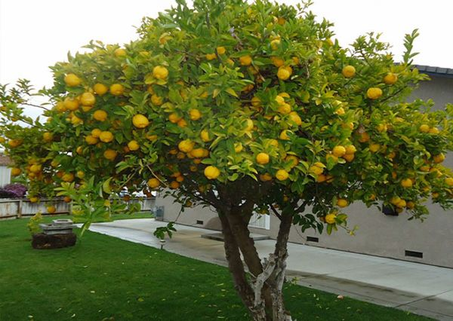
Pruning Citrus Trees

Slide 30
Basic reasons for pruning fruit trees
Necessary for best production of fruit
Invigorates tree and improves branch configuration – less splitting under a heavy crop
To reduce crop load, which will improve the potential size of fruit

Slide 31
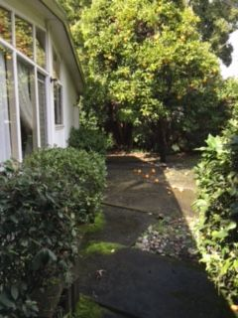
But…. What about citrus?
They are different -
Citrus trees should not be pruned as deciduous trees
Citrus wood is naturally strong and is not as likely to give under the stress of a large fruit load.
Notes:
The orange tree in the background is 60 years old and continues to produce fruit.

Slide 32
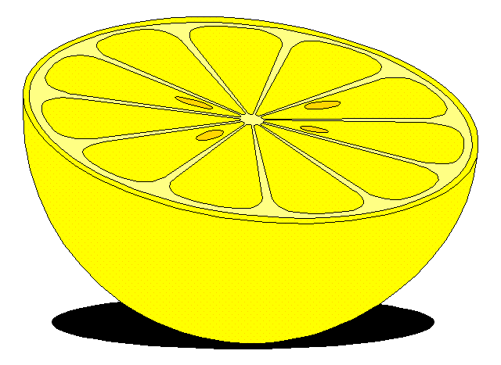
Citrus are hardy
Citrus can produce in the shade of the tree
Citrus fruit is as good or better without pruning.
So why prune at all?
Notes:
So no need to prune out the center

Slide 33
Why prune?
Lack of fruit – if there is no fruit at center, then the interior should be opened up
Also the bottom of the canopy may need to be removed “skirting”
Lemons are the exception as they require thinning and heading back to keep control of vigorous shoot growth.
Manage the size so they are easy to harvest

Slide 34
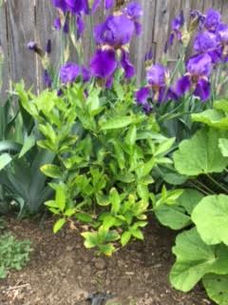
Basic fundamentals
Trees may be pruned to any desired shape
They will look fuller with occasional pruning
Light pruning can be done at any time of year except winter
Notes:
Dwarf lime

Slide 35
General pruning
Remove discolored, damaged or dead wood throughout the year.
Remove crossing branches or branches that shade out lower branches
Citrus bark is thin and easily damaged, so avoid nicking the bark and make careful cuts
Notes:
Preserve the branch collar

Slide 36
Time of pruning
Isn’t highly critical for citrus…*
but avoid late-season pruning, which can stimulate excessive tender growth that is likely to be injured by frost.
Different varietals may require special times to prune, i.e. Valencia, summer grapefruit and lemons**
Notes:
*Research has shown that for the best results, physiologically – pruning should take place early in the spring after the danger of frost has passed and before the start of a new growth cycle
**These should be pruned after harvest in summer. Protect any exposed branches after pruning from sunburn by painting with a 50:50 white interior latex paint and water mixture

Slide 37
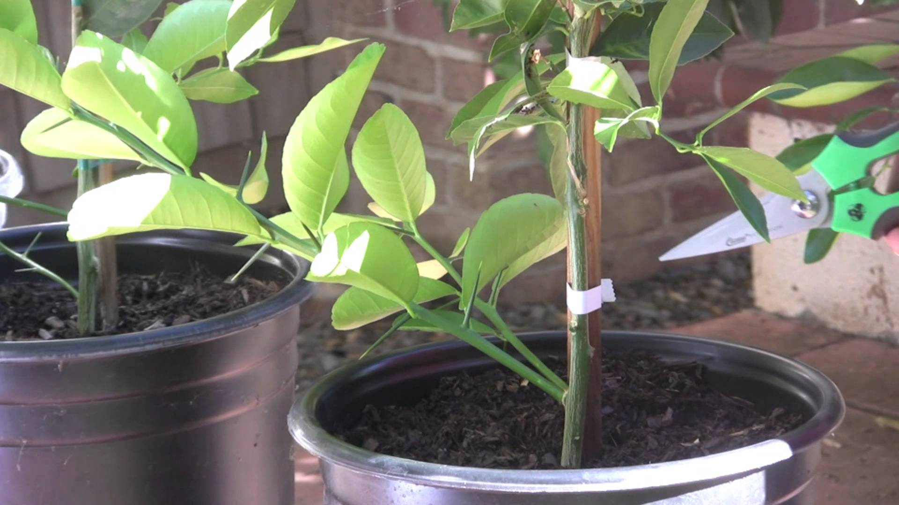
Common Problems
Water Sprouts https://www.fourwindsgrowers.com/solving-common-problems/water-sprouts-tutorial.html
Suckers https://www.fourwindsgrowers.com/solving-common-problems/suckers-and-graft-lines.html
Skirting
Canopy Thinning
Reducing Tree height
Notes:
Water sprouts or “gourmands” are:
Found above the graft line on branches, usually vertical, very vigorous and thick they grow rapidly and use large amounts of water and nutrients – prune these off at the base
https://www.fourwindsgrowers.com/solving-common-problems/water-sprouts-tutorial.html
Shoots from the bud union.
They grow from the rootstock and will not be productive.
Remove them as soon as they appear.
https://www.fourwindsgrowers.com/solving-common-problems/suckers-and-graft-lines.html
Some citrus, like mandarins, have branches that hang to the ground. These are called skirt branches and if not removed, will attract pests and diseases.
Trees should be skirted up to 18”-24 “ above the ground every few years. These branches can impede weeding, fertilizer and compost applications, and provide pathways for ant populations to use trees, enabling scale to be maintained by ants
Thinning out center branches can increase fruiting wood in the center of the tree
Before they get too large Take the tree as a whole and divide it in quadrants and prune each one at a time.

Slide 38
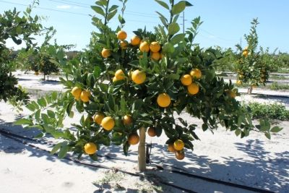
Reducing Tree Height
To bring fruit within reach and keep the height of the tree under 8 ft
For a young tree, if it is tall and spindly, cut it back.
For mature trees, not more than one third of the tree should be pruned back
Notes:
This leaves enough branches with foliage to continue photosynthesis and water draw through the plant.

Slide 39
Pruning before a storm
Pruning before a storm:
    A qualified arborist should inspect large trees prior to a storm.
  Once a storm is forecast, it’s usually too late to prune meaningfully. However, try to:
    Prune dead & detached branches.
    Prune large fruit.
    Thin or shorten long branches.
    Turn off irrigation system to keep soil as dry as possible.
    Edward F. Gilman, An Illustrated Guide to Pruning (3rd ed. 2012).
Notes:
Timely topic given that climate scientists predict more dramatic weather overall.
Before a storm, seek out a qualified arborist. See our Resource List for how to find one.
Once a storm is forecast, if you still have time, try to prune accordingly.
Last bullet point—turning off the irrigation system is important because wet soil makes trees less stable (recall newspaper photos)..

Slide 40
What to do after a storm
  Restore or replace a tree – factors to consider:
    Expected lifespan
    Value of tree
    Health of tree
    Heartwood exposure
    Structure
    Failure potential
    Trunk cracks
    Crown damage
    Pruning cost
    Root decay
    Stem-girdling roots
    Partial uprooting
    FEMA (trees are often unnecessarily removed when someone else will pay for removal)
    Edward F. Gilman, An Illustrated Guide to Pruning (3rd ed. 2012).
Notes:
Expected lifespan: short-lived trees = poor candidates to save.
Heartwood exposure: trees with breaks are more likely to decay.
Structure: Does remaining structure lend itself to building a new crown?
Failure potential: Is there a history of failure?
Trunk cracks: Usually dictate removal.
Crown damage: If there are many broken branches—more than 4-6 inches in diameter—and distribution is uneven around crown, the tree will be difficult to restore.
Root decay: if severe, remove.
Stem-girdling roots: if severe, remove.
Partial uprooting: remove.
FEMA: If someone else will pay to remove a tree, this often leads to unnecessary removal.
Late great mother’s tree rescue.

Slide 41
Resources
  Christopher Brickell & David Joyce, Pruning & Training (DK 1996).
  Colin Crosbie, Easy Pruning (DK 2007).
  Barbara W. Ellis, How to Prune Trees & Shrubs: Easy Techniques for Timely Trimming (Storey 2016).
  Cindy Fake, Horticulture & Small Farms Advisor, Nevada and Placer Counties, “Pruning Citrus,” UCCE Publication Number 31-008c (Jan 2012).
  Edward F. Gilman, An Illustrated Guide to Pruning (Delmar, 3rd ed. 2012).
  Lewis Hill & Penelope O’Sullivan, The Pruning Answer Book.

Slide 42
Resources
Melissa Levangle, “Sharpening Pruners (ten minutes spent with a diamond file and your blades will cut like new),” Fine Gardening Issue 95.
Peggy A. Mauk & Tom Shea, “Questions and Answers to Citrus Management”; UCCE Riverside County.
UC ANR - California Master Gardener Handbook, Second Edition.
Paul Vossen, UCCE Napa County Advisor Ten Basics of When and How to Prune Fruit Trees.
“Pruning Citrus,” UACE Publication Number AZ1455 (July 2008).
Four Winds Growers - www.fourwindsgrowers.com
Find an arborist - http://www.treesaregood.com/findanarborist/findanarborist.aspx

Slide 43
Resources
Online Resources:
  Pruning small trees and shrubs:
  http://ceventura.ucanr.edu/Environmental_Horticulture/Landscape/Pruning/
  Training and pruning trees for strength, clearance, and aesthetics:
  http://www.urbantree.org/prunehome.shtml
  Time to prune your fruit trees:
  http://davesgarden.com/guides/articles/view/4703/
  Wisconsin Dept. of Natural Resources PublicationFR-262-2003

