Slide 1
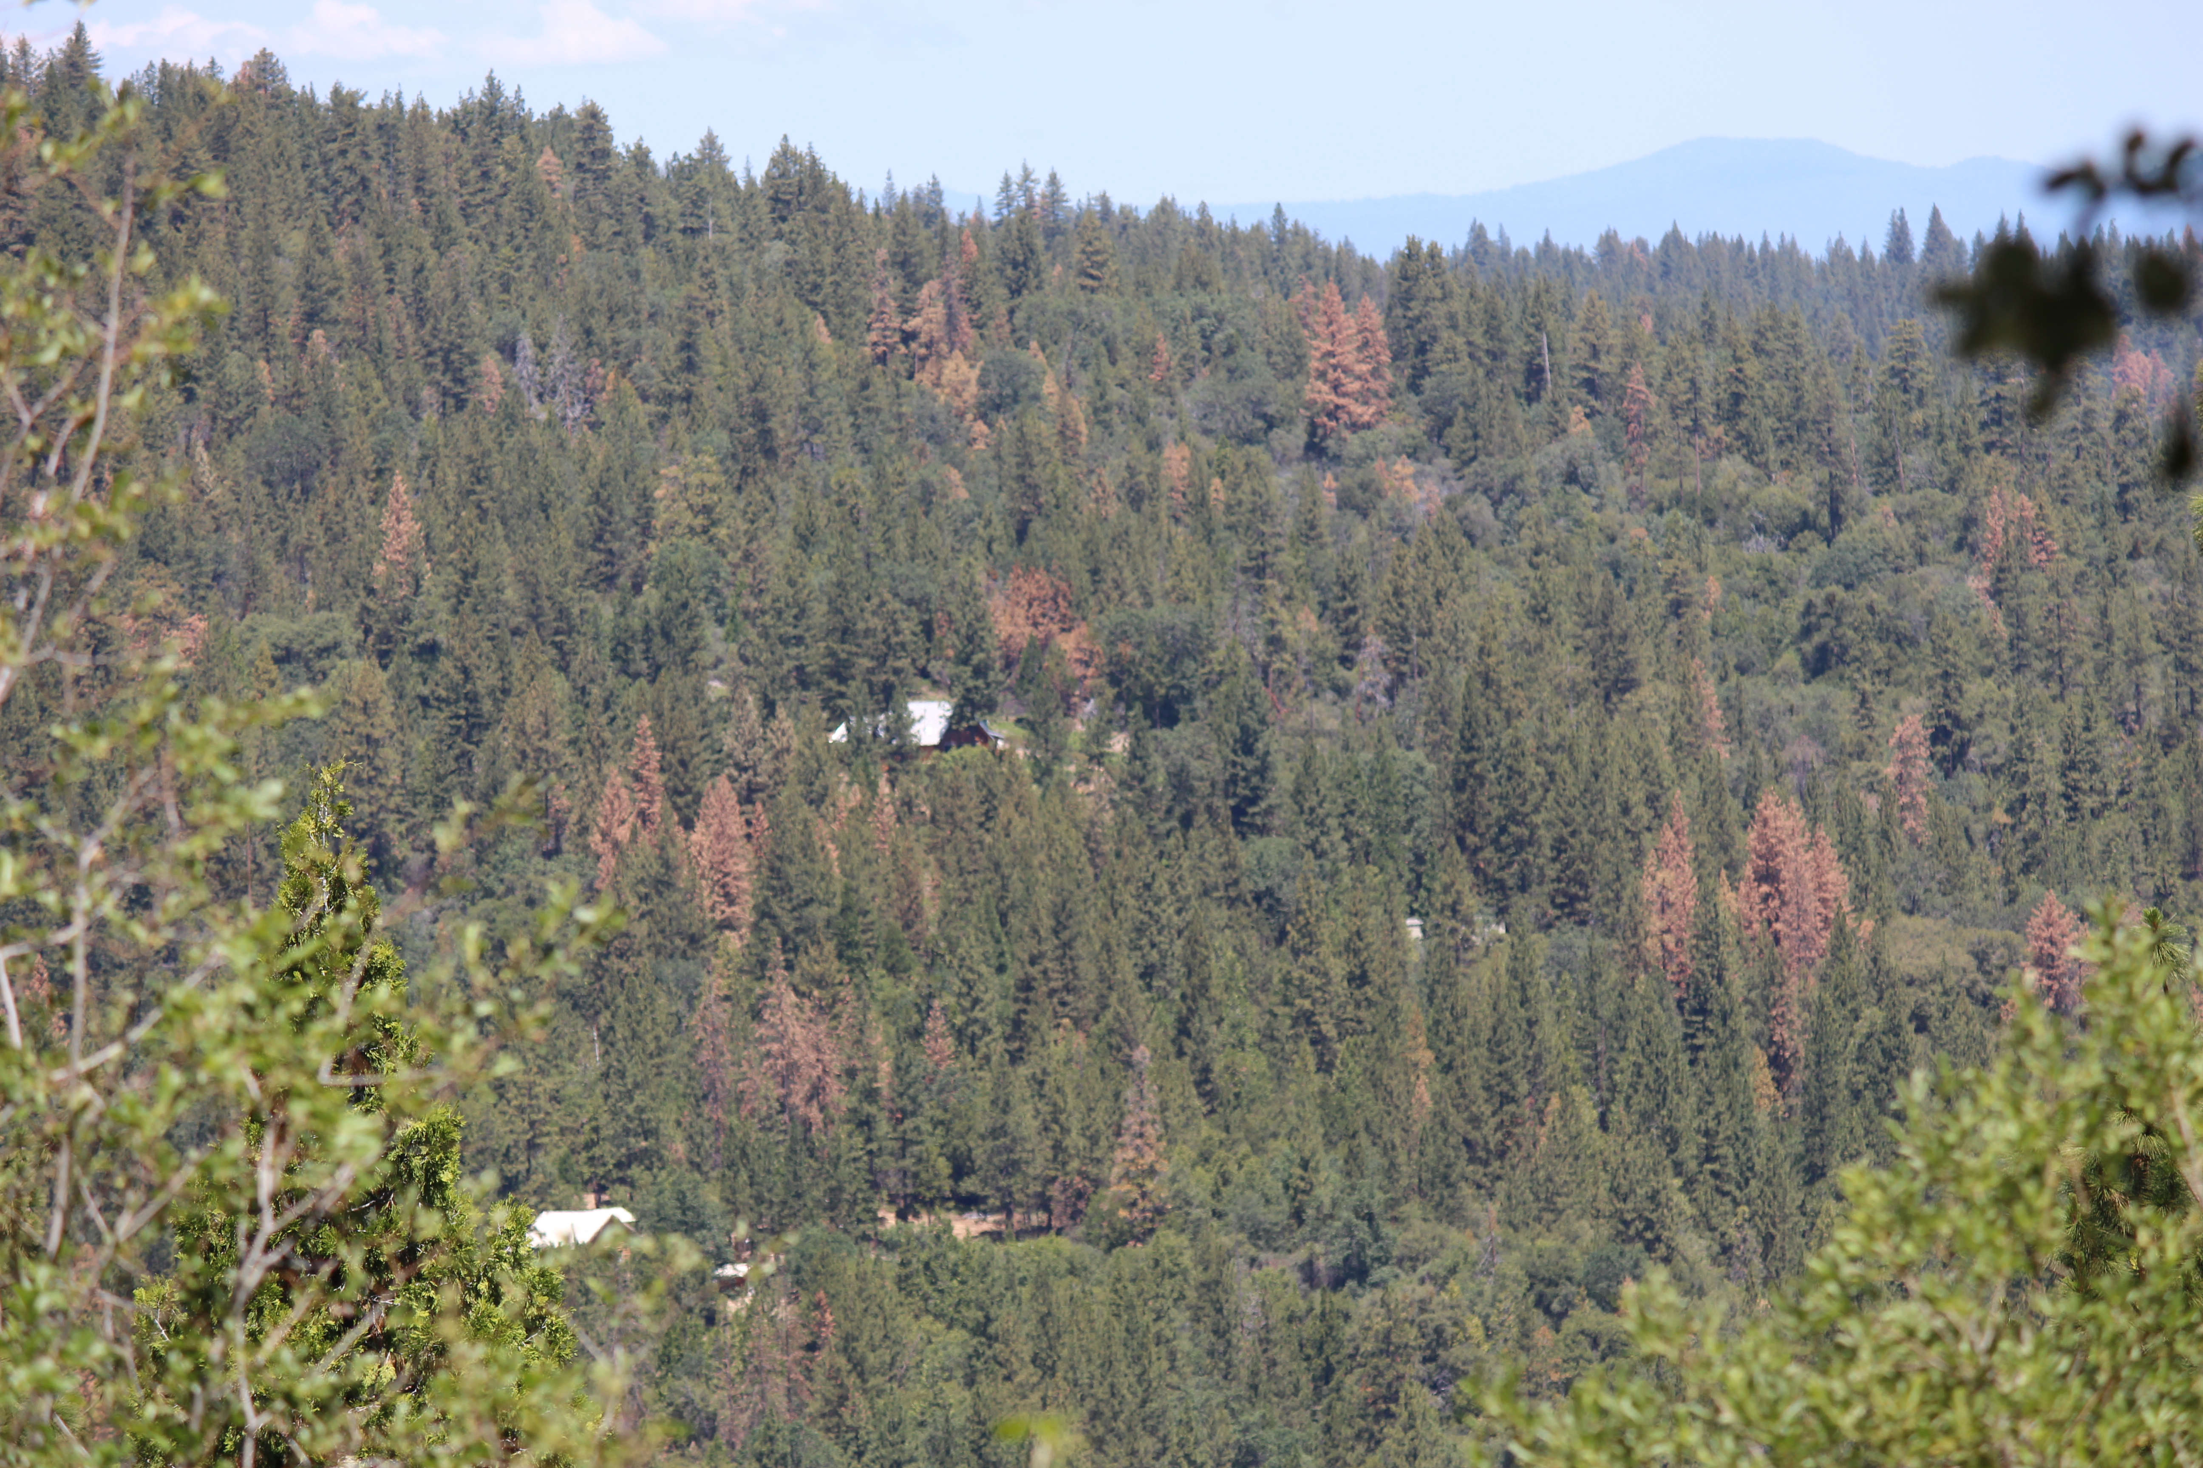
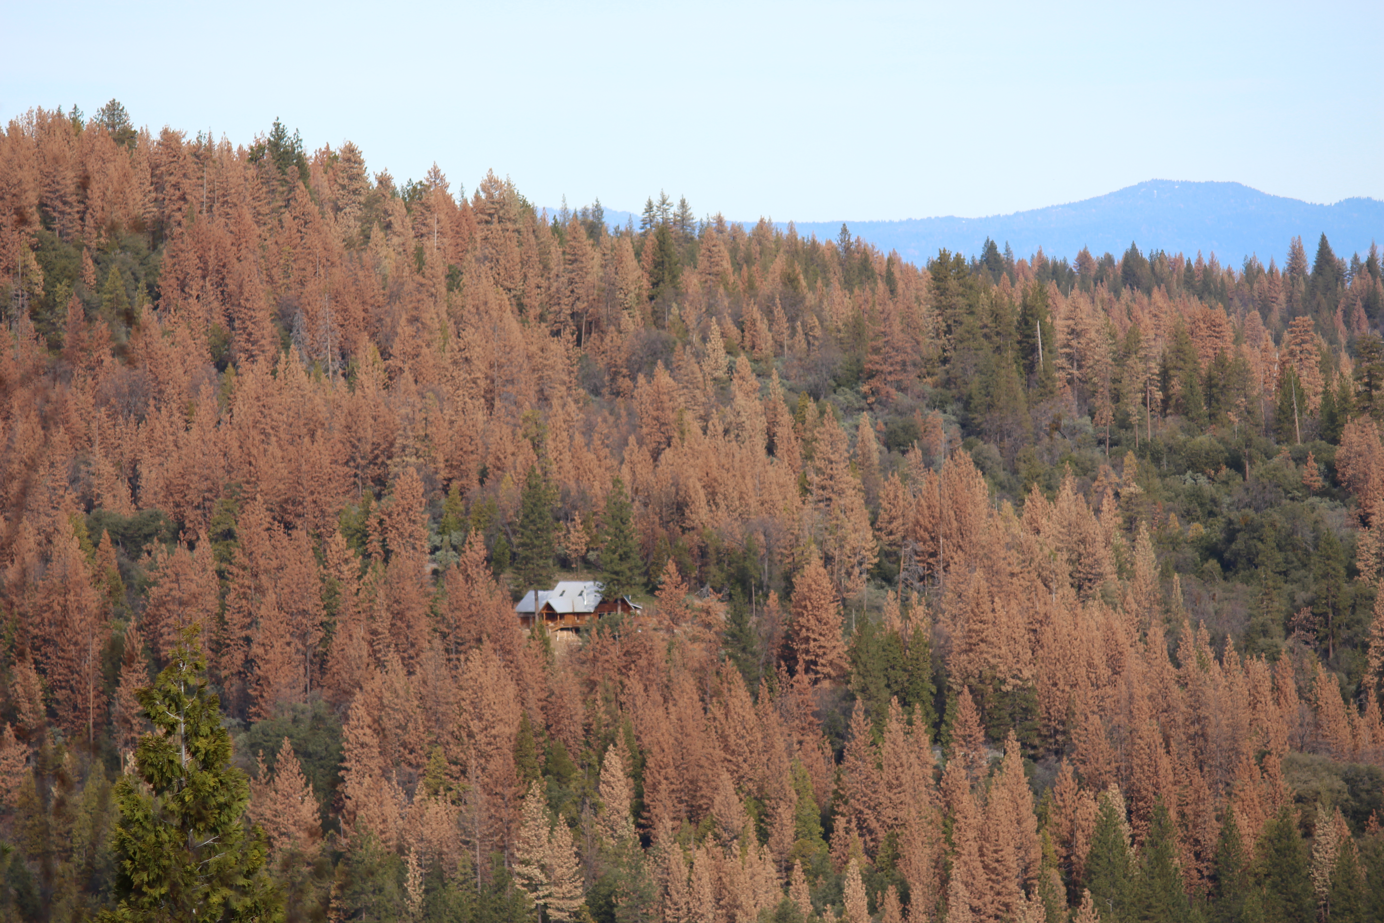

CALIFORNIA FOREST IMPROVEMENT PROGRAM
KEY CONCEPTS for LANDOWNERS
Presented by Zsolt Katay
Forestry Assistant Specialist – CAL FIRE

Slide 2
WHAT IS CFIP?
A state funded program aimed at improving the economic value and environmental quality of non federal lands
Reimbursement program, providing 75-90 % cost-share to non-industrial private forest landowners
It’s purpose is to encourage private and public investments in forestlands
To ensure adequate future high quality timber supplies
Provide employment opportunities and other economic benefits
Protect, maintain, and enhance forest resources for the benefit of present and future generations

Slide 3

WHO IS ELIGIBLE?
Individuals
Groups
Associations
Nonprofit and public entities
Corporate land owners

Slide 4
MINIMUM QUALIFICATIONS?
Ownership must be 20 to 5,000 acres
01
Must be capable of supporting at least 10% native tree cover
02
Zoning does not prohibit Forest Management*
03
* A Land Use Addendum is filed with the County for projects not under TPZ

Slide 5
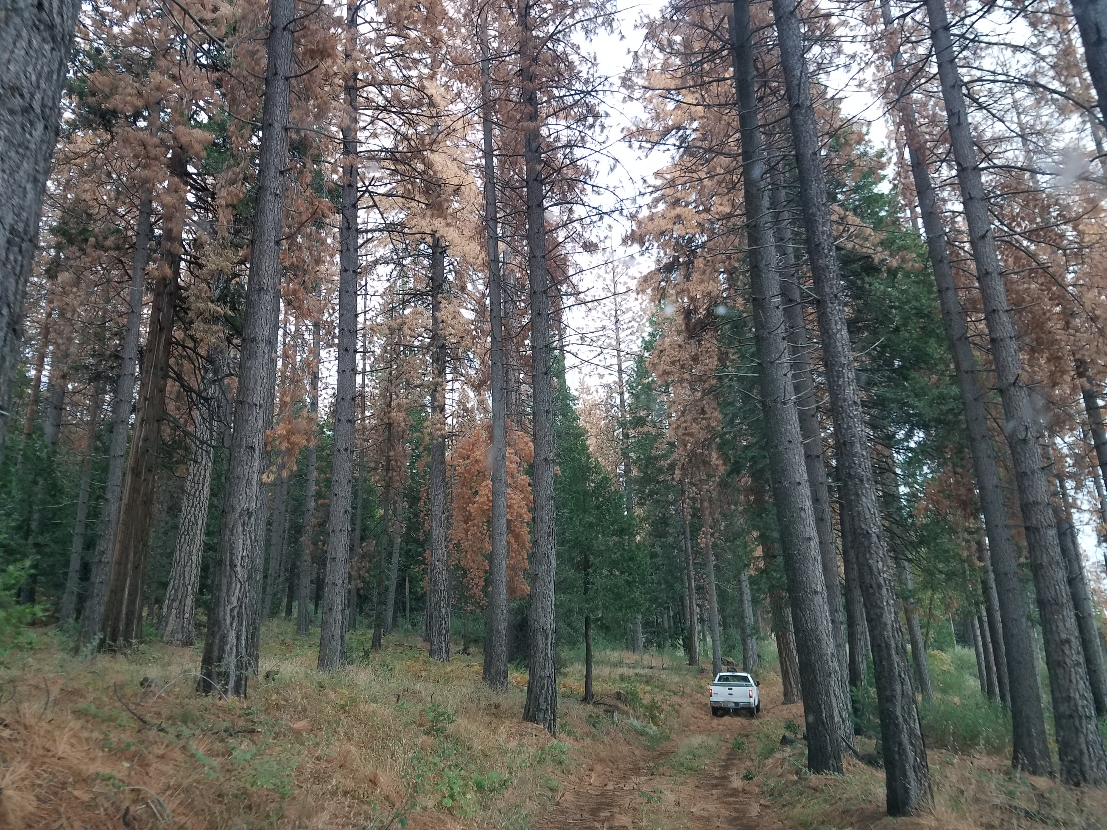
Eligible Forest Improvement Practices
1. Reforestation and timber
stand improvement
2. Wildlife habitat improvement
3. Land conservation

Slide 6
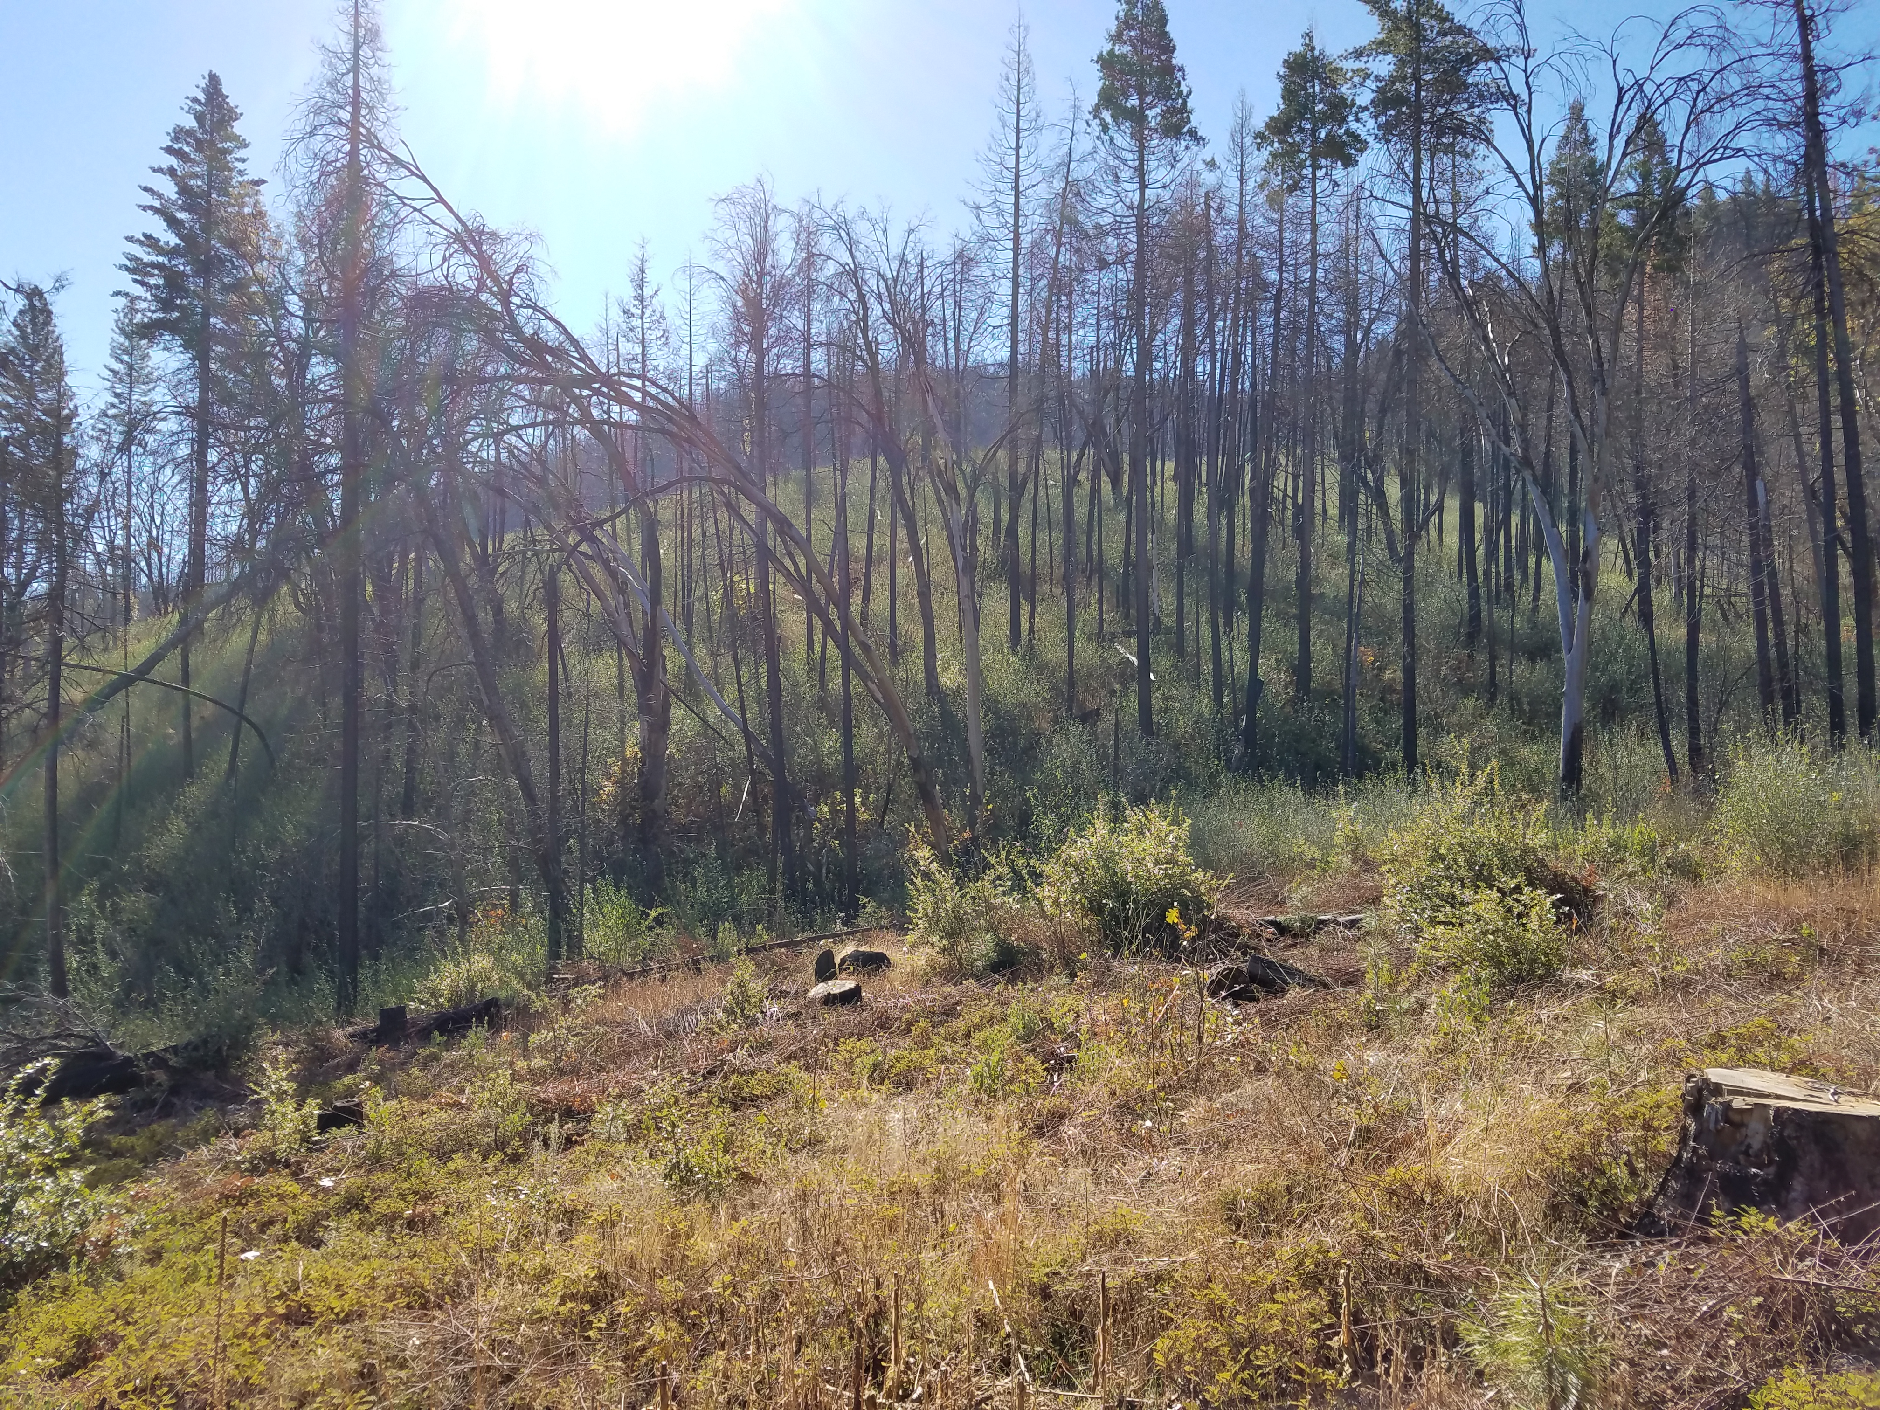

Reforestation and timber stand improvement
Management plans
RPF supervision
Site preparation
Tree planting
Tree shelters
Pre-commercial thinning
Pruning
Follow up / Slash disposal
Release

Slide 7
Management Plan Writing and Registered Professional Forester Supervision

Slide 8
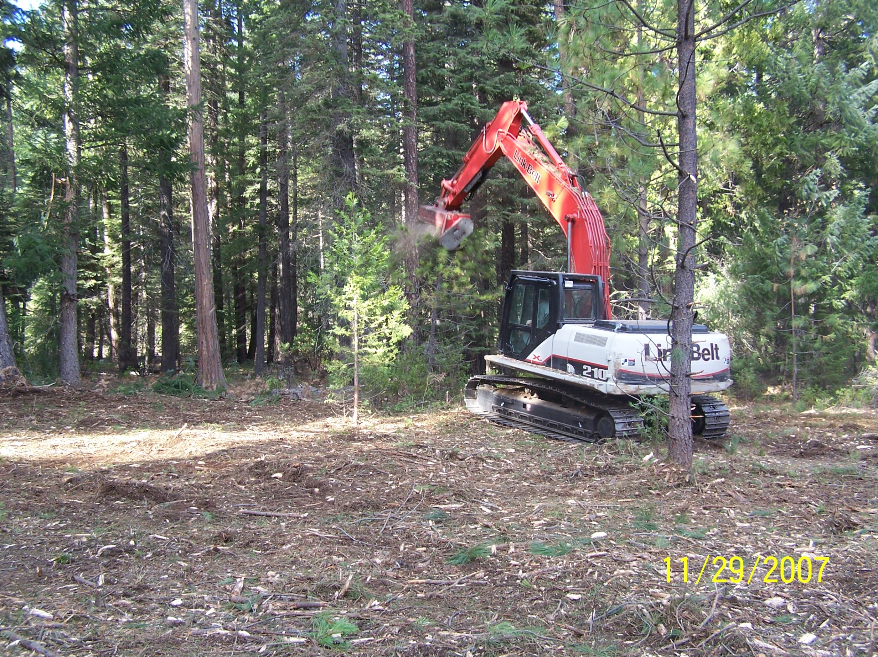
Site preparation & Follow up slash disposal
Notes:
Mastication work to reduce fuel loading…

Slide 9
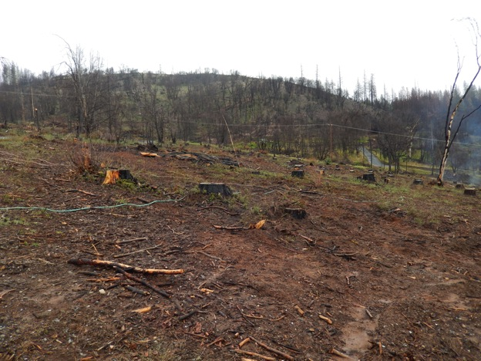
2014 King Fire—Area Prepared for Planting
Site is cleared of debris, dead standing trees removed, little or no shrub or grass cover
Notes:
This is a photo from the 2014 King Fire showing a site that has been cleared and prepared for planting.

Slide 10
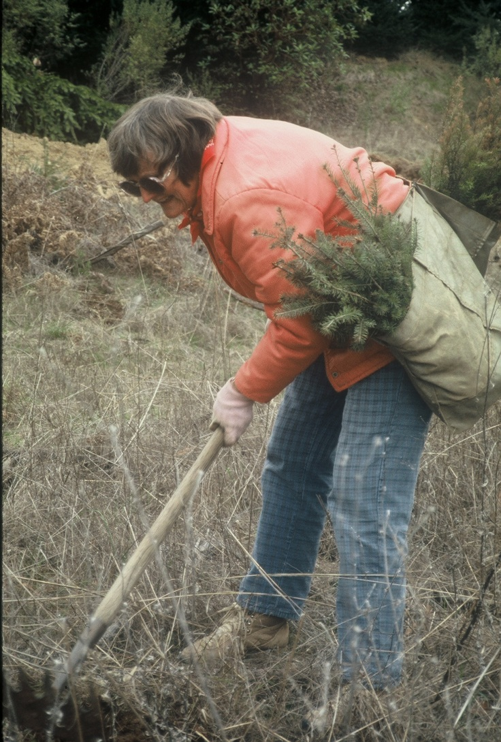
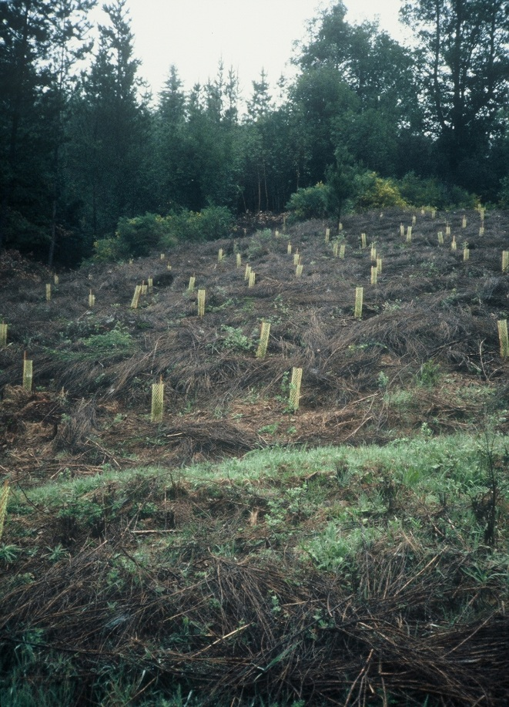
Conifer Planting and Seedling Protection
Vexar tubes
Notes:
Planting conifer seedlings and protecting them with vexar tubing to protect them from animal brousing...

Slide 11
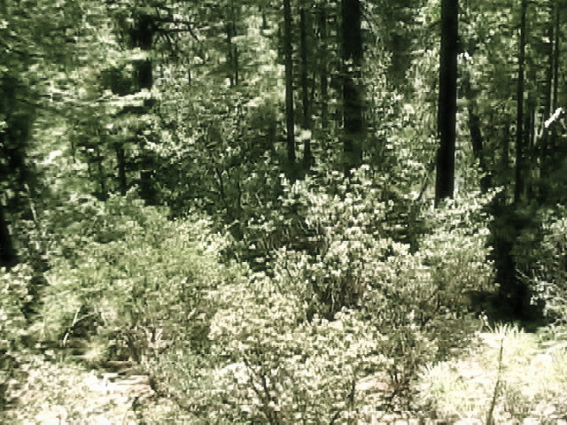
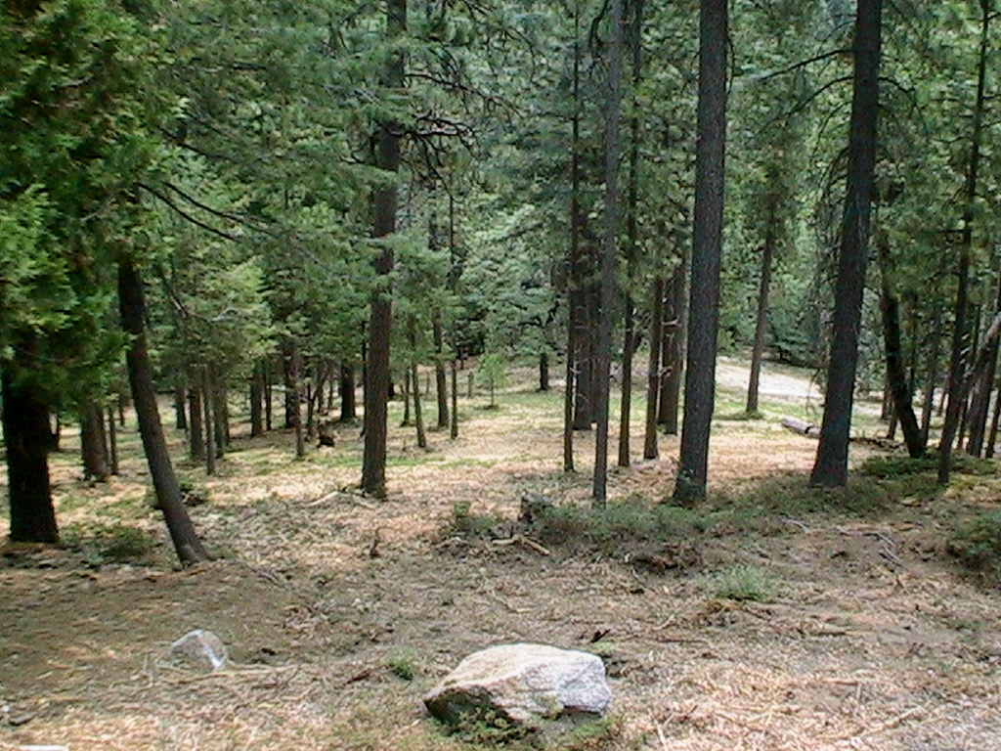
BEFORE
AFTER
Musick Creek Fuel Treatment Project (Fresno County near Shaver Lake) Before and After Photos
Notes:
This set of before and after photos from the southern Sierra Nevada shows how fuel treatments can reduce tree density and the risk of crowning wildfires.

Slide 12
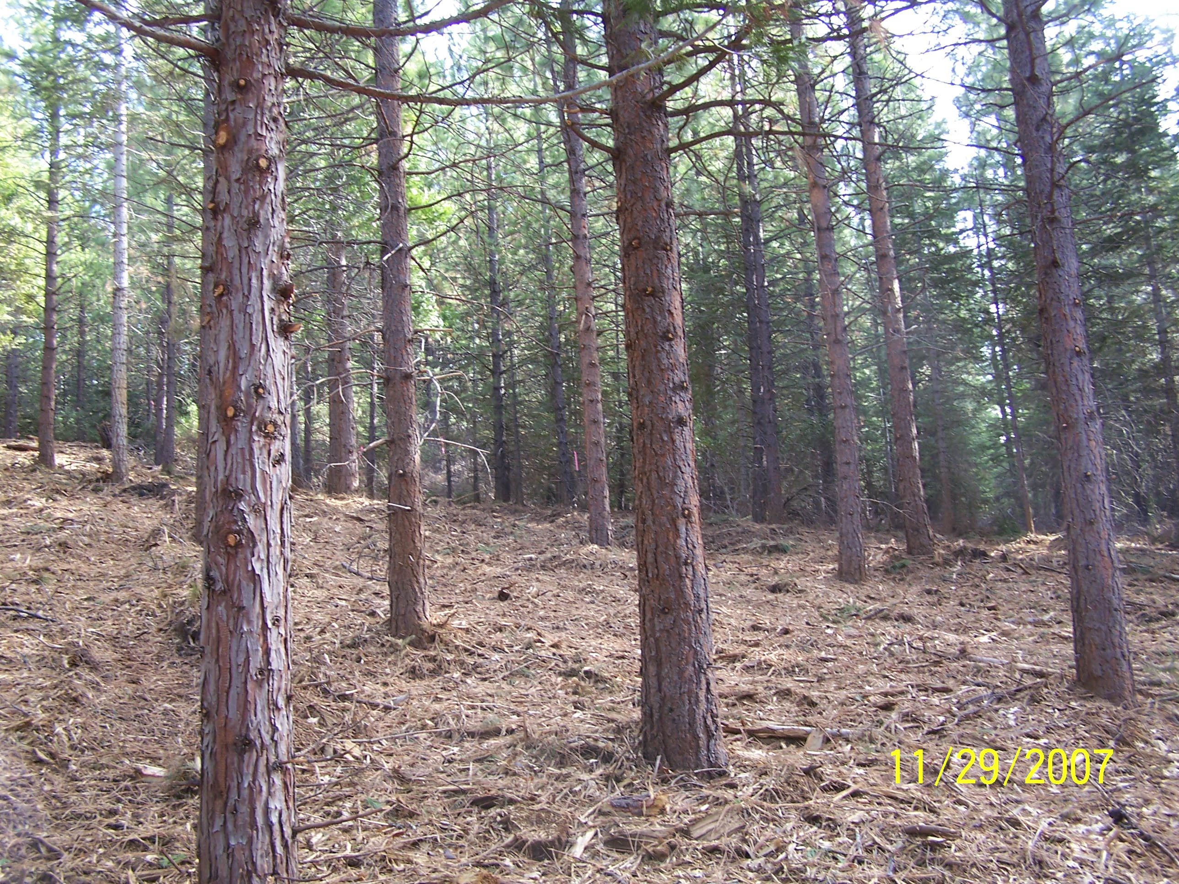
Notes:
Resulting in stands that look like this.

Slide 13
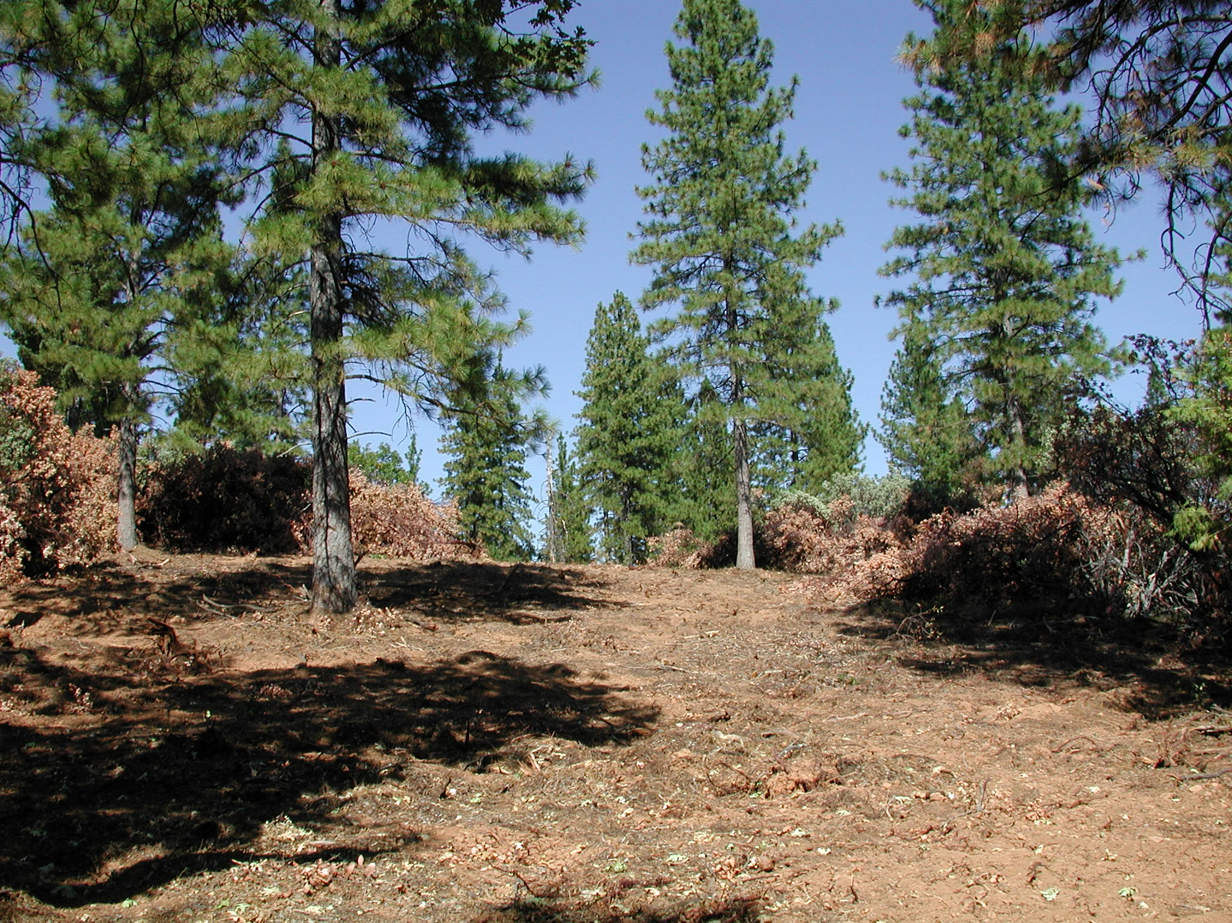
Understory Brush Removal for Fuel Reduction
Notes:
Understory brush removal for fuel reduction…

Slide 14
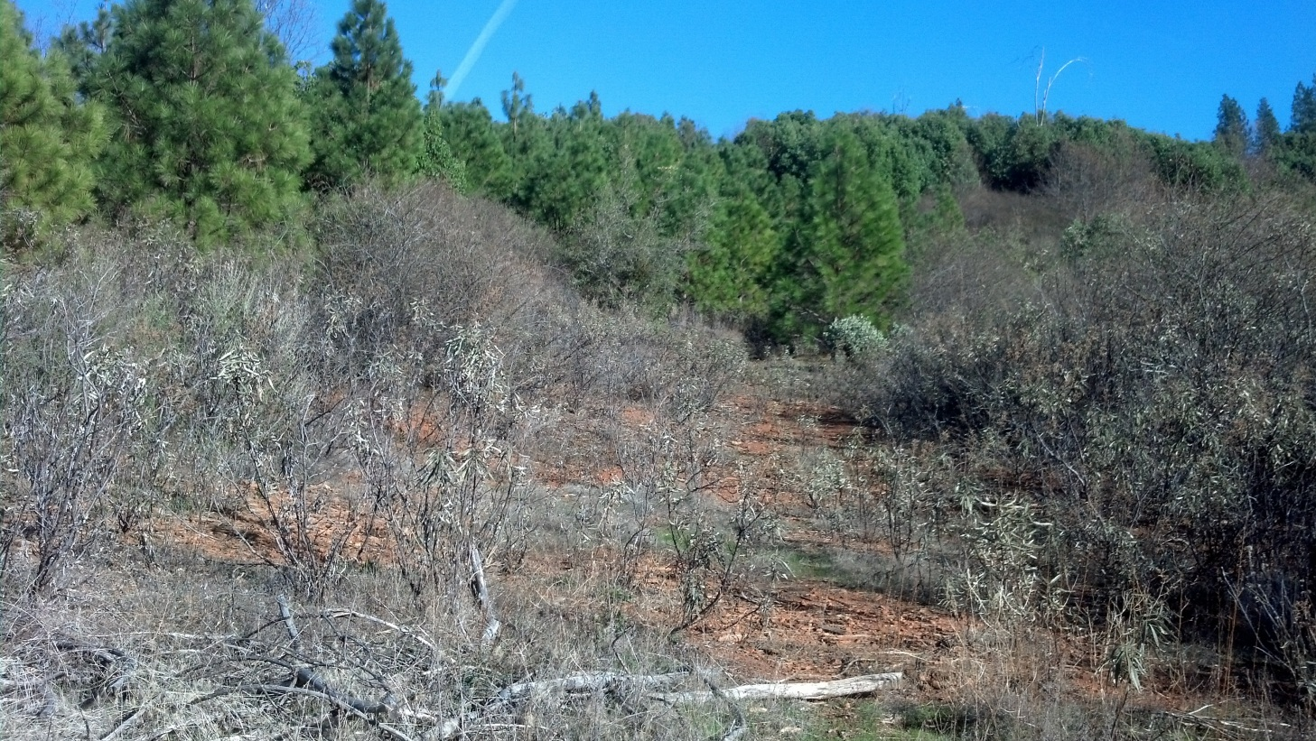
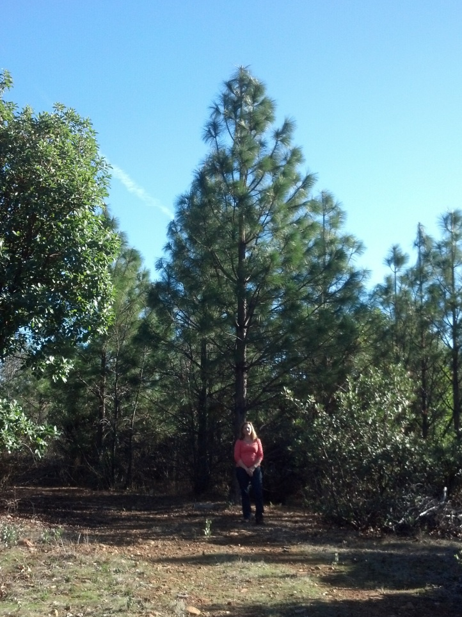
The California Forest Improvement Program--CFIP
Planted (private)
Unplanted (BLM)
Trees planted in 2000 following the 1999 Pendola fire in Yuba County, photos taken in 2014
Photos: J. Calvert, CAL FIRE
Notes:
The results can be dramatic, as illustrated in this photo showing trees planted following the 1999 Pendola Fire in the central Sierra Nevada, and where they were not planted.

Slide 15
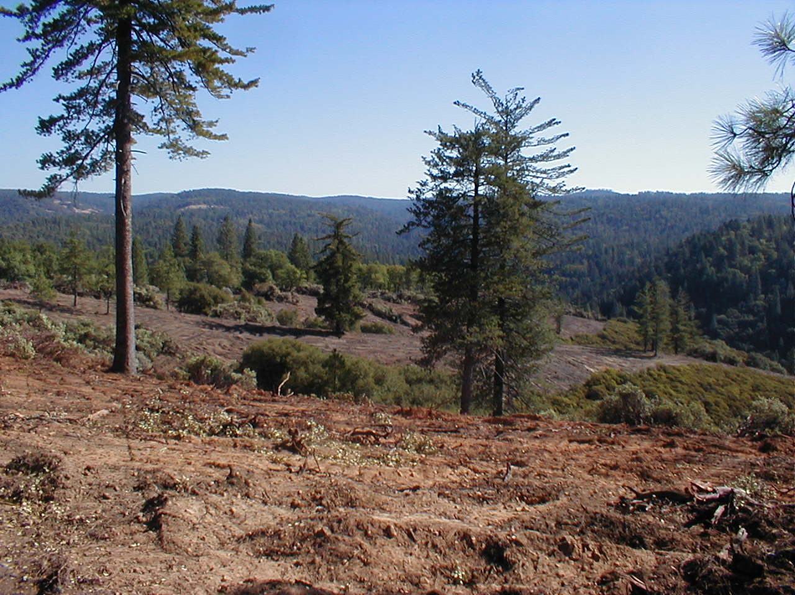
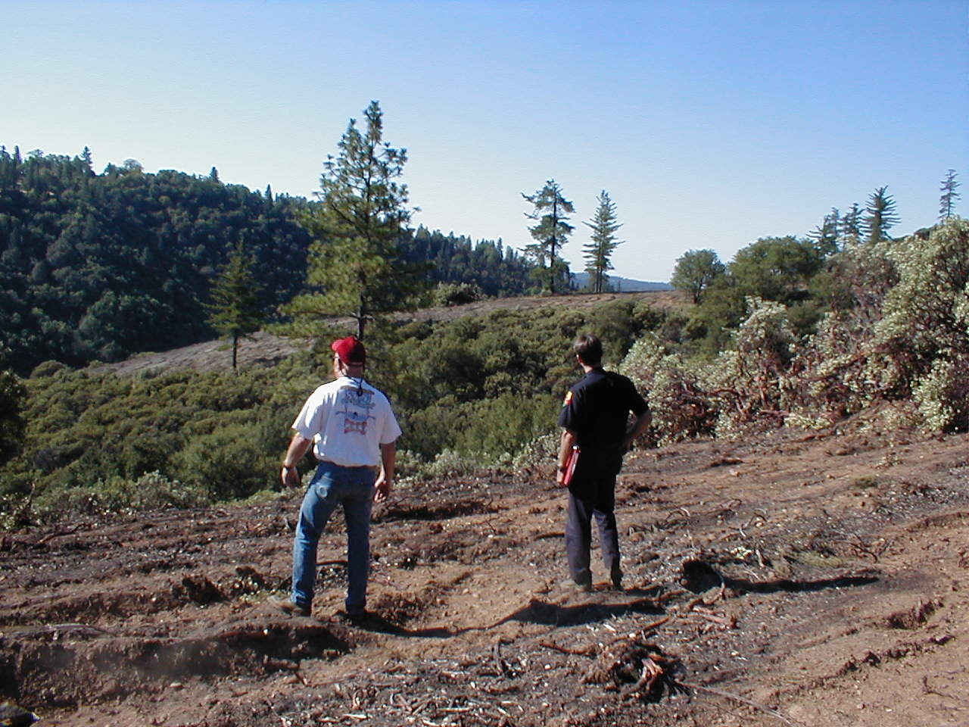
California Forest Improvement Program Conversion of Brush Field to Trees
Tuolumne County
Photos: H. Bunt, CAL FIRE (retired)
Notes:
Here are some examples; they include conversion of brush fields to conifer plantations...

Slide 16
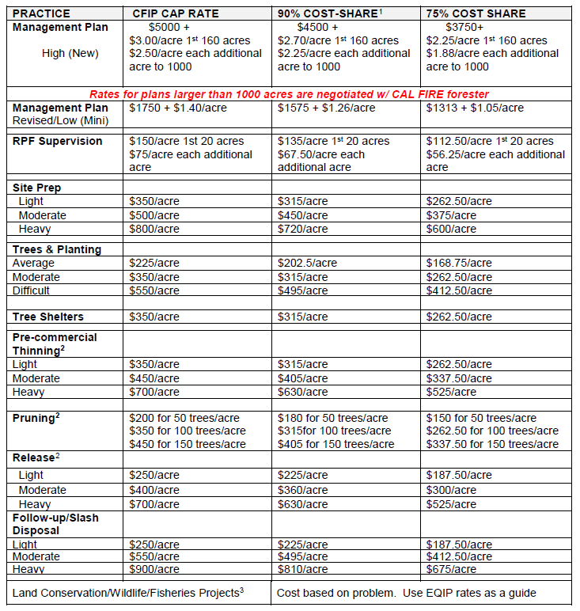
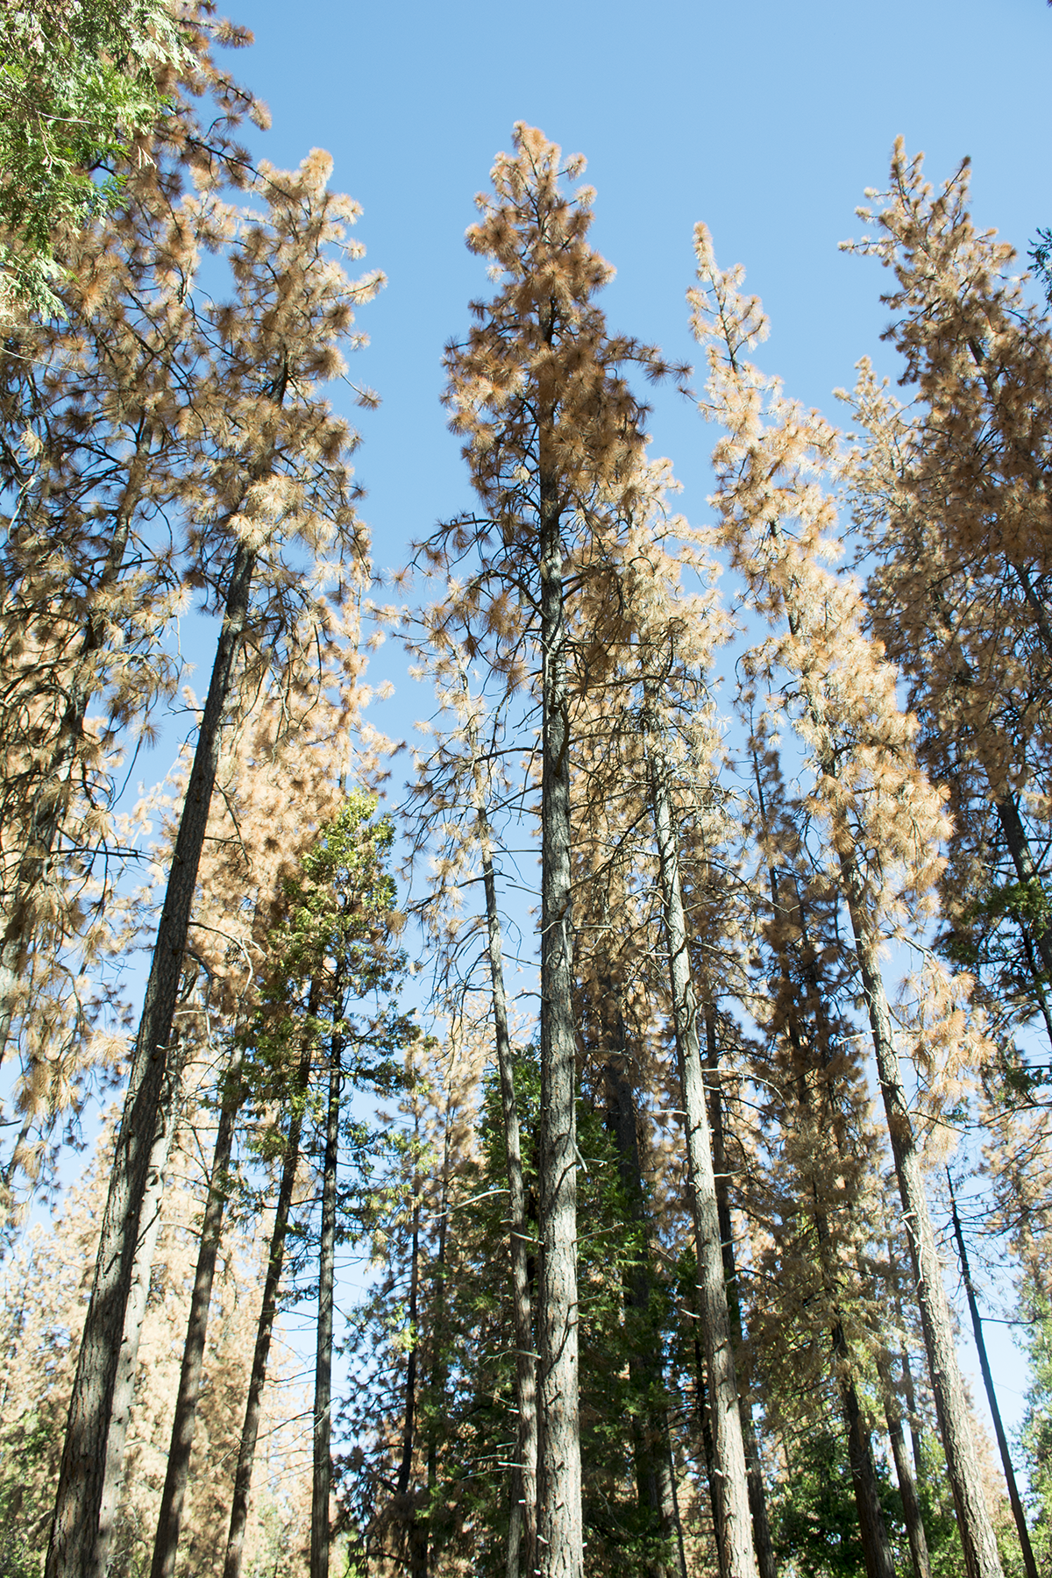
ELIGIBLE PRACTICES and RATES

Slide 17
LAND CONSERVATION and WILDLIFE/FISHERIES PROJECTS
Improvement of drainage facilities to reduce soil erosion and sedimentation of streams
Forest road repair and upgrading*
Planting native oaks
Planting streamside vegetation**
Planting or reshaping eroding stream banks or gullies
Remedial work for stabilizing landslides (requires analysis and design by a Certified Engineering Geologist or Geotechnical Engineer) **
and others!
* Funding of forest road repair and upgrading is only allowed if it protects, maintains, or enhances fish and wildlife habitat.
** Projects involving work on stream channels or banks may require permits from the California Department of Fish and Game or other agencies.

Slide 18
PRACTICES NOT ELIGIBLE
Work required for compliance with the Forest Practice Act and Rules.
Construction of new roads or bridges.
Fencing to protect stands from livestock.
Planting of Christmas trees and greenery.
Costs of land, water, irrigation, or purchase of tools or equipment.
Projects designed solely for the production of fuelwood.

Slide 19
INITIAL LANDOWNER REQUIREMENTS
Retain the services of a Registered Professional Forester (RPF)
Have the funds available to pay for your project until reimbursement arrives
  ~$5k for management plan only
  ~$50-100k+ for projects, depending on treatments

Slide 20
THE PROCESS (BRIEFLY)
Submit the Application, Agreement, and other required elements to your local Forestry Assistance Specialist (FAS)
Office review and site inspection
Review and approval by Sacramento
Multi-agency Environmental Review
Project Implementation
Invoicing
Reimbursement

Slide 21
ENVIRONMENTAL REVIEW
The Confidential Archeological Addendum for the property (CAA)
A copy of the Management Plan for the property
A CFIP Project Review Environmental Checklist
RPF check list
Land use addendum (if not zoned TPZ)
A licensed Pest Control Advisors recommendation for proposed herbicide treatment
Natural Diversity Database Findings

Slide 22
ENVIRONMENTAL REVIEW
Usually takes 30 days from the date sent to local agencies and tribes:
  CA Dept. of Fish and Wildlife
  Water Quality
  County Clerk
  Local Tribes
  US Forest Service (if adjacent)
  Caltrans

Slide 23
KEEP IN MIND:
CFIP cannot be used in conjunction with other cost-share programs (e.g., EQIP)
Priority Ranking is implemented when program funding drops below $1 million
You will receive a 1099R form for the tax year(s) in which you receive a CFIP reimbursement payment. Consult your tax advisor/CPA before applying.

Slide 24
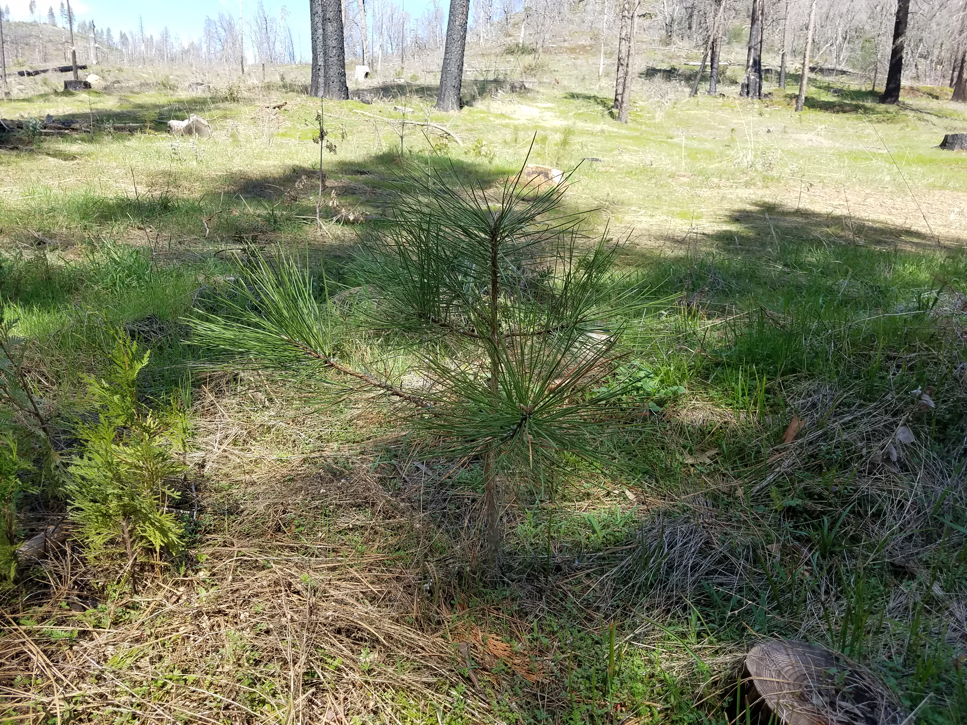
QUESTIONS?
Zsolt Katay
Forestry Assistance Specialist
CAL FIRE TCU & MMU
(209) -754-2707
785 Mountain Ranch Rd.
San Andreas, CA 95249

