Slide 1

Your delegates to the Council of
UC Staff Assemblies:
Jeannette Warnert, senior delegate
LeChé McGill, junior delegate

Slide 2
An assembly of staff dedicated to improving communications between UC administrators and staff and between staff at UC locations.
Founded in 1974.
In 1992, CUCSA chair and vice chair began presenting annual reports to the UC Board of Regents.

Slide 3
CUCSA worked for 10 years to get staff representation at the Regents “table.” This was realized in 2006-07 when the first staff advisor to the Regents was appointed.
Two delegates (senior and junior) from each campus, lab and UC ANR attend three-day meetings quarterly. The meetings rotate between the campuses and sites.
CUCSA will be hosted by UC ANR in September 2018.

Slide 4
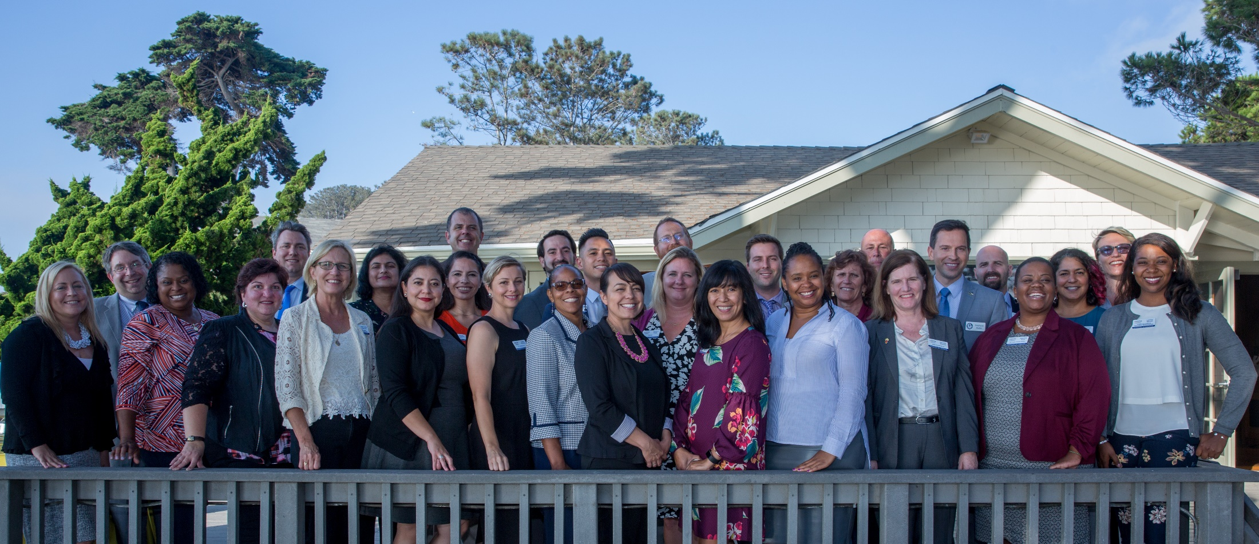
CUCSA delegates, 2017-18

Slide 5
2016-17 Workgroups
Diversity and Inclusion (UC ANR Junior Delegate Jeannette Warnert)
Financial Wellness
Government Advocacy
Work-Life Balance (UC ANR Senior Delegate Lori Renstrom)
Internal Operations

Slide 6
2017-18 Action Teams
Diversity and Inclusion (UC ANR Junior Delegate LeChé McGill)
Financial Wellness
Government Advocacy (UC ANR Senior Delegate Jeannette Warnert)
Mental Wellness
Internal Operations

Slide 7

Develop a training module for all campuses that includes
  Concepts of bias
  Micro aggressions
  How to train search committees

Slide 8
Develop a training module for all campuses that includes
  Concepts of bias
  Micro aggressions
  How to train search committees
Leverage CUCSA and local staff assemblies for brainstorming, and sharing diversity and inclusion practices

Slide 9
Develop a training module for all campuses that includes
  Concepts of bias
  Micro aggressions
  How to train search committees
Leverage CUCSA and local staff assemblies for brainstorming, and sharing diversity and inclusion practices
Ask hiring managers and HR to work with local staff assembly and share open positions in order to increase diversity, especially in senior management level

Slide 10
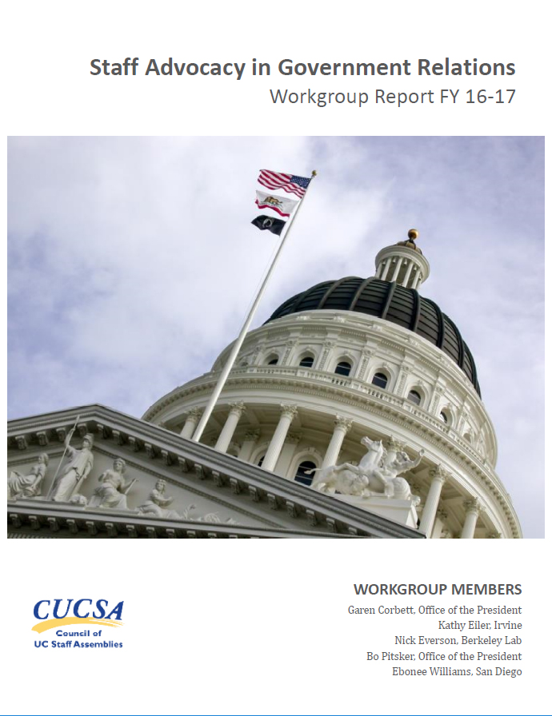
Build a stronger link between staff and UC government relations

Slide 11
Build a stronger link between staff and UC government relations
Add the unique voice of staff to advocacy, in addition to student and faculty voices

Slide 12
Build a stronger link between staff and UC government relations
Add the unique voice of staff to advocacy, in addition to student and faculty voices
Involve staff in local events with legislators in their districts

Slide 13
Build a stronger link between staff and UC government relations
Add the unique voice of staff to advocacy, in addition to student and faculty voices
Involve staff in local events with legislators in their districts
Communicate the ability of staff to strengthen UC’s message

Slide 14
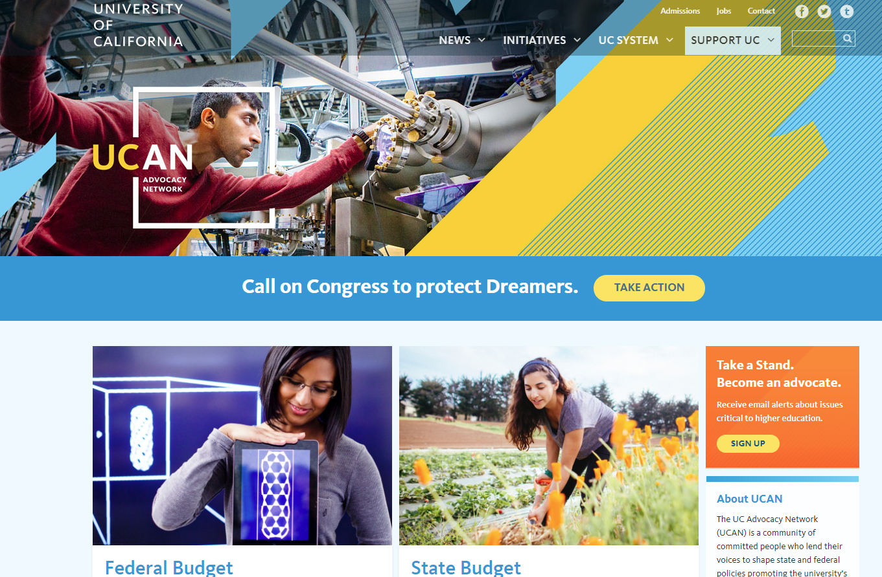
https://www.universityofcalifornia.edu/support-uc/ucan (Or Google UC Advocacy Network)

Slide 15

2017 UC Staff Engagement Survey
Agriculture and Natural Resources
Notes:
Another key activity of CUCSA is the Staff Engagement Survey. Many of you probably filled out the survey. It didn’t go to all, but to a statistically significant sample.

Slide 16
Organizational Change
Agriculture and Natural Resources
Total Favorable
Ag and Natl Rescs 2015
University of California Overall 2017
US National Norm
Organizational Change
32
2
2
-18*
15a
Generally, recent major organizational changes across the UC system have been: Planned well
34
2
4
-8*
15b
Generally, recent major organizational changes across the UC system have been: Explained well
33
2
1
-23*
15c
Generally, recent major organizational changes across the UC system have been: Executed well
28
2
2
-22*

Slide 17
Performance Management
Agriculture and Natural Resources
Total Favorable
Ag and Natl Rescs 2015
University of California Overall 2017
US National Norm
Performance Management
52
5
-5
-11*
3
I feel my campus/location does a good job matching pay to performance.
20
5
-11*
-27*
5
I feel my personal contributions are recognized.
67
19*
0
-1
25
I think my performance on the job is evaluated fairly.
70
-8
-4
-5

Slide 18
Wellness
Agriculture and Natural Resources
Total Favorable
Ag and Natl Rescs 2015
University of California Overall 2017
US National Norm
Wellness
60
n/a
-8*
n/a
32
My supervisor is supportive of my participation in health or wellness-related initiatives and programs offered at my campus/location. ⋆
61
n/a
-11*
n/a
35
My organization promotes an environment of physical, mental, and social well-being. ⋆
60
n/a
-5
-12*

Slide 19
Collecting your input on actions to take in key areas.

Slide 20
Thank you!

