Slide 1
History of the previous UC ANR Staff Congress (Assembly)
Why was the Staff Congress formed and by whom?
When did the program take place?
Who was involved? How what it structured?
What types of programs were available? How were the programs supported by administration/leadership?
Where did the Staff Congress end up?

Slide 2
Why was the Staff Congress formed and by whom?
“Give a voice to staff employees.”
a “real voice” & “not the usual lip service/empty promises”
To create a direct line of communication from staff employees to administration/leadership.
To develop and maintain a monetary reward system for those employees that illustrate outstanding work ethic, teamwork, and ingenuity.
Established by VP of Research & Extension and Human Resources

Slide 3
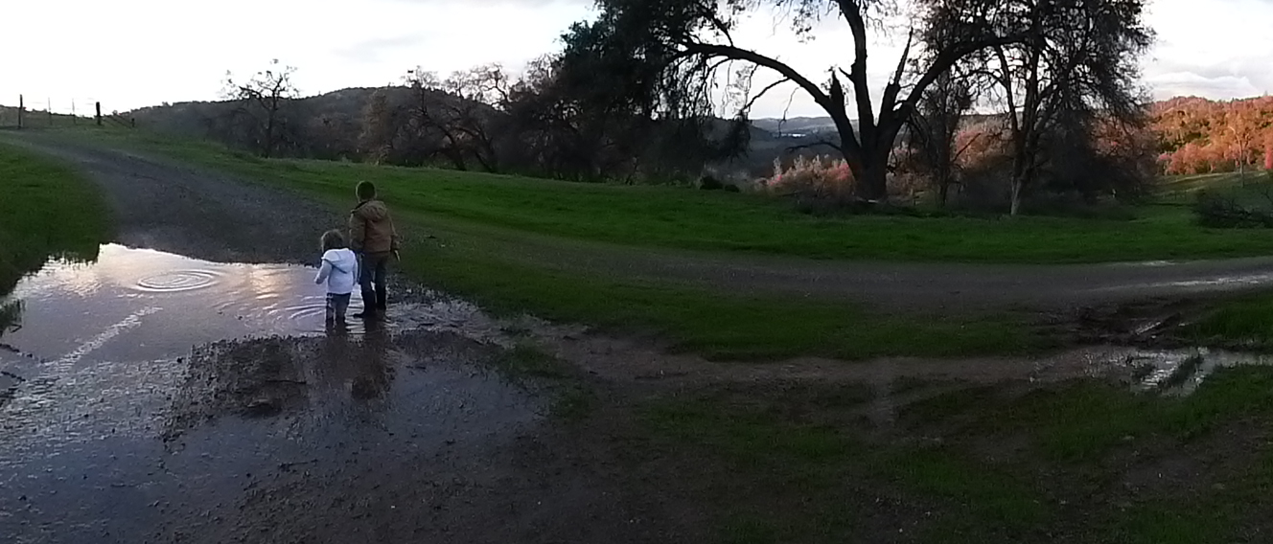
When did the program take place?
Approx. from 1998 to 2003

Slide 4
Who was involved?
Assistant Vice President of Research and Extension Centers,
Director of Human Resources,
Superintendents from each REC,
Appointed delegates (staff employees) from Desert, Hopland, Hansen, Intermountain, Kearney, Lindcove, Sierra Foothill, South Coast REC, Westside REC, and ANR (campus)

Slide 5
How was it structured?
Superintendents asked for volunteers from each REC and ANR to serve as delegates representing their location. How long did the delegates serve?
Delegates attempted to meet every 6 months at different Research and Extension Centers.
Human Resource director was available for policy/budgetary assistance and served as the main communication channel to administration for staff decisions, opinions, and comments. The meeting minutes were given to the HR personnel and they decided what information was important to present to the VP.
Staff Assembly may need to examine our current situation.

Slide 6
What types of programs were available?
Staff Advisory Board – Staff delegates voted for which employee/s to receive the “Outstanding Service” award. Amount awarded to employees?
Agricultural Ambassador program – Staff employees would work alongside their counterparts from other REC’s. This provided career training, continued education, direct sharing of ideas, thoughts, and processes with peers, development of professional relationships (sharing resources - equipment, personnel, materials, policies).
Education Program – Available funding for purchasing textbooks, continuing ed. courses, training materials, etc.
Not involved in Council of University of California Staff Assemblies (CUCSA)

Slide 7
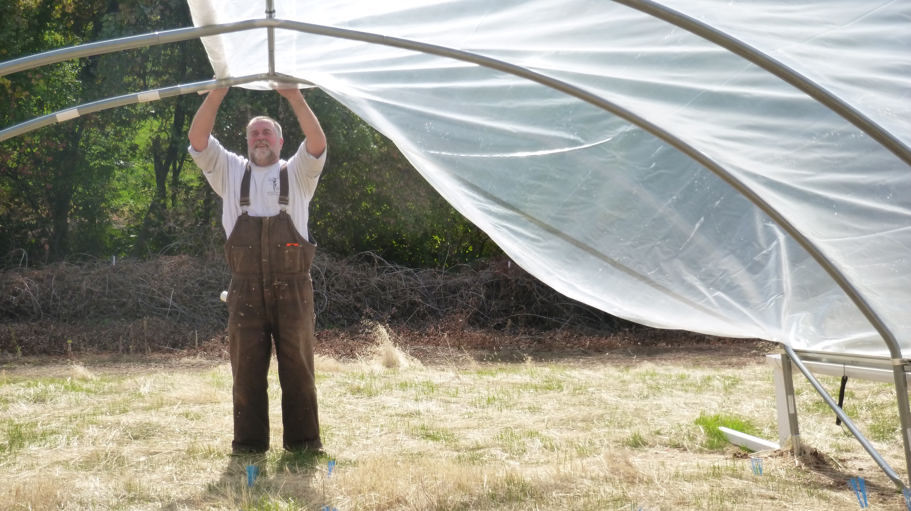
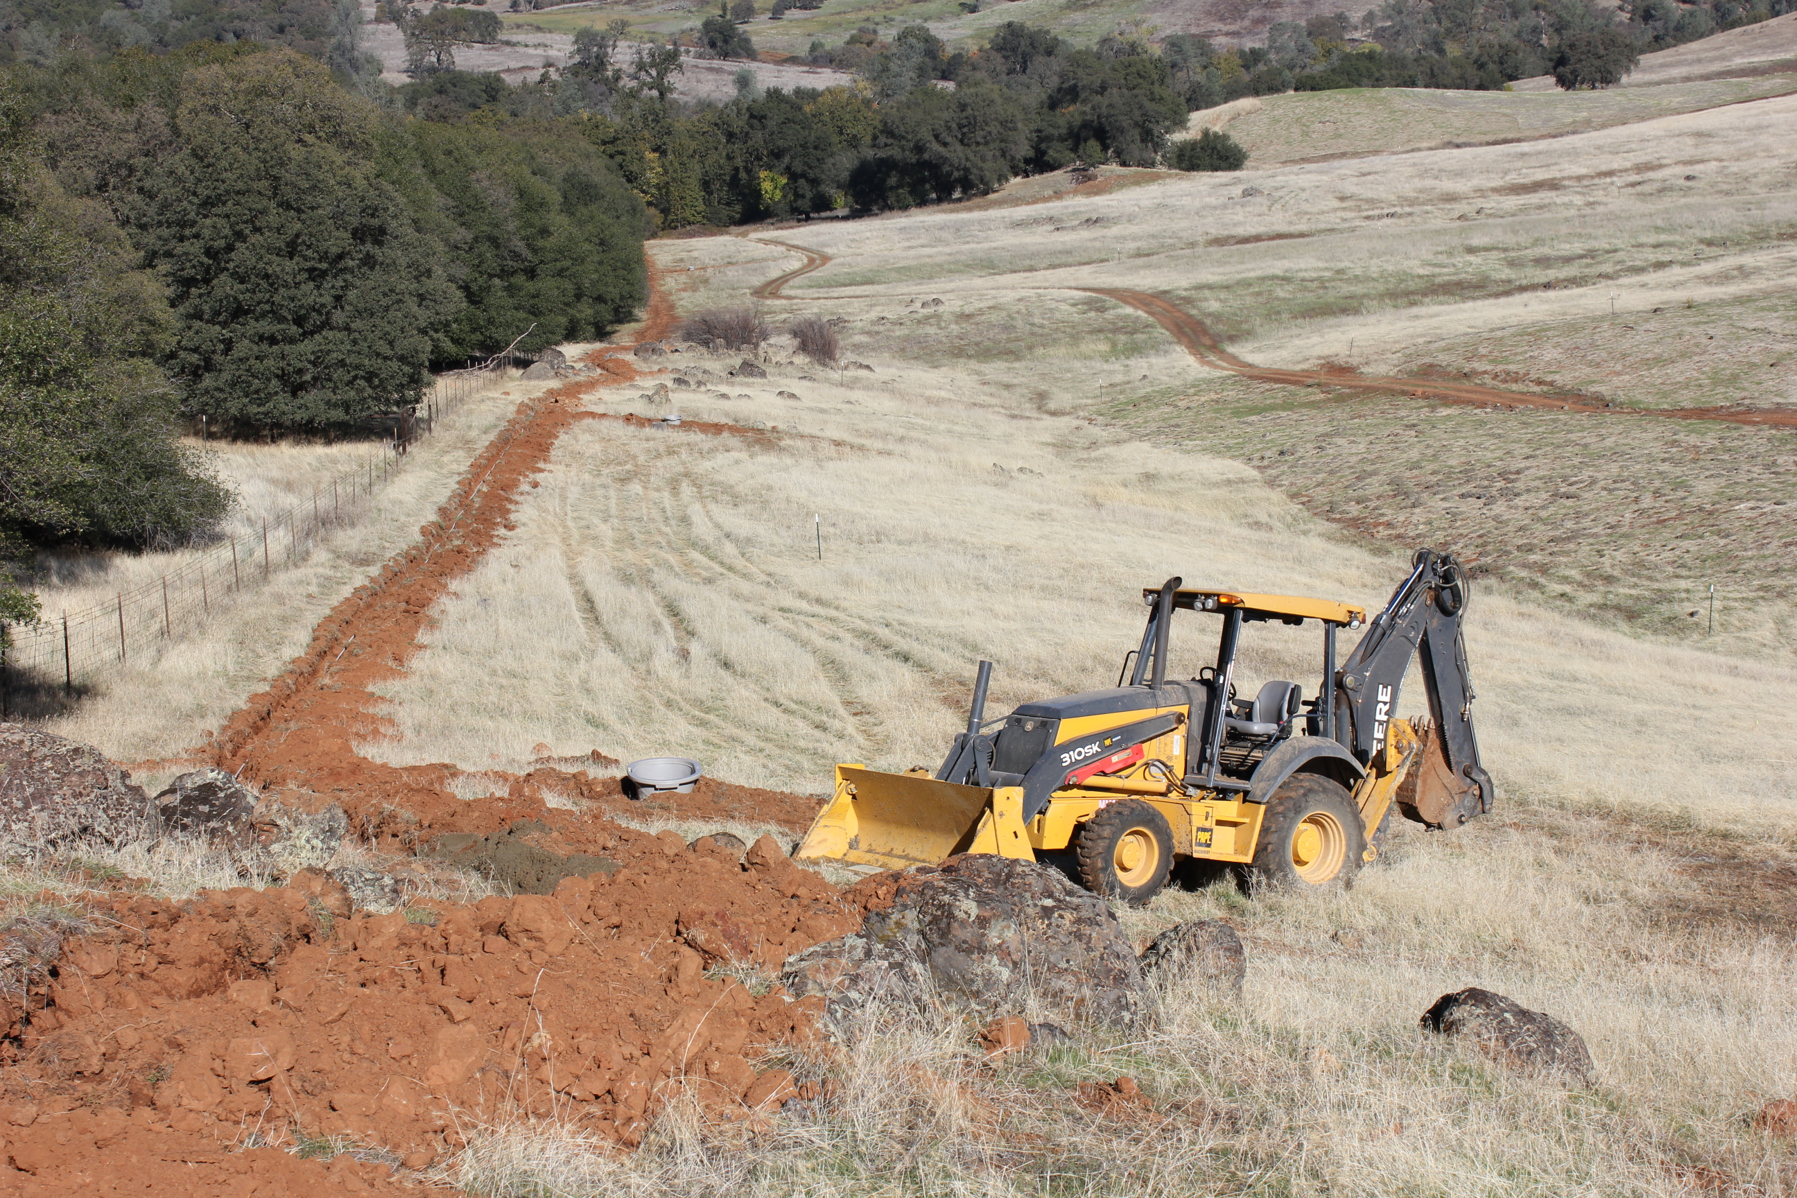
How were the programs supported by administration/leadership?
Supported the Staff Congress with temporary funding each year, with stipulations.
Superintendents were deeply involved in the staff decision making.
There was no real influence to which Staff Congress could yield to make changes.

Slide 8
Where did the Staff Congress end up?
Defunct within 4-5 years
Unable to sustain itself due to lack of UC ANR staff employee involvement.
Dissolved due to “perceived” discriminatory reasoning which influenced returning delegates to vote for specific parties.
Increased administration involvement within Staff Congress dictating terms and policy. Describe Examples:

Slide 9
Thank you!
Any Questions?

