Slide 1
Herb Gardening 101
For Medicinal, Therapeutic, Aromatherapy and Culinary Use
UC Master Gardeners of Monterey & Santa Cruz
February 2018

Slide 2
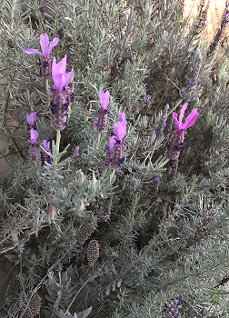
What Is An Herb
Herbaceous
Any plant with leaves, seeds or flowers used
for flavoring food, medicine or perfume
Any seed-bearing plant that does not have a woody stem and dies down at the end of the growing season
Annual, Biennial or Perennial

Slide 3
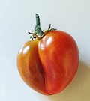
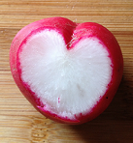
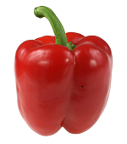
What’s All The Other Stuff
Fruit - a seed-bearing structure that develops from the ovary of a flowering plant
Vegetable – any edible part of a plant that isn’t a fruit –
roots, leaves, stems, tubers,
bulbs, flowers
Spice – comes from the root, stem, bulb, bark or seeds of a plant - most often dried

Slide 4
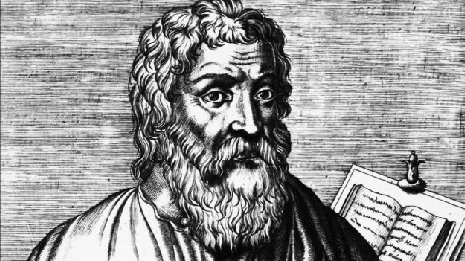
The Ancients Knew the Score
Hippocrates – Greek - Father of Medicine
“Let your food be your medicine, and your medicine be your food.”
Chinese – currently 13,000 medicinals, 100,000 medicinal recipes in ancient literature
India – Ayurveda - used to find balance for whole being - body, mind and spirit
Egyptians – plant and fruit extracts for medicinal purposes
Roman Empire - took herbs to far reaches of Empire
Ancient Hebrews – Bible mentions 128 plants part of everyday life – garlic, milk thistle myrrh a few
Christians - Monks - collected and used them for healing purposes
Native Americans – Medicine Man – priest and doctor

Slide 5
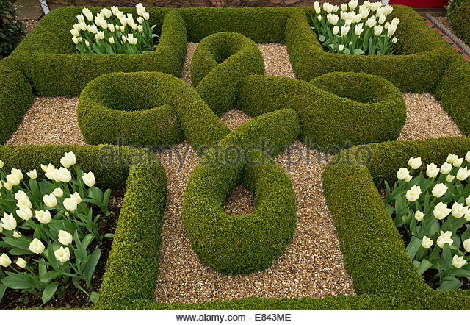
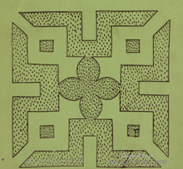
Tie the Knot
Add Elizabethan culture to your garden
Essential part of most Elizabethan gardens - near kitchen
Knot gardens had their origins in medieval kitchen gardens where medicinal and cooking herbs were divided into separate beds to prevent confusion
In these early gardens, inner beds for herbs, vegetables or flowers created the patterns.
Later - borders

Slide 6
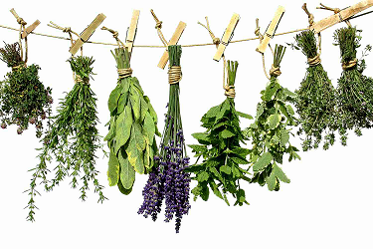
How to Get What You Need
Distillation – water, steam, solvent to get oil
Infusion – steep herb in medium (oil) to make an essential oil
Drying –
dehydrator,
bundles,
screens or baskets

Slide 7
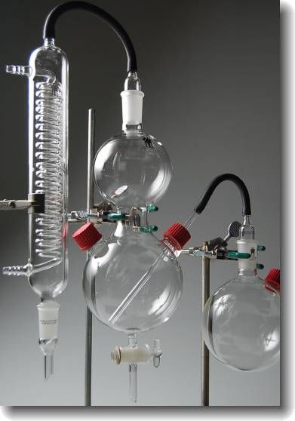
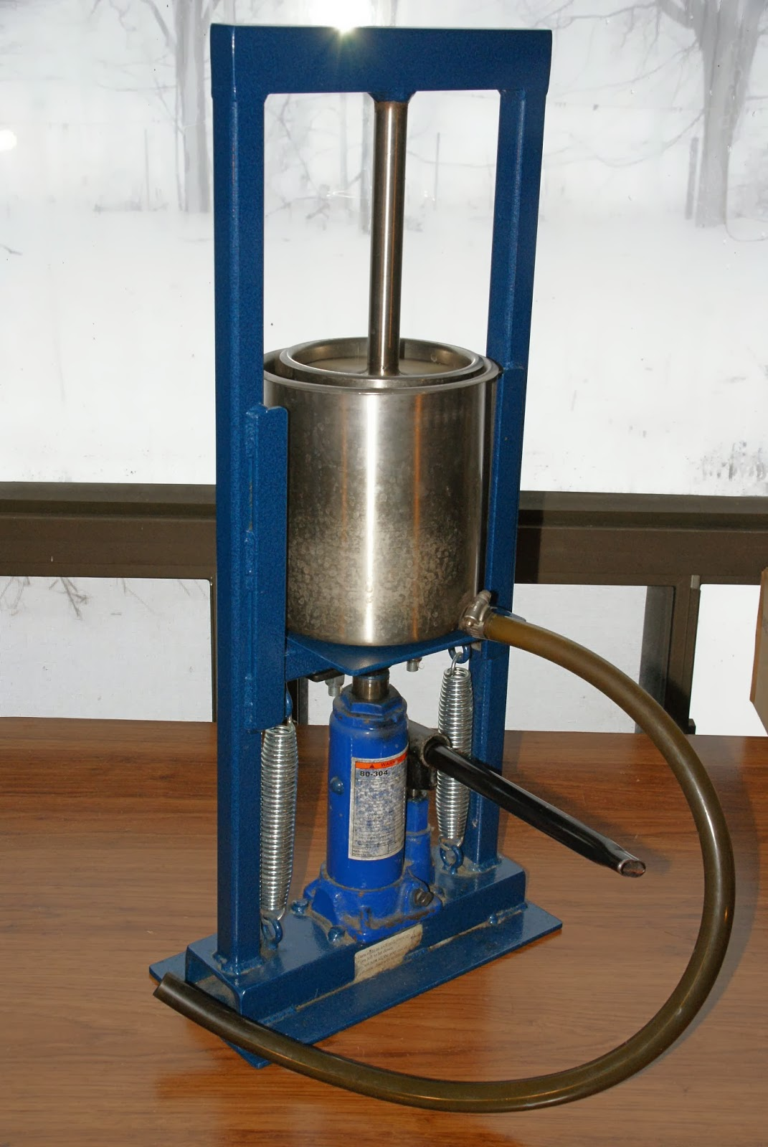
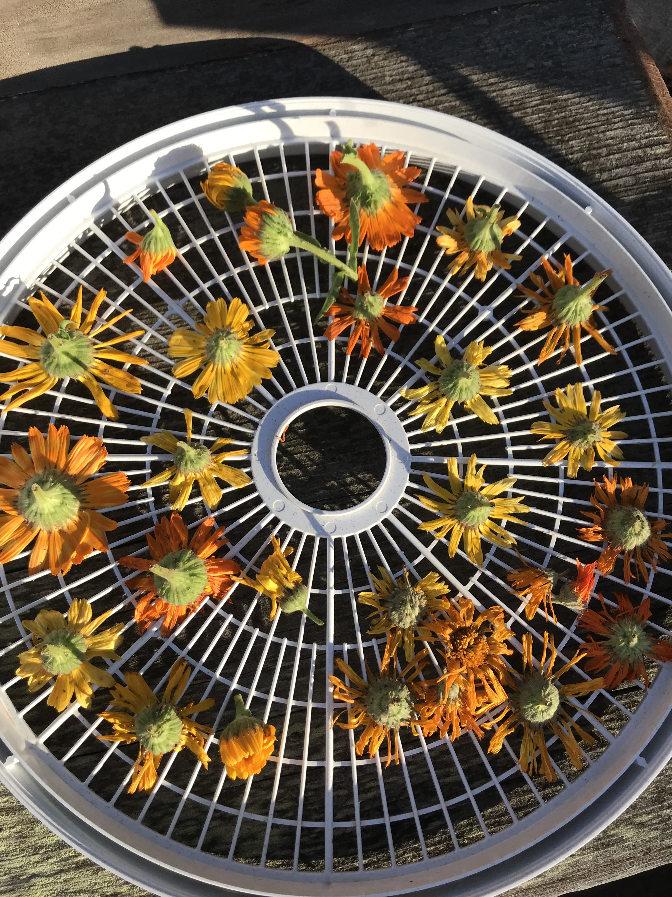
Processing
Distiller
Tincture Press
Dehydrator

Slide 8
Medicinal Uses
Herbal Tea
Poultice – make a paste, put in cloth
Compress – dip cloth in herbal tea
Infusion – a long steep
Decoction – boil smashed/chopped product for a long time
Syrup
Tincture – concentrated extract, generally in alcohol – used by the drop
Salves, balms, creams and lotions
Herbal Steam

Slide 9
Healing Body Products
Sugar Scrub
Skin cleaners
Moisturizers
Shampoos
Herb scented water
Bath salts
Balms
Powders
Perfumes - rosemary and lavender were burned in French hospital during wars to fumigate them - perfumare - translates to smoke through

Slide 10
Aromatherapy
Fragrance - evoke memories
Sachets
Pomanders
Pot-pourri
Scented candles
All used for unwanted smells

Slide 11
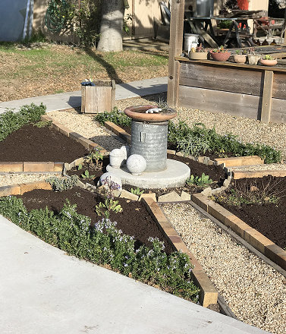
A Place for Herbs
Even the smallest herb garden can be a source of joy
Most common herbs thrive in full sun
Some of the most popular herbs - rosemary, lavender, bay, winter savory - can survive in gritty soil as long as it’s well-drained
Plant what you want to use- culinary, medicinal, therapeutic

Slide 12
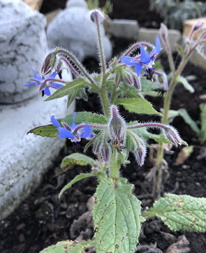
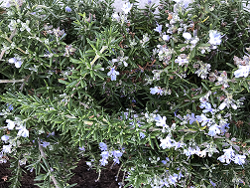
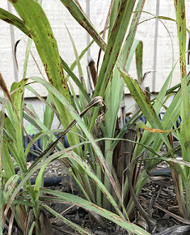
How to Begin
Grow from seed - basil, borage, calendula, chervil, coriander, lemon balm, parsley, sage
Root division - bee balm, chives, garlic chives, marjoram, oregano, thyme
Stem Cuttings – lavender, rosemary, thyme, oregano, mint, basil, marjoram, sage, winter savory, summer savory, scented geraniums,
lemon verbena
Plants -

Slide 13
What to Grow
Angelica Angelica archangelica biennial Culinary
Basil Ocimum basilicum annual Culinary/Medicinal
Bay Laurus nobilis perennial Culinary
Bergamot Monarda didyma perennial Medicinal
Borage Borago officinalis annual Culinary/Medicinal
Calendula Calendula officinalis annual Medicinal
Catnip Nepeta cataria perennial Medicinal
Chamomile Chamaemelum nobile perennial Medicinal/Aromatic
Chives Allium schoenoprasum perennial Culinary
Comfrey Symphytum officinale perennial Culinary
Coriander Coriandrum satibum annual Culinary
Dill Anethum graveolens annual Culinary/Medicinal
Fennel Foeniculum vulgare perennial Culinary/Medicinal
Horseradish Armoracia rusticana perennial Culinary
Hyssop Hyssopus officinalis perennial Culinary/Medicinal
Lady’s Mantle Alchemilla vulgaris perennial Medicinal
Lamb’s Ears Stachys byzantina Perennial Medicinal
Lavender Lavandula angustifolia Perennial Culinary/Medicinal
Lemon Balm Melissa officinalis Perennial Culinary/Aromatic
Lemon Verbena Lippia citriodora Perennial Culinary/Medicinal

Slide 14
Marjoram Origanum marjorana Perennial Culinary
Mint Mentha Perennial Culinary/Medicinal
Mullein Verbascum thapsus Biennial Medicinal
Nasturtium Tropaeolum majus Annual Culinary/Medicinal
Oregano Origanum vulgare Perennial Culinary/Medicinal
Parsley Petroselinum crispum Biennial Culinary/Medicinal
Rosemary Rosmarinus officinalis Perennial Culinary/Aromatic
Rue Ruta graveolens Perennial Medicinal
Sage Salvia officinalis Perennial Culinary/Medicinal/Aroma
Santolina Santolina chamaecyparisus Perennial Medicinal
Savory Satureja hortensis Annual (summer) Culinary/Medicinal
Savory Satureja montana Perennial(winter) Culinary/Medicinal
Scented Geraniums Pelargonium species Perennial Culinary/Medicinal/Aroma
Silver King Artemisia Artemisia ludoviciana Perennial Medicinal
Tansy Tanacetum vulgare Perennial Culinary/Aromatic
Tarragon Artemisia dracunculus Perennial Culinary/Medicinal
Thyme Thymus Vulgaris Perennial Cuinary/Aromatic
Valerian Valeriana officinalis Perennial Culinary/Medicinal
Violets Viola odorata Perennial Culinary/Aromatic
Woodruff Asperula odorata Perennial Culinary/Medicinal/Aroma
Yarrow Achillea millefolium Perennial Culinary/Medicinal

Slide 15
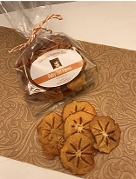
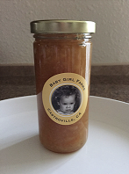
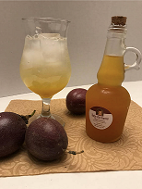
Now What?
Branding
Marketing
Rules & Regulations
Spiral Gardens, Berkeley, CA
www.spiralgardens.org
Soul Flower Farm
soulflowerfarm.blogspot.com
Cole Canyon Farm
www.wolecanyonfarm.com
Books
Culpepper’s Complete Herbal
The Complete Book of Herbs:
A Practical Guide to Growing
and Using Herbs – Lesley Bremness

