Slide 1
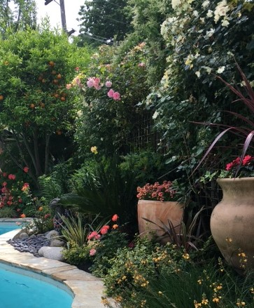

June 16, 2018
By UC Master Gardeners Jeanne Jones, Jan Hughes and Robert Buehler
Notes:
Jeanne to do the introduction

Slide 2

A Creative Container Garden
Genius way to grow your own edibles and flowers when you’re:
short on space
limited in time
new to gardening
looking for easy ways to add to your existing area
wanting to know what is in and on your food
We will show you how to do it yourself with displays and demonstrations!
Notes:
Jeanne to do introduction, what do you want to learn about today – use white board for questions from attendees and
use index cards during workshop too.

Slide 3
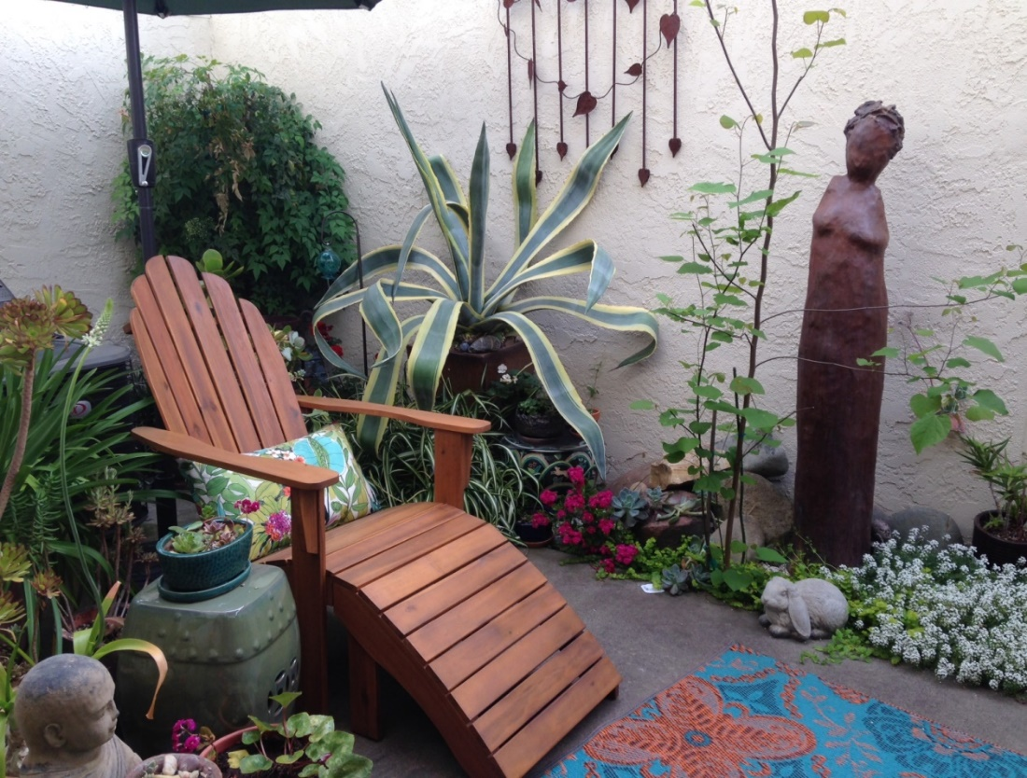
Basic Elements of Garden Design
Surfaces
Boundaries
Containers
Water Features
Time Constraints
Use of Plants,
Color, Form &
Seasonal Variation
Notes:
Jeanne. Planning a garden is similar to decorating and furnishing a house – can’t be done without knowing what materials
and techniques are at your disposal. This private courtyard is 15’ x 18’= 270 SF

Slide 4
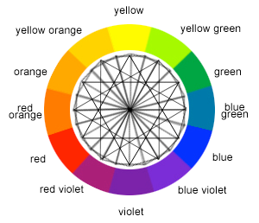
Painting with Plants
Lessons: Let Opposites Attract; Meet the Neighbors; Make a Triangle; Play with Shades & Tints
(Image credit: sessions.edu)
Notes:
Sir Isaac Newton (1642-1727) – sunlight is broken into individual colors when passing through a prism.
Newton noticed that there were 7 of these colors – color spectrum Richard of York gave battle in vane. ROYGBIV
www.sessions.edu/color-calculator/ for interactive program

Slide 5
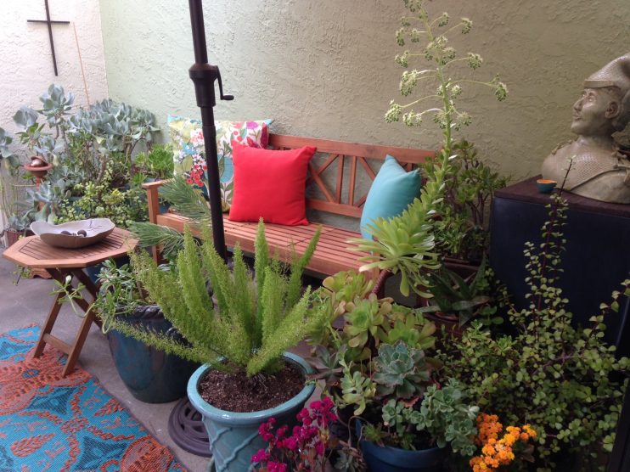
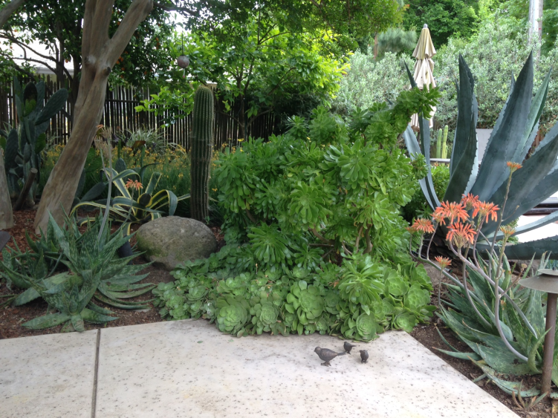
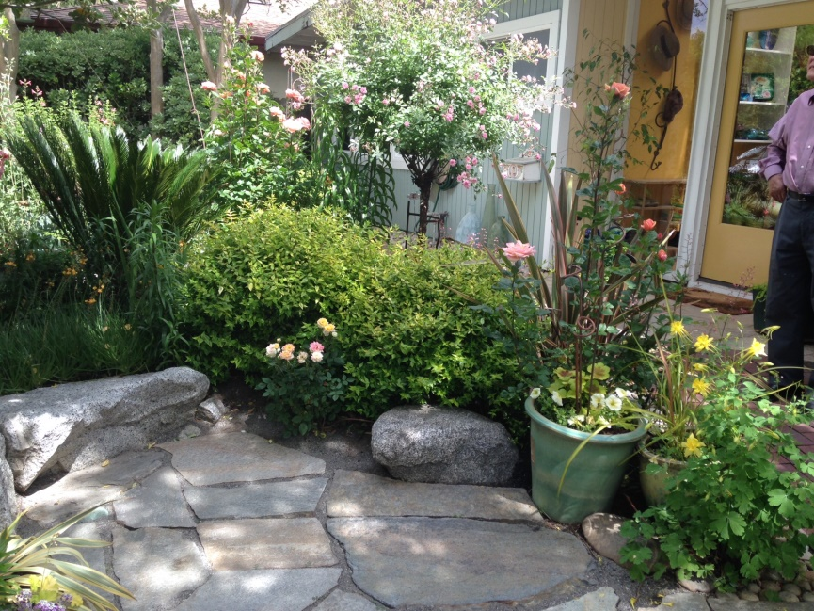
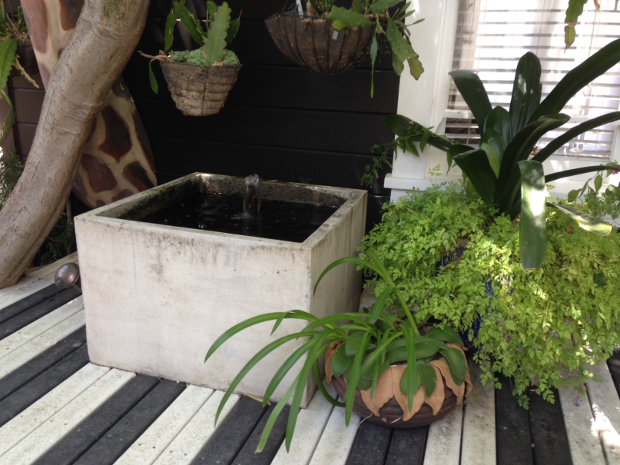
Containers & Turf-free Gardening
Notes:
Containers on Concrete slab, flagstone and wood deck; water feature

Slide 6
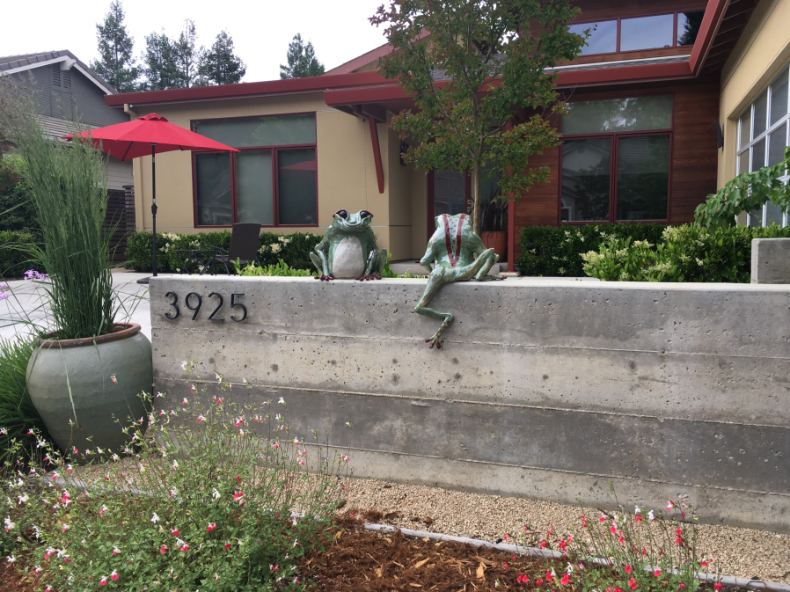
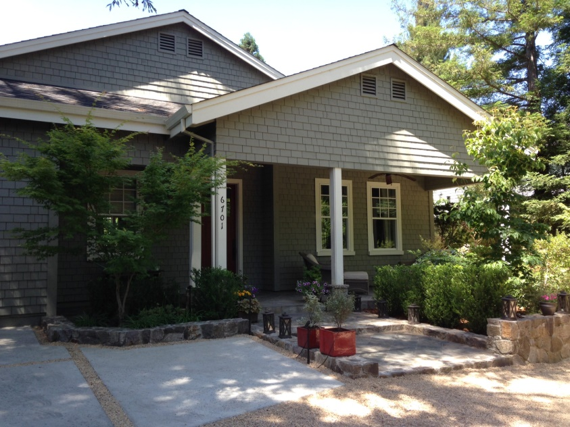
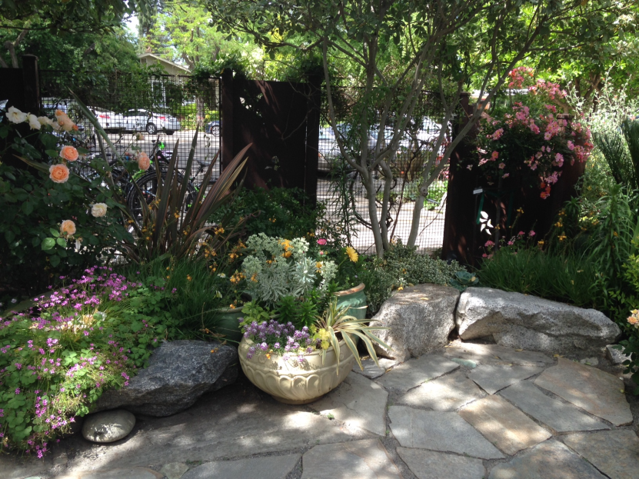
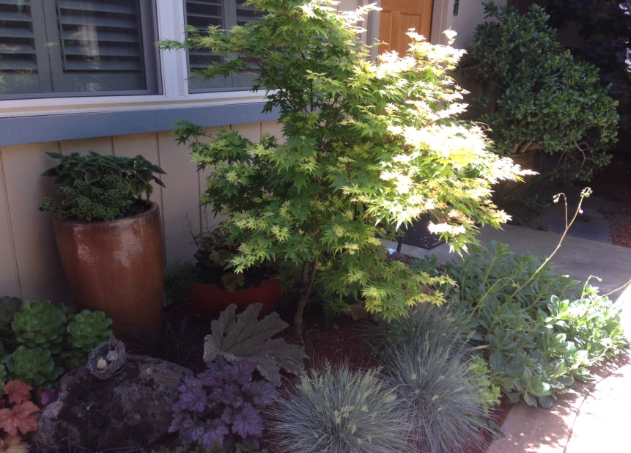
Approaching Your Front Door
Notes:
Form and Function “If there’s soil or potting mix, plants and air, it’s a garden!” Family Circle May 2018, p. 20
Motor court driveway entry.

Slide 7
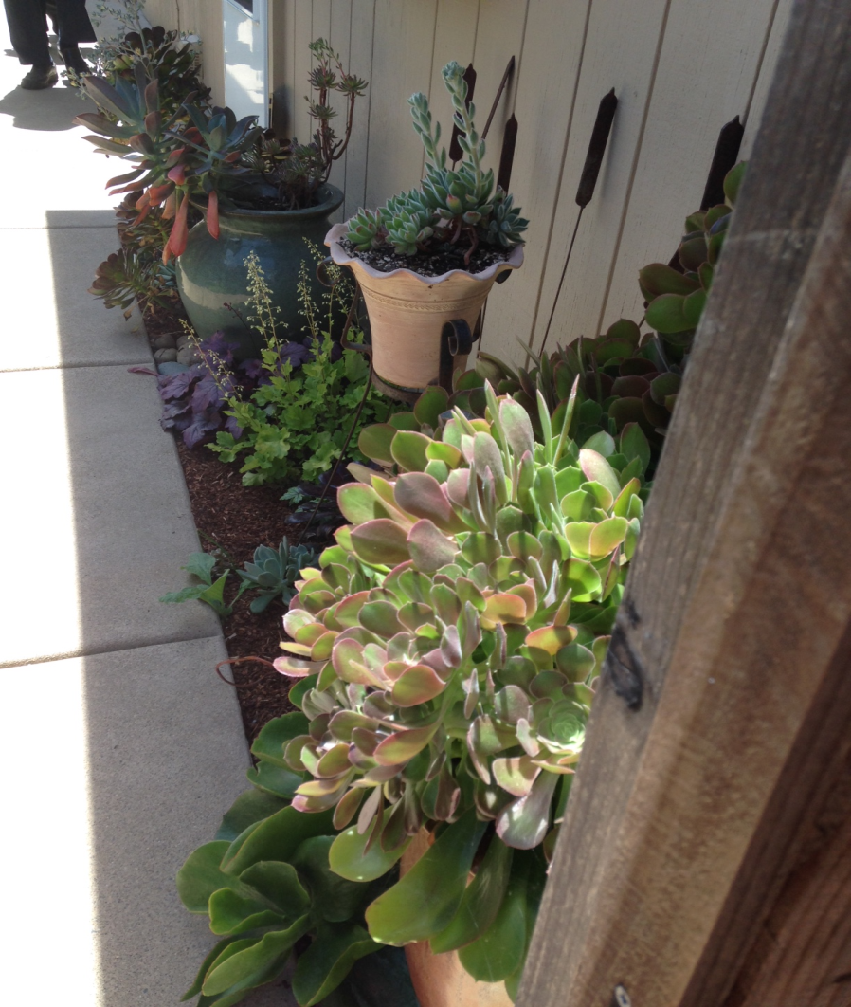
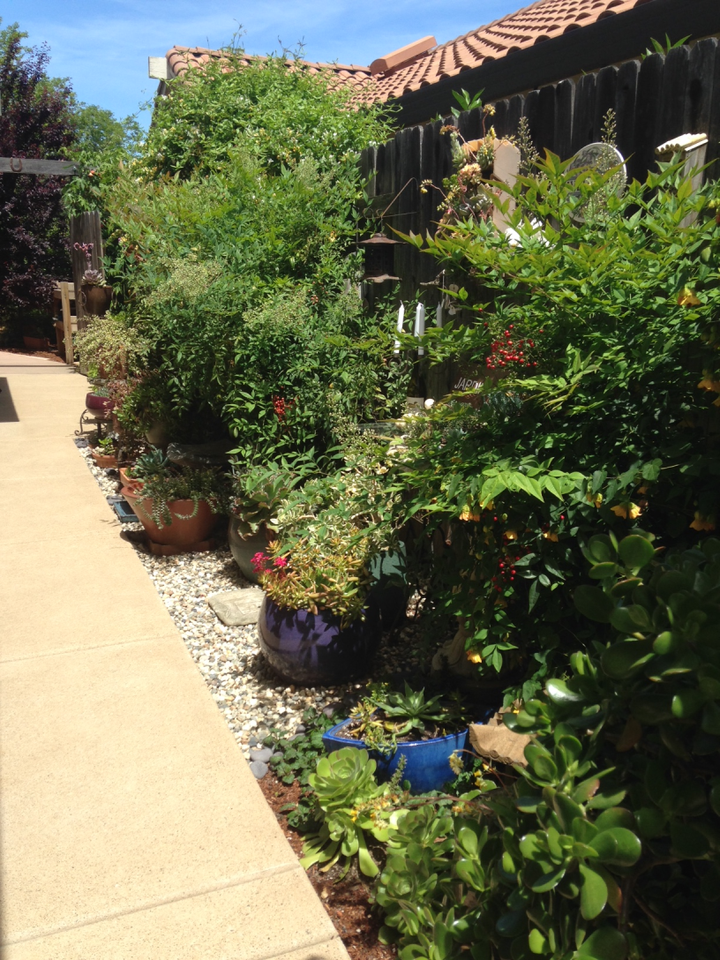
Narrow Side Passages

Slide 8
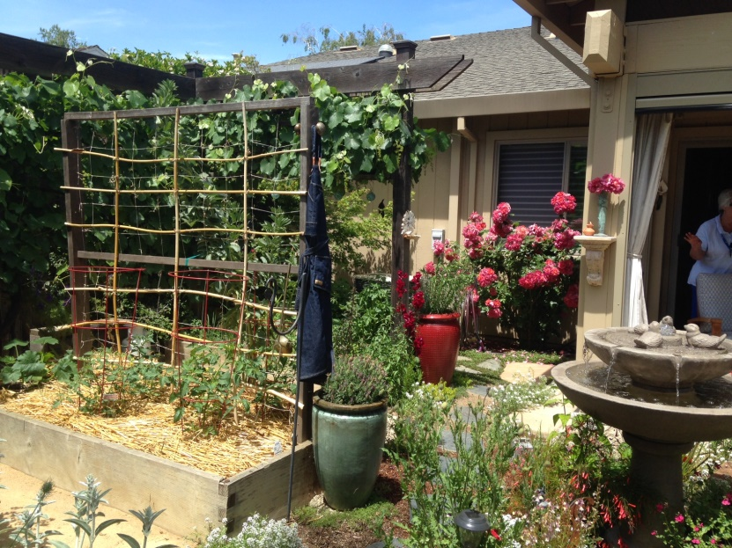
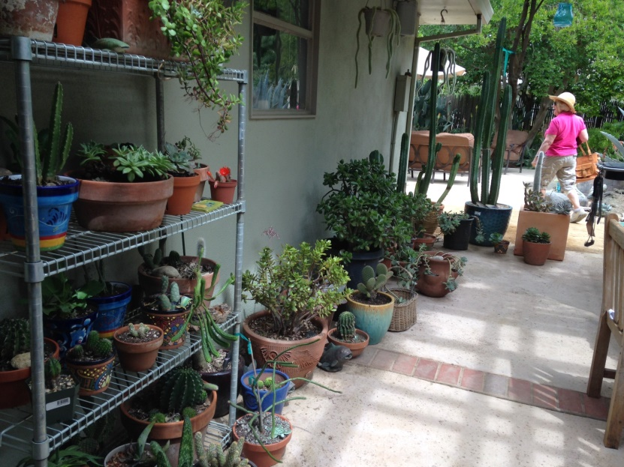
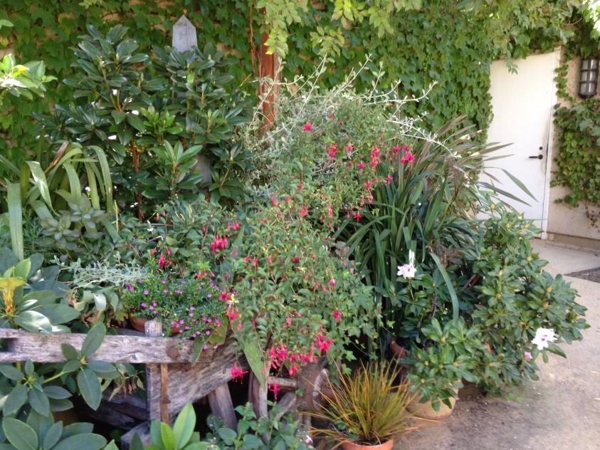
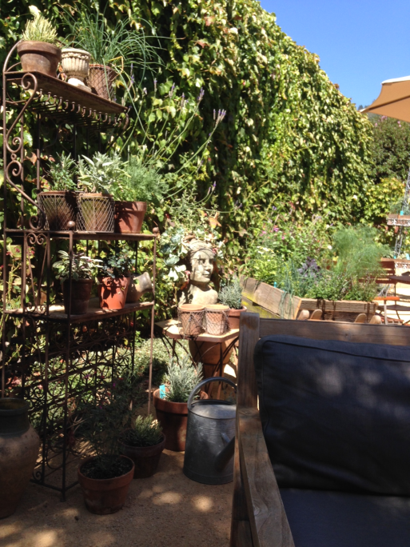
Verticality

Slide 9
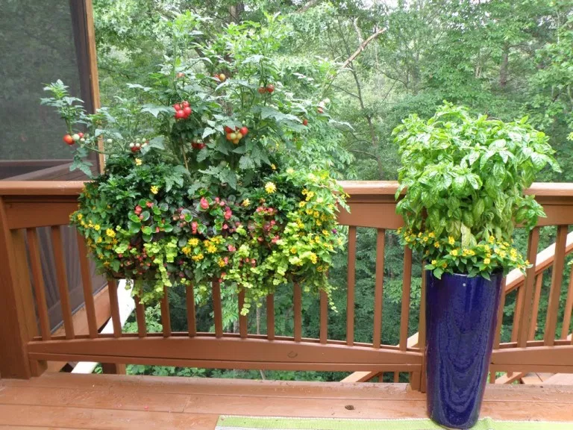
Using a large railing planter for the tomato plant and a tall, slender pot for the basil prevents this garden from taking up valuable deck space.
Notes:
Thriller, Spiller, Filler

Slide 10
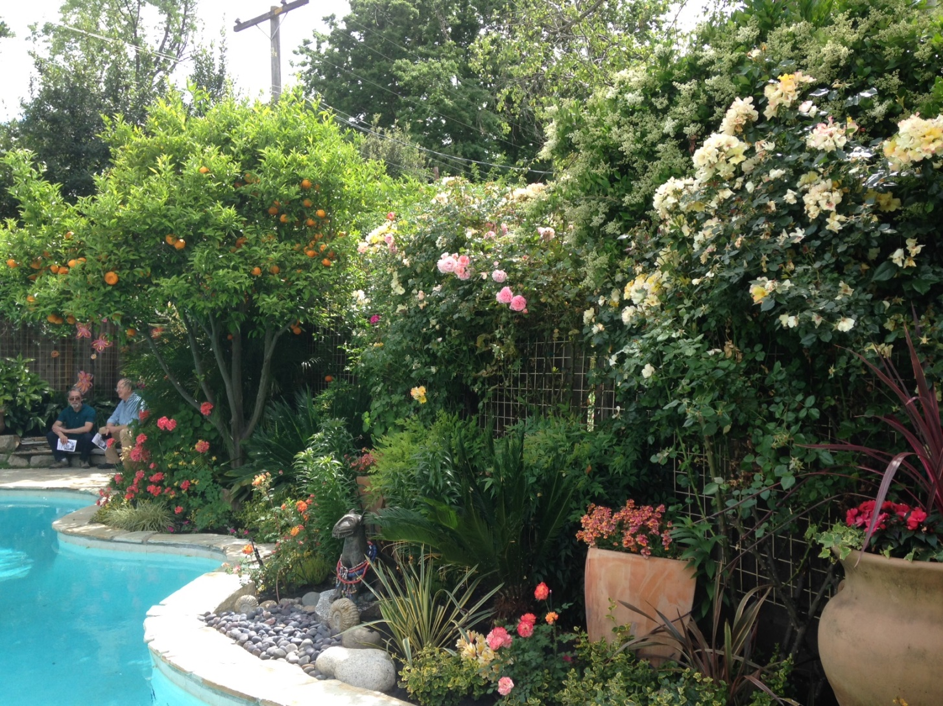
Narrow Borders
Notes:
Design Elements – Food among the Flowers, containers, verticality, relaxing place to chat

Slide 11
Food Among Your Flowers
Vegetables, Herbs and
Flowers
Nectar Plants
Garden to Attract
  Pollinators – St. Helena
  Library, Sept 4, 5:30 pm
  Free
Photo Credit: http://balconygardenweb.com
Notes:
Thriller; Spiller; Filler

Slide 12
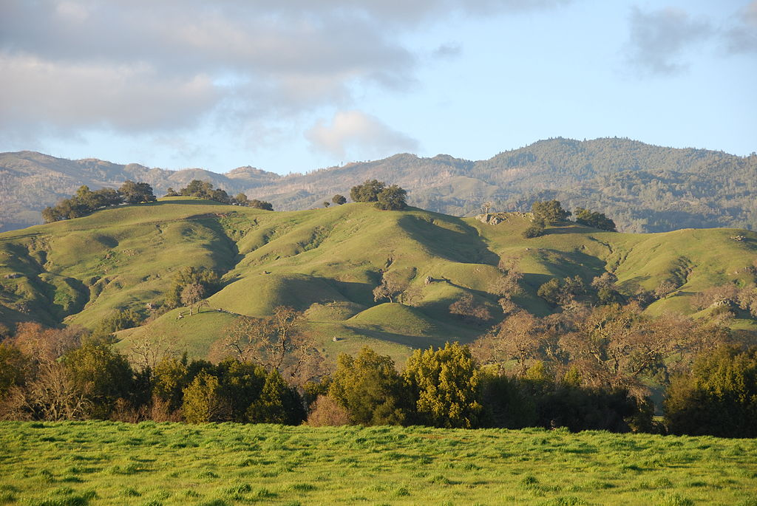
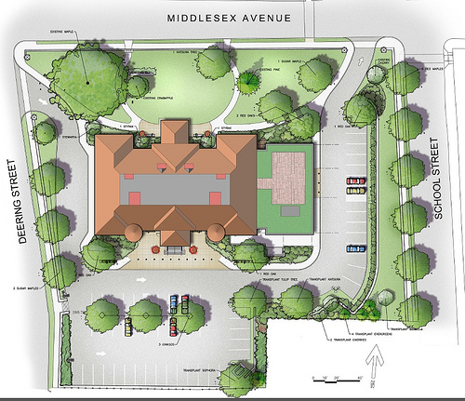
Let’s Get Started
Napa Climate Zones
Assessing Your Space
& Sun Tracking
                Right Plant/Right Place
Concept
Microclimates Lesson
Notes:
Jan

Slide 13
USDA Climate Zones
Based on Winter Minimum Temperature Only

Slide 14
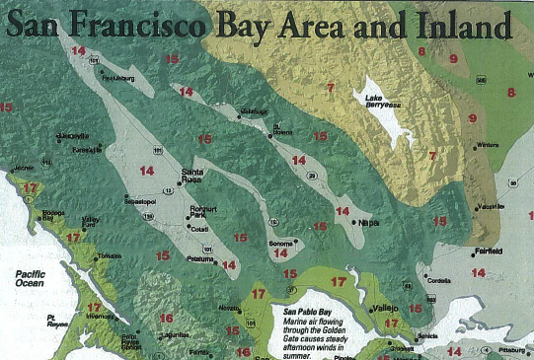
Sunset’s Regional Climate Zones
Notes:
ZONE 14: Northern California’s inland areas with some ocean influence.
Zones 15 and 16 are areas of Central and Northern California that are influenced by marine air approximately 85 percent of the time and by inland air 15 percent of the time.

Slide 15
What is a Microclimate?
climatic condition
specific to a small area
different from its surrounding conditions

Slide 16
Factors Influencing Microclimates
Temperature
Rainfall
Sunlight
Wind
Elevation
Topography
Frost
Exposure
Shade
Buildings
Fences
Paved areas
Overhangs
Drainage
Soil

Slide 17
Sun Tracking
Make a rough drawing of your space
Draw in trees, walls, fences
Take your first sun measurement at 8 am
Repeat at noon and 4 pm
Flip chart lesson
Notes:
Apps Sun Tracker, Sun Surveyor

Slide 18
Hours of Sun Needed
As a general rule, crops grown for leaves (e.g., lettuce, chard, spinach) or crops grown for roots (e.g., carrots, turnips, parsnips) will manage in a shady environment.
Whereas, crops grown for fruits (e.g., tomatoes, eggplants, cucumbers) want lots of sun, at least 6 hours of full light a day.

Slide 19

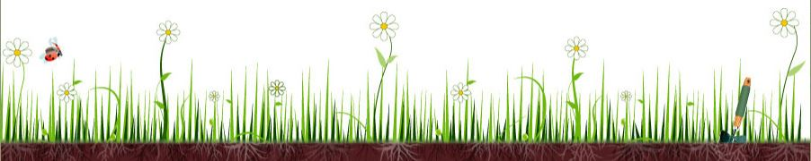
FOLLOW THE
MOONLIGHT
Midnight during a full moon =
Noon sunlight in 6 months
MOONLIGHT=SUNLIGHT MOONLIGHT=SUNLIGHT
JAN=JUL JUL=JAN
FEB=AUG AUG=FEB
MAR=SEP SEP=MAR
APR=OCT OCT=APR
MAY=NOV NOV=MAY
JUN=DEC DEC=JUN
Notes:
https://www.timeanddate.com/moon/phases/usa/napa Full Moon June 27, July 27, Aug 26, Sept 24, Oct 24, Nov 22, Dec 22

Slide 20
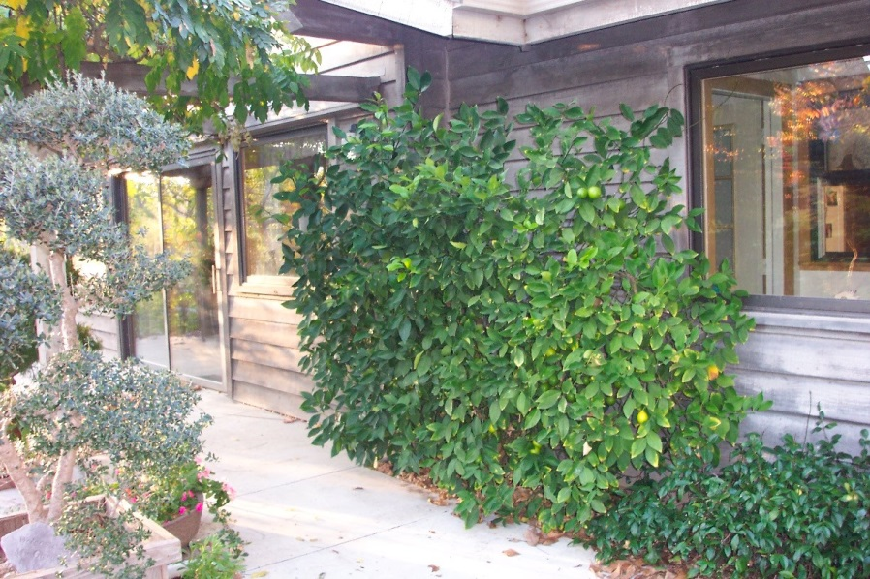
Under Eaves, Reflected Heat, Winter Sunshine

Slide 21
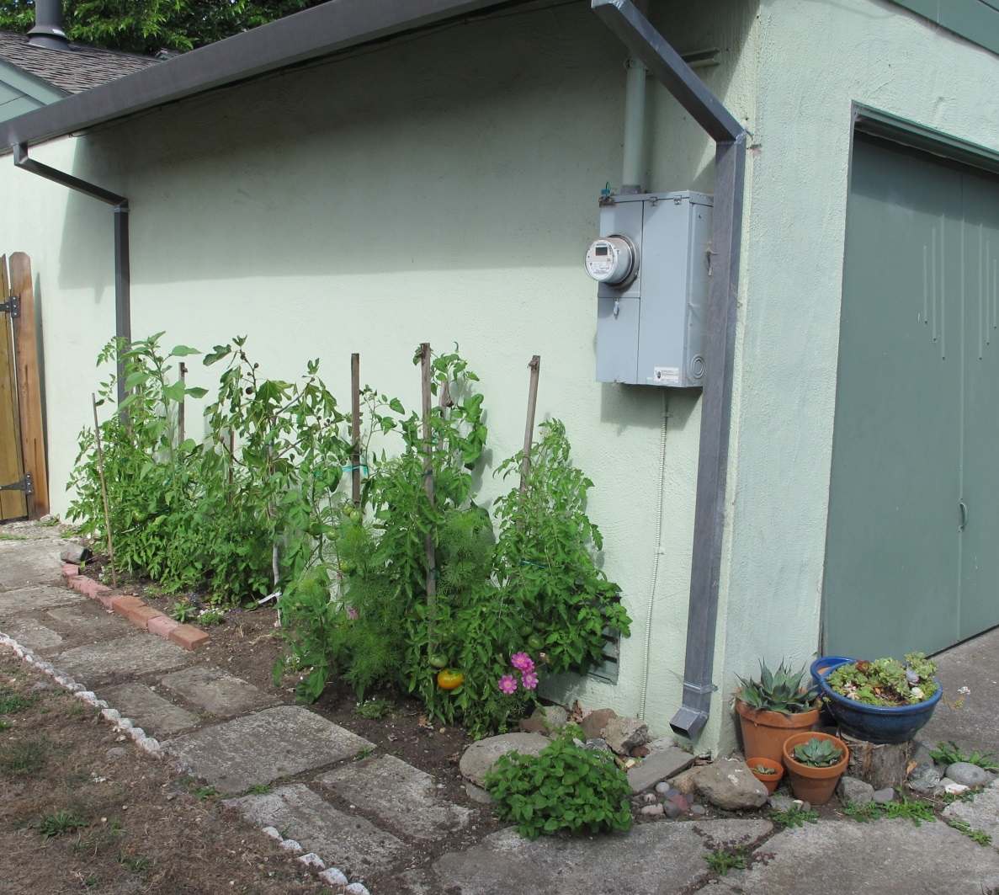
Reflected Heat & Heat Sink with Garage Wall
Notes:
Transition to Robert’s Container Selection & Crop Guide … where and why to plant where you choose for success

Slide 22
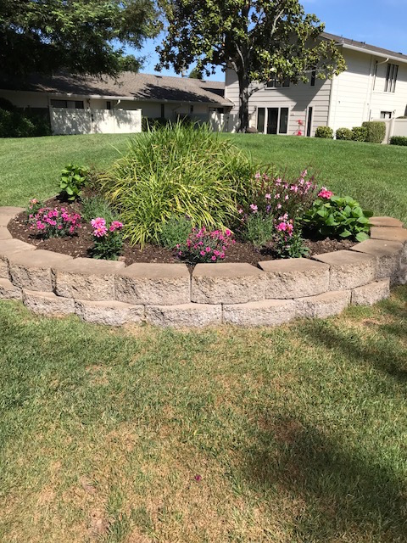

Slide 23
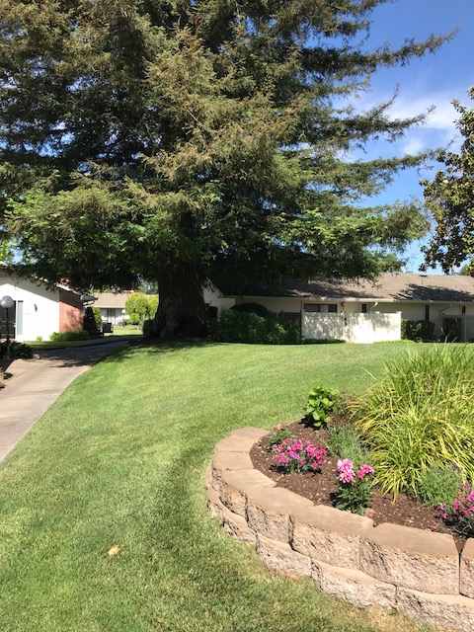

Slide 24
Choosing for Success-Checking the Boxes
Design – Plants are the Show Piece, not the Container
Food among the Flowers
Select Plant Colors to Compliment, be Analogous or Triadic on Color Wheel
Microclimates & Tracking the Sun
Right Place/Right Plant
Container Selection
Pay Attention to Soil/Mixes
Start with Quality Plants!
Notes:
Jan - Transition into Robert’s presentation and Demo Table exercise.

Slide 25
Container Selection
& Guidelines
What Size Container
Needed
Drainage + Water Source
Potting/Planting/Soil Mixes
Read the Label Demo
Soil Amendments &
Fertilizing
Read the Label Demo
Planting
Notes:
Robert. Dual purpose landscape useful in small yards. Read the Label station exercise for mixes, amendments, fertilizing.

Slide 26
What Size Should the Container Be?
Shallow Rooting
-Maximum depth of 12-16 inches, doesn't need more than 12 inches
Onion
Potatoes
Radish - Very shallow, can be grown with only 4-6 inches of depth
Spinach - Very shallow, can be grown with only 4-6 inches of depth
Strawberries - Roots are very shallow, but grow about 1 foot laterally
Most Herbs (basil, chive, cilantro, mint, oregano, parsley, tarragon, thyme)
Arugula
Blueberries - Roots are very shallow, but grow about 2’ wide
Broccoli, Bok Choy, Brussels Sprouts
Cabbage, Cauliflower, Celery, Collard Greens
Corn - Shallow, but roots spread about 20” wide
Jerusalem Artichoke
Kale, Kohlrabi
Leeks, Lettuce - Very shallow, can be grown with only 4-6” of depth
Napa Cabbage

Slide 27
Medium Rooting
-Maximum depth of 16-24 inches, doesn't need more than 16 inches
Beans - Roots grow about 10” wide, Beets
Carrots, Cantaloupe, Chard
Cucumber - Roots grow about 20” wide
Eggplant
Peppers, Peas
Rosemary, Rutabagas
Sage, Squash, Summer Squash
Turnips
Deep Rooting
-Maximum depth of 36+ inches, requires at least 24 inches
Artichoke
Asparagus
Parsnips
Pumpkins
Rhubarb
Squash, Winter
Sweet Potatoes
Tomatoes
Watermelon

Slide 28
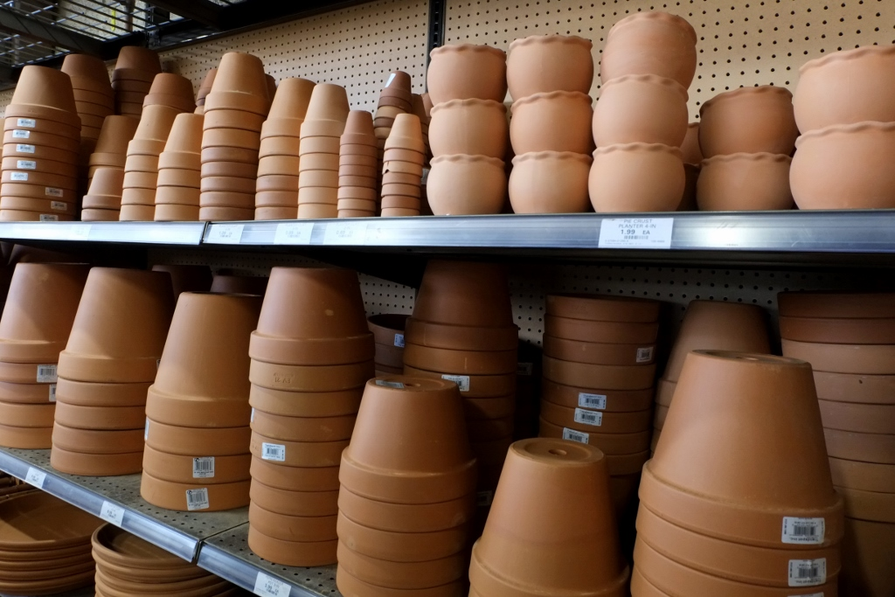

Slide 29
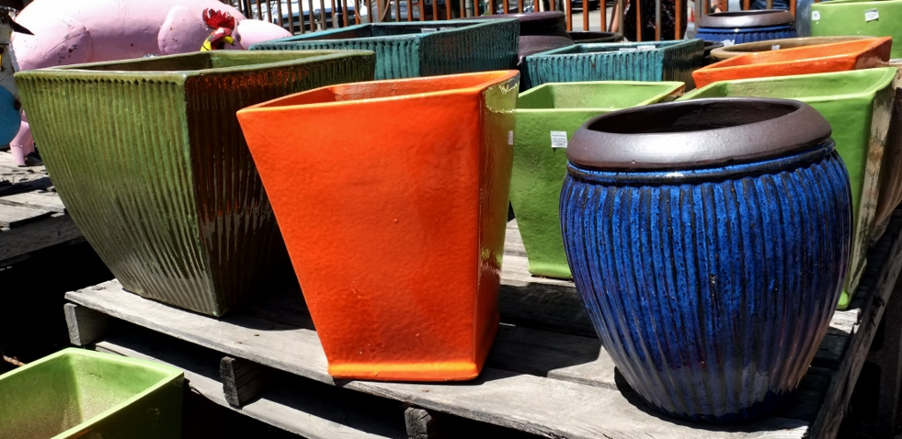
Notes:
Feet elevate off concrete and decks; pros/cons include plastic pot topic

Slide 30
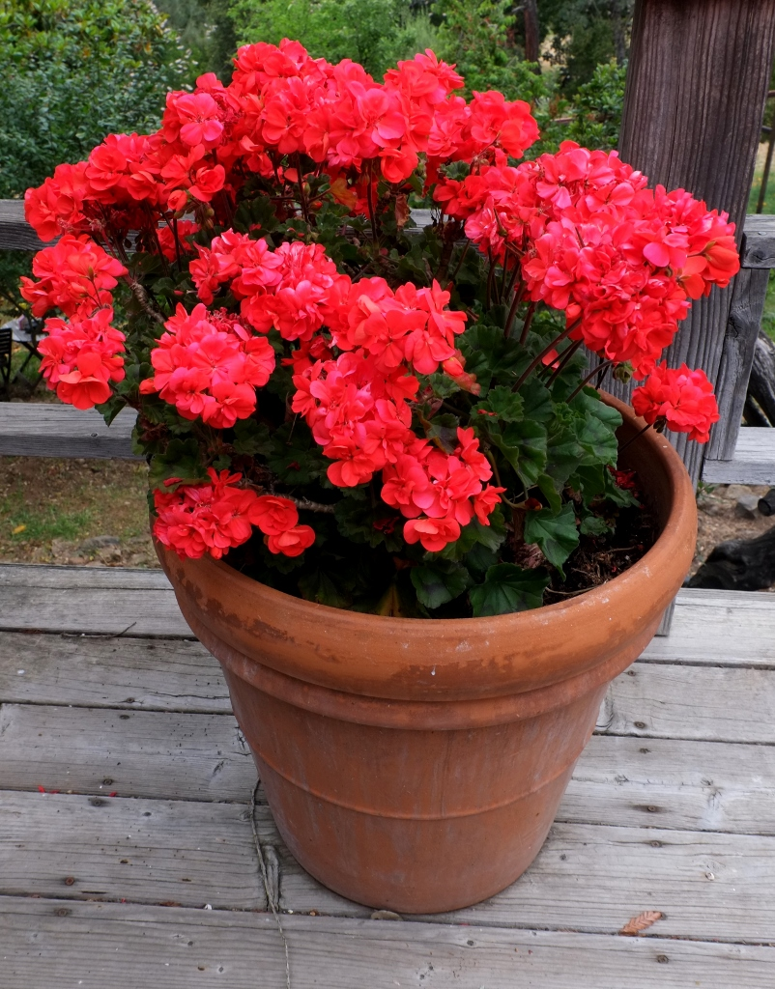

Slide 31
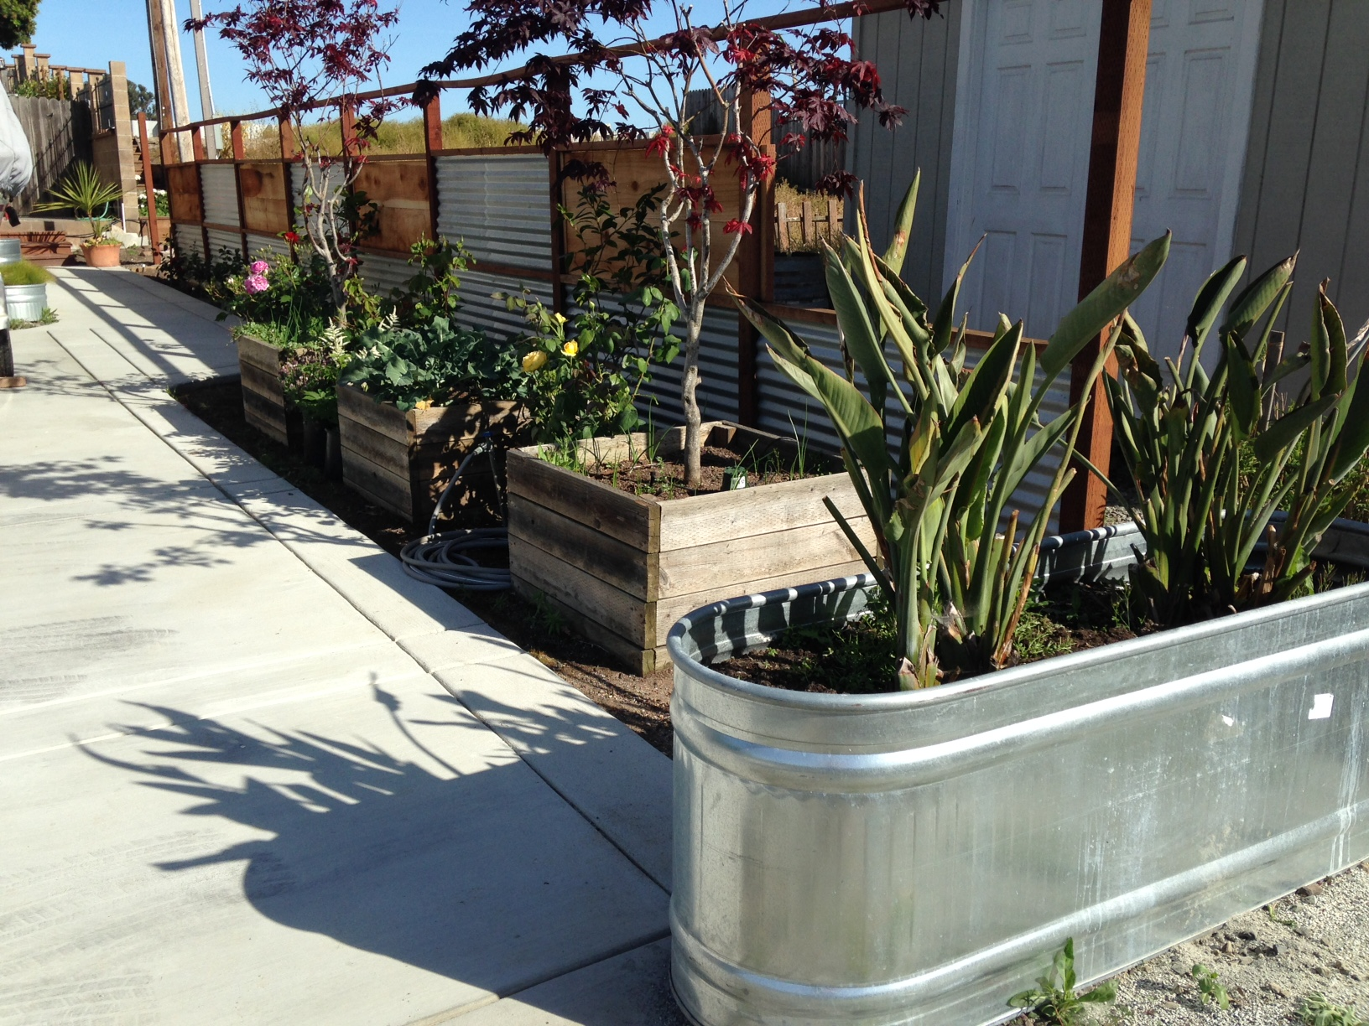
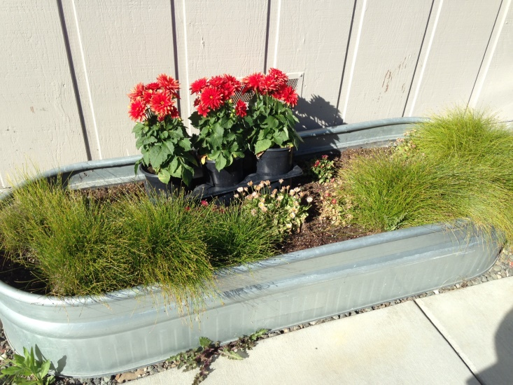
Notes:
Galvanized steel troughs, wood boxes

Slide 32
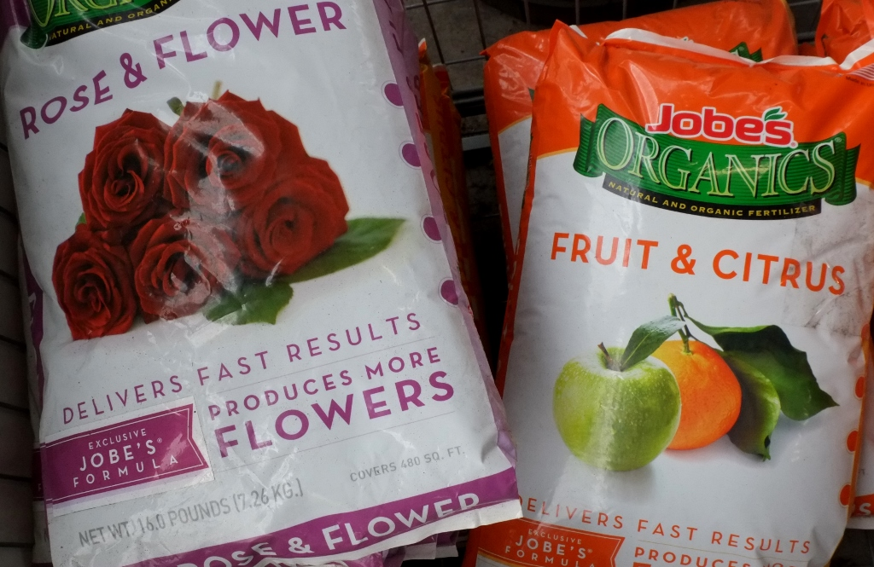
Potting/Planting/Soil Mixes
Notes:
Will get into more Read the Label at Break-out Demonstration Table

Slide 33
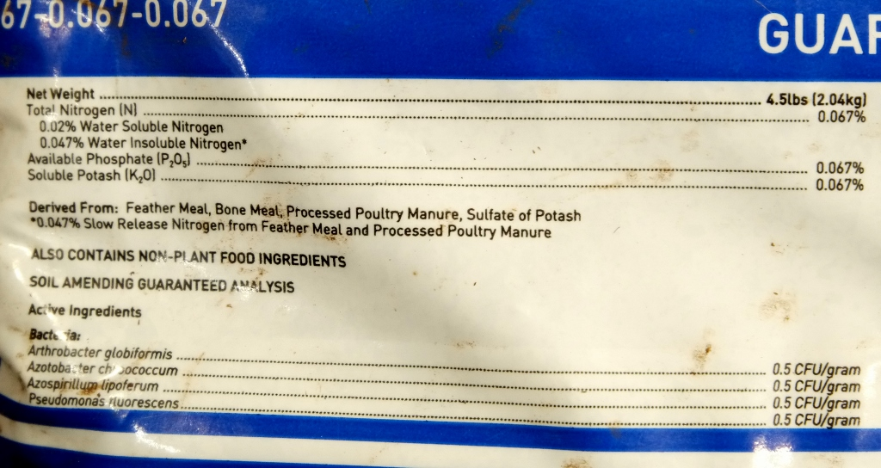
Guaranteed Analysis
Notes:
N-P-K formula; Derived From …..; Soil Amending Guaranteed Analysis; Active Ingredients - Bacteria

Slide 34
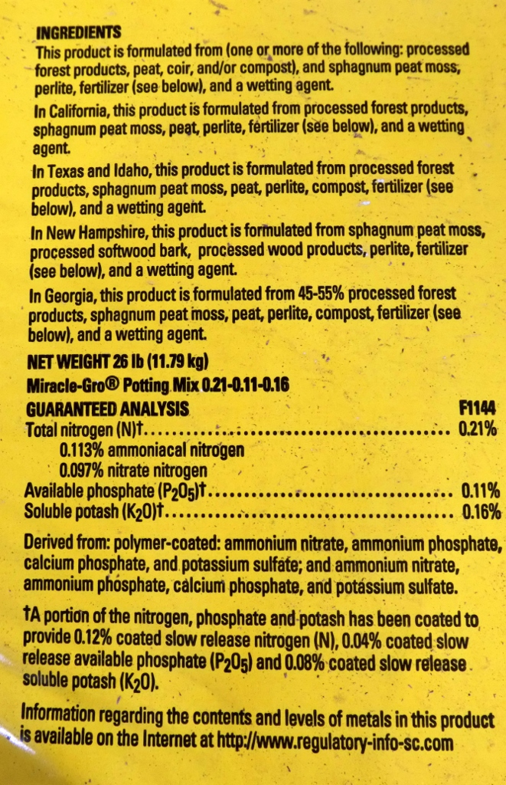

Slide 35
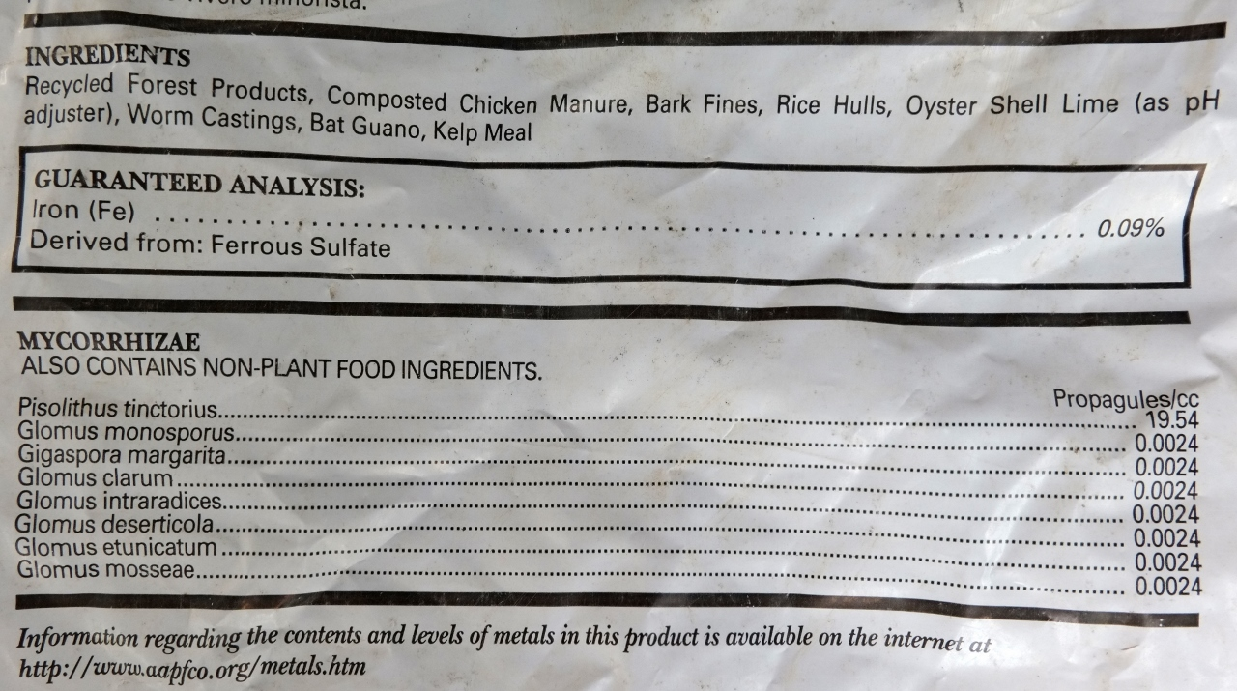

Slide 36
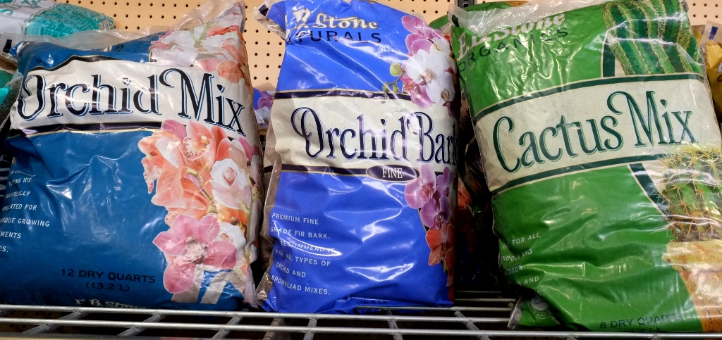
Specialty Mix Blends
Cactus & Succulent Example: pumice, aged fir bark, aged redwood and sand
Notes:
Blended

Slide 37
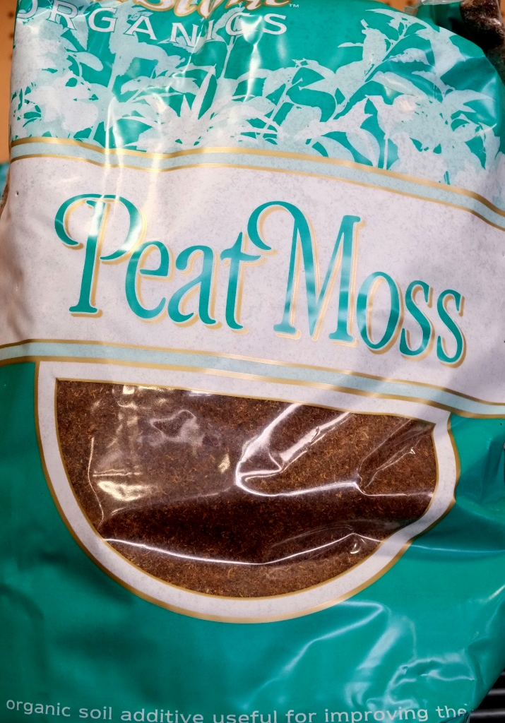
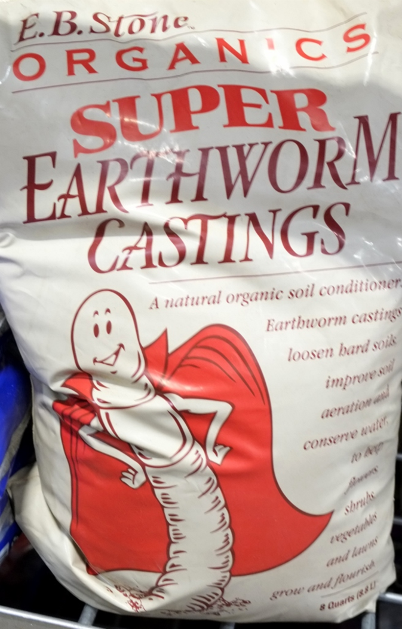
Soil Amendments
Notes:
Amendments are mixed into soil

Slide 38
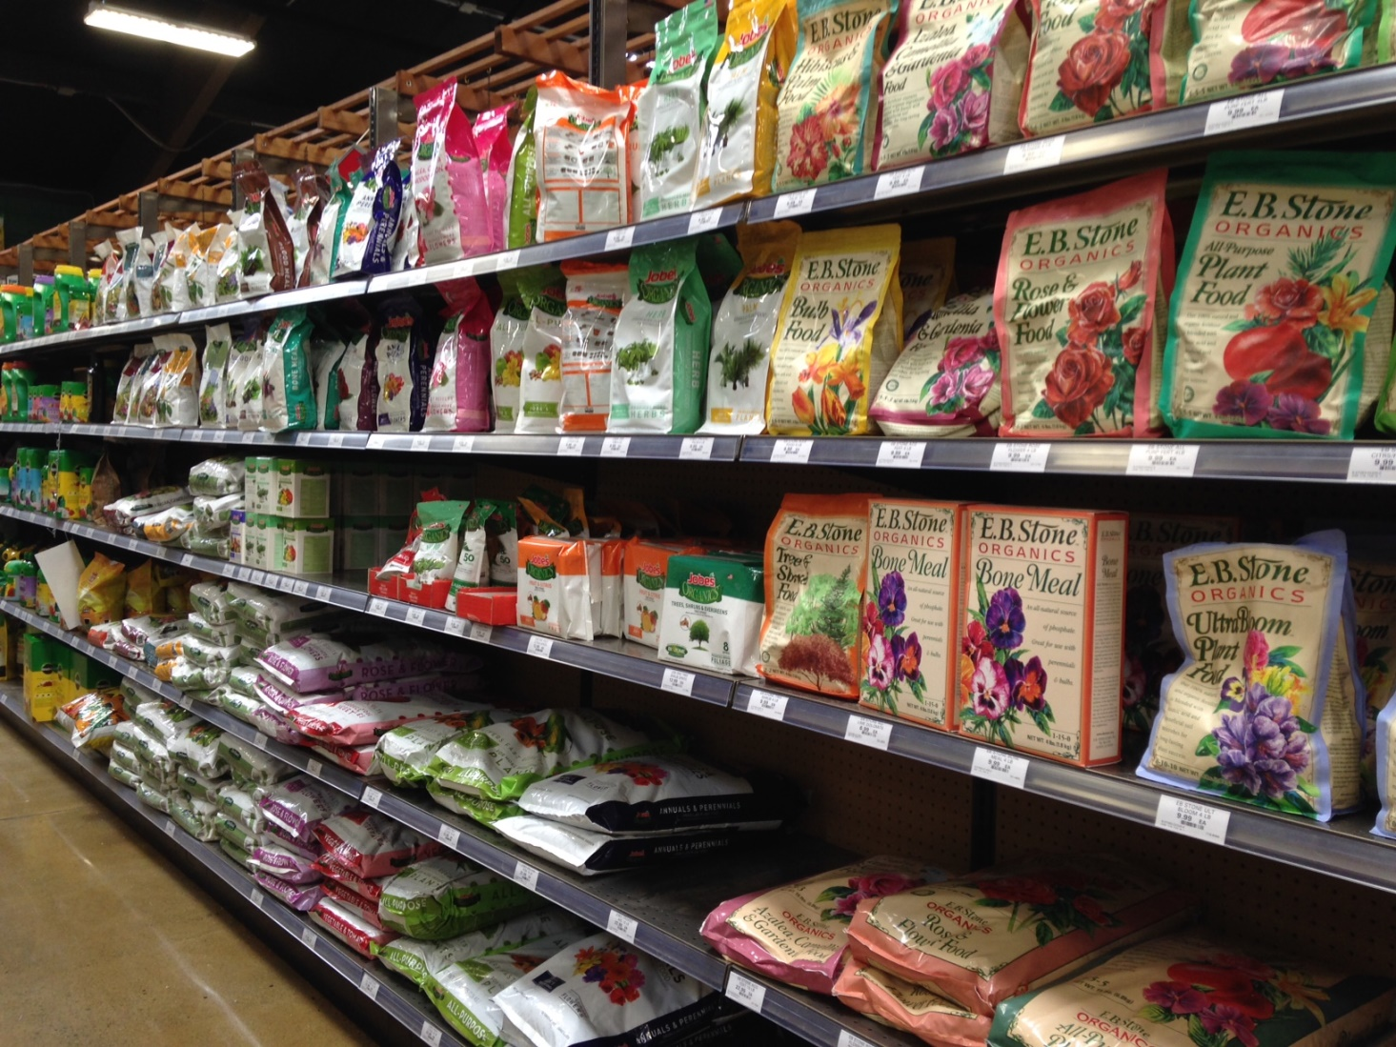
Fertilizing – So Many Choices

Slide 39
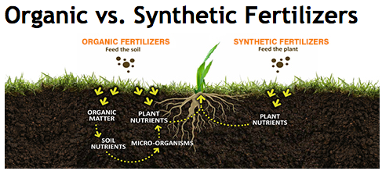
Illustration from www.milorganite.com
Organic
  -Slower-acting, sustained release
  -Requires microbiological activity to make nutrients available
  -Longer-lasting
Synthetic
  -Fast-acting
  -Water-soluble
  -Immediately available to plants
  -Not retained in soil
39
Notes:
39
*complete, incomplete
*Guaranteed analysis: N-P-K (e.g., 12-12-12)
*N: Nitrogen, needed for healthy green vegetative growth, Results in fast growth too much can weaken plant.
*P: Phosphorus, needed for healthy root growth, fruit and seed development (plant maturation). Occasionally needed for older plants and hardpan soils.
*K: Potassium, needed for vigor: strong stems, healthy root systems, good-size fruit, healthy seeds. Not typically needed by our soils.

Slide 40
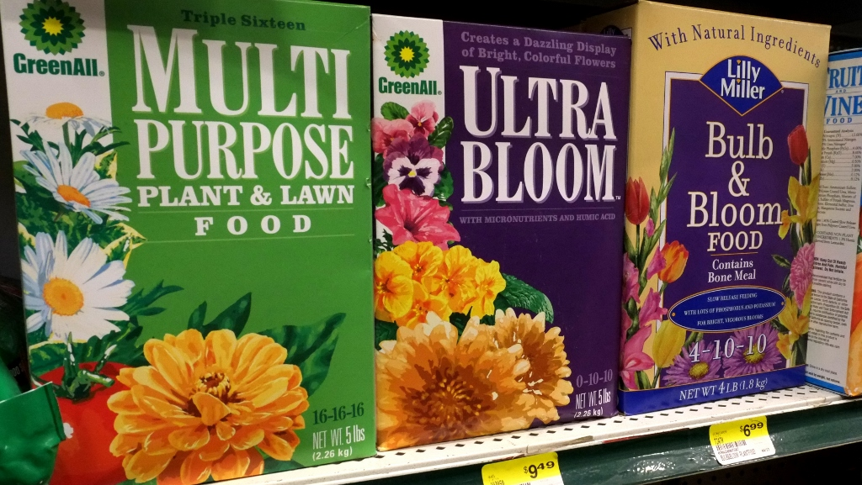
Read the Label
Notes:
Explain NPK

Slide 41
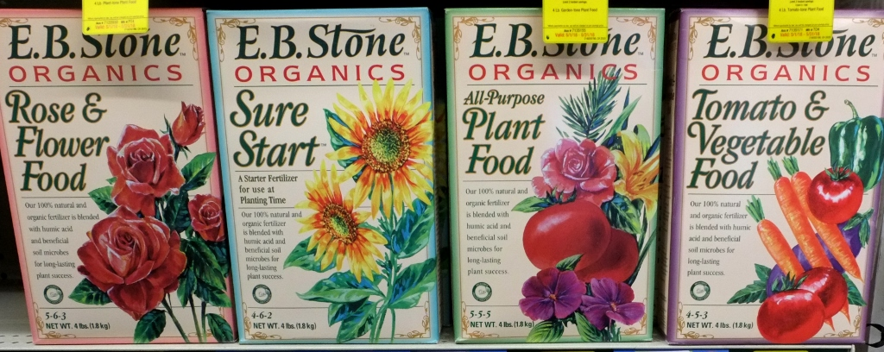
Read the Label - Organics

Slide 42
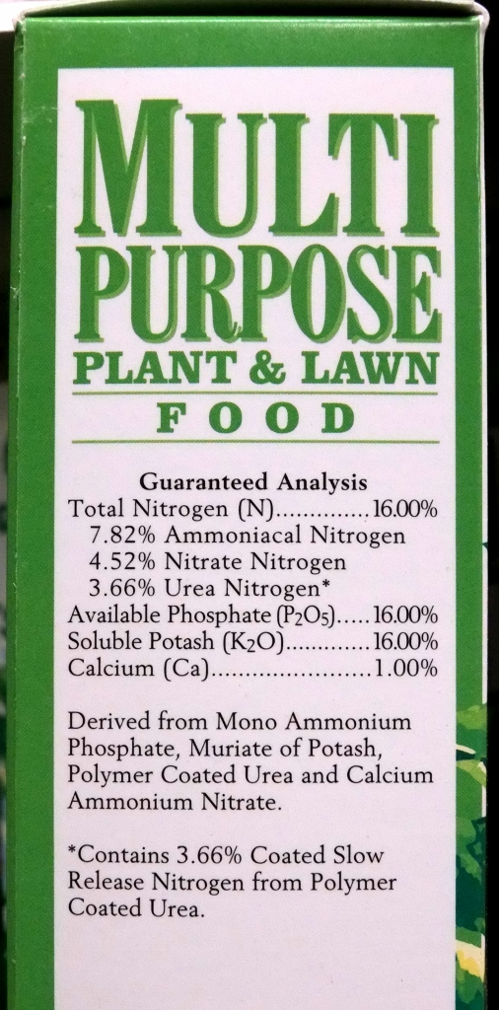
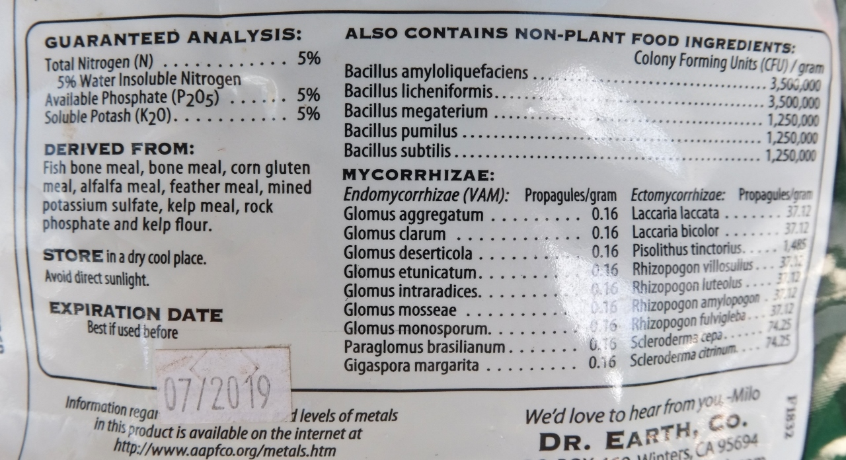
Guaranteed Analysis

Slide 43
Break-Out Demonstrations
Station #1 - Robert
Read the label potting mixes
Selecting Good vs. Not so Plants
Demo Planting a Container using Color Wheel
Station #2 - Jan
Read the label plant stakes
Hours of Sun
Notes:
Use 7 minutes per station and rotate attendees; use station time to answer attendee questions; container poster in MG room

Slide 44
Questions to Review before Wrapping Up
Participant Questions
Attendees additional Questions
Thank you for coming this morning
Complete Quick Evaluation Survey
Workshops: Grow Culinary Herbs & Cocktail Garnishes next Sat. & Sun.
Success with Succulents, July 7

Slide 45
Resource Information
Home and Garden Resources for the General Public www.plantsciences.ucdavisedu/plantsciences/outreach/home_garden.htm
Healthy Garden Tips – Soil Mixes for Container Gardening, Plants for Containers, Small Space and Container Maintenance http://ucanr.edu/sites/ucmgnapa
Golden Gate Gardening, 3rd edition, 2010 by Pam Peirce
Iowa State University, Raised Beds for Vegetable Production https://www.extension.iastate.edu/smallfarms/raised-beds-vegetable-production
Bay-Friendly Garden Tour in May and East Bay Regional Demonstration Gardens (Sunset Gardens @ Cornerstone, Sonoma; Ruth Bancroft Gardens, Walnut Creek)
Upcoming NVMG Workshops - http://ucanr.edu/ucmgnapa/

Slide 46
Hours of Sun Needed
As a general rule, crops grown for leaves (e.g., lettuce, chard, spinach) or crops grown for roots (e.g., carrots, turnips, parsnips) will manage in a shady environment. Whereas, crops grown for fruits (e.g., tomatoes, eggplants, cucumbers) want lots of sun, at least 6 hours of full light a day.
Needs 4-5 hours of sun a day
Peas and Beans –
Growing them in partial shade will slow their growing a little, but they'll be okay.
Roots - e.g., Parsnips, Turnips, Beets, Carrots, Potatoes
Will grow in shade, but mature slower
More light…faster growth
Needs at least 6 hours of full light a day
Tomatoes, eggplants ,cucumber
Needs 2 hours of sun a day
Bok Choy
Will do great with only short bursts of strong light.
Pretty much gets by on reflected and ambient light
Needs 3-4 hours of sun
Arugula - put in shade, warm weather and full sun makes it bolt
Chard - grown in shade tend to be smaller than in full light, but leaves will be more tender.
Herbs - Chives, Cilantro, Marjoram, Mint, Oregano, Parsley - while most culinary herbs like lots of sun, these don't mind shadier conditions
Kale - grown in shade will be slightly smaller than grown in full light,
Lettuce , Spinach – do well in shade
Strong light bolting
More time to harvest when grown in shade
Mustard Greens - Especially good in shade as baby greens.
Green Onions/Scallions - Well in shade throughout growing season
Notes:
Possible Handout at Break-out Demonstration Table #2 Talk to Jan; Sun-wise, water-wise, and fertilizer wise compatibility

