Slide 1

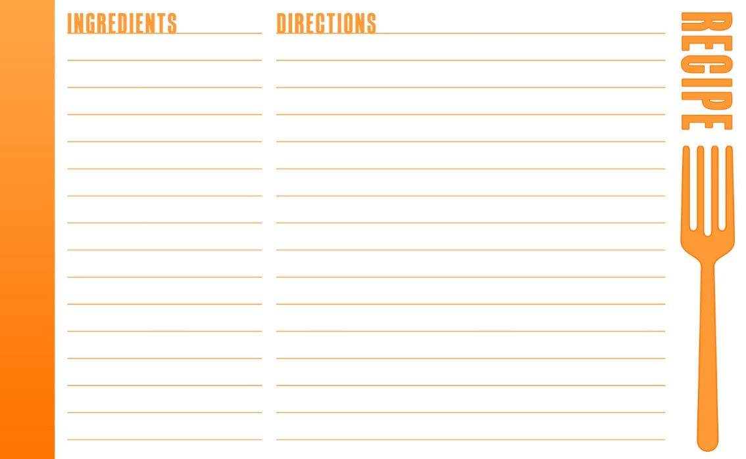




Marcel Horowitz,
Kelley Brian
& Ethan Horowitz
New ideas for 4-H Cooking Projects
Notes:
3:45-3:50

Slide 2
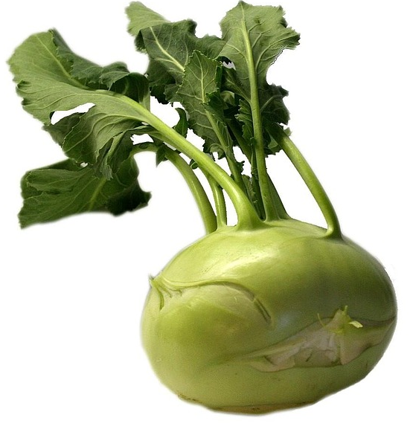
Why teach cooking?
Find your partner by matching the vegetable picture with the name of the vegetable.
Once you find your partner, discuss:
  “Why do you teach cooking?”
Notes:
3:50- 4:00- Kelley- unique vegetables and name
-Why are you teaching cooking?
-Discuss with partner

Slide 3
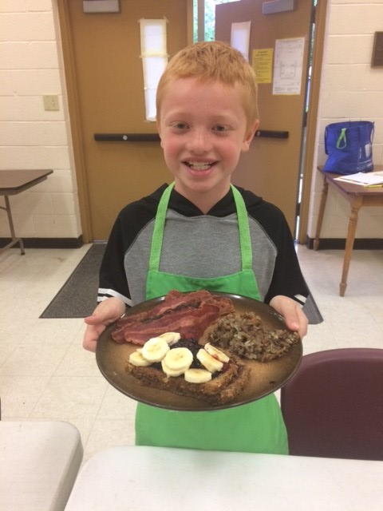
Why teach cooking?
To expand your palate
For an adventure
As a job skill
To learn about new cultures
To connect family and friends
To have fun
For experiential learning
Support partners and University Goals
Real world science and education
Establish healthy food habits
So you can feed yourself!
Notes:
4:00- 4:05- Kelley & Marcel- Poll the audience

Slide 4
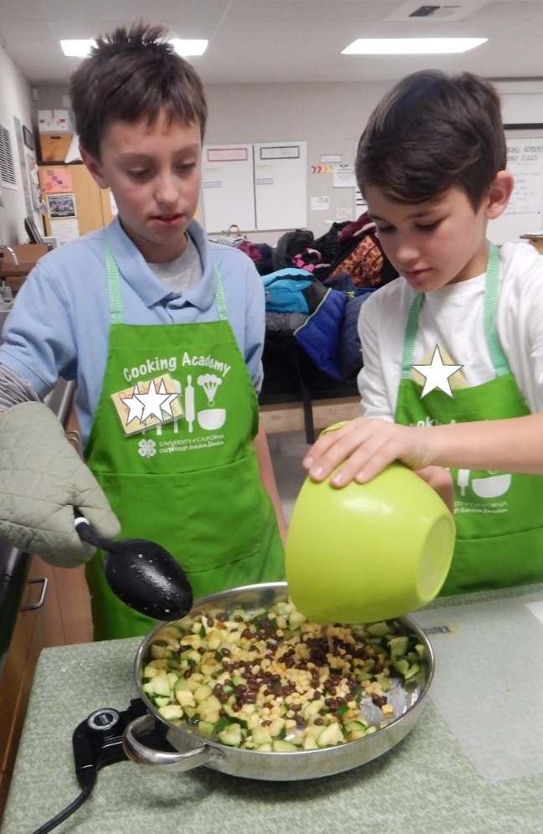
Tools for Effective Cooking Projects
Do not force, coerce, or bribe
Teach how to politely spit out.
Allow them to play with it.
Discuss the aging of taste buds.
Try it together, including you
Notes:
4:05-4:08- Marcel- review
Ethan- toss around a foam food and have people come up with other words for “icky”. Write on poster paper and discuss how to do group agreements.

Slide 5
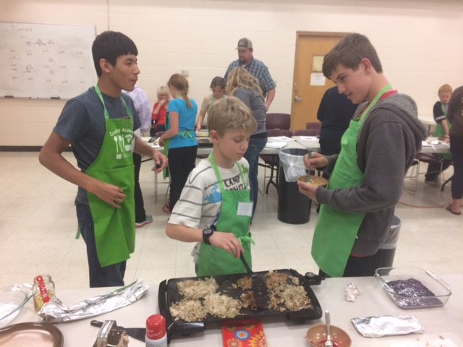
What Are
Group Agreements?
Making the list
Initials
Consequences
Always have it
Notes:
4:08-4:15- Ethan to discuss and role play
Toss the apple for “icky” terms

Slide 6
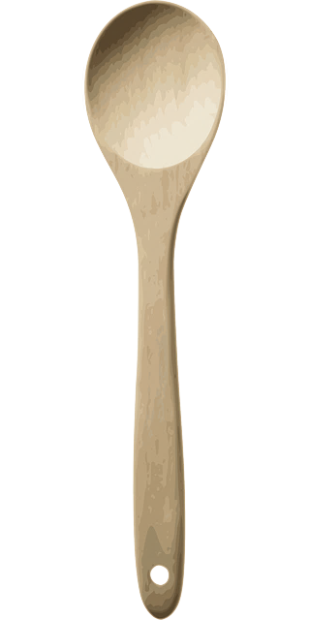
Why Teach Cooking?
Support Partners & UC Goals
Cooperative Extension in many counties has funding to conduct nutrition education classes.
Sites must be income-eligible.
Educators can help teach the project.
Primary nutrition objectives include healthier diets and self-sufficiency.
After-school programs.
Teens-as-teachers.
Notes:
4:15-4:18- Kelley- review

Slide 7
Why Teach Cooking?
Real World Science & Education
Cooking Up Healthy Choices
  Learner-centered demonstration
  Deepen understanding of nutrition concepts
  Encourage tasting of new vegetables
  Observe cooking techniques
  Seasonal
  Cultural
https://cns.ucdavis.edu/resources/classroom/cook-healthy-choices
Notes:
4:18-4:28-Kelley-

Slide 8

Why Teach Cooking?
Experiential Education
Cooking 101
  Focus on food preparation skills
  7, 2 hour meetings
  Each child prepares their own dish
  Full, family-style meal
  Beginner, Intermediate & Advanced skills
Recipes
  Toast
  Whole grain broccoli mac and cheese
  BBQ chicken with caramelized onions
Notes:
4:28-4:38- Ethan to overview as a project

Slide 9
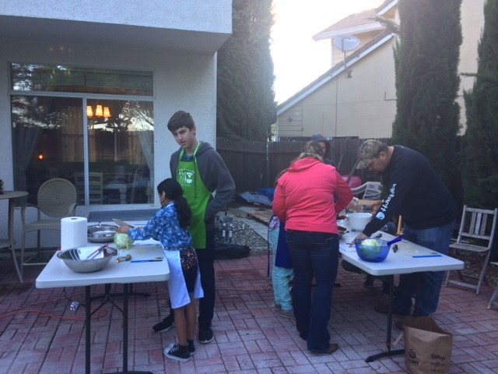
Why Teach Cooking?
Teaching vs. Demonstrating
Notes:
4:38-4:48- Marcel-Create a range of interaction. Scale of 1-10. Tape numbers on the wall. Give participants an example and have them order themselves. Read what you have.
Kelley- Pro’s and con’s of each
-What’s the difference between teaching and demonstrating

Slide 10
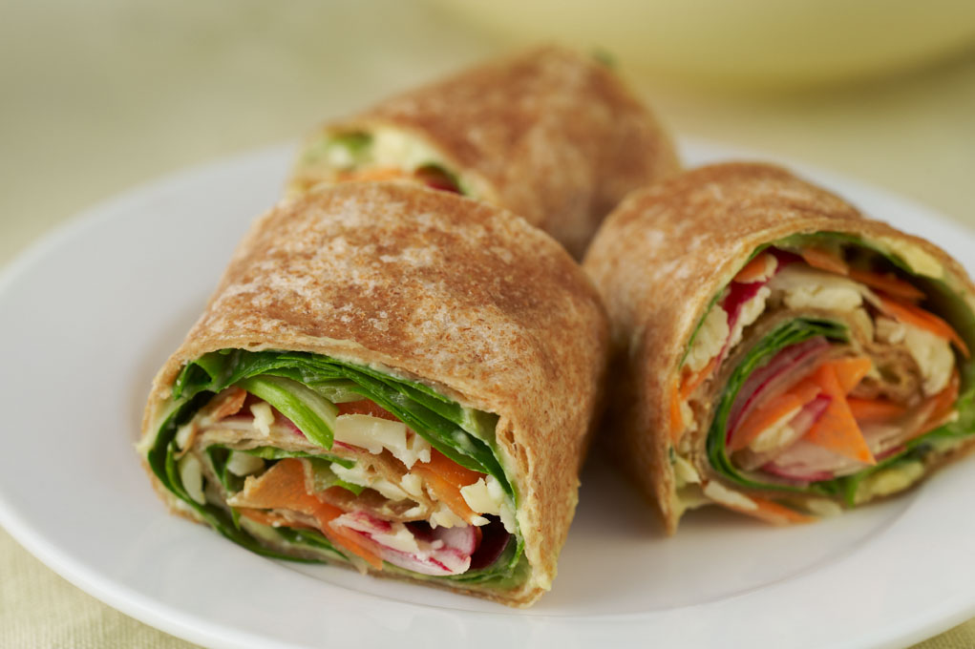
Colorful Pinwheel Veggie Wraps
Notes:
4:50- 4:55-Pass out sample
OPTIONAL- Ethan- demonstrate grating carrots

Slide 11
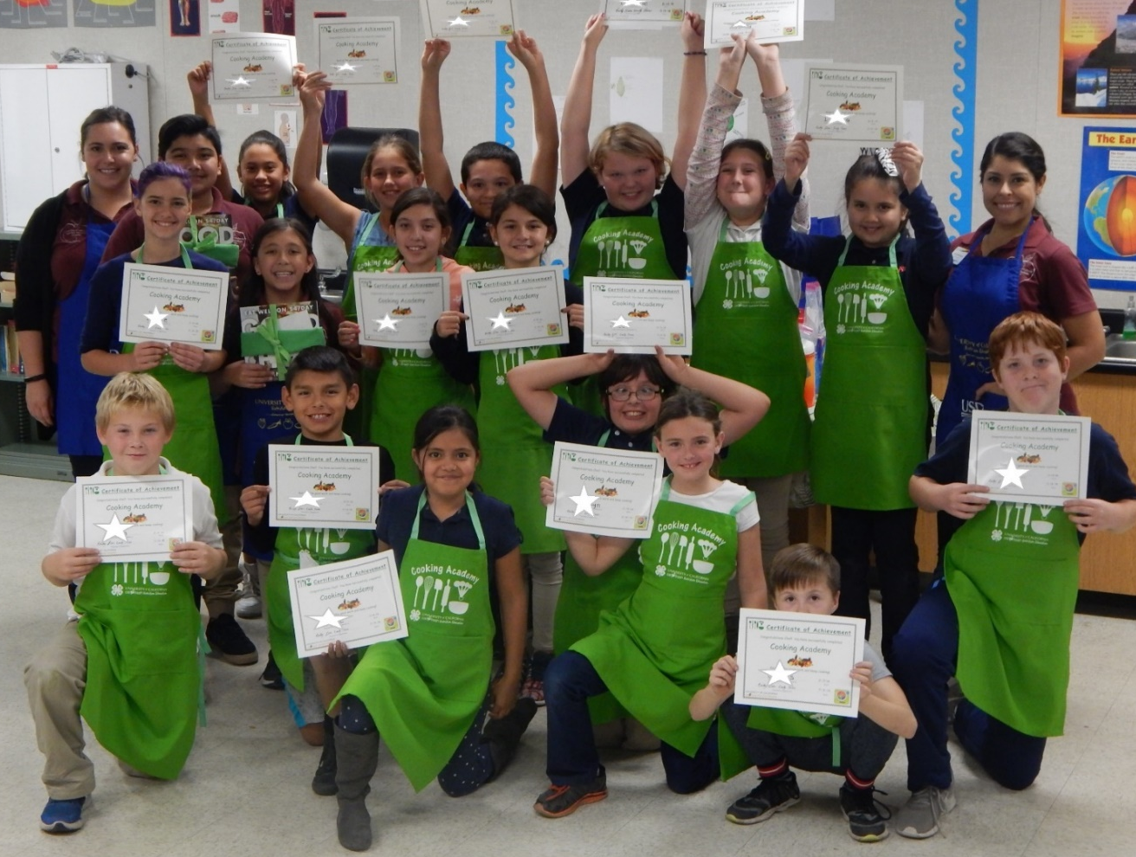
Why Teach Cooking?
Because Food is an Adventure
Learn about new cultures
Celebrate your bravery!
Notes:
4:48-4:50- Marcel- reinforce small steps of bravery
Congratulate success at the end
Incorporate foods from the kids cultures
Let the kids plan their own menu when ready
Reflect on what new skill or taste they learned

Slide 12
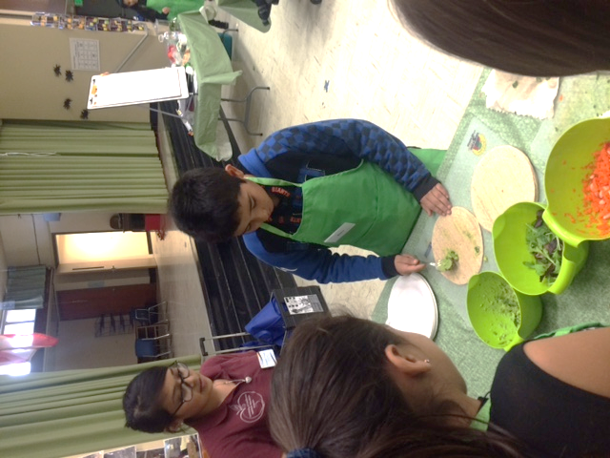
Why Teach Cooking?
So You Can Feed Yourself!
Make your own lunch
  How to tear and wrap tinfoil
  How to keep foods cold
  Sandwich ideas
  How to peel and prep fruit
  Trying new dips for your veggie sticks
  How to hard boil an egg
Notes:
4:50-4:52- Marcel- quick overview

Slide 13
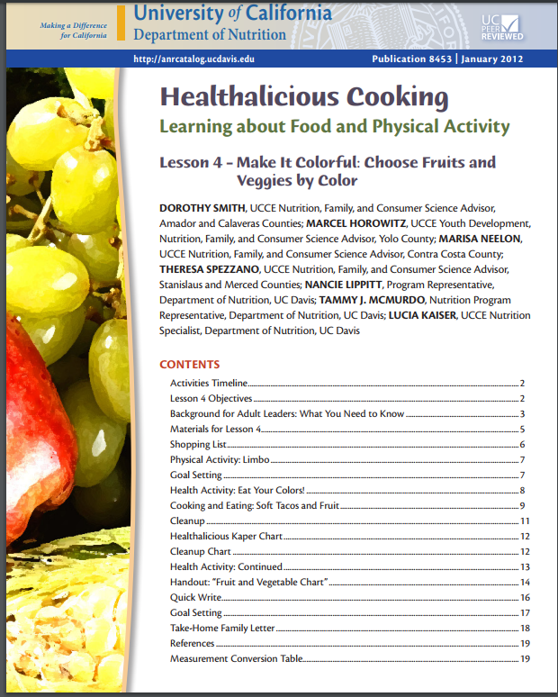
Why Teach Cooking?
To Connect with Family & Friends
Free @
Anrcatalog.ucanr.edu
Notes:
4:52-4:54- Marcel- quick overview.

Slide 14
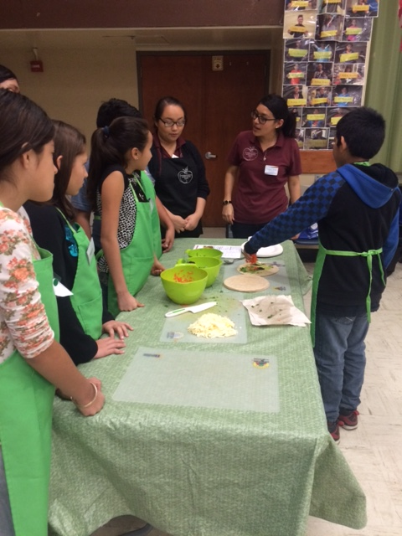
Why Teach Cooking?
Life & Job Skills
Responsibility
Sense of accomplishment
Connection to science and mathematics
Connection to language arts
College and career readiness
Notes:
4:50- 4:55- OPTIONAL IF TIME PERMITS-
Kelley-
-more likely to eat it if they made it; self esteem
-fractions; temperature; geometry; food science; chemistry

Slide 15
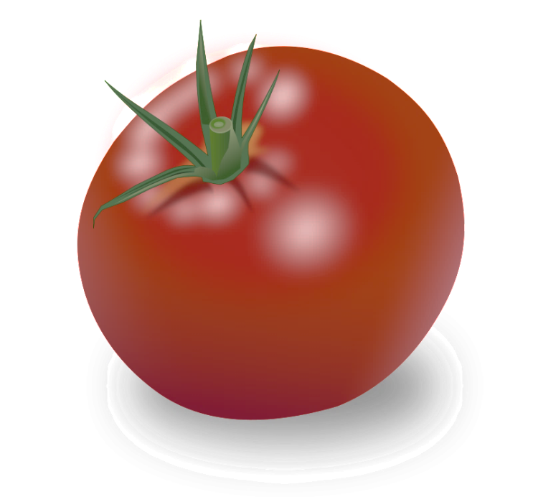


Why Teach Cooking?
For fun!
Start a Cooking Competition
Notes:
4:55- 5:00- Kelley-
-What do you do in your county or state?

Slide 16

Contact us
Mhorowitz@ucanr.edu
kmbrian@ucanr.edu

