Slide 1
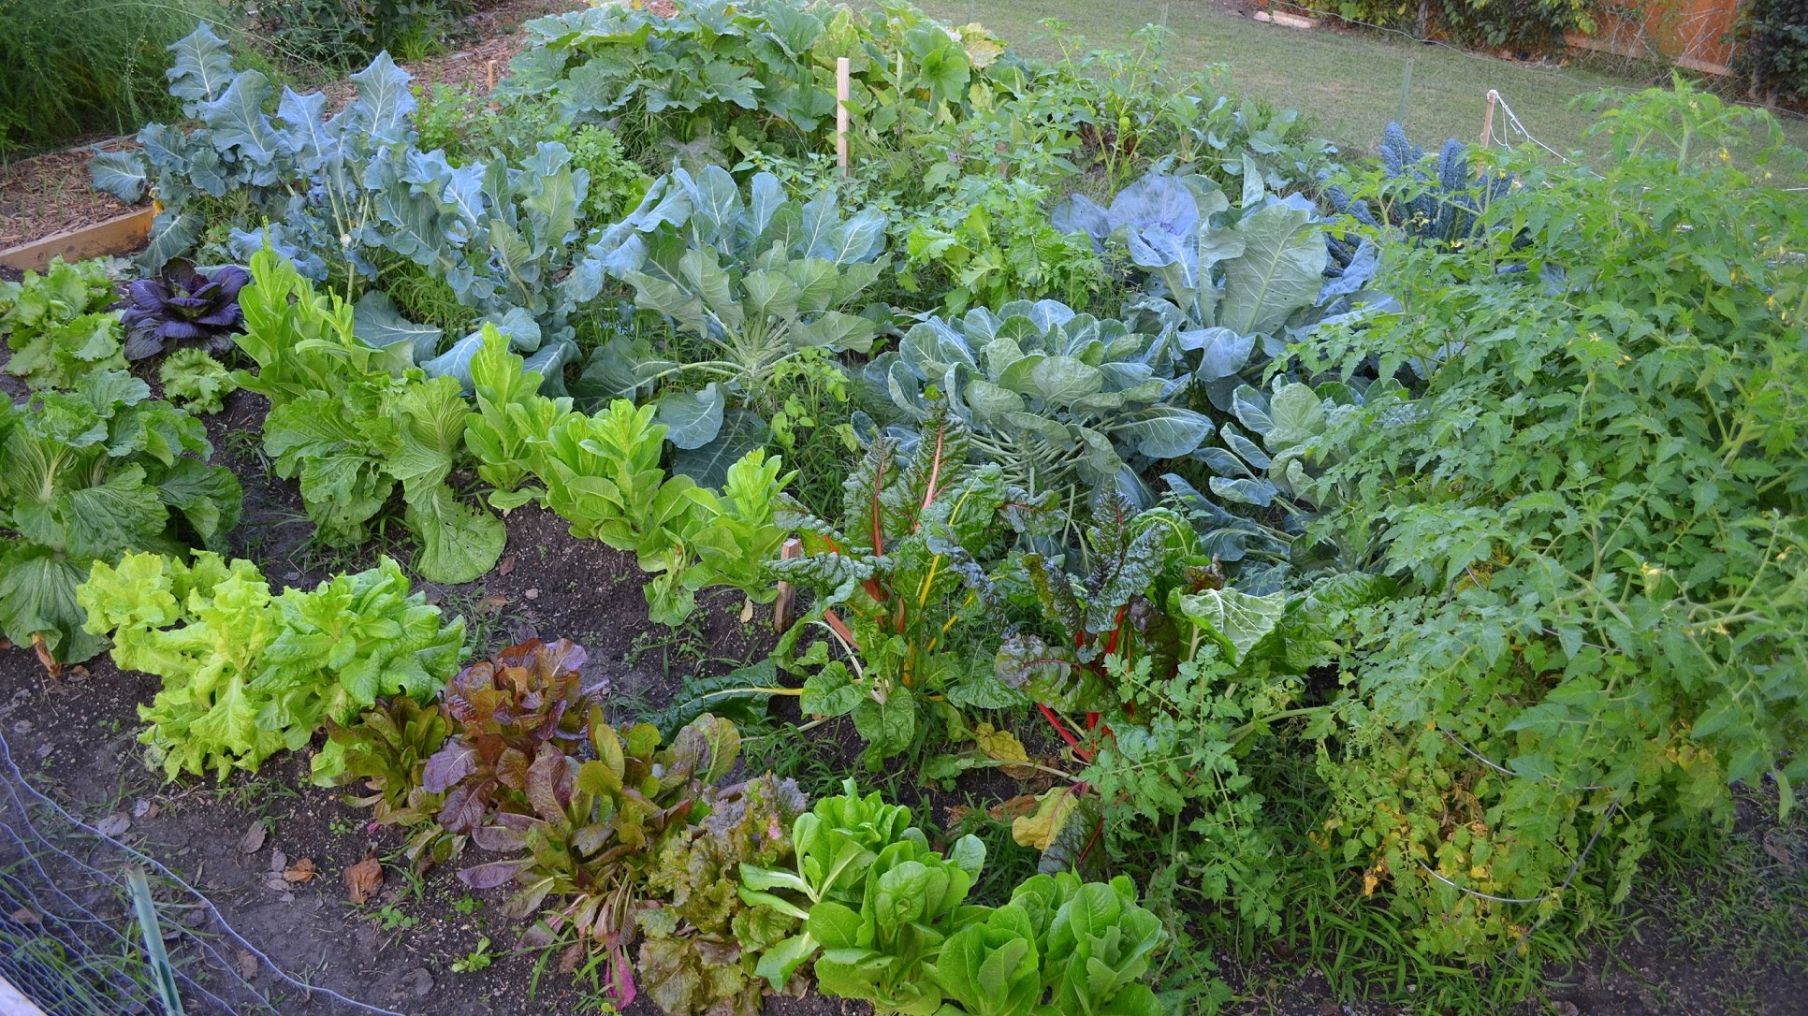
Vegetable Garden Planning
January 2019
Notes:
DD

Slide 2
Learning Objectives
By the end of this class you should have the tools & knowledge to layout and plan a small vegetable garden.
Appropriate for beginning gardeners and experienced gardeners who want to maximize yield.
Notes:
DD
Will the certified Master Gardeners please stand up.
There are probably 100 years of gardening expertise in this room. This room is full of people with a wealth of knowledge about gardening. If you have questions, these people have answers.
Who considers themselves an experienced gardener?

Slide 3
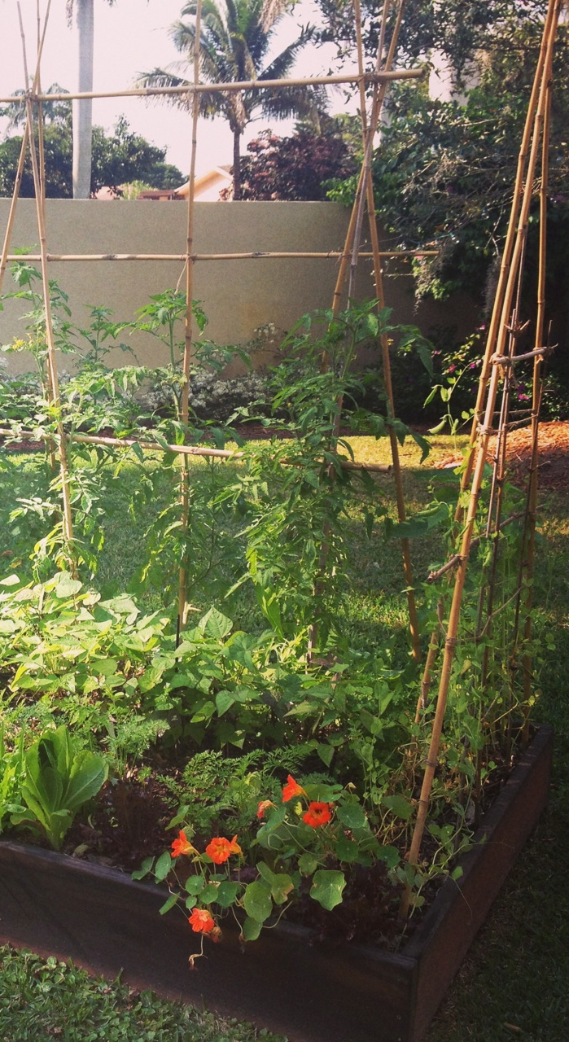
Outline
Garden Goals
Location
Layout
Plant selection & timing
Planning Exercise
Online Tools
Notes:
DD
Agenda today

Slide 4
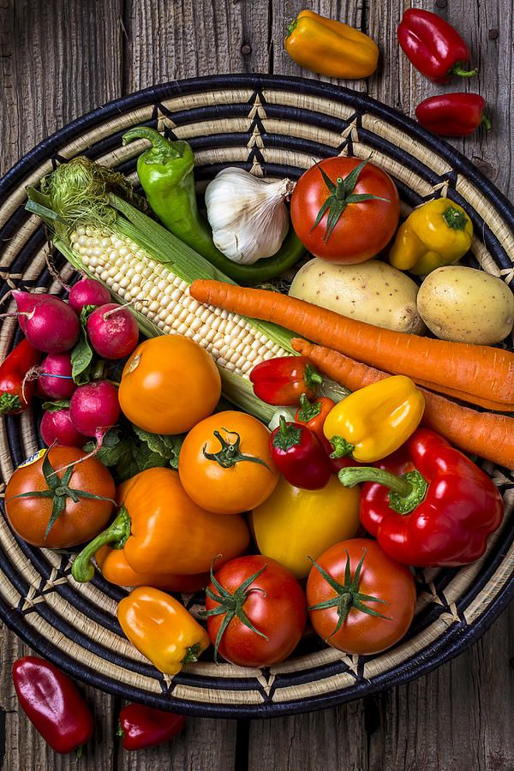
Goals for your veggie Garden

Slide 5
Why Are You Here Today?
# of people to feed : rule of thumb 100 sq. ‘ per person
Grow what you like to eat
What you plan to preserve
Learn what works in your yard
New? Get started growing food
Maximize yield
Notes:
# of people to feed : rule of thumb 100 sq. ‘ per person
Grow what you like to eat
What you plan to preserve
Learn what works in your yard
Get started growing food
Maximize yield with companion, vertical or succession planting

Slide 6
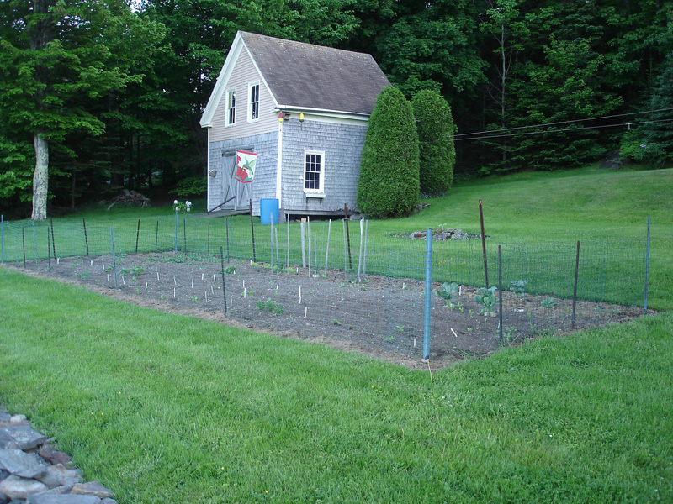
Location selection

Slide 7
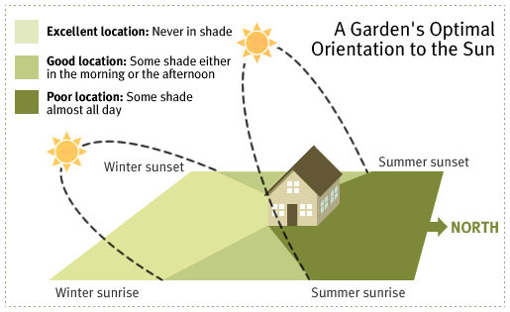
Site Selection – Let There Be Light
Minimum 6-8 hours of sun per day for most crops
Consider winter solar orientation
Near water source
Shade? Slope? Wind?
Water table?
Drainage?
Soil…
Notes:
DD
Watch the sun in your yard on the winter solstice when the angle of the sun is lowest – the spot that gets sun for 8 hours then, is the sunniest place in your yard.
Solar orientation is different in winter. Mark shade lines with stakes
South facing will get you best exposure in winter
6-8 hours
If you don’t have shadeless space, try containers in sunny spots

Slide 8
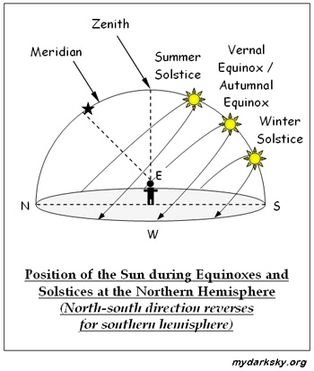
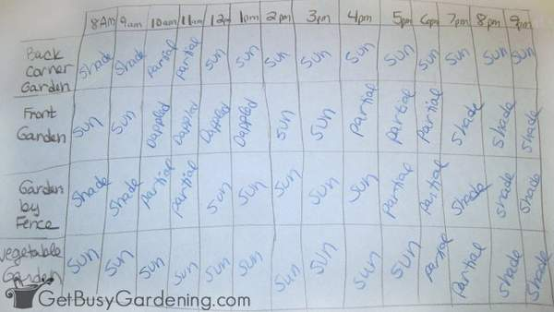
Map Your Shade
Full sun – 6 plus hours
Part sun – 4-5 hours of sun
Part shade – 2-3 hours of sun
Full shade – less than 1 hour of sun
https://www.thegardencontinuum.com/blog/bid/28513/how-much-sun-does-your-garden-have
Notes:
Do this now for your spring garden and again at summer solstice.

Slide 9
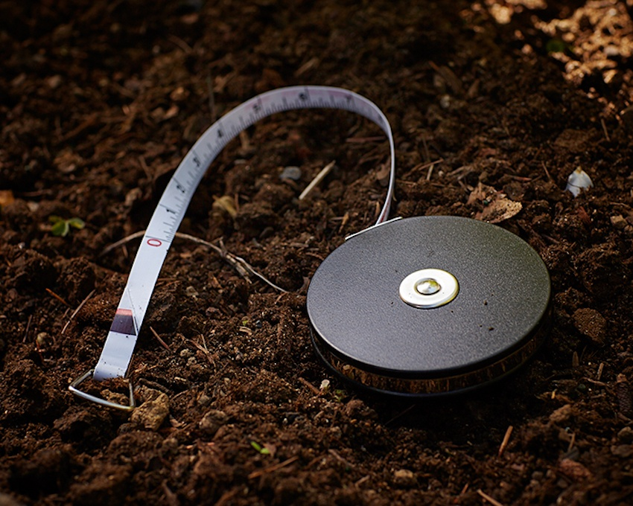
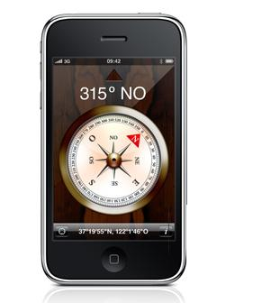
Measure & Map
Measure overall space with pathways, borders, etc.
Planting area
Map it in 2 dimensions on graph paper 1 sq. = 1’
Compass orientation, – which way is north? (download a phone app)

Slide 10
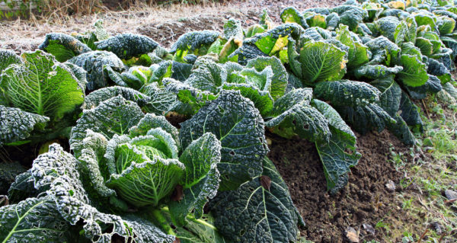
Hardiness
Check for your last frost date
USDA Zone https://planthardiness.ars.usda.gov/PHZMWeb/
First and last frost by zip https://morningchores.com/frost-dates/
Monterey 93940 – no frost
Ben Lomond 95005 – last frost Dec 17
Salinas – 93906 last frost Jan 26
Santa Cruz – 95062 last frost Feb 7

Slide 11
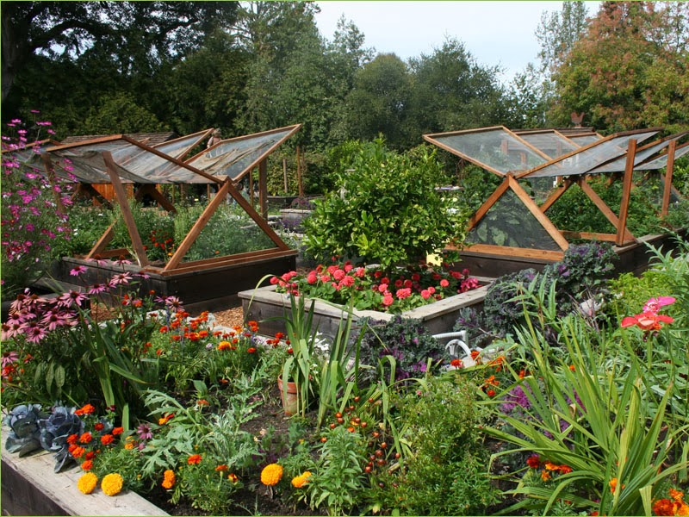
PLANt selection

Slide 12
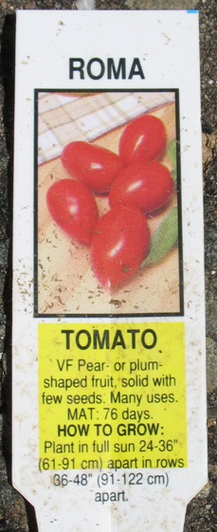
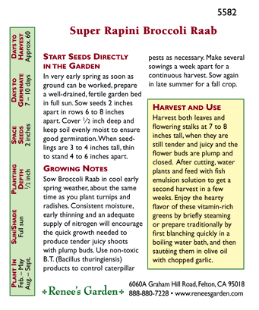
Plant Selection Decisions
What do you want to grow?
When should you plant it?
Plant from seed or transplant?
How far apart?
Specials plant needs
  Trellis
  Soil, water, nutritional or pH needs
  Day length, Light and temperature needs

Slide 13
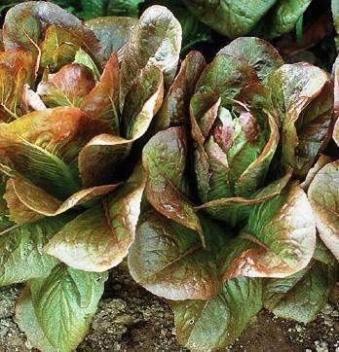
Plant Info Resources
Planting guide handout
Square foot spacing guide
Seed packet backs (depends, good ones are Botanical Interests & Renee’s Garden)
SC Planting calendar http://cesantacruz.ucanr.edu/files/130451.pdf
Vegetable plant spacing guide https://www.gardeningknowhow.com/edible/vegetables/vgen/plant-spacing-chart.htm
The interwebs….
Notes:
Information you will need after you decide what you like to eat.

Slide 14
Layout Decisions
2 foot pathways between beds or rows
Beds no more than 3-4 feet wide
Tall plants on the north side
Configure rows or beds based on available space

Slide 15
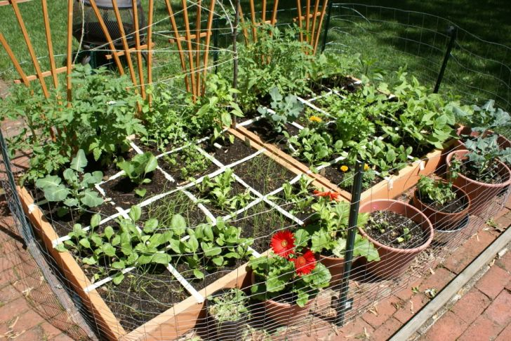
Square Foot Gardening

Slide 16
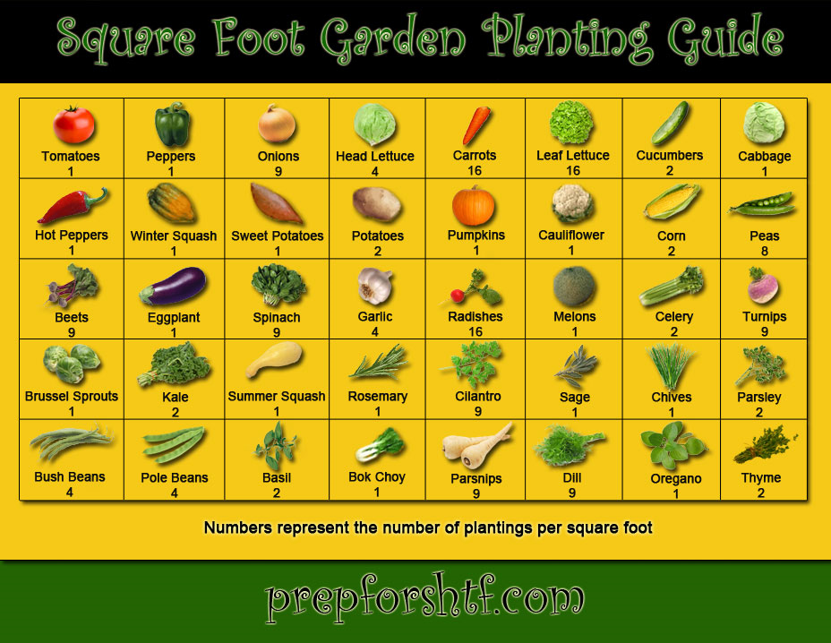

Slide 17
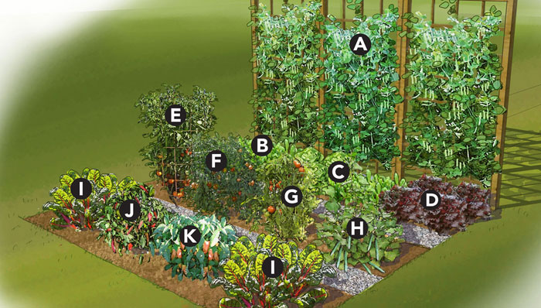
Grow Your own - exercise

Slide 18
Exercise – you get 100 sq..’ of land!
Task: Design on graph paper
a 100 square foot vegetable garden
that includes at least 4 plant varieties
for an area that gets 7 hours of full sun per day
that you will plant in April

Slide 19
Exercise – you get 100 sq..’ of land!
Find a partner
Using graph paper design a layout that provides 2’ border and pathways. Any configuration
Plant at least 4 varieties
Your garden gets 7 hours of sun per day
You will plant in April.

Slide 20
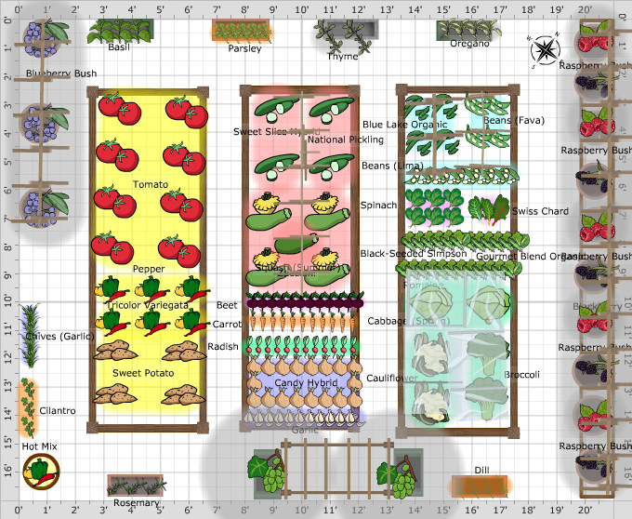
Layout ideas

Slide 21
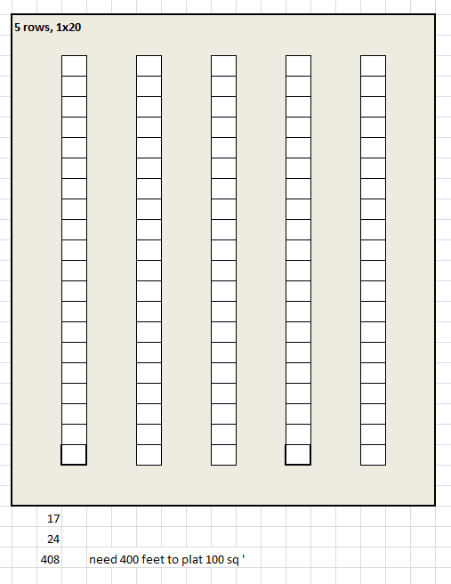
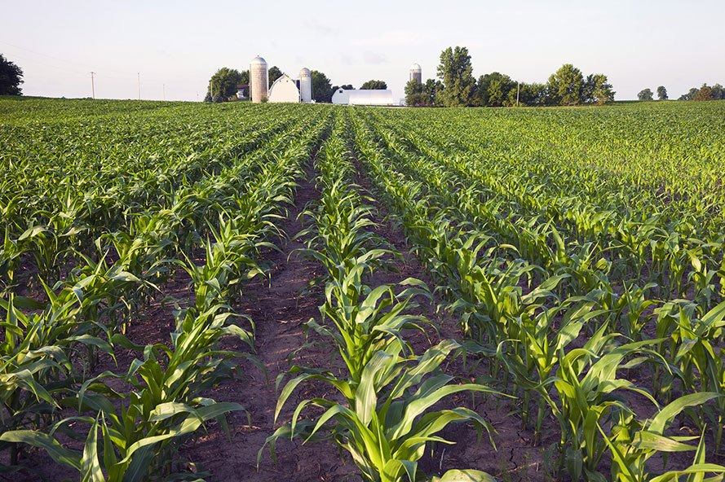
Need 408 sq.‘ to get 100 sq.’ of planting space

Slide 22
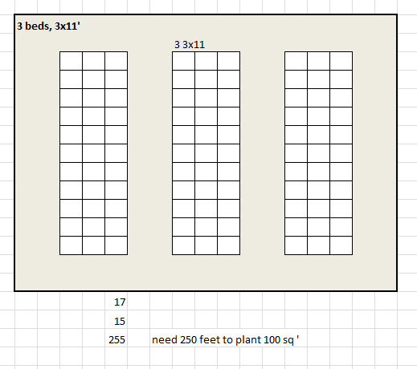
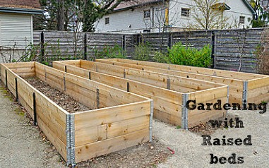
Need 255 sq.‘ to get 100 sq.’ of planting space

Slide 23
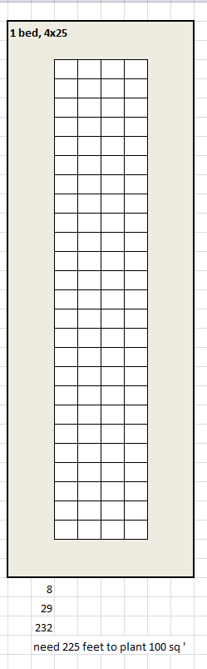
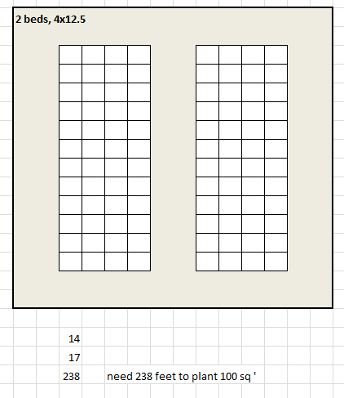
Need 235 sq.‘ to get 100 sq.’ of planting space

Slide 24
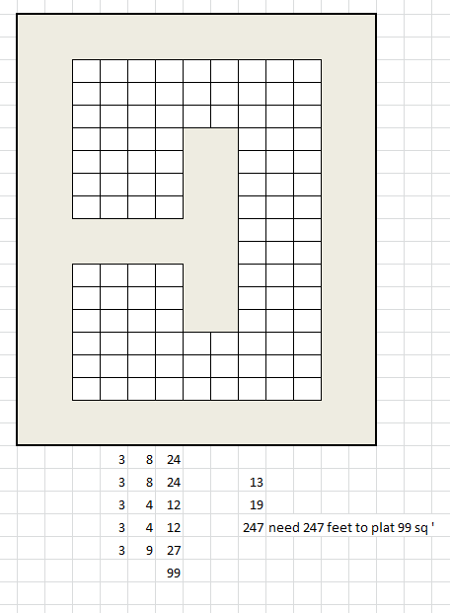
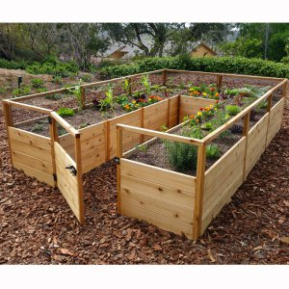
Need 247 sq.‘ to get 100 sq.’ of planting space

Slide 25
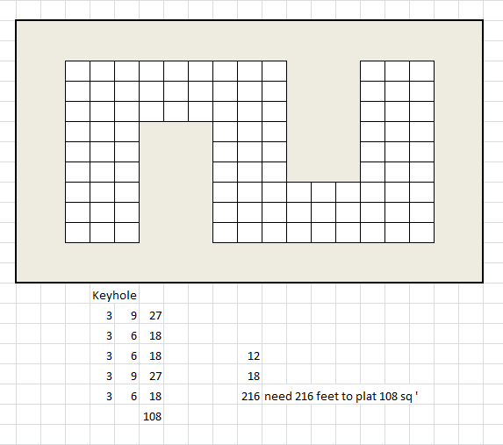
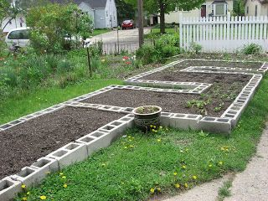
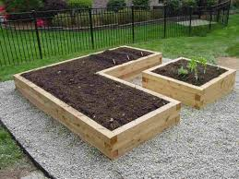
Need 216 sq.‘ to get 100 sq.’ of planting space

Slide 26
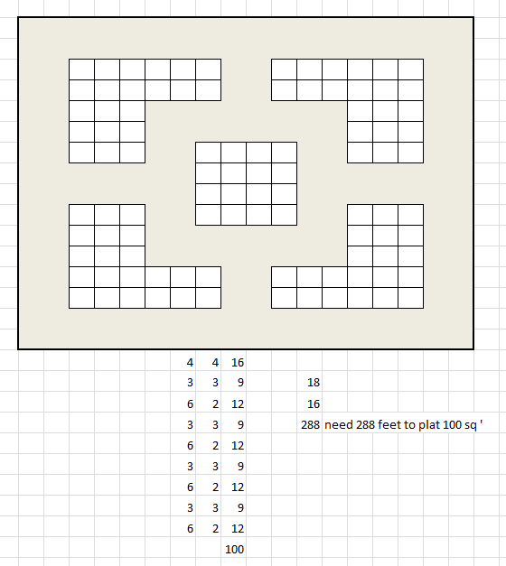
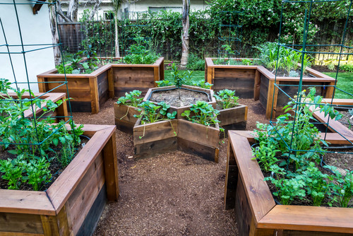
Need 288 sq.‘ to get 100 sq.’ of planting space

Slide 27
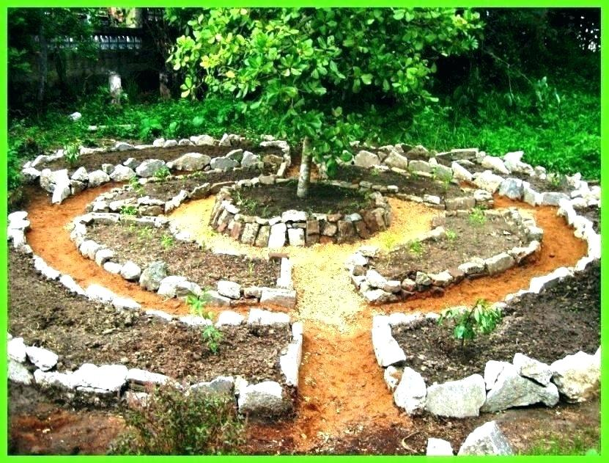
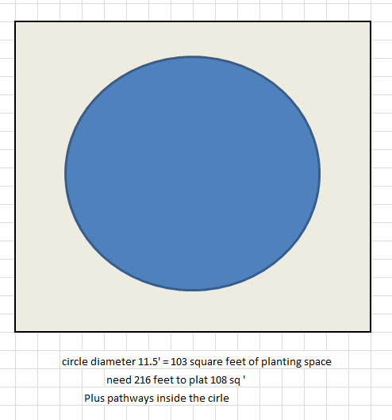
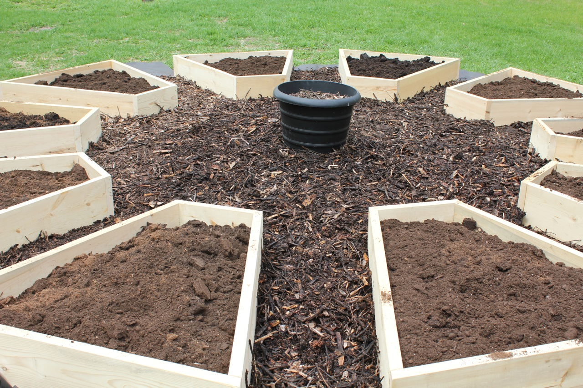
Need 216 sq.‘ to get 100 sq.’ of planting space
Square foot calculator – any shape
https://www.squarefootagearea.com/calculator/square-footage-calculator/

Slide 28
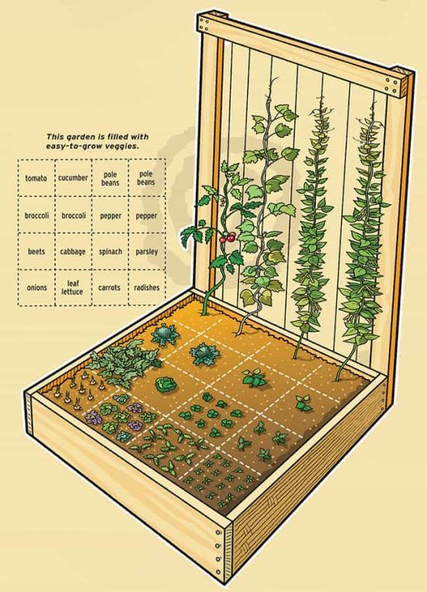
Exercise Time

Slide 29
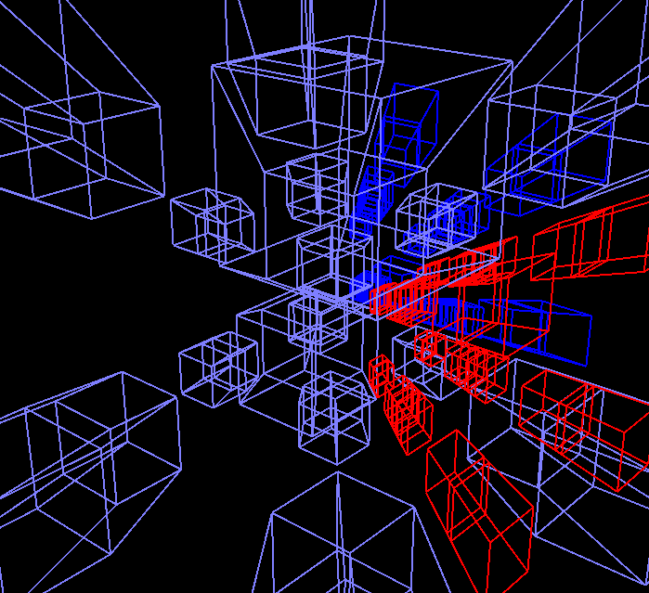
Thinking in Dimensions
DIMENSION 1: Length = rows
DIMENSION 2: Length + width = bed
DIMENSION 3: Length + width + height = trellis or vertical
DIMENSION 4: Length + width + height + time
Succession planting, growing two or even three crops on same ground in same season.
A 5th DIMENSION?: Put time where it is not!
Even more abundant harvest; longer harvest season
Notes:
DD
Agenda today

Slide 30
Other Planning Tips
Rotate your crops
Avoid soil borne pests and disease. Change up the crops you plant in a given space from year to year.
Rotate heavy feeders
Alternate nitrogen hungry plants with nitrogen fixing legumes
Cover crop or let soil lay fallow
The soil feeds you, you feed the soil 1 x year
Plant tall sun lovers with low shade lovers
Example – trellised beans & lettuce
Notes:
Don’t plant the same crop in the same place year after year. That invites soil borne disease and pest problems

Slide 31
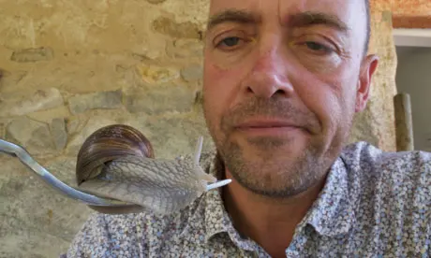
Planning for Disaster
You can calculate your yield in a perfect world until disaster strikes. Add a 10-30% loss rate
Early insults to your planting scheme:
Damping off disease
Snails and slugs
Birds
Gophers
Notes:
Don’t plant the same crop in the same place year after year. That invites soil borne disease and pest problems

Slide 32
Succession Planting
You can calculate your yield in a perfect world until disaster strikes. Add a 10-40% loss rate
Early insults to your planting scheme:
Damping off disease
Snails and slugs
Birds
Gophers
Notes:
Don’t plant the same crop in the same place year after year. That invites soil borne disease and pest problems

Slide 33
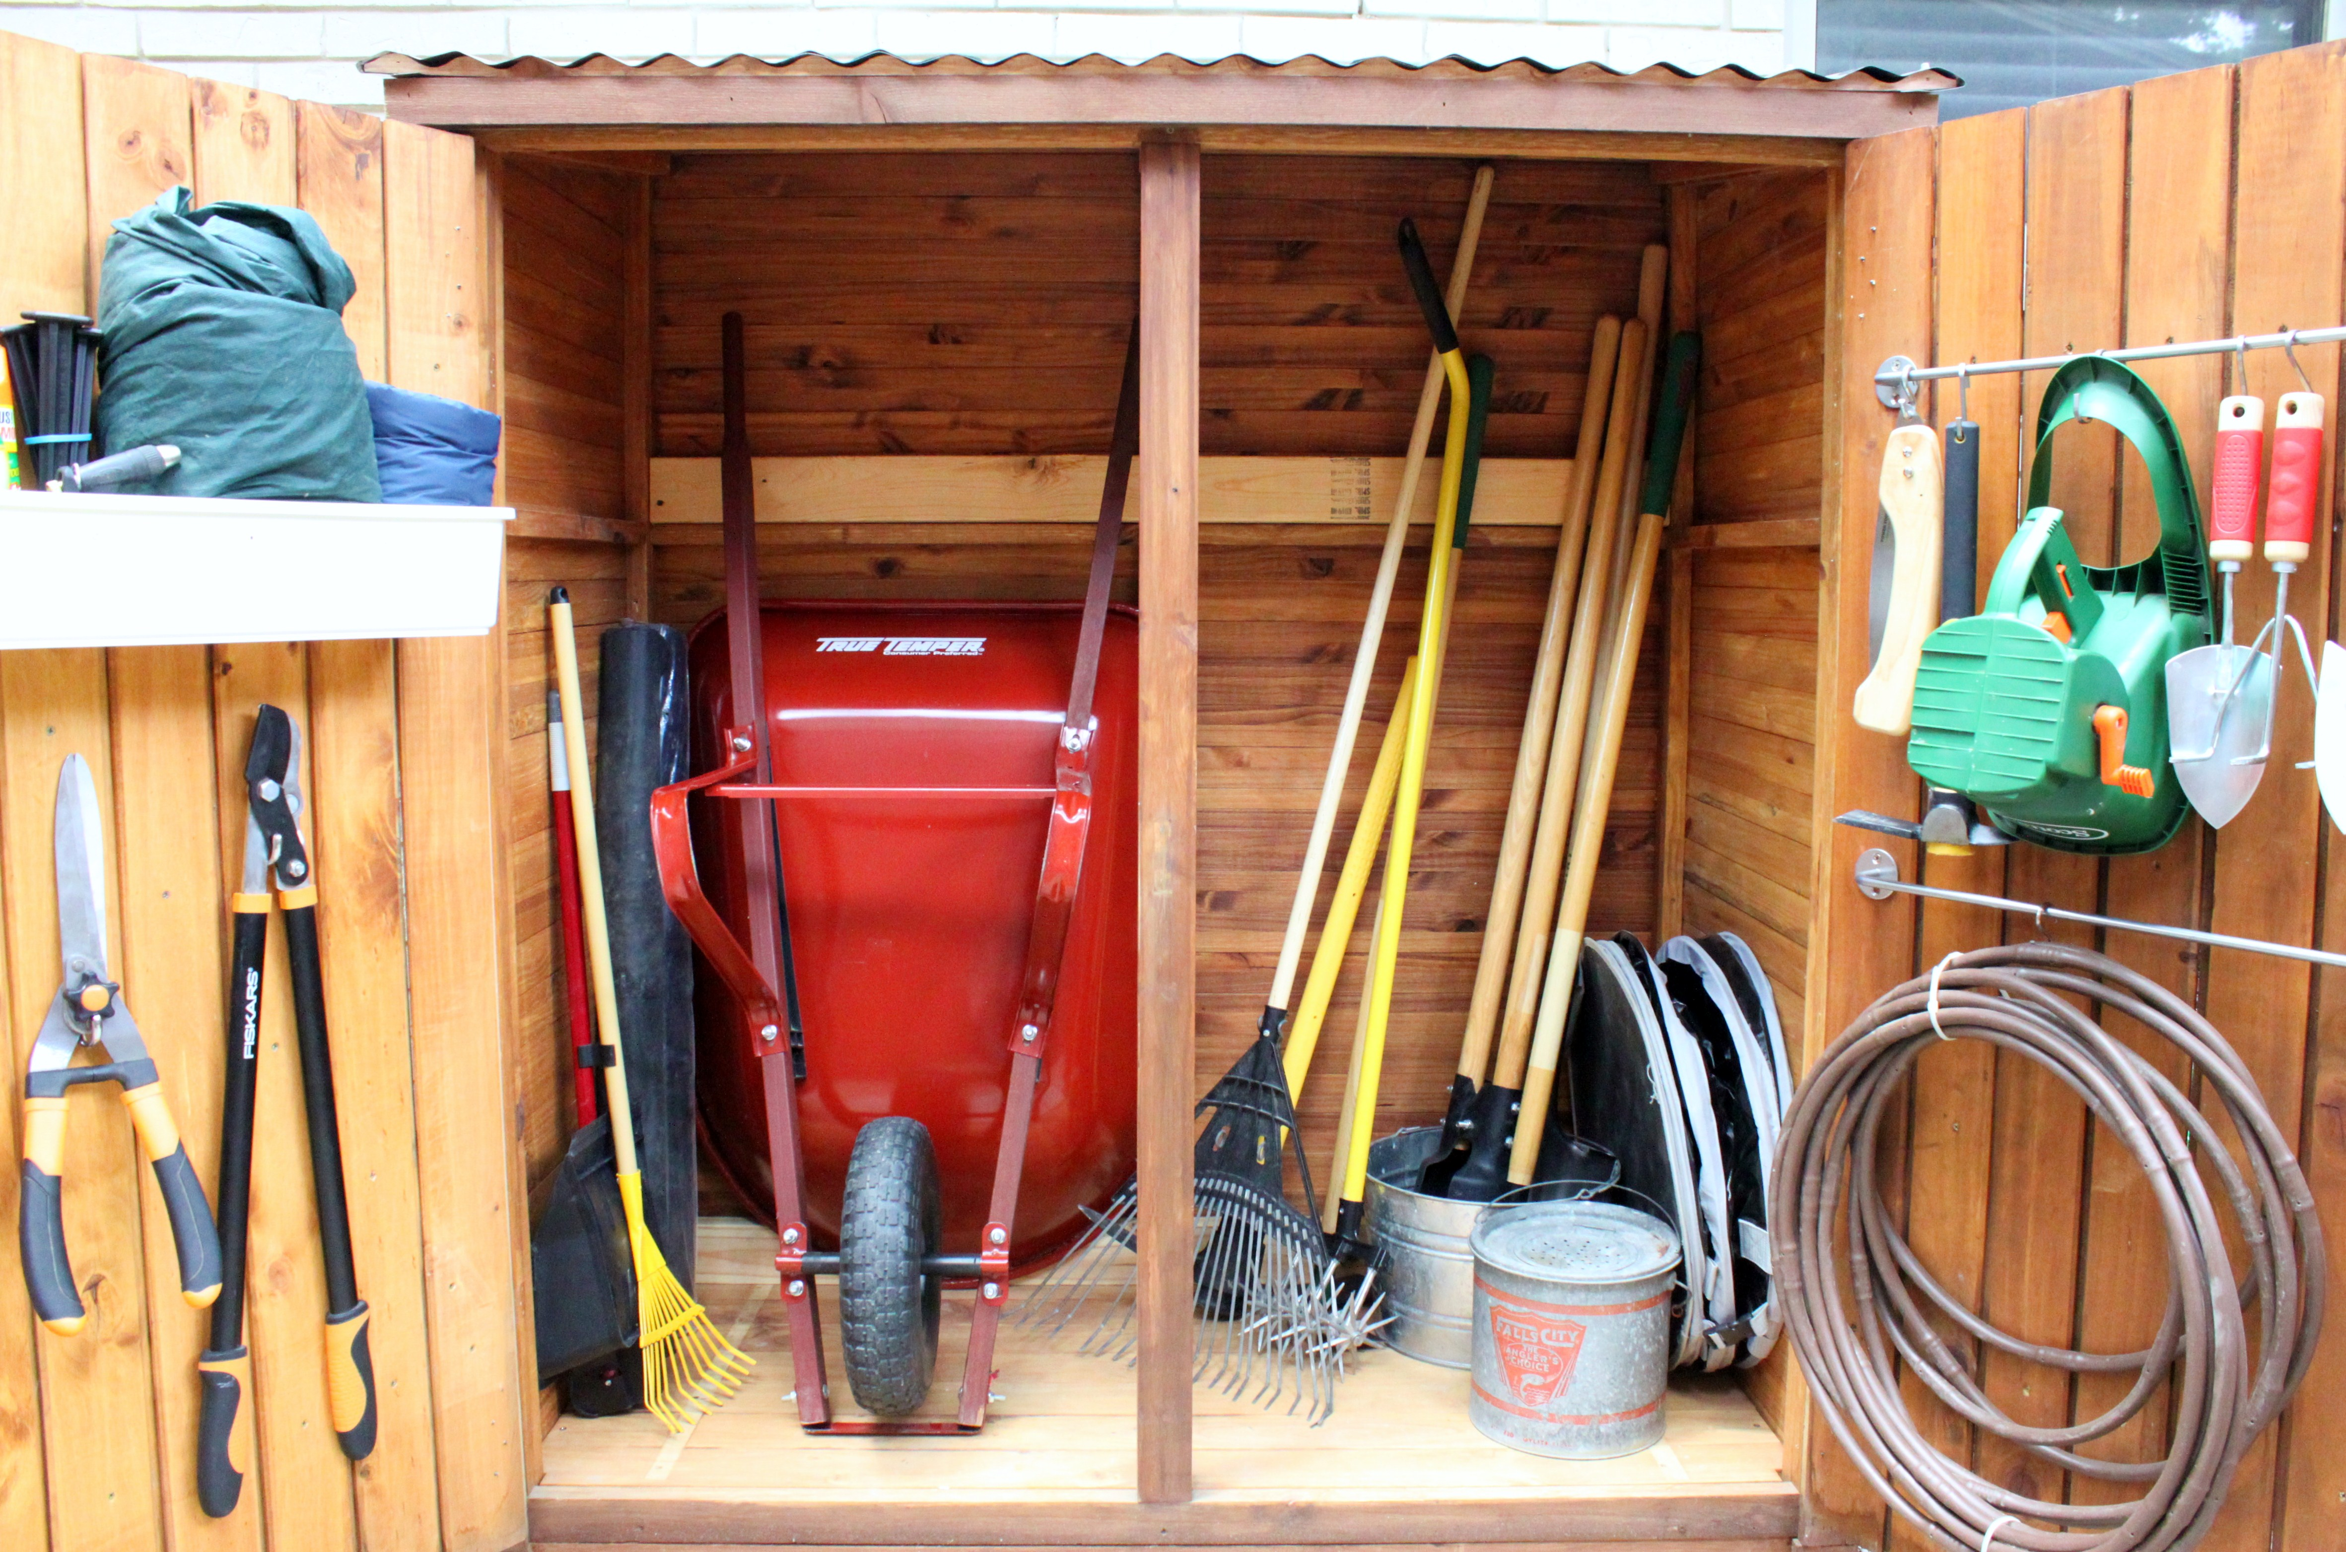
Online tool shed
Notes:
Lets see how all this science applies to your garden

Slide 34
Online Planning Tools
Square foot calculator – any shape
https://www.squarefootagearea.com/calculator/square-footage-calculator/
Vegetable spacing chart – rows and beds
https://home.howstuffworks.com/vegetable-spacing-guide.htm
Plant spacing calculator – requires you know spacing but gives you yield
http://www-users.math.umn.edu/~white004/personal/plantcalc.html

Slide 35
Online Planning Tools
Seed starting Date calculator
http://www.johnnyseeds.com/growers-library/seed-planting-schedule-calculator.html
  Monterey – last frost Jan 22
  Santa Cruz – last frost Feb 5
  Ben Lomond – last frost Apr 6
  Salinas – last frost Feb 22
Days to Maturity chart (In Iowa)
https://hortnews.extension.iastate.edu/2004/7-23-2004/vegguide.html
Statewide planting guide
https://ucanr.edu/sites/gardenweb/files/29040.pdf

Slide 36
Online Planning Tools
Succession planting guide for continuous harvest
file:///C:/Users/Delise/Downloads/continuousharvest%20(1).pdf
Johnny’s Succession Planting Calculator
https://www.johnnyseeds.com/growers-library/successionplantingspreadsheet.html
Johnny’s Planning Tools & Calculators
https://www.johnnyseeds.com/growers-library/online-tools-calculators.html

Slide 37
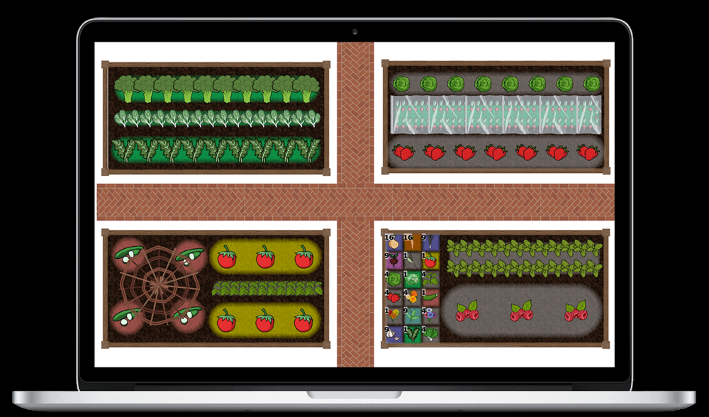
Automated Planning Apps
Notes:
Lets see how all this science applies to your garden

Slide 38
Online Planning Applications
Full review of each:
https://www.smallfootprintfamily.com/online-vegetable-garden-planning-tools
Name | URL | Free Trial | Price | Notes
Gardeners Supply Kitchen Garden Planner | https://www.gardeners.com/how-to/kitchen-garden-planner/kgp_home.html | Free | Free | easy to use, limited function, free
GrowVeg | https://www.growveg.com/ | 7 day | $29/year | Cadillac of home garden planning tools, not THE easiest to use
Smart Gardener | https://www.smartgardener.com | no | $6/90 days $20/360 days | affordable, robust and fairly easy to use
Plangarden | http://www.plangarden.com | 45 day | $20/year | Looks low end but quite robust for an experienced gardener. Harvest feature for succession planning
Notes:
We’ll go through these live

Slide 39
Feature Comparison
Feature | Gardeners Supply | Grow Veg | Smart Gardener | Plangarden | Tend.ag
Price | $0 | $29/yr | $6/90 days $20/360 d | $20/yr | $399/yr $39/mo
Free trial | Free | 7 day | no | 45 day | 14 day
Pre-planned | Yes | no | no | no | Agricultural system for managing commercial plantings. Projects yields, income, costs, succession plantings & analytics
Frost date | no | Yes | Yes+overide | Calculator
North/South | no | Yes | ? | No
Spacing | Sq. foot | Yes | Yes | Calculator
Buy seeds | Yes | no | Yes | ?
Community | Ask expert | Yes | Yes | ?
Reminders | no | Yes | Yes | Yes
Succession | no | Yes | Yes | Yes
Plant list | no | Yes | Yes | ?
Journal | no | Yes | Yes | Yes, good

Slide 40
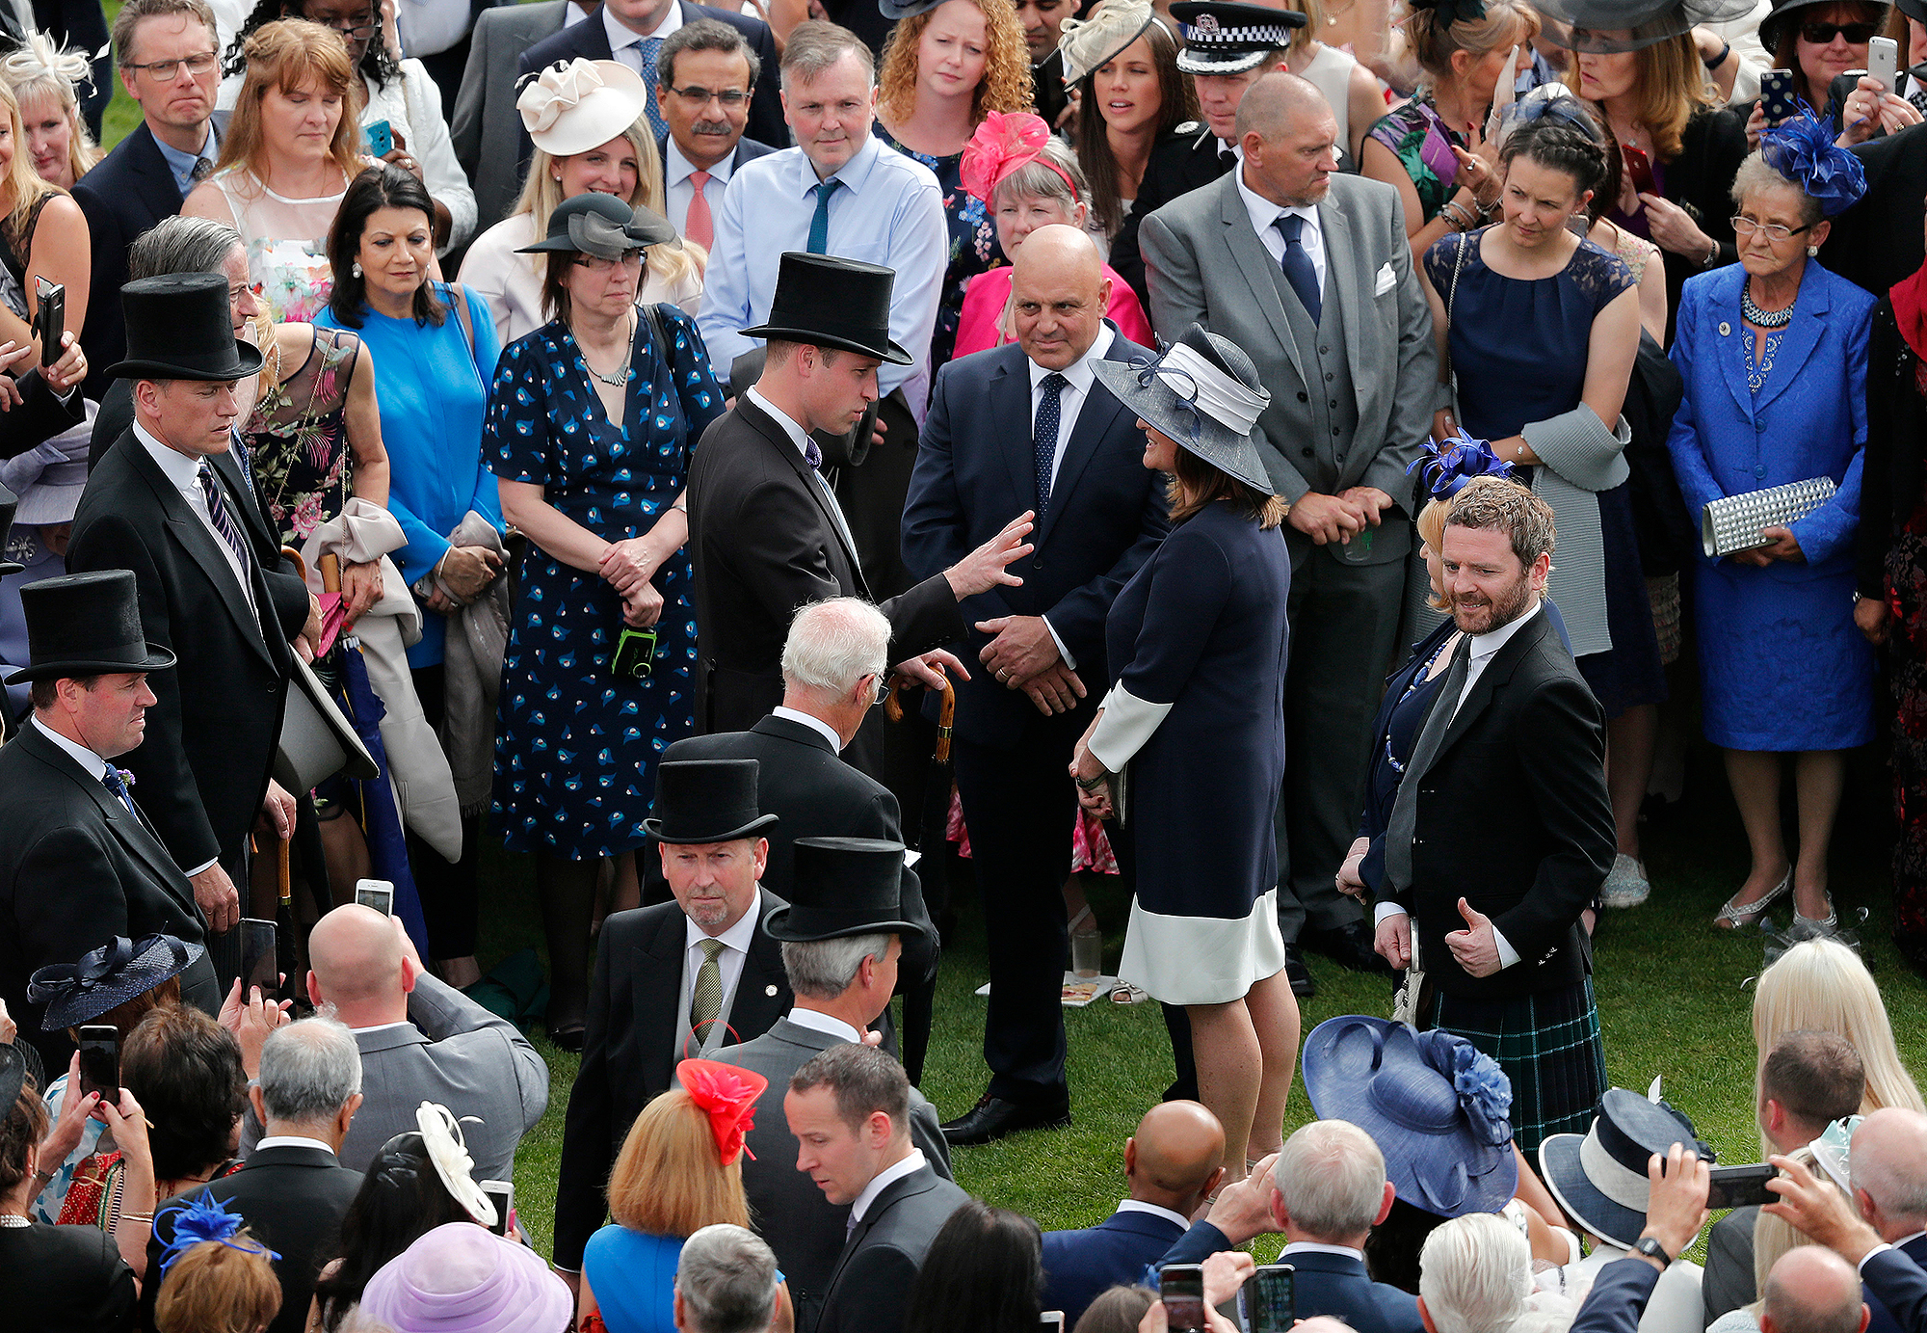
Q&A Mixer

Slide 41
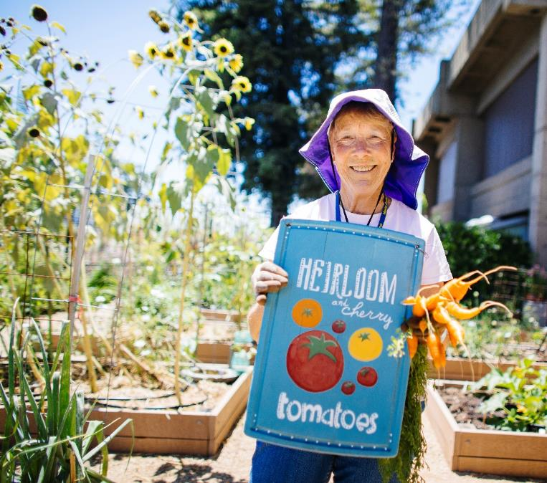
Help Us Improve!
  Our follow-up survey provides the tools we need to improve the quality of our program.
  Please respond to the short survey you will receive in a few weeks.
Notes:
DD
Notes:
We strive for continual improvement and as a non-profit, we justify funding by demonstrating our impact on the community. In a few weeks you will receive a survey by email asking if you used any of the skills you learned in this class. We urge you to respond to that survey.

Slide 42

What About MY Backyard? Outside!
Try these ideas things out
Dig in some cover crops
Build a lasagna garden bed
Question and Answer
Remember! You can always address questions to the
Master Gardener Hotline
http://mbmg.ucanr.edu/hotline/
831.763.8007
Notes:
Once outside in the demo garden we’ll split into two groups – one for the cover crop section, the other for lasagna garden.
Then we’ll switch

Slide 43
Appendix

Slide 44
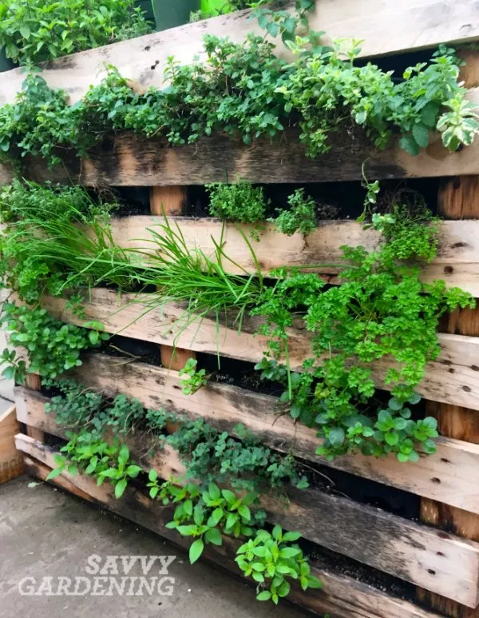
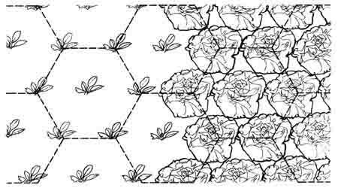
More Space Savers
Planting on a hexagonal grid
Vertical Gardening

