Slide 1
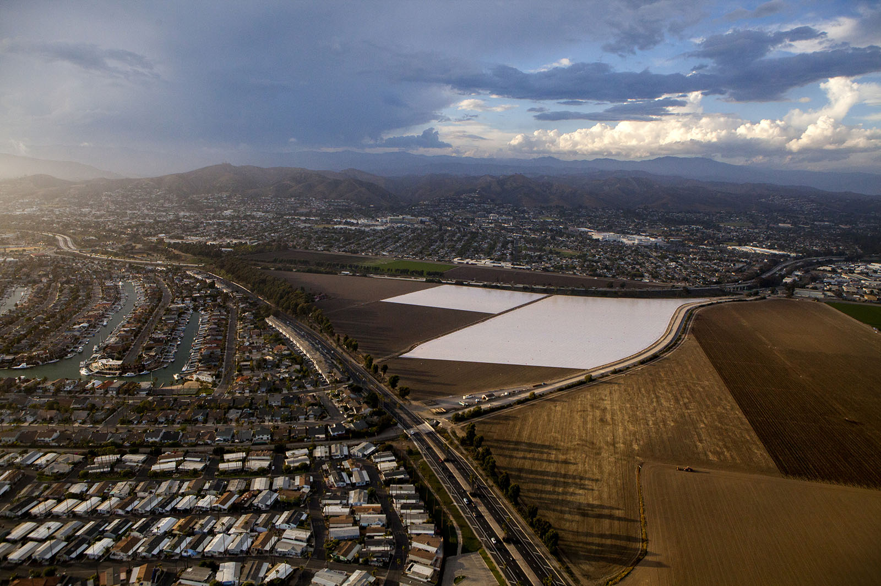
Sothern California update on soil disinfestation methods
Ventura county

Slide 2
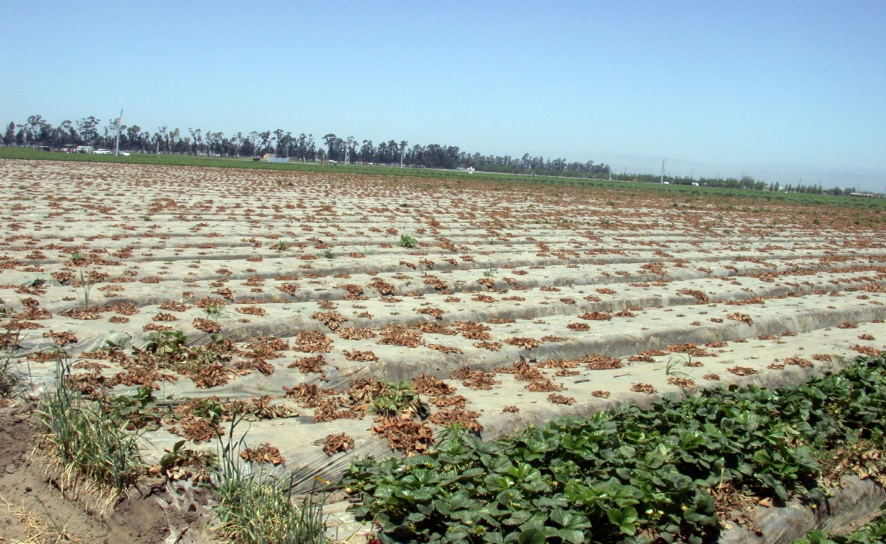
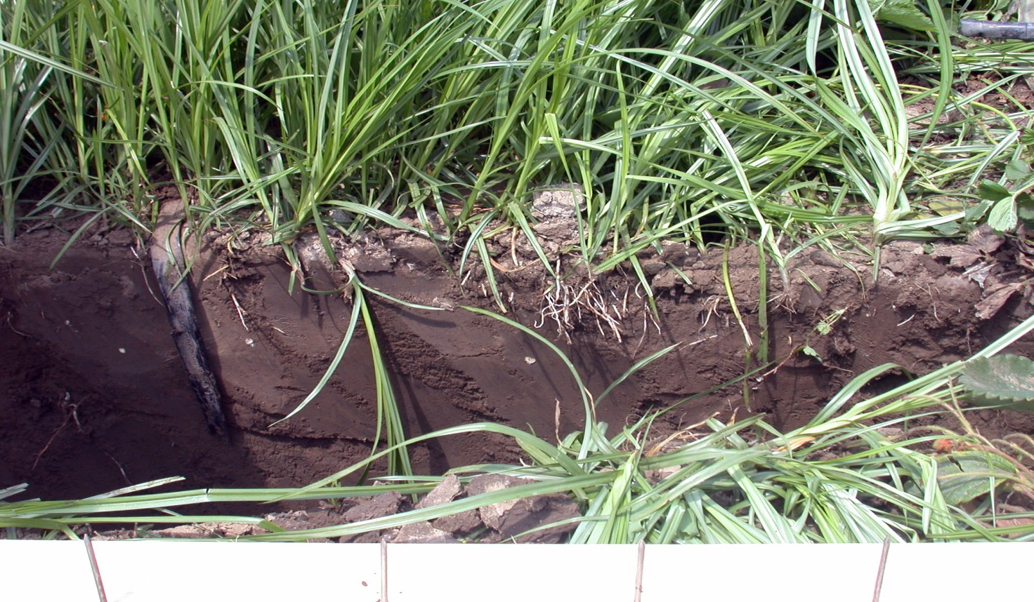
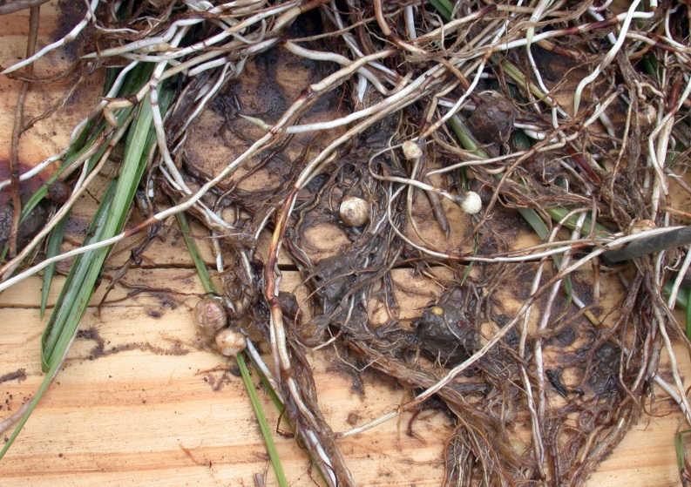
What’s in our soils
Documented fields during last 8 years with:
Fusarium oxysporum: 16
Macrophomina phaseolina: 11
Verticillium dahliae: 5
Phytophthora fragariae 3
Undocumented: 30%? 60%? 100%?
‘Minor’ pathogens:
cause 10-50% reduction in yield when soil is untreated
Yellow nutsedge: 25-30% of fields
In both: winter and summer strawberries

Slide 3
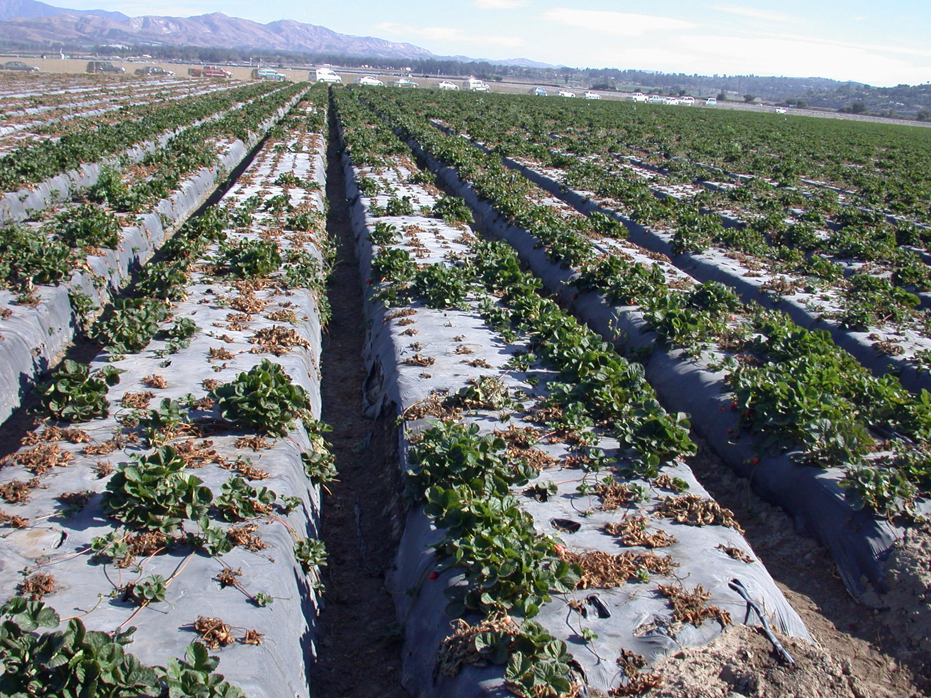
Summer-planted
Portola,
200lbs/A Pic

Slide 4
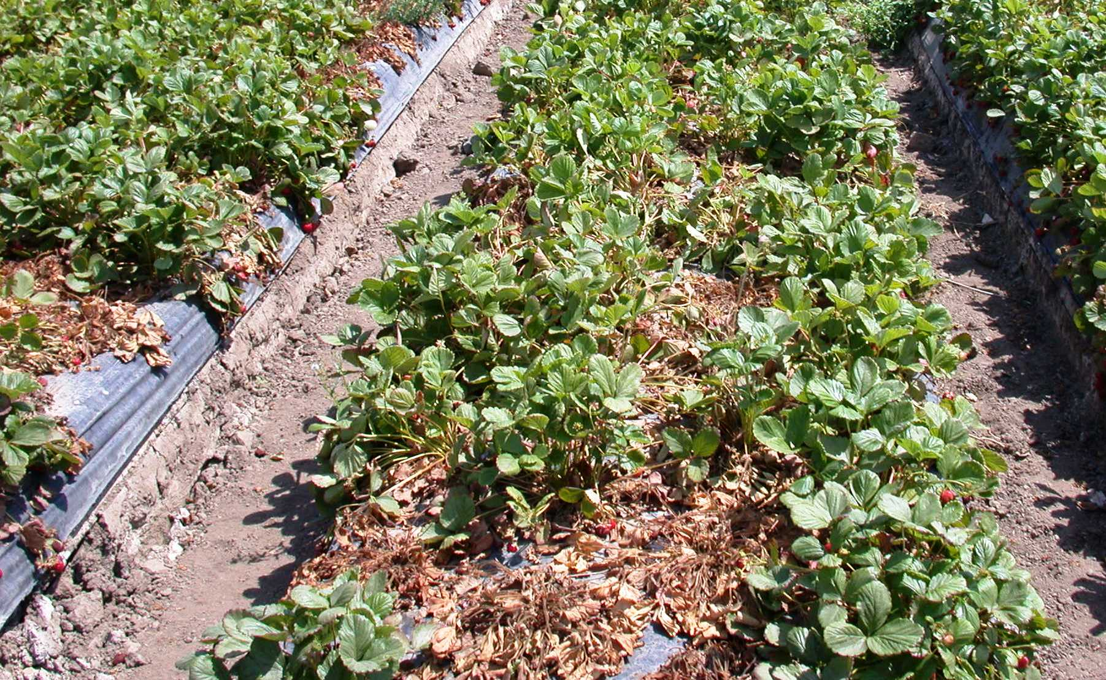
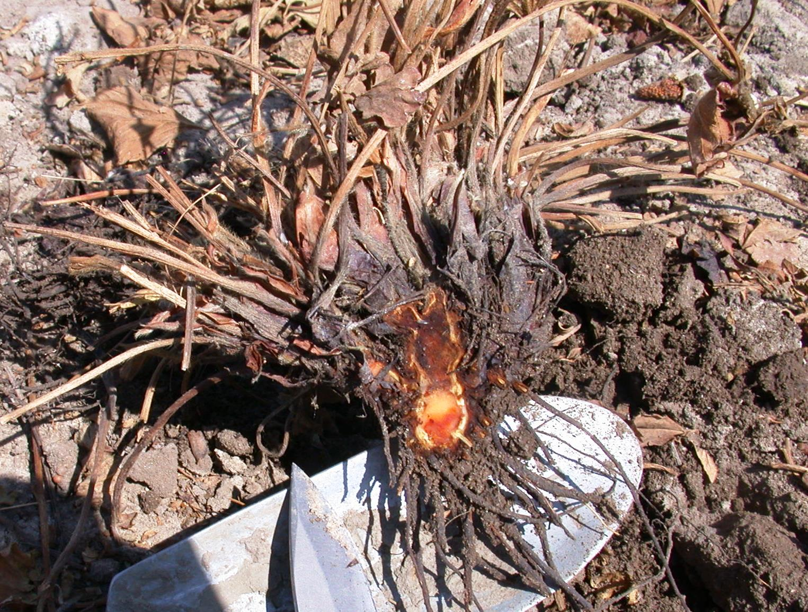
‘Fronteras’ is resistant to F.oxysporum ?!

Slide 5
CONVENTIONAL
PRODUC TION
FUMIGATION COSTS:
Flat fumigation = $3,000-3,700/Acre
Drip (bed) fumigation = $ 1,200-1,800/Acre (>70% of all fumigated acres)

Slide 6
FLAT-FUMIGATED, Pic 300

Slide 7
FLAT-FUMIGATED, Pic 300

Slide 8
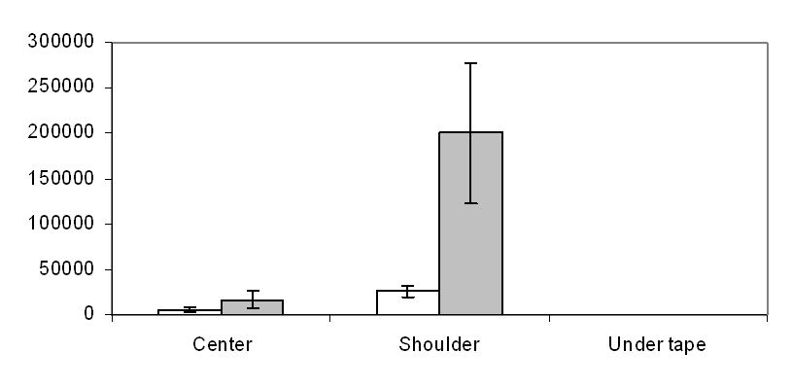
Effect of location in bed on fumigant efficacy
DRIP-FUMIGATED with Piclor 60, 300lbs/a
6” depth
12” depth
Fusarium: Spores per gram of soil
Location in bed

Slide 9
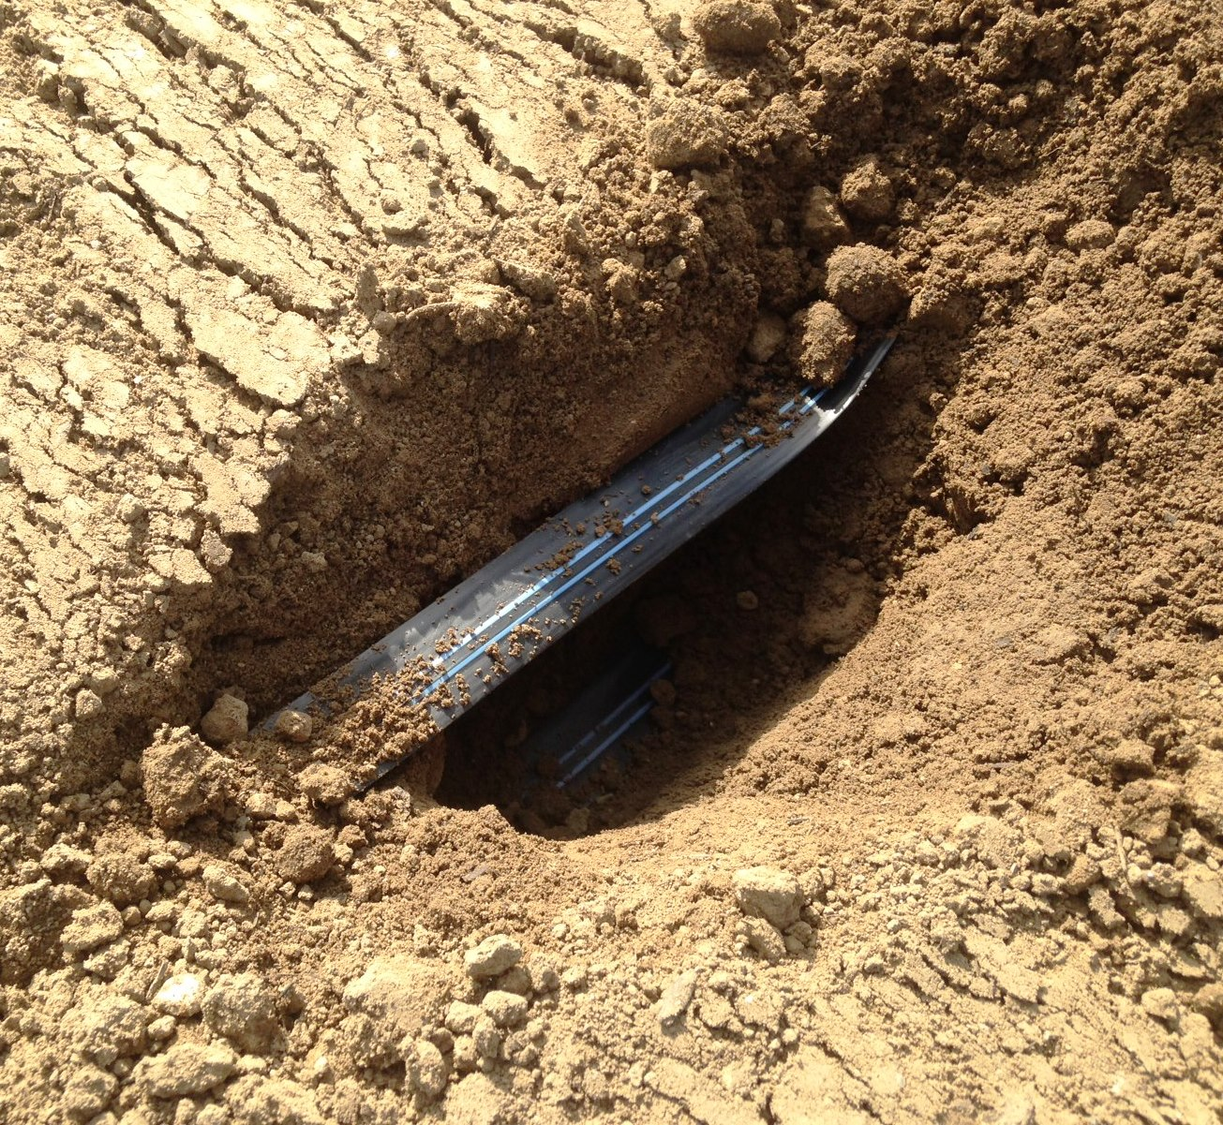
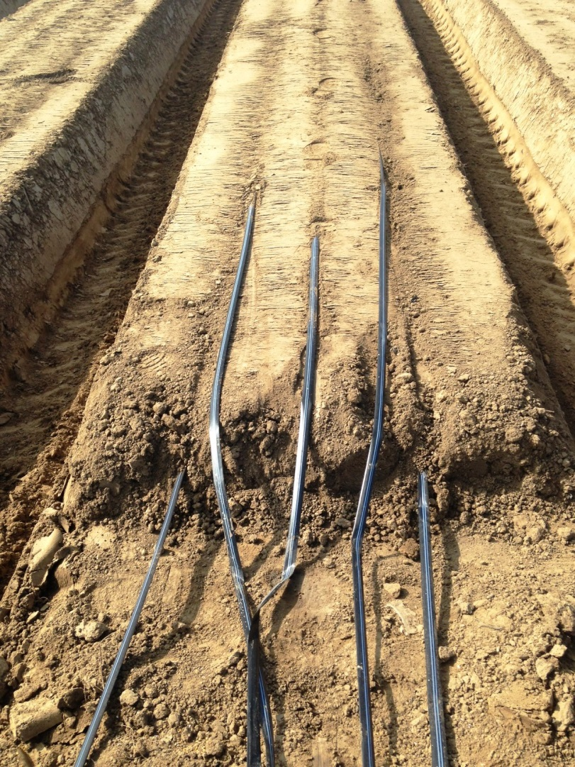
Adding lines for drip fumigation

Slide 10
2014 Oxnard trial with Tri-Clor EC
Full rate:
224 lbs/ac
12”
CT value is accumulated (fumigant concentration * fumigation time)
Notes:
Similar resuolt showed in 2014.

Slide 11
2015 Oxnard trial with Tri-Clor EC: full rate: 200 lbs/ac half rate: 100 lbs/ac
12”
Notes:
This slide shoewd that the CT higher than 350 shoed in full rate under TIF. In most locations under PE, the CT value is not enougj. The TIF performace is so good and even with half rate, still higher than PE/ful. CT controll mainly occurred acover 25 cm ingenerl.

Slide 12
FUSARIUM survivorship
Four drip tapes at 2.5” depth:
6” depth
12” depth
Spores per gram of soil
Not detectable
Location in bed

Slide 13
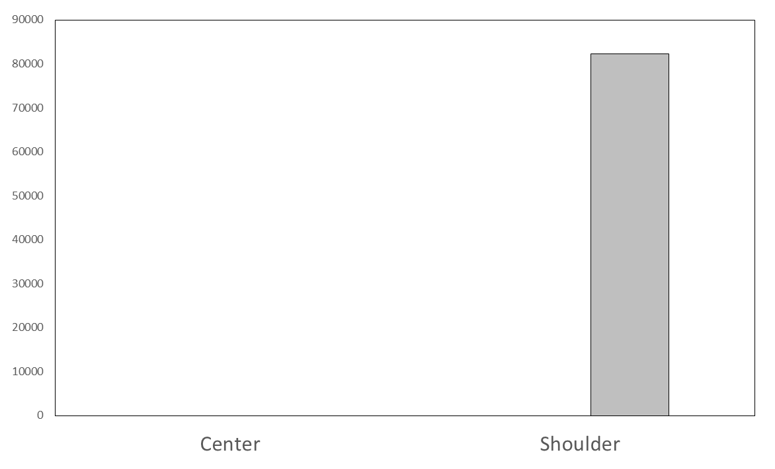
two shallow (2.5”) +
two deep (7”)
FUSARIUM survivorship
Four drip tapes:
6” depth
12” depth
Spores per gram of soil
Not detectable
Location in bed

Slide 14
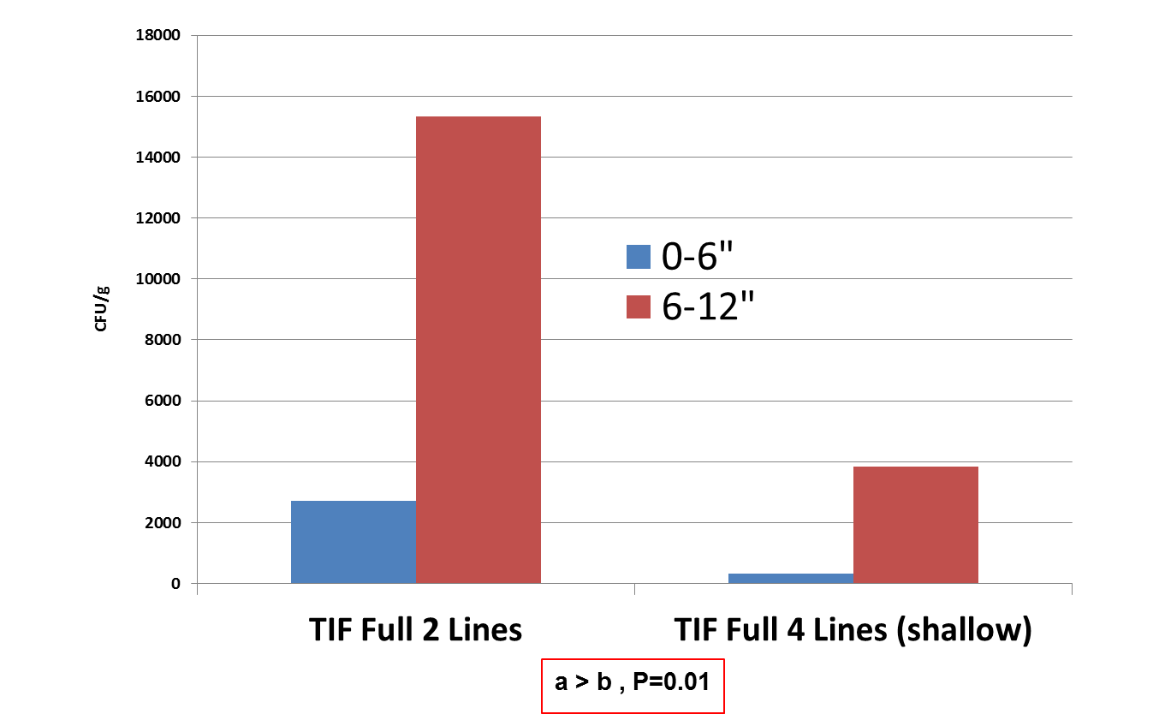
Fusarium in sand inoculum
a
b

Slide 15
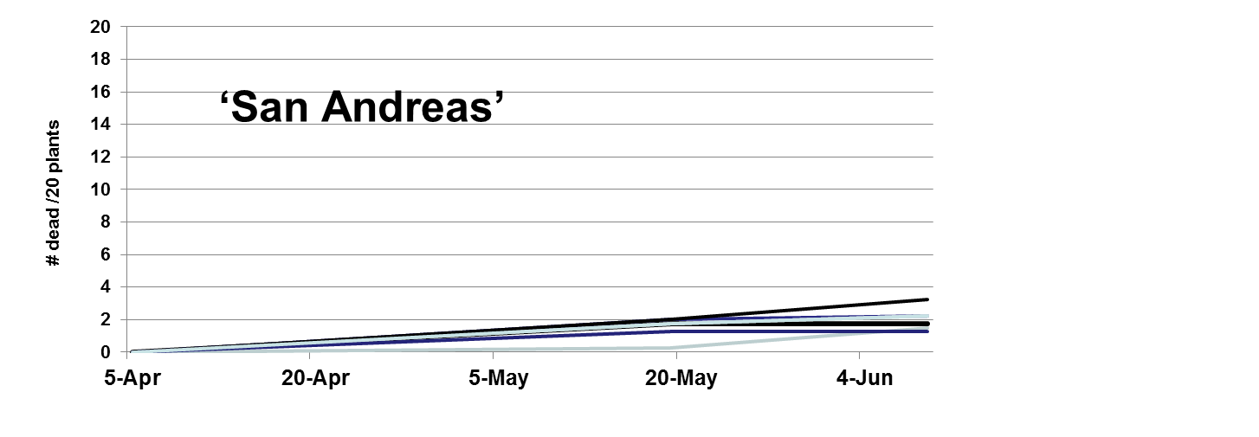
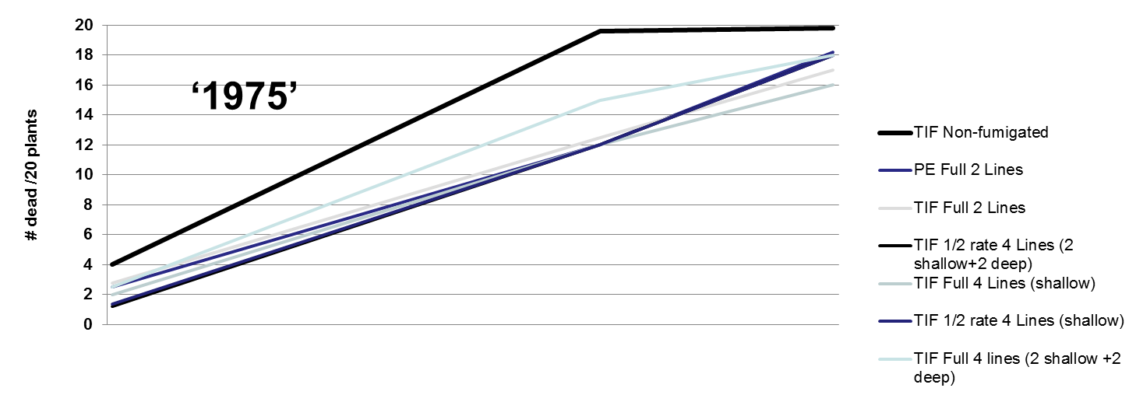
Plant mortality (due to Fusarium)
100%
100%

Slide 16
What else can we do?
Removal or destruction of infested crowns
Precision fumigation/or other management based on need
Using low-cost MITC generators as only pre-plant fumigants
Getting new varieties with genetic resistance/tolerance

Slide 17
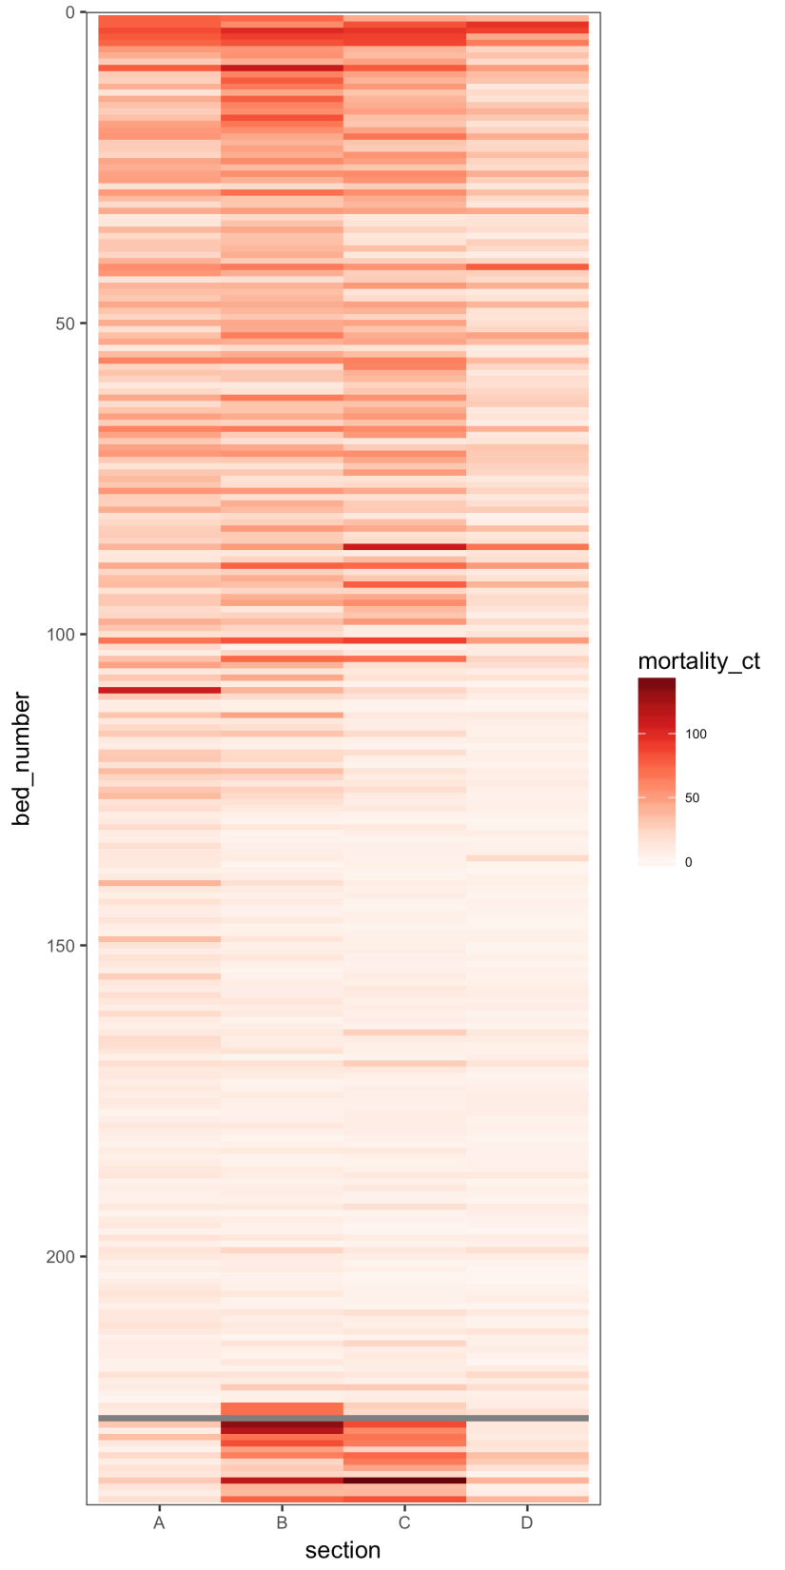
P
S
S
P
P
S
P
350
350
P
P
350 S
Mortality and rates
350
S = Standard
P = Precision
300
300
250
250
Rate Zones
300
High
Medium
250
Low

Slide 18
Plant early vigor after flat Pic
NO SIGNIFICANT DIFFERENCES AMONG RATES (P=0.21)

Slide 19
Jan, 2018 Marketable fruit #: no differences among rates

Slide 20
Can we sustain production
with less expensive, bed-applied MITC generators?
Vapam single application of 58 gal/A,
Vapam (58) fb Vapam (36) split application and
Vapam (36) after flat Pic (300) application

Slide 21
Plant early vigor

Slide 22
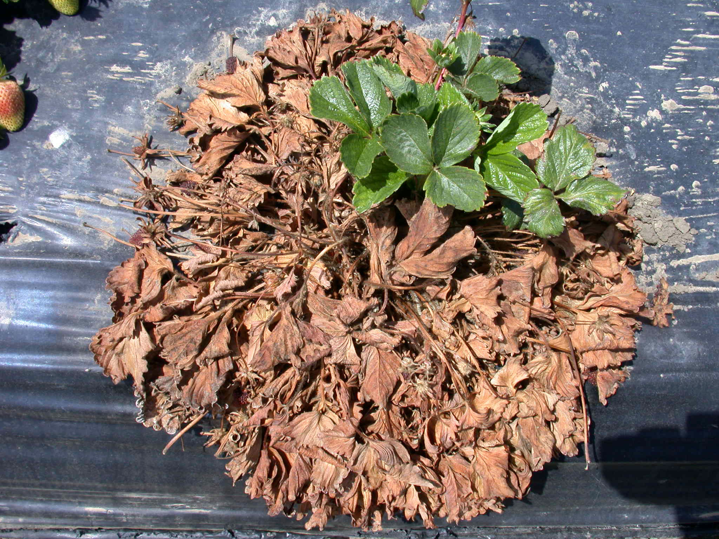
What about Fusarium and Macrophomina?

Slide 23
Inoculum buried before Vapam treatments
Drip lines
6 in
x
x
12 in
x
x

Slide 24
CFU, g/sand
Lab stored untreated sand = 500,000+CFU/g
between tapes
at 12” depth

Slide 25
Fusarium survivorship in crowns after Vapam:
no treatment effect
Drip lines
6 in
11%
43%
12 in
56%
50%
Fusarium in untreated lab soil: 2/6 (33%)

Slide 26
Macrophomina survivorship in crowns after Vapam:
no treatment or location effect
Drip lines
6 in
23%
50%
12 in
27%
26%
Macrophomina in untreated lab soil: 6/6 (100% )

Slide 27
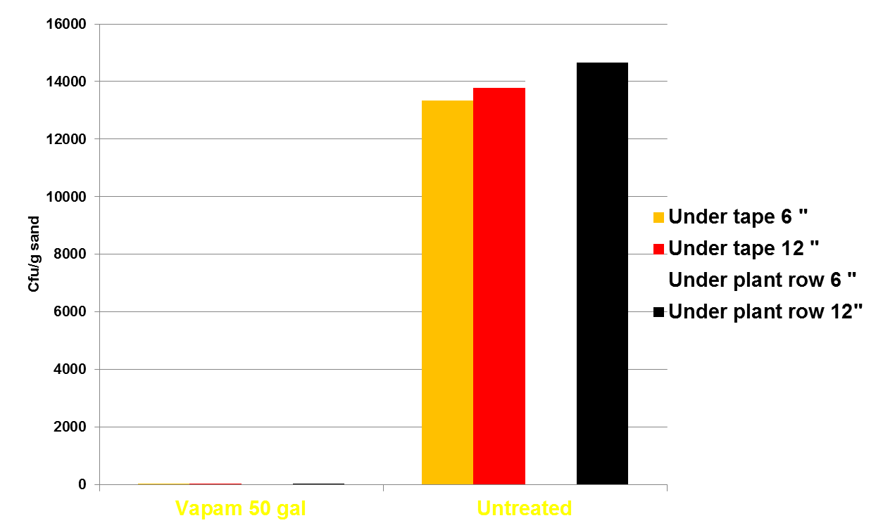
F. oxysporum in sand inoculum after end-season fumigation
*
VAPAM 50 GAl
Unterated

Slide 28
ORGANIC
PRODUCTION

Slide 29
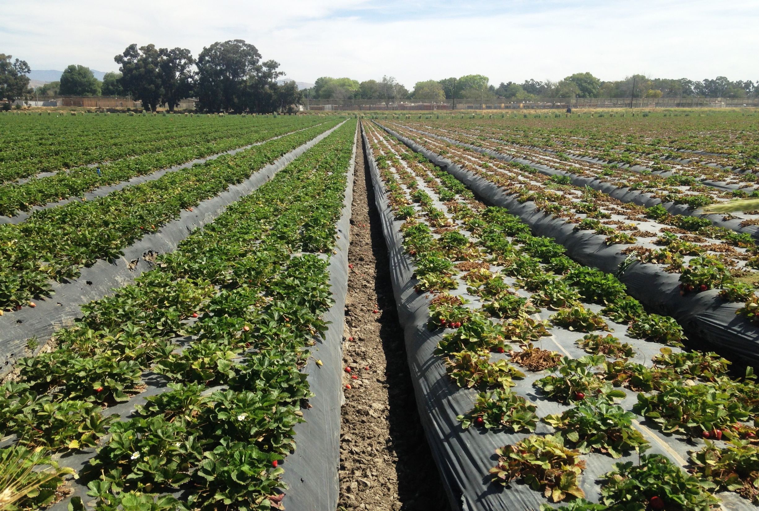
organic field with M. phaseolina: Sabrina vs Ventana

Slide 30
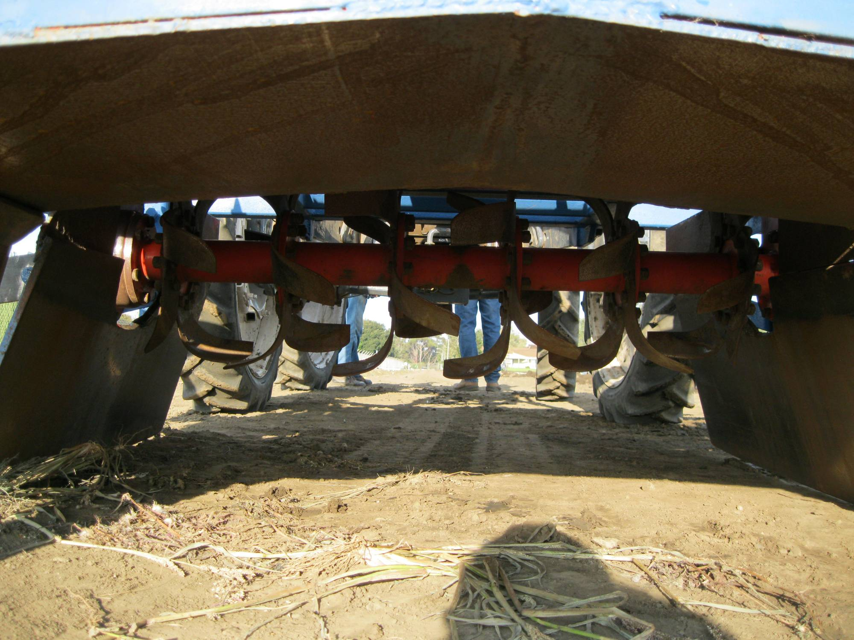

ASD = Carbon source + water + plastic
With RICE BRAN ~$2,800-3,000/A

Slide 31
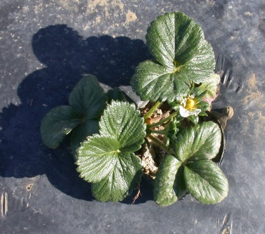
Adding rice bran to soil for ASD
Anaerobiosis
Available Nitrogen
Organic acids
Infiltration and salt leaching
pH reduction
Available Phosphorus
Micronutrient availability
Microbial population shifts
Interaction with pathogenic organisms?
Short vs long term?
Other C-sources and soil environments?

Slide 32
For C-source:
Rice bran
Glycerin
Grape pomace
Molasses
Coffee grounds
Grass clippings
Spent grain
And other
Favorable C/N
Easy to apply
Cheap or Free and Available
Min.Transportation
Works consistently

Slide 33
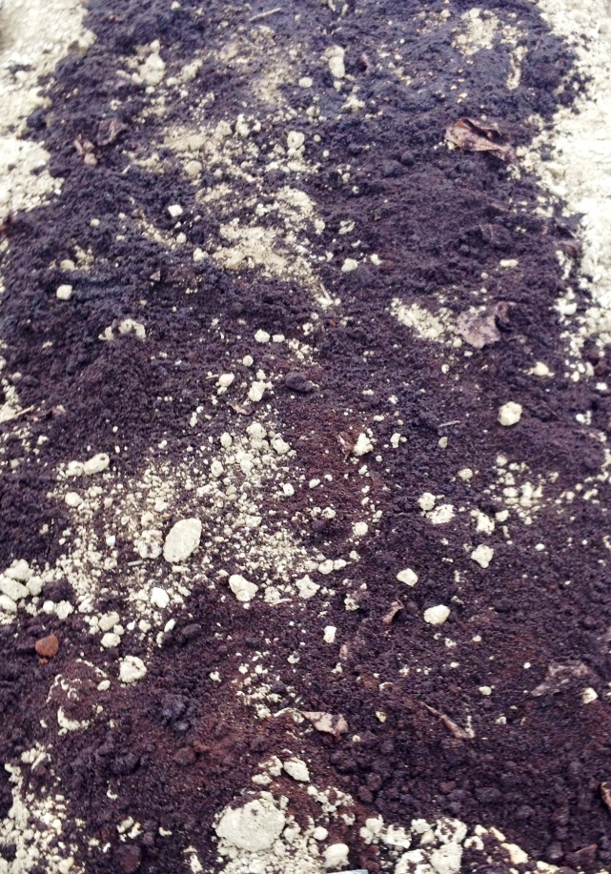
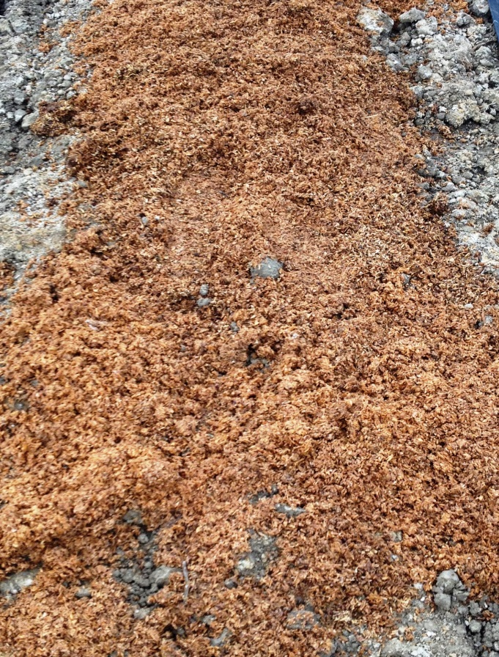
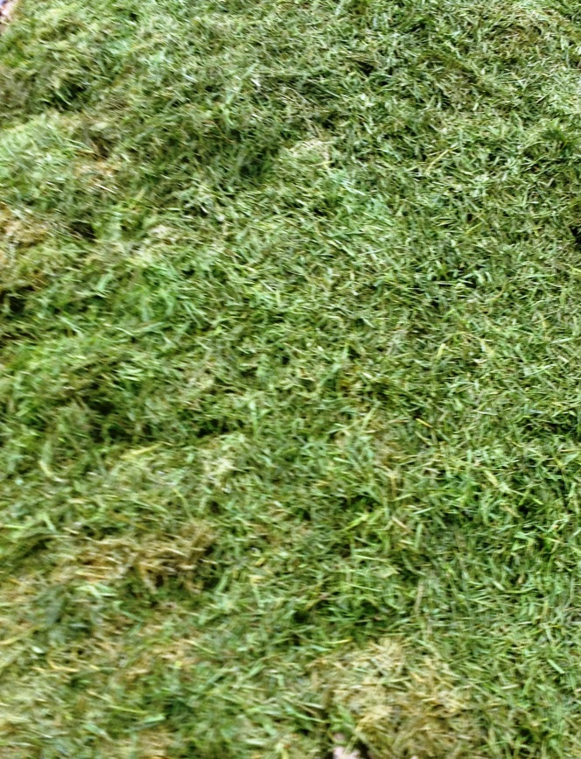
ASD C-sources:
favorable C/N ratio, local, available, cheap
Coffee grounds
Spent grain
Grass clippings

Slide 34
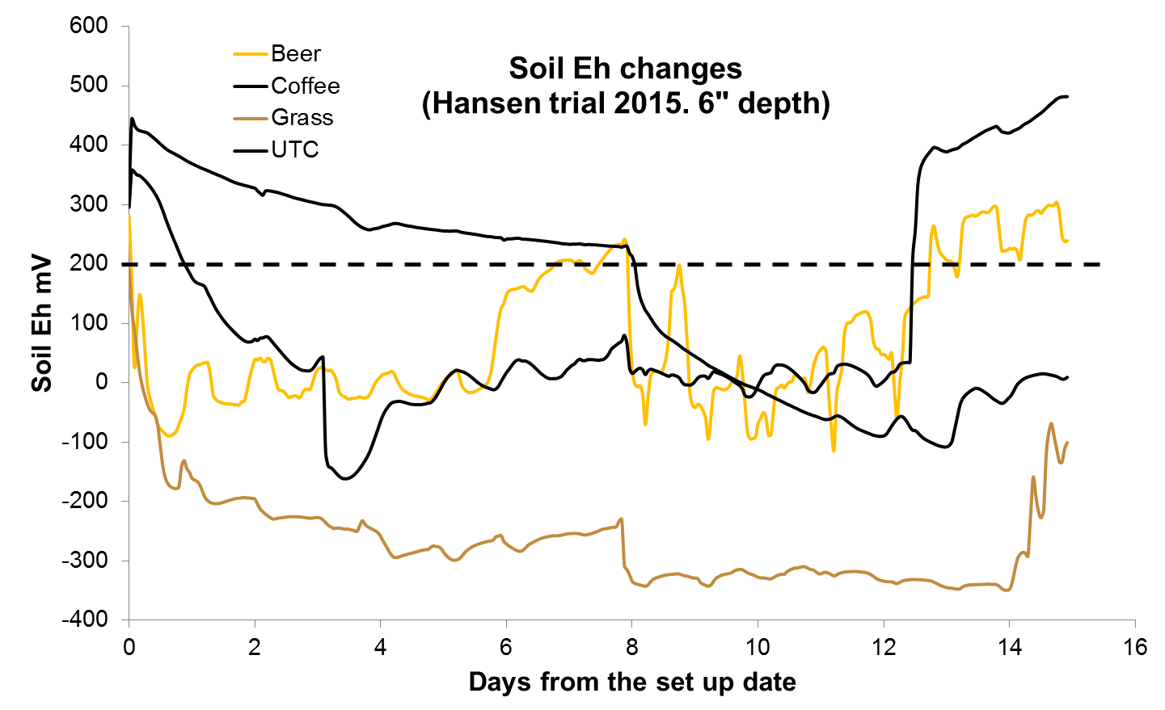
Anaerobic conditions in clay loam soil
(9 t dry weight /acre)

Slide 35
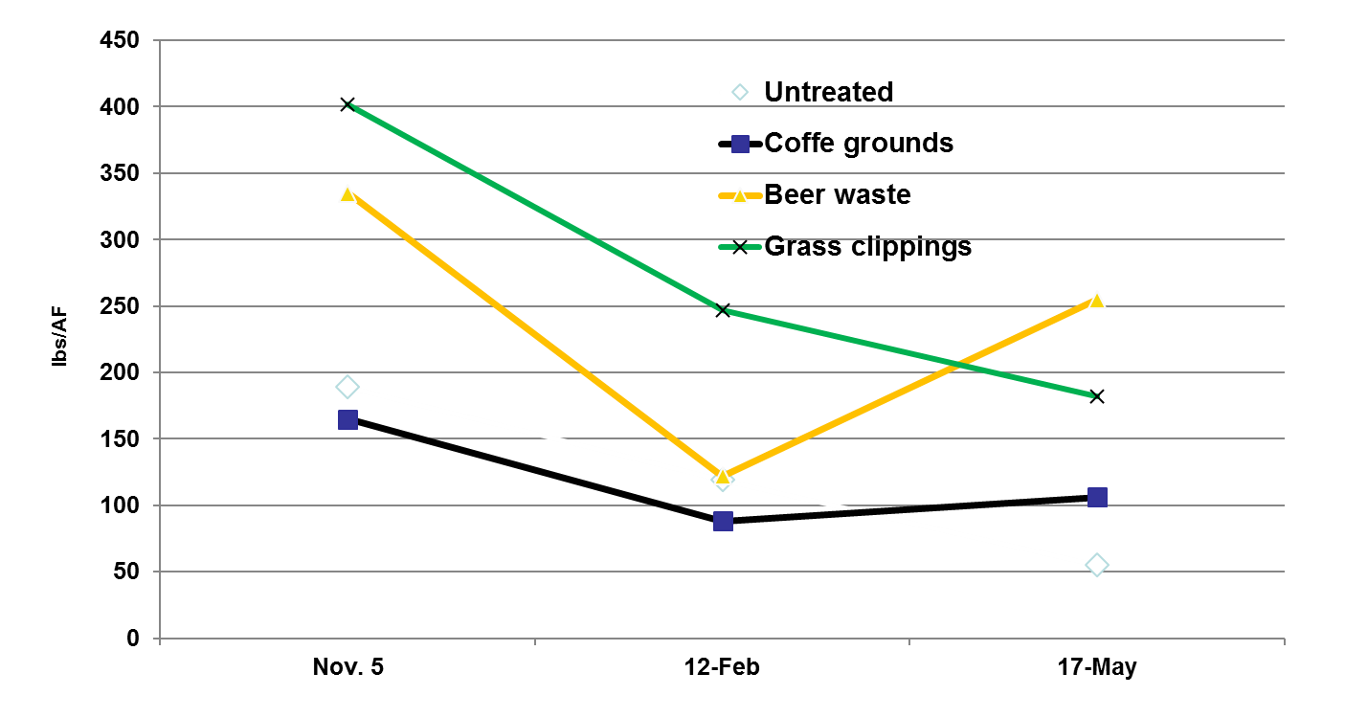
2015-16:
NO₃-N at 0 -12”
Untreated check beds received 500 lbs/A of 18-6-8 pre-plant

Slide 36
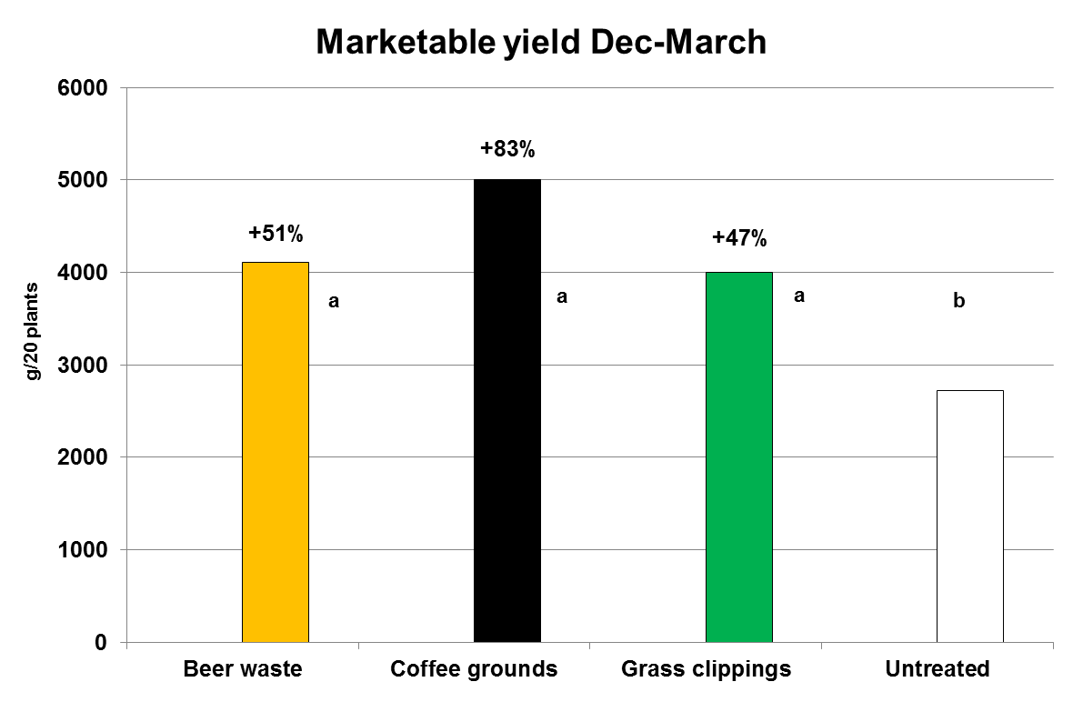
2015-16

Slide 37
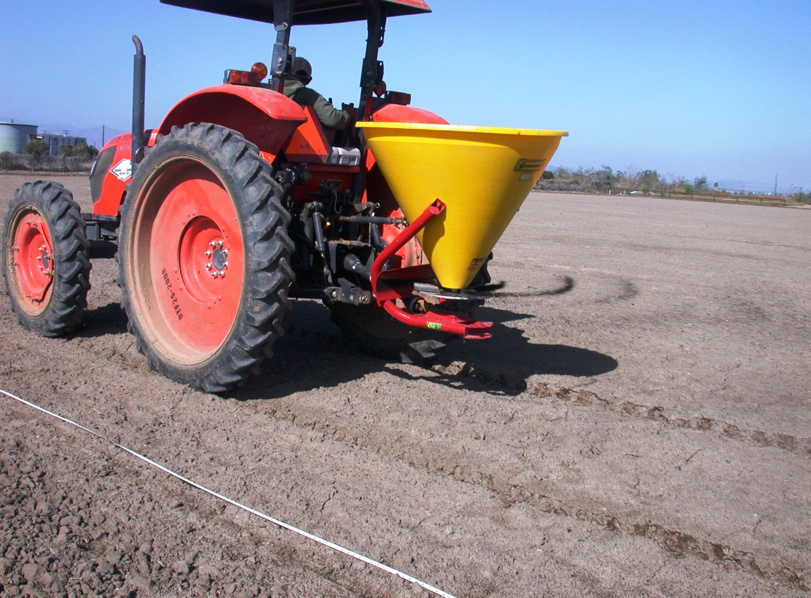
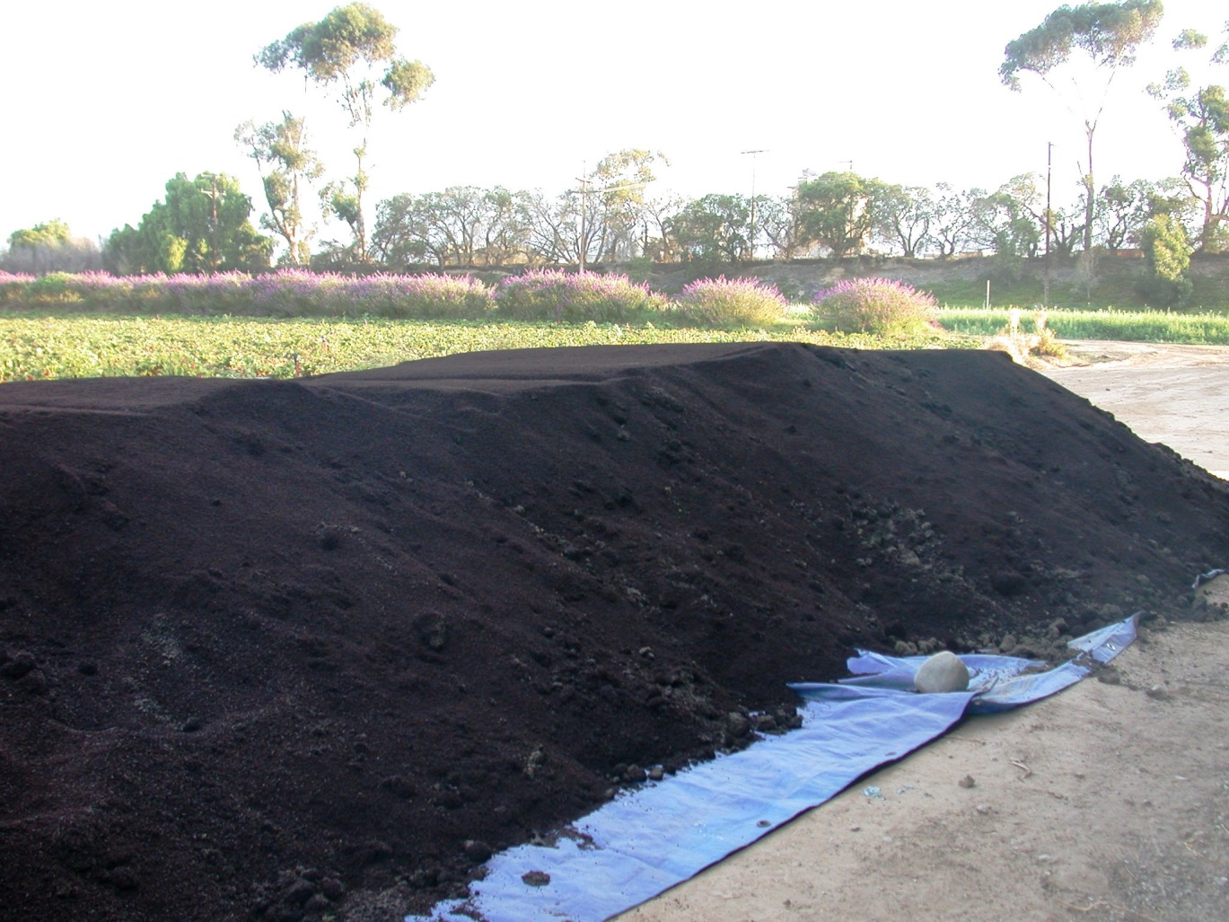
2016-17
Roasting facility
for Starbucks
= coffee grounds
< 15 miles from
application sites
Free + free delivery
15-20 cu yards
available weekly
Can be stored at field site
Easy to apply

Slide 38
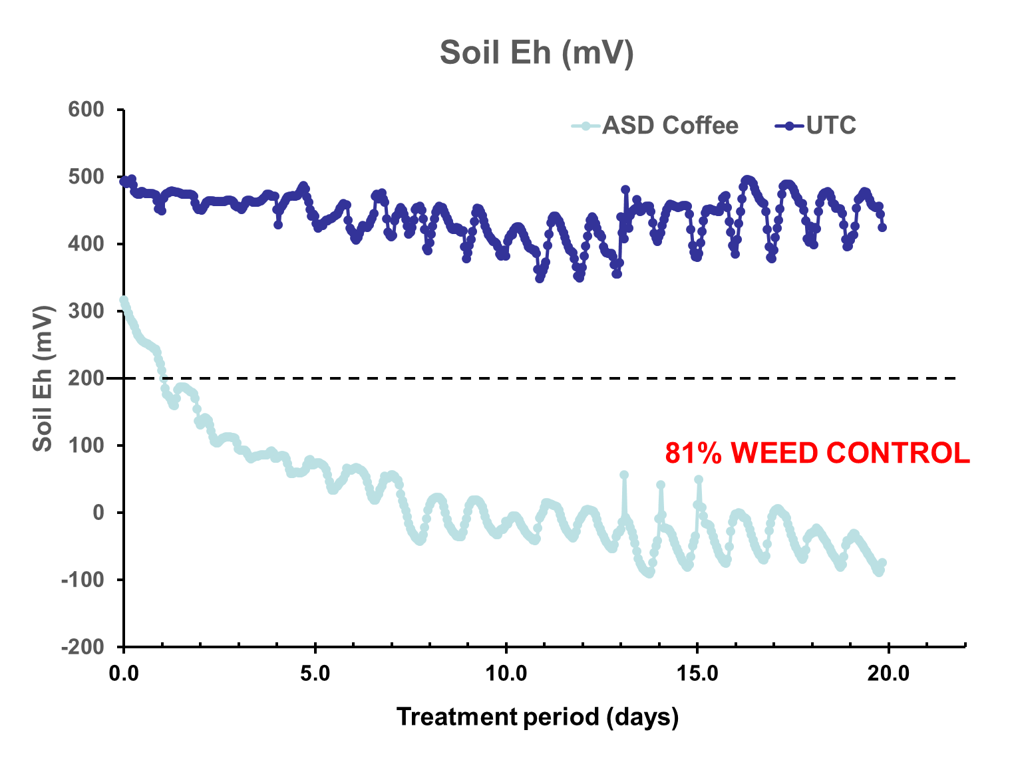
ANAEROBIC CONDITIONS

Slide 39
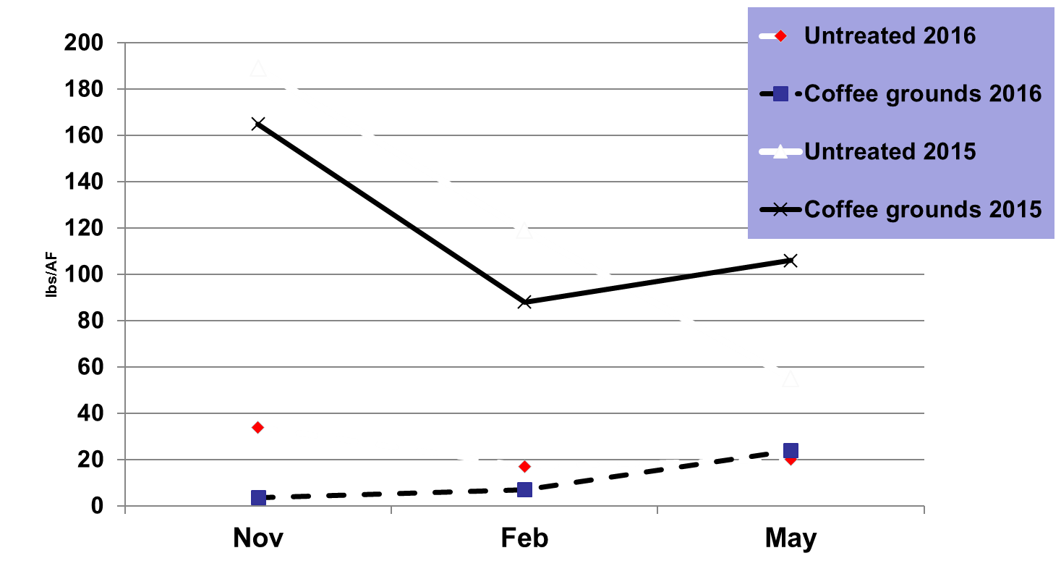
NO₃-N at 0 -12”
2015-16
2016-17
Untreated check beds in 2015 received 500 lbs/A of 18-6-8 pre-plant

Slide 40
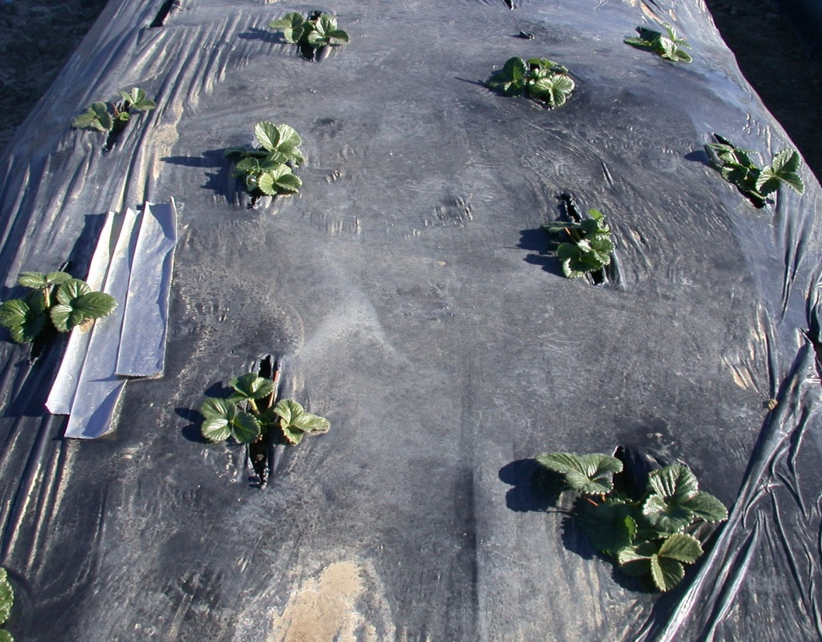
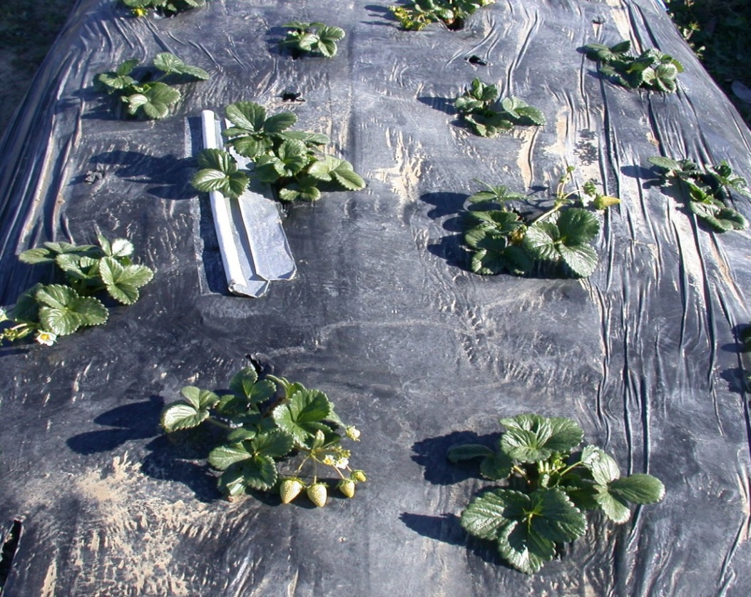
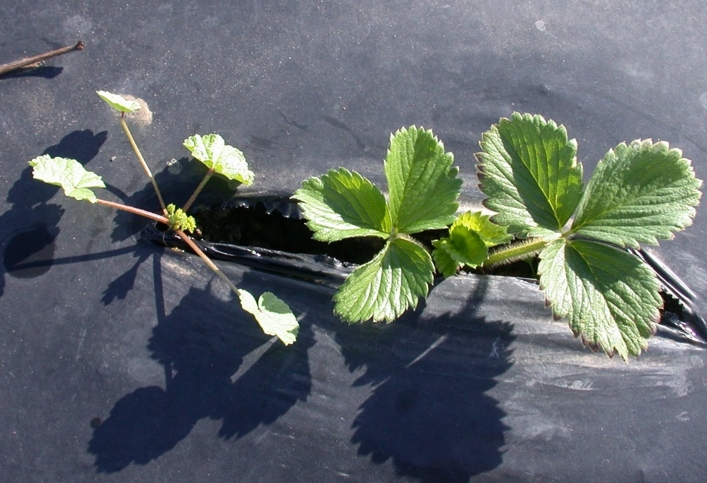
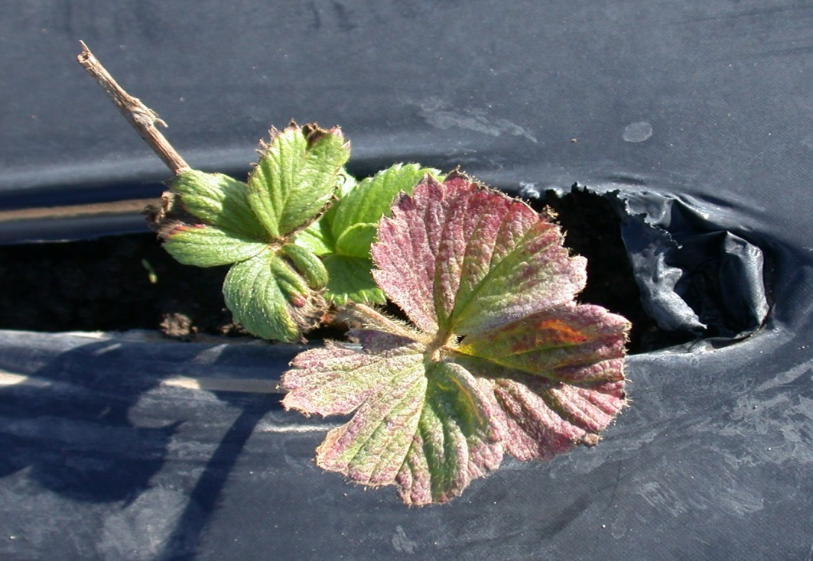
Nov 13, 2015
Untreated
Coffee grounds
Nov 13, 2016

Slide 41
Coffee grounds (as applied)
 | Peet’s | Starbucks
Total N, % | 2.4 | 0.9
Total C, % | 54.1 | 22
C:N ratio | 22:1 | 24:1
Total P₂O₅ , % | 0.1 | 0.1
Total K₂0, % | 0.26 | 0.23
EC, dS/m | 3.5 | 3.1
pH | 6.1 | 5.6
Ash % | 2.5 | 8.4
Moisture% | 63 | 24

Slide 42
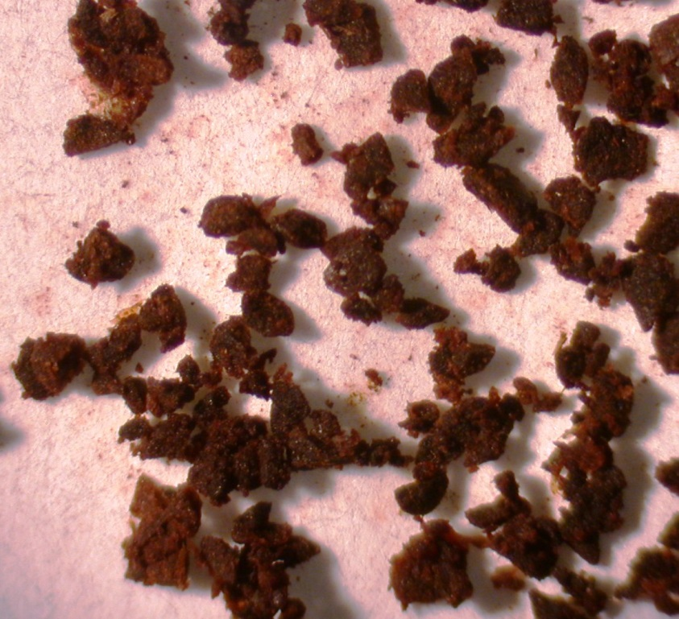
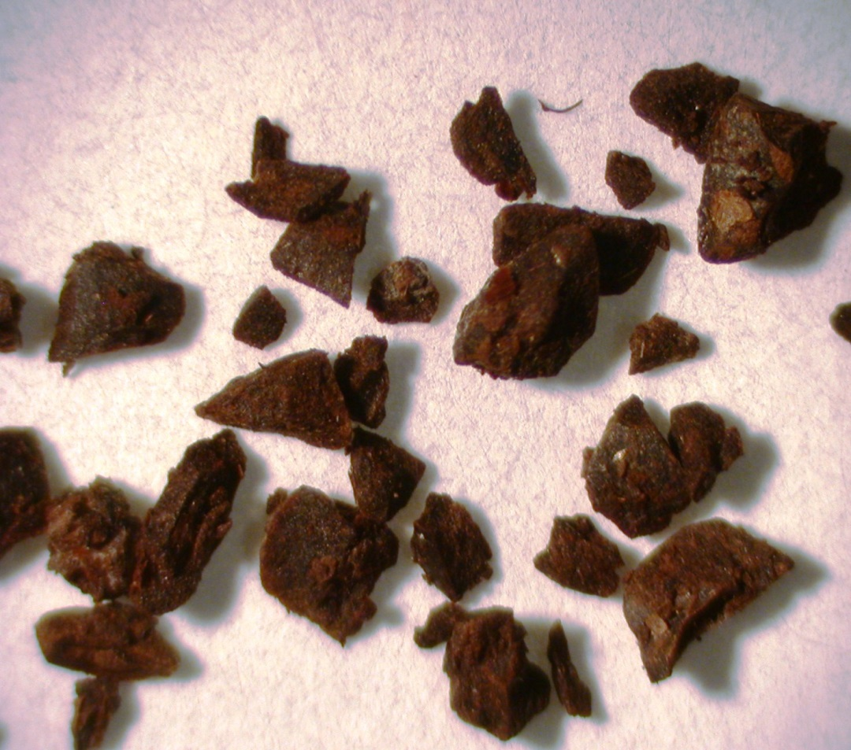
Pete’s
Starbucks

Slide 43
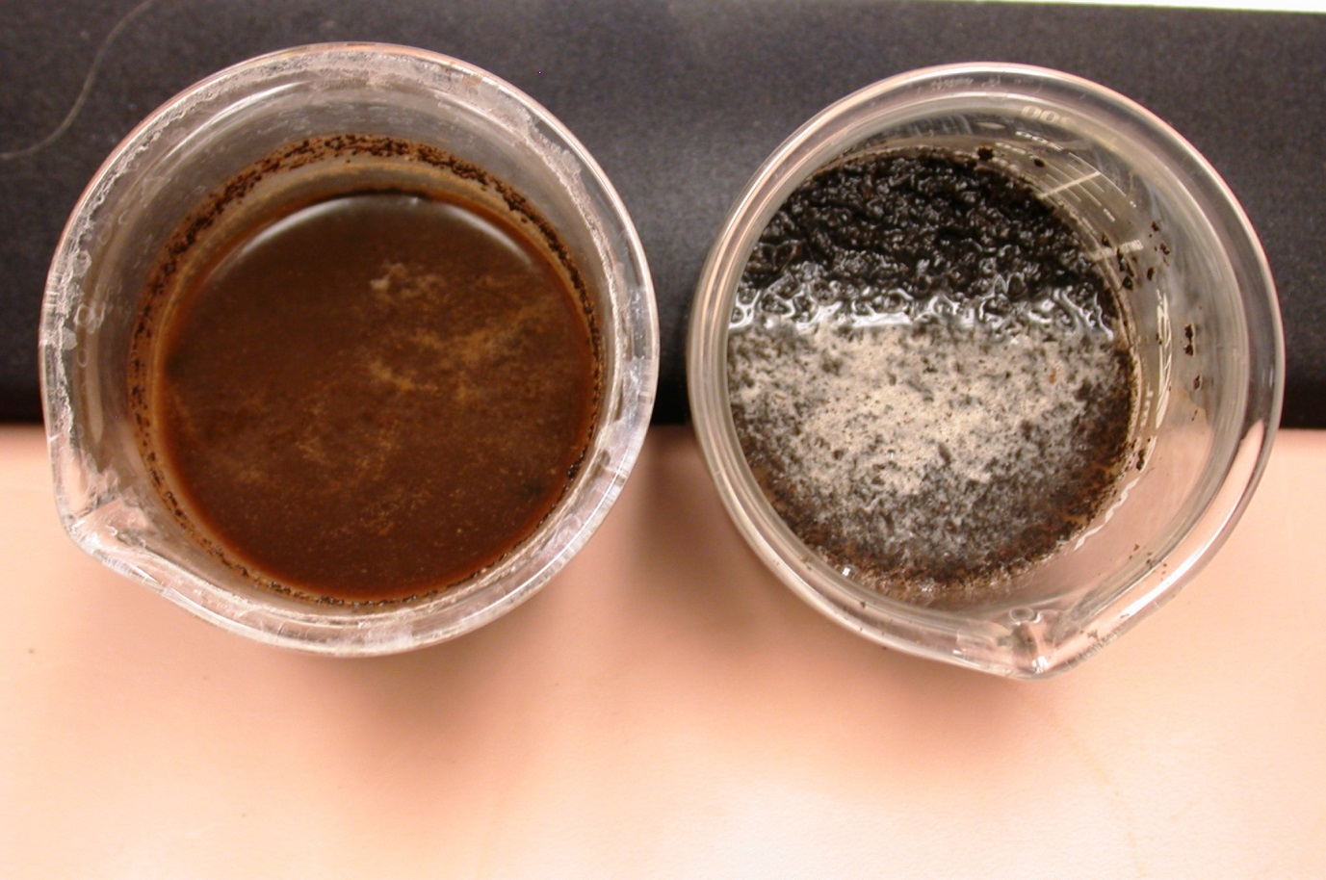
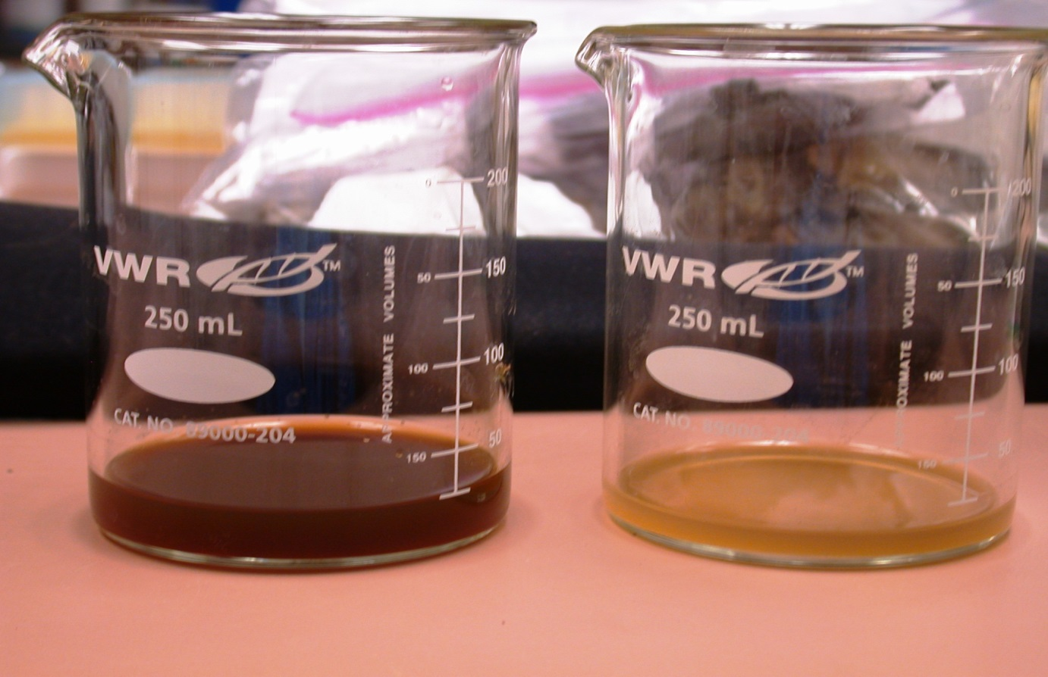
Pete’s
Starbucks
60% less

Slide 44
ASD-COFFEE
In spring plants started to grow more rapidly and were not different than untreated plants (too late for fresh market)
At another location Coffee-ASD plots had 52% fewer dead plants with M. phaseolina in May 2017.

Slide 45

Acknowledgements
Matt Conroy and Dave Murray (Andrew and Williamson fresh produce)
Hector Gutierrez (Otillo Farms)
Henry Ito (Ito Bros.)
Will Doyle with DW Berry Farms
Tom Gordon's lab (UCD)
Cal strawberry commission
CDFA SCBG
and CDPR Funding

