Slide 1
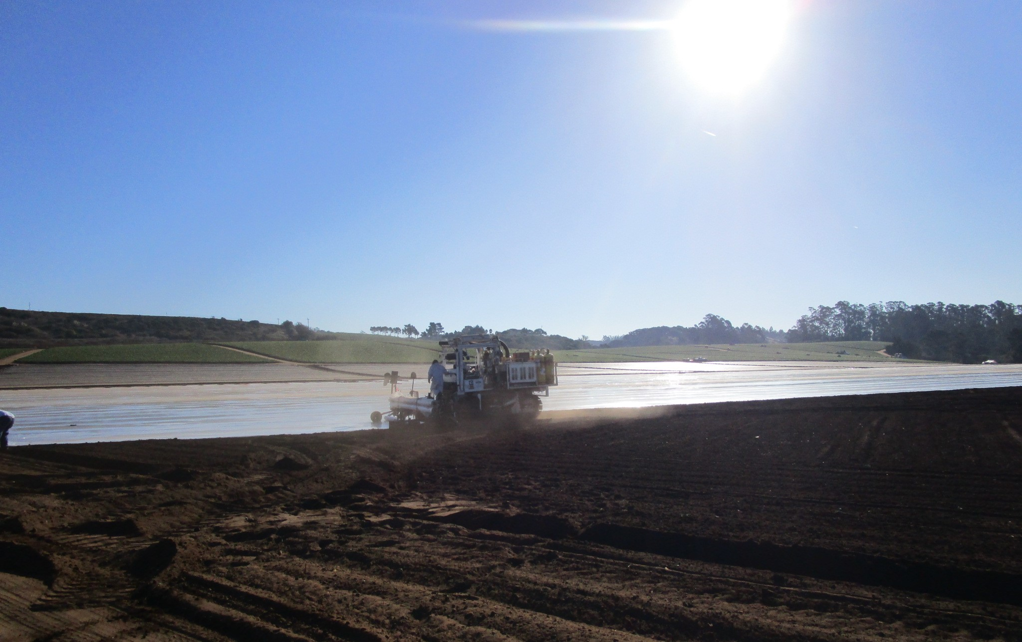
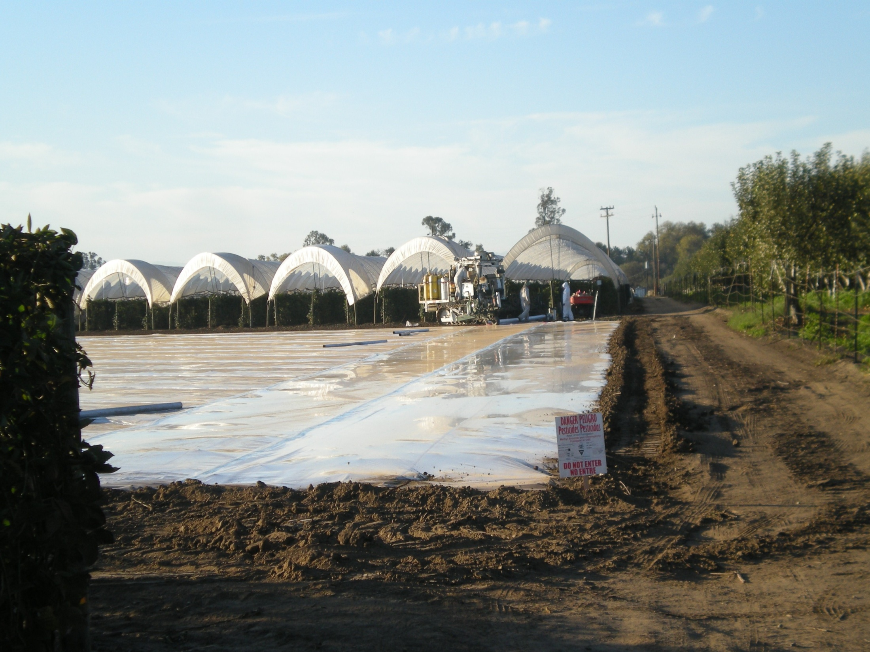
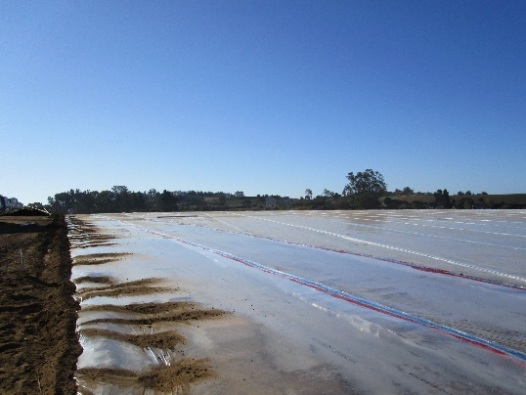

Field Fumigation & Regulatory Update
2019 UCCE Annual Strawberry Meeting
Santa Cruz County Agricultural Commissioner’s Office
175 Westridge Drive Watsonville, CA 95076
(831)763-8080
www.agdept.com

Slide 2
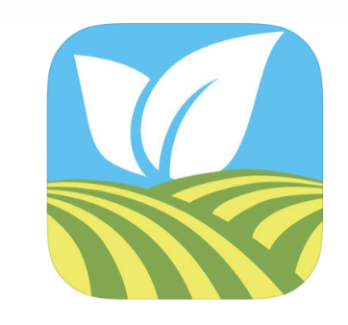
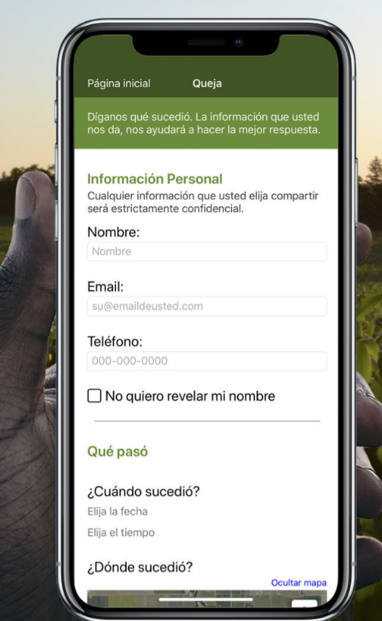
CASPIR
California’s System for Pesticide Incident Reporting
New DPR developed app allows fieldworkers and the public to submit pesticide related incidents
Easy to use interface currently in English & Spanish
Available in Apple and Android Store
Soft launch: released at the end of January to allow testing by Agricultural Commissioner staff and others

Slide 3
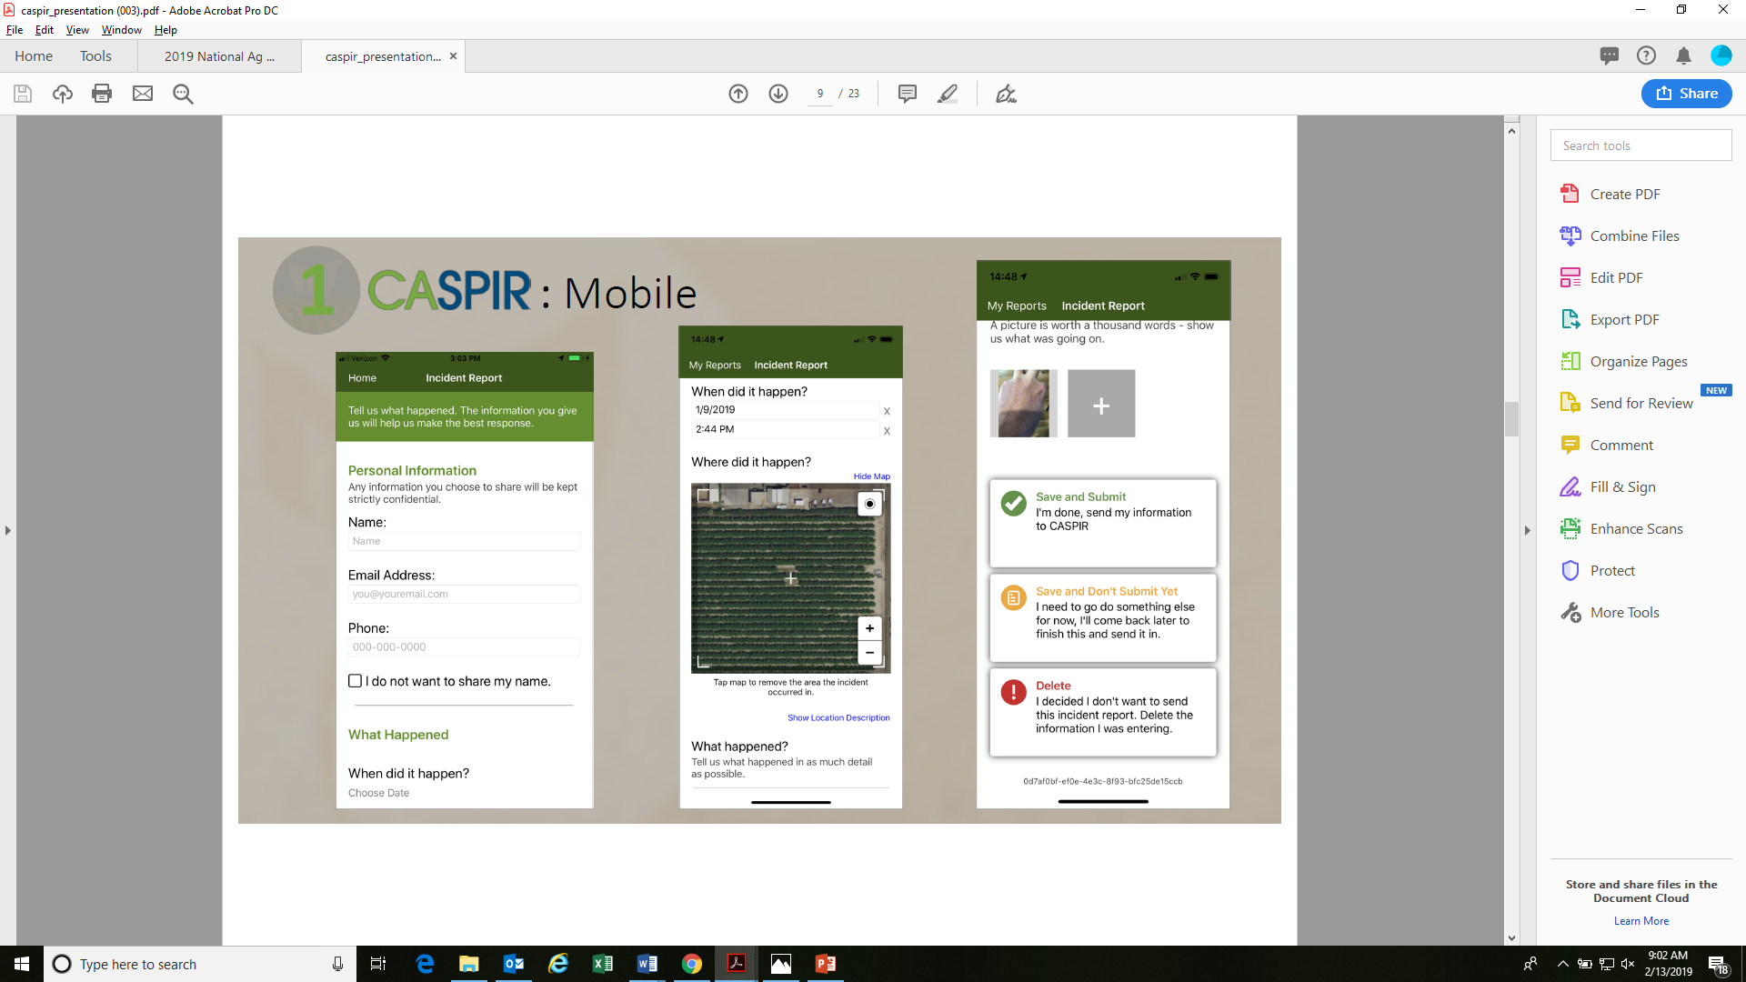
Anonymous option
Individuals can track their cases
GPS functions, Picture and Video
Immediately received by CAC for investigation

Slide 4
2018 Fumigation Season…
Fumigated acreage for pre-plant berries was down 25% from 2016 and 2017…
2,645 acres
2,027 acres

Slide 5
2018 Fumigation Season, continued…
640,466

Slide 6
2018 Fumigation Season, continued…
Chloropicrin rates per acre have increased since 2016… 1, 3-D rates per acre have decreased…
284
250
88
67

Slide 7
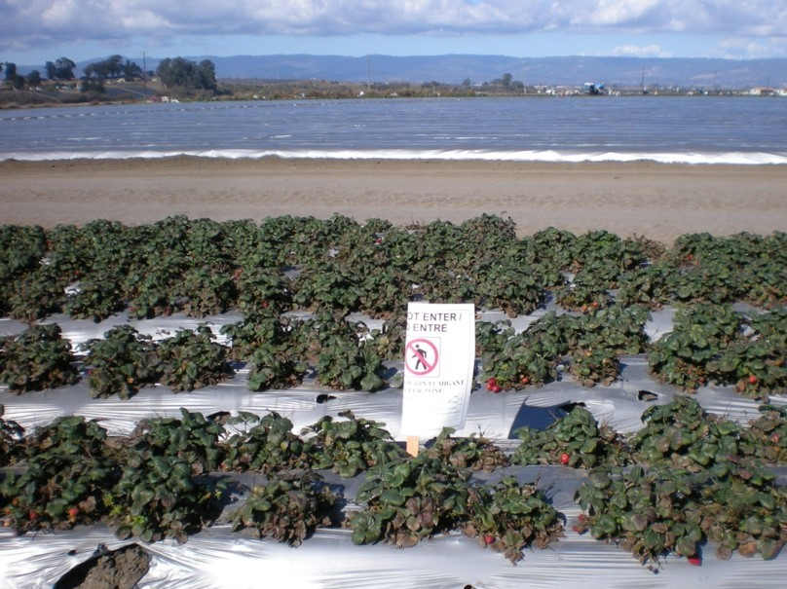
Areas in need of improvement:
Communication
Continue to improve communication about posted buffer zones with:
Fieldworker crews
PCAs
Neighbors
Ensure employees understand what buffer zone postings are and their purpose
Ensure your field supervisors know when a buffer zone has expired and when signs can be taken down to allow access to harvest areas

Slide 8
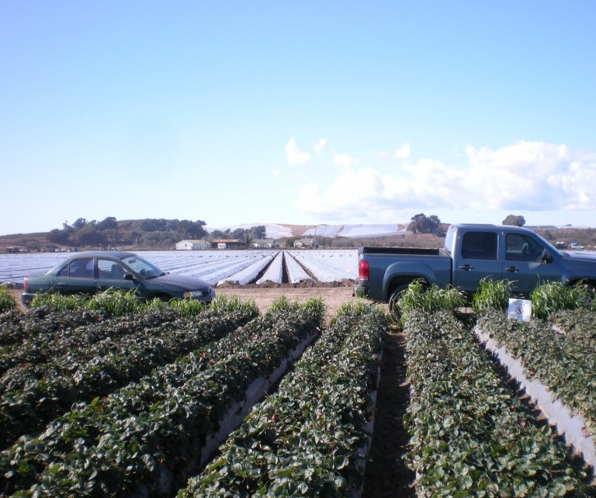
Areas in need of improvement:
Communication (continued)
Ensure adjacent operators receive notification at least 48 hours ahead that a buffer will be posted on their property
Ensure employees and other persons stay outside posted buffer areas
Remember that employees or other persons are not allowed to walk through buffer zones
Buffer zones CANNOT be used as parking areas

Slide 9
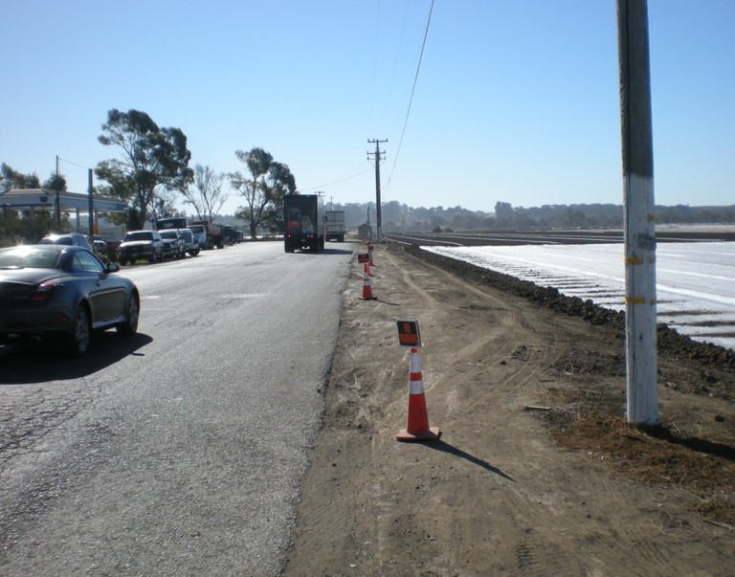
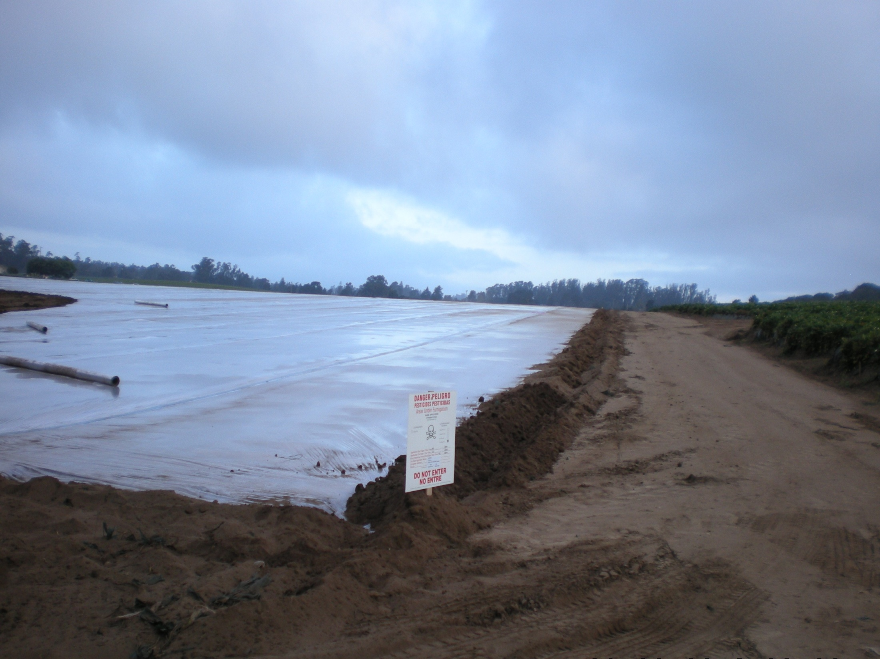
Areas in need of improvement:
Be Proactive
Anticipate potential problems and plan accordingly
Consider alternative solutions to challenges
Identify potential problems before they occur
If you believe there is a risk of exposure to fieldworkers or other people nearby ask them to leave the area

Slide 10
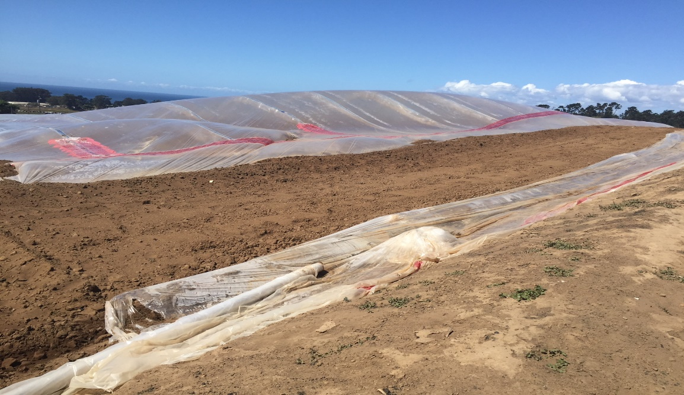
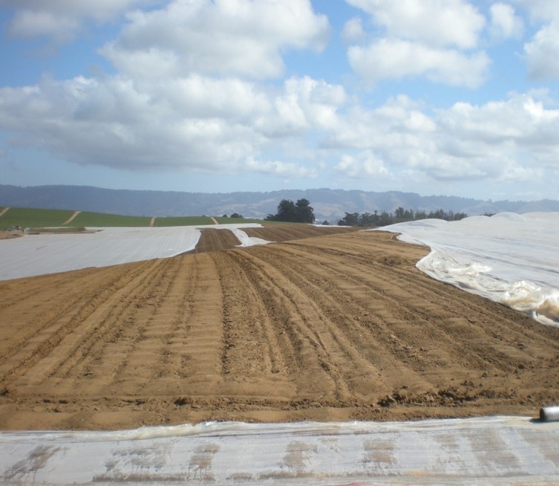
Areas in need of improvement:
Be Proactive (continued)
Check National Weather Service for current forecasts
Be aware of changing weather conditions
Monitor your fumigated fields for signs of problems
Ensure the safety of people nearby
Contact your PCA and Agricultural Commissioner’s office when a fumigated field has been compromised

Slide 11
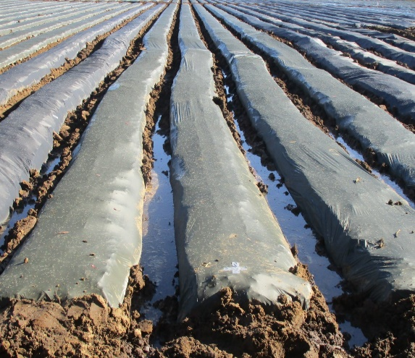
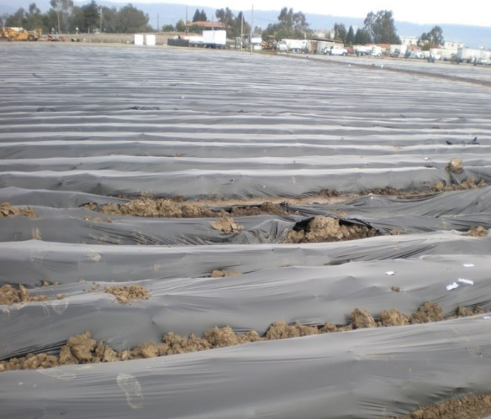
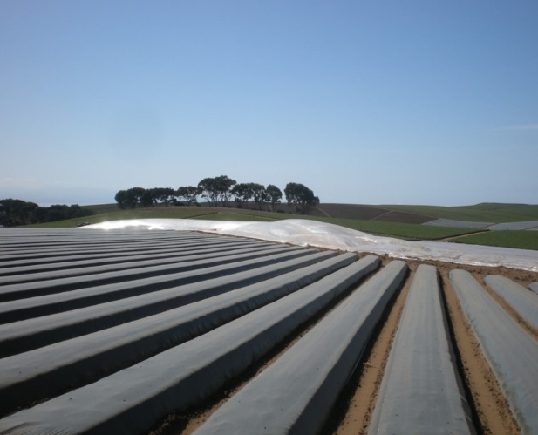
In-line (drip) fumigations…
Proper preparation of the planting beds and installation of the TIF tarp is important
Dirt clods, tarp tears and breaches, leaks, etc.
The CAC will shut down a fumigation job if the lack of proper bed preparation poses a risk of creating problems during the application

Slide 12
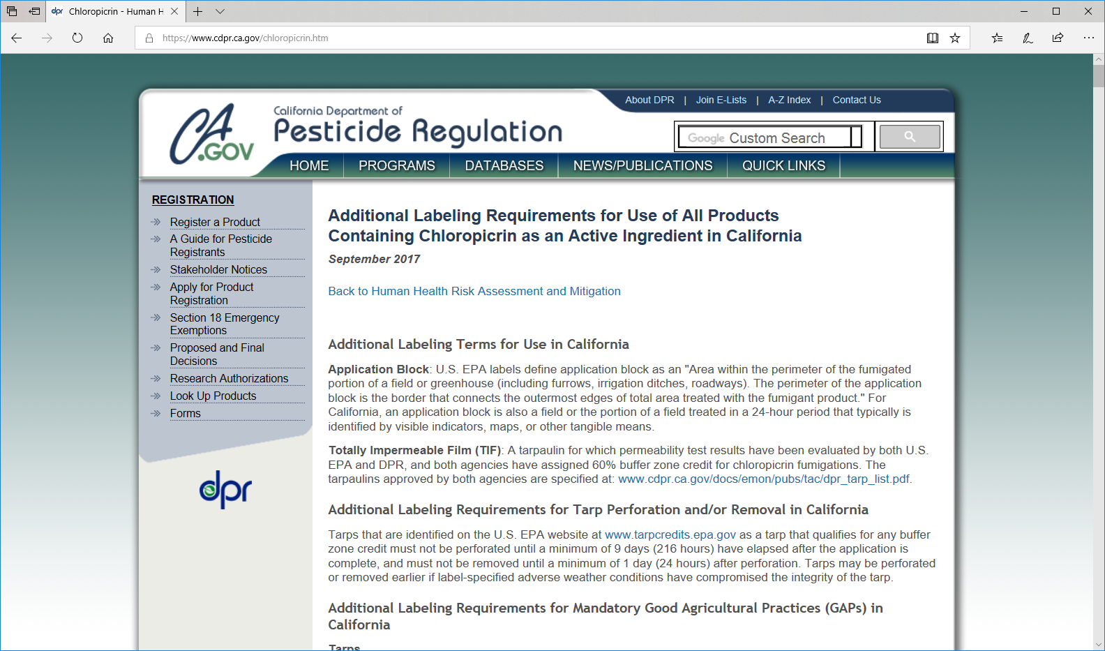
Chloropicrin – Additional Labeling Requirements

Slide 13
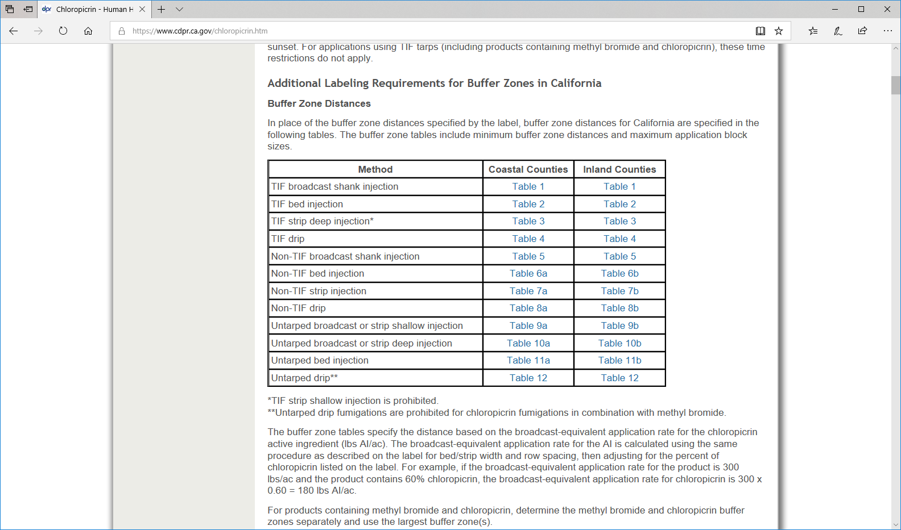
Chloropicrin – Additional Labeling Requirements (continued)

Slide 14
K-PAM HL – Fumigant crop termination on strawberries
Interest has been developing with some growers in the use of K-PAM HL (Potassium N-methyldithiocarbamate) to terminate strawberries at the end of the production season.
The goal is additional control of Fusarium oxysporum in the field (potentially reducing inoculum density).
Applications are made through the drip-system directly to the strawberry beds. (Despite the plastic remaining on the beds at the end of the season, these are un-tarped applications.)
Our office has developed some baseline conditions for this use of K-PAM in the county, but will evaluate any proposed applications on a site-by-site basis to determine safety, feasibility and specific conditions that may apply.

Slide 15
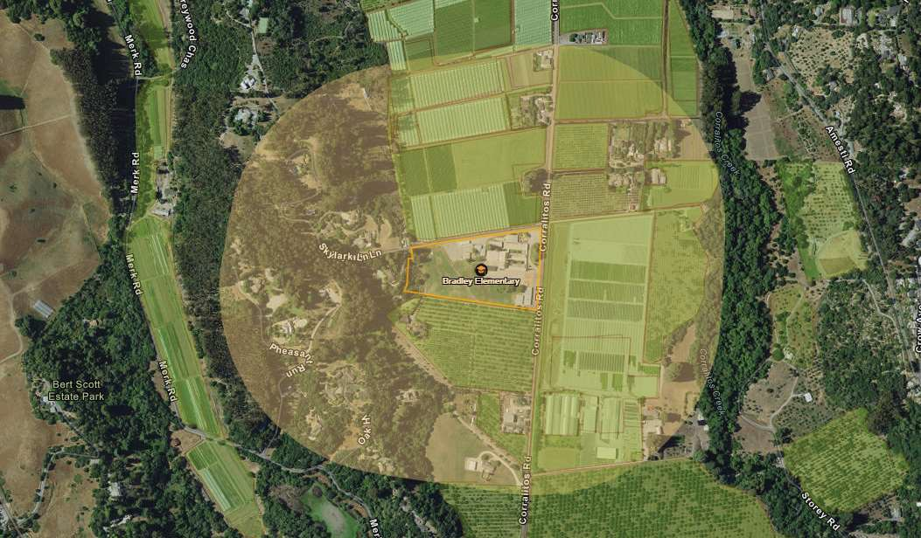
Pesticide Use Near
Schools - 3 CCR
§6690-6692
2018 was first year of implementation
For the Annual Notification requirement for growers within 1/4 mile of a school (§6692), statewide compliance was 93%
Heading into 2019…
No later than Apr 30, 2019: annual notifications must be submitted for July 2019 – June 2020 applications
Submit notification through your CalAgPermits account
Contact our office if you have questions

Slide 16
Updated Pesticide Safety Information Series (PSIS)
Available at our office or at
www.agdept.com or www.cdpr.ca.gov

Slide 17
Questions??
Thank you!
Santa Cruz County Ag Commissioner’s Office
175 Westridge Drive
Watsonville, CA 95076
(831) 763-8080
Mon-Fri, 8am-5pm
www.agdept.com

