Slide 1
UCPath and the
UC ANR UCCE
Presented by the BOC Kearney
February 2019

Slide 2

Goal of small-group meetings
Review information provided previously from other sources
Identify action items for all UC ANR employees
Provide opportunity to ask questions regarding your county’s specific issues
Ensure each county has toolkit to transition successfully into UCPath

Slide 3
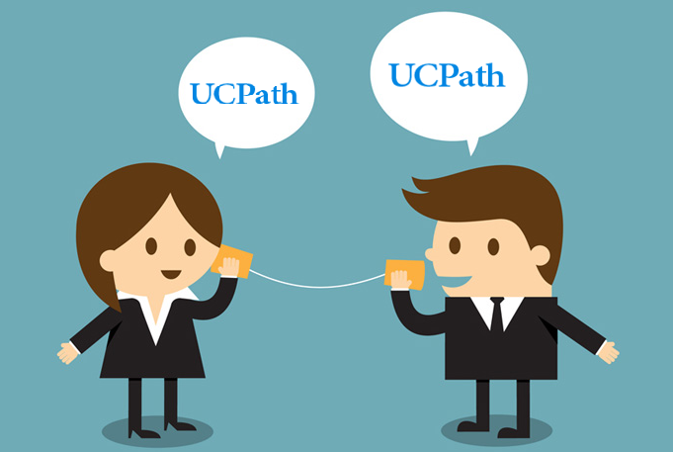
Communication is key
Town Hall – January 29 (Glenda, Tu, UC Path Project Team)
County Director Meetings
ANR UCPath Network - monthly meetings
UC ANR communications (ANR Update)
UC Davis communications
http://ucpath.ucanr.edu/
BOCK webinars with small groups

Slide 4
UCPath
University of California Systemwide HR/Payroll system
  220,000+ employees
  Campuses already live with UCPath – Merced, LA, Riverside, Santa Barbara, UCOP
  All campuses eventually included
    Deployment 1 – Davis, ANR, Berkeley (March)
    Remaining: Irvine, San Diego, UCSF, Santa Cruz, Lawrence Berkeley National Laboratory, UC Hastings

Slide 5

UCPath Benefits
  Unified management practices
  Aligns all UC campuses under one system
  One central team responsible for processing HR/Payroll transactions
  Consolidated data resources/reporting

Slide 6
UCPath Benefits
Employee self-service option
  Allows for change of personal information
  Improved and electronic access, 24/7
  Support team available at UCPath Center
  Promotes self-service and personal employee interaction

Slide 7

Schedules

Slide 8

UCPath Schedule
Go-live March 1, 2019
Current PPS appointments/distributions will be converted to UCPath
Use of PPS ends after MO and BW conversion periods
All new HR/salary actions will then be entered into UCPath
Accurate records now will make for a smoother transition later

Slide 9
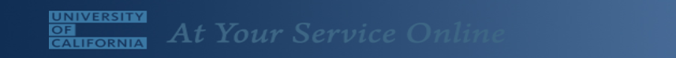
UCPath Schedule – Critical Dates
At Your Service Online (AYSO) will not be used to make changes after 3/1/19
CHANGES MUST BE MADE prior to 2/28/19
Will be read only 3/1/19 (tax forms / check stubs can still be seen here during March)
April 1 - changes will be made through UCPath Employee Portal

Slide 10
UCPath Schedule – Critical Dates
  UCPath conversion dates
    3/1 - 3/10 – Monthly (Snapshot 3/2)
    3/14 – 3/23 - Biweekly (Snapshot 3/16)
  PPS inactive after conversion
    Last day to enter MO transactions – 3/1
    Last day to enter BW transactions – 3/14
    Submit changes now to ensure timely entry

Slide 11
UCPath Schedule – Pay Dates
First UCPath generated pay
  Issued April 1 for employees paid monthly
  Issued April 3 for employees paid bi-weekly
Earnings statements available one day before payday at UCPath online.
There will be no changes to pay dates

Slide 12
Timing of Staffing Changes/Extensions
When entry begins into UCPath (after conversion period)
  Monthly – Effective dates > March 1
  Biweekly - Effective dates > March 14
Planning ahead is critical!
  New hires / resignations
  Salary actions
  Funding extensions/changes

Slide 13

What’s changing?

Slide 14
UC ANR Changes
Recognized as a UC “Business Unit”
  Has other positive implications in UCOP budget
Decreased reliance on UC Davis for payroll function
Increased reliance on UCPath for HR & payroll-related services
Will have its own Payroll Unit within BOCD

Slide 15
UCPath Central Team Changes
Processing of transactions previously processed at UC Davis
  Garnishments
  Worker’s compensation
  Unemployment insurance transactions
  Other select functions
Paychecks will be issued from UCPath Center
Direct resource for employees – Self Service
Support Team – Customer Service
AYSO replaced by UCPath Employee Portal

Slide 16
UC ANR HR Changes
Continues to be responsible for all HR functions
New position management process to document approval of all positions (with RPM)
Assuming responsibility for entry of UCPath transactions (e.g. new hires, pay changes, separations)

Slide 17

UC ANR HR Changes
New Forms to be introduced soon!
  Expanded content / designed to meet UC Path needs
  Will replace SPR and Payroll Data Change Requests
  Position-driven
  Potential for electronic routing and streamlining
  Samples, details and instructions closer to go-live

Slide 18
UC ANR HR Changes
Staff recruitment process
  CATS being replaced by TAM (Talent Acquisition Management System) in April 2019
  Tools and training will be available for hiring managers
ePerformance System
  Expected to be implemented in Spring 2020 for Staff Performance Appraisals

Slide 19
BOC Payroll Unit Changes
  Payroll function for Advisors and staff already consolidated and transitioned to the BOCD
  Financial control approval of positions as proposed by hiring manager will route through BOC (similar to SPR now)
  Review of pay reports for accuracy
  BOCD’s new Payroll Team
    Payroll Manager Anne Scott , new analyst position, 2 payroll processors Veronica Geiger and Will Moua
    Serve as ANR Central Payroll team, assuming functions previously performed by UC Davis Payroll

Slide 20
BOCK Account Management Changes
Salary Expense Transfers (SETs) replaced by “Direct Retro” actions
  Submit all SETs by 4/30/19
  For pay periods after March 1, Direct Retros will be required
PPS to become ‘read only’ after UCPath go-live
Review of staff appointments critical
BOCK is currently reviewing all business processes
New reports being designed by UCPath teams
  Payroll reports will no longer available in FIS DS (e.g. 339)

Slide 21
BOCK as your UCCE Fiscal Officer
In UC ANR Admin and SW programs
  Business Managers are Account Managers (fiscal officers)
  Access to all systems
  Monitor staffing levels and budgets
UCCE has unique structure - BOCK is your Business Manager/Fiscal Officer and is responsible for
  KFS/Decision Support transaction entry
  Review of documents submitted by PIs/CDs
  Internal controls
  UC policy compliance

Slide 22
BOCK as your UCCE Fiscal Officer
Documentation still originates in UCCE
Continues to be routed through BOCK
Structure is no different than before
Adaptations being made to new processes in UCPath
Awareness of uniqueness important

Slide 23
UCCE Office Responsibilities
New Hires – plan ahead
  Employees cannot start working prior to ANR HR & UCPath Center’s completion of documentation process
  Allow 3-5 days minimum – submit documentation early
  Early start of employees working prior to record being in UCPath will result in being out-of-compliance with policy – requires financial damage payments!
Notify BOC of terminations/resignations promptly to avoid overpayments

Slide 24
UCCE Office Responsibilities
Timesheet Review
  Length of time to review/approve in time reporting system shortened
  Submission by BW employee and approval by supervisor critical - no submission/approval, no pay!
  Monthly employees will continue receiving pay until appointment end date or termination date entered – be aware that termination documentation is critical
  Extensions
  Project through 5/31/19 and submit documentation pre go-live if possible (target by 2/15/19)

Slide 25
What’s NOT changing
Time Reporting System (TRS) - upgrade may result in minor changes
Academic recruitment
Academic merit and promotion
AggieTravel
AggieBuy

Slide 26

What you can do to prepare

Slide 27

Employee Preparation Checklist
1
Enroll in Duo
Every employee is required to have multifactor authentication
To enroll in Duo, go to anrcs.ucanr.edu/isc/MFA.
Allows access to current Davis/ANR systems
Access to time cards will be denied unless employee enrolls
Uses smart phone, tablet or land line for MFA
Tokens available for purchase from AggieBuy
Contact help@ucanr.edu for IT assistance
DEADLINE FOR ENROLLMENT EXTENDED TO MARCH 31

Slide 28
Employee Preparation Checklist
2
Log into At Your Service Online (AYSO)
Verify and update your home address and personal information before Feb 28 at atyourserviceonline.ucop.edu.
Employee’s home address will be used to mail checks in UC Path (for those without direct deposit)
PO boxes cannot be used for mailing checks
Employees to provide home address rather than UCCE County Office address
Make changes prior to 2/28 in preparation for conversion snapshot
AYSO will be read-only after March and replaced
with UCPath Employee Portal

Slide 29
Employee Preparation Checklist
3
Sign up for direct deposit if you are currently receiving a paper paycheck at directdeposit.ucdavis.edu.
If you already have direct deposit for your UC paycheck, it will continue in UCPath.
Options if employee does not wish to use direct deposit
Non-represented employees – direct pay card
Represented employees – Home address other than PO box or UCCE Office
Urged to enroll in direct deposit as soon as possible – the sooner the better!

Slide 30
Employee Preparation Checklist
4
SSO (Single Sign On)
New login system that will make it easier to access any web system (Portal, Zoom, Project Board, UCPath tools)
Being implemented in phases (UCCE still to come)
Only requires simple reset of password
More information to follow

Slide 31
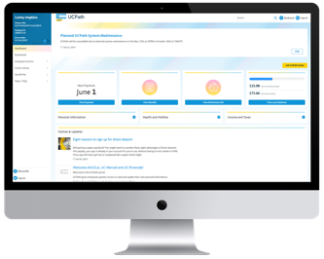

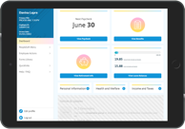
What else employees can do to prepare
View the UCPath Employee and Manager Self-Service demonstration videos.
Employee Self-Service video available
  in Spanish

Slide 32

Stabilization

Slide 33

Stabilization period
UC ANR support available
ANR is committed to ensuring your UCPath Center issues are resolved
Temporary ANR UC Path Support Center (est. 4-6 weeks)

Slide 34
Stabilization period
ANR’s team will work in conjunction with UCPath Center
Staffed by UC ANR SMEs
Will be active until transition period stabilized

Slide 35

Thank you for…
Completing the four items on Employee Checklist
Preparing your employees/supervisors to submit/review timesheets timely
Communicating to those in your units
Project your staffing needs through 5/31
  Submit to BOCK no later than 2/15
Reviewing future communications
Demonstrating patience and understanding

Slide 36

Additional Resources

Slide 37
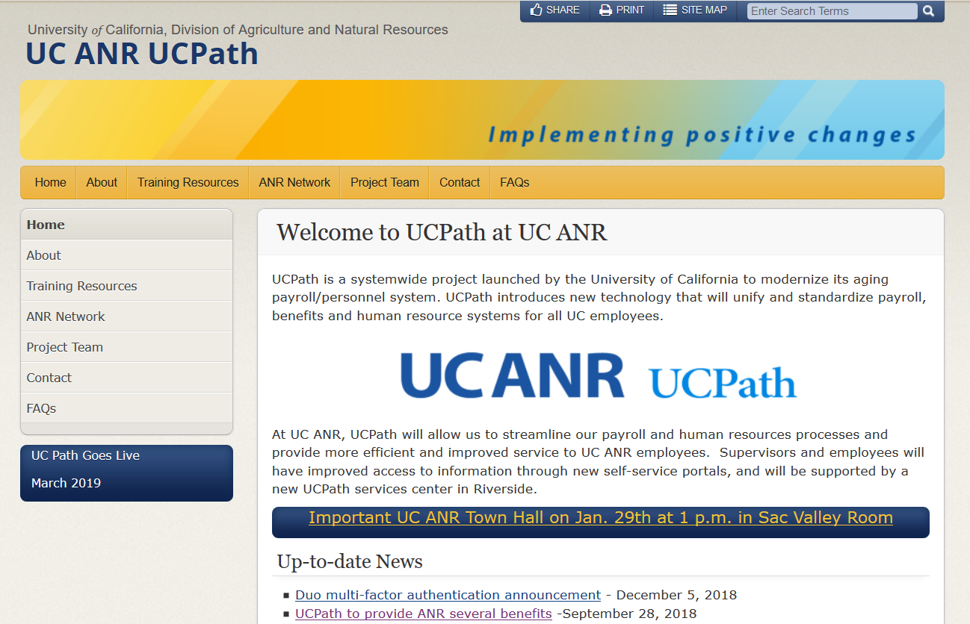
Website: ucpath.ucanr.edu

Slide 38
Other Web Resources / Sites
UCPath website: http://ucpath.ucanr.edu
Changing personal info: Atyourserviceonline.ucop.edu
Direct deposit: directdeposit@ucdavis.edu
Duo: anrcs.ucanr.edu/isc/MFA
Duo token: https://AggieBuy.ucdavis.edu
Single Sign on (SSO): anrcs.ucanr.edu/isc/SSO/

Slide 39

Questions? UCPath@ucanr.edu

