Slide 1
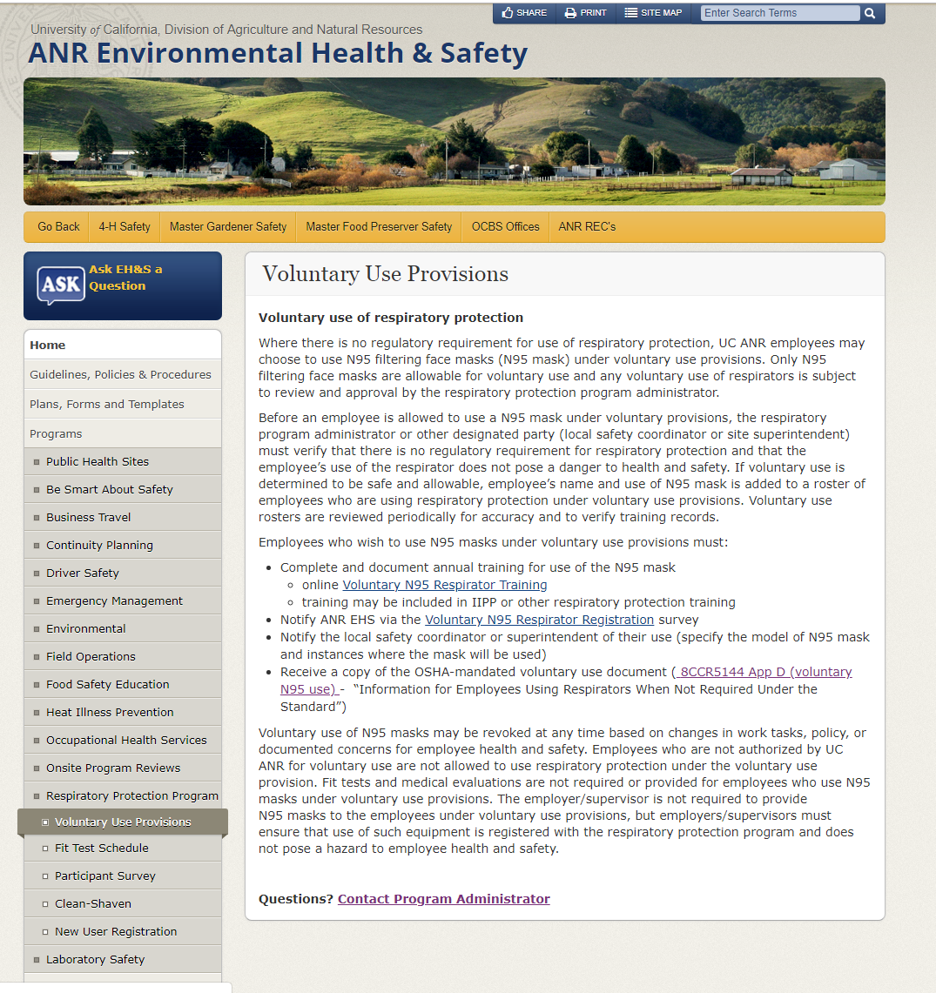
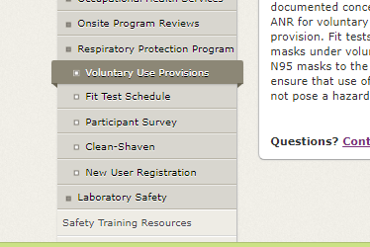
Voluntary N-95 Respirator Use
New training resources and
user registration online!
http://safety.ucanr.edu/Programs/Respiratory_Protection_Program/Voluntary_Use_Provisions/

Slide 2
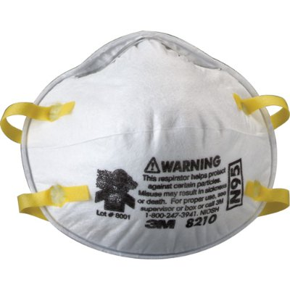
Voluntary N-95 Respirator Use
“Filtering Face Piece” Respirators
  Disposable mask with filter integral to mask (N95)
  Restricts air intake and breathing
  Protection from particulates if properly fitted
  Becomes a respiratory hazard if not used properly
  Does not supply air or provide protection from gases, vapors, high risk exposures, or IDLH atmospheres
  Designed for one-time use only
  How do I know whether I am using a respirator or not?

Slide 3
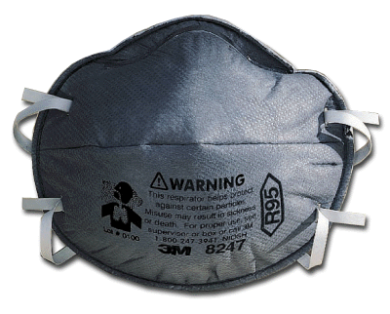
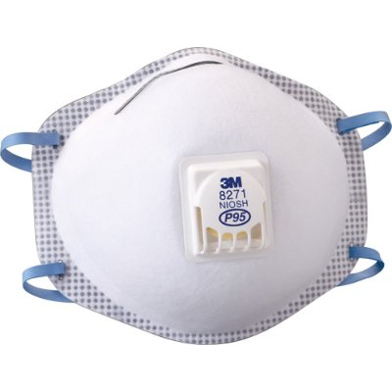
Voluntary N-95 Respirator Use
There are many types of Filtering Face Piece Respirators
What do those numbers and letters mean?
N for Not resistant to oil,
R for Resistant to oil
P for oil Proof
N100 – 99.97% efficiency
N99 – 99% efficiency
N95 – 95% efficiency
An exhalation valve can help prevent accumulation of hazardous air inside a poorly fitted respirator

Slide 4
Voluntary use is allowable when protection from hazardous airborne contaminants is not required under any regulation or policy
Voluntary N-95 Respirator Use
Examples of contaminants* that fall under voluntary use provisions:
Wildfire smoke pollution
Pollen and allergens
Chemicals that do not require use of a respirator
Nuisance dust and agricultural dusts below OSHA exposure limits
Nuisance odors
*Exposure assessment may be required.

Slide 5
Voluntary N-95 Respirator Use
UC ANR Requirements for Voluntary Use:
Complete and document annual training (training may be included in IIPP or other respiratory protection training)
Notify ANR EHS via the Voluntary N95 Respirator Registration survey
Notify the local safety coordinator or superintendent of their use (specify the model of N95 mask and instances where the mask will be used)
Receive a copy of the OSHA-mandated document (8CCR5144 App D)
http://safety.ucanr.edu/Programs/Respiratory_Protection_Program/Voluntary_Use_Provisions/

Slide 6
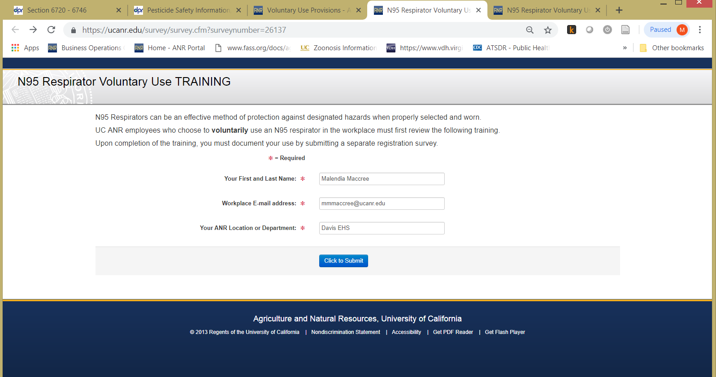
Provide Name and Email for Access to Training
Voluntary N-95 Respirator Use
http://ucanr.edu/voluntaryN95training

Slide 7
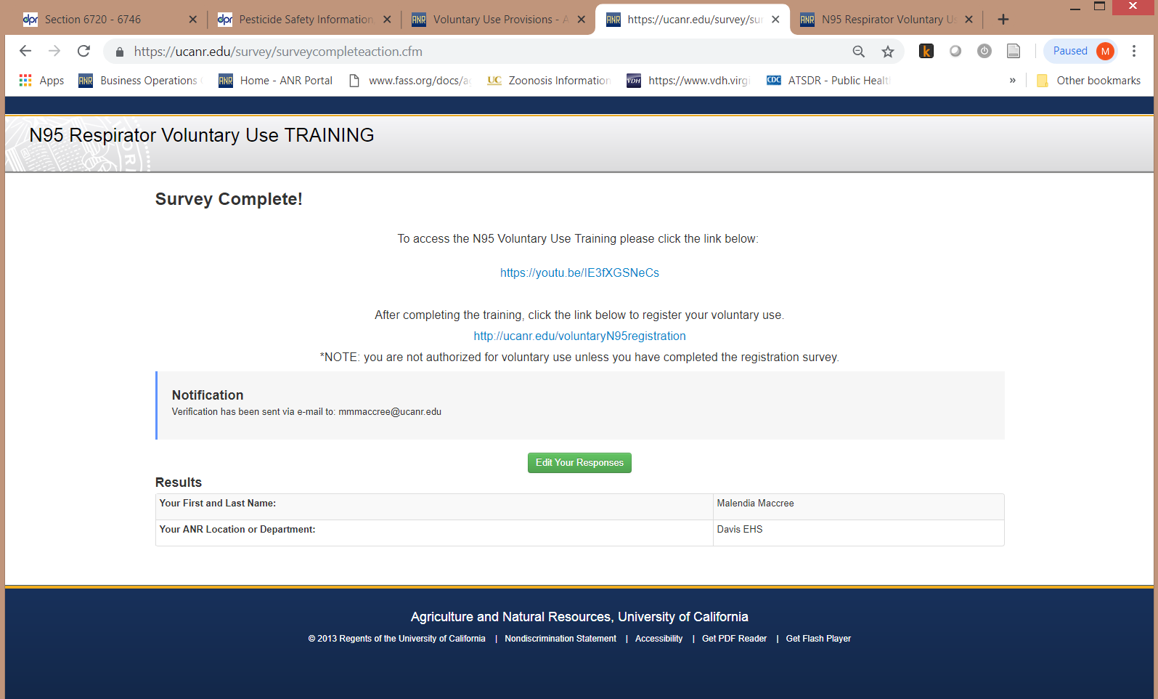
Obtain Link to Training Presentation
Voluntary N-95 Respirator Use
https://youtu.be/IE3fXGSNeCs

Slide 8
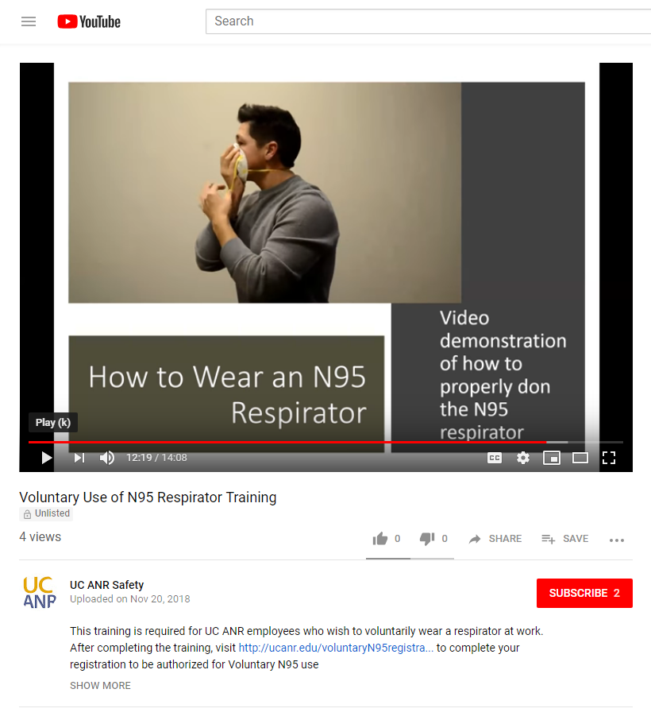
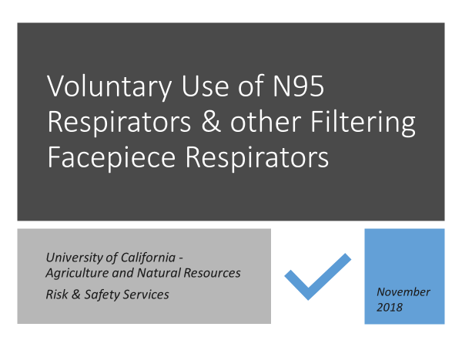
Watch Short Training Presentation on YouTube
Voluntary N-95 Respirator Use
https://youtu.be/IE3fXGSNeCs

Slide 9
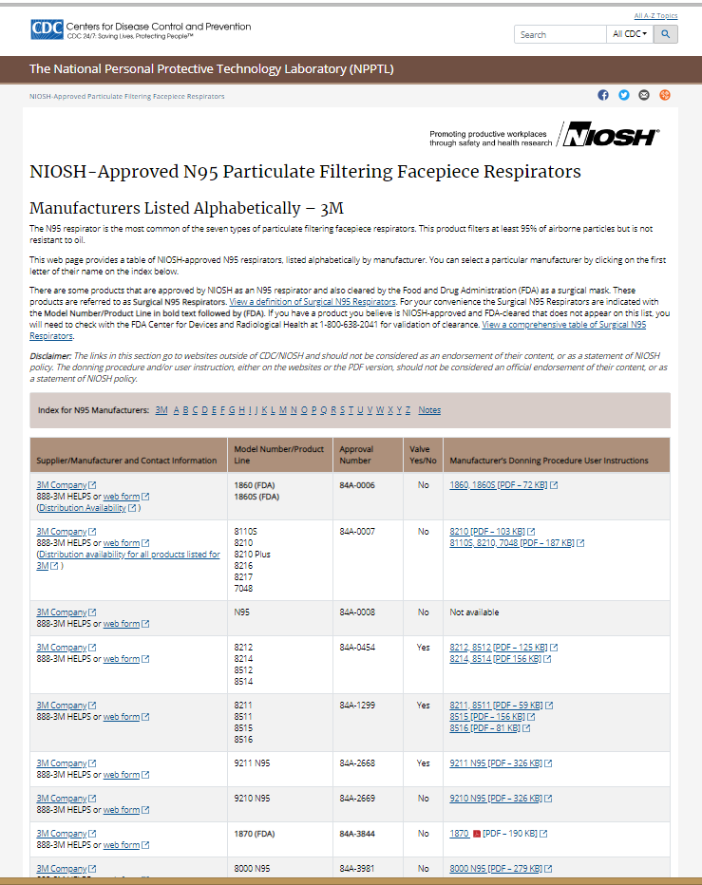
Review Manufacturer’s Instructions for use of
N95 Respirator
Voluntary N-95 Respirator Use
https://www.cdc.gov/niosh/npptl/topics/respirators/disp_part/n95list1.html
Donning procedures
Limitations of use
Hazards of use

Slide 10
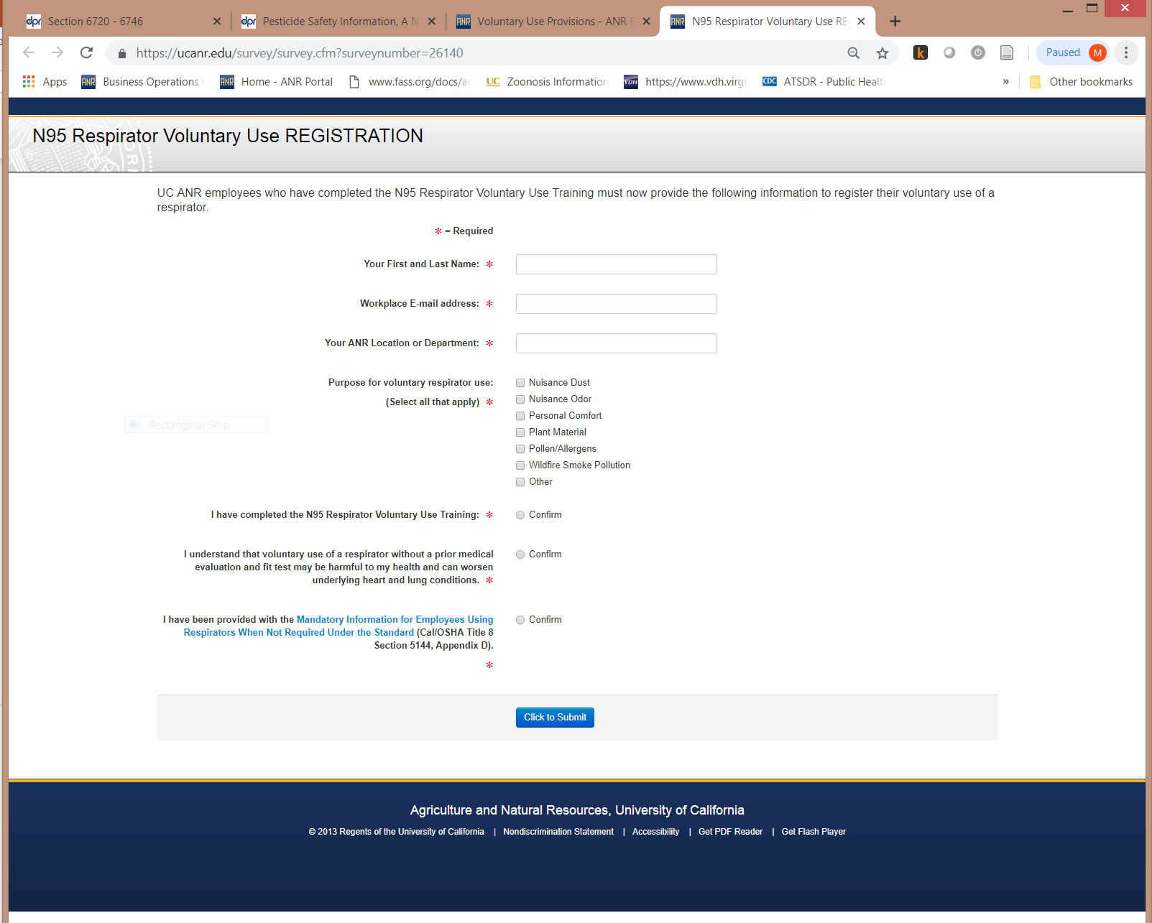
Register Respirator Use with EHS
Voluntary N-95 Respirator Use
http://ucanr.edu/voluntaryN95registration
Remember to notify your supervisor and EHS!

Slide 11
Why should I register voluntary use of N95 respirators?
Voluntary N-95 Respirator Use
Purchase of respirators requires EHS approval
Some respirators are NOT allowable under voluntary use provisions
EHS assessment of respiratory hazards may be required because a regulated hazard is or may be present
Use of respirator may be hazardous to employee health and a medical evaluation is required
Use of administrative or engineering controls to avoid nuisance irritants would be more effective and safer than respirator use

