Slide 1

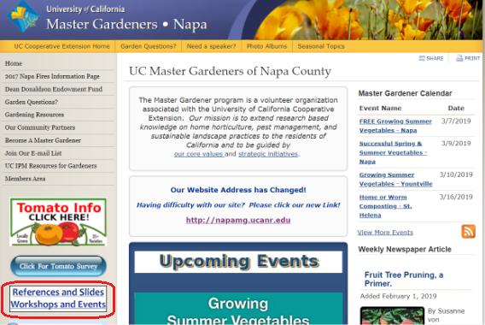
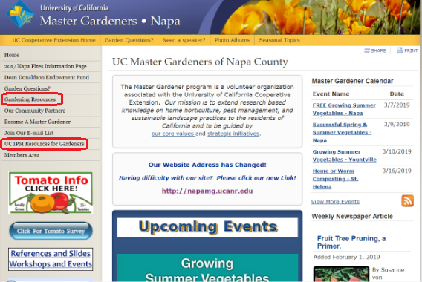
UCMG WEBSITE NAVIGATION
INSTRUCTIONS
Go to UCMG website
http://napamg.ucanr.edu/
For past Public Events topics & Information
Click on this box
For researched based gardening information from the University of California
Click on these two links
Once each link is clicked a new page will open with
many new links to follow. Just click on the item you’d like to investigate
TAKE TIME TO EXPLORE ALL THE LINKS ON OUR WEBSITE
WE HAVE LOTS TO OFFER!
The University of California does not discriminate in any of its program

