Slide 1
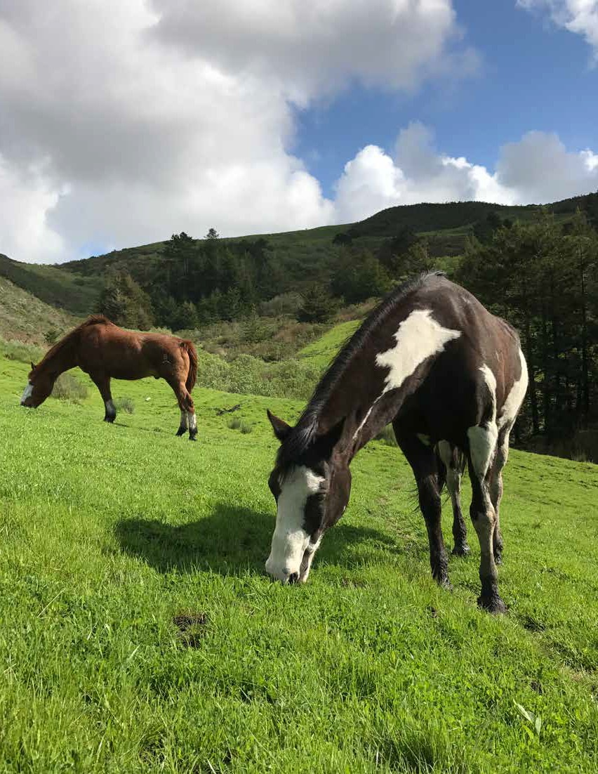

Elkus Ranch
Environmental Education Center
2018 Report

Slide 2
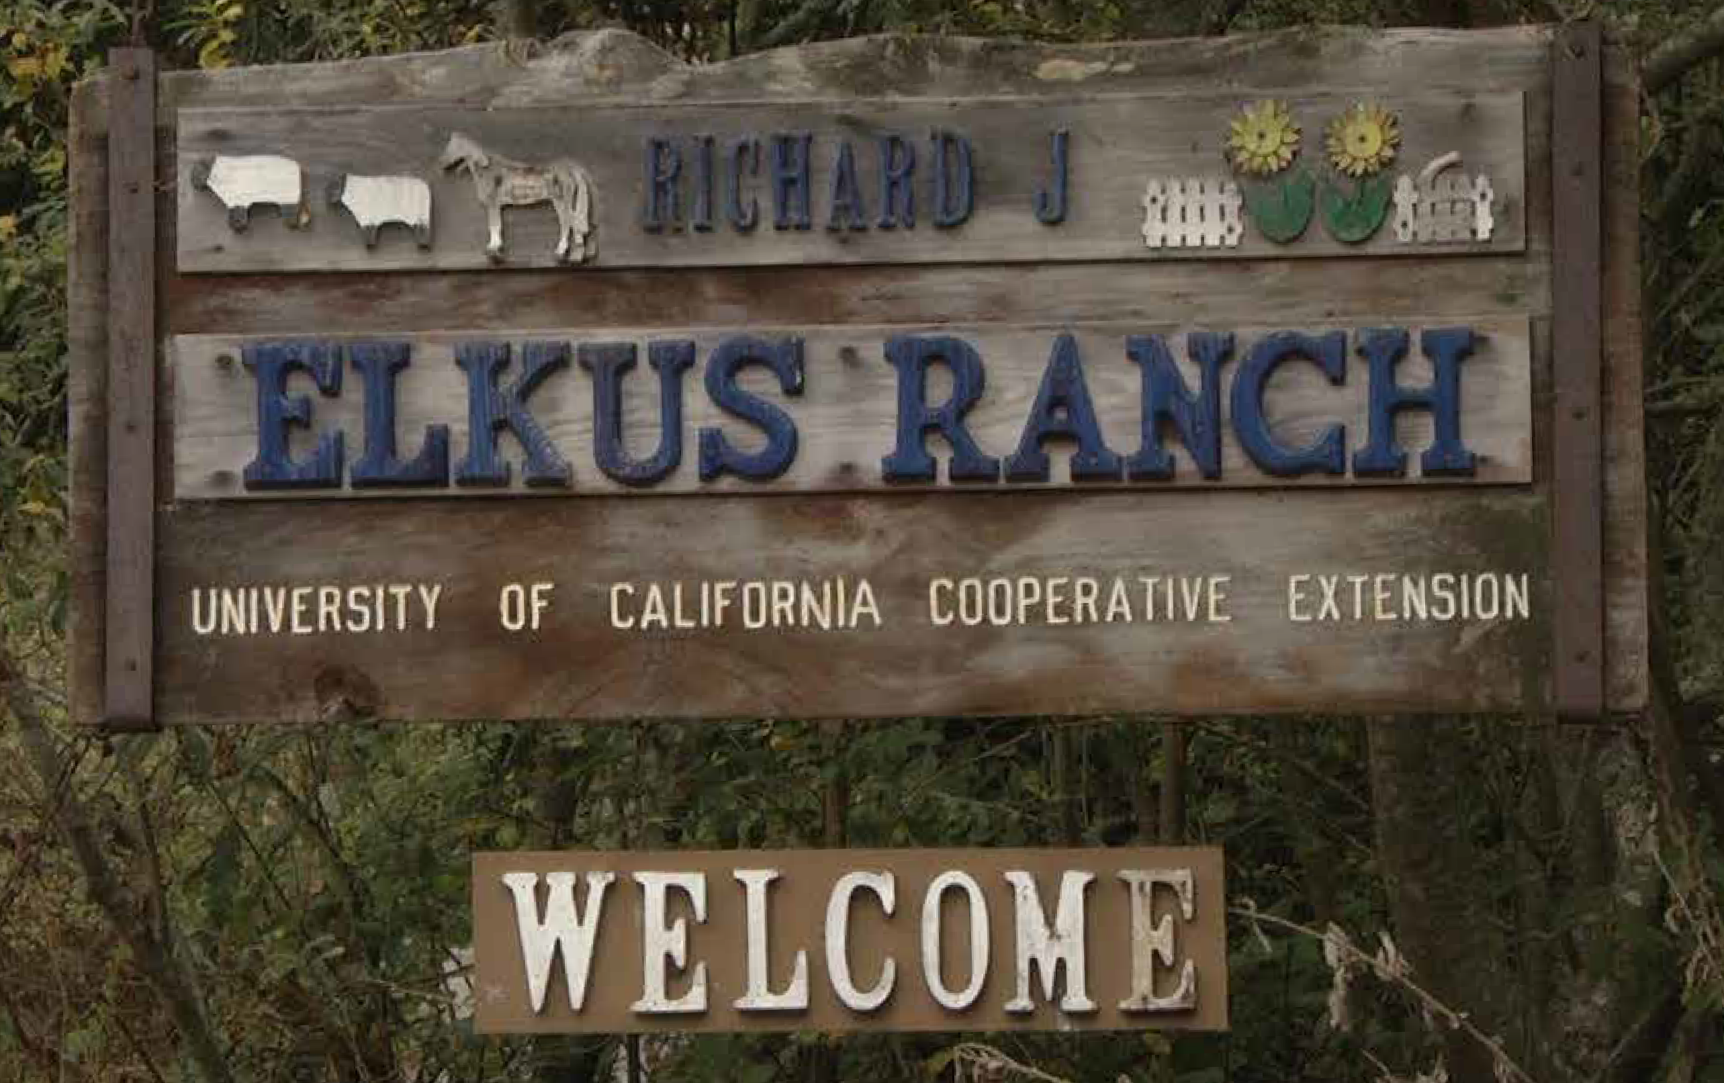

Beloved Ranch, Big Impact
Since 1980, Elkus Ranch Environmental Education Programs have served the Bay Area community by providing students with immersive, hands-on learning experiences in agricultural and environmental education. Our goal is to inspire children to connect with the rich ecology of our coastside community to become caring stewards and engaged citizens.
Our programs are aimed to develop science literacy based on California’s Next Generation Science Standards (NGSS). We educate young people to understand our food systems and the interrelationships between farming, wildlife and the environment.
As part of UC Cooperative Extension, Elkus Ranch is also a site for bringing people working in the fields of sustainability and environmental education together, and for doing and sharing research on issues of public value. In the coming years, we look forward to continuing our
programs for youth, and to pursuing new programs and events to serve adults and families, too!
Thank you sincerely for your support of Elkus Ranch and UCCE, now and in the future.
Maggie La Rochelle Gunn
Elkus Ranch Director and 4-H Youth Development Advisor
UC Cooperative Extension, San Mateo and San Francisco Counties

Slide 3
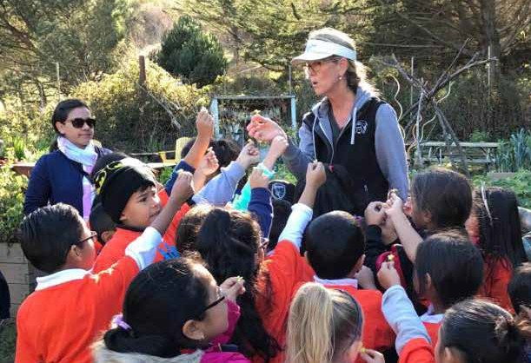
2 0 1 8
Youth Programs
# of students by grade
K-3 5611
PreK 1269 4-6 412
7-12 112
7492
Student participants
135
Schools served
Educational programming is the heart and soul of Elkus Ranch. Each year thousands of students spend a day with our educators learning about our region’s agricultural heritage.

Slide 4
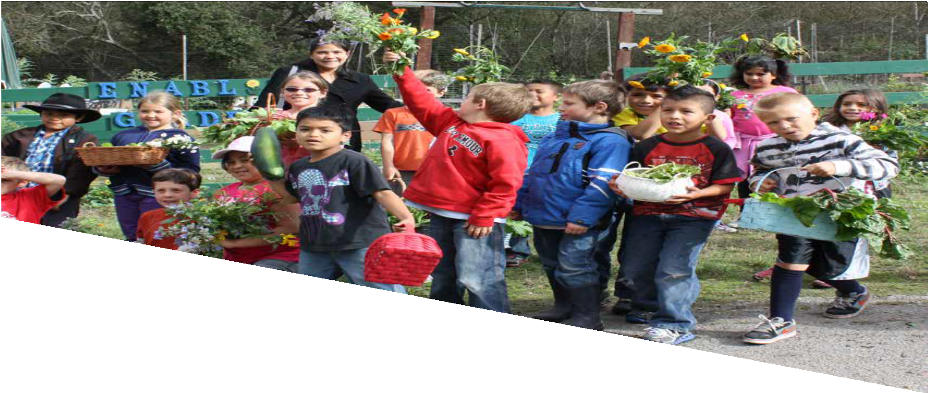
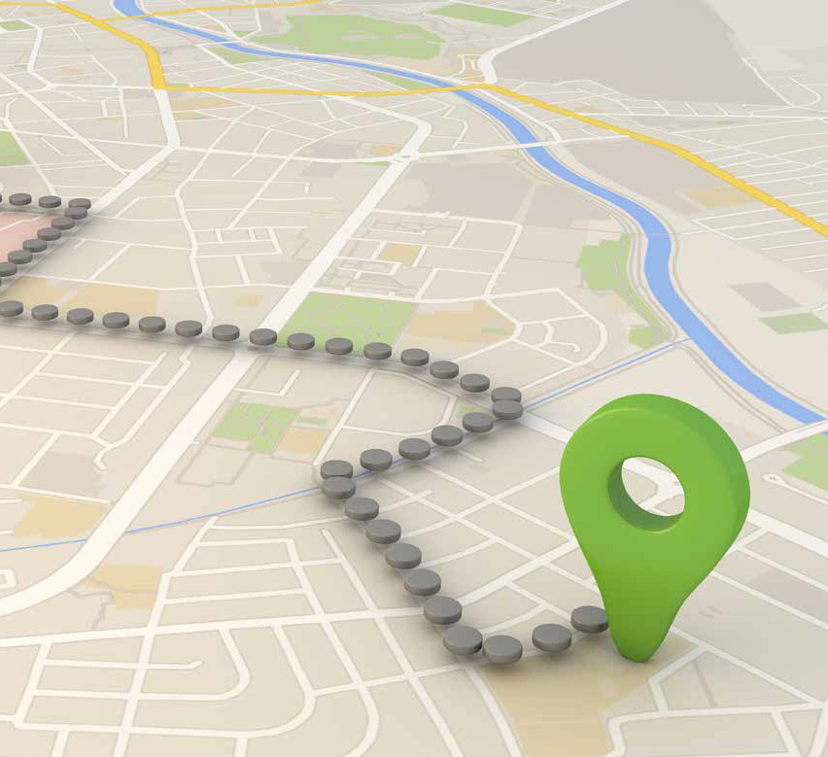
Top School Districts
Schools from throughout the San Francisco Peninsula and greater Bay Area come to attend programs at Elkus Ranch. Our top three school districts are:
Cabrillo Unified
San Mateo - Foster City Unified Pacifica Unified

Slide 5
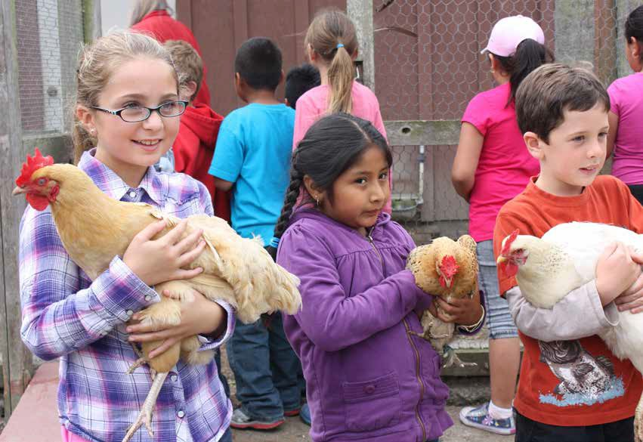
Ranch Tours
PreK - 3rd grade
Guided ranch tours at Elkus are a mainstay of our programming throughout the year. They provide an opportunity for students to actively learn about the production of food and fiber, interrelationships of plants and animals, and the importance of environmental stewardship in the ranch setting.
On a given tour students will meet and care for our goats, donkeys, sheep and chickens, plant a seedling, taste a flower or fresh vegetable from the
garden, and learn about composting, predator-prey relationships, pollinators and more…
Learning Themes
Plants and pollinators Livestock and wildlife
Roles of the farmer and rancher

Slide 6
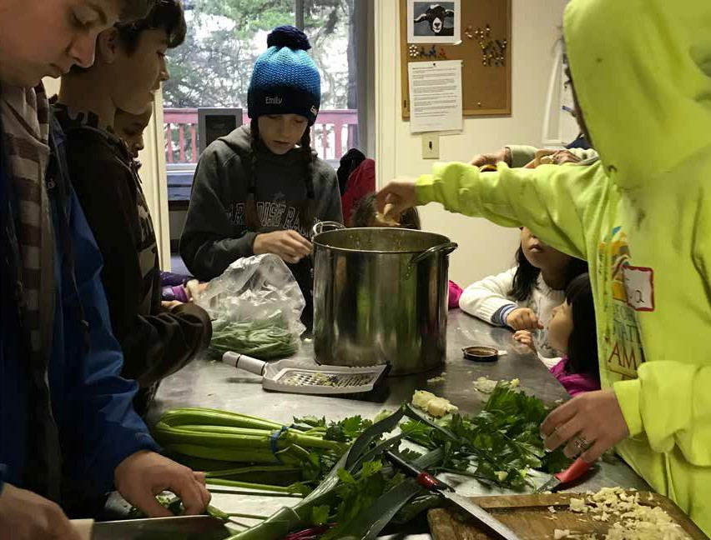
Lunch
at the Ranch
Learning Themes
Sustainable agriculture
Farm to fork food preparation
Nutrition and food systems
2nd grade - high school
This nutrition program starts with leading children into the Elkus garden to harvest fresh produce, and then to our commercial kitchen to make and enjoy a three-course, garden-to-table meal! After preparing vegetable-topped pizzas, garden salads, and zucchini chocolate chip cookies, students and chaperones sit down to enjoy the family-style meal they’ve prepared complete with linens and a floral centerpiece. This garden-to-table experience is a great opportunity for children to try new foods, build confidence in cooking skills, and experience the satisfaction of a healthy meal well-prepared and well-enjoyed.

Slide 7
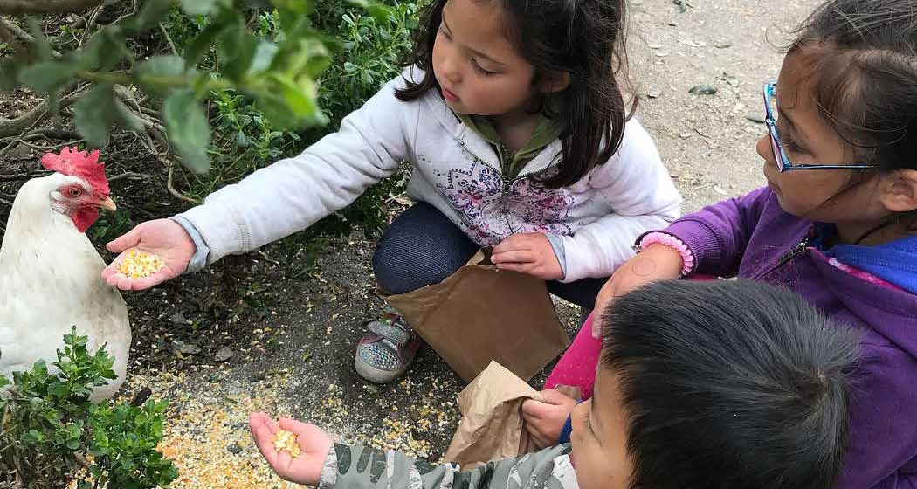
Scholarships
1625
A core value of our organization is to maintain the accessibility of our programming to all students, regardless of their financial means.
As school districts experience reduced budgets for out of classroom activities, Elkus Ranch has stepped in to subsidize program expenses to encourage under- resourced schools to participate in our programming.
For many of our urban schools, a visit to Elkus Ranch represents the first time many students will visit a working farm, encounter livestock, plant seeds, and make a meal from scratch.
We’re grateful for our many donors that have provided us with their generous support. With your help we can ensure equal opportunities for diverse student groups.
Students Supported
“Environmental education provides important opportunities for students to become engaged in real world issues that transcend classroom walls. They can see the relevance of their classroom studies to the complex environmen- tal issues confronting our planet and they can acquire the skills they’ll need to be creative problem solvers and powerful advocates.”
-Ms. Campbell, California’s Superintendent of San Mateo County Schools

Slide 8
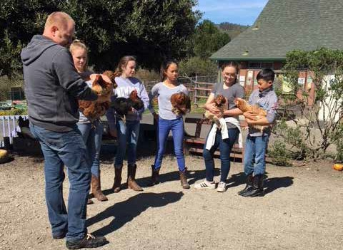
Special Events
It’s no yolk, raising chickens engages backyard poultry enthusiasts in some serious science!
Raising backyard chickens is part of an urban farming movement that has gained popularity nationwide. Despite its popularity, there is a lack of awareness about poultry disease, protection from common urban predators, and how to detect and treat health problems. These were the topics dis- cussed at a Backyard Poultry Workshop held at Elkus Ranch on March 17, 2018.
4-H poultry project teen leaders were enlisted to work with UC veterinarian Maurice Pitesky, DVM, poultry specialist Richard Blatchford, PhD., and Youth Scientific Literacy Specialist, Martin Smith, Ed.D, to design the day of learning.
4-H teen leaders were the primary
instructors with the specialists stepping in as needed to support the presentations which covered various topics including: biosecurity methods, disease transmission, coop
design and management systems, and animal health and welfare. The 50+ participants had opportunities to talk with other backyard chicken enthusiasts as well as 4-H project leaders.
“I wanted to let you know what a positive experience and impact the backyard poultry workshop was to the teens involved. Only at Elkus Ranch is there the unique opportunity to have this connection with local 4H, a UC 4H farm and UC experts”.
Linh Chan, 4-H Poultry Project Leader
Annual Events
Sheep to Shawl Preschool Days Summer Camps Winter Camps

Slide 9
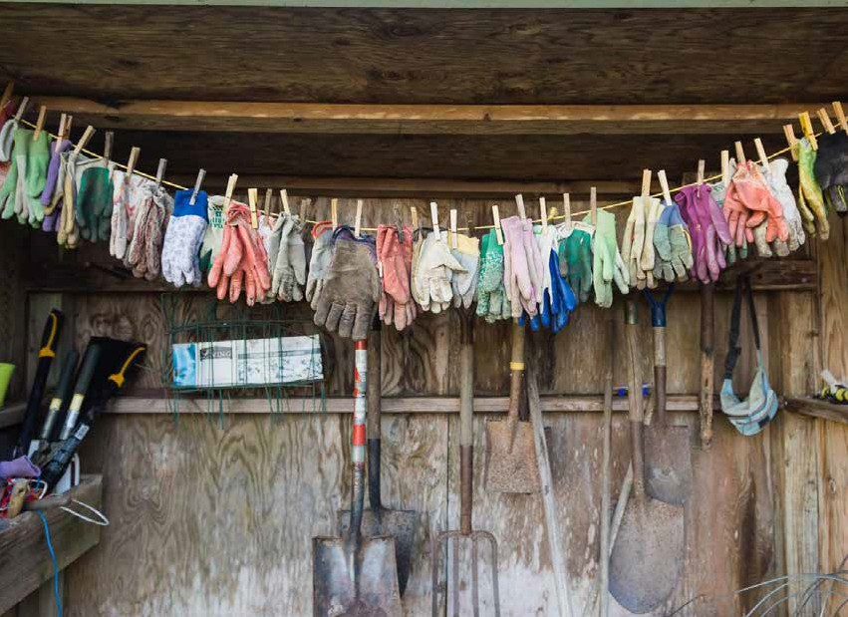
Community
We are so very grateful for all the support that Elkus Ranch receives from individuals and organizations. This strong philanthropic culture dates back to our origins as Richard J. Elkus originally gifted the ranch to the University of California in 1975.
Our donors help us expand our reach, engage students from underserved areas and incorporate real world experiences into the educational curriculum.
This year we are proud to announce a new partnership with Hands On Bay Area volunteer network and the implementation of monthly volunteer days. Volunteers spend many hours at the ranch helping us to maintain our working farm.
Together we deliver programs and experiences that instill the values of education, stewardship, and sustainability to the community.
H ig h lig h ts
$79,084
Private support
Monthly
Volunteer days

Slide 10
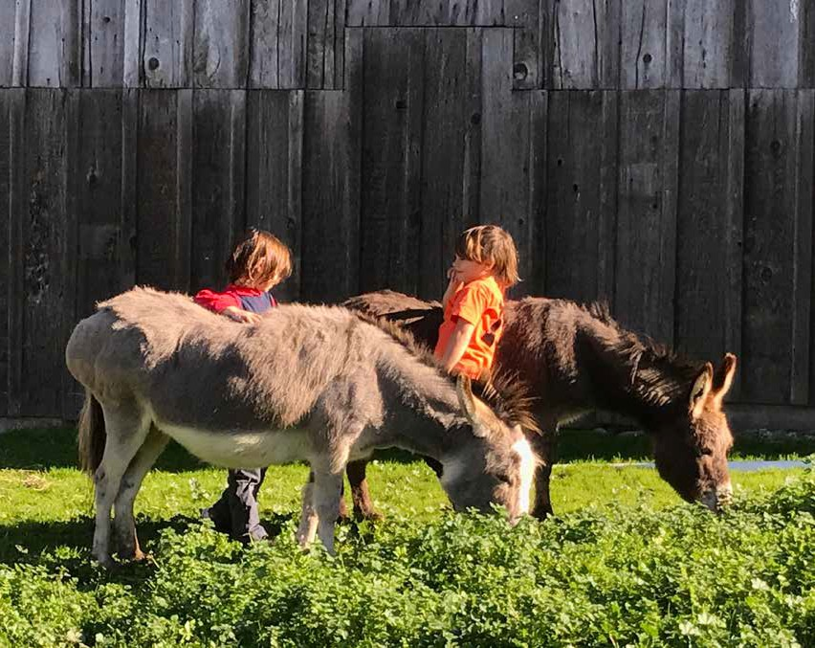
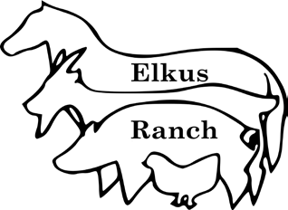

Elkus Ranch Environmental Education Center 1500 Purisma Creek Road
Half Moon Bay, CA 94019
650-712-3151
elkusranch@ucanr.edu http://elkusranch.ucanr.edu

