Slide 1
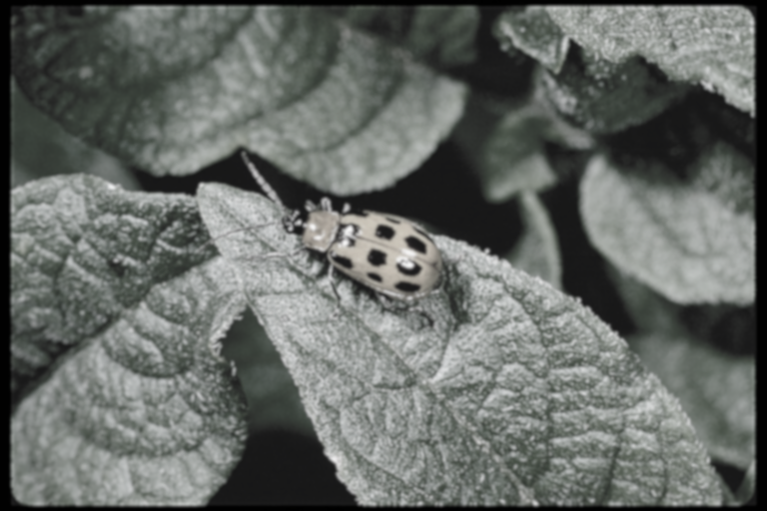
Diagnosing Insect Pests of Vegetables
Developed by UC IPM for UC Master Gardeners

Slide 2

Insect Identification for Diagnosing Plant Problems
Notes:
When diagnosing plant problems identifying the pest or problem is the first and most important step. Once you have identified your pest, you can proceed to assess management options. Today we’re going to focus on insect pests and identification of insect pests by signs and symptoms of plant problems.

Slide 3
Insect Information
Insect order
Type of metamorphosis
Mouthparts
Life stage
Notes:
There are a few key traits of insects that you can use to identify what pest you have and how to manage those pests.
Knowing common insect orders (how insects are grouped) can be very useful in identification. The type of metamorphosis, or development, that insects undergo is connected to the insect order. This will help you understand the biology and ecology of the insect pest. Paying attention to the life stage of the insect, whether immature or adult, will help guide management decisions. Knowing what kind of mouthparts insects have, and what damage is characteristic of different mouthparts, can help you diagnose pest problems even if you don’t see the pest.

Slide 4
Insect Classification, Growth & Development
Orthoptera: grasshoppers, crickets
Thysanoptera: thrips
Hemiptera: stink bugs, aphids, scales
Neuroptera: lacewings, antlions
Coleoptera: beetles and weevils
Diptera: flies, mosquitoes
Lepidoptera: butterflies, moths
Hymenoptera: ants, bees, wasps
Dermaptera: earwigs
Blattodea: cockroaches, termites
Notes:
There are about 30 insect groups called orders. These are some of the most common orders you’ll find in vegetable gardens and around the home. Not all species of insects are pests. Some are beneficial, and most are benign.
Orders displayed in red, listed on top, exhibit hemimetabolous, gradual or incomplete metamorphosis. The immatures look like the adults and are sometimes called nymphs. Some of these insects have chewing mouthparts while other have piercing sucking mouthparts.
Orders displayed in orange, listed on the bottom, exhibit holometabolous or complete metamorphosis. The immatures look different from the adults and their life cycle includes a pupation stage. The immatures are sometimes called larvae. For some orders, immatures are called grubs (coleoptera) or worms or caterpillars (lepidoptera). Does anyone know what order has immatures called maggots? (diptera) Insects in these orders have different kinds of mouthparts. As immatures, most have chewing mouth parts. As adults, they have different mouth parts or some don’t feed at all.

Slide 5
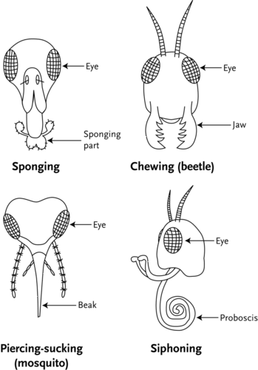
Mouthparts
Common types of mouthparts seen in garden insect pests
  chewing
  piercing-sucking
Notes:
Insects have many different mouth parts including sponging (also called sponging lapping), chewing, piercing sucking, and siphoning. Flies are an example of insects with sponging mouthparts. Butterflies and moths have siphoning mouth parts.
Many of the insect pests of vegetables have chewing or piercing-sucking mouth parts. Today we’ll focus on the plant damage from insects with these types of mouthparts.
Insects with chewing mouthparts have large mandibles which remove plant matter in a chewing manner. Beetles are an example of insects with chewing mouthparts. Beetles can be large, and you’ll be able to see their mouthparts (the mandibles) with a hand lens. Some beetles are smaller and their damage may look different, but it is still chewing damage if it’s a beetle. You will see a hole in the plant tissue from chewing damage. Sometimes, however, the hole does not go through the entire plant, they may only eat through one layer of the plant. Caterpillars and maggots also have chewing mouthparts.
Piercing sucking insects have stylets that poke into plants and suck plant juice (phloem or xylem) out of the plant. Aphids are an example. Other hemipterans and true bugs like stink bugs have piercing sucking mouthparts.
Since insects have different ways of eating, the damage they cause looks different. Looking at the damage will help you identify what kind of pest you may have.

Slide 6
Damage and Diagnostics

Slide 7
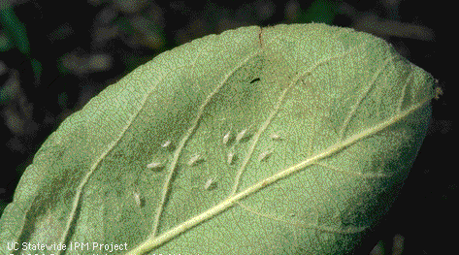
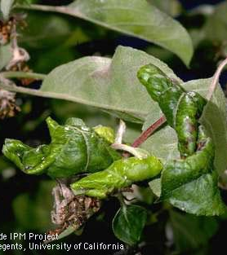
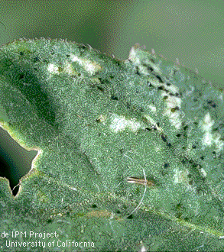
Signs & Symptoms of Insect Pests
Dieback
Frass, honeydew
Cast skins, wax
Webbing, curled leaves
Chewed leaves, holes
Notes:
Being able to recognize different signs and symptoms of insect pests can help you diagnose what pest you have. Based on the kinds of damage you see, you can usually narrow down what kind of insect pest you have.
What are some of the key things to look for that tells you there is damage from insects?
Signs of insects include physical evidence of insects such as frass (poop), honey dew (liquid poop), cast skins shed during molting (top photo), wax, or webbing. Some caterpillars called leafrollers will use silk to wrap leaves around themselves.
Symptoms of insect pests are expressed by plants as a result of feeding damage. This can include dieback, curled leaves (bottom left photo), and holes.
In the picture on the bottom right, you can see thrips on the leaf as well as stippling damage and black excrement. Typically, if you see stippling and frass, it’s a sign of thrips damage.
You may not always see the insect that is causing damage. Sometimes the pest is below ground, or inside a stem. You may just see symptoms or damage. In addition, just because you see an insect, doesn’t mean it caused the damage. It’s important to note that not all damage needs to be treated. Healthy plants can sustain a certain amount of damage before they need to be treated.

Slide 8
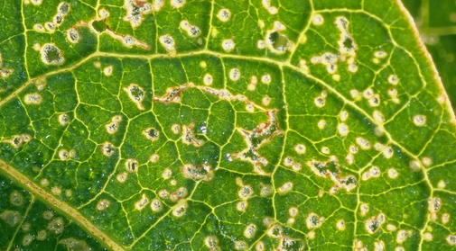
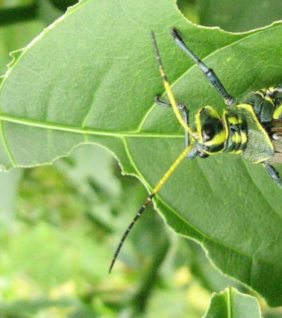
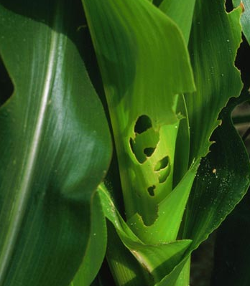
Signs of Chewing Damage
Skeletonizing
Shotholing
Notching
Leaf mining
Windowpaning
Notes:
Some common chewing insects include dermaptera (earwigs), orthoptera (grasshoppers), coleoptera (beetles), immatures of diptera (flies), lepidoptera (caterpillars, moths, butterflies), hymenoptera (ants, bees, wasps). Their damage can vary depending on the size of the insect or where they are feeding.
Some larger chewing insects make big, obvious holes in plants. Smaller chewing insects like flea beetles, may not make holes all the way through a leaf. But they are removing plant material with their mandibles. If you looked closely a this eggplant leaf (top photo), there would be layers of plant tissue removed on the light spots. Up close, they look like little craters in the leaf.
There are different names for damage done by chewing insects.
In the top photo, the flea beetle damage is called shotholing. A grasshopper chewed notches on bean leaves in the lower left photo. Some kind of armyworm has chewed holes and notched the corn in the lower right.
Skeletonizing is a term used to describe chewing damage on leaves that leave the veins intact, often done by caterpillars. Leafmining looks like weaving, serpentine trails on leaves. Windowpaning is a type of damage where the chewing insect does not eat all the way through the leaf, but leaves a thin layer of leaf that becomes almost see through.

Slide 9
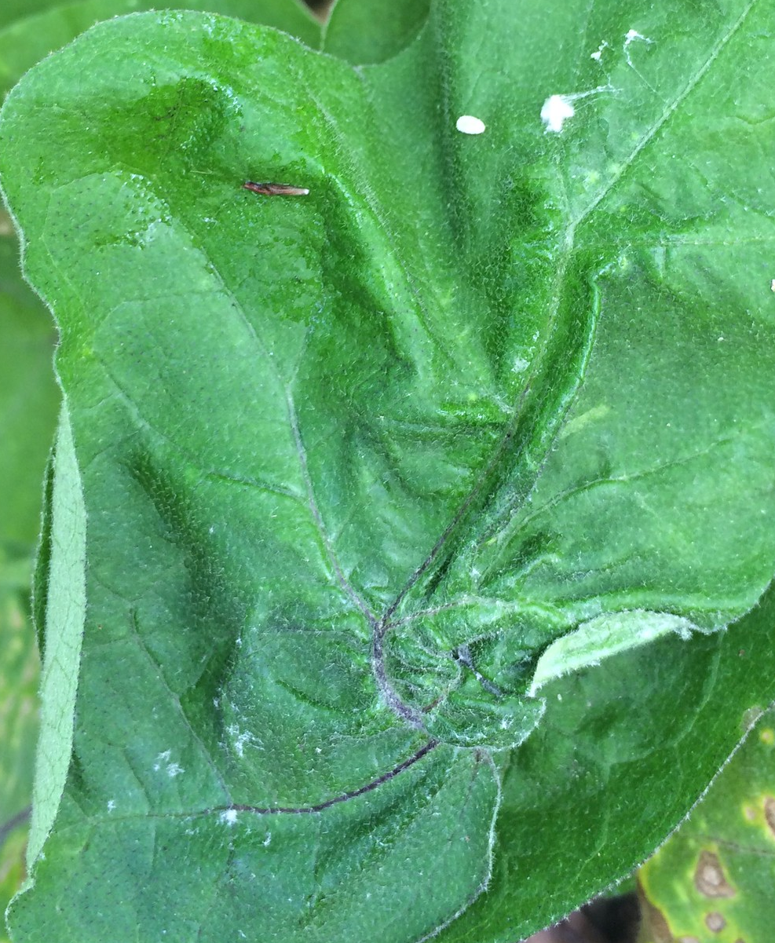
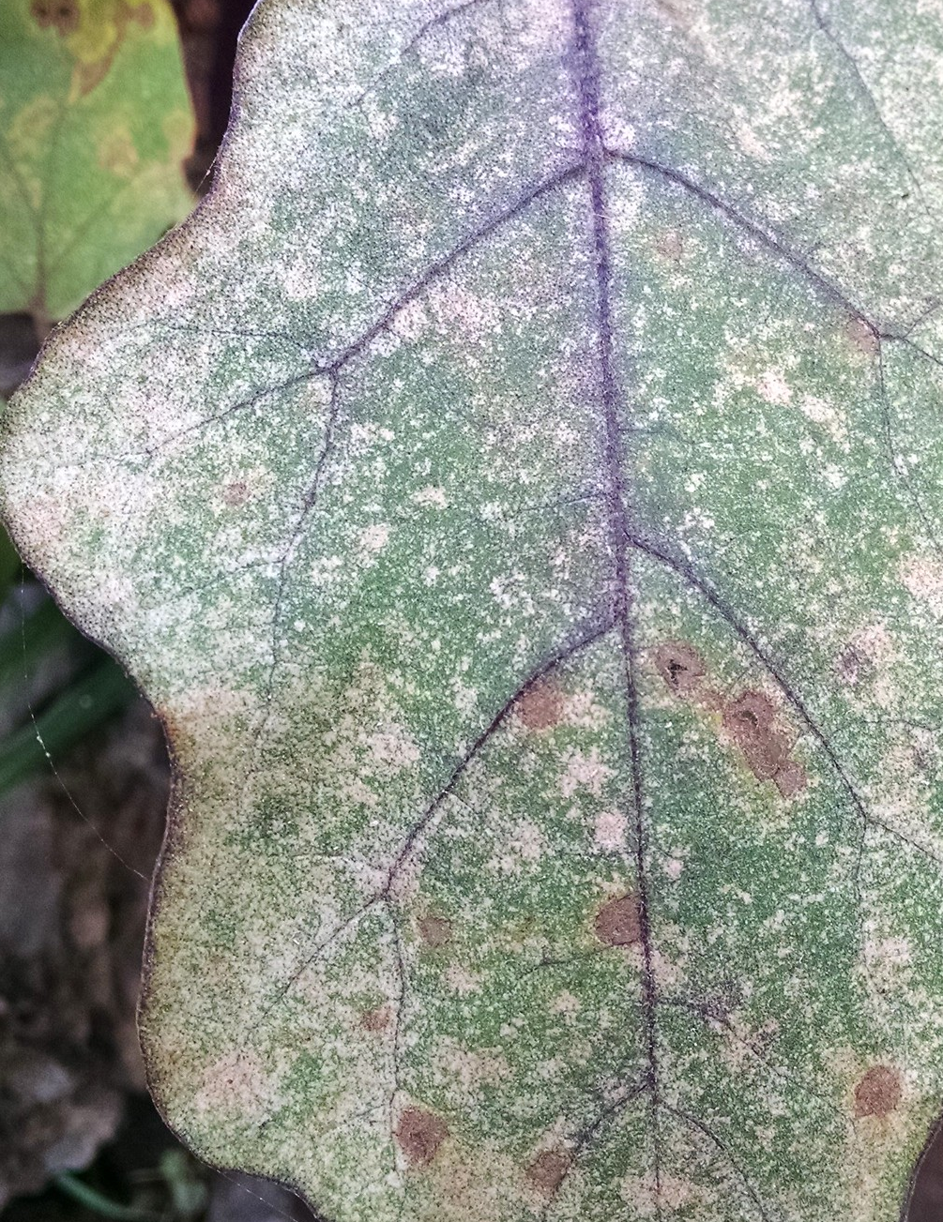
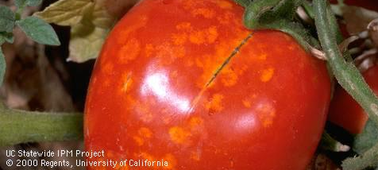
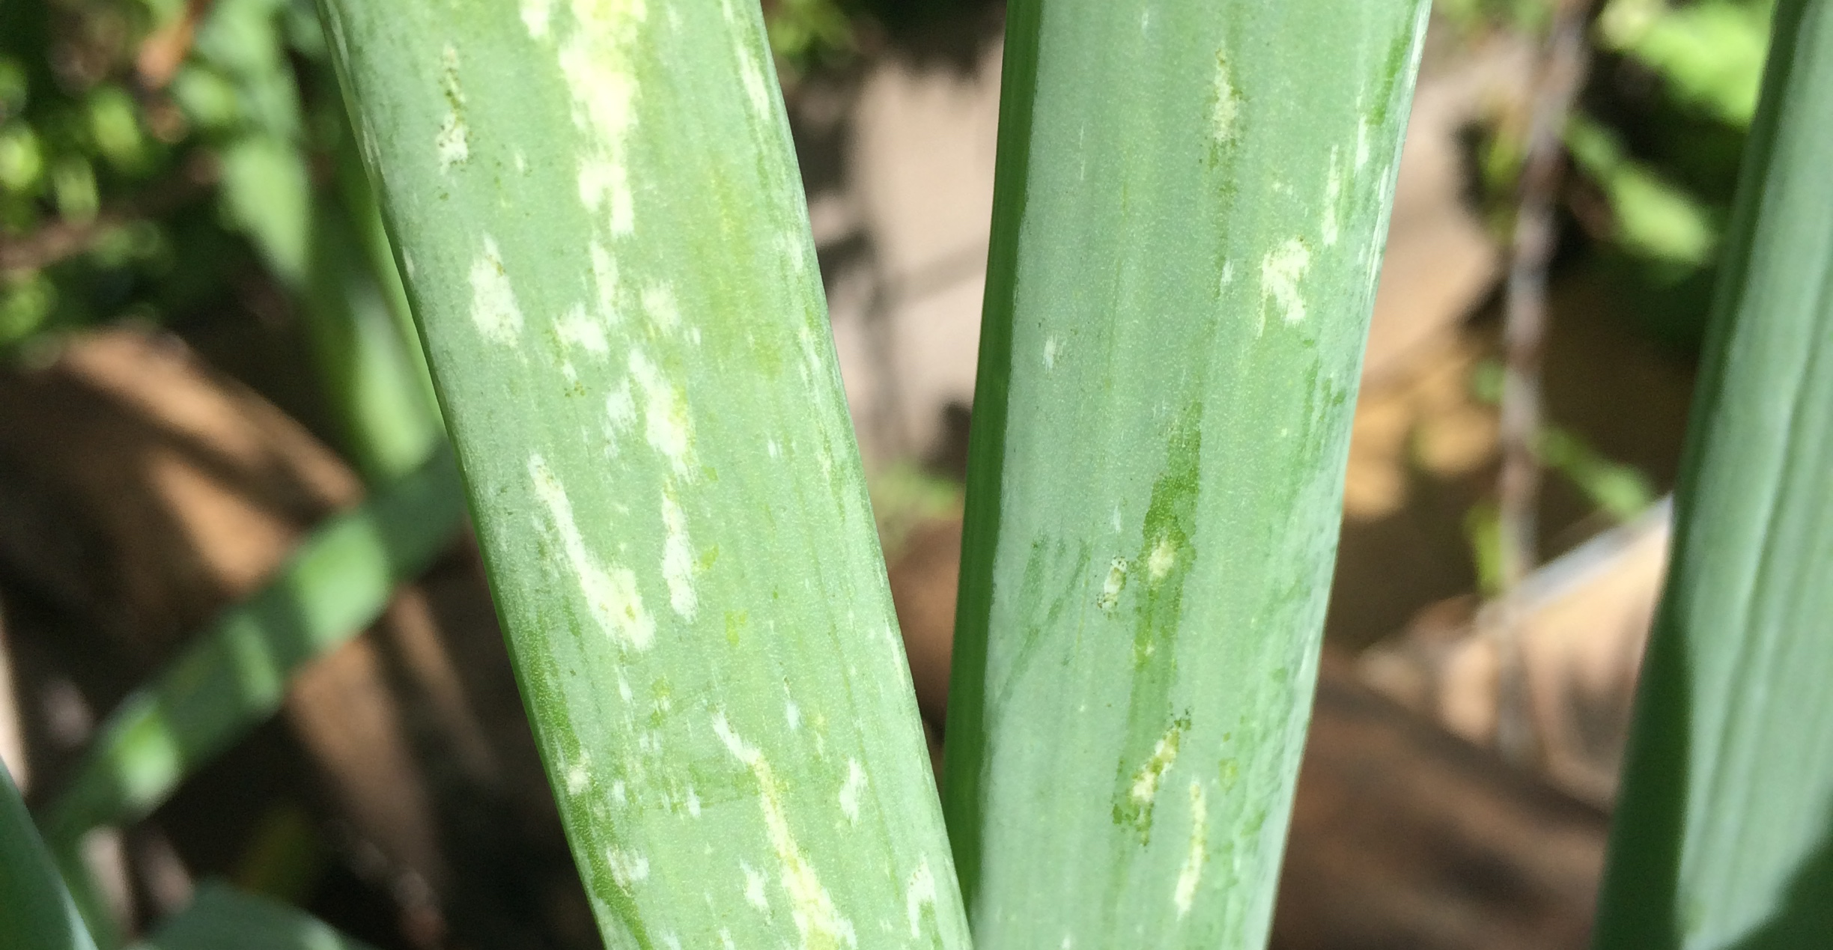
Signs of Piercing-Sucking Damage
Leaf curling or cupping
Stippling
Catfacing
Scaring
Notes:
Piercing sucking insects commonly found in the garden include those in the Order Hemiptera (all true bugs, aphids, scales, leafhoppers).
Insects with these mouth parts cause different kinds of damage including stippling like this thrips damage on onion (lower right) and on eggplant (upper right), leaf curling or cupping (upper left). They suck plant juice out of the plants. Some insects are phoem feeders, which means they feed on the tissue in the plant that conducts sugars. Others are xylem feeders, feeding on the water and dissolved nutrients of the plants.
Stink bugs often like to feed on the fruit or the seeds of plants. On this tomato, some kind of piercing sucking insect has scarred the fruit. Catfacing is a term that describes fruit that grows kind of funny and smushy. This is common in tomatoes and other soft fruit like apples and pears. Catfacing is caused by insects that release a toxin when they feed, so the cells around the feeding continue to grow around the dead tissue.

Slide 10
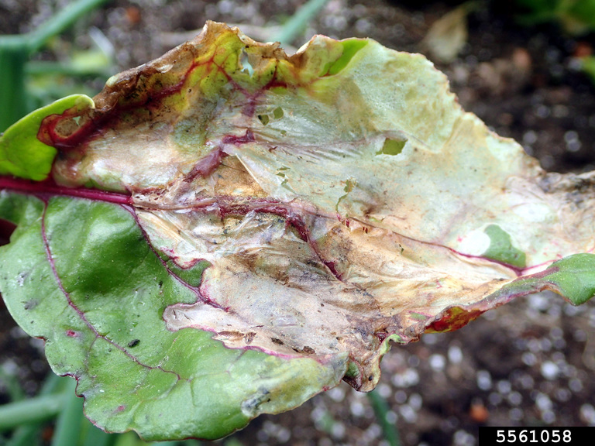
Diagnosing Plant Problems
What is the host?
What is the problem?
What other information do you need?
What is the pest?
Notes:
When you’re diagnosing plant problems, it’s important to start with the host. Some insect pests are generalist feeders, meaning they eat a lot of different things. Others are specialists, which means you’ll find certain pests on certain plants and not feeding on others.
There are diagnostic tables in the CA Master Gardener Handbook as well as the Pests of Gardens and Small Farms book that list different pests, and descriptions of their damage.
So, once you know the host plant, you need to define the problem. What does the damage look like? Did it come on suddenly? Has it always been that way? Where on the plant are the symptoms occurring? That can lead you to what kind of pest you may have.
Consider other information about the plant, the soil, how much sun the plant gets, etc. Is it only one plant that is damaged or many? Of the same crop or different crops?
Once you’ve gathered all your information and asked a lot of questions, you can try to identify the pest. Sometimes you need to know the exact species of the pest that’s causing damage in order to manage. Other times, you may just need to know what kind of pest you’re dealing with. For example, you may have found a caterpillar feeding on your cabbage. You can find management solutions for caterpillars without knowing if you have a cabbage looper or a diamond back moth.
Other times, it may be important to identify a Brown Marmorated Stink Bug from other stink bugs if it’s an economically important pest in your area.

Slide 11
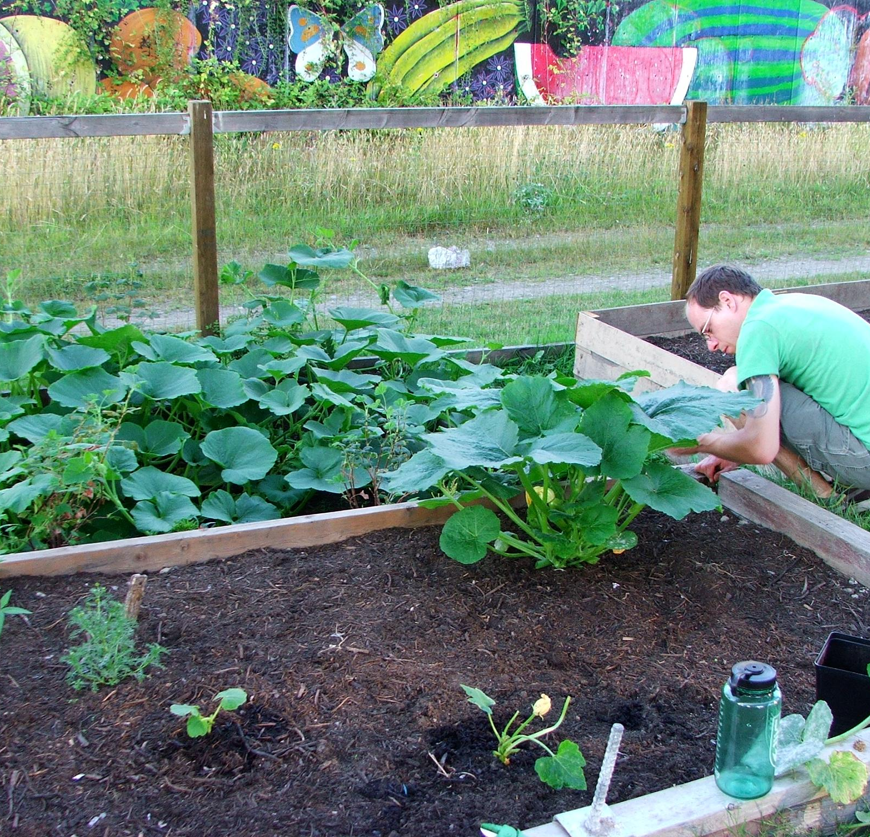
Diagnosing Plant Problems
Check roots, growing tips, under side of leaves
What are the symptoms?
  Look for effects on plants such as wilting or dieback
What are the signs?
  Evidence of insect pests such as cast skins or frass
Notes:
To diagnose plant problems, be sure to look all over the plant for both damage and signs of pests. Sometimes there may be soil dwelling insects that are affecting the plant from the roots. The tips and the underside of the leaves are common areas where insects feed.
Some symptoms such as wilting or dieback may be caused by insects. But these symptoms can also be cause by viruses or plant diseases.
Be sure to look for the signs of insect pests. Does anyone remember examples of signs of insect pests? (cast skins, frass, wax, webbing)

Slide 12
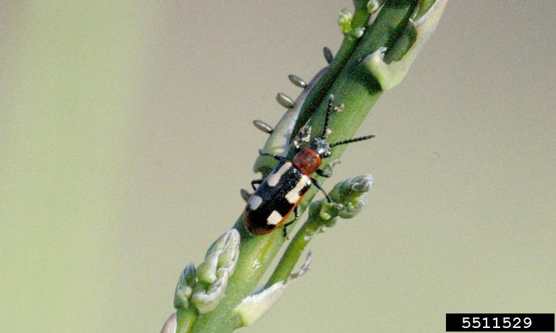
Diagnosing Plant Problems
Did the insect cause damage?
  Damage may look similar
  Pests may look similar
  Identification is essential for effective treatment
What is the threshold for pest before taking action?
Notes:
Sometimes you will only see signs and symptoms of insect pests. Chewing damage from beetles and chewing damage from caterpillars may not be distinguishable.
Other times, you may find insects on plants. But they may not be the ones causing damage! They may just happen to be on the plant at the time you are looking for a pest. In fact, some beneficial insects may look like the pest insects so proper identification is essential before determining treatment. Especially if you are trying to determine if the problem is caused by an insect or a disease or something else. This insect looks a lot like a lady beetle. But it’s actually a pest! It’s an asparagus beetle.
Healthy plants can withstand a fair amount of damage so you may not need to treat for pests.
Pictured: Crioceris asparagi

Slide 13
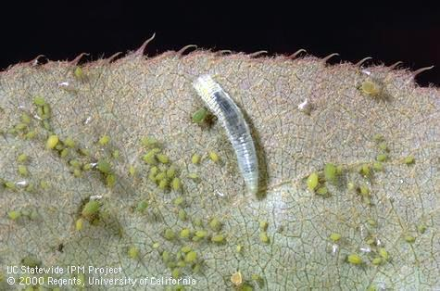
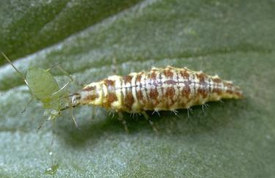
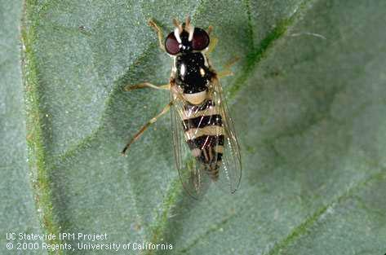
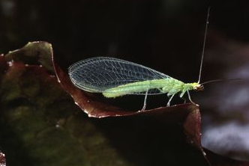
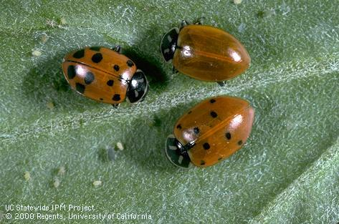
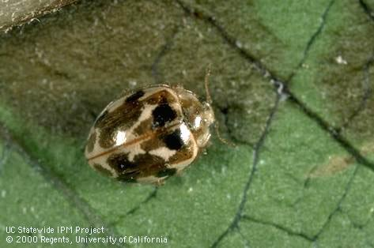
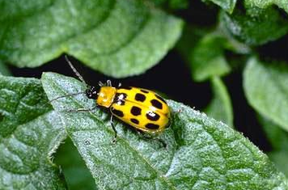
Look alike insects in the garden
Know how to identify
Adult and immature stages
Pests versus beneficial insects
Notes:
Some insects resemble each other either in shape or color. Identification is important, especially since many beneficial insects are often mistaken for pests.
Which of these are beneficial? Which are pests?
Pictured in the group of four photos on top: syphid fly larva and adult, also called a hover fly (left) and a green lacewing larva and adult (right). Are they beneficial? Are they pests? Both are beneficial predators that feed on garden pests such as aphids. In both these cases, the larvae are the primary predators of insects. The adults typically feed on nectar and pollen.
The three photos at bottom show:
- Convergent lady beetle adults. These feed on aphids and other soft-bodied insects. Note in this photo that they differ slightly in size, one lacks spots, one has faint spots, and one shows distinct spots. These are all adults and will not grow any bigger. Lack of spots is not an indication of male or female, just pigment differences. Even though they look different, they are all the same species and type of lady beetle.
Adult twenty-spotted lady beetle (middle), which is also called the small ashy gray lady beetle, Psyllobora vigintimaculata. It feeds powdery mildew spores. It’s also a beneficial, but it’s not a predator.
This is not a ladybug/lady beetle and not a beneficial insect. This is a spotted cucumber beetle and is actually a pest on plants.

Slide 14
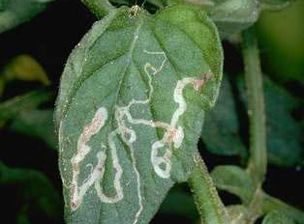
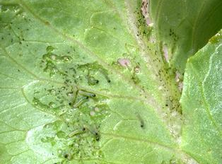
Who caused this damage?
What kind of damage is shown?
What insect orders could cause this damage?
How might this damage look different as the insect gets older?
How would you manage this pest?
Notes:
Let’s try to diagnose these plant problems together.
What kind of damage is shown on the top? What kinds of insects could cause this damage? What are some strategies to manage this pest?
What about on the bottom?
Answers:
These are examples of chewing damage.
Top photo: Leafminer damage from immature fly (maggot) on tomato. The egg was laid at the smallest end of the tunnel. As it ate and grew, it got larger, so the tunnels get bigger. Sometimes you can see frass inside the serpentine tunnels. Then they pupate and emerge or emerge and pupate in soil. If you were to spray a pesticide, it may not be effective because the leafminer is inside the leaf. If you smush the leaf, it may not be effective if the insect has already emerged.
Bottom photo: Beet armyworm damage on lettuce. These are very young caterpillars, so they don’t eat through the entire leaf. This can be described as windowpaning. As they get older, however, they may chew larger holes or notches in the leaf.

Slide 15
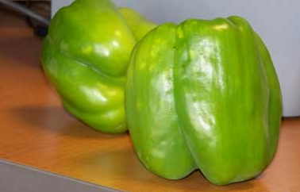
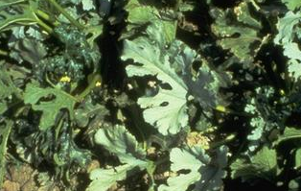
Who caused this damage?
What kind of damage is shown?
What insect orders could cause this damage?
How might this damage look different as the insect gets older?
How would you manage this pest?
Notes:
What about these kinds of damage? Let’s go through the diagnoses together.
Answers:
These are examples of damage caused by piercing sucking insects.
Stink bug damage on pepper is an example of catfacing. The surface of the pepper is rippled, not smooth on the top photo.
Silverleaf whitefly damage on squash leaves (squash silverleaf) is shown in the lower photo. The piercing sucking mouthparts of the whiteflies cause a silvering of the leaf.

Slide 16
Integrated Pest Management
Notes:
Your role as UC Master Gardeners is to extend research-based pest management information to the public and help your clientele choose safe and effective practices. Integrated pest management is an ecosystem approach to help reduce pests and their damage.

Slide 17
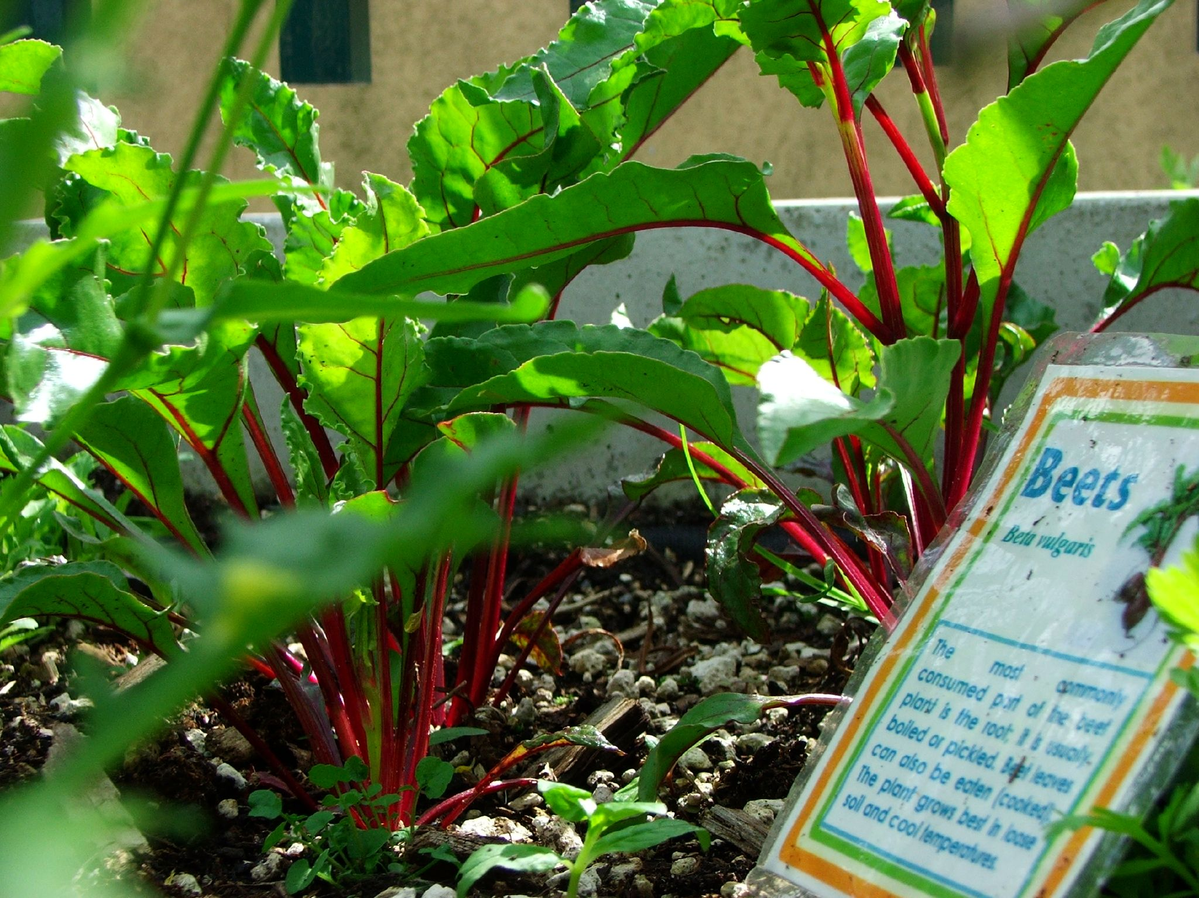
Prevention
Provide proper growing conditions
Healthy plants can tolerate damage
Notes:
When looking for pest management solutions, prevention is key.
Healthy plants are the best defense against pests. Provide plants with proper fertilization, irrigation, and other practices that support vigorous growth. Healthy plants can tolerate a certain amount of damage from pests and may not need to be treated. If you have a plant that’s not doing well, sometimes the best solution can be to remove it and plant it somewhere else. Plant the right thing, in the right place, under the right climate conditions.
Be sure to check nursery plants for any insects they may accidentally harbor.

Slide 18
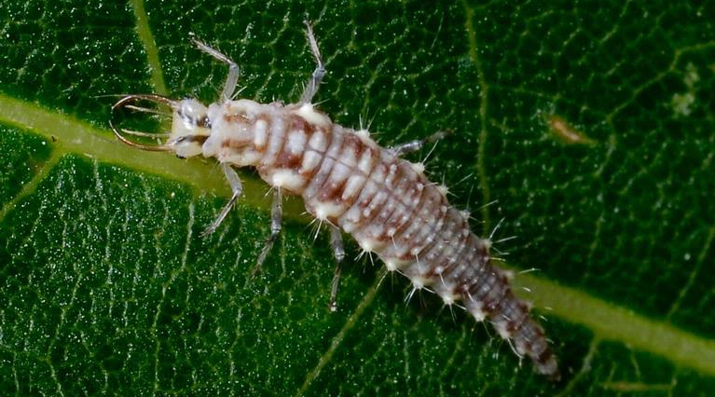
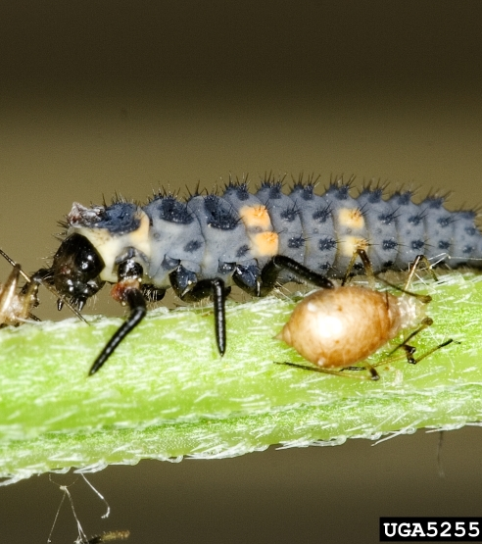
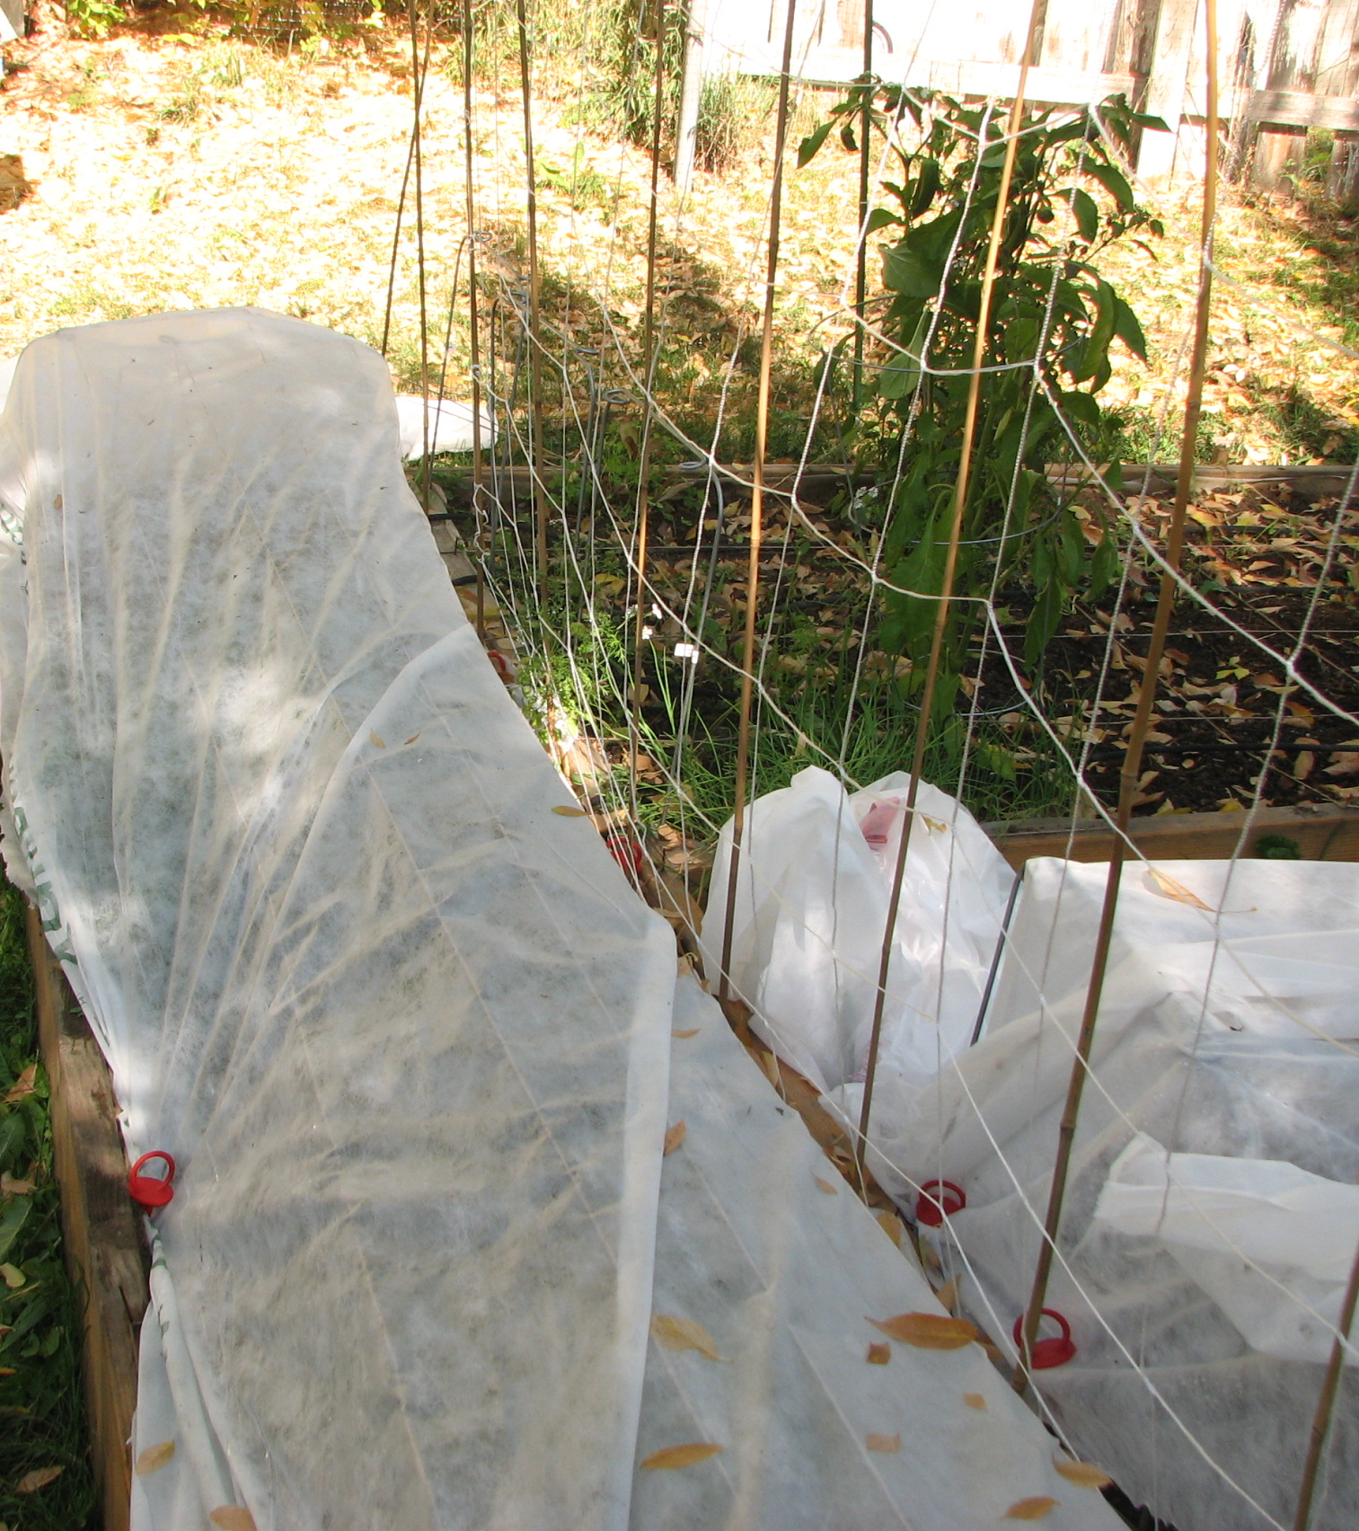
Management
Cultural control
  Crop rotation, change planting time, crop diversity
Mechanical & physical control
  Plant cages and row covers, traps
Biological control
  Natural enemies, predators, parasites
  Ant management for honeydew producing insects
Chemical control
  Least toxic insecticide
Notes:
IPM uses different kinds of management techniques in combination to address pest problems. These are cultural controls, mechanical and physical control, biological control, and chemical control.
Cultural control includes things like rotating crops, increase crop diversity, sanitation.
An example of mechanical and physical control includes row covers can help prevent flying insects from colonizing plants or handpicking insects off plants.
For biological control, while you can buy ladybugs and lacewings to improve biological control in your garden, there are usually natural enemies already present. The best option is to conserve, protect, support natural enemies that are already present.
Chemical control is considered a last resort if other management methods are not working. When using chemicals, use the least toxic insecticides to help protect natural enemy populations and allow biological control to help manage pests.
Use of all of these strategies in combination with each other can help you manage pests in your yards and gardens.

Slide 19
For information about managing vertebrate pests and other pests of homes, gardens, landscape, and turf, visit the UC IPM website
ipm.ucanr.edu
Developed by the University of California Statewide Integrated Pest Management Program (UC IPM)
Special thanks to UCCE Advisors Drs. Lucia Varela, Kris Tollerup, John Kabashima, and Surendra Dara for their contributions.

