Slide 1
Conducive environmental condition
Wet and mild
Host plant
Bean
Pathogen Name
Botrytis cinerea
First technique mentioned in vegetable pest ID cards
Maximize air movement with planting densities

Slide 2
Conducive environmental condition
Rainy and cool
Host plant
Lettuce
Pathogen Name
Sclerotinia sp.
First technique mentioned in vegetable pest ID cards
Don’t overwater

Slide 3
Conducive environmental condition
Hot
Host plant
Melon
Pathogen Name
Fusarium solani f.sp. cucurbitae
First technique mentioned in vegetable pest ID cards
Plant resistant varieties

Slide 4
Conducive environmental condition
Warm and wet
Host plant
Potato
Pathogen Name
Pectobacterium (=Erwinia) carotovora)
First technique mentioned in vegetable pest ID cards
Plant in well-drained areas

Slide 5
Conducive environmental condition
Cold
Host plant
Cabbage
Pathogen Name
Cold injury
First technique mentioned in vegetable pest ID cards
Sprinkle plants prior to cold weather

Slide 6
Conducive environmental condition
Wet and mild
Host plant
Bean

Slide 7
Pathogen Name
Botrytis cinerea
First technique mentioned in vegetable pest ID cards
Maximize air movement with planting densities

Slide 9
Conducive environmental condition
Rainy and cool
Host plant
Lettuce

Slide 10
Pathogen Name
Sclerotinia sp.
First technique mentioned in vegetable pest ID cards
Don’t overwater

Slide 11
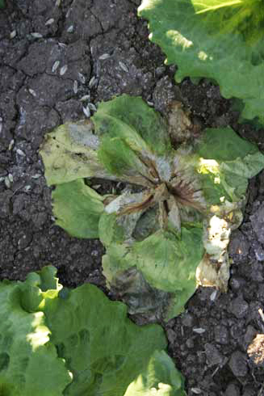

Slide 12
Conducive environmental condition
Hot
Host plant
Melon

Slide 13
Pathogen Name
Fusarium solani f.sp. cucurbitae
First technique mentioned in vegetable pest ID cards
Plant resistant varieties

Slide 15
Conducive environmental condition
Warm and wet
Host plant
Potato

Slide 16
Pathogen Name
Pectobacterium (=Erwinia) carotovora)
First technique mentioned in vegetable pest ID cards
Plant in well-drained areas

Slide 18
Conducive environmental condition
Cold
Host plant
Cabbage

Slide 19
Pathogen/disorder Name
Cold injury
First technique mentioned in vegetable pest ID cards
Sprinkle plants prior to cold weather

