Slide 1
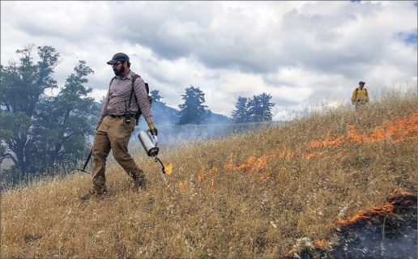
Prescribed Fire on Private Lands Workshop
Opportunities for utilizing fire as a tool
Photo Credit: Lenya Quinn-Davidson

Slide 2
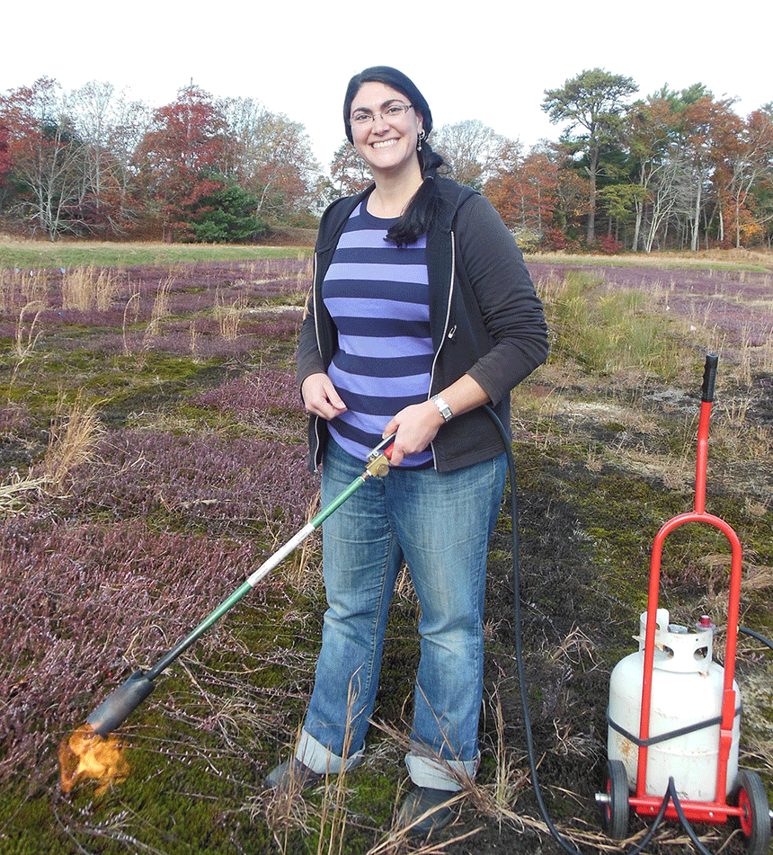
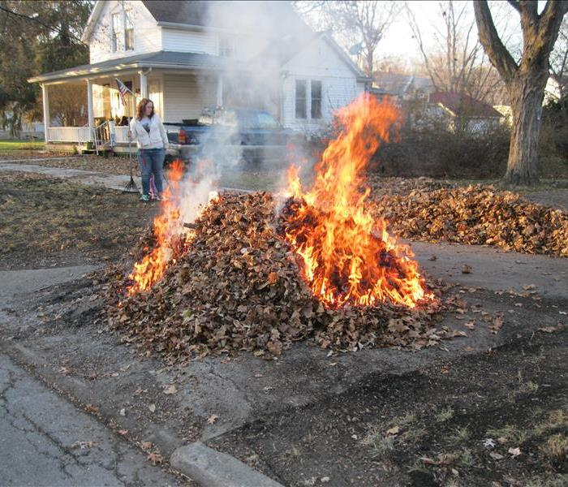
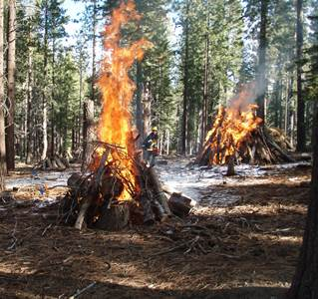
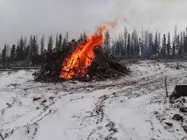
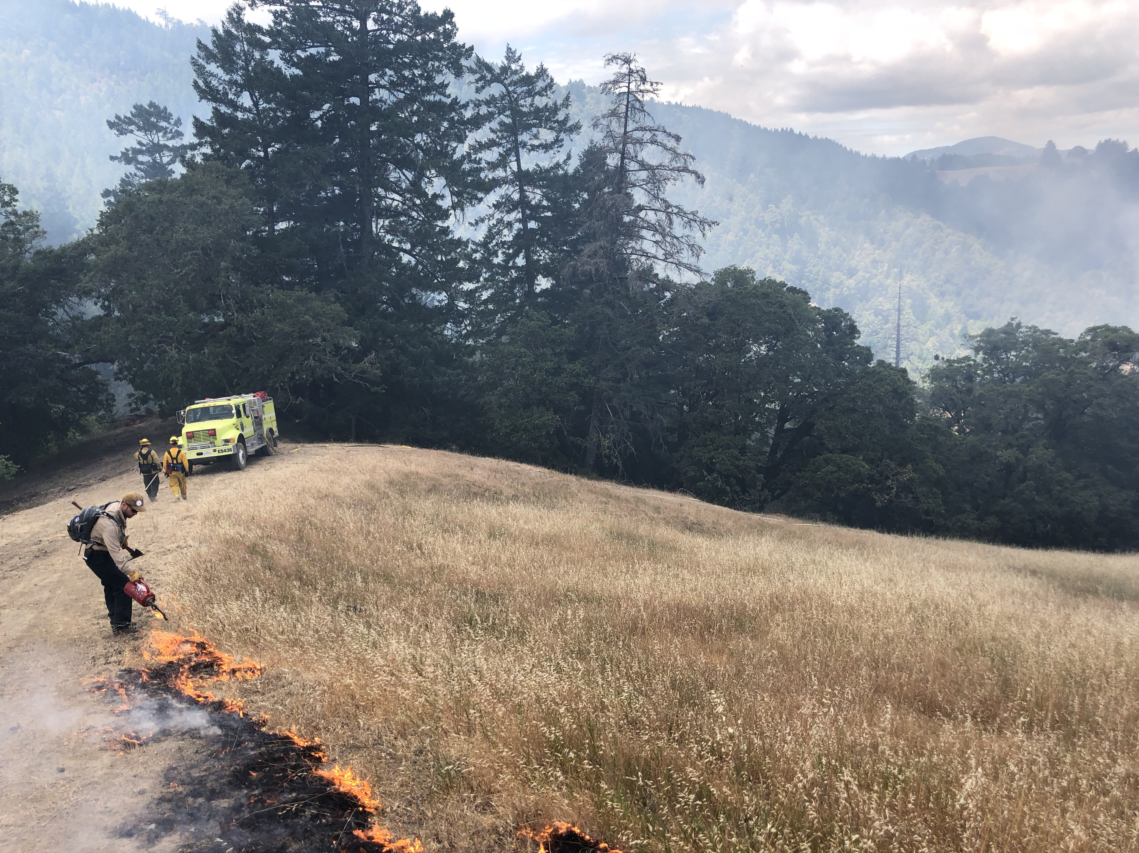
Application of prescribed fire as a mgmt. tool
Ag.mass.edu
servpro
USDA Forest Service
Colorado State Forest Service
Photo Credit: Lenya Quinn-Davidson

Slide 3
Implementation options for prescribed fire:
OPTION | Regulatory Compliance | Liability | Cost
DIY | LE-5 or LE-7 permit with burn plan, smoke permit | No indemnification | Labor
PBA | LE-5 or LE-7 permit with burn plan, smoke permit | No indemnification | Labor & Lunch
Contractor (Burn Boss) | LE-5 or LE-7 permit with burn plan, smoke permit | Still open to liability, but partial coverage | Up to $10K/day
CALFire VMP | CEQA, LE-7 permit with burn plan, smoke permit | Indemnifies the landowner | Time and Cost share

Slide 4
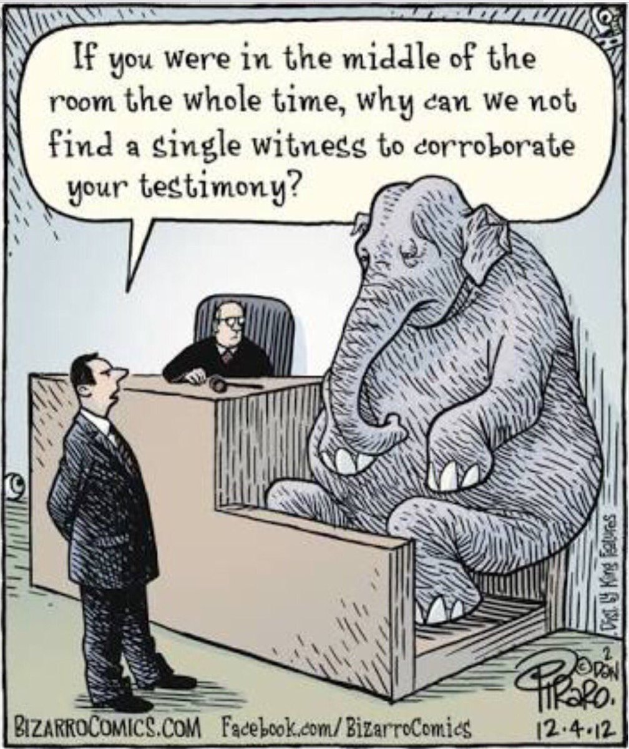
Let’s talk about Liability (in California)
Even with a permit one may be liable:
For damages
For suppression costs
Strict Liability vs negligence
Hope that compliance with permit constitutes “prima facie”
Benefit of VMP: CalFire 100% liable
Proposed Burn Boss Certification Insurance Pool

Slide 5

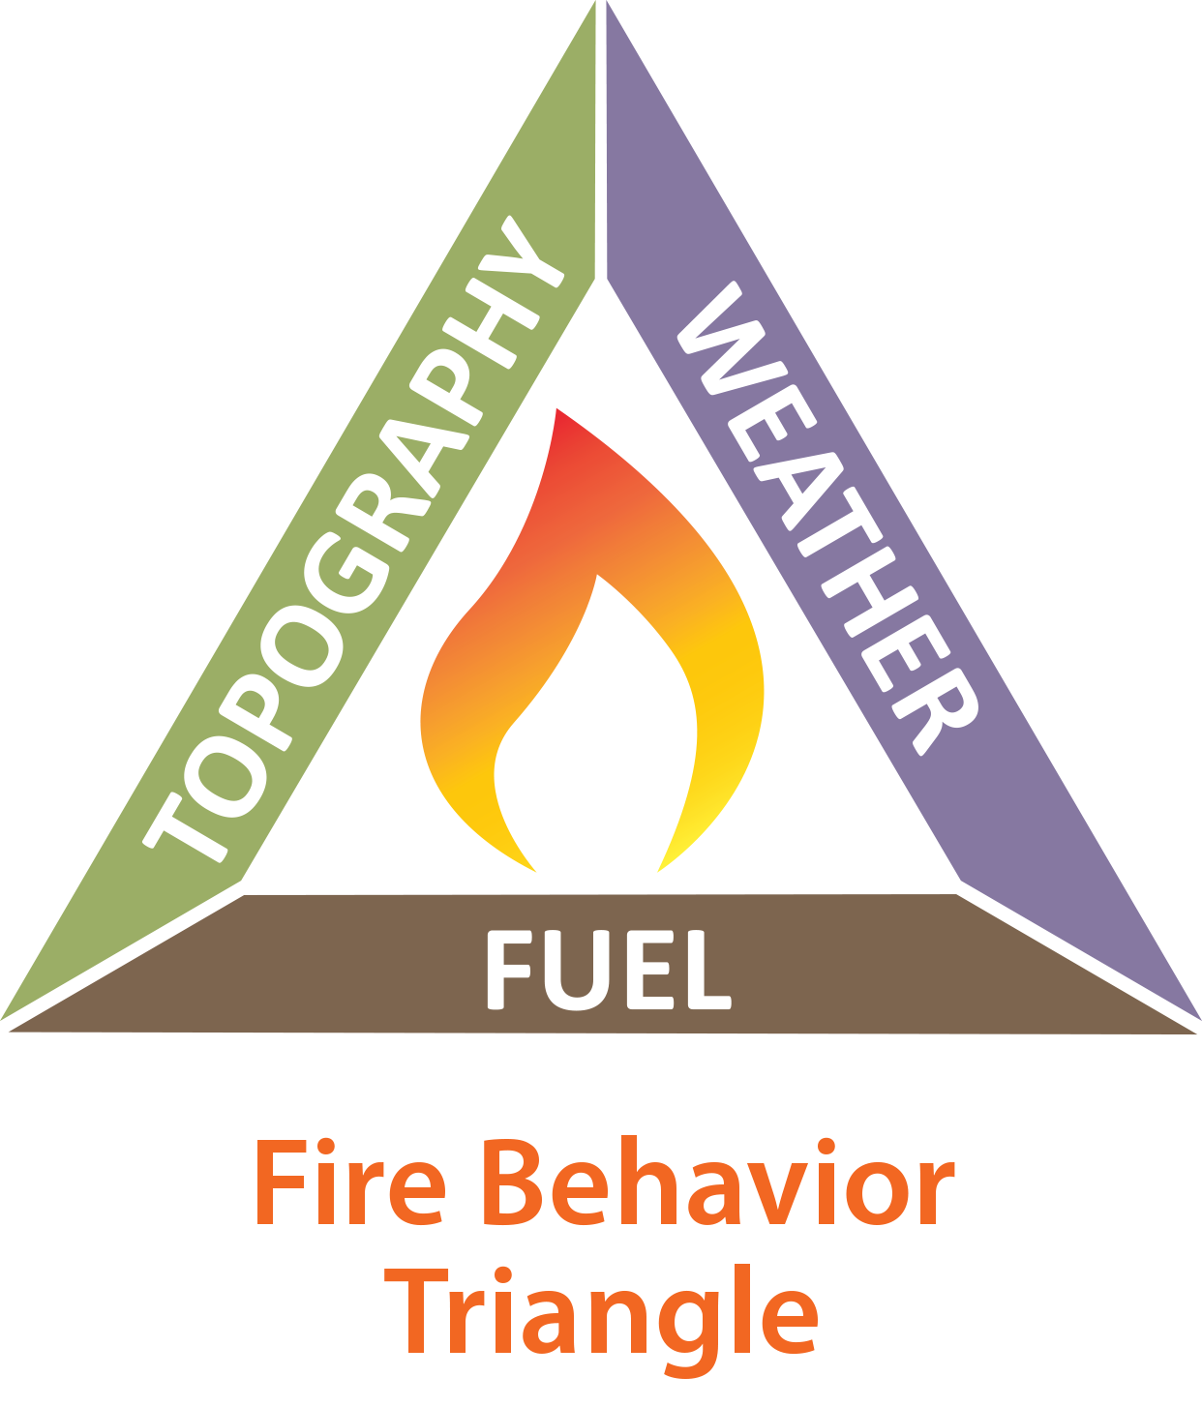
Options to mitigate risk?
Hiring Resources
Insurance
Pre-Treatment of fuels
Careful weather prescription development
Thoughtful burn plan
Invest in burn unit prep
Invest in tools & equipment
Community partners as resources
Be conservative
Commit to the ENTIRE process (plan to patrol)
Consider Efficacy and Longevity
What is the cost of doing something versus the cost of assuming the stability of the status quo?

Slide 6





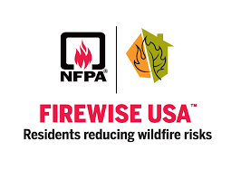




Partners with Resources:

