Slide 1
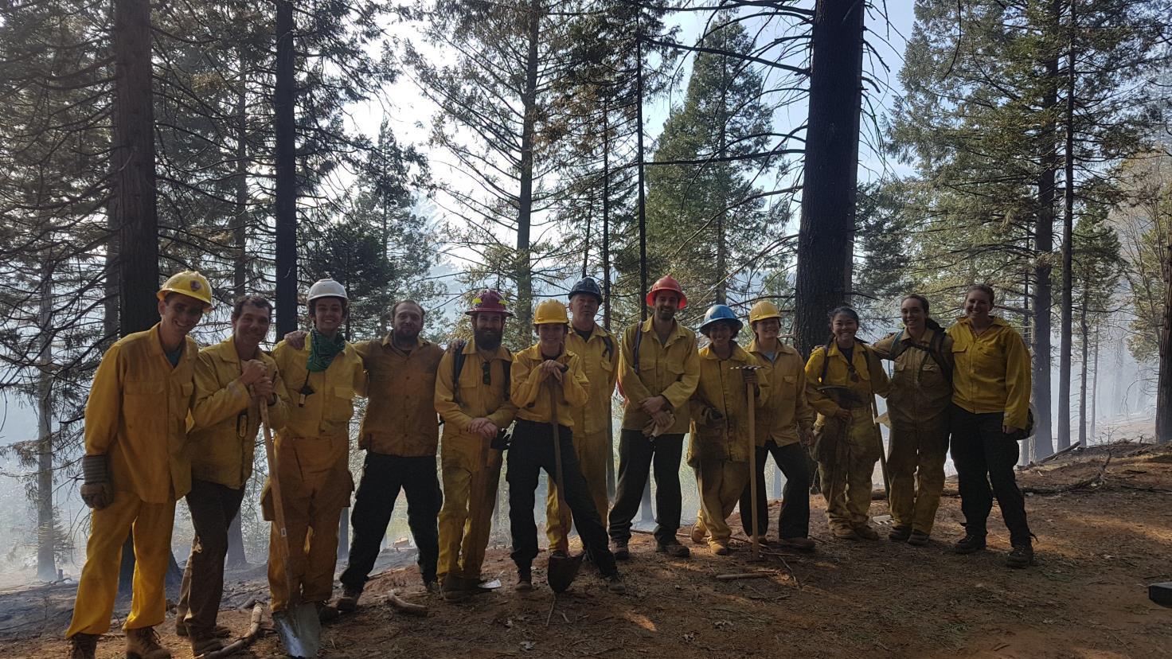
Winter burning opportunities for private landowners
April, 2019 (no permit required)

Slide 2
Outline
What is winter burning?
Pros and cons
Where and when it is possible
Case study of winter burning success

Slide 3
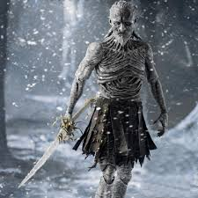
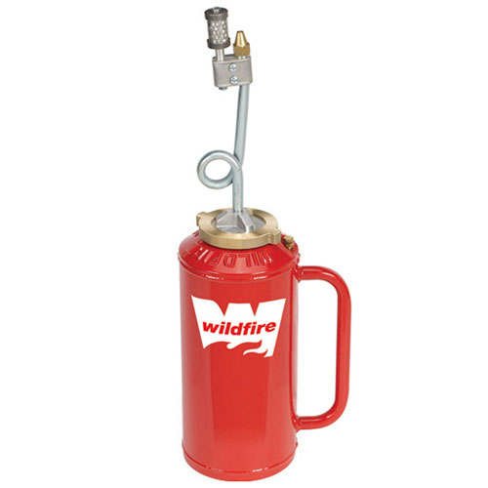
What winter burning is not:
A song of ice and fire

Slide 4
What is winter burning?
Two definitions:
The ecologically logical definition
The ecologically illogical but regulatorily logical definition

Slide 5
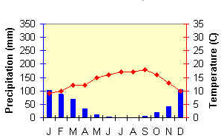
Windows and winks: Ecosystem v. permit seasons in CA
Overlap is small (2018 in El Do County… 3 days)
So far in 2019 at Forestry camp… 1 day
Burning “winks”
Burning “winks”
Window = multiple days “in prescription”
Wink = one or two days
Permit window
Permit window
Ecosystem window

Slide 6

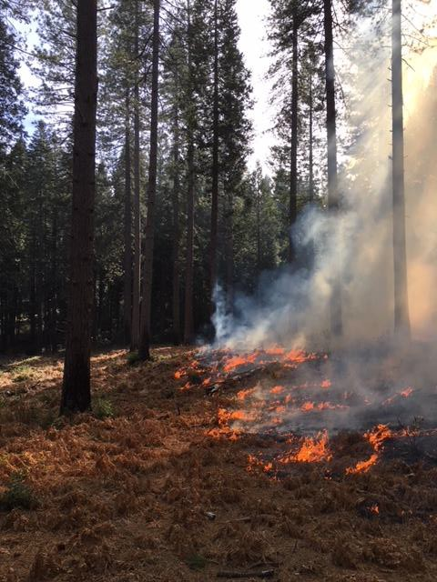

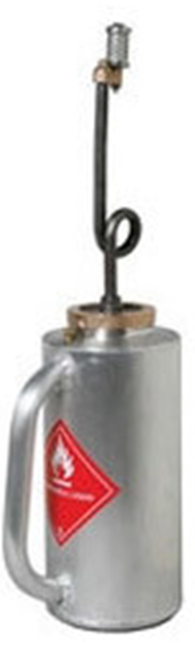
Nudging wink-wink burn opportunities
Must be:
As patient as Jon Snow
As nimble as Arya Stark
Winter burning at 4,000’ elevation
February, 2018

Slide 7
Winter burning pros:
No permit required
Low risk (relatively)
More opportunities
Effective at inhibiting ladder fuel development
Effective at reduce the fuel size that has the biggest impact on fire behavior (smaller diameter fuel)
Gateway burning, to get experience for permit-burning

Slide 8
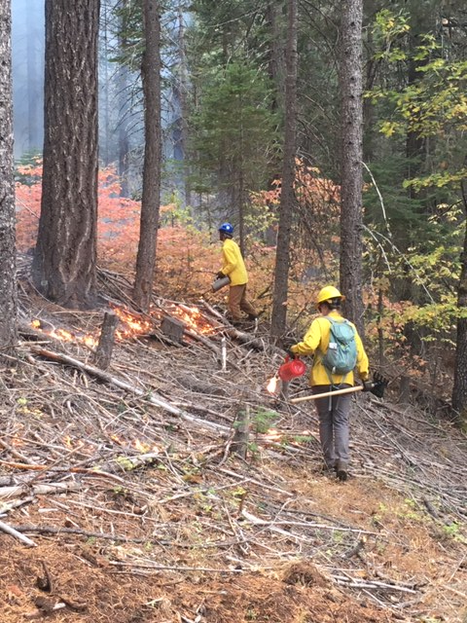
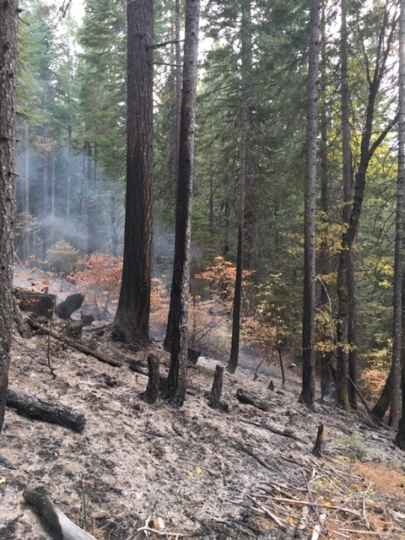

Slide 9
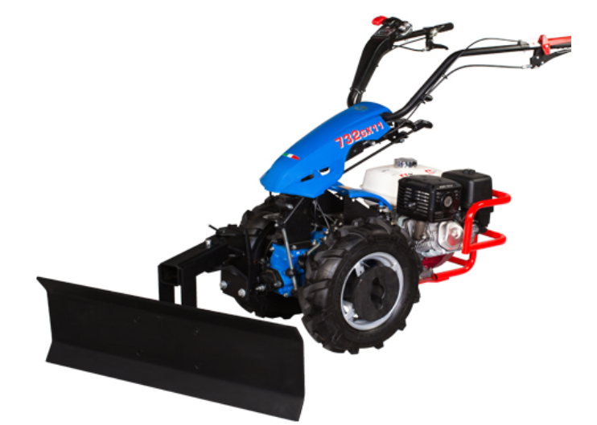
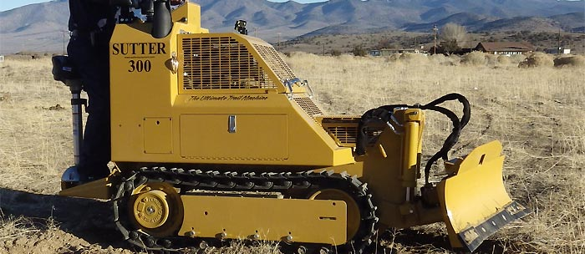
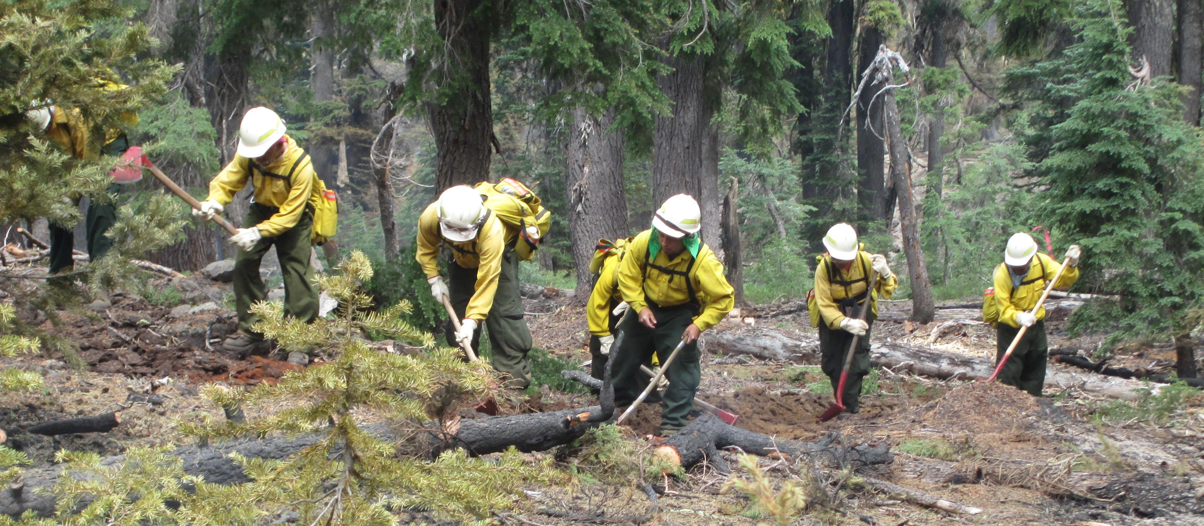
Side bar 1:

Slide 10
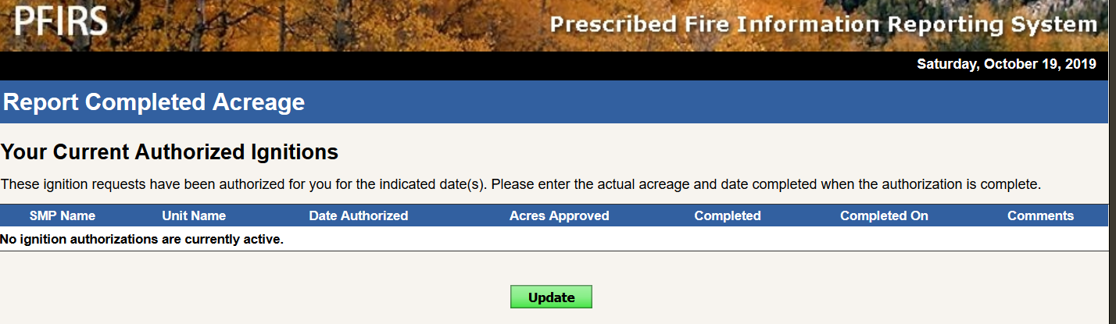
Side bar 2: Reporting smoke status via PFIRS

Slide 11
Winter burning cons:
More prep work, potentially
Less consumption, generally
May take multiple burns/years to accomplish objectives
Not aligned with natural disturbance regime seasonality (but neither is most permit burning)

Slide 12
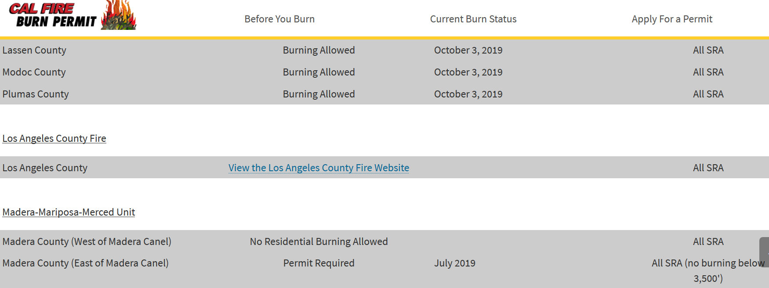
Finding out the permit status… get ready to be dazed and confused

Slide 13
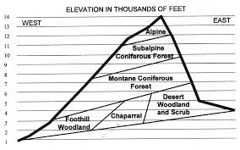
Physical geographic factors- elevation
Below snow-rain transition
This has been going up…
Rule of thumb:
Presence of ponderosa pine = potential for winter burning

Slide 14

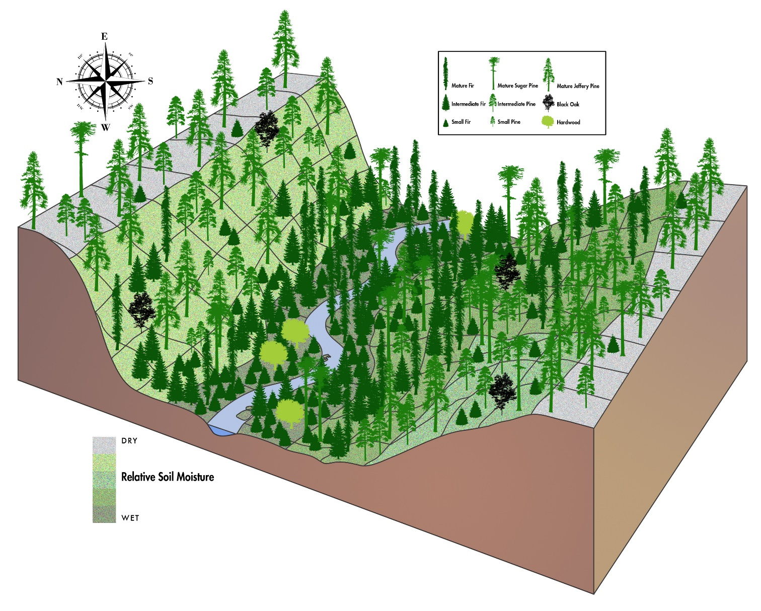
Physical geographic factors- aspect
Look for south- and west facing slopes
Image from Malcolm North

Slide 15
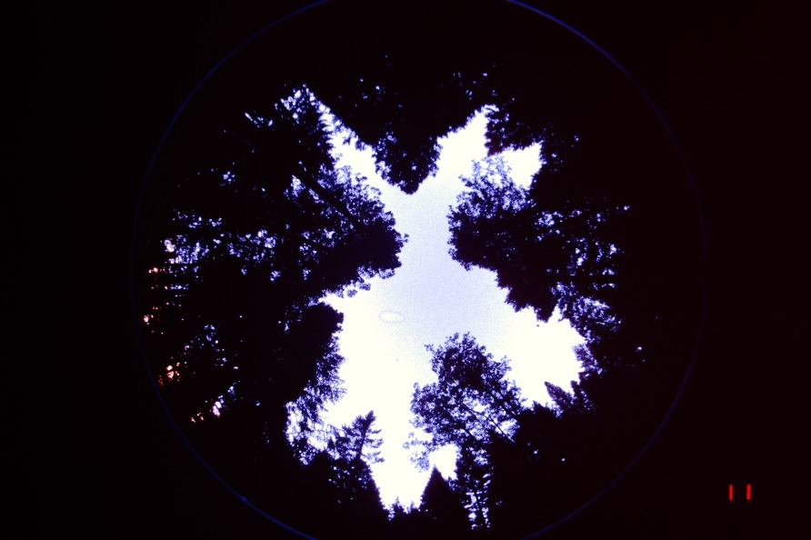
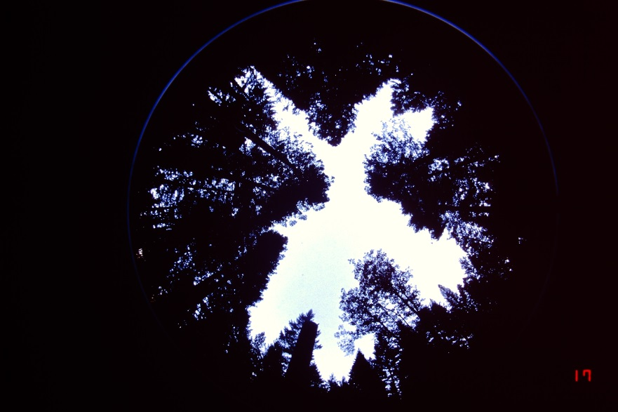
Forest structure and composition factors
You can influence these with silviculture
Canopy Cover
Rule of thumb: <50% = Potential winter burn opportunity
Unfortunately, removing just small trees often won’t get you there:
Pre-treatment cover = 66%
Post-treatment cover = 63%

Slide 16
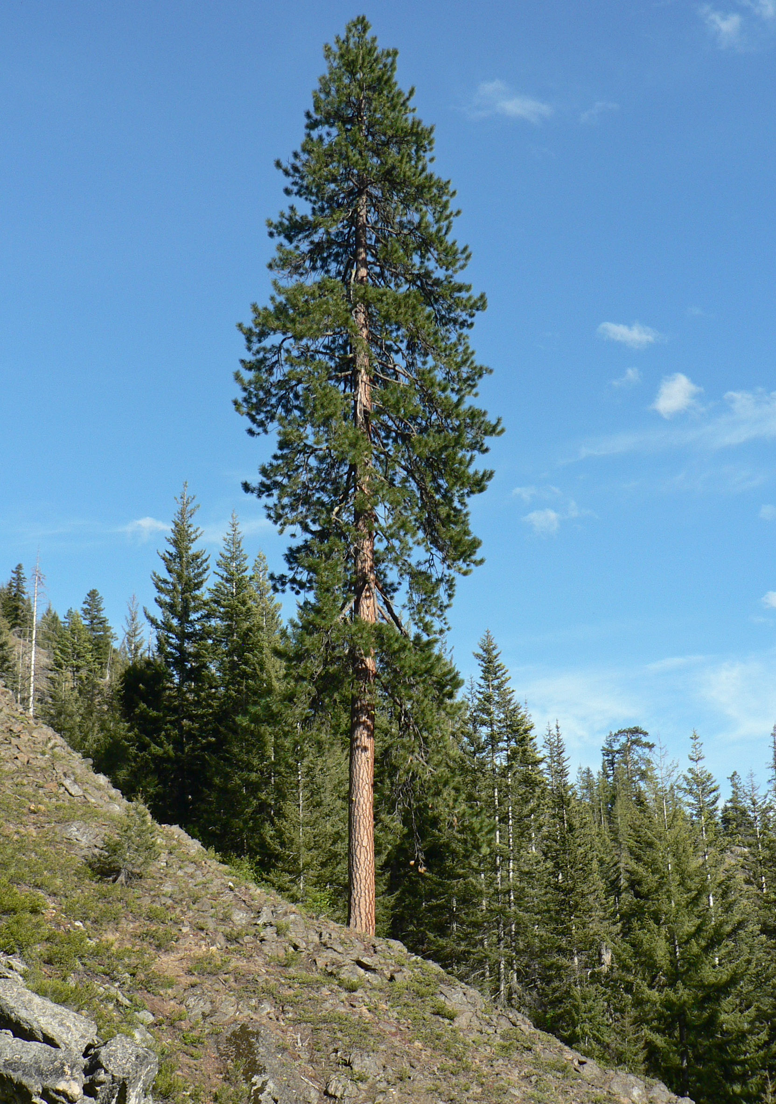
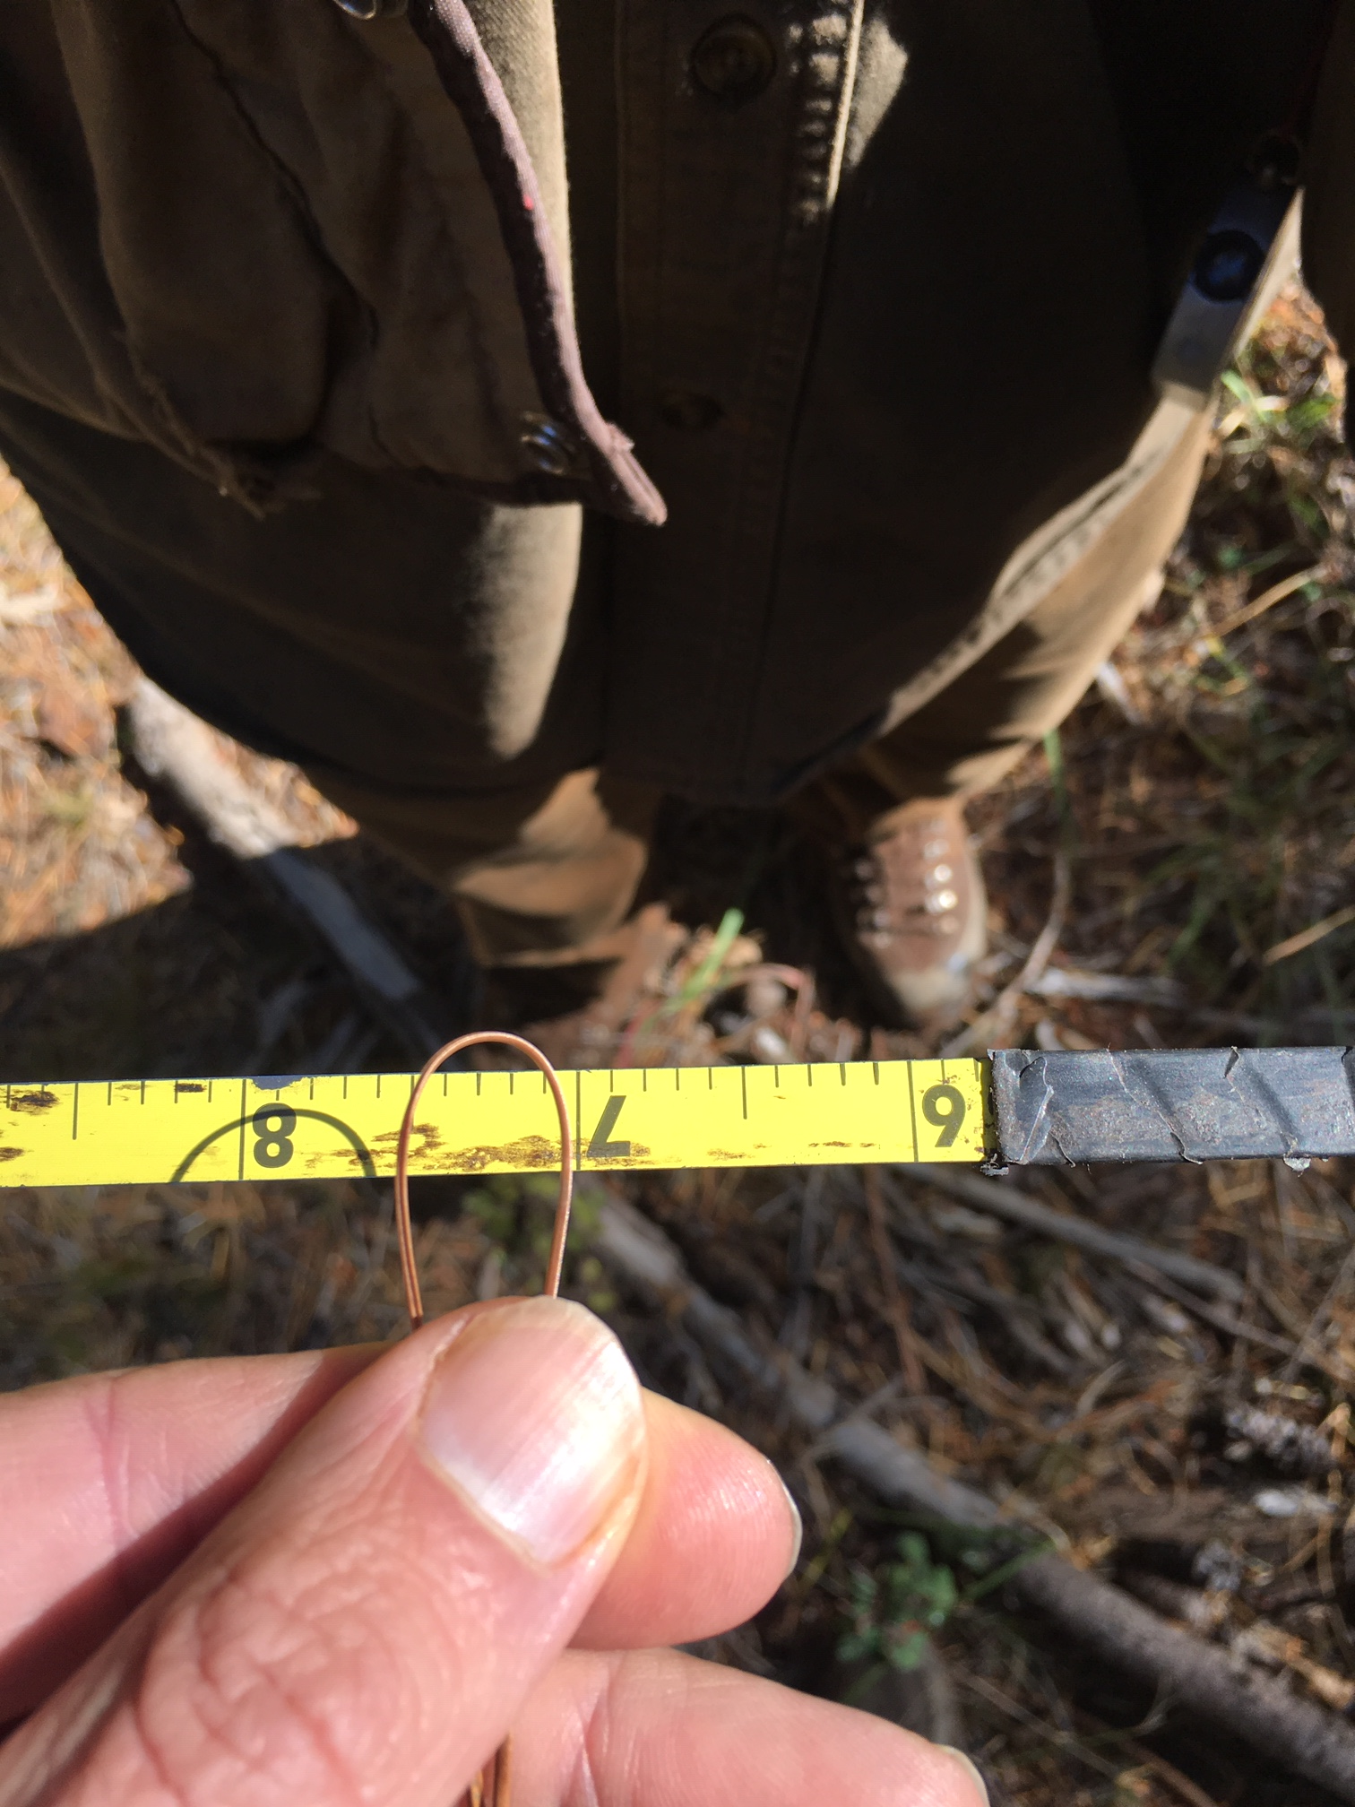
Overstory species composition
Ponderosa pine is the winter burner’s friend
Low crown density
Low bulk density litter (dries out faster)
Rule of thumb: Pine needle snap test

Slide 17
Understory species composition
Flammable species
  Winter season senescence
    E.g. Bracken fern, grass
  Volatile leaves
    E.g. Bear clover
February, 2018
NE facing slope
4,000’ elevation
Thinned canopy
Bracken fern understory

Slide 18
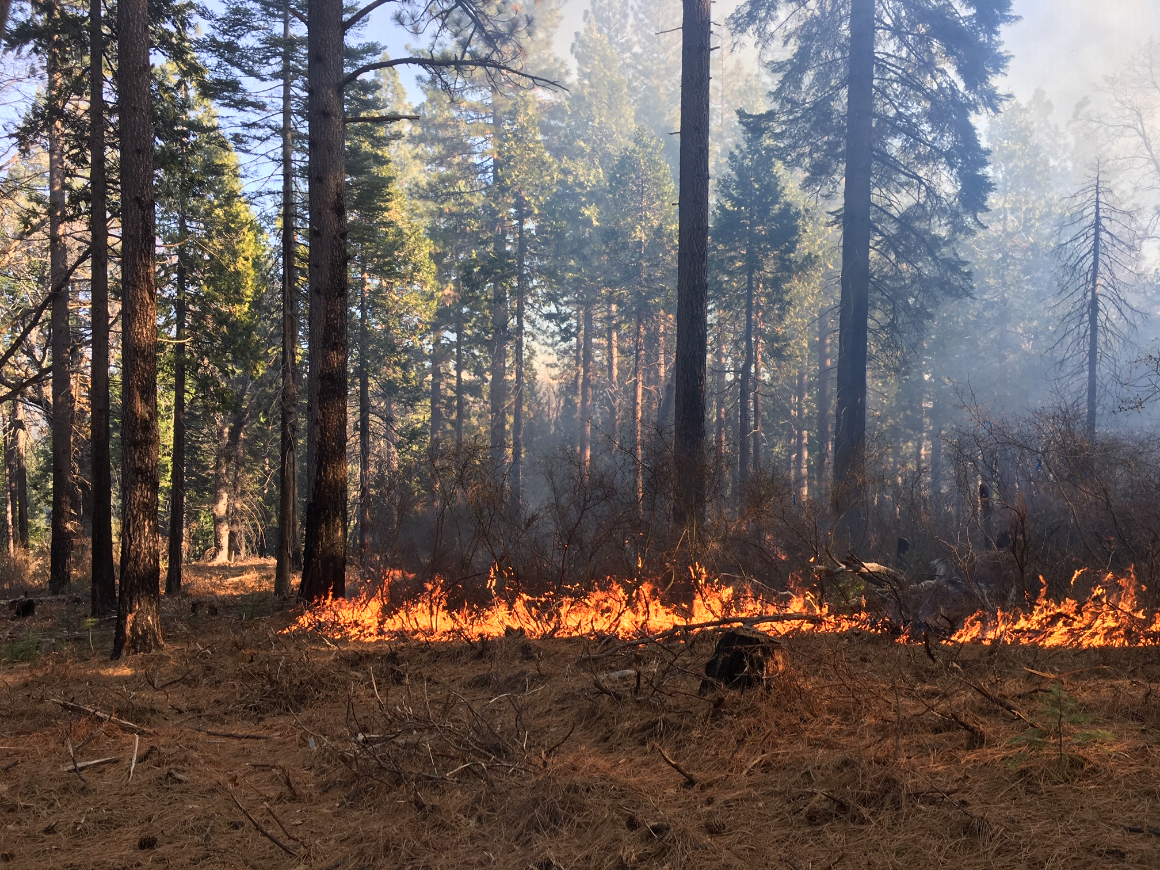
Fuel bed:
Density piece size
January 2, 2019
NE facing slope
60% canopy
4,200’ elevation
Thinned canopy
Masticated fuelbed
(1-yr cured)

Slide 19
Weather is king
Ideal:
Track days since last precipitation
Measure 10-hr fuel moisture, look for 8% or lower
Do snap test
Develop a prescription that works on YOUR property
  E.g. 25 to 40% RH
  Wind < 9mph
  Temp < 75 degrees

Slide 20
Winter burning opportunities- what do weather data suggest?
E.g. 2012-2013 at 4,300’ in the central Sierra Nevadas:
How many days during the winter period had:
  More than 10 days since last precipitation?
  AND Minimum Relative Humidity < 45%?
  And were allowable burn days for air quality?
Number of days
48
37
26

Slide 21
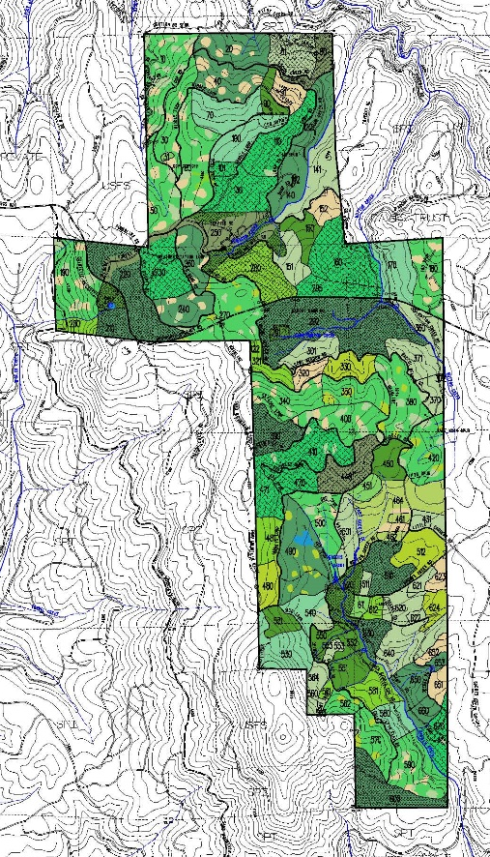
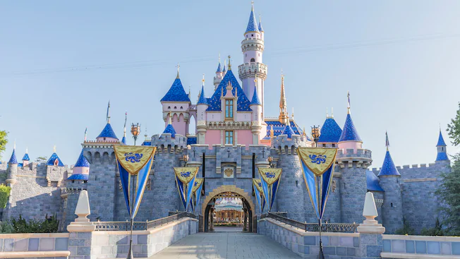
Case study: Blodgett Forest
If it is the Disneyland of forestry, then…
=

Slide 22

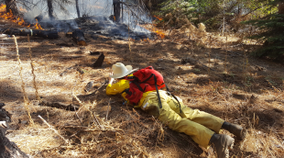
… then winter burning is Mr. Toad’s Wild Ride
=

Slide 23
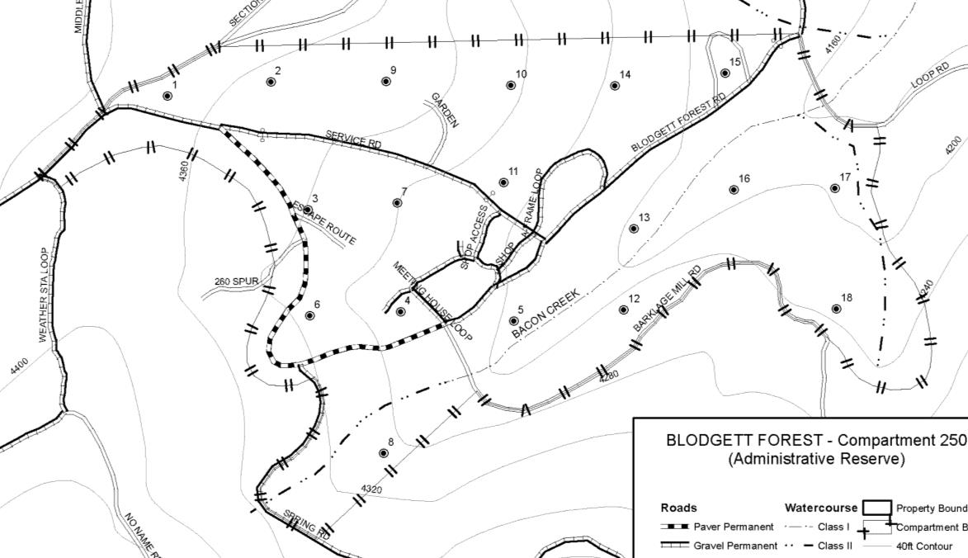
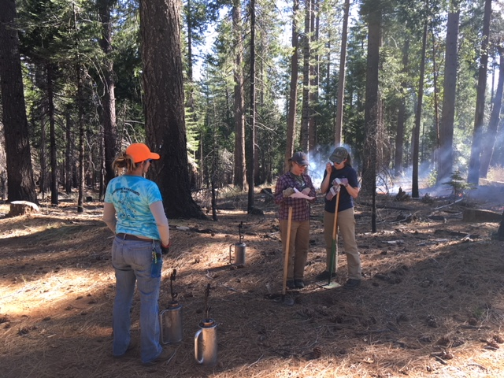
Compartment 250: 60 acres burned in past 6 years
Current torching probability: 0.1
Torching index: 80 mph
Key factors:
Commercial harvest to reduce canopy to 50%
Retention of ponderosa pine trees
Bracken fern in wetter areas

Slide 24
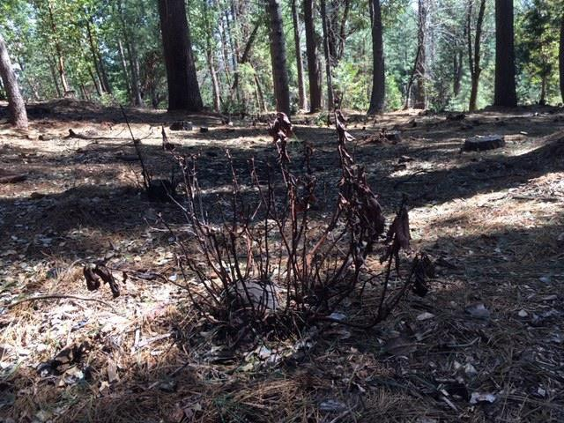
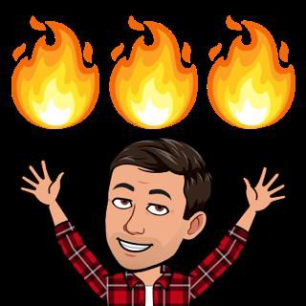
Case study: My 5 acres burned in past 5 years
Chainsaw thin
Pile burn
Pilecast burn
Broadcast burn
Prescription RH 30-40
FM 6-10
WS 0-5 mph

Slide 25
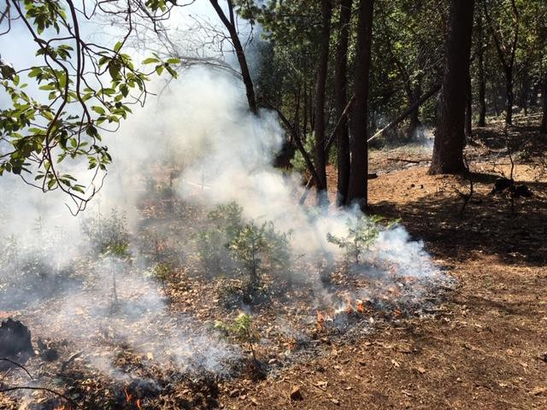
My winter weather toolkit
Tools:
Drip torch $140
McCloud $60
5-gal backpack pump $150
Pocket weather meter $100
Total: $450*
*Local RAWS station gives 10-hr FMC

Slide 26
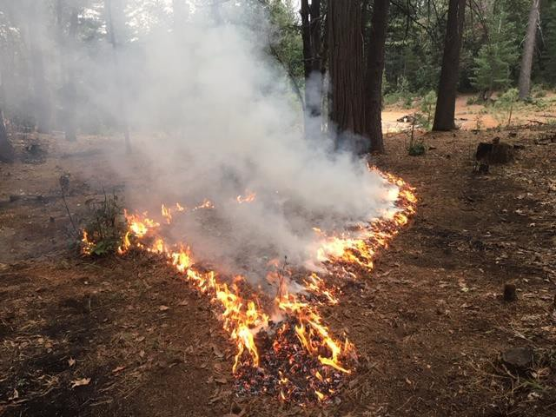
Fiat flamma!
ryork@berkeley.edu

