Slide 1
Planting a Bare Root
Fruit Tree
Terence Welch
Orchardscapes
831-435-8733

Slide 2
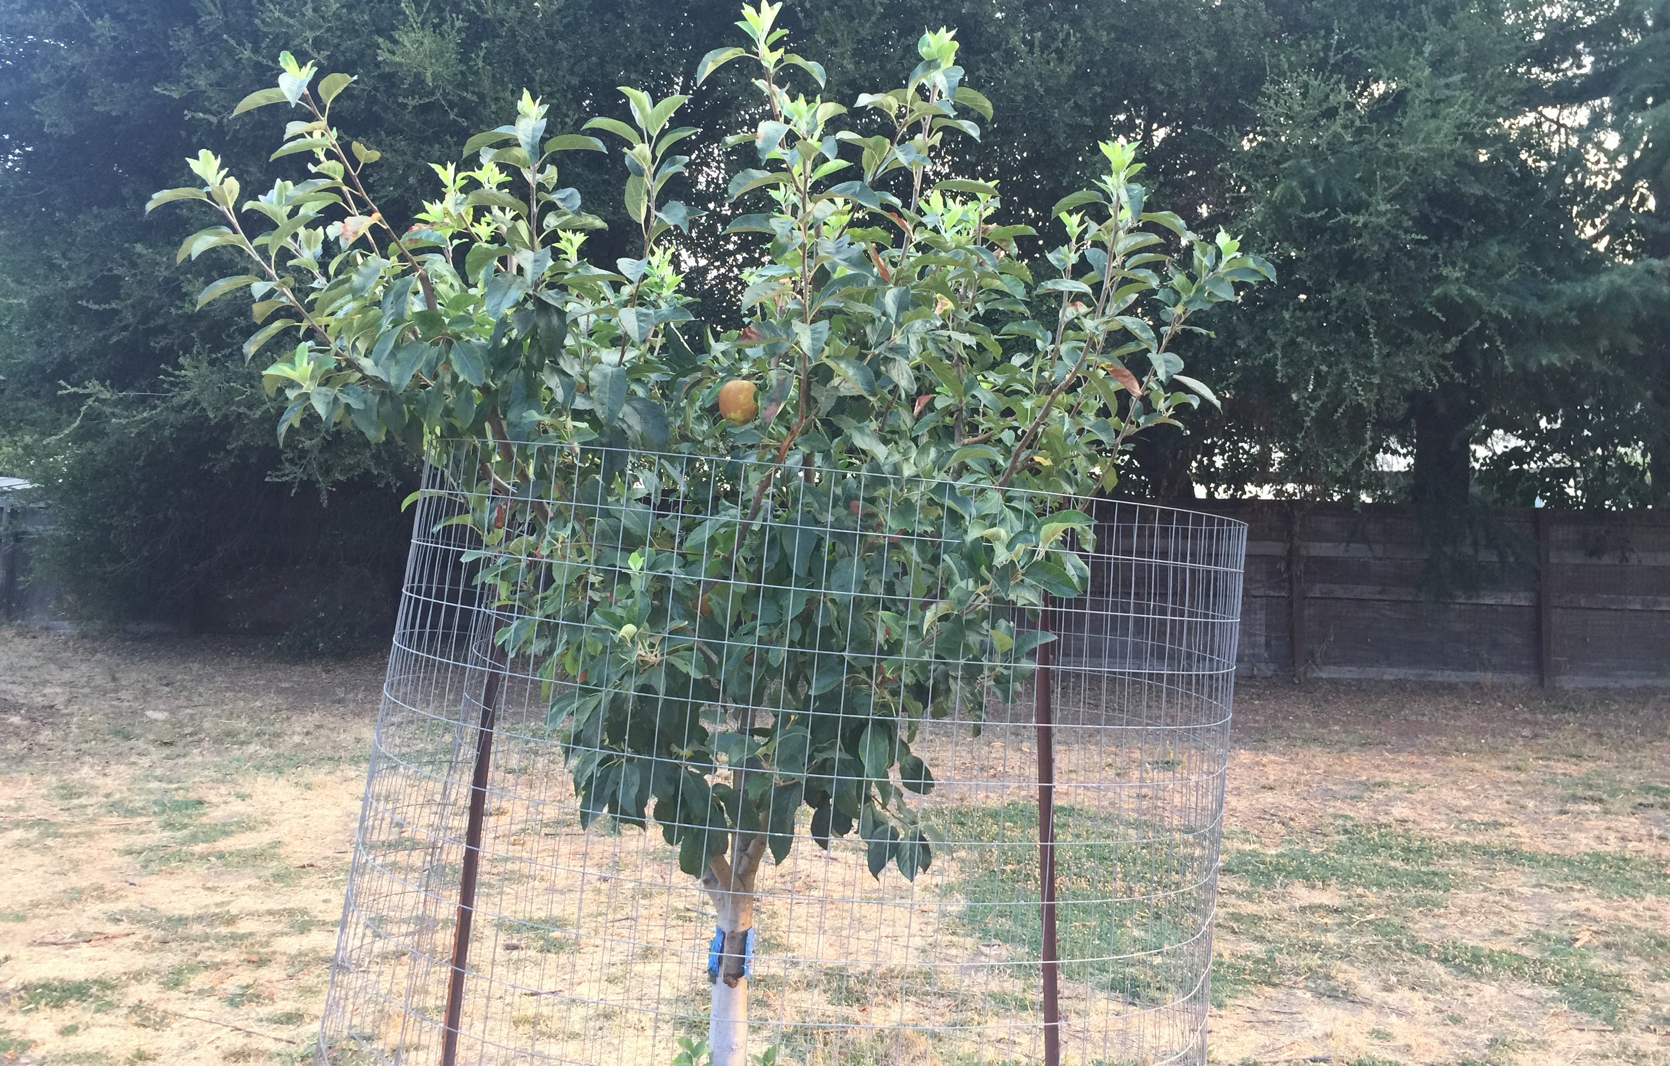
Deer Protection
Apple, 6’, 12 gauge wire with 3 T posts

Slide 3
Gopher basket, protection
-5 or 15 gallon galvanized basket, available at most nurseries, including San Lorenzo Garden Center
-Figs only: largest circular stainless steel basket, approximately 36” in diameter, 15” tall, available from Thomas Whitman at Gophers Unlimited, 303 Potrero, Suite 39, Santa Cruz. 831-335-2400

Slide 4
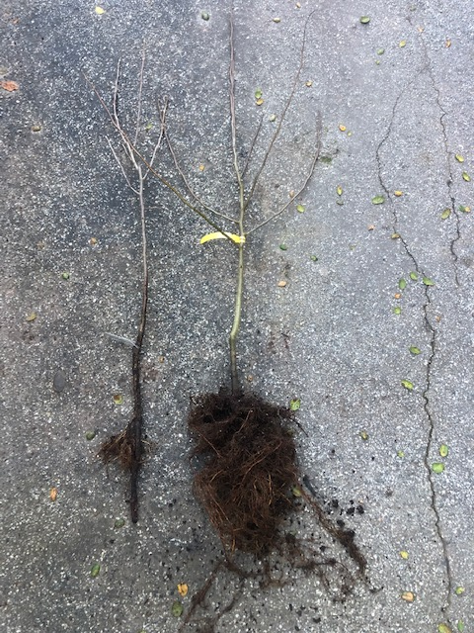
Choose healthy root system, undamaged

Slide 5
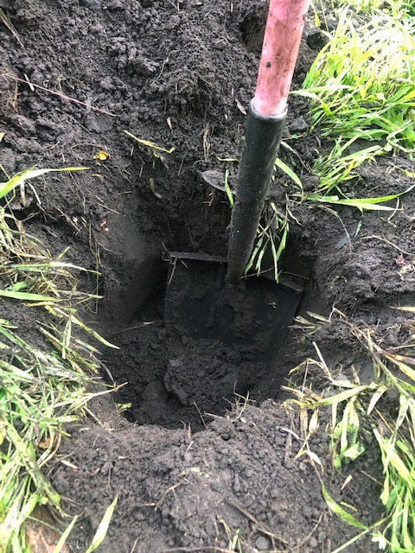
Dig hole, size of gopher basket

Slide 6
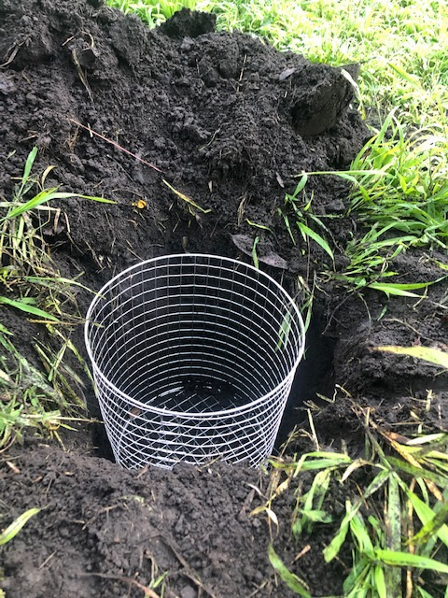
Use gopher basket, 15 gallon galvanized preferred

Slide 7
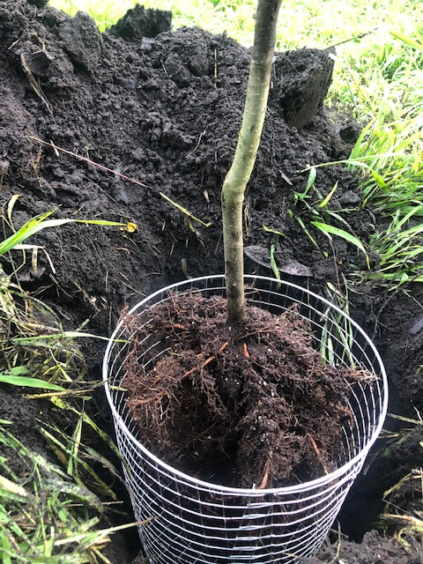
Plant, with graft scar facing northeast,

Slide 8
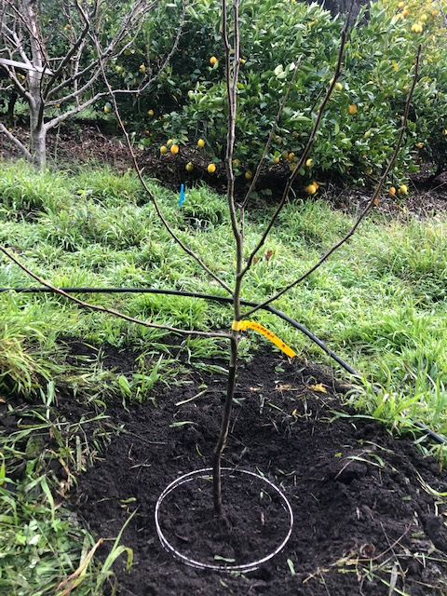
Fill hole, plant 2” higher than grade

Slide 9
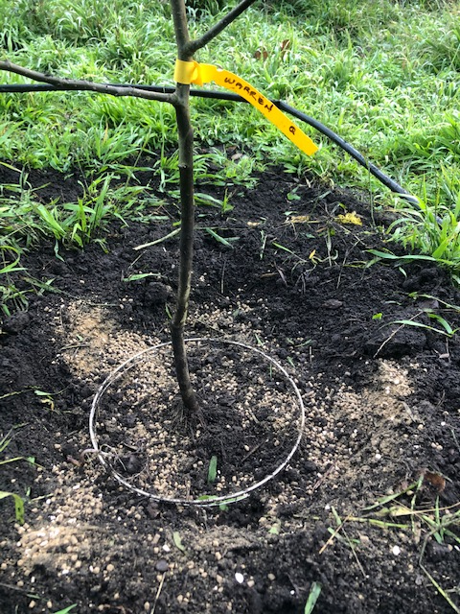
Fertilize and Compost

Slide 10
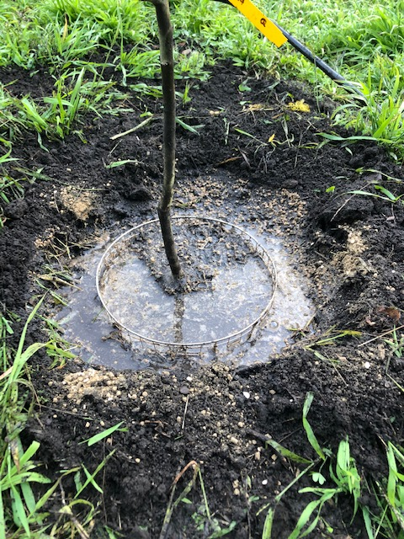
Flood area inside berm with water, 2x

Slide 11
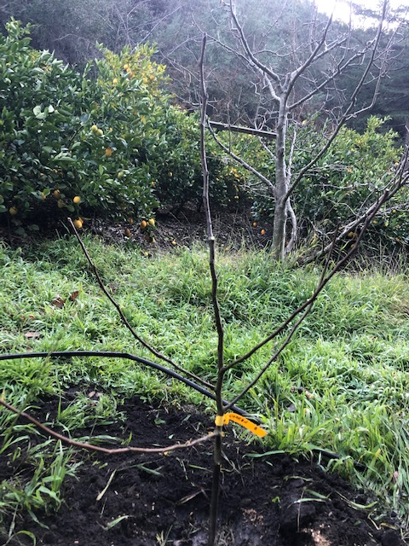
Prune leader and side branches

Slide 12
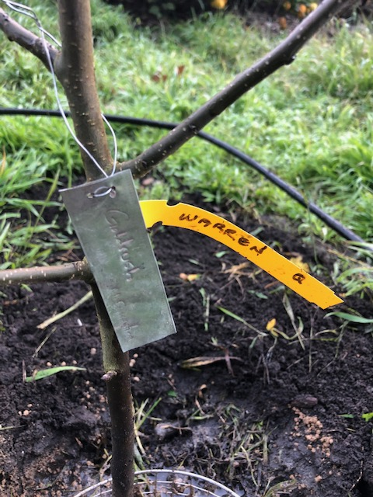
Label with a metal tag!

Slide 13
Low chill varieties (climate change)
<100 hours=extremely low chilling requirement. Example: most figs, Dorsett Golden Apple.
100-300 hours= very low chilling requirement. Example: Anna Apple.
300-500 hours=low chilling requirement. Example: Mid Pride Peach, Santa Rosa Plum, Fuji & Gala Apple. Goldrush Apple (although listed at 800 hours!)
Over 500-700 hours=moderate chilling requirement, riskier in our climate. Example: Gold Dust Peach
Over 700 hours=high chill, not recommended for our climate. Example: Northern Spy, Honeycrisp Apples, most European Plums.
Chill hours=32-45 degrees F. between November 1 and February 28. Each hour over 60 degrees F. negates an hour of chill.
Bay Laurel Nursery specializes in low chill apples, as it is located in Southern California. Mail order, order early.

Slide 14
Adapting to Climate Change
Plant on north facing slopes, for added chill hours, and fewer negating hours.
Plant subtropicals, like citrus and avocado. These trees are not drought tolerant however.
Mulch deeply to preserve water.
Recycle household water into the garden.

Slide 15
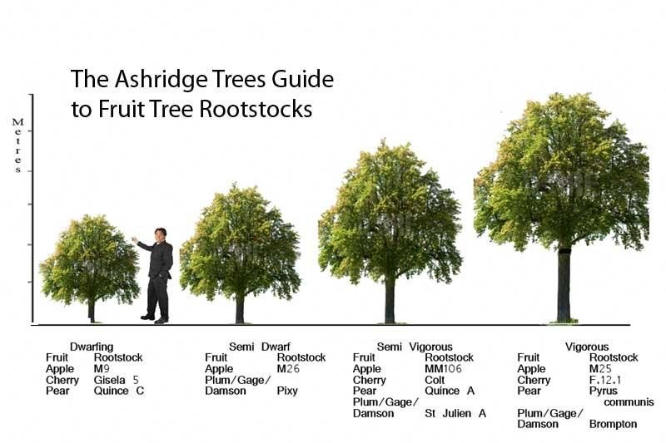
Relative sizes- rootstocks (climate change)

Slide 16
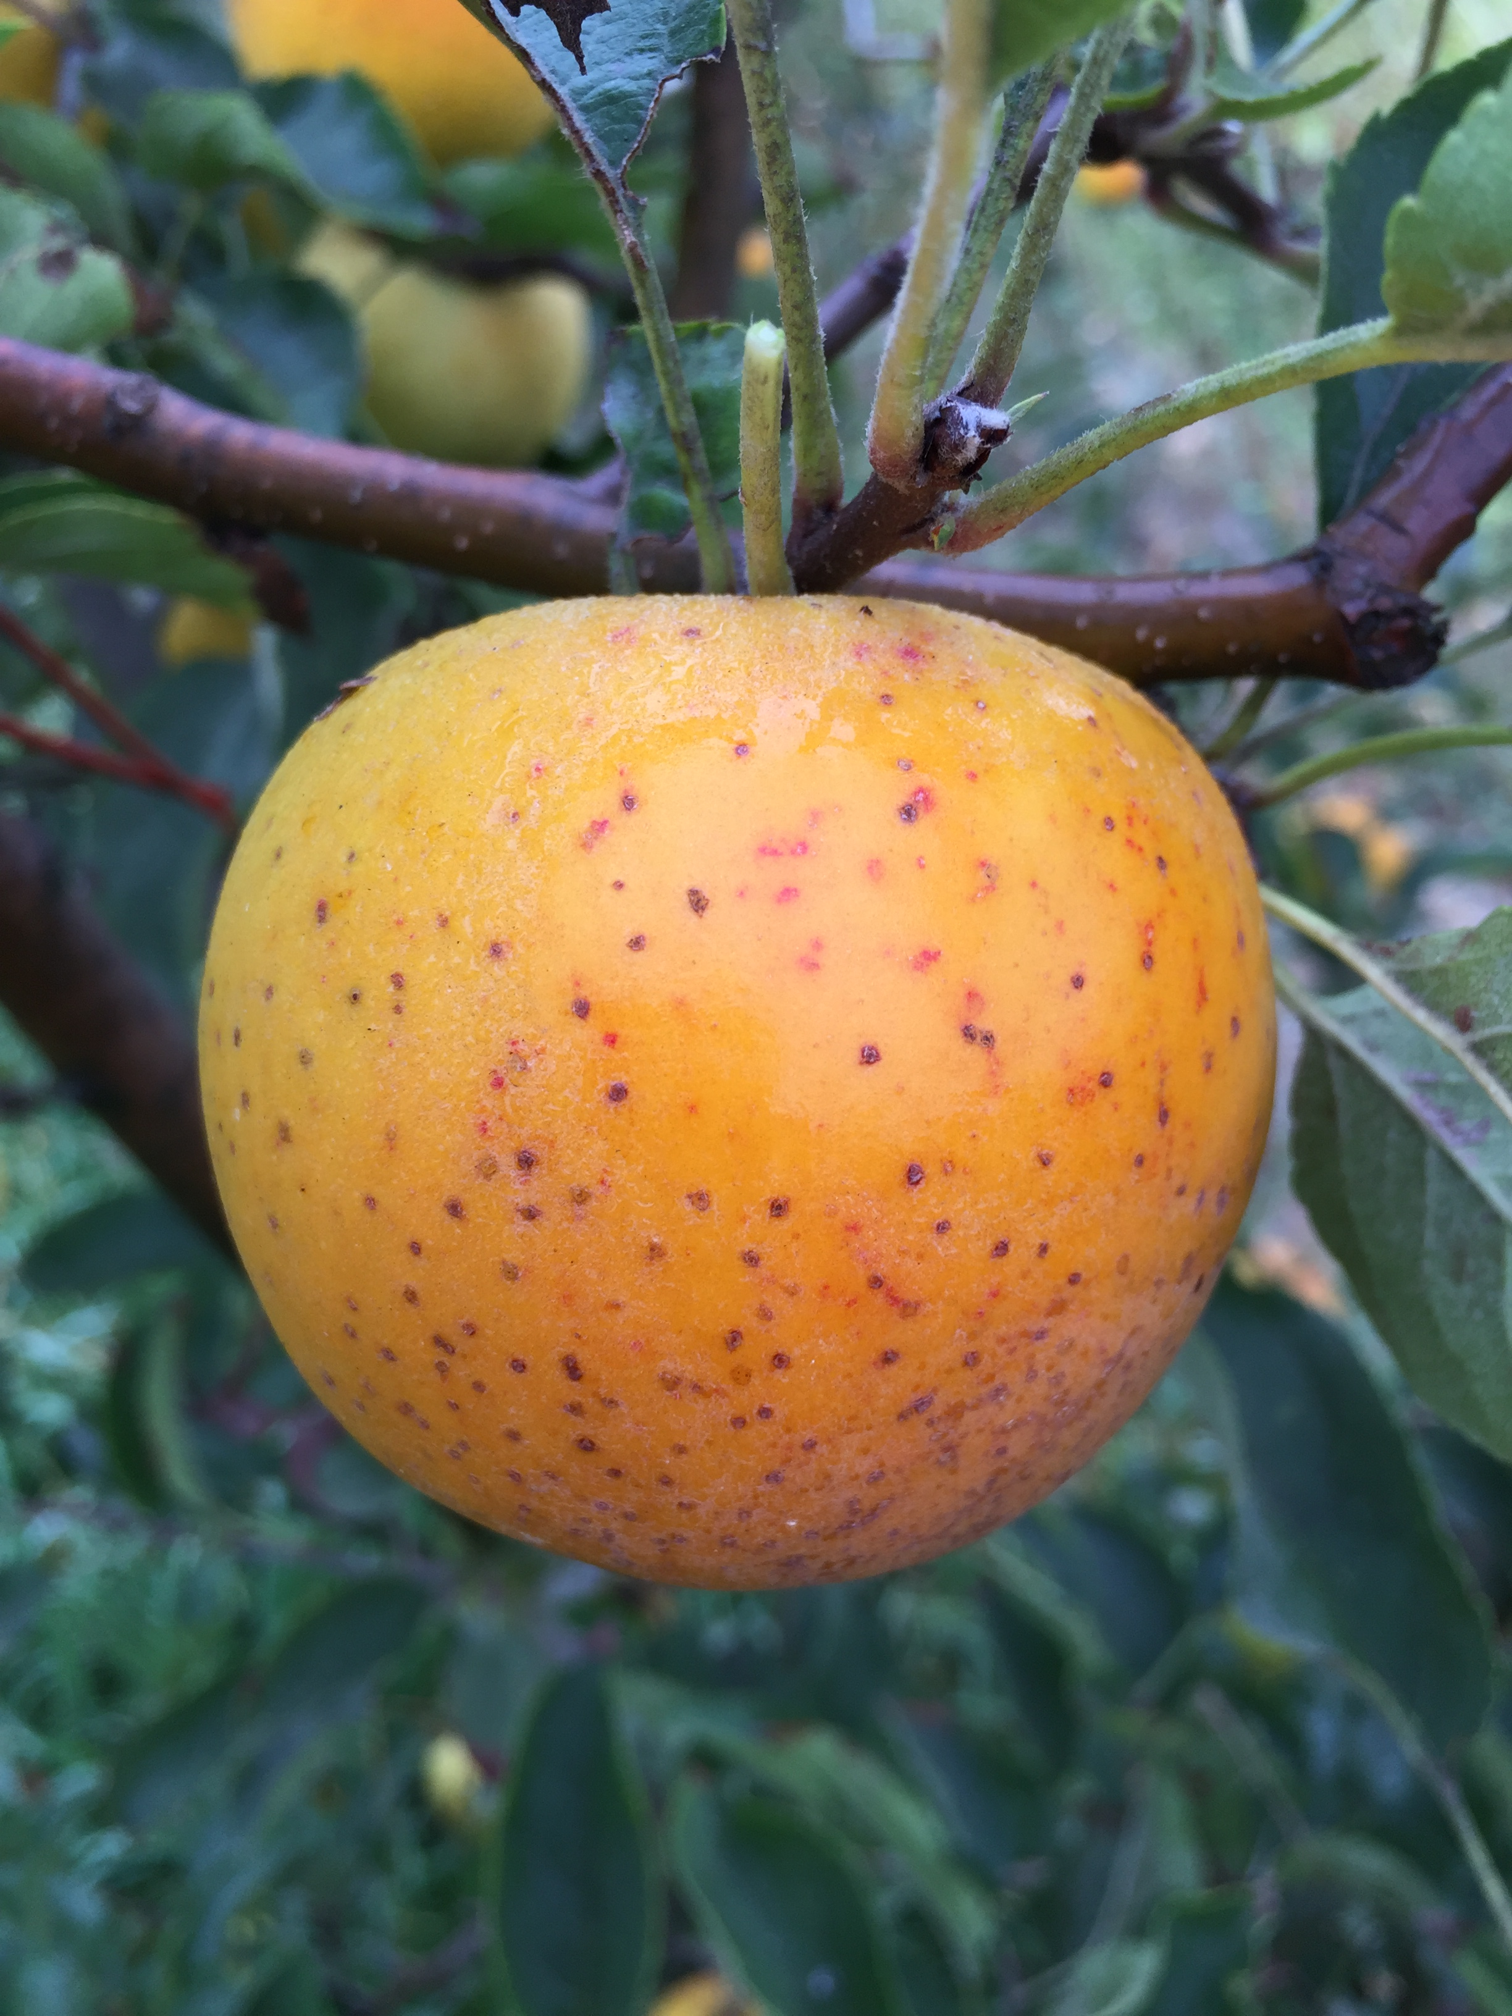
Goldrush, showing prominent lenticels

Slide 17
Goldrush Apple
1972, Purdue, Gold Delicious x Coop 17
Uses: Fresh, Juice, Cider, Apple Butter
Bred for scab and powdery mildew resistance
High sugar, High acid, mellows in cold storage
Harvest 10/1-10/10
Will store till May with proper conditions
Medium size apple, very dense, will bruise during harvest when ripe, handle gently.
Tree is low vigor. Use vigorous rootstocks. Thin crop by pruning, as it oversets.

Slide 18
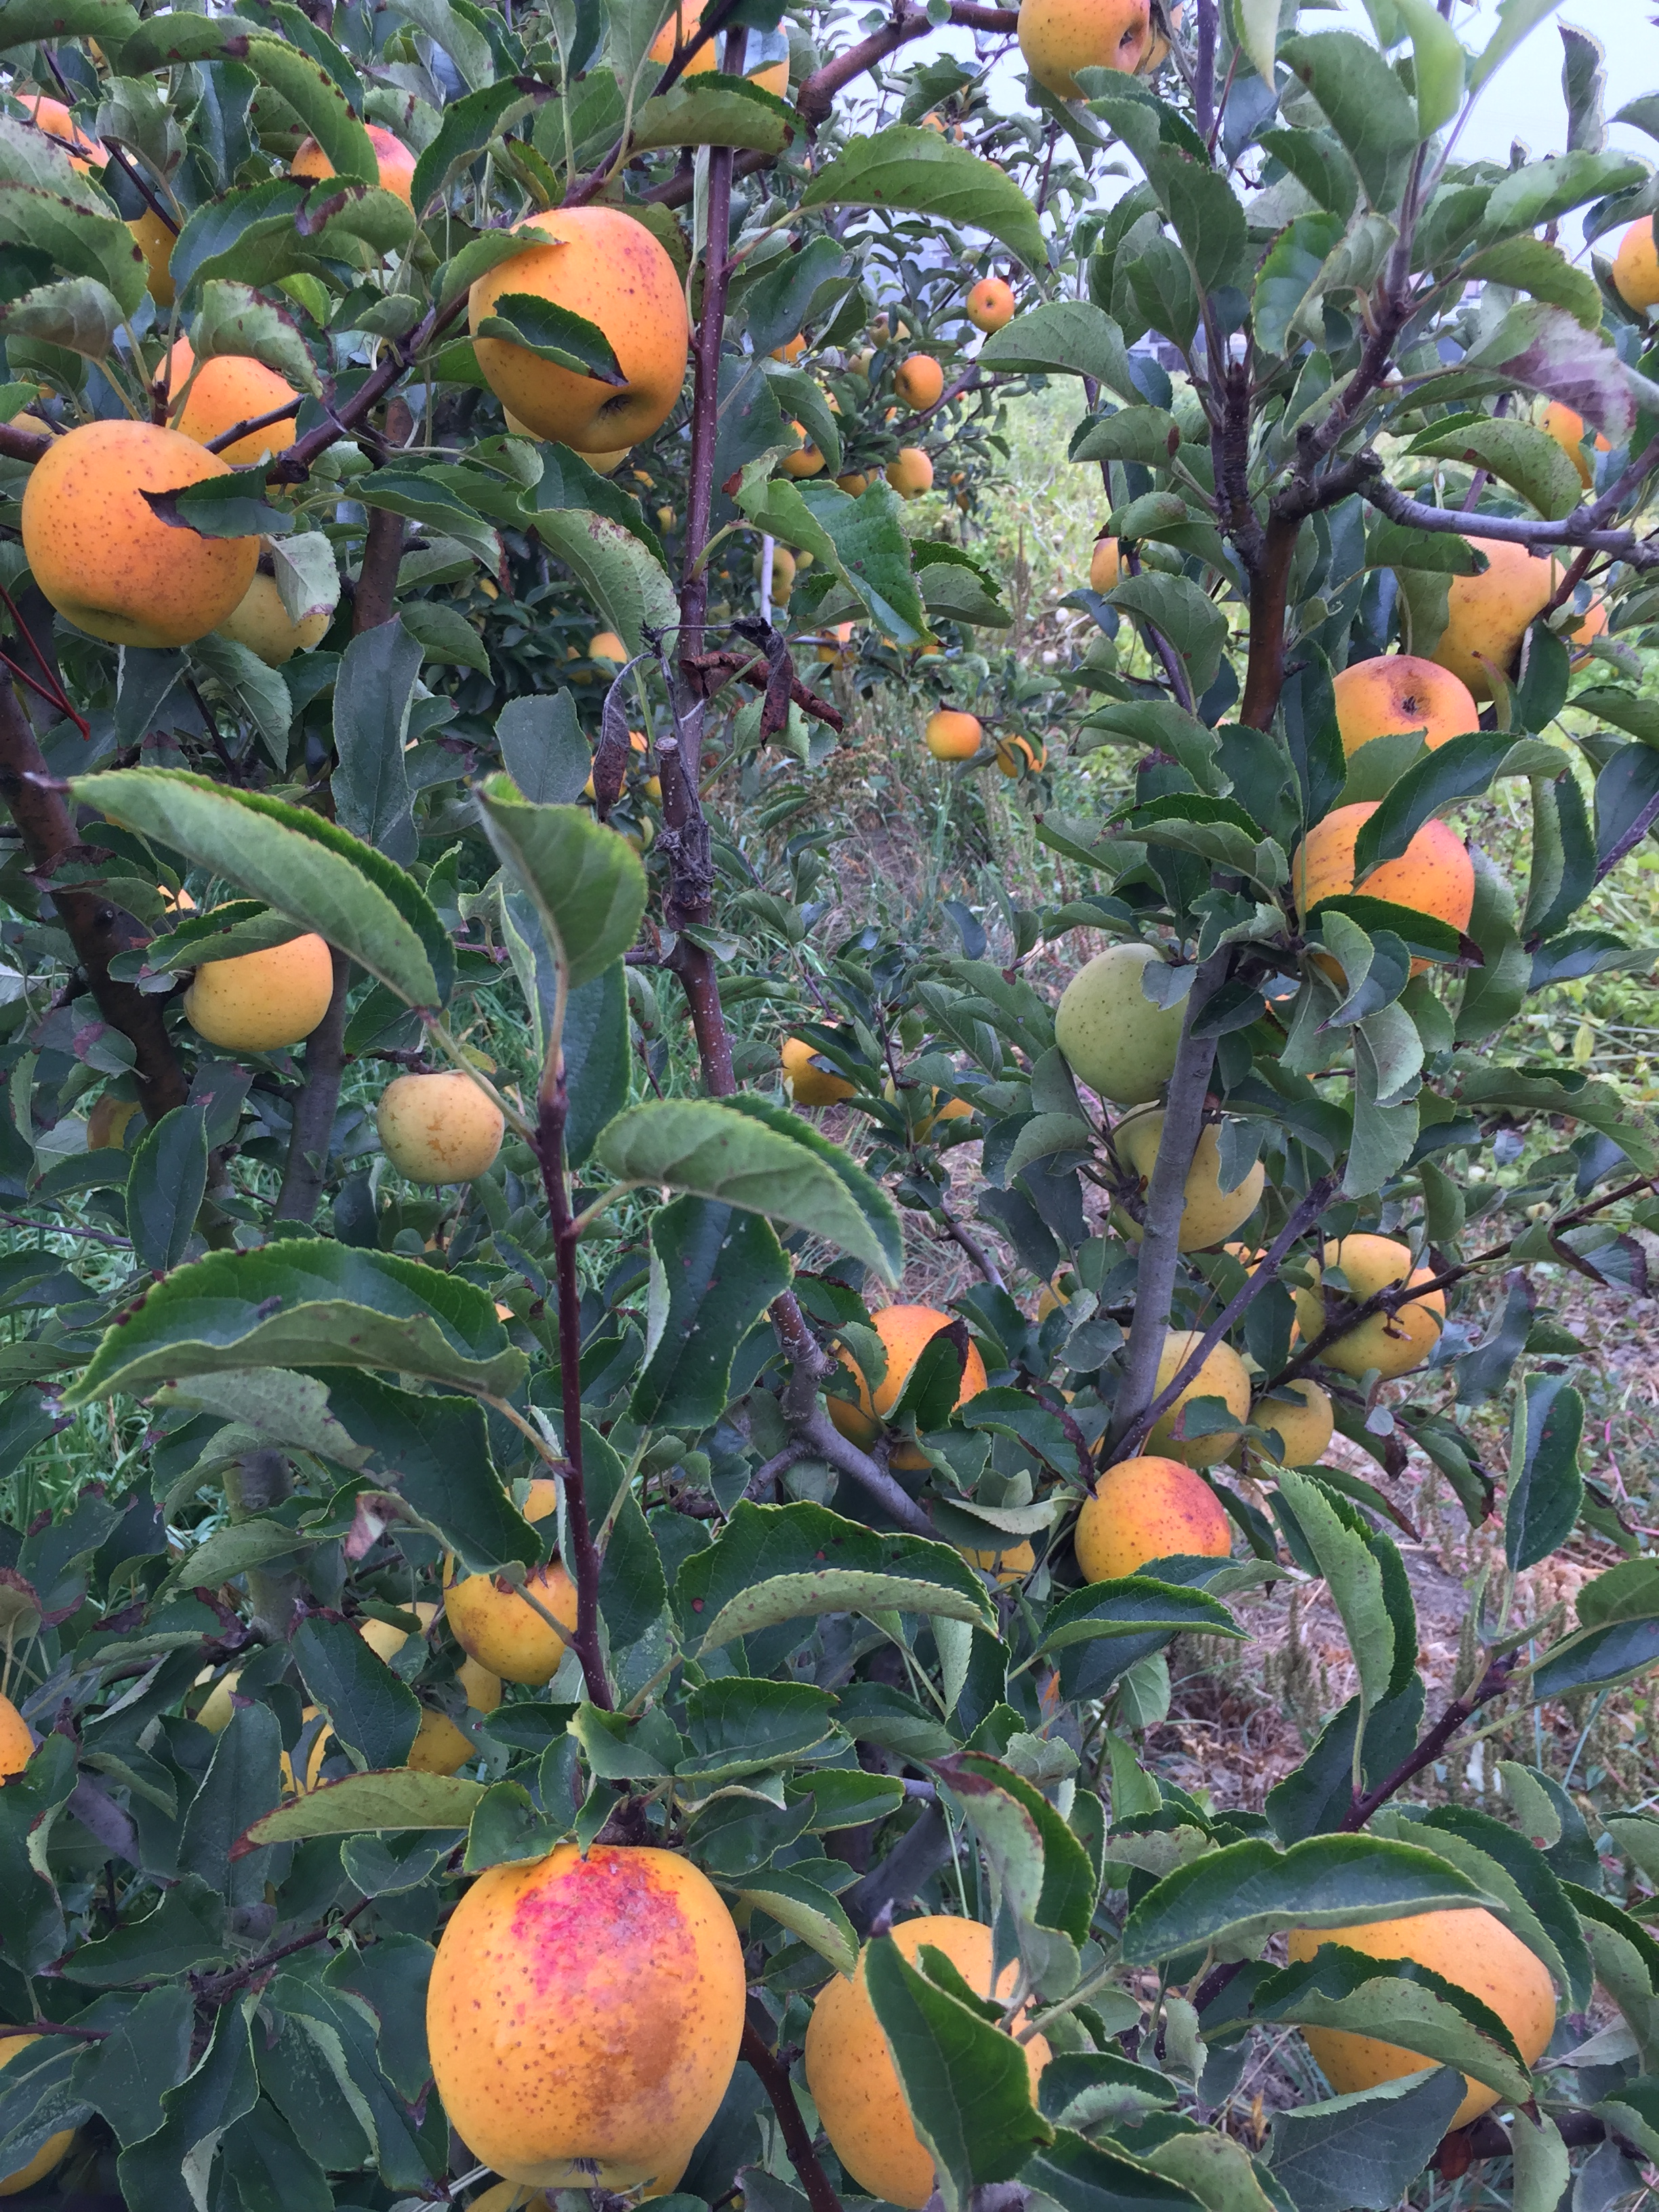

Slide 19
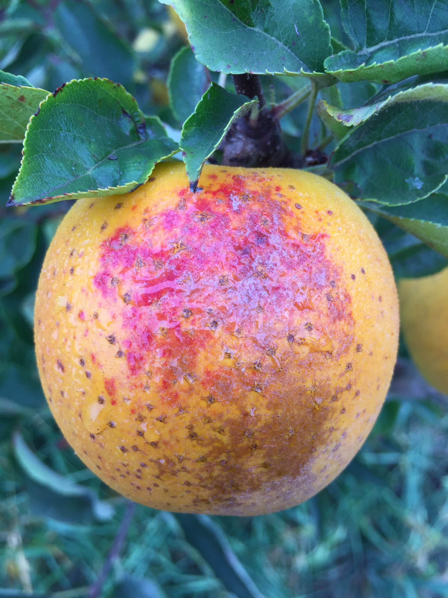
Goldrush, with damage from sunburn

Slide 20
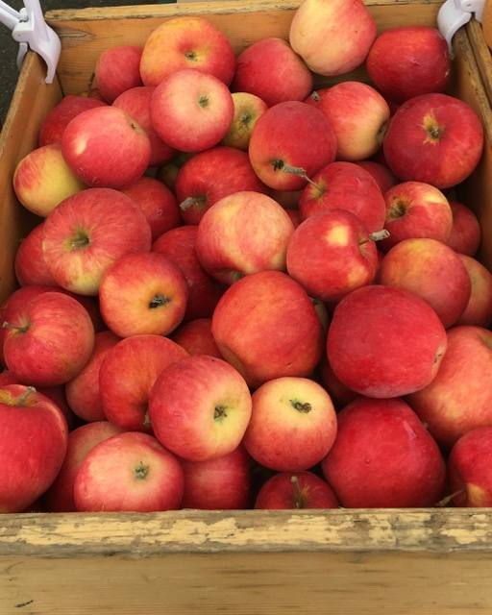
Sansa

Slide 21
Sansa
1961, New Zealand (via Japan) , Gala x Akane
Small apple, like Gala. Tree is Low-medium vigor
Ripens 1 week BEFORE Gala
Very sweet with unique flavor
Resists fireblight and scab
Favorite of the farm laborers!

Slide 22
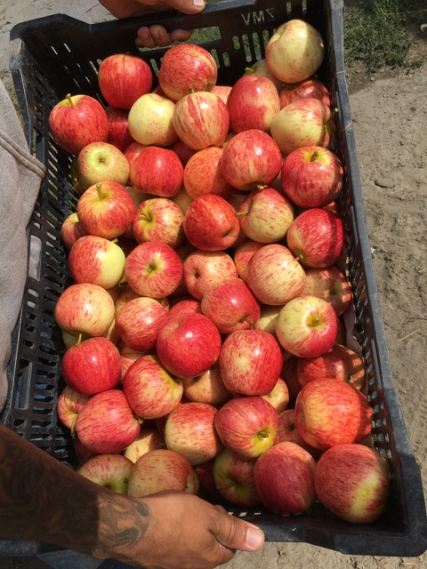
Gala (original striped)

Slide 23
Gala
Small apple in coastal California. Requires hotter and longer days to get big size (Washington, Chile)
Thin early and heavily, and winter prune for size
Ripens 8/15-8/25
Excellent flavor when tree ripened, will often hang on tree for a few weeks, sugars improving
Well behaved tree to train
Moderately suscptible to fireblight

Slide 24
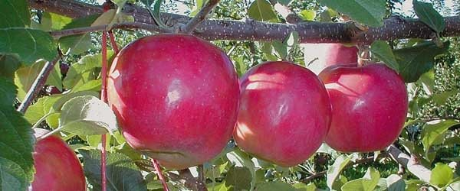
Early Fuji (September Wonder)

Slide 25
Early Fuji (September Wonder)
1997, C&O (sport of Fuji)
Wicked red color under Central Coast conditions, much redder than Fuji BC#2
Ripens fully 9/1-9/5. Flesh when fully ripe turns the same yellowish color as Fuji
Same excellent flavor when allowed to fully ripen on the tree
Will keep in cold storage, but why bother? Sell them before Washington floods market

Slide 26
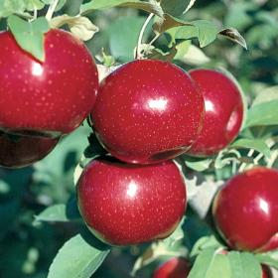
Empire

Slide 27
Empire
1966, Geneva, Red Delicious x McIntosh
Outstanding flavor, red delicious color
Ripe 9/10
Medium size apple
Low vigor tree, use vigorous rootstocks
Excellent fresh, or juice apple.

Slide 28
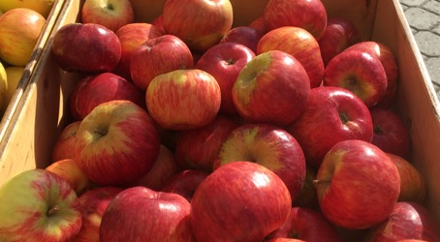
Crimson Topaz

Slide 29
Crimson Topaz
1990s, Institute of Experimental Botany, Czech Republic, Vanda x Ruben
Bred for scab resistance
Intense flavor, complex
Ripens 9/20
Smallish fruit
In highest fireblight pressure year in Watsonville, was subject to fireblight as a young tree

Slide 30
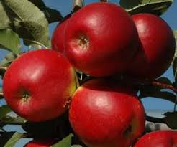
Crimson Crisp

Slide 31
Crimson Crisp
Medium apple, deep red color
High flavor, tart, complex
Ripens 9/20
Stores well, up to 6 months
Moderate resistance to fireblight

Slide 32
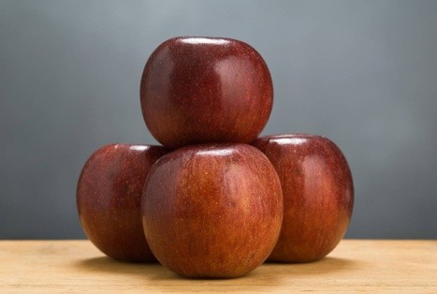
Winecrisp

Slide 33
Winecrisp
1989, University of Illinois (=Coop 31)
Cox x Jonathan x M. floribunda x misc.
Intense spicy flavor, high sugar and acid
Excellent deep color, some green streaks
Resistant to scab, and resistant to fireblight
Harvest 10/10
Allegedly stores 3 months plus

Slide 34
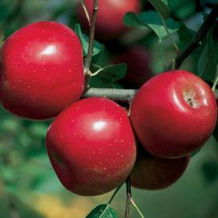
Enterprise
photo

Slide 35
Enterprise
1994, Purdue (=Coop 30) Mac x RD x Rome x Malus floribunda
Bright red, large apple
Intense, sprightly flavor
Ripens 10/20
Bred for scab immunity, resists Fireblight
Thick skin, like Mutsu

Slide 36
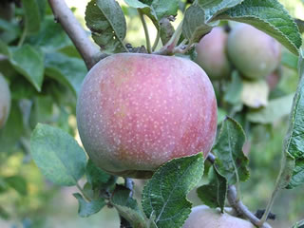
Hauer
Photo

Slide 37
Hauer
1890-ish,chance seedling in Aptos, CA
?Cox Orange Pippin x ?Yellow Bellflower
Proper name is not “Hauer Pippin”
Discovered by Peter Hauer
Local variety (grown commercially by Jim Rider’s family), harvest very late (Dec/Jan)
Excellent flavor after mellowing in cold storage. Needs very long growing season.

Slide 38
Honeycrisp
1991, Univ. of Minnesota, Macoun x Honeygold
Difficult tree to grow in northern California
Susceptible to bitter pit and powdery mildew
Weak grower, use vigorous rootstock in N. Cal if you must grow it
Apparently happy in cooler/cold winter regions (requires chill hours 32-45 degrees.
Outstanding, famous fruit that sells well.

Slide 39
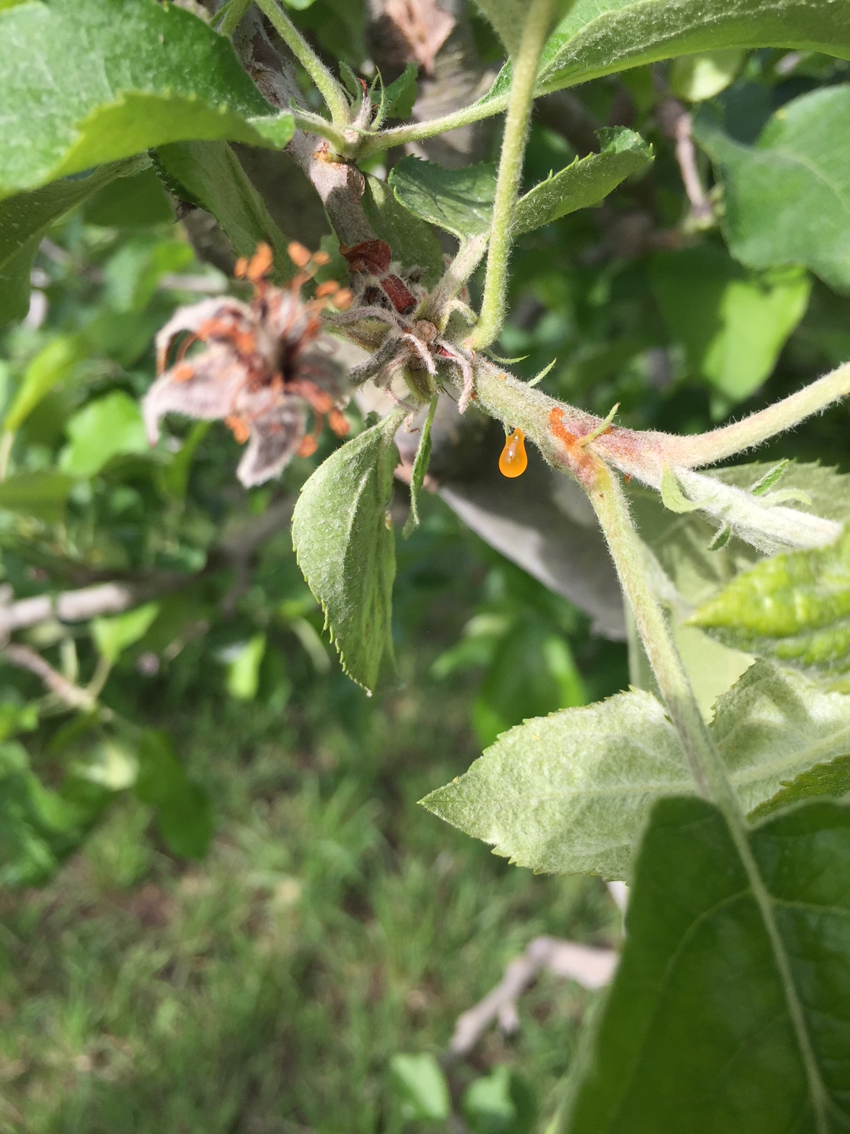
Fireblight exudate on Apple

Slide 40
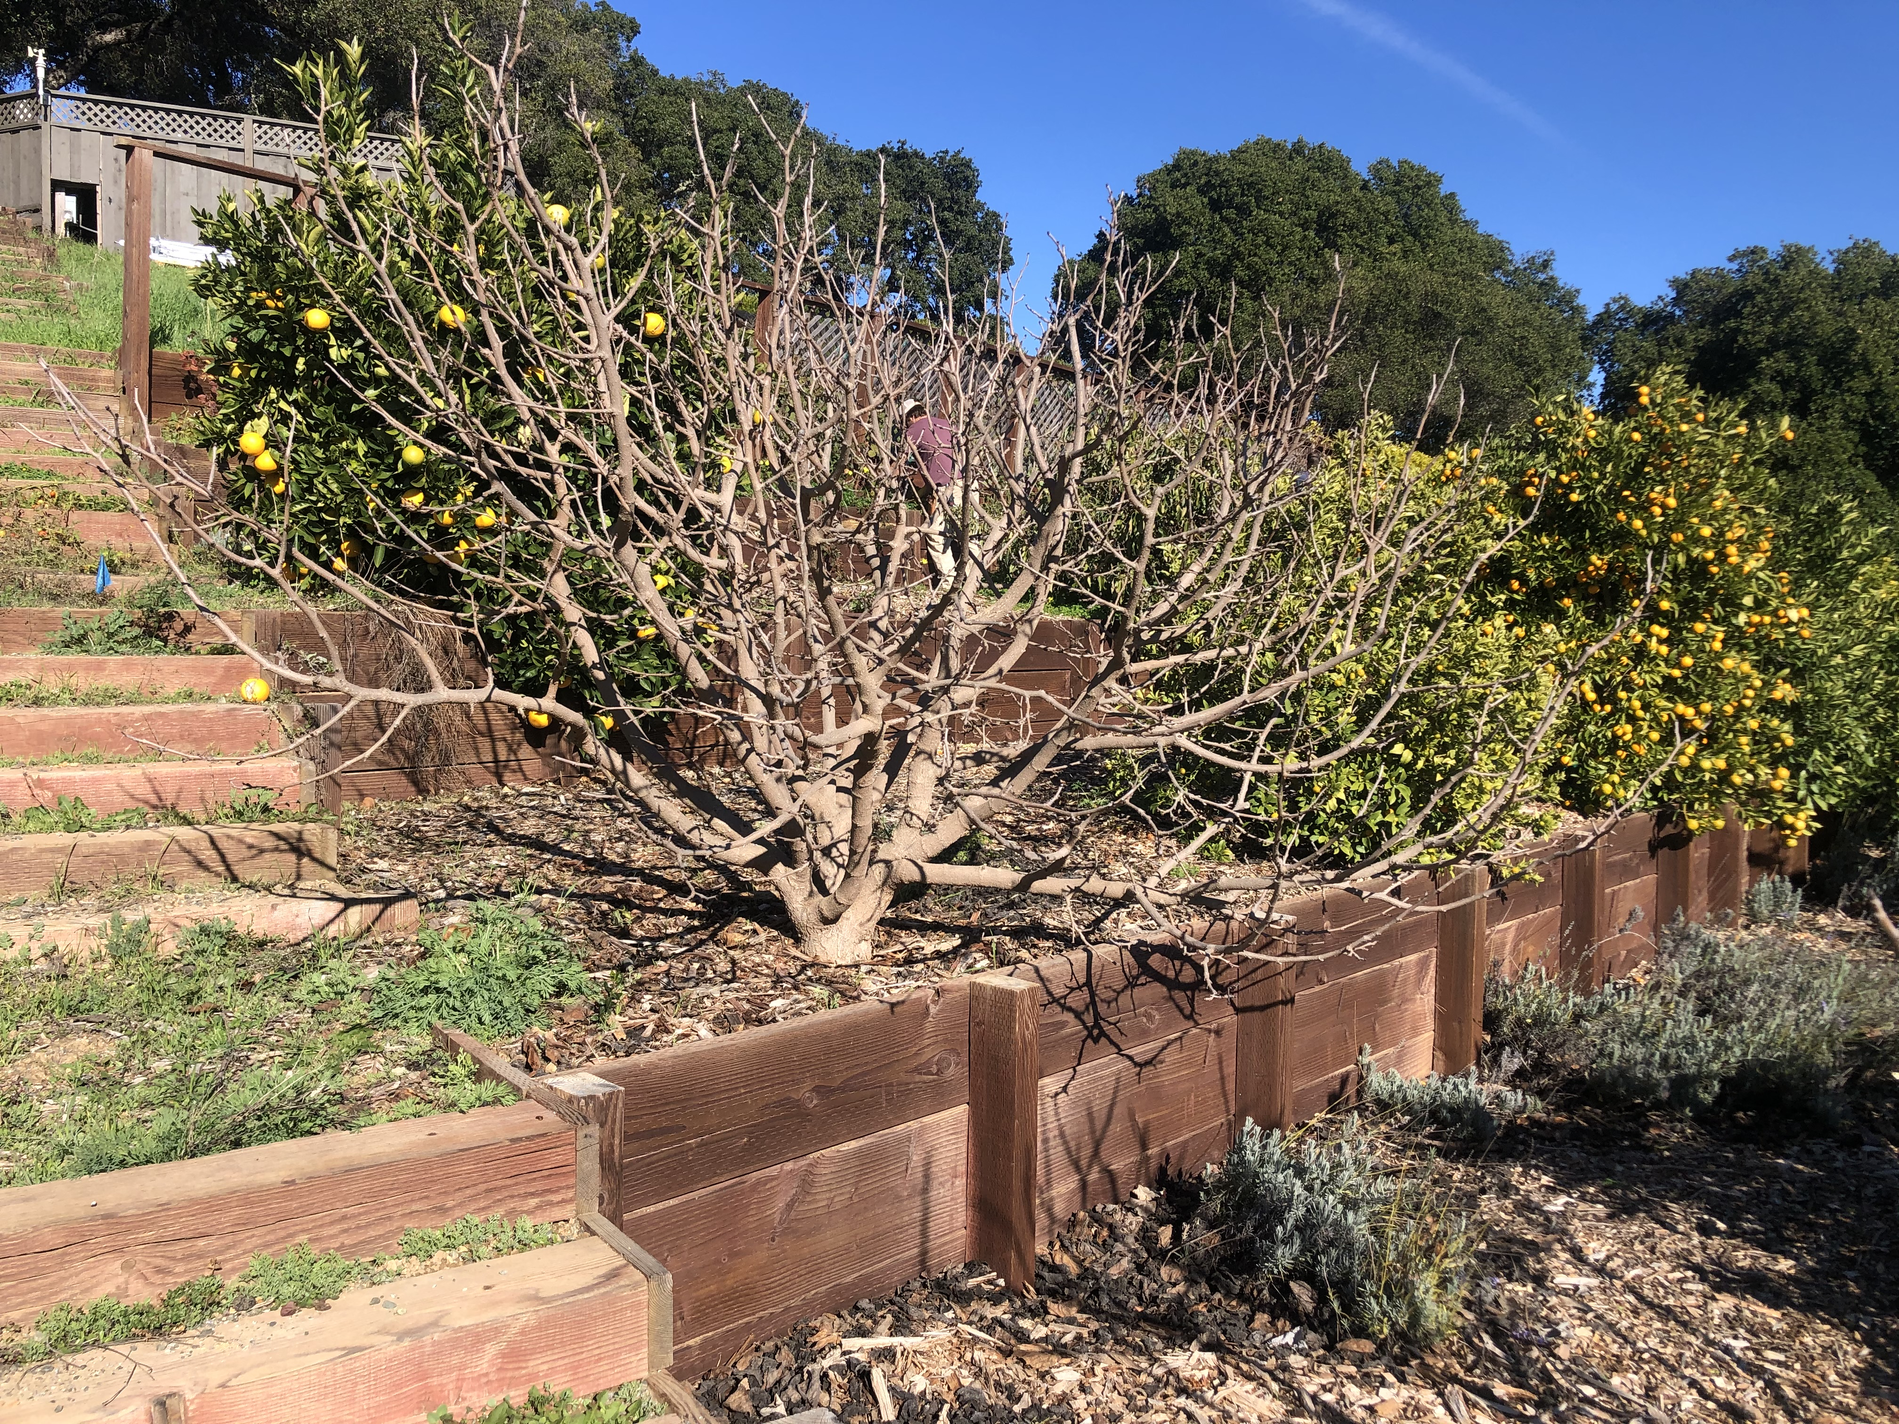
Black Beauty Mulberry

Slide 41
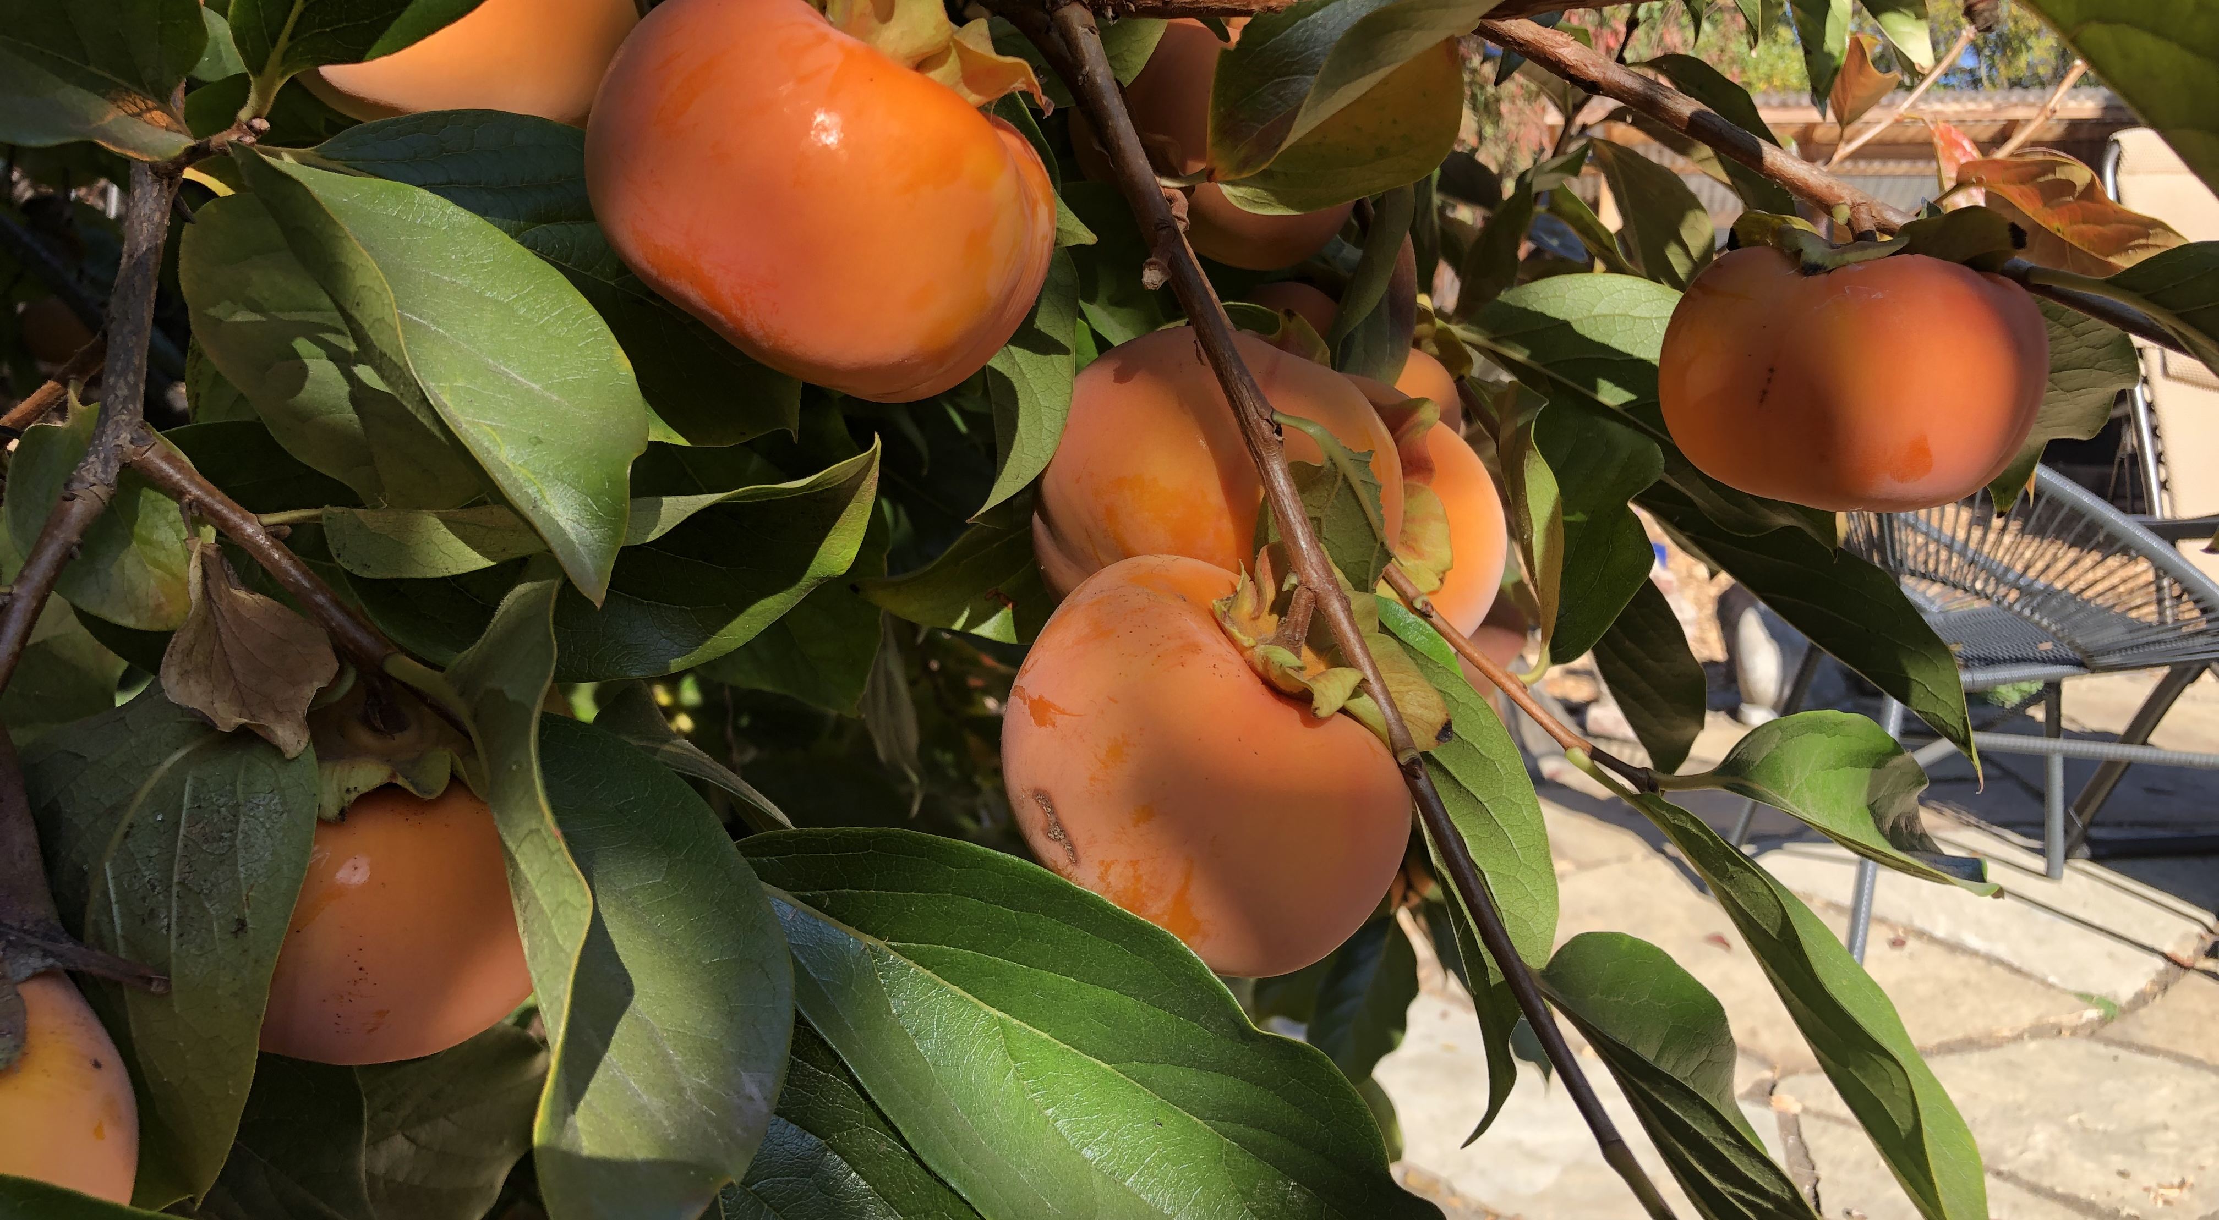
Fuyu Persimmon (non-astringent)

Slide 42
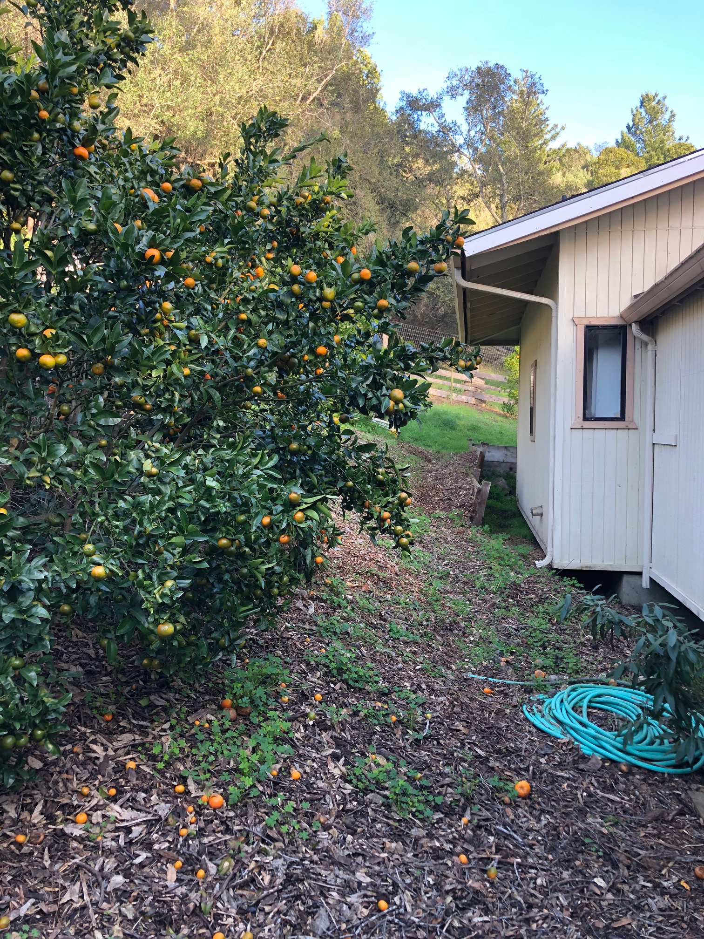
Citrus pruning-before

Slide 43
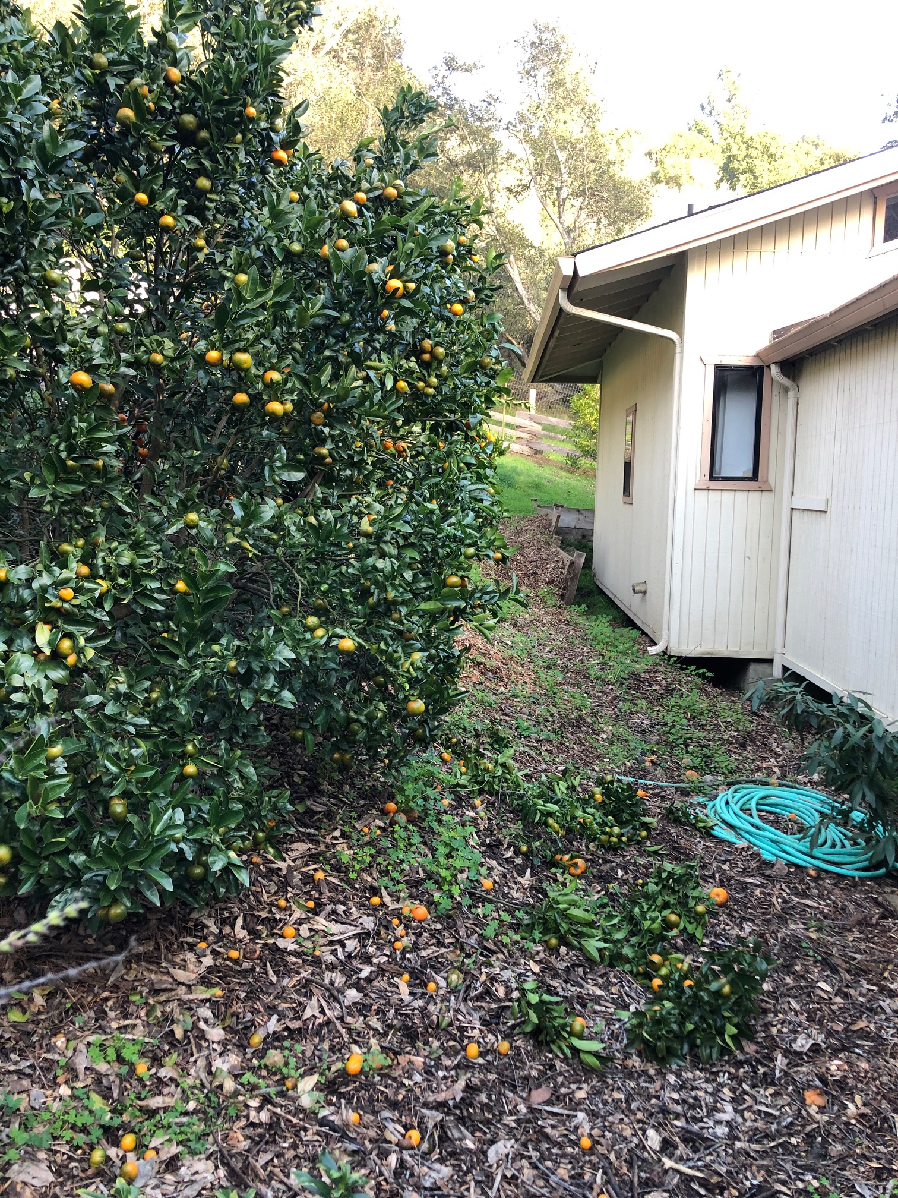
Citrus pruning-after

Slide 44
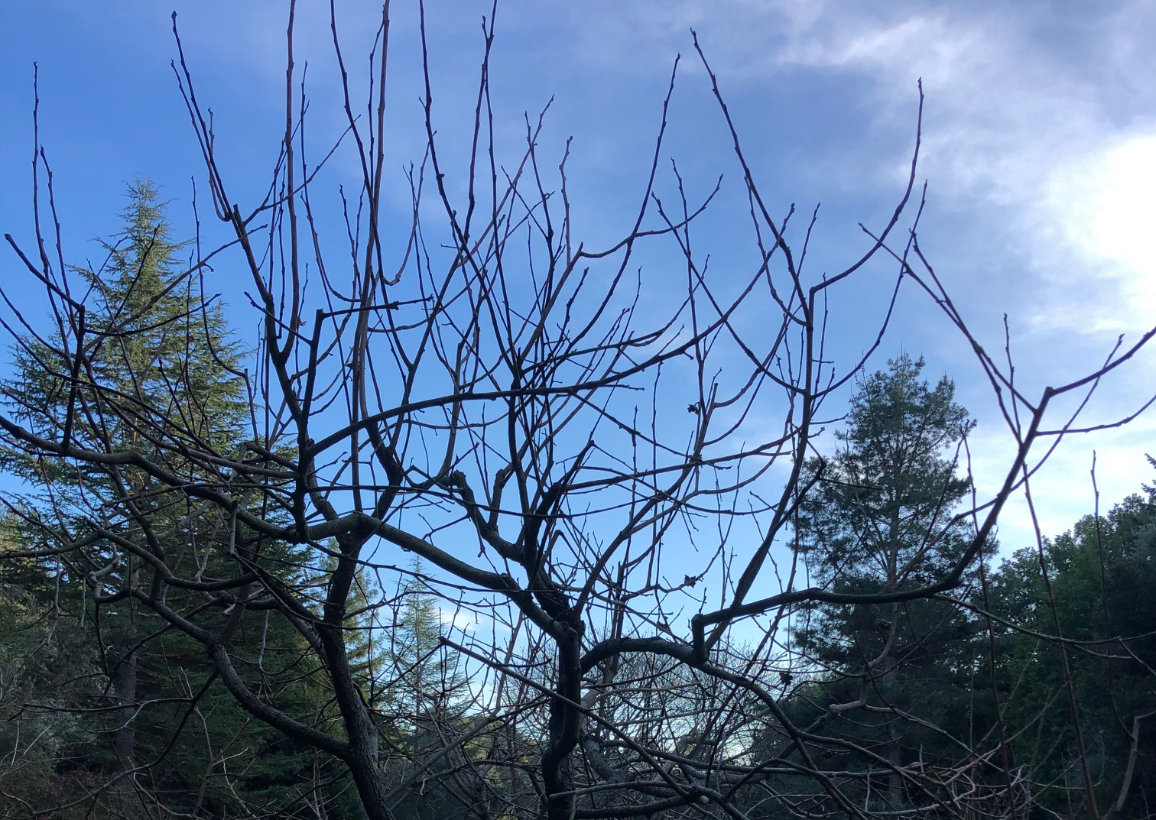
Persimmon, before pruning

Slide 45
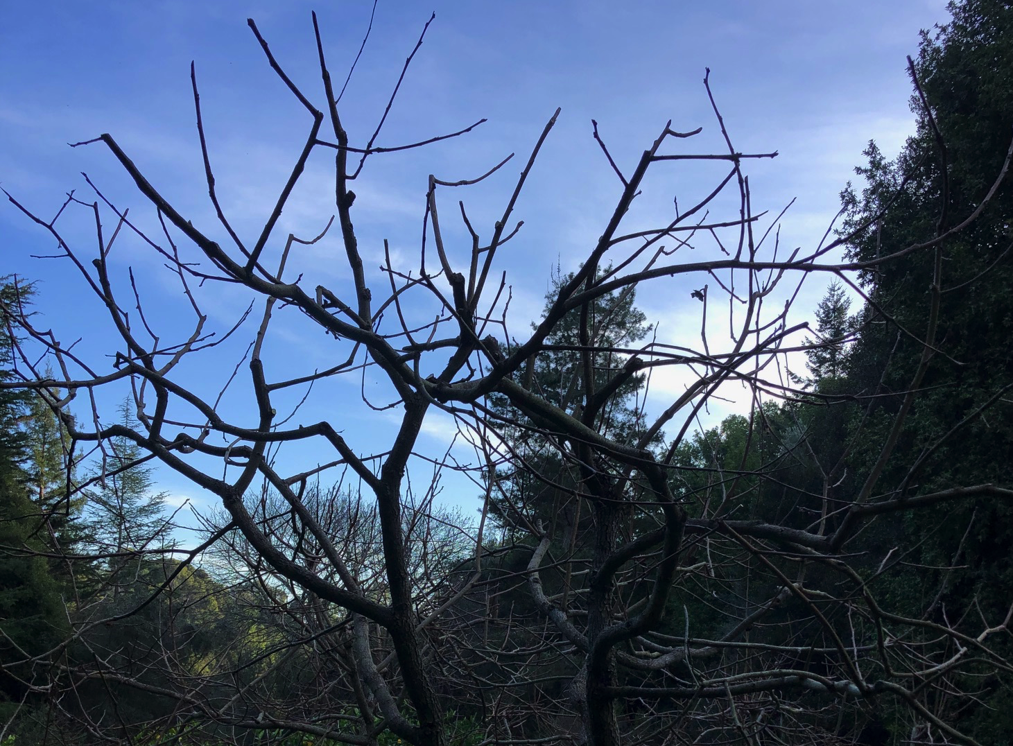
Persimmon, after pruning

Slide 46
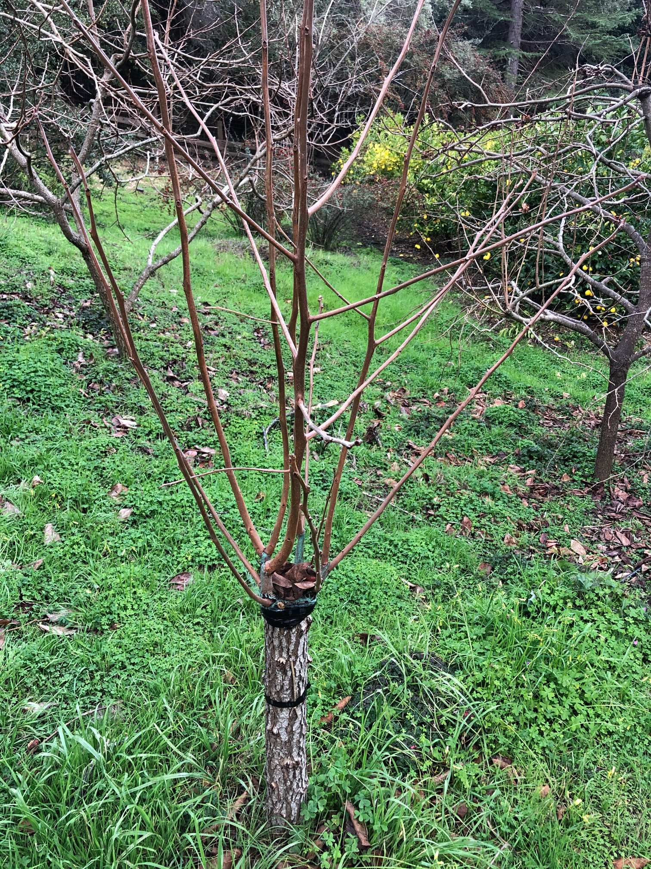
Grafted persimmon, before pruning

Slide 47
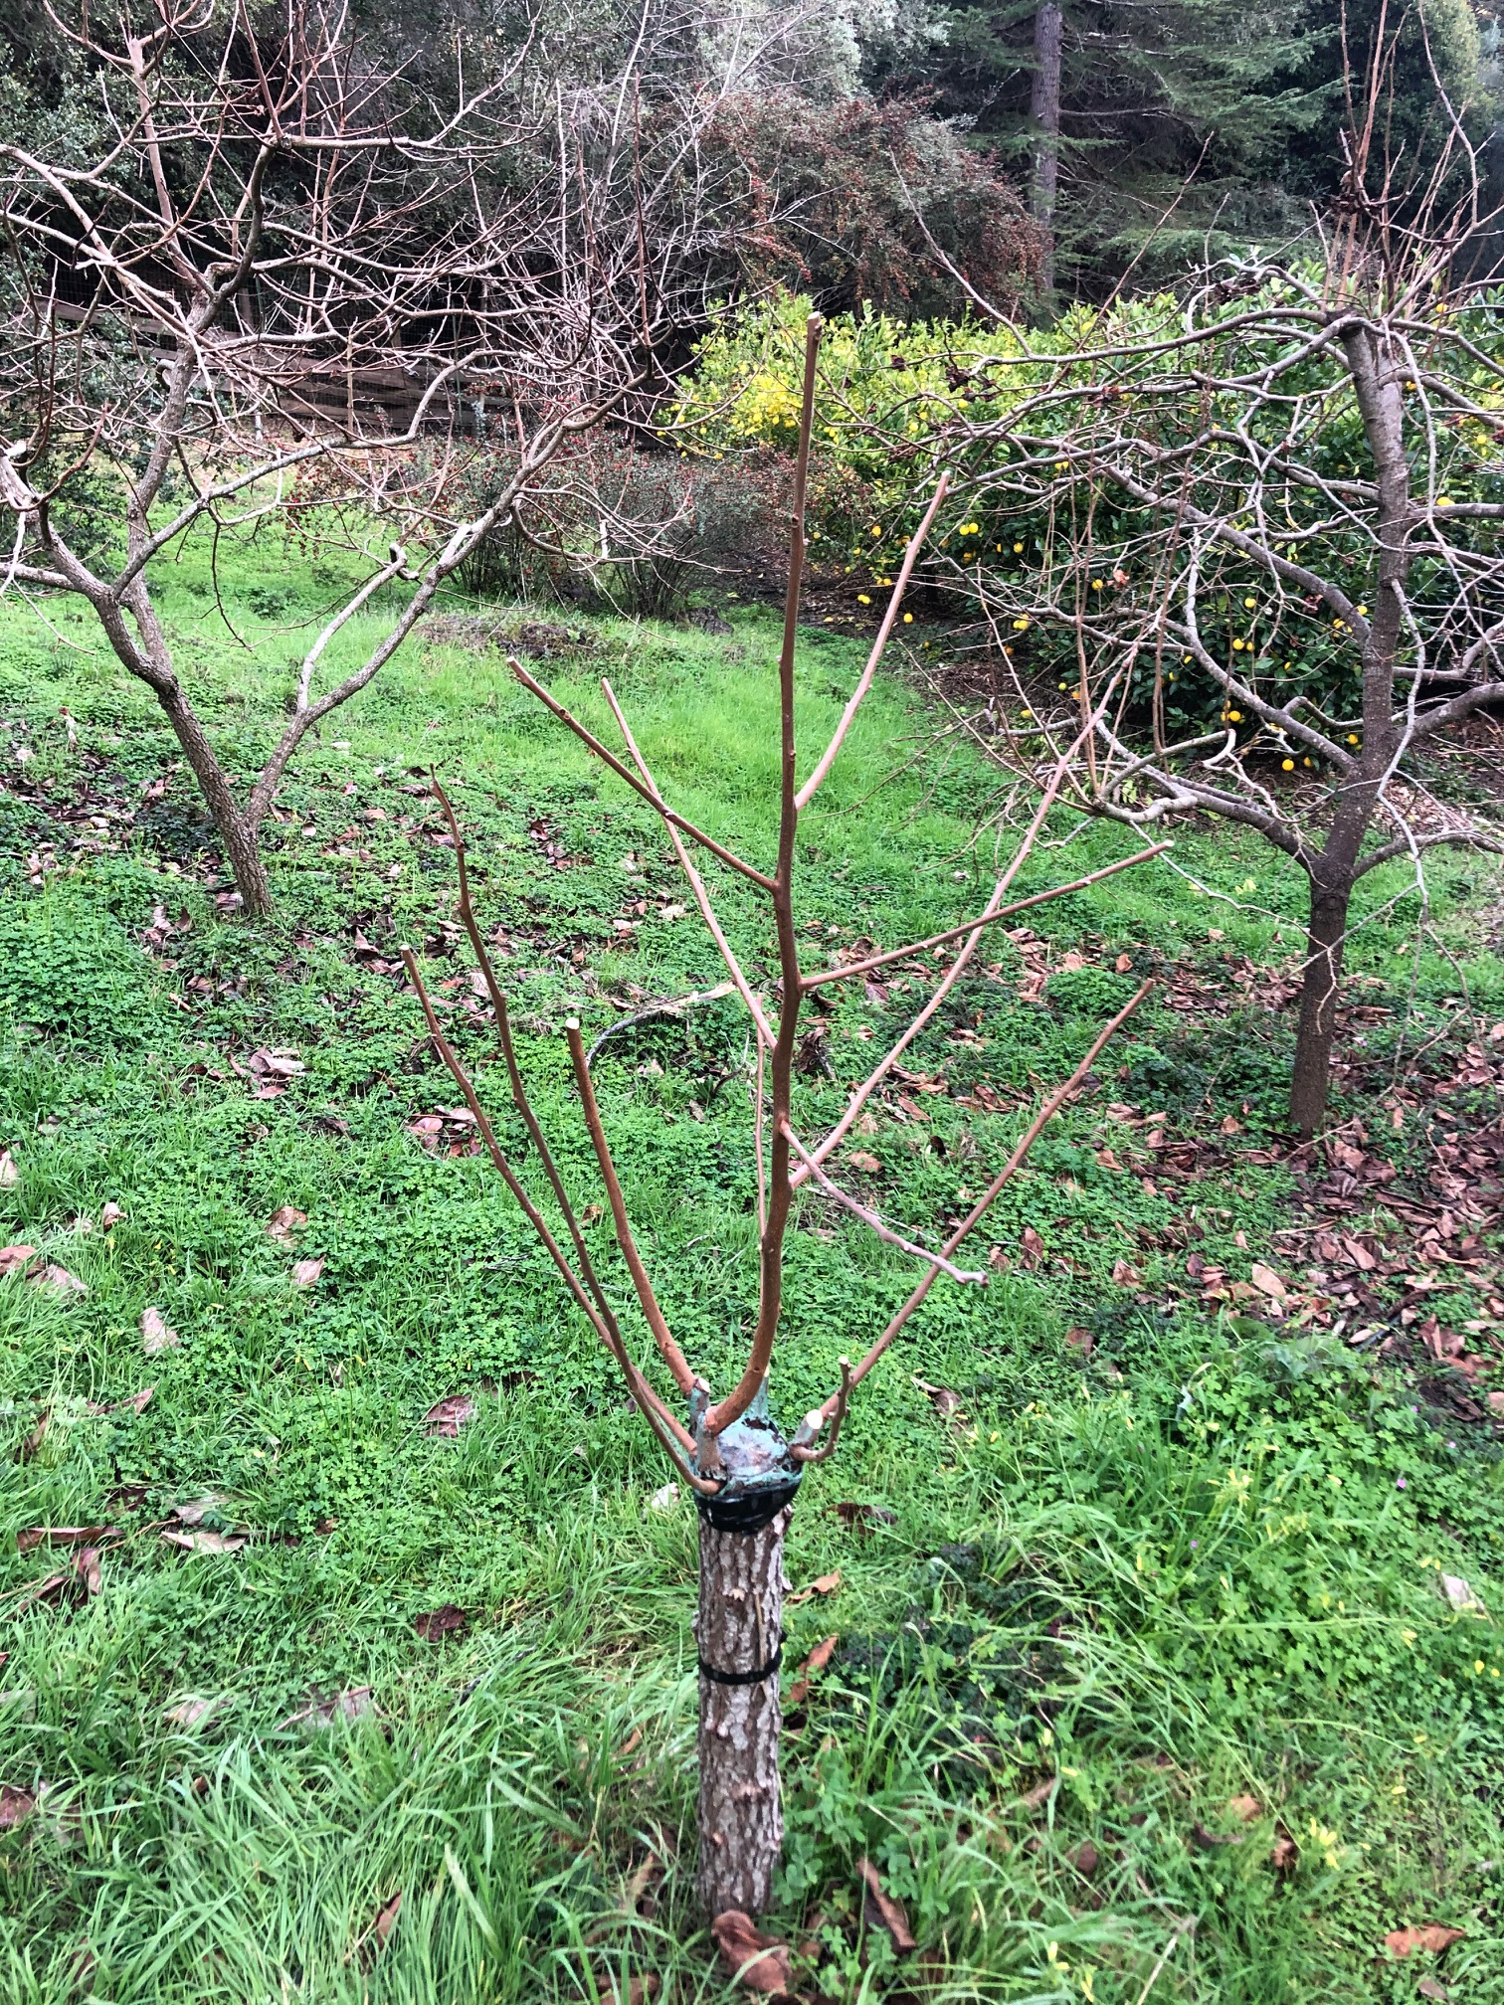
Grafted persimmon, after pruning

Slide 48
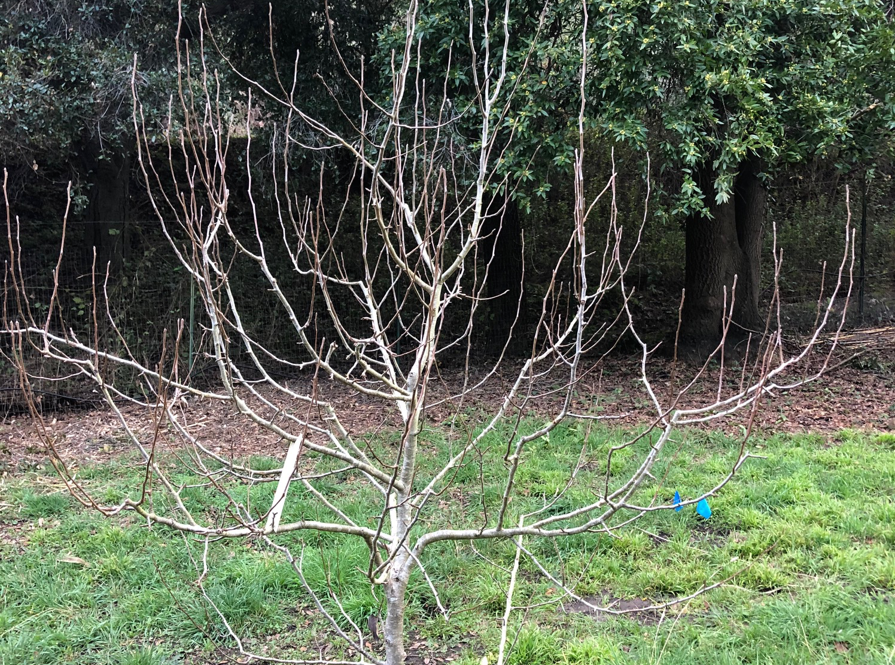
Pear, before pruning

Slide 49
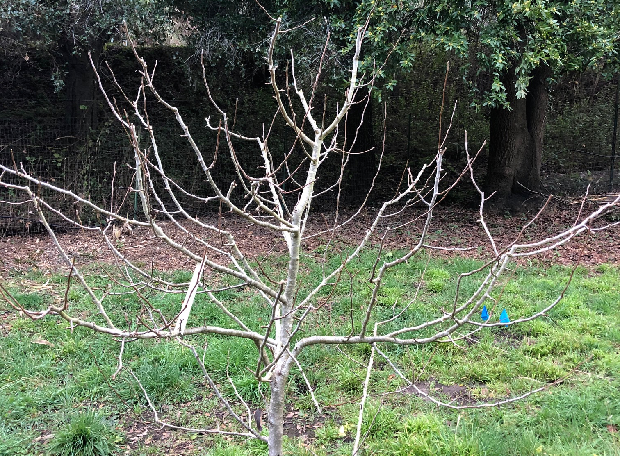
Pear, after pruning

Slide 50
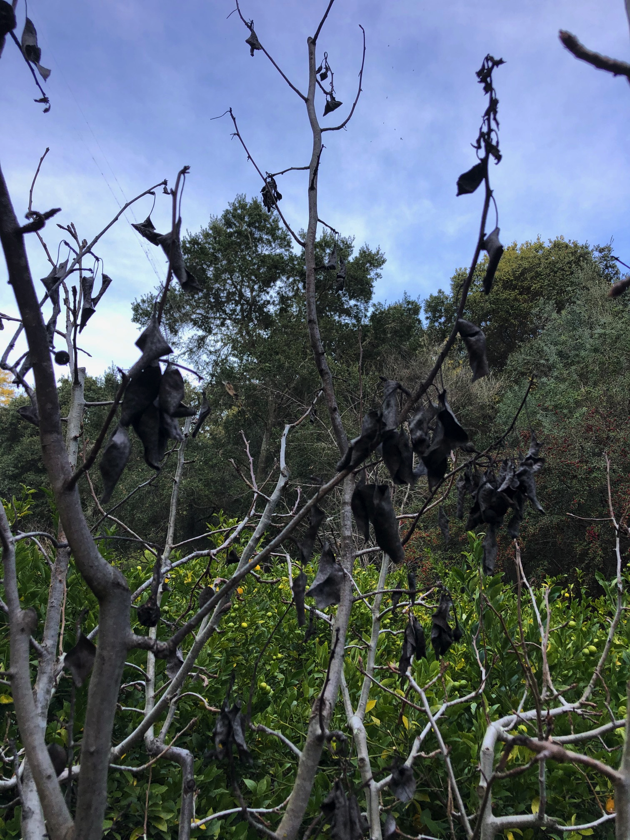
Fireblight on pear

Slide 51
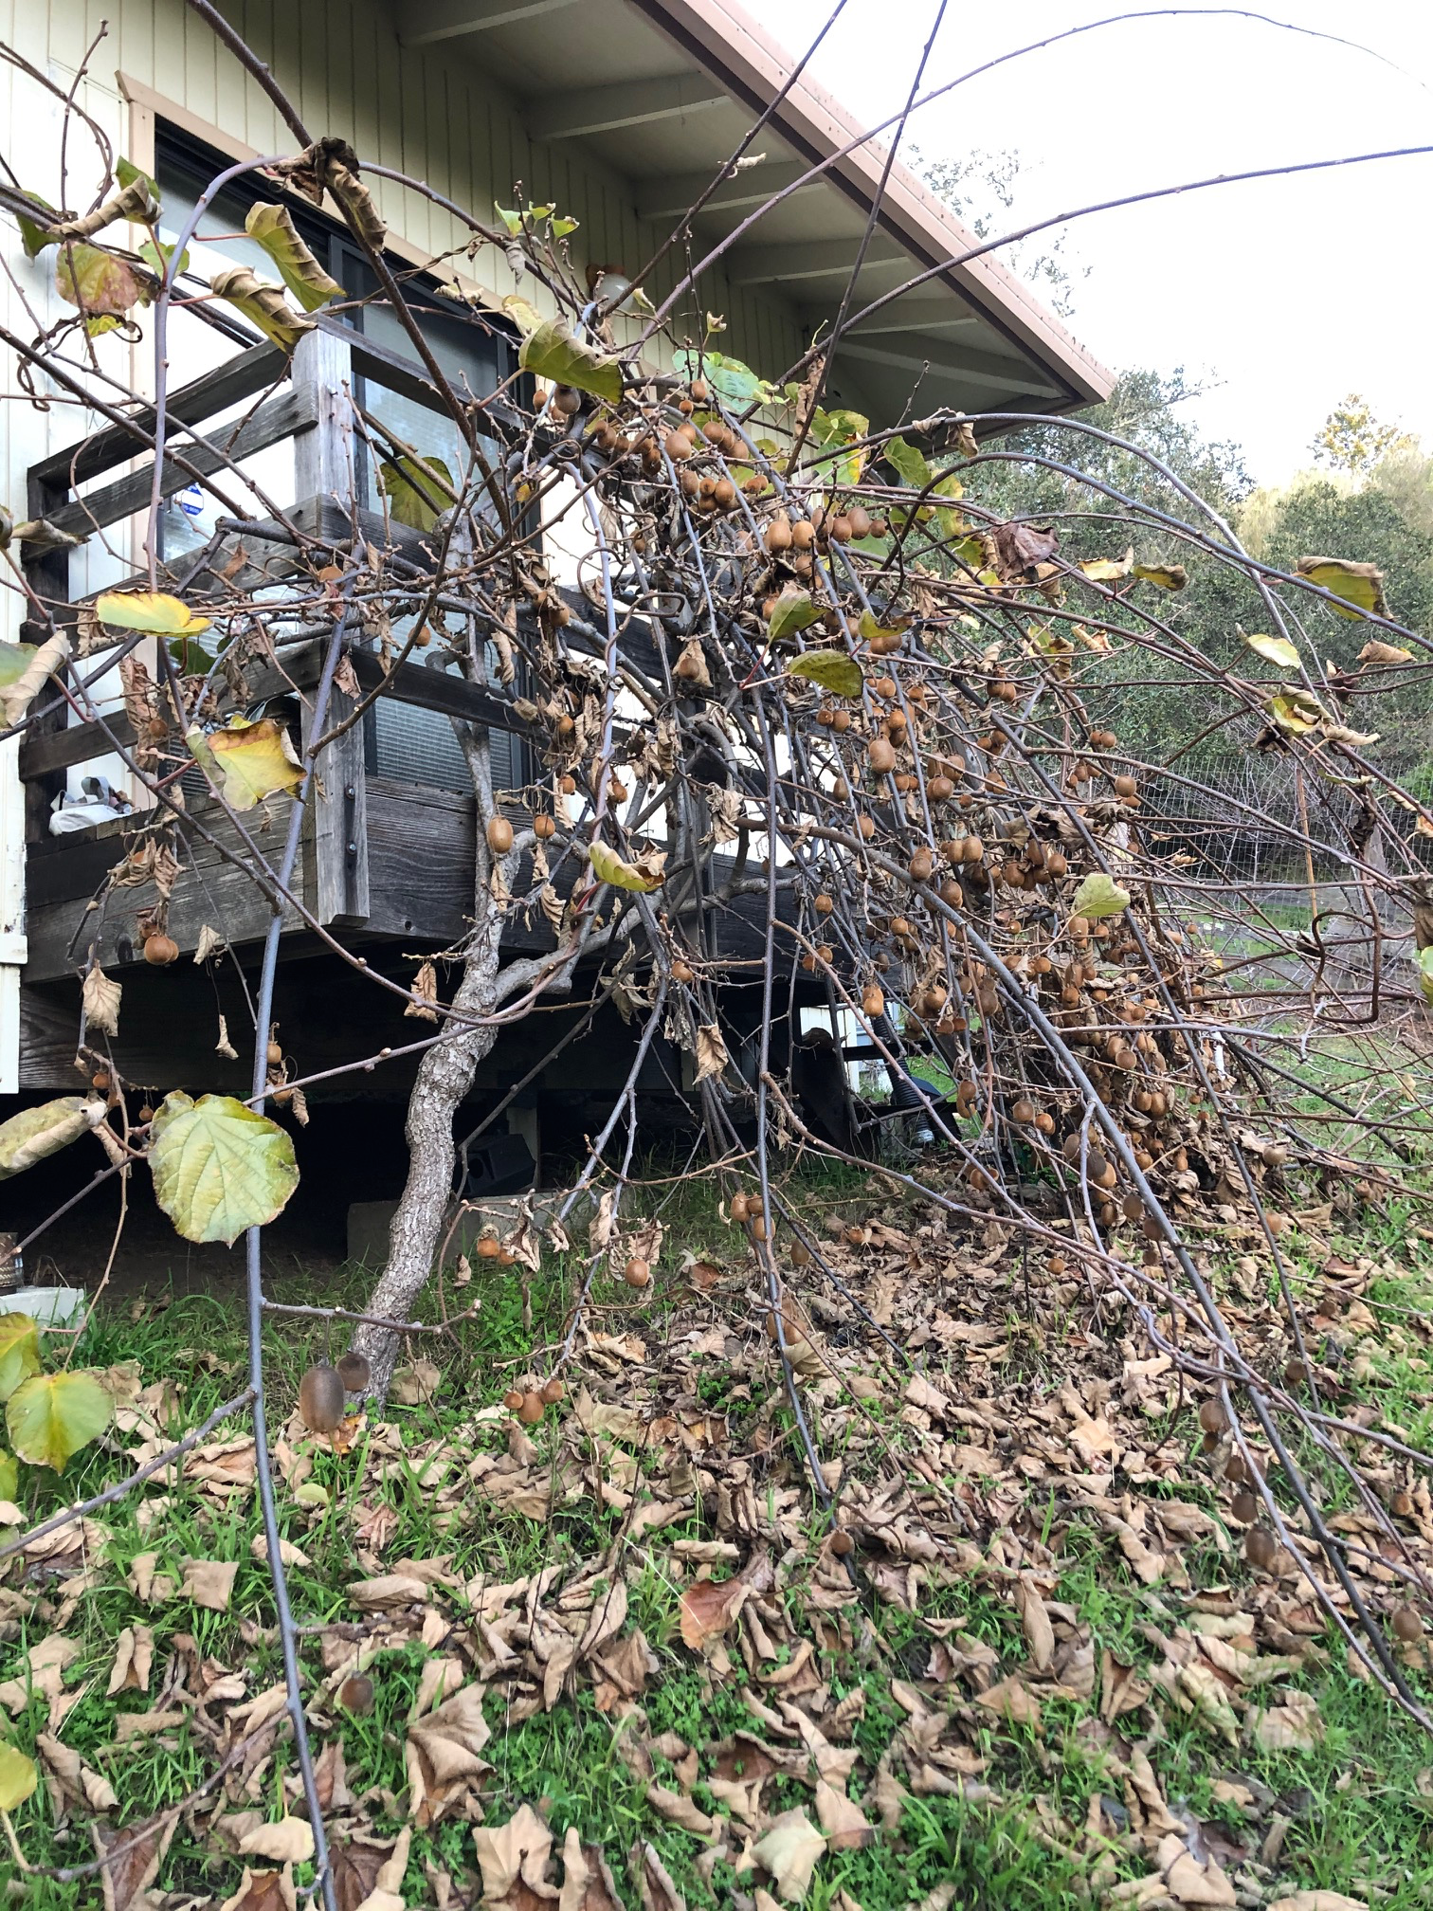
Kiwi, before pruning

Slide 52
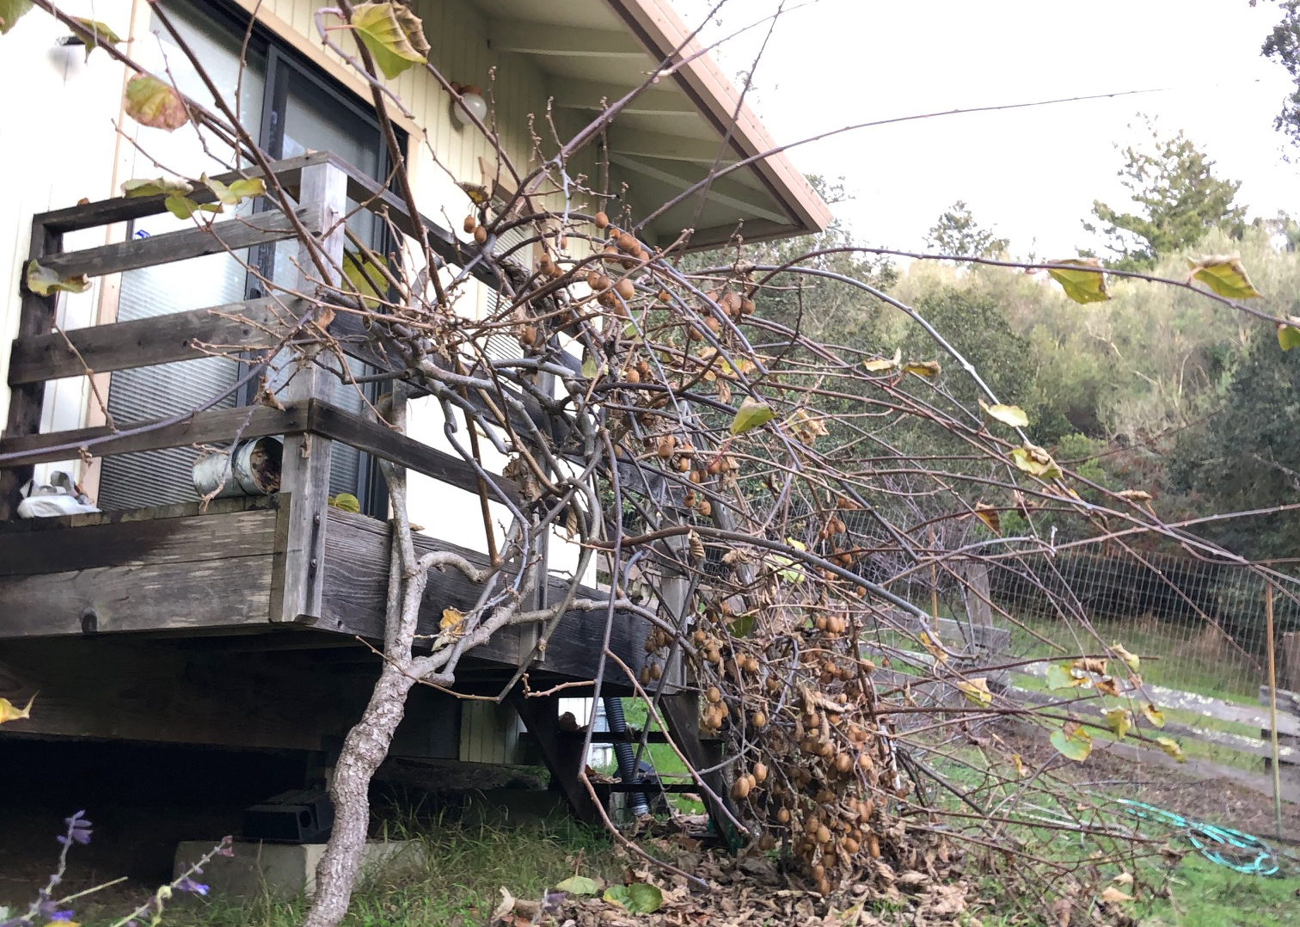
Kiwi, after pruning

