Slide 1

UCCE Nutrition Education Programs
Coronavirus Update
The next few slides will cover:
Communication and Resources
Telecommute and Limited On-Site Operations Transition Plan and Timeline
Meetings, Events and Gatherings
Equipping Staff to Work Remotely
  Communication, IT Assistance, Telecommuting Activities for EFNEP Staff

Slide 2
Communication and Resources
An ANR Emergency Communication Group has been formed to provide updates and guidance on COVID response
Information will be shared on this website: http://ucanr.edu/covid19
For questions/assistance, contact:
Brian Oatman (baoatman@ucanr.edu) or 530-304-2054
John Fox (jsafox@ucanr.edu) or 530-650-6112

Slide 3
Telecommute and Limited On-Site Operations Transition Plan
Starting Monday March 16, all UC ANR locations and programs will begin moving in phases to telecommuting and limited on-site operations status with the goal of having all functions, events, activities, meetings, etc. either postponed, cancelled or moved to Zoom, and all employees working remotely by Friday, March 20.
This directive also includes all volunteer-led youth or adult programming, meetings, or gatherings.
Notes:
For REC Directors, UCCE County Directors, SI Leaders, Statewide Program Directors Prepared by the UC ANR COVID 19 Task Force
(with the exception of designated on-site staff/academics).

Slide 4
Telecommute and Limited On-Site Operations Transition Plan
This guidance will stay in effect through close of business on April 7, 2020 and may be extended.
UC ANR academics and staff will continue to operate on their normal business hours unless otherwise specifically stated.
The goal of this decision is to support all UC ANR employees, volunteers, and our broader communities by reducing the risk of community spread through minimization of face-to-face interactions, reduction in commuting and travel, and an increase in social-distancing.

Slide 5
Telecommute and Limited On-Site Operations Transition Plan Timeline
In accordance with UC guidelines, UC ANR will implement a Phased Approach to Telecommuting and Limited On-Site Operations as follows:
Group 1: Staff who are in the CDC COVID 19 High Risk Populations should work with their supervisors to transition to telecommuting as soon as possible.
Group 2: Staff who are fully equipped and approved by their Director to work remotely must telecommute starting today, Tuesday, March 17.

Slide 6
Telecommute and Limited On-Site Operations Transition Plan Timeline
Group 3: Staff who are not yet equipped to work remotely, but whose function can be performed remotely when equipment is available, will continue to report to the office until they have been equipped to work from home. Supervisors of these individuals should also continue to report to the office until their team has been fully transitioned. The goal is to move this group to telecommuting by Friday, March 20.

Slide 7
Telecommute and Limited On-Site Operations Transition Plan Timeline
Group 4: Staff required for limited on-site operations whose work cannot be done remotely will continue to report to work and will have continual access to the office. Staff with reduced work hours will be eligible for administrative leave according to UC’s Novel Coronavirus 2019 (COVID-19) and Paid Leave and Remote Work Provisions.
Notes:
Aprons and bags

Slide 8
Telecommute and Limited On-Site Operations Transition Plan Timeline
Group 5: Staff who are required to support limited on-site operations may be asked to work from home but be available to report to the office/worksite on an as needed basis and will have continual access to the office/worksite.
Advisors and Supervisors should work with their County Director to determine who will have access to the building and to determine a plan for receiving mail and shipments.
Notes:
Aprons and bags

Slide 9
Meetings, Events and Gatherings
Following UC-wide protocols, all UC ANR-hosted meetings, events and gatherings of any size that are scheduled to take place through April 7, 2020 must be conducted via Zoom, postponed or cancelled.
This includes all in-person programming, meetings and gatherings - whether led by UC ANR employees or volunteers (e.g., 4-H club or project meetings, and Nutrition Education programs, etc.).

Slide 10
Meetings, Events and Gatherings
Nutrition Class Series Guidance
Staff are encouraged to work with community partners to decide the best strategy for completing existing lesson series.
Postpone, reschedule, provide online/ video chat (i.e. Zoom) options and/or make-up lessons to adult participants nearing the end of a series.

Slide 11
Meetings, Events and Gatherings
Classes may also be transitioned to the UCCE Connects to You! model, ZOOM or a similar online platform such as Skype or Facebook
  EFNEP: See guidance developed by Kentucky EFNEP posted in the documents section of Collaborative Tools
For all: Be creative. This is an opportunity to try new things!
Share successes, challenges and locally developed protocol/procedures with the State Office
  Each state is being asked to report strategies nationally

Slide 12
Meetings, Events and Gatherings
County Directors and program staff will need to communicate with their participants and volunteer leaders about this guidance and the need to pause in-person programs for the next few weeks in support of state and national efforts to employ social distancing in our communities.
For program activity being conducted as part of an agreement (MOU) with a partner agency, inform the partner of the UC ANR directive to restrict in-person activities.

Slide 13
Meetings, Events and Gatherings
In addition, UC guidance further extends the date of this directive to April 30 for UC-hosted in-person meetings or events of 10 participants or more. This is based on the more restrictive California guidance.
Note that dates may be extended. If your county mandates more restrictive guidelines, you must follow your county’s directive.

Slide 14
Meetings, Events and Gatherings
We recognize that this requirement to cancel programs and meetings may result in cancelation of some contracts for meeting space, activities, hotels, etc.
This may also affect contract agreements with community partners. Please notify Katie Panarella if you need assistance resolving issues or communicating with partnering agencies.

Slide 15
Equipping Staff to Work Remotely
In order to facilitate effective telecommuting, staff may take work equipment home during this work-from-home period if needed to fulfill job duties (for example, monitor, docking station, keyboard, mouse, headset, webcam, desktop computer).
Those working on county office equipment and/or networks will need to consult with the responsible county officials before taking any equipment home.
Advisors and Supervisors must approve and track any equipment taken home – This is a great time to update the EFNEP computer and equipment inventory tracking spreadsheet.
Notes:
If an employee has physical limitations in transporting equipment, they should notify their Director who will work to make accommodations.

Slide 16
Equipping Staff to Work Remotely - Communications
Each location should develop and distribute an Employee & Key Stakeholder/Volunteer Contact List with phone numbers and email addresses.
It is important that program volunteers and participants feel connected during this time. Ensure that they have contact information and be sure to keep them informed of all status/scheduling changes.
Supervisors and employees are expected to work normal UC ANR business hours (or business hours previously established by each location) and regular email and/or phone contact is expected.

Slide 17
Equipping Staff to Work Remotely - Communications
Updates will be posted regularly at http://ucanr.edu/covid19. All staff should frequently check this site for the most up to date information; it will show our “work status” and will be updated as the status changes. Communication will also be sent weekly via ANR Update or more frequently as needed.
Official Back to Work Protocols are being developed. However, unless otherwise informed, we are all expected to return to our regular work locations on Tuesday, April 7th.
Formal communication regarding return to work will be sent to all employees by their Directors and via ANR Update by COB on Friday, 4/3.

Slide 18
Equipping Staff to Work Remotely – IT Assistance
UC ANR IT Services Zoom Hotline
For support, an on-going Zoom meeting will be running during business hours (8 a.m.-5 p.m.)
Phone: 669 900 6833
Meeting ID: 908 346 0196
https://UCOP.zoom.us/j/9083460196
Notes:
If an employee has physical limitations in transporting equipment, they should notify their Director who will work to make accommodations.

Slide 19
Equipping Staff to Work Remotely - Activities for
Telecommuting Staff
Encourage Ergonomics: #155 Home Office Safety: https://ucanr.edu/sites/safety/files/1404.pdf
Please take the online training and assessment “Ergonomics for Computer Users” through the UC
Learning at this link: http://safety.ucanr.edu/Programs/Ergonomics/Ergonomic_Assessment/
Remember to MOVE around every 20 minutes or so, take a two minute break. Get up, walk around, look at something else other that your monitor.
Notes:
Ergonomics:
When working and computing from home it is important to create a good ergonomic set-up. Follow the
tips below to get started.
• Please take the online training and assessment “Ergonomics for Computer Users” through the UC
Learning at this link: http://safety.ucanr.edu/Programs/Ergonomics/Ergonomic_Assessment/
• If you do not have a good computer set up at home or only a laptop, please consider taking
your keyboard, mouse, and monitor home.
• This article will help you select a desk and chair to work safely at home. Safety Note
#155 Home Office Safety: https://ucanr.edu/sites/safety/files/1404.pdf
• Please view this link https://safetyservices.ucdavis.edu/article/what-good-posture and verify
your posture is ergonomically correct. Remember to think about and adjust you posture or computer
set-up regularly.
• Take a look at this link https://safetyservices.ucdavis.edu/article/technology-tips-tricks-
reduce-ergonomic-risk and find out about technology tips and tricks to improve ergonomics at your
workplace or home.
• Remember to MOVE around every 20 minutes or so, take a two minute break. Get up, walk around,
look at something else other that your monitor.
If you have any questions about or need help with your home computer set-up, please contact me at:
daritz@ucanr.edu.

Slide 20
Equipping Staff to Work Remotely - Activities for
Telecommuting Staff
All EFNEP Staff should maintain a Weekly Activity Report (WAR) with actual and projected activities in accordance with EFNEP policy.
Find best practices located on the efnep website under “administrative tools”
https://ucanr.edu/sites/EFNEP_CA/files/300027.pdf

Slide 21
Equipping Staff to Work Remotely - Activities for
Telecommuting Staff
For CFHL, UC: Please see email from Katie Panarella sent March 11, 2020 at 4:36pm.
For both programs:
Data entry and quality around PEARS/WebNeers
Work on PEARS/ EFNEP Success Stories
Professional Development – online courses and refreshers tied to your work
Organize shared drives
UC required trainings – such as Cybersecurity – can be done ahead of due date. Log in to https://lms.ucdavis.edu (UCD Login required) and go to ‘Required Trainings’
Have a training you wanted to take? Logon using your Lynda.com membership via the ANR Portal
CITI Responsible Conduct for Researchers Training (RCR) for all EFNEP staff is due every 3 years: https://www.citiprogram.org/index.cfm?pageID=14
Center for Nutrition in Schools trainings: https://cns.ucdavis.edu/resources/webinars.

Slide 22
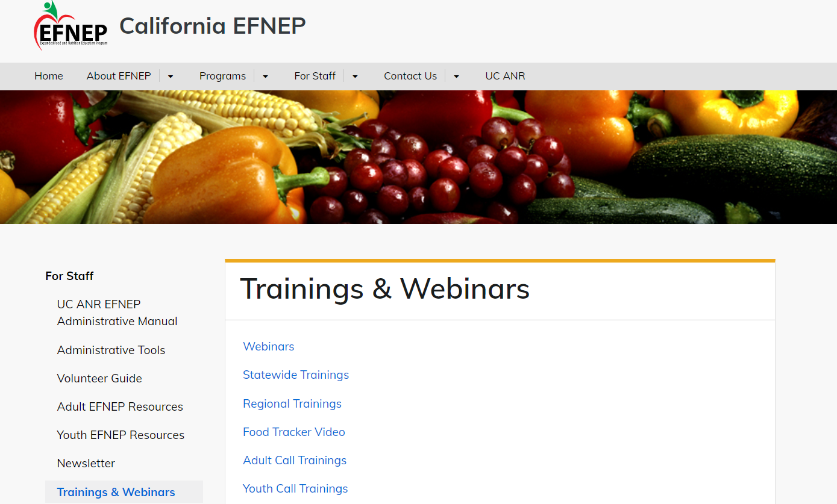
Equipping Staff to Work Remotely - Activities for
Telecommuting Staff
For EFNEP, Tasks can include:
WebNEERS data entry (About Me, About My Class, Food Trackers, FPAQ, completed Youth evaluations)
Review guides, trainings and webinars available on the EFNEP website
New!

Slide 23
Equipping Staff to Work Remotely - Activities for
Telecommuting Staff
Trainings/Webinars Available on the EFNEP Website:
Recipe Guidance and Physical Activity
Working in Rural Areas
Text Messaging with Adult Participants
Recruitment and Outreach
Creating an Emotionally Safe Space for Students to Thrive
Classroom Transitions, PA, and Brain Breaks
Recruitment and Outreach
Food Tracker Video
And more….

Slide 24
Coronavirus Update
Thank you for your flexibility and commitment to your local communities!
Questions?
Contact your supervisor, advisor, County Director or Katie Panarella, khpanarella@ucanr.edu

