Slide 1
PLANT SELECTION
Vegetables Families
Grow Oakhurst Victory Garden
Randy Thomson,
UCCE Master Gardener, Madera Co.

Slide 2
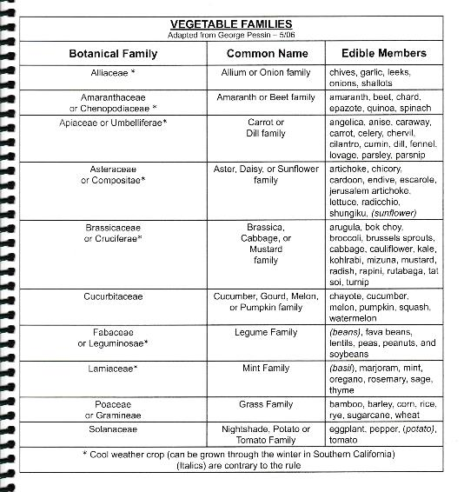
Botanical Family
Alliaceae
Amaranthaceae or Chenopodiaceae
Apiaceae or Umbellifererae
Asteraceae or Compositae
Brassicaceae or Cruciferae
Cucurbitaceae
Fabaceae or Leguminosae
Lamiaceae
Poaceae or Gramineae
Solanaceae

Slide 3
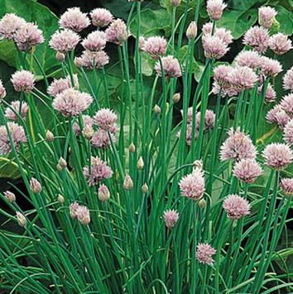
Alliaceae
Com. Name: Allium or Onion Family
Edible members: Chives,

Slide 4
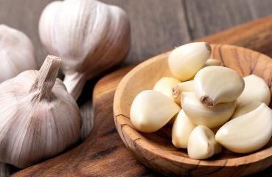
Alliaceae
Com. Name: Allium or Onion Family
Edible members: Chives, garlic,

Slide 5
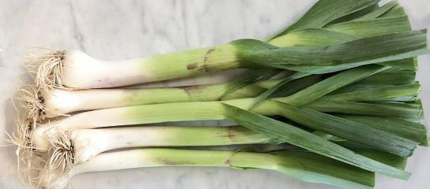
Alliaceae
Com. Name: Allium or Onion Family
Edible members: Chives, garlic, leeks,

Slide 6
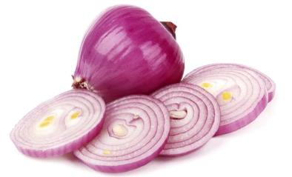
Alliaceae
Com. Name: Allium or Onion Family
Edible members: Chives, garlic, leeks, onions,

Slide 7
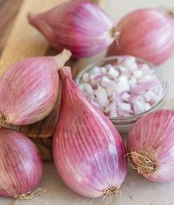
Alliaceae
Com. Name: Allium or Onion Family
Edible members: Chives, garlic, leeks, onions, shallots.

Slide 8
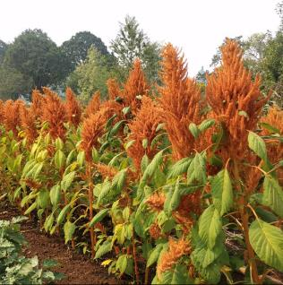
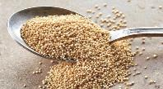
Amaranthaceae or Chenopodiaceae
Common Name: Amaranth or Beet Family
Edible members: Amaranth,

Slide 9
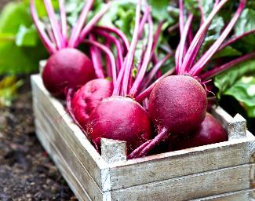
Amaranthaceae or Chenopodiaceae
Common Name: Amaranth or Beet Family
Edible members: Amaranth, beet,

Slide 10
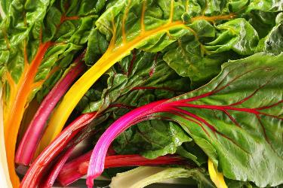
Amaranthaceae or Chenopodiaceae
Common Name: Amaranth or Beet Family
Edible members: Amaranth, beet, chard,

Slide 11
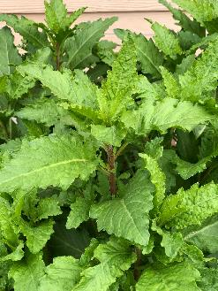
Amaranthaceae or Chenopodiaceae
Common Name: Amaranth or Beet Family
Edible members: Amaranth, beet, chard, epazote,

Slide 12
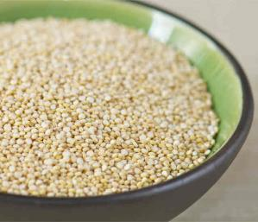
Amaranthaceae or Chenopodiaceae
Common Name: Amaranth or Beet Family
Edible members: Amaranth, beet, chard, epazote, quinoa,

Slide 13


Amaranthaceae or Chenopodiaceae
Common Name: Amaranth or Beet Family
Edible members: Amaranth, beet, chard, epazote, quinoa, spinach.

Slide 14
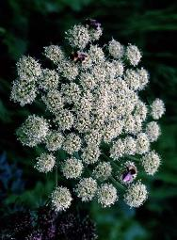
Apiaceae or Umbelliferae
Common Name: Carrot or Dill Family
Edible members: Angelica,

Slide 15
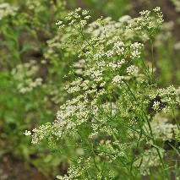
Apiaceae or Umbelliferae
Common Name: Carrot or Dill Family
Edible members: Angelica, anise,

Slide 16
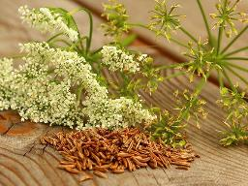
Apiaceae or Umbelliferae
Common Name: Carrot or Dill Family
Edible members: Angelica, anise, caraway,

Slide 17
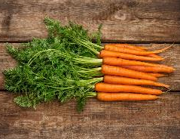
Apiaceae or Umbelliferae
Common Name: Carrot or Dill Family
Edible members: Angelica, anise, caraway, carrot,

Slide 18
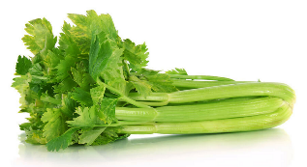
Apiaceae or Umbelliferae
Common Name: Carrot or Dill Family
Edible members: Angelica, anise, caraway, carrot, celery,

Slide 19
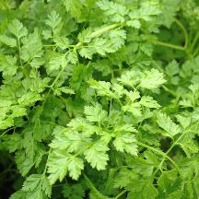
Apiaceae or Umbelliferae
Common Name: Carrot or Dill Family
Edible members: Angelica, anise, caraway, carrot, celery, chervil,

Slide 20
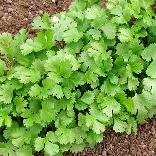
Apiaceae or Umbelliferae
Common Name: Carrot or Dill Family
Edible members: Angelica, anise, caraway, carrot, celery, chervil, cilantro,

Slide 21
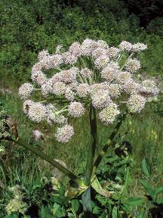
Apiaceae or Umbelliferae
Common Name: Carrot or Dill Family
Edible members: Angelica, anise, caraway, carrot, celery, chervil, cilantro, cumin,

Slide 22
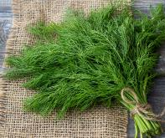
Apiaceae or Umbelliferae
Common Name: Carrot or Dill Family
Edible members: Angelica, anise, caraway, carrot, celery, chervil, cilantro, cumin, dill,

Slide 23
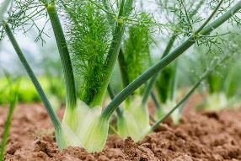
Apiaceae or Umbelliferae
Common Name: Carrot or Dill Family
Edible members: Angelica, anise, caraway, carrot, celery, chervil, cilantro, cumin, dill, fennel,

Slide 24
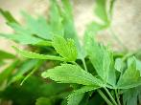
Apiaceae or Umbelliferae
Common Name: Carrot or Dill Family
Edible members: Angelica, anise, caraway, carrot, celery, chervil, cilantro, cumin, dill, fennel, lovage,

Slide 25
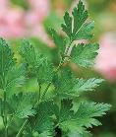
Apiaceae or Umbelliferae
Common Name: Carrot or Dill Family
Edible members: Angelica, anise, caraway, carrot, celery, chervil, cilantro, cumin, dill, fennel, lovage, parsley,

Slide 26
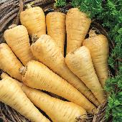
Apiaceae or Umbelliferae
Common Name: Carrot or Dill Family
Edible members: Angelica, anise, caraway, carrot, celery, chervil, cilantro, cumin, dill, fennel, lovage, parsley, parsnip.

Slide 27
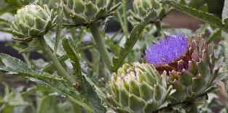
Asteraceae or Compositae
Common Name: Aster, Daisy, or Sunflower family
Edible members: Artichoke,

Slide 28
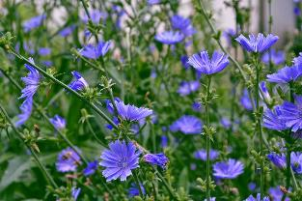
Asteraceae or Compositae
Common Name: Aster, Daisy, or Sunflower family
Edible members: Artichoke, chicory,

Slide 29
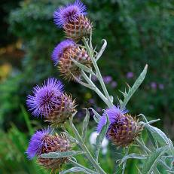
Asteraceae or Compositae
Common Name: Aster, Daisy, or Sunflower family
Edible members: Artichoke, chicory, cardoon,

Slide 30
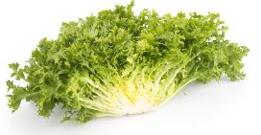
Asteraceae or Compositae
Common Name: Aster, Daisy, or Sunflower family
Edible members: Artichoke, chicory, cardoon, endive,

Slide 31
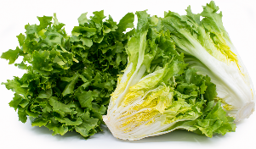
Asteraceae or Compositae
Common Name: Aster, Daisy, or Sunflower family
Edible members: Artichoke, chicory, cardoon, endive, escarole,

Slide 32
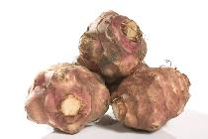
Asteraceae or Compositae
Common Name: Aster, Daisy, or Sunflower family
Edible members: Artichoke, chicory, cardoon, endive, escarole, jerusalem artichoke,

Slide 33
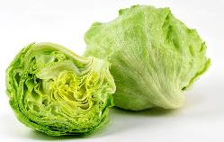
Asteraceae or Compositae
Common Name: Aster, Daisy, or Sunflower family
Edible members: Artichoke, chicory, cardoon, endive, escarole, jerusalem artichoke, lettuce,

Slide 34
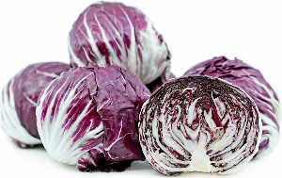
Asteraceae or Compositae
Common Name: Aster, Daisy, or Sunflower family
Edible members: Artichoke, chicory, cardoon, endive, escarole, jerusalem artichoke, lettuce, radicchio,

Slide 35
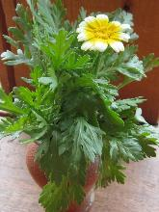
Asteraceae or Compositae
Common Name: Aster, Daisy, or Sunflower family
Edible members: Artichoke, chicory, cardoon, endive, escarole, jerusalem artichoke, lettuce, radicchio, shungiku,

Slide 36

Asteraceae or Compositae
Common Name: Aster, Daisy, or Sunflower family
Edible members: Artichoke, chicory, cardoon, endive, escarole, jerusalem artichoke, lettuce, radicchio, shungiku, sunflower.

Slide 37
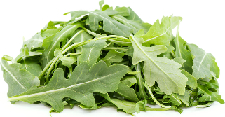
Brassicaceae
Common Name: Brassica, Cabbage, or Mustard Family
Edible members: arugula,

Slide 38
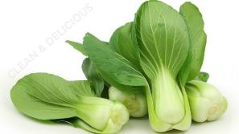
Brassicaceae
Common Name: Brassica, Cabbage, or Mustard Family
Edible members: arugula, bok choy,

Slide 39
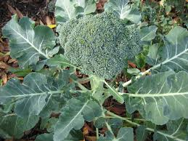
Brassicaceae
Common Name: Brassica, Cabbage, or Mustard Family
Edible members: arugula, bok choy, broccoli,

Slide 40
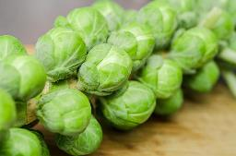
Brassicaceae
Common Name: Brassica, Cabbage, or Mustard Family
Edible members: arugula, bok choy, broccoli, brussels sprouts,

Slide 41
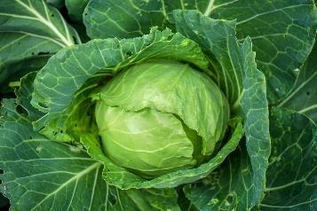
Brassicaceae
Common Name: Brassica, Cabbage, or Mustard Family
Edible members: arugula, bok choy, broccoli, brussels sprouts, cabbage,

Slide 42
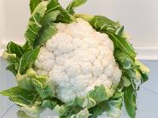
Brassicaceae
Common Name: Brassica, Cabbage, or Mustard Family
Edible members: arugula, bok choy, broccoli, brussels sprouts, cabbage, cauliflower,

Slide 43
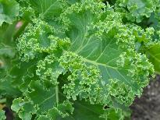
Brassicaceae
Common Name: Brassica, Cabbage, or Mustard Family
Edible members: arugula, bok choy, broccoli, brussels sprouts, cabbage, cauliflower, kale,

Slide 44
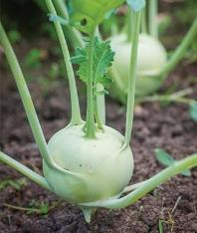
Brassicaceae
Common Name: Brassica, Cabbage, or Mustard Family
Edible members: arugula, bok choy, broccoli, brussels sprouts, cabbage, cauliflower, kale, kohlrabi,

Slide 45
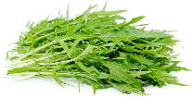
Brassicaceae
Common Name: Brassica, Cabbage, or Mustard Family
Edible members: arugula, bok choy, broccoli, brussels sprouts, cabbage, cauliflower, kale, kohlrabi, mizuna,

Slide 46
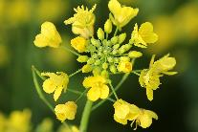
Brassicaceae
Common Name: Brassica, Cabbage, or Mustard Family
Edible members: arugula, bok choy, broccoli, brussels sprouts, cabbage, cauliflower, kale, kohlrabi, mizuna, mustard,

Slide 47
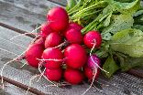
Brassicaceae
Common Name: Brassica, Cabbage, or Mustard Family
Edible members: arugula, bok choy, broccoli, brussels sprouts, cabbage, cauliflower, kale, kohlrabi, mizuna, mustard, radish,

Slide 48
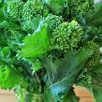
Brassicaceae
Common Name: Brassica, Cabbage, or Mustard Family
Edible members: arugula, bok choy, broccoli, brussels sprouts, cabbage, cauliflower, kale, kohlrabi, mizuna, mustard, radish, rapini,

Slide 49

Brassicaceae
Common Name: Brassica, Cabbage, or Mustard Family
Edible members: arugula, bok choy, broccoli, brussels sprouts, cabbage, cauliflower, kale, kohlrabi, mizuna, mustard, radish, rapini, rutabaga,

Slide 50

Brassicaceae
Common Name: Brassica, Cabbage, or Mustard Family
Edible members: arugula, bok choy, broccoli, brussels sprouts, cabbage, cauliflower, kale, kohlrabi, mizuna, mustard, radish, rapini, rutabaga, tatsoi,

Slide 51

Brassicaceae
Common Name: Brassica, Cabbage, or Mustard Family
Edible members: arugula, bok choy, broccoli, brussels sprouts, cabbage, cauliflower, kale, kohlrabi, mizuna, mustard, radish, rapini, rutabaga, tatsoi, turnip.

Slide 52
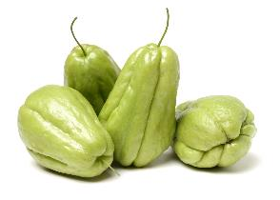
Cucurbitaceae
Com. Name: Cucumber, Gourd, Melon, Pumpkin Family
Edible members: chayote,

Slide 53
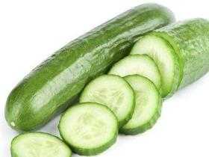
Cucurbitaceae
Com. Name: Cucumber, Gourd, Melon, Pumpkin Family
Edible members: chayote, cucumber,

Slide 54
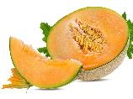

Cucurbitaceae
Com. Name: Cucumber, Gourd, Melon, Pumpkin Family
Edible members: chayote, cucumber, melon,

Slide 55
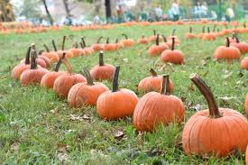
Cucurbitaceae
Com. Name: Cucumber, Gourd, Melon, Pumpkin Family
Edible members: chayote, cucumber, melon, pumpkin,

Slide 56

Cucurbitaceae
Com. Name: Cucumber, Gourd, Melon, Pumpkin Family
Edible members: chayote, cucumber, melon, pumpkin, squash,

Slide 57

Cucurbitaceae
Com. Name: Cucumber, Gourd, Melon, Pumpkin Family
Edible members: chayote, cucumber, melon, pumpkin, squash, watermelon.

Slide 58

Fabaceae or Leguminoasae
Common Name: LegumeFamily
Edible members: (beans),

Slide 59

Fabaceae or Leguminoasae
Common Name: LegumeFamily
Edible members: (beans), fava beans,

Slide 60

Fabaceae or Leguminoasae
Common Name: LegumeFamily
Edible members: (beans), fava beans, lentils,

Slide 61

Fabaceae or Leguminoasae
Common Name: LegumeFamily
Edible members: (beans), fava beans, lentils, peas,

Slide 62

Fabaceae or Leguminoasae
Common Name: LegumeFamily
Edible members: (beans), fava beans, lentils, peas, peanuts,

Slide 63

Fabaceae or Leguminoasae
Common Name: LegumeFamily
Edible members: (beans), fava beans, lentils, peas, peanuts, and soybeans.

Slide 64

Lamiaceae
Common Name: Mint Family
Edible members: (basil),

Slide 65

Lamiaceae
Common Name: Mint Family
Edible members: (basil), marjoram,

Slide 66

Lamiaceae
Common Name: Mint Family
Edible members: (basil), marjoram, mint,

Slide 67

Lamiaceae
Common Name: Mint Family
Edible members: (basil), marjoram, mint, oregano,

Slide 68

Lamiaceae
Common Name: Mint Family
Edible members: (basil), marjoram, mint, oregano, rosemary,

Slide 69

Lamiaceae
Common Name: Mint Family
Edible members: (basil), marjoram, mint, oregano, rosemary, sage,

Slide 70

Lamiaceae
Common Name: Mint Family
Edible members: (basil), marjoram, mint, oregano, rosemary, sage, thyme.

Slide 71

Poaceae or Gramineae
Common Name: Grass Family
Edible members: Bamboo,

Slide 72

Poaceae or Gramineae
Common Name: Grass Family
Edible members: Bamboo, barley,

Slide 73

Poaceae or Gramineae
Common Name: Grass Family
Edible members: Bamboo, barley, corn,

Slide 74

Poaceae or Gramineae
Common Name: Grass Family
Edible members: Bamboo, barley, corn, rice,

Slide 75

Poaceae or Gramineae
Common Name: Grass Family
Edible members: Bamboo, barley, corn, rice, rye,

Slide 76

Poaceae or Gramineae
Common Name: Grass Family
Edible members: Bamboo, barley, corn, rice, rye, sugarcane,

Slide 77

Poaceae or Gramineae
Common Name: Grass Family
Edible members: Bamboo, barley, corn, rice, rye, sugarcane, wheat.

Slide 78

Solanaceae
Common Name: Nightshade, Potato or Tomato Family
Edible members: Eggplant,

Slide 79

Solanaceae
Common Name: Nightshade, Potato or Tomato Family
Edible members: Eggplant, pepper,

Slide 80

Solanaceae
Common Name: Nightshade, Potato or Tomato Family
Edible members: Eggplant, pepper, (potato),

Slide 81

Solanaceae
Common Name: Nightshade, Potato or Tomato Family
Edible members: Eggplant, pepper, (potato), tomato.

Slide 82


Slide 83


Plant Selection—ten pointers
Fall and winter crops are slower, smaller—plant more!
Try planting disease resistant varieties.
Consider maturity dates.
Always try new types of vegetables!
Crops with short harvest periods allow for successive plantings.
Several varieties can help stagger harvest.
Start seeds 4–6 weeks before transplanting date.
Crop rotation confuses pests
and allows depleted soil to recover.
Site Perennials away from
Annual disturbances.
Think about mature plant sizes
when planting.

Slide 84





The End (A Quiz)

Slide 85
The End (A Quiz)
Romanesco
Broccoli
Brassicaceae
Napa
Cabbage
Brassica
Lentil
Legumenoseae
Watermelon
Cucurbitaceae
Gourds
Squashes
Cucurbit.

