Slide 1
Virtualogy 2020
Small Animal Competition Results
Jordan Miner ARBA Judge #1020

Slide 2
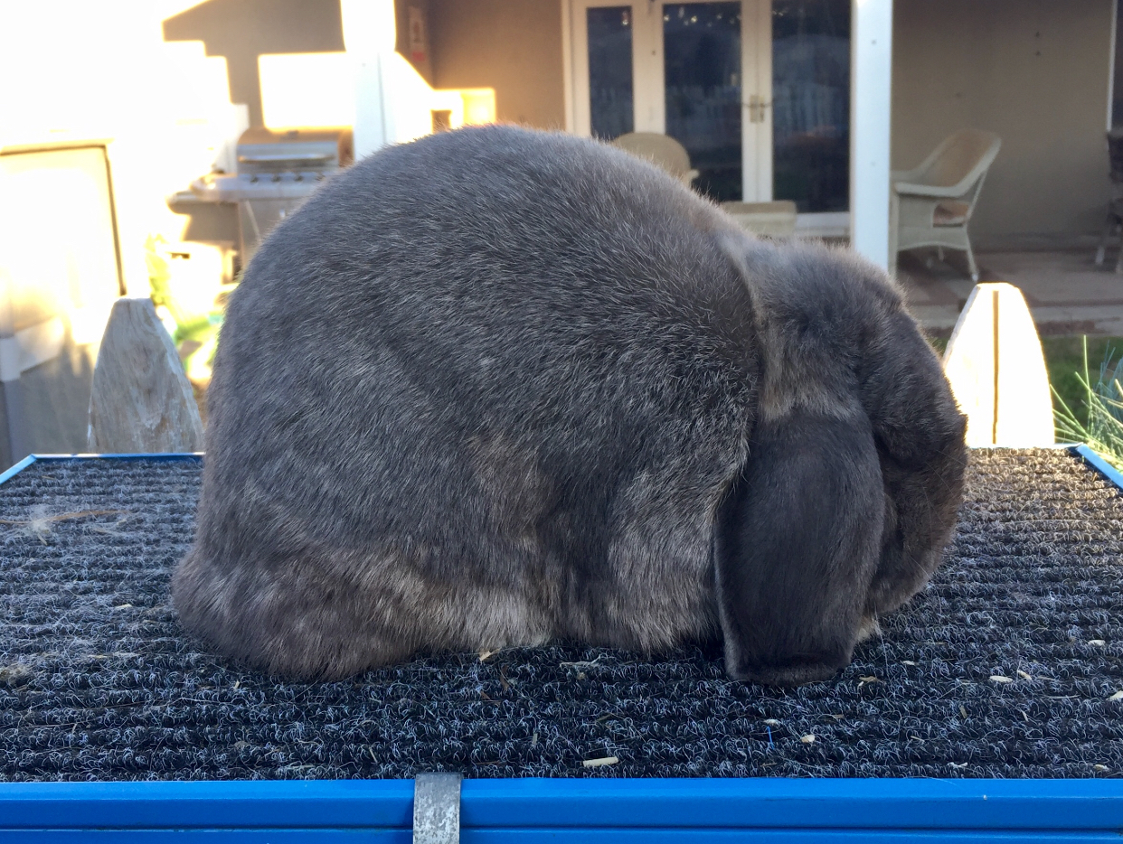
BEST IN SHOW RABBIT
Maddi Ford - FVC 4H
Mini Lop SSB

Slide 3
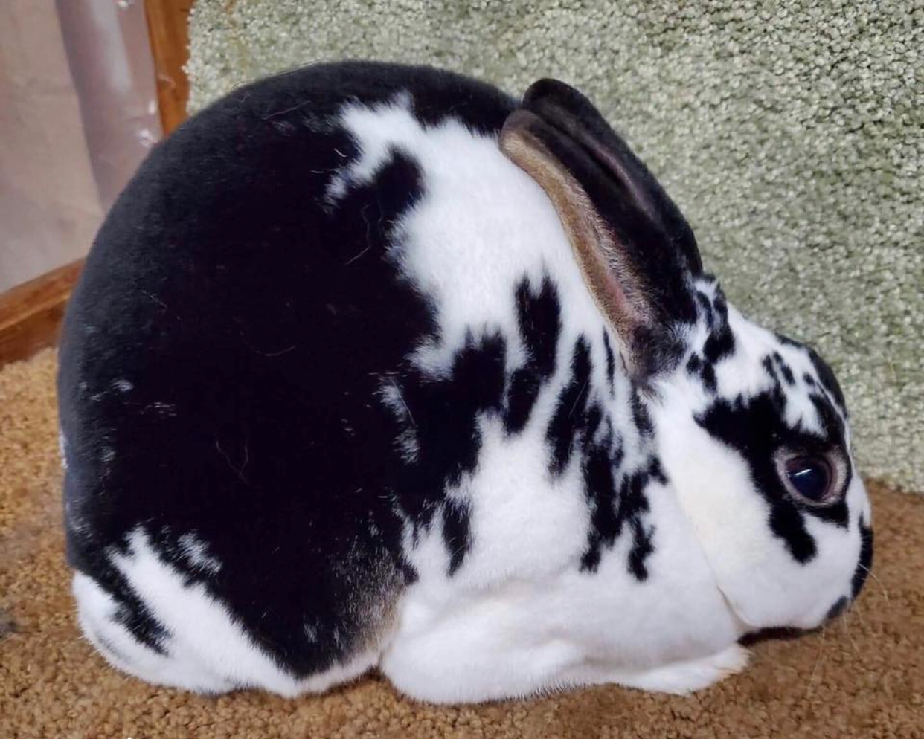
RESERVE IN SHOW RABBIT
Mika Horan - OABB 4H
Mini Rex Broken Sr Buck

Slide 4
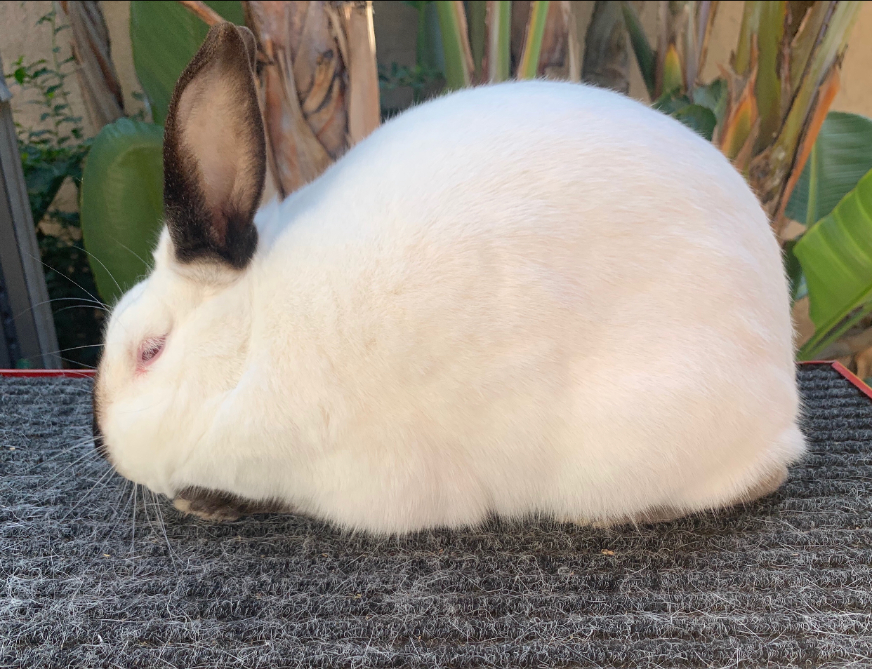
2nd RESERVE IN SHOW RABBIT
Audrey Mullins - TT 4H
Californian Sr Buck

Slide 5
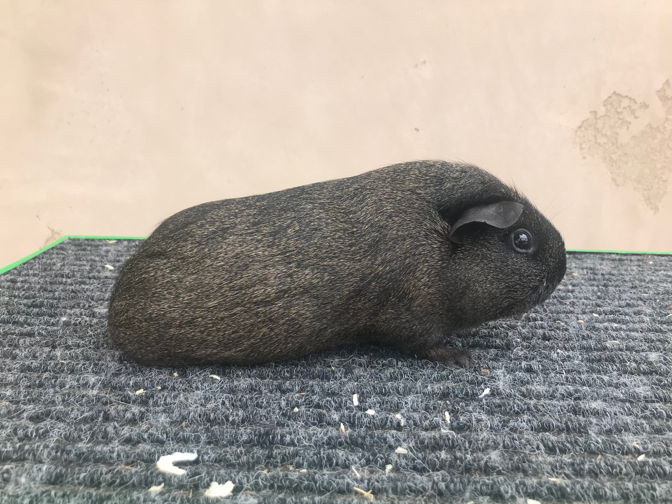
BEST IN SHOW CAVY
Mika Horan - OABB 4H
American Dilute Solid Sr Sow

Slide 6
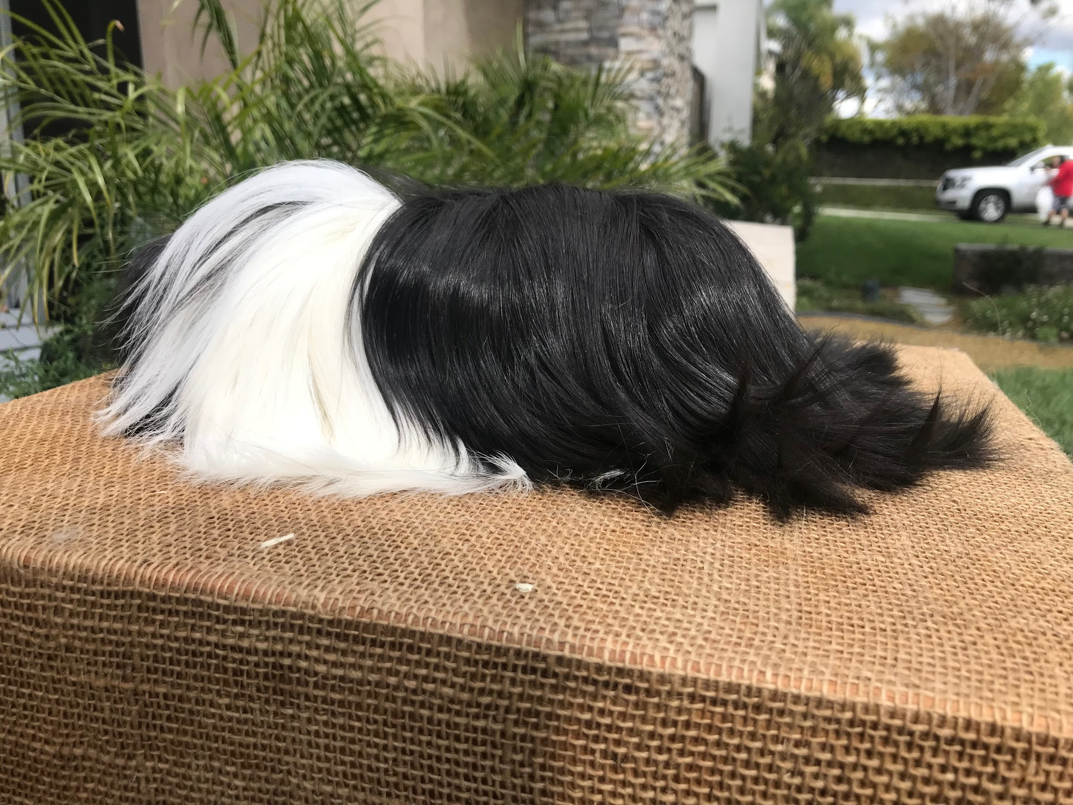
RESERVE IN SHOW CAVY
Mika Horan - OABB 4H
Peruvian Broken Sr Boar

Slide 7
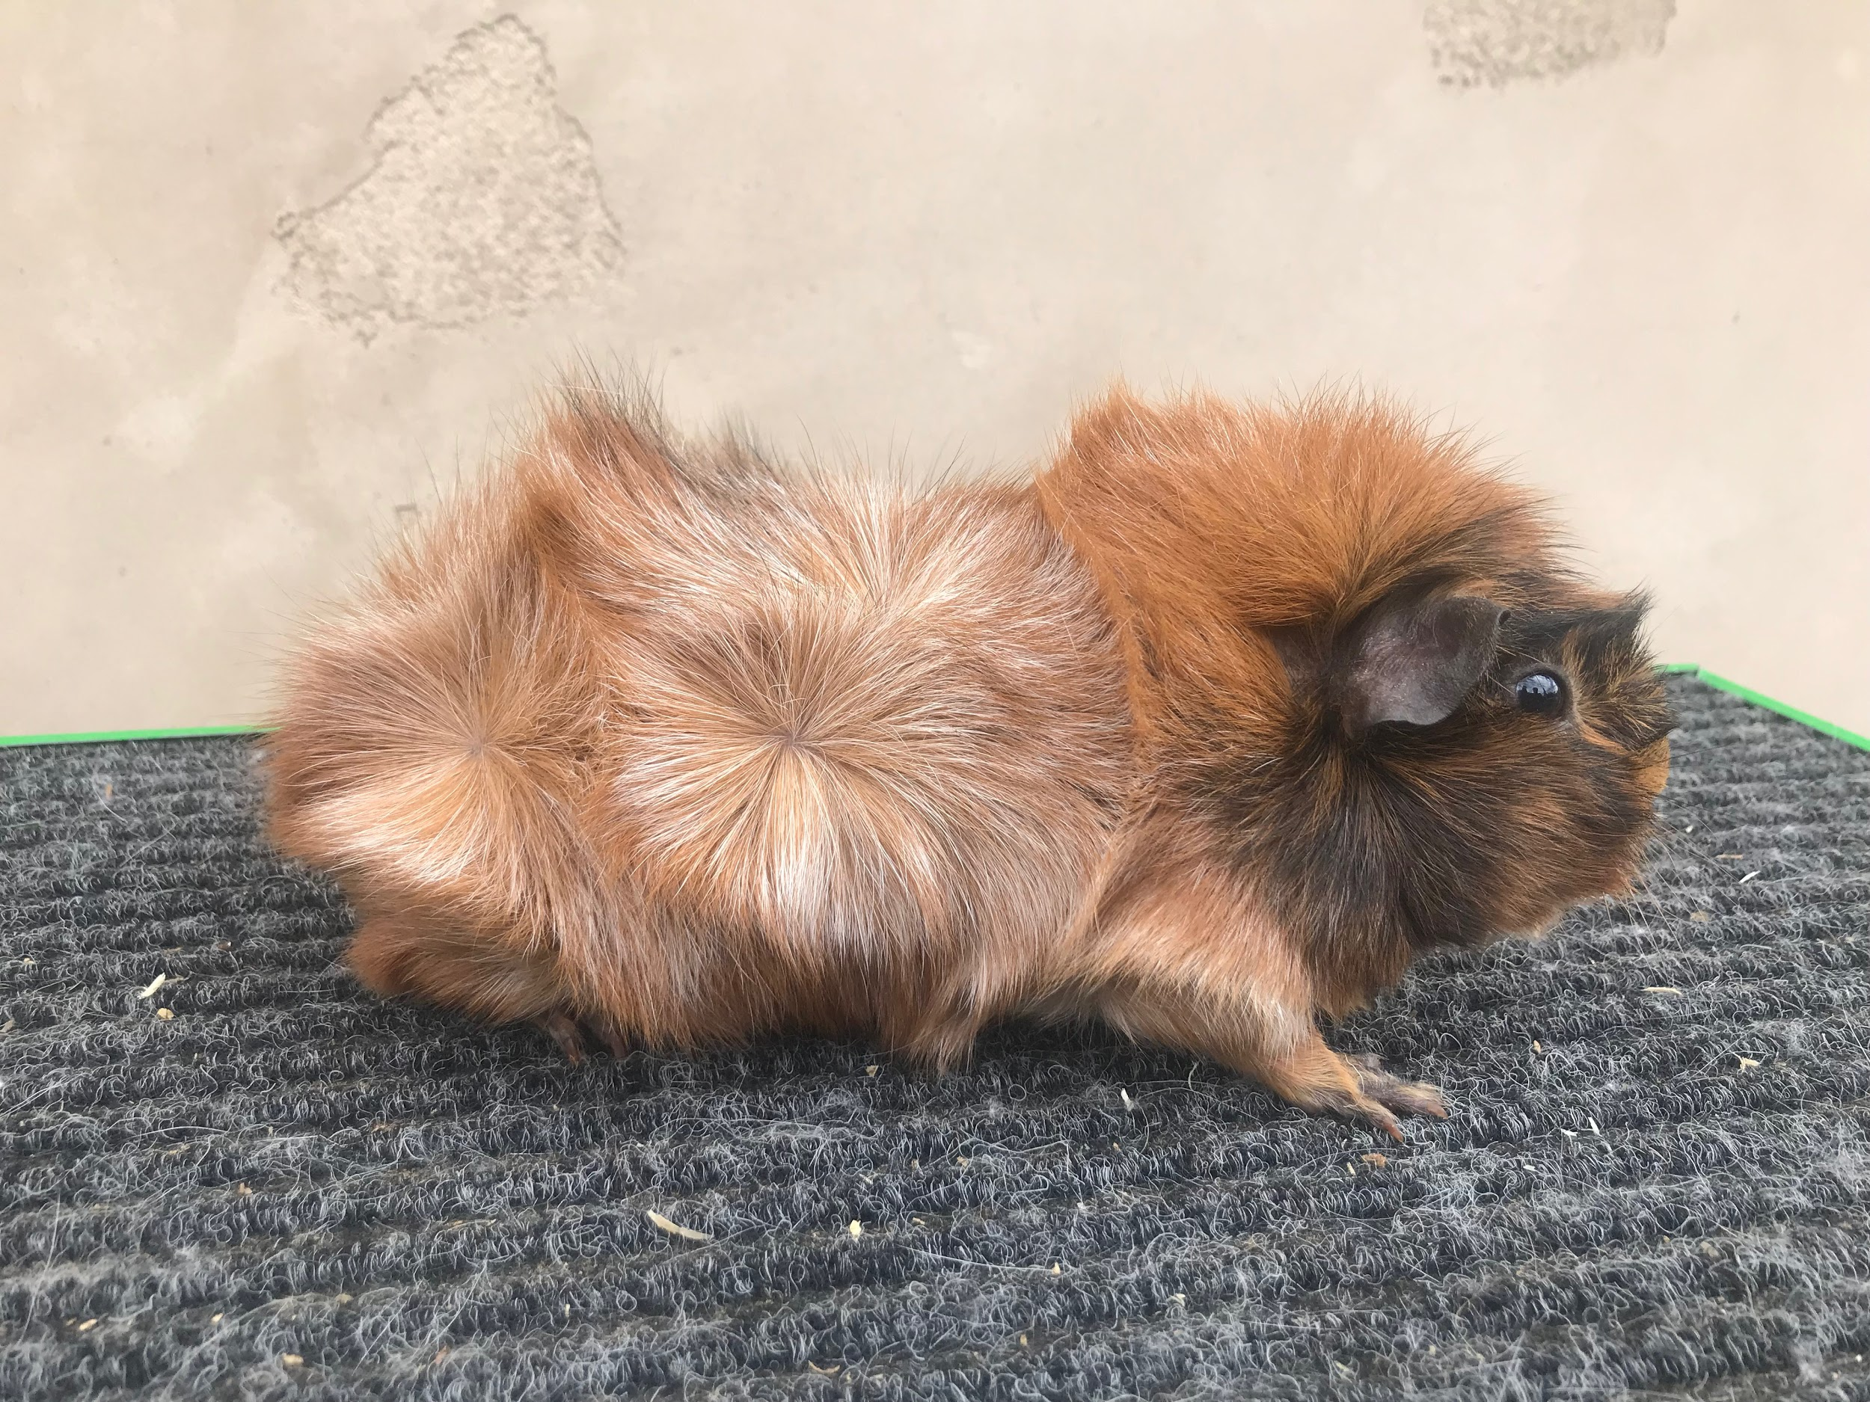
2nd RESERVE IN SHOW CAVY
Mika Horan - OABB 4H
Abyssinian Roan INT Sow

