Slide 1
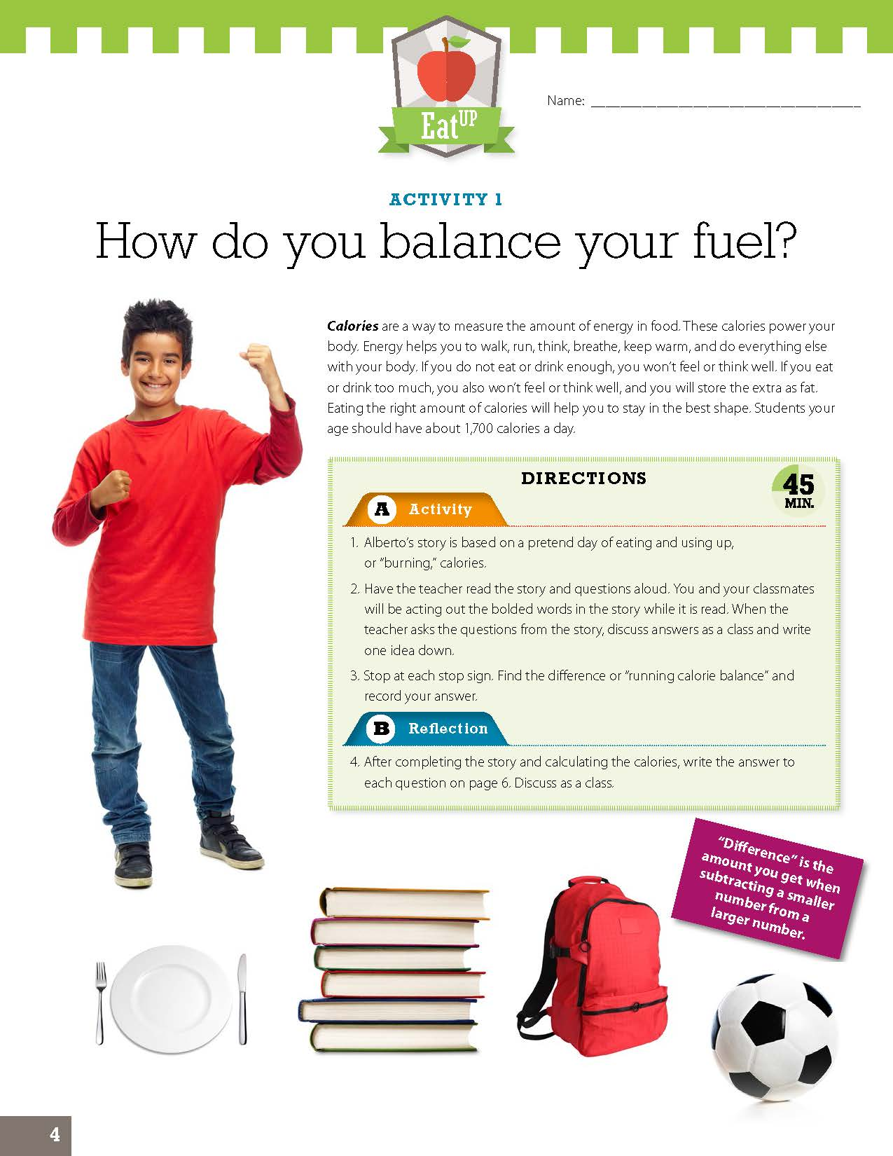
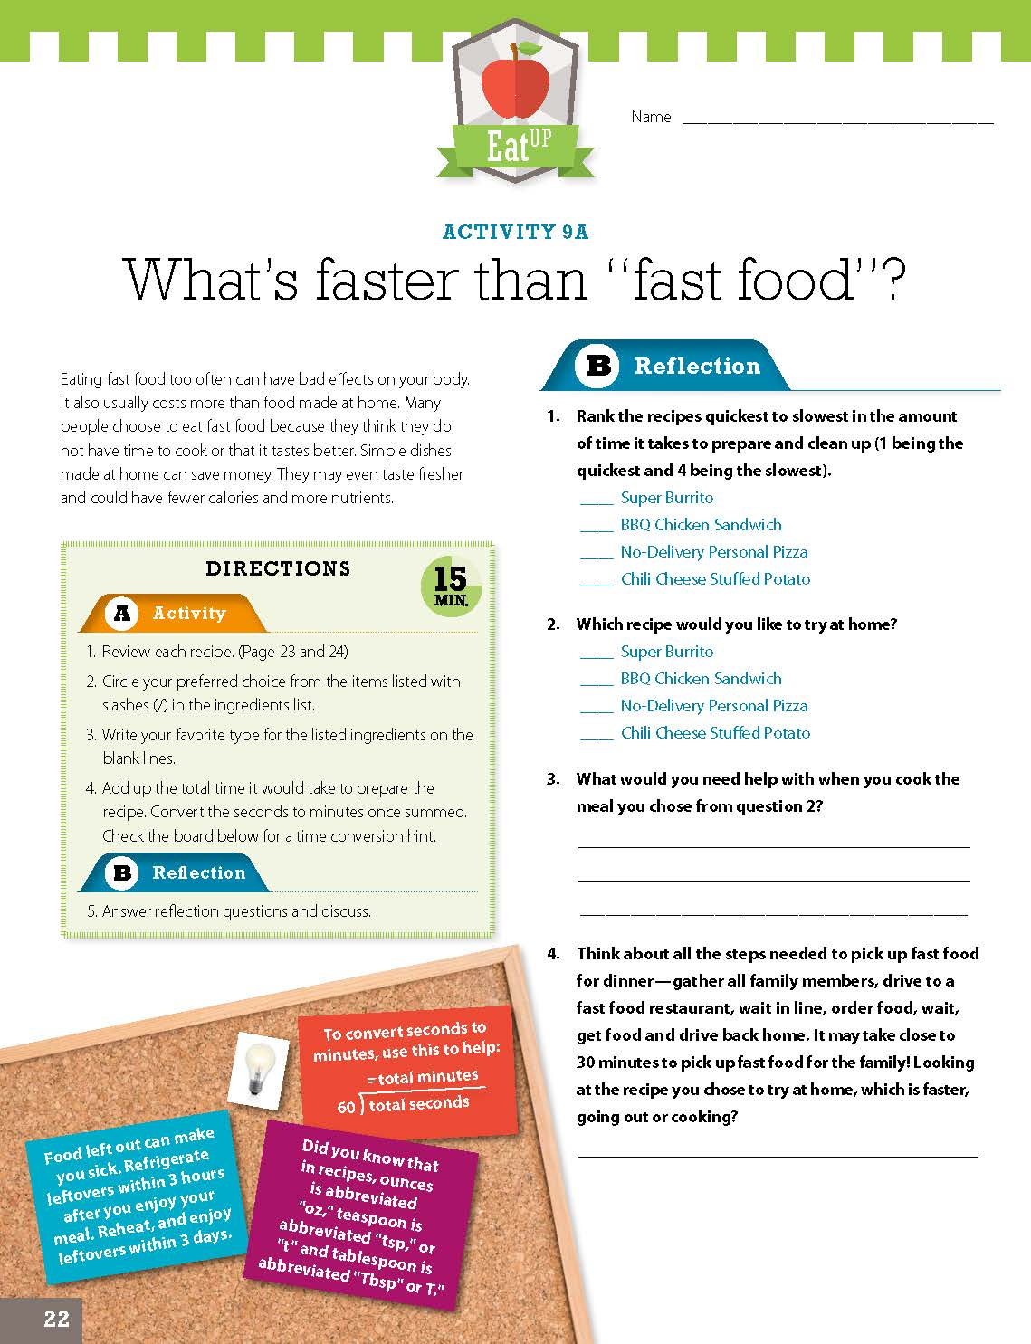
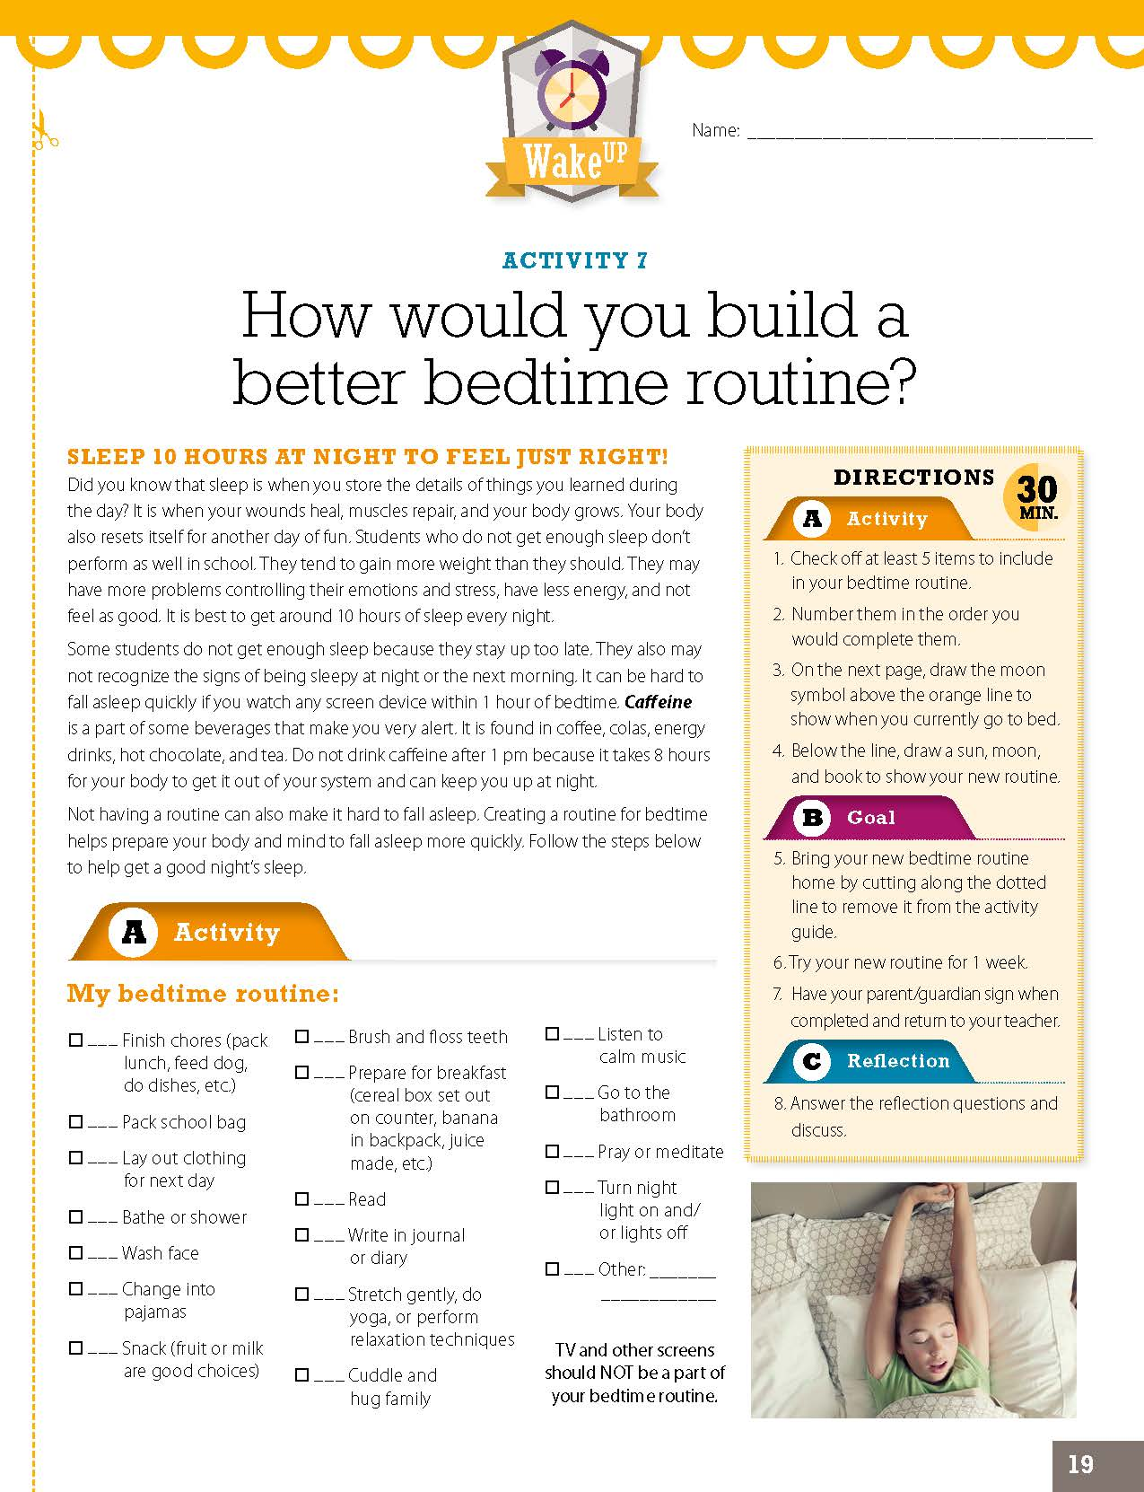
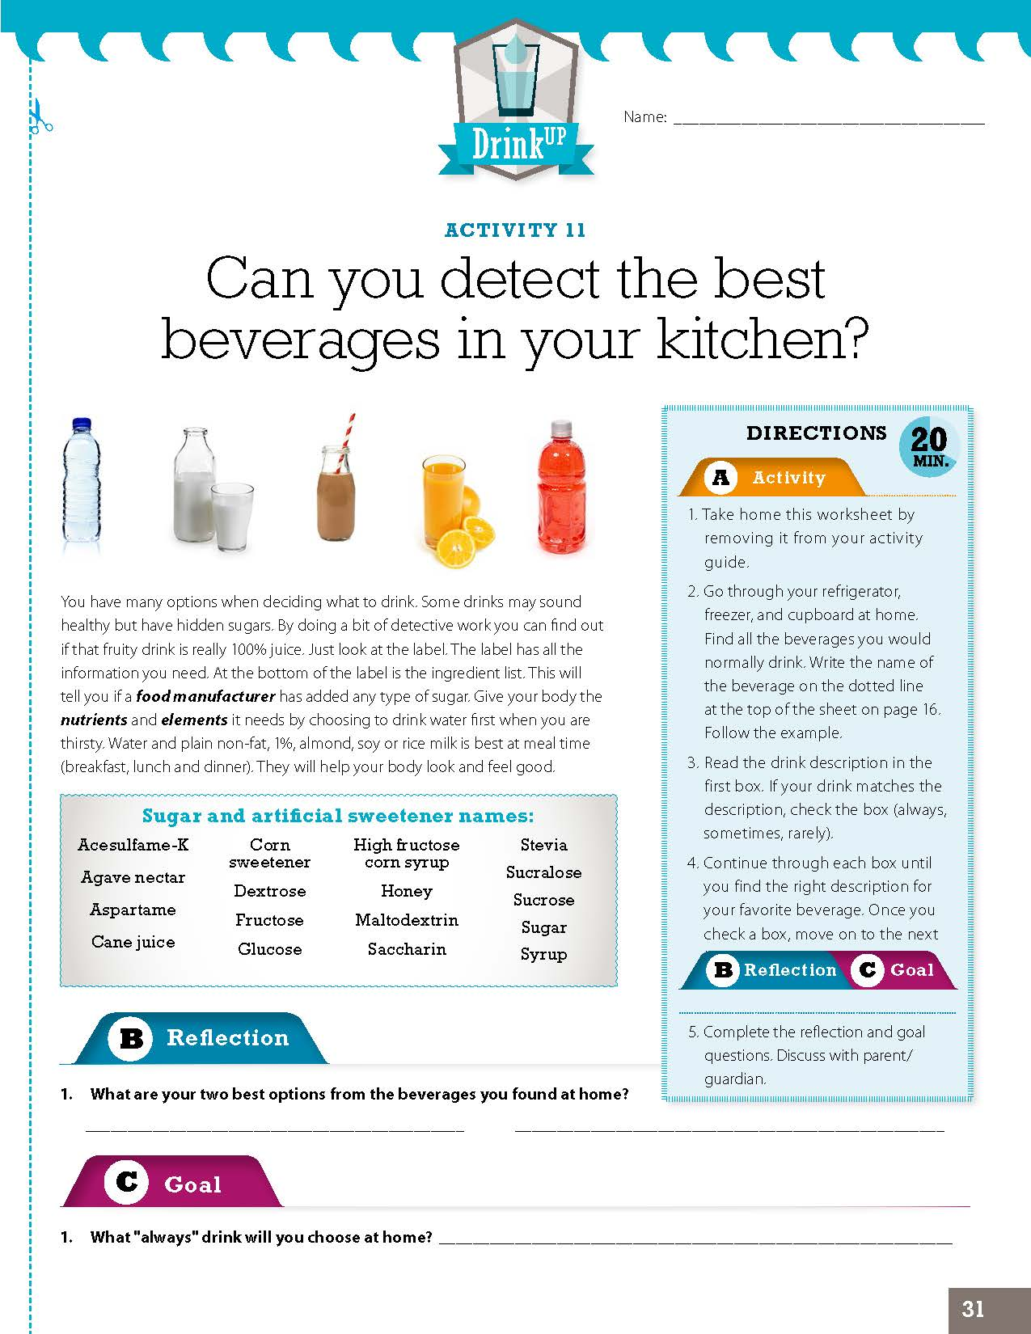
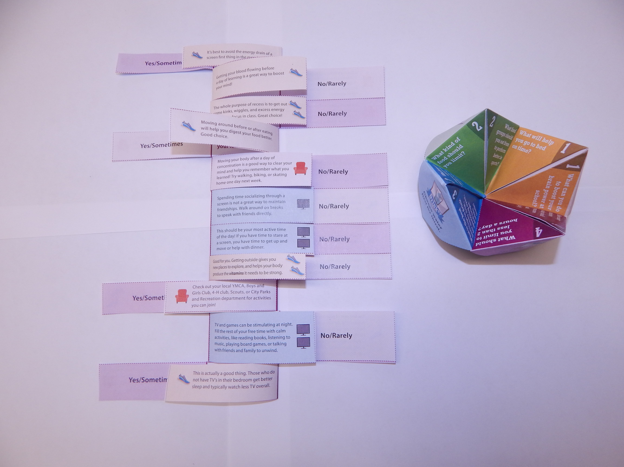
UP4it
Obesity Prevention Intervention for 4th- 5th Graders
Background
Methods
A child who is overweight or obese at 8 years of age is 7 times more likely to develop risk factors for cardiovascular disease as a teenager than a child with a healthy weight. Childhood obesity is also associated with depression and problems in school, including missed school days and grade repetition. Long-term studies show that overweight children who grow into a healthier weight and adopt a healthy lifestyle can reduce their risk of future health problems. A gap exists in the availability of curriculum that can help school-aged children learn how to make choices specifically that impact their weight.
UP4it was developed by the University of California. The materials target known correlates to excess weight gain in youth, with a primary focus on four key areas:
Wake^{UP}- Sleep ten hours at night to feel just right.
Eat^{UP}- Select the right food for a better mood.
Drink^{UP}- Choose water first for thirst.
Get^{UP}- Move and play at least an hour a day.
UP4it activity guides utilize youth development principles that get students engaged in their learning, using problem-solving, teamwork, and 21st century skills. The activities require no additional resources beyond what you would normally find in a classroom. They link to California Common Core Standards.
Results
Discussion
UP4it was evaluated in the spring of 2018 during formative field testing. Students (n122) completed EFNEP pre/post evaluations.
72% of children improved their ability to choose foods according to Federal Dietary Recommendations.
27% of children improved their physical activity practices or gained knowledge.
31% of children used safe food handling practices more often or gained knowledge.
UP4it Teacher Observation Tool feedback from one teacher indicated that in 9/10 areas, students showed improvement.
“These programs greatly inspire me to include more health education throughout the school year.”
UP4it Level One was designed and written for 4th – 5th grade students. Materials align with Common Core State Standards. The activity guides will be available to order for the upcoming 2019-2020 school year.
UP4it training will be available in the near future for SNAP-Ed Programs who are planning to, or interested in, implementation.
UP4it Level Two (5th-6th grade)
is currently being reviewed and will be coming soon.
“Fantastic program! Very kid friendly.”
“Excellent!”
Responses to the UC CalFresh Teacher Observation Tool and UP4it Teacher Feedback form were positive.
While activities are paper-based, they are designed to be student-directed and hands-on, requiring no outside supplies.
Marcel Horowitz, Christie Hedrick, Marisa Neelon, Chelsey Slattery, Leah Sourbeer, Jona Pressman, Molica Sim, Shyra Murrey
The mission of the California Supplemental Nutrition Assistance Program Education (SNAP-Ed) is to inspire and empower underserved Californians by promoting awareness, education and community change through diverse partnerships to result in healthy eating and active living.
California SNAP-Ed is administered by the California Department of Social Services in partnership with the California Department of Public Health, UC CalFresh Nutrition Education Program
the California Department of Aging, and Catholic Charities of California, Inc.
Funded by USDA SNAP-Ed, and USDA/NIFA, EFNEP, equal opportunity providers and employers.

