Slide 1

Social Media Training
Haille Margarite
Stanislaus County 4-h

Slide 2
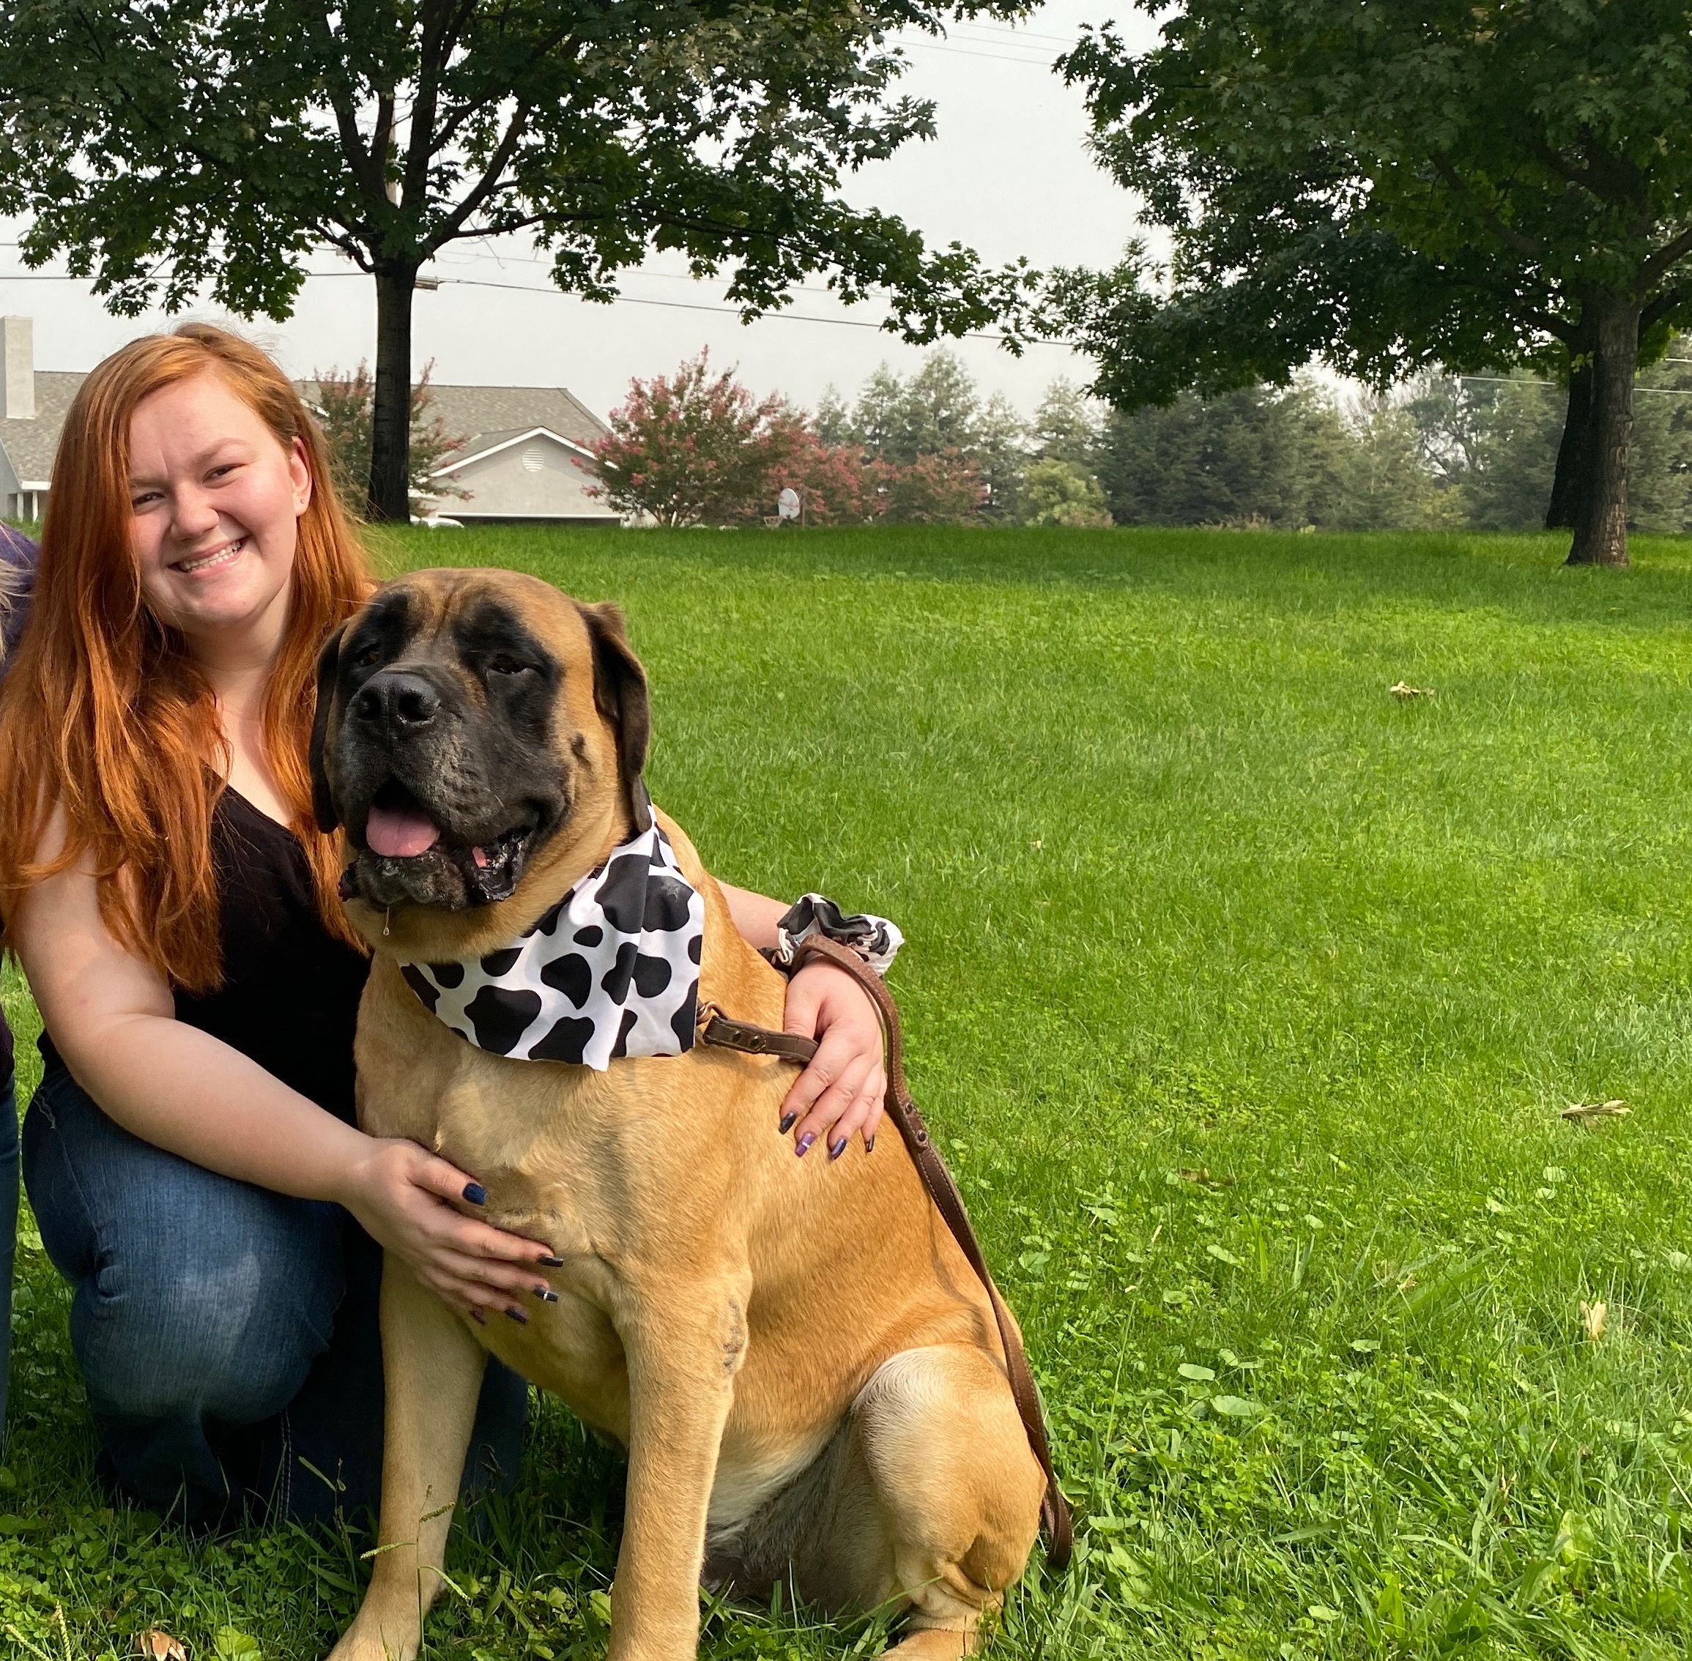
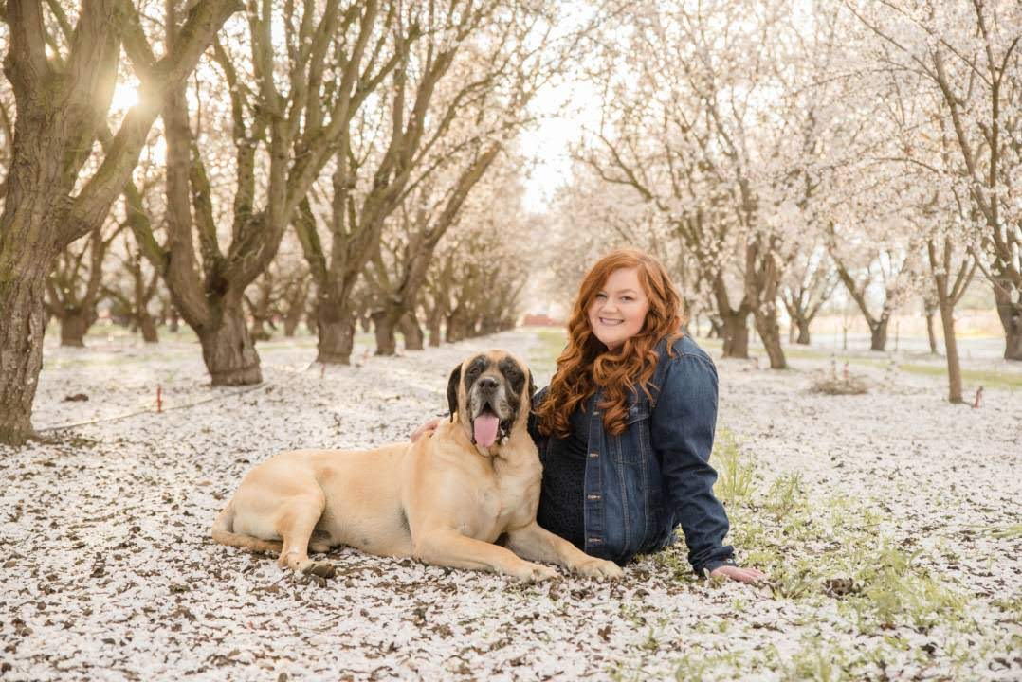
About Me
12 years in 4-H
BS in Agricultural Science from CSU Stanislaus
Worked for UCANR for 2 years

Slide 3
Platforms Commonly Used
Social Media
Virtual Meetings
Facebook
Instagram
YouTube
Zoom
Google Classroom
Microsoft Teams
Facebook Live

Slide 4
Requirements for Social Media Accounts
California 4-H
  http://4h.ucanr.edu/files/133821.pdf
National 4-H
  https://4-h.org/wp-content/uploads/2016/02/Social-Media-Community-Guidelines.pdf

Slide 5
Purpose
The purpose of the 4-H page is to build a community of 4-H fans to engage in positive and productive conversation
should be used to provide educational/informational posts about 4-H activities
Community guidelines should be set to make sure everyone knows the expectations of the page and that it must follow the 4-H code of conduct
  Ex: The purpose of the 4-H page is to build a community of 4-H fans to engage in positive and productive conversation

Slide 6
Administrator Access
Administrator Access must be given to:
  At least two unrelated adult volunteers
  A UCANR 4-H Employee

Slide 7
Responsibilities
Notify the county 4-H office if your club, unit, or project has or wishes to establish a social media site/platform/ channel.
All 4-H YDP and UC policies as well as these guidelines must be followed.
We recommend youth members work in partnership with a 4-H adult volunteer or older teen mentor in the development and maintenance of the site.
A 4-H member or 4-H adult volunteer should be designated to regularly update the site.
A designated 4-H adult volunteer, such as the Community 4-H Club Leader, must monitor the page regularly (at least weekly).
Upon request of the UCCE 4-H YDP staff, remove the site immediately

Slide 8
Guidelines
Photographs:
  Do not use the names of 4-H members when posting photos.
  Tagging is not permitted.
  Do not post photos meant to embarrass a member (cyberbullying).
Do not post photos that might be taken to resemble suggestive behavior.
Do not post copyrighted material. This includes videos with copyrighted music (e.g., event “afterglows” with copyrighted music).
Follow all policies regarding the use of the 4-H name and emblem and be sure to use a proper 4-H logo.

Slide 9
Consequences for Violating Policy or Guidelines
Removal of the 4-H-specific portion of the social media site
Access to the 4-H-specific portion of the site restricted or blocked
Any of the consequences outlined in the 4-H Member Code of Conduct or 4-H Adult Code of Conduct, Responsibilities, and Rights
Other consequences a deemed appropriate by County Director.

Slide 10
Facebook private vs public group
Private Group
Public Group
May join after approval
Group members will more likely be able to see posts.
Individuals can post as themselves and not the page
All group members will be able to post, comment and share in the group
Allow anyone to join
General public won’t be able to see posts
All group members can comment

Slide 11
Making Virtual Events/Social Media Interactive and Fun
Flyers
  https://www.canva.com/
Games
  Kahoot
  Bingo
  Two Truths
  Simon says
Contests
  Pumpkin
  Ugly Sweater
Activities
  Scavenger hunt
  Planting seeds
  Photography-weekly challenge
Whiteboard meetings

Slide 12
Any Questions?

