Slide 1

Project Prioritization Rubric Practice
Wed. Nov. 4th 2020 – 1:00 PM-2:00 PM
Welcome! This beginning of this meeting will be recorded and posted to the UC Master Gardener Program Coordinator website. All materials will be shared via the Coordinator website and Collaborative Tools
We will begin exactly at 1:00 PM.
Notes:
Hi everyone and welcome to this Brown Bag Webinar on the topic of our upcoming COVID-19 and Volunteerism Survey Results. My name is Marisa Coyne and I am the Academic Coordinator for Volunteer Engagement with the UC Master Gardener Program. We are joined today by my statewide program teammates, Missy Gable, Melissa Womack, Lauren Snowden, and Tamekia Wilkins.
Results of a COVID-19 and volunteerism statewide survey of UC Master Gardener Program volunteers (n=3500) indicate that the UC Master Gardener Program should expect diminished volunteer commitment for the 2020-2021 program year. 45% of respondents indicated that they are interested in continuing in-person volunteer commitments, as public health guidance allows. 45% of respondents indicated that they are interested in providing community education online. Only 22% of respondents stated that they open to volunteering both in-person and online. Local, county-based UC Master Gardener Program coordinators need tools and support as they make decisions to move forward impactful projects in a moment of limited volunteer capacity.
The UC Master Gardener Program developed a rubric to help county-based staff score UC Master Gardener Program projects on their connection to mission, strategic initiatives, partnerships, local priorities, unique areas of volunteer brilliance, alignment with community need, and other criteria. Coordinators can use the rubric results to identify focus projects for the coming program year, to assess proposed projects, and/or to improve existing projects.
This meeting is being recorded and will be posted to the Coordinator website.

Slide 2
Agenda
    Welcome + Background
    Meeting Logistics
    Rubric Practice (Breakout Rooms)
    Discussion + Closing Remarks

Slide 3
Welcome + Background
Marisa Coyne, Volunteer Engagement Coordinator – UC Master Gardener Program
Appreciation to Dustin Blakey (County Director, Inyo Mono) and Danica Taber (Coordinator, Santa Barbara)

Slide 4
Timeline
March 2020 – Volunteer Match national survey 1
May 2020 – Volunteer Match national survey 2
June 2020 – UC Master Gardener Program survey concept introduced (via Brown Bag Webinar)
July 2020 – UC Master Gardener Program COVID-19 and Volunteerism Survey deployed
September 2020 – Statewide results distributed (via Brown Bag Webinar)
October 2020 – County-level results distributed
November 2020 – Project prioritization rubric ‘finalized’
Notes:
<< Add bullets representing your county’s processes >>

Slide 5
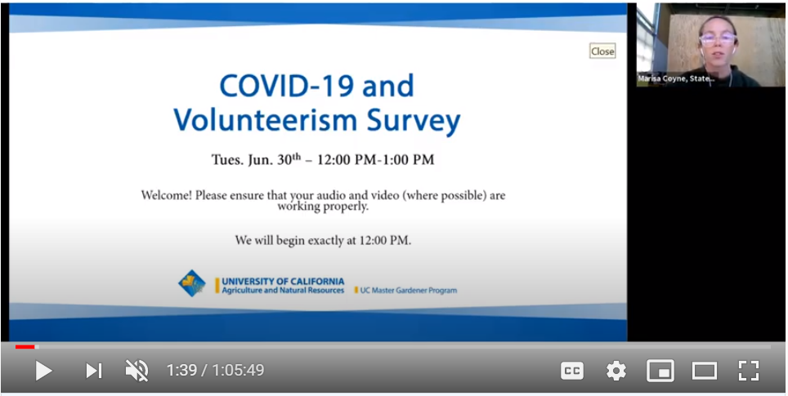
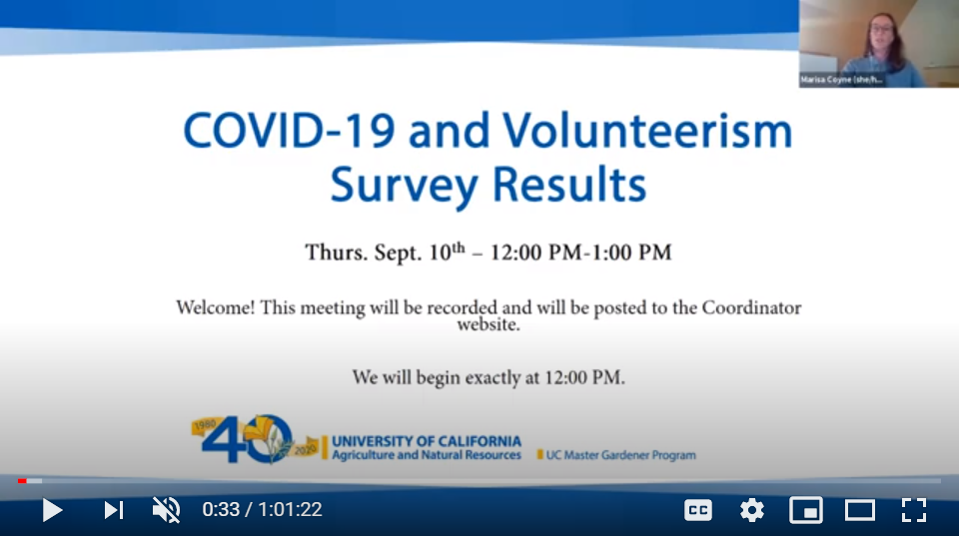
Brown Bag Webinars: COVID-19 + Volunteerism Survey – Roll out + Results
Notes:
Background information on this project can be found on the UC Master Gardener Program Coordinator website’s Brown Bag Webinar page. Recordings detail the motivation behind this project as well as statewide results.
Links
COVID-19 and Volunteerism Survey:
https://www.youtube.com/watch?v=1csB3cYqahY&feature=youtu.be&ab_channel=UCMasterGardenerProgram
COVID-19 and Volunteerism Survey RESULTS (statewide):
https://www.youtube.com/watch?v=r0SNh7xliP0&feature=youtu.be&ab_channel=UCMasterGardenerProgram

Slide 6
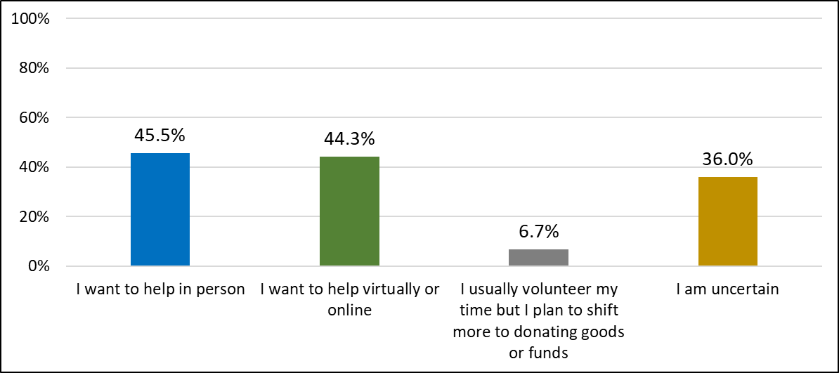
What statement best reflects your intentions for volunteering during the next program year assuming the current environmental, economic, and social conditions?
Notes:
Let’s take a look at a few statewide figures.
These figures reflect the percentage of the TOTAL number of respondents. 22% of responding volunteers are interested in both in-person and online. This is a significant because it indicates that nearly a third of volunteers ONLY want to help in-person … meaning that 44% (or less than one half of respondents) are interested in continuing their commitment regardless of the extension method).

Slide 7
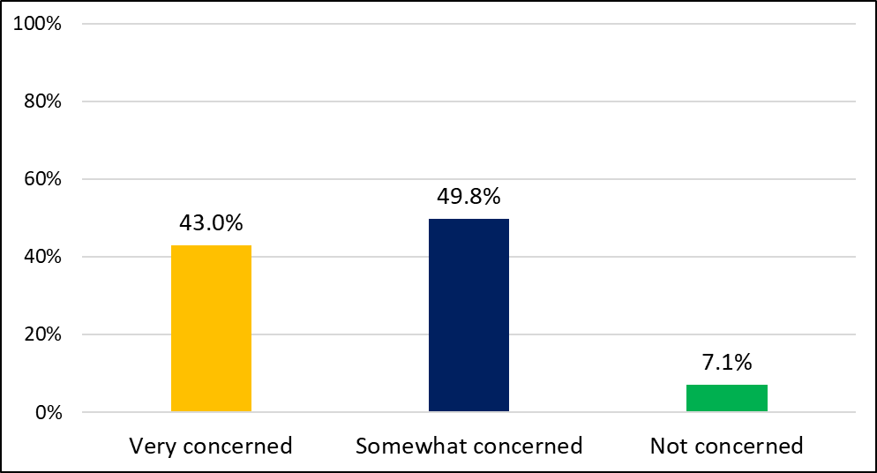
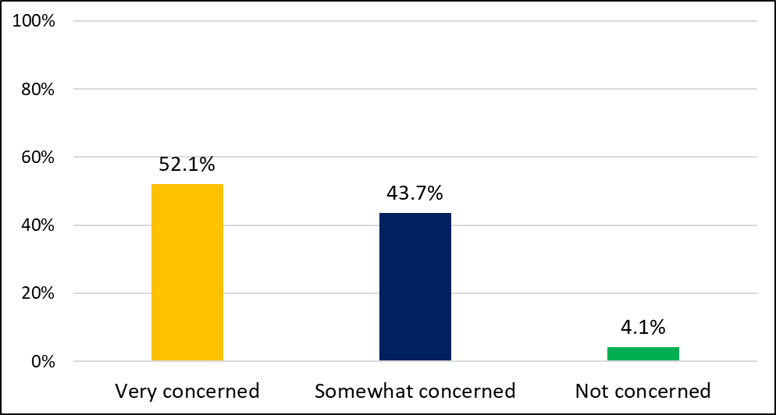
How concerned are you about the impact of current conditions (environmental, economic, social) on the UC MG Program?
How concerned are you about the impact of current conditions (environmental, economic, social) on individual UC Master Gardener Program activities and projects?
Notes:
The take away here is that volunteers are concerned about the impact of COVID-19 on the program, but they are MORE concerned about THEIR specific activities and projects. This means that limiting the number of projects for the coming program year may require some strategy on your part as a coordinator. You may want to think about how you want to position and roll-out this change. Of course, you are welcome to these slides and to anything you need to make the case. Remember: staff and academics ARE the program authority in their counties.

Slide 8
Background
National and statewide data indicate that COVID-19 has significantly impacted volunteer commitment for the 2020-2021 program year (and may continue to impact volunteer commitment thereafter).
UCANR personnel may need to limit the number of projects and initiatives until volunteer commitment can be restored to a pre-COVID-19 level.
Coordinators have indicated that a rubric for scoring projects would help them strategically plan in the “new normal.”
Notes:
The context for this project is that: there is expected depression in volunteer commitment; we may need to do ‘less with less’ per UCANR’s VP Glenda Humiston; we need tools to help us strategically plan during these unprecedented times

Slide 9
Anticipated uses
Understand if/how current projects align with key UC Master Gardener Program criteria.
Identify specific areas of improvement for all projects.
Elevate and invest resources in projects that are closely aligned with the UC Master Gardener Program mission, core values, strategic initiatives, local priorities, and fundraising objectives as well as the needs/assets of communities underinvested by UCANR.
Reduce project load by pausing projects requiring significant improvement for the 2020-2021 and/or 2021-2022 program years.
Notes:
Remember – You do not need to use this rubric to pause or furlough projects. Instead, you might use it to get specific about areas of potential improvement.

Slide 10
Project Prioritization Rubric
Marisa Coyne, Volunteer Engagement Coordinator – UC Master Gardener Program

Slide 11
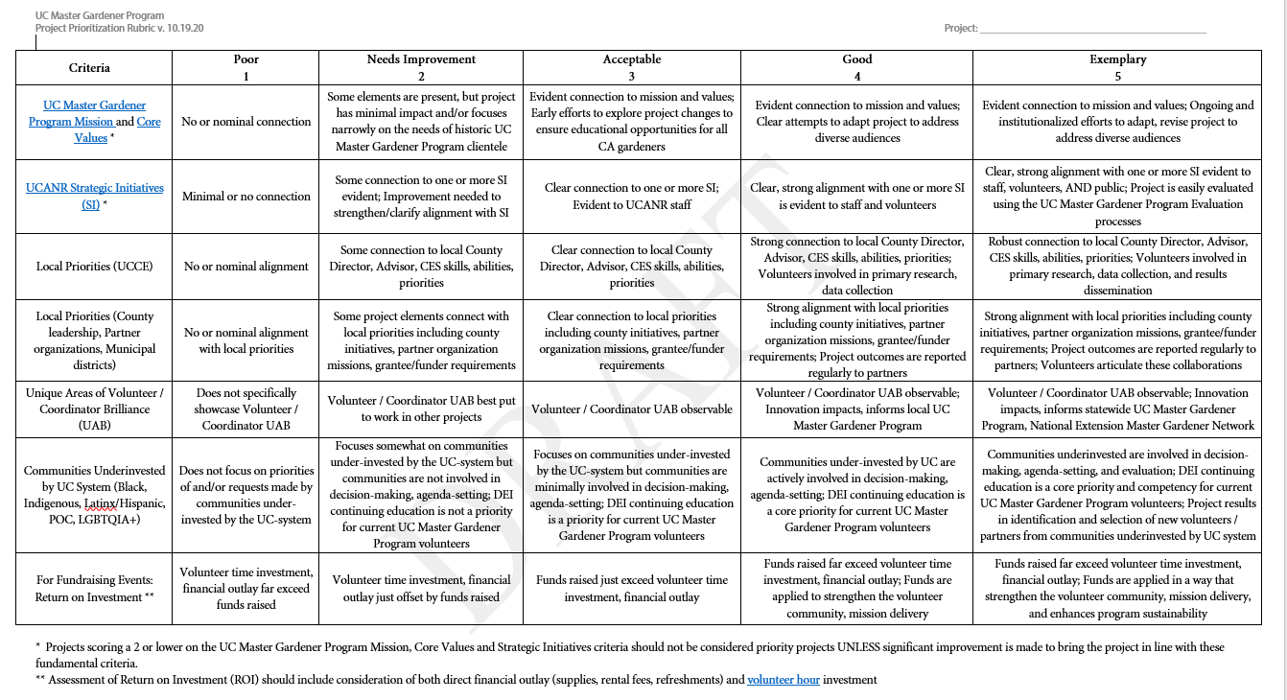
Current DRAFT
Notes:
<< DROP into chat! >>
We are going to quickly run through the Project Prioritization Rubric criteria. (We won’t be spending much time on these slides because they are covered in depth in our prior Brown Bags).

Slide 12
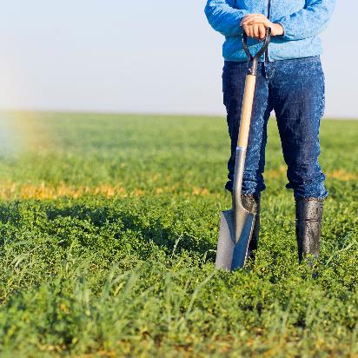
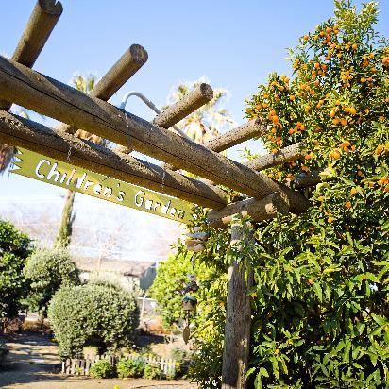
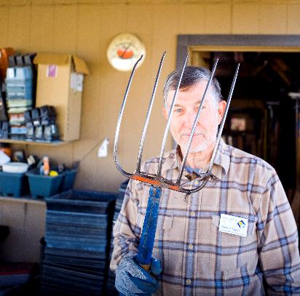
Mission Statement
“To extend research based knowledge and information on home horticulture, pest management, and sustainable landscape practices to the residents of California and be guided by our core values and strategic initiatives.”
© University of California

Slide 13
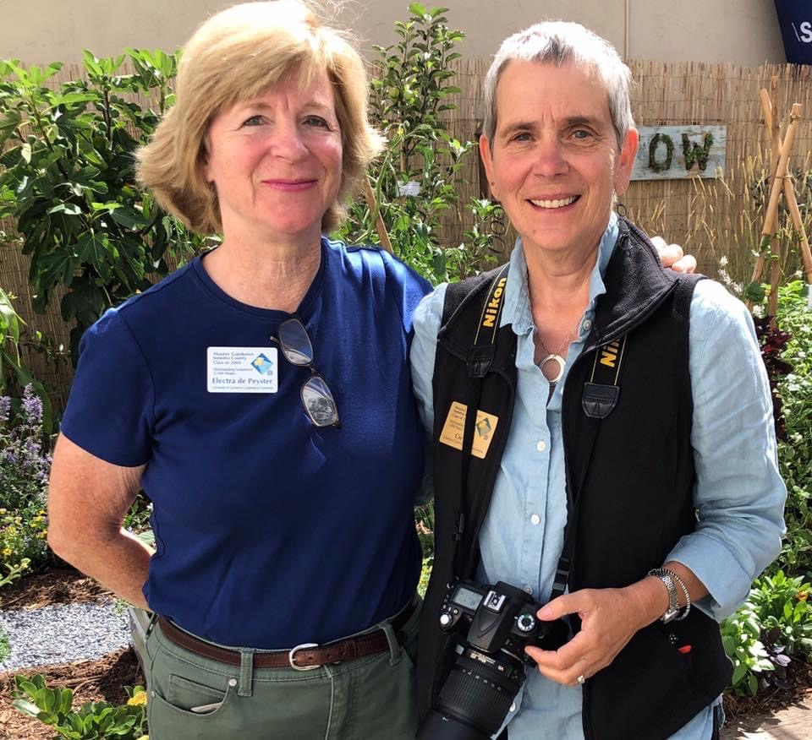
Core Values
Utilize trained and certified
volunteers at the county level
Conduct research-based
educational programs that meet
horticulture and pest management needs of
non-commercial clientele
Focus on educational programs
that address the Strategic Vision
of UC ANR

Slide 14

Strategic Initiatives
Endemic and invasive pests and diseases
Healthy families and communities
Sustainable food systems
Sustainable natural ecosystems
Water quality, quantity and security

Slide 15



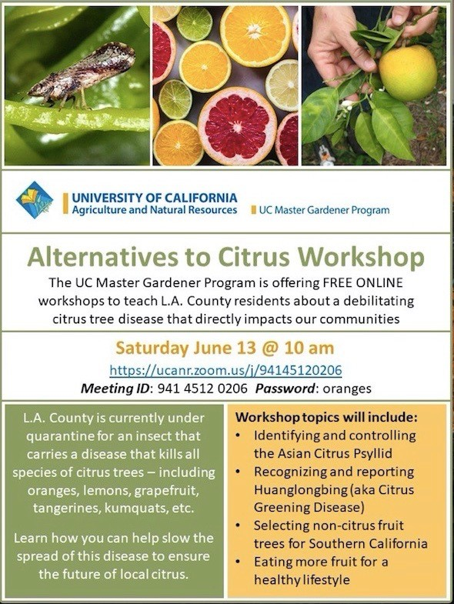


Local Priorities
Local UCCE
County leadership
  Advisor research projects
Partner organizations, community-based organizations
  School districts
  Resource conservation districts
  Crisis centers
Program funders, sponsors, grant makers
  Municipal districts

Slide 16
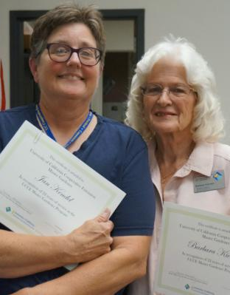
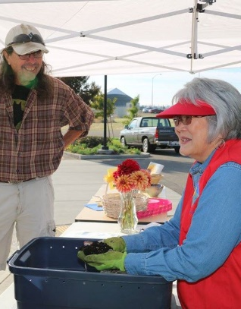
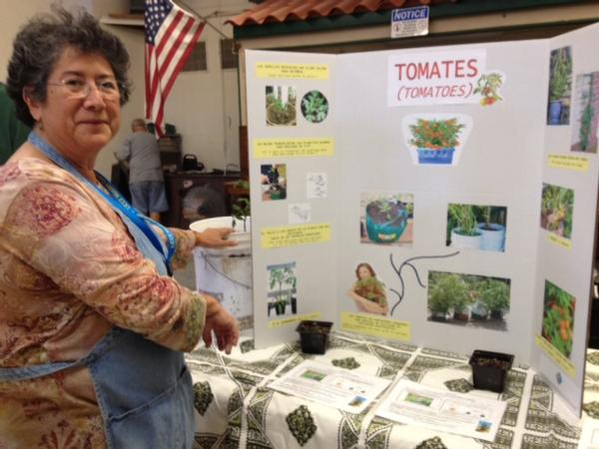
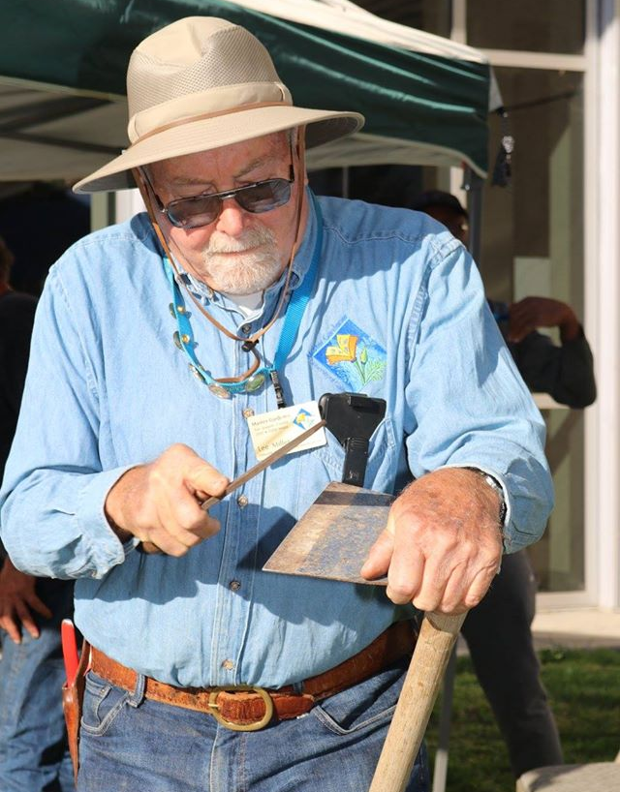
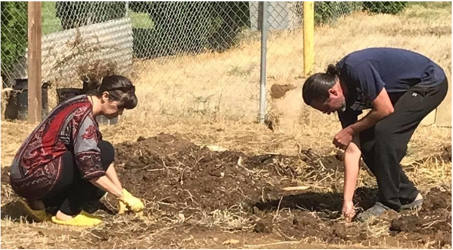
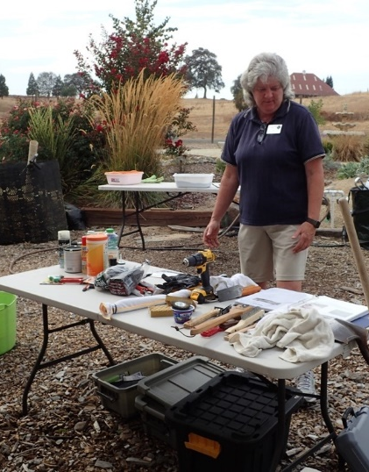
Unique Areas of Brilliance

Slide 17
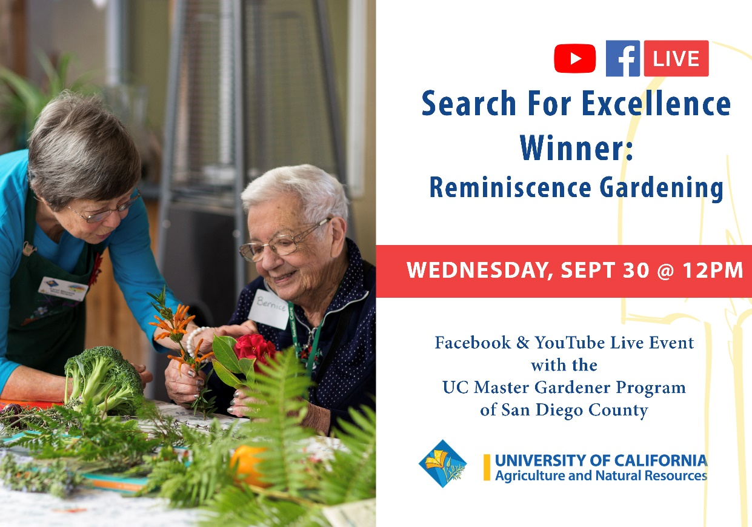
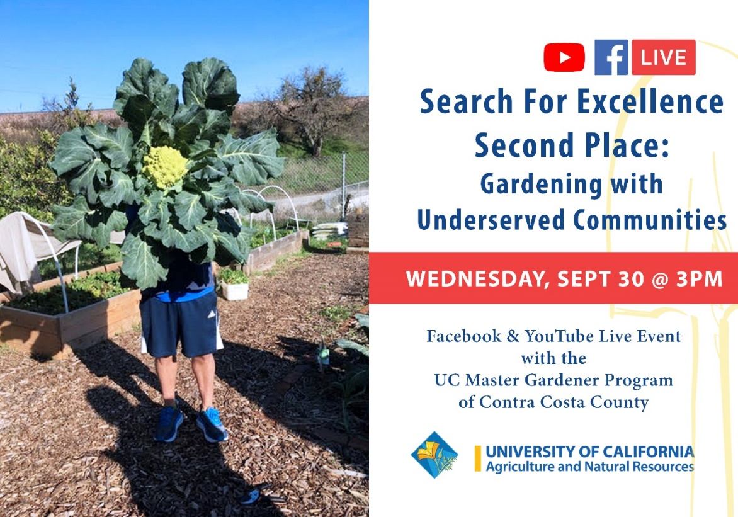
Communities Underinvested by Extension
Notes:
2020’s Search for Excellence winners are GREAT examples of projects that excel in this area!

Slide 18
Feedback-informed Updates
Solicited RUBRIC feedback at our September 2020 Brown Bag on statewide results
Added criteria for fundraising events (based on feedback from coordinators)
Met with Dustin Blakey (Inyo-Mono), Danica Taber (Santa Barbara)
Developed an INSTRUCTIONS sheet to accompany the RUBRIC
Developed SCENARIOS for use in this meeting

Slide 19
Breakout Room Sessions
Marisa Coyne, Volunteer Engagement Coordinator – UC Master Gardener Program

Slide 20
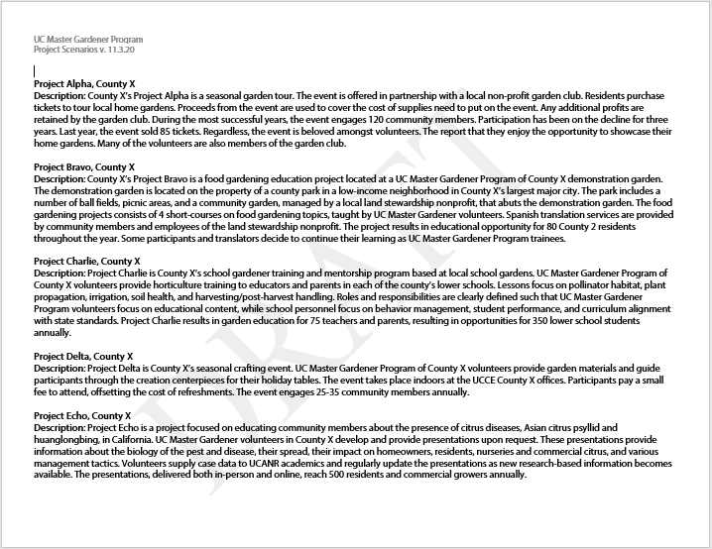
Instructions
Check the chat box for PDF copies of:
  DRAFT Rubric (PDF)
  SAMPLE Projects (PDF)
  Pull up the Digital Rubric (link)
If you have trouble accessing these docs message the presenters in the chat with your e-mail address
Notes:
Digital Rubric Templates are available in

Slide 21
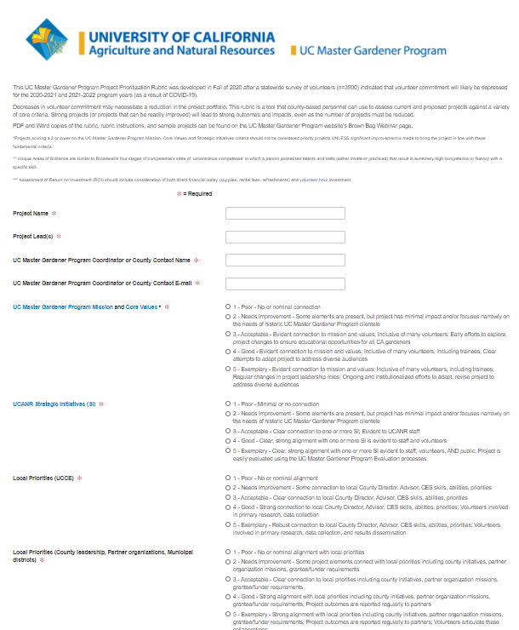
Instructions
Join your Breakout Room
Note the scenarios your room has been assigned
  EXAMPLE: Room 10 will do scenarios X and Y
Complete the digital rubric for your scenarios
  Be sure to add include the project name!
Note which aspects of the rubric your group spends the most time on
Notes:
SAMPLE Digital Rubric: http://ucanr.edu/survey/survey.cfm?surveynumber=32373

Slide 22
Discussion + Questions
Marisa Coyne, Volunteer Engagement Coordinator – UC Master Gardener Program
Notes:
Now we are going to discuss you came up with when you reviewed sample projects in your breakout rooms. Note: Projects that raise funds must include the ROI criteria. The overall score for these projects is out of 35. Projects that do not raise funds do not include the ROI criteria. The overall score for these projects is out of 30.

Slide 23
Project Alpha, County X
County X’s Project Alpha is a seasonal garden tour. The event is offered in partnership with a local non-profit garden club. Residents purchase tickets to tour local home gardens. Proceeds from the event are used to cover the cost of supplies need to put on the event. Any additional profits are retained by the garden club. During the most successful years, the event engages 120 community members. Participation has been on the decline for three years. Last year, the event sold 85 tickets. Regardless, the event is beloved amongst volunteers. The report that they enjoy the opportunity to showcase their home gardens. Many of the volunteers are also members of the garden club.
Notes:
OVERALL SCORE: 9 = NEEDS IMPROVEMENT
Program Mission + Core Values: 1
Strategic Initiatives: 1
UCCE Priorities: 2
County + Partner Priorities: 2
Unique Areas of Brilliance: 1
Communities Underinvested: 1
Fundraising ROI: 1
How could this project be improved? What specific changes would you make?
Note: This is an event that raises funds. Therefore, reviewers included the ROI criteria. The overall score for this event is out of a total of 35.

Slide 24
Project Bravo, County X
County X’s Project Bravo is a food gardening education project located at a UC Master Gardener Program of County X demonstration garden. The demonstration garden is located on the property of a county park in a low-income neighborhood in County X’s largest major city. The park includes a number of ball fields, picnic areas, and a community garden, managed by a local land stewardship nonprofit, that abuts the demonstration garden. The food gardening projects consists of 4 short-courses on food gardening topics, taught by UC Master Gardener volunteers. Spanish translation services are provided by community members and employees of the land stewardship nonprofit. The project results in educational opportunity for 80 County 2 residents throughout the year. Some participants and translators decide to continue their learning as UC Master Gardener Program trainees.
Notes:
OVERALL SCORE: 17 = ACCEPTABLE
Program Mission + Core Values: 3
Strategic Initiatives: 3
UCCE Priorities: 3
County + Partner Priorities: 3
Unique Areas of Brilliance: 3
Communities Underinvested: 2
Fundraising ROI: N/A
How could this project be strengthened?
Note: This is an event that does not raise funds. Therefore, it will include exclude ROI criteria. The overall score for this event is out of a total of 30.

Slide 25
Project Charlie, County X
Project Charlie is County X’s school gardener training and mentorship program based at local school gardens. UC Master Gardener Program of County X volunteers provide horticulture training to educators and parents in each of the county’s lower schools. Lessons focus on pollinator habitat, plant propagation, irrigation, soil health, and harvesting/post-harvest handling. Roles and responsibilities are clearly defined such that UC Master Gardener Program volunteers focus on educational content, while school personnel focus on behavior management, student performance, and curriculum alignment with state standards. Project Charlie results in garden education for 75 teachers and parents, resulting in opportunities for 350 lower school students annually.
Notes:
OVERALL SCORE: 21 = GOOD
Program Mission + Core Values: 4
Strategic Initiatives: 4
UCCE Priorities: 3
County + Partner Priorities: 4
Unique Areas of Brilliance: 3
Communities Underinvested: 3
Fundraising ROI: N/A
How could this project be strengthened?
Note: This is an event that does not raise funds. Therefore, it will include exclude ROI criteria. The overall score for this event is out of a total of 30.

Slide 26
Project Delta, County X
Project Delta is County X’s seasonal crafting event. UC Master Gardener Program of County X volunteers provide garden materials and guide participants through the creation centerpieces for their holiday tables. The event takes place indoors at the UCCE County X offices. Participants pay a small fee to attend, offsetting the cost of refreshments. The event engages 25-35 community members annually.
Notes:
OVERALL SCORE: 10 = POOR
Program Mission + Core Values: 1
Strategic Initiatives: 1
UCCE Priorities: 2
County + Partner Priorities: 2
Unique Areas of Brilliance: 3
Communities Underinvested: 1
Fundraising ROI: 2
How could this project be improved?
Note: This is an event that raises funds. Therefore, reviewers included the ROI criteria. The overall score for this event is out of a total of 35.

Slide 27
Project Echo, County X
Project Echo is a project focused on educating community members about the presence of citrus diseases, Asian citrus psyllid and huanglongbing, in California. UC Master Gardener volunteers in County X develop and provide presentations upon request. These presentations provide information about the biology of the pest and disease, their spread, their impact on homeowners, residents, nurseries and commercial citrus, and various management tactics. Volunteers supply case data to UCANR academics and regularly update the presentations as new research-based information becomes available. The presentations, delivered both in-person and online, reach 500 residents and commercial growers annually.
Notes:
OVERALL SCORE: 27 = EXEMPLARY
Program Mission + Core Values: 5
Strategic Initiatives: 5
UCCE Priorities: 5
County + Partner Priorities: 5
Unique Areas of Brilliance: 4
Communities Underinvested: 3
Fundraising ROI: N/A
Note: This is an event that does not raise funds. Therefore, it will include exclude ROI criteria. The overall score for this event is out of a total of 30.

Slide 28

Next Steps from the Statewide Office
Portions of this presentation have been recorded. These recordings will be posted to the UC Master Gardener Coordinator website.
  Feedback from today will be used to create an ‘answer key’ for project scenarios.
  This key and other materials, once finalized, will be post to the UC Master Gardener Program Coordinator website.
Mark your calendar for our upcoming Brown Bag Webinars and events:
  Dec. 1st – 24 hours – GIVING TUESDAY
    Emily’s newsletter “The Scoop” with a link to the ‘Campaign-in-a-BOX’ materials, went out TODAY. E-mail Emily at eddelk@ucanr.edu if you have questions.
  Dec. 9th – 12:00 PM – 1:00 PM - Brown Bag Webinar: All Reasonable Effort and Outreach to Diverse Audiences
  Jan. 13th – 12:00 PM – 1:00 PM - Brown Bag Webinar: Digital Inclusion - Making Our Content More Accessible
  Feb. 10th – 12:00 PM – 1:00 PM - The UC Master Gardener Program in the National Context - Tools and Resources

Slide 29

Thank you for joining us!
Project Prioritization Rubric Practice
Missy Gable, Director – UC Master Gardener Program
Tamekia Wilkins, Evaluation Coordinator – UC Master Gardener Program
Lauren Snowden, Training Coordinator – UC Master Gardener Program
Marisa Coyne, Volunteer Engagement Coordinator – UC Master Gardener Program
Melissa Womack, Marketing Coordinator – UC Master Gardener Program

