Slide 1
Slides to help ANR personnel share vaccine information
Please feel free to use one, any or all of the following slides to share vaccine information with your clients.
And feel free – while keeping the message the same – to adapt the language for your audiences.

Slide 2
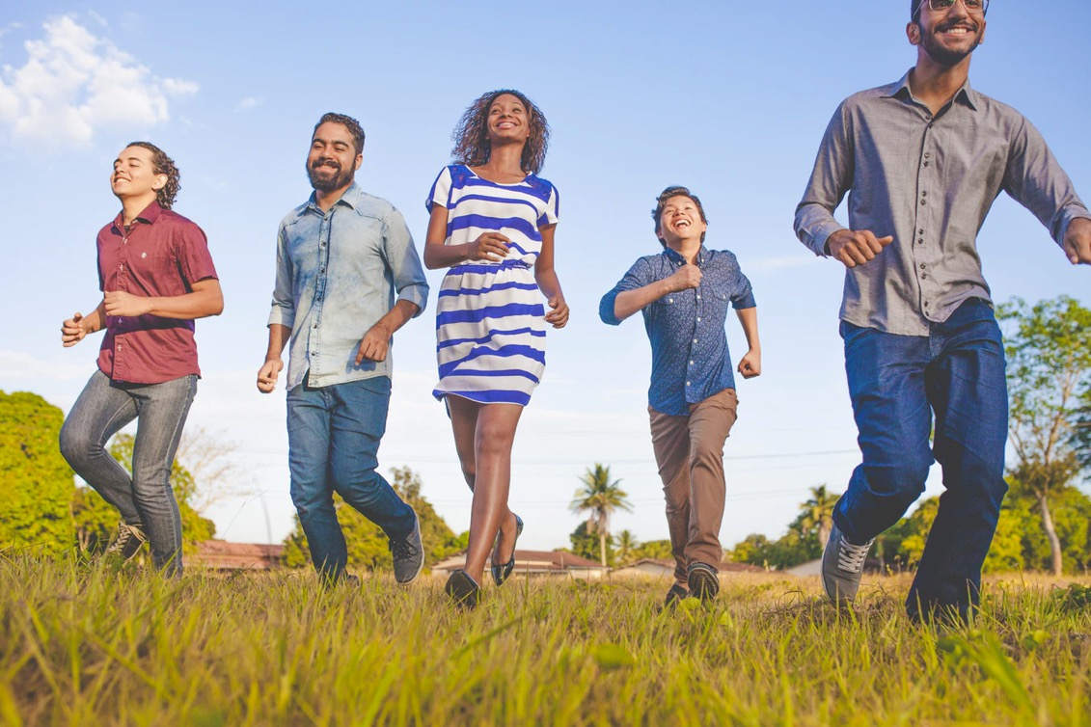
Let’s fight COVID-19 together
COVID-19 Vaccine
Myths and Facts:
ucanr.edu/covid19
Photo by @naassomz1 from unsplsh.com

Slide 3

At UC ANR, we make recommendations based on science.
Our intent is not to convince you to get vaccinated, but to present information to help you make an informed decision.
Photo by @aaronburden from unsplash.com

Slide 4
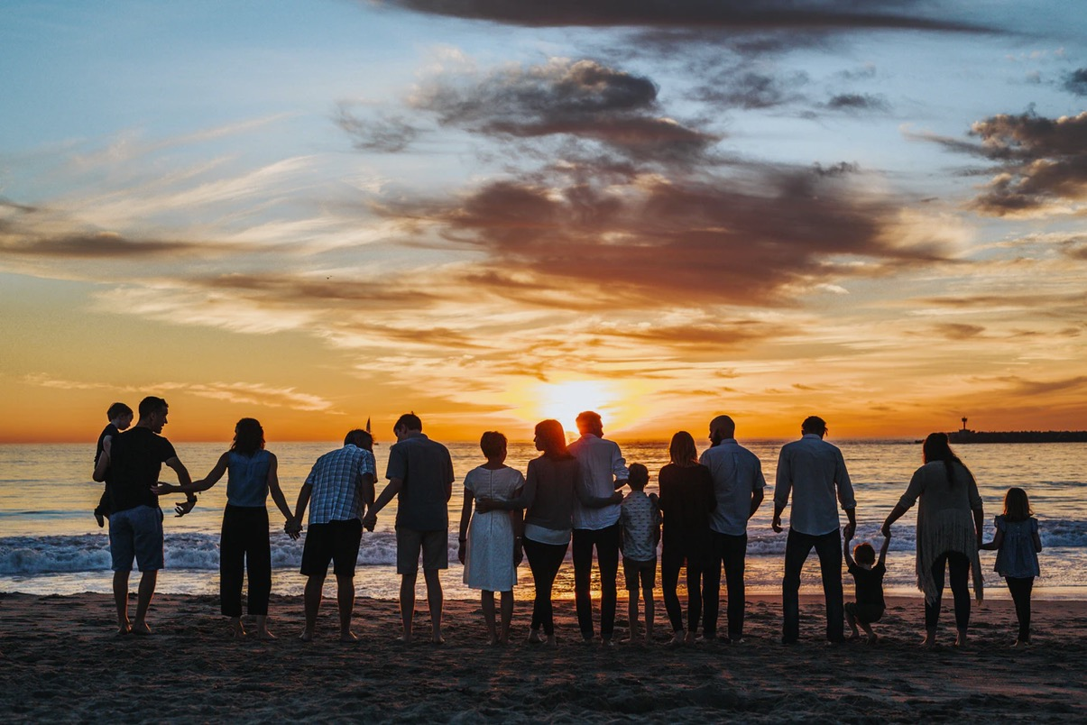
Let’s get back together (safely)!
Protect yourself, your family and your community.
Act now:
Find tips @ ucanr.edu/covid19
Photo by @jtylernix from Unsplash.com

Slide 5
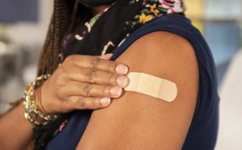
Join these famous people who have been vaccinated.
President Joe Biden
Vice President Kamala Harris
Former President George Bush
Former Vice President Mike Pence
Journalist Stephanie Elam
Dr. Anthony Fauci
UN Secretary-General António Guterres
Former Governor Arnold Schwarzenegger
Celebrity Kareem Abdul Jabbar
Celebrity Martha Stewart
Photo nba.com

Slide 6

Fact-checking
Find out about vaccine myths and facts
(UC Davis)
Learn more:
ucanr.edu/covid19

Slide 7

Learn more:
CDC guidance
ucanr.edu/covid19

Slide 8

Learn more:
CDC guidance
ucanr.edu/covid19

Slide 9

Learn more:
CDC guidance
ucanr.edu/covid19

