Slide 1
New Pcard Reconciliation Process Training
ANR Pcard Holders
Presented by ANR Business Operations Center, Maru Fernandez and UC Davis Supply Chain Management, Mary Jackson
Thursday, July 29th

Slide 2
Today’s Agenda
Why the process is changing and when
Benefits
How to process Pcard expenses in Aggie Travel
Appendix
Delegates create/edit report
Workflow & Ad-hoc Routing for county approvals
Best Practices
Concur App
Resources

Slide 3
Why the process is changing
ANR contracts with UC Davis Procurement Services
When: August 27, 2021
To improve and expedite the reconciliation process
•Streamlined expense types
•Easier interface
•Mobile app functionality
Consolidate p-card and travel card reconciliation processes
in a single system
Aggie Enterprise is coming…

Slide 4
Benefits
Multiple card transactions can be reconciled at one time on one single report (bi-weekly, weekly)
No need to complete Pcard Detail Form – info imports to system
Concur App – take photo of receipt (paper or email) – upload to system automatically
No lost receipts
Saves time and easier to track
Expenses can be reflected in ledgers faster

Slide 5
How to Process Pcard Expenses in Aggie Travel-DEMO

Slide 6
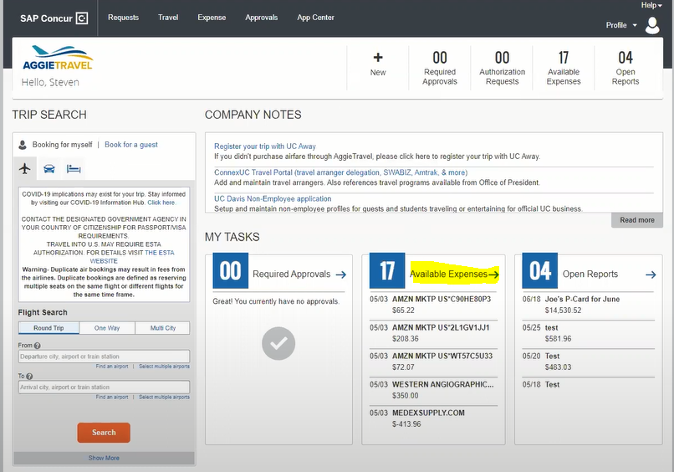
How to process Pcard expenses in AT
Pcard expenses will upload directly into AT

Slide 7
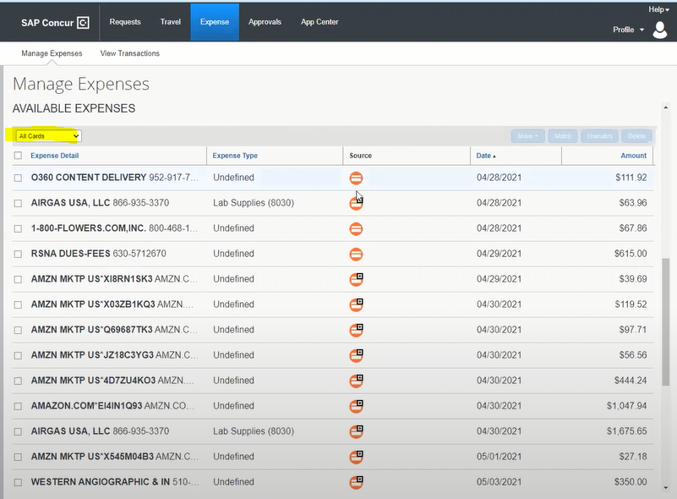
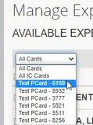
How to process Pcard expenses in AT - continued
Select Card on the scroll down under Available expenses
Orange – Pcard expense
Green – Travel Corporate card expense

Slide 8
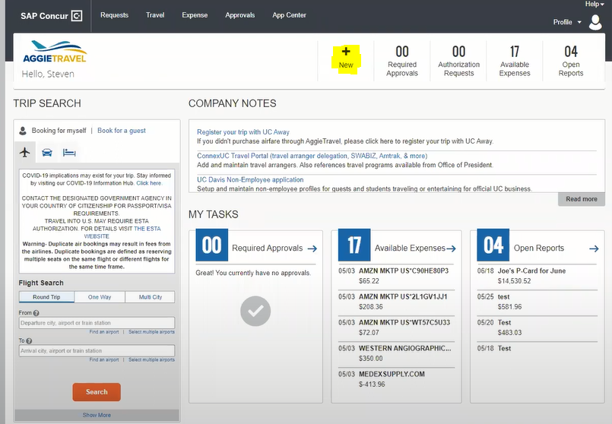
How to process Pcard expenses in AT - continued
Create Report

Slide 9
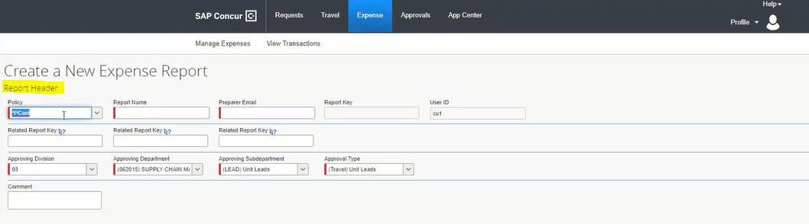
How to process Pcard expenses in AT - continued
Create Report
Use Naming Standard: PCARD - First 4 letters of last name – Month – 1 or 2 (depending on the # of reports that need to be submitted)
Example: PCARD FERN JULY 1
For UCCE Pcard Holders
Select Pcard (Policy drop down defaults to Travel Card)

Slide 10
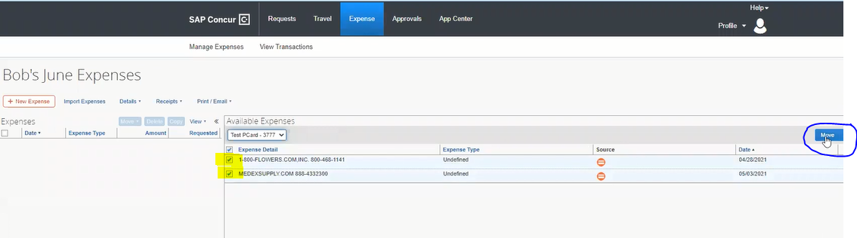
How to process Pcard expenses in AT - continued
Move selected expenses to report
Click on Move to transfer selected expenses to current report
Select expenses

Slide 11
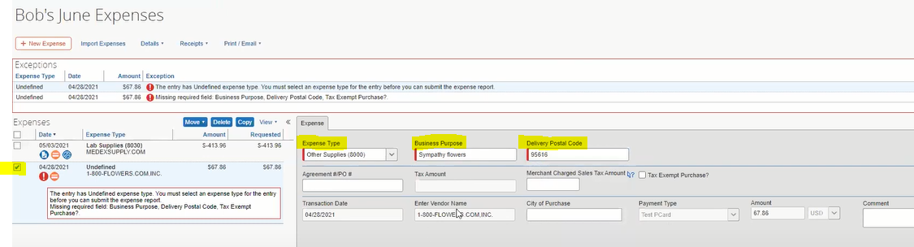

Completing expense details
Click here if same account is being used for all the transactions
Important: Enter Delivery Postal Code – Determines the tax rate. In-store purchase use zipcode of store. If online purchase, use delivery address zipcode.
Select Expense to complete the Expense fields, allocate expenses and attach receipts
Select expense type from drop down menu
Detail Business Purpose includes what, why (benefit), program or project. Field has 64 characters (Use Comment section as needed)
Notes:
Postal Code – If purchased on site, use the store’s zip code; If purchase on line, use the delivery address zip code

Slide 12
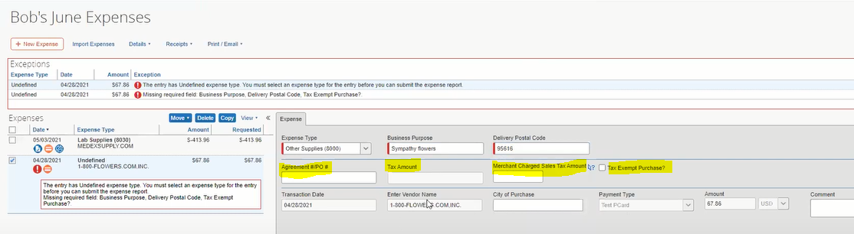
Completing expense details
If sales tax was not prepopulated but charged, enter amount here.
Select box if purchase is sales tax exempt in CA: non-tangible items; Enter the tax exempt reason in the Comments field
If purchase had an approved Purchase Agreement or Purchase Order – enter number here
If transaction charged sales tax it will prepopulate this field

Slide 13
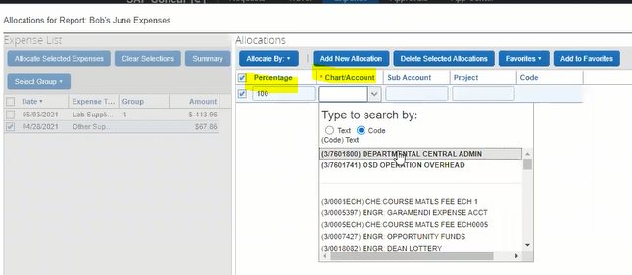
Completing expense details
Always attach receipts to individual expenses (from available receipts in your Concur dashboard or from your computer)
Once completed, save, allocate expense to an account and attach receipts.
Percentage – allocate 100% or split
Chart/Account – L/349PDSL
*Use “/” (not dash); The accounts most frequently used will show up at the bottom. As you start typing, the system will locate the account. Enter Subaccount and/or Project code as needed.

Slide 14
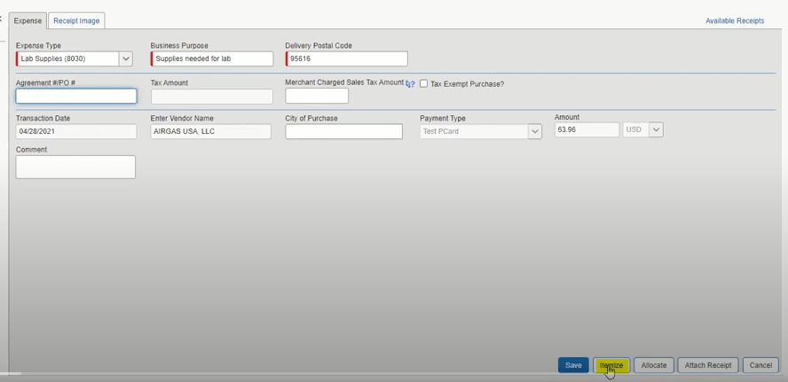
Completing expense details - itemize
In case the purchase has something that is nontaxable such as shipping, you will need to itemize the expense. Select Itemize on the bottom right hand corner.

Slide 15
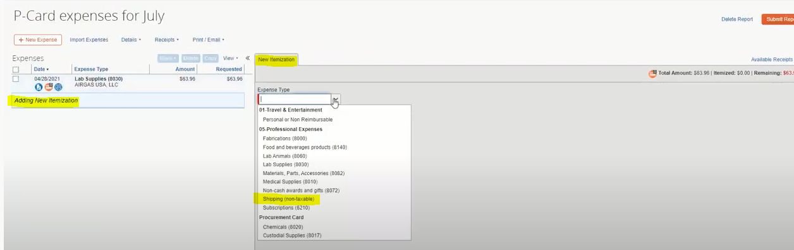
Completing expense details - itemize
Select the expense type that is nontaxable

Slide 16
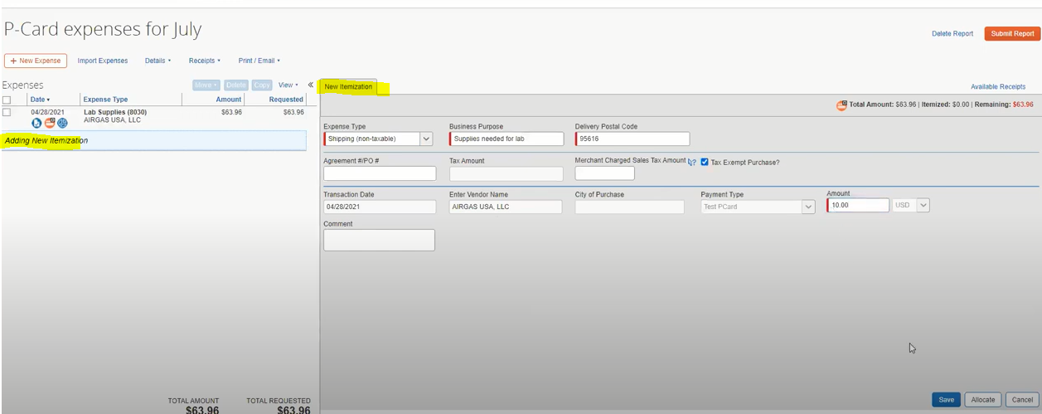
Completing expense details - itemize
Select Shipping (nontaxable)
Click the tax exempt radio botton

Slide 17
Completing expense details - itemize
Select Shipping (nontaxable)
Click the tax exempt radio botton

Slide 18
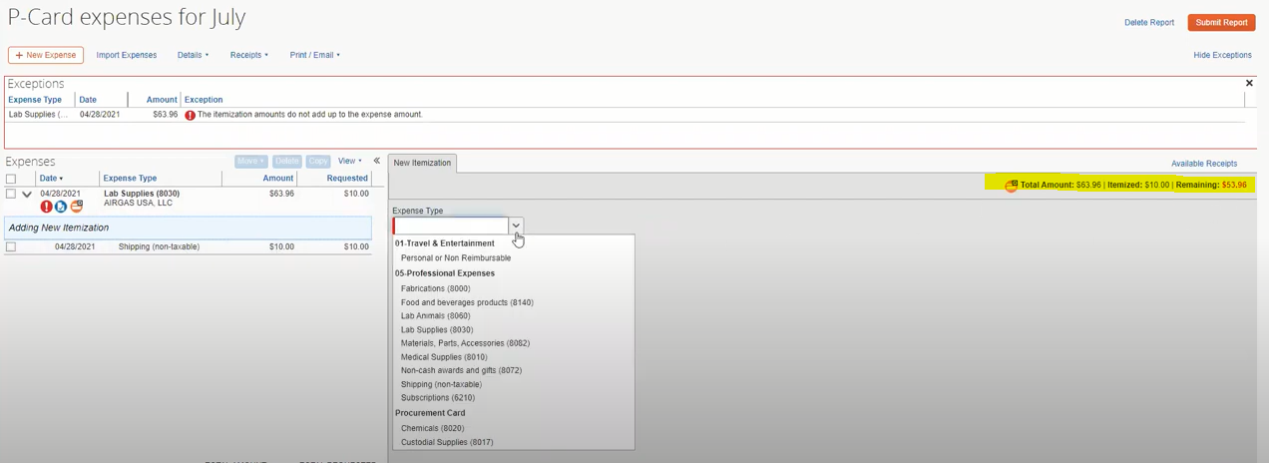
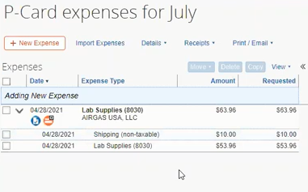
Completing expense details - itemize
To finalize itemization, you need to add another line for the remaining amount shown at the top right corner in red. Select the expense type and make sure the total of the itemization is the total of the expense

Slide 19
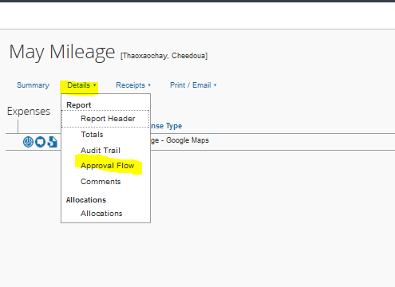
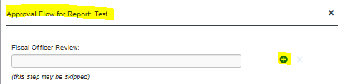
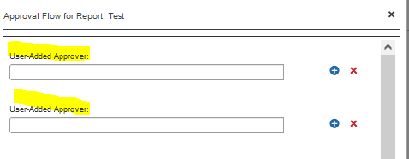

Adhoc to approver
2
1
3
From main page of expense report, select Details, and Approval Flow
This screen will be your initial viewing screen, click on the plus sign – no need to know who the fiscal officer is or add it. The system will do depending on the accounts used.
Add your adhoc approver(s)
Save Workflow
4

Slide 20
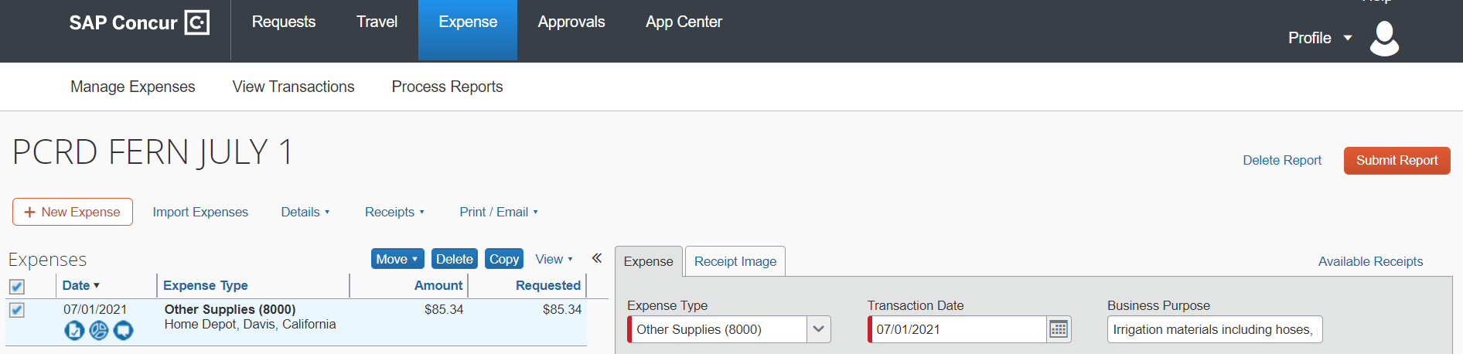
Submit Pcard expense report
Checklist:
All expenses selected from available expenses
Select expense type
Complete Business Purpose and Tax information
Allocate account
Attach Receipt
Add Adhoc routing
7. If Delegate creates report, select Orange button “Notify Employee”
8. Pcard holder Submits report.

Slide 21
Appendix
Creating Delegates
Adhoc Routing
Best Practices
Concur App
Resources

Slide 22
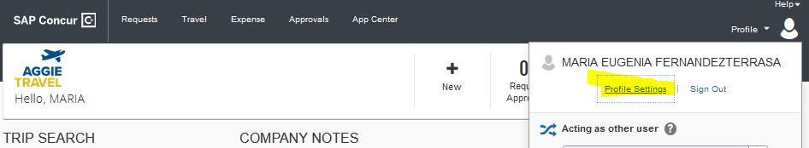
How to set up Expense Delegates
Office Manager or Admin Assistant can be set up as expense delegates to create expense reports for a Pcard holders
1. On the main page of your Aggie Travel Dashboard, select Profile, and select Profile Settings

Slide 23
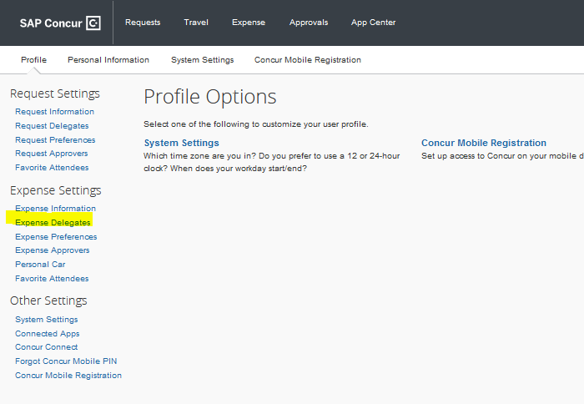
How to set up Expense Delegates continued
2. Select Expense Delegates

Slide 24
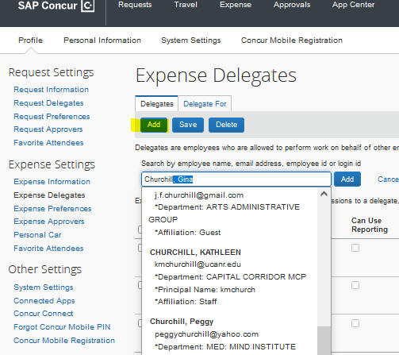

How to set up Expense Delegates continued
3. Select Add and start writing the name of your delegate until it populates
4. Select boxes for “Can Prepare”, “Can View Receipts”, “Receive Emails” and “Receives Approval Emails”
5. Click Save Button to save new added delegate,

Slide 25
Adhoc Routing Required
Pcard expense reports automatically route to BOC/Fiscal Officer as default
County level approval required before BOC/Fiscal Officer
Each county/program will follow Adhoc routing scenarios that best suit their needs
Adhoc approvals need to be entered on each report (no way of pre-setting these)

Slide 26
Workflow Options
1
Card Holder creates expense Report
Adhoc for county level review and/or approval
BOC/FISCAL OFFICER reviews and approves
Expenses post to ledgers next day
2
Delegate creates expense Report
Card Holder reviews and submits report
Adhoc for county level review and/or approval
BOC/FISCAL OFFICER
Reviews and approves
Expenses post to ledgers next day

Slide 27
Adhoc Routing Scenarios
A
Cardholder submits expense report
Adhoc to County Director to approve
For those counties where CD currently signs all Pcard Details Forms. Low # of Pcard holders and transactions.
BOC/FISCAL OFFICER
Adhoc to Supervisor/
Program Coordinator
For Pcard holder’s expenses where CD has authorized Supervisor or Program Coordinator to approve expenses and currently sign their Pcard Details Forms. (MG, 4H, EFNEP, Calfresh)
B
Cardholder submits expense report
BOC/FISCAL OFFICER
BOC/FISCAL OFFICER
C
Cardholder submits expense report
Adhoc to Office Manager
Adhoc to PI if award account
Adhoc to CD if PDSL/CEGS or other
BOC/FISCAL OFFICER
For counties where Office Manager currently reviews all Pcard Detail Forms and adhocs them to the corresponding approver; and/or
If account used to charge expense is an award/sponsored program, PI needs to approve; and/or
Program Support accounts are being used, CD needs to approve

Slide 28
Best Practices
Reconcile transactions at least biweekly, or as frequently as necessary for your county. Each Pcard holder must submit their expense reports and is ultimately responsible for managing their charges.
Attach receipts and backup to each line individually, not at the Header section
Assign delegates to prepare cardholder reports if that is the case in your county. A Pcard holder can have multiple delegates.
A delegate can either prepare or approve a report, but not both.
Utilize the Concur app for remote capture of receipts and backup

Slide 29
Pcard requirements that have not changed
The deadlines and importance of completing the reconciliation process in a timely manner do not change
Within 30 days of the transaction posting
After 60 days, it becomes taxable income
Pcard privileges can be revoked for non-compliance
Follow allowable uses for the Procurement Card and existing policies
Annual Pcard Training is required
FIS 418 shows unreconciled expenses

Slide 30
Remember…
Naming standard for Pcard expense reports:
PCRD - First 4 letters of Last name - Month - report # in that month
Example: PCRD FERN JULY #2
Adhoc reports to county approver before submitting
Each county determines the adhoc routing scenario to use
Expenses charged to an award always need to be approved by PI
Program Support expenses need to be approved by CD

Slide 31
Tips for Approvers
Review:
Naming Standard
Allowable expenses
Detailed Business Purpose per each expense transaction
Correct account used on each expense
Appropriate receipts and documentation are attached
Adhoc to any additional approver as needed

Slide 32
Concur App

Slide 33
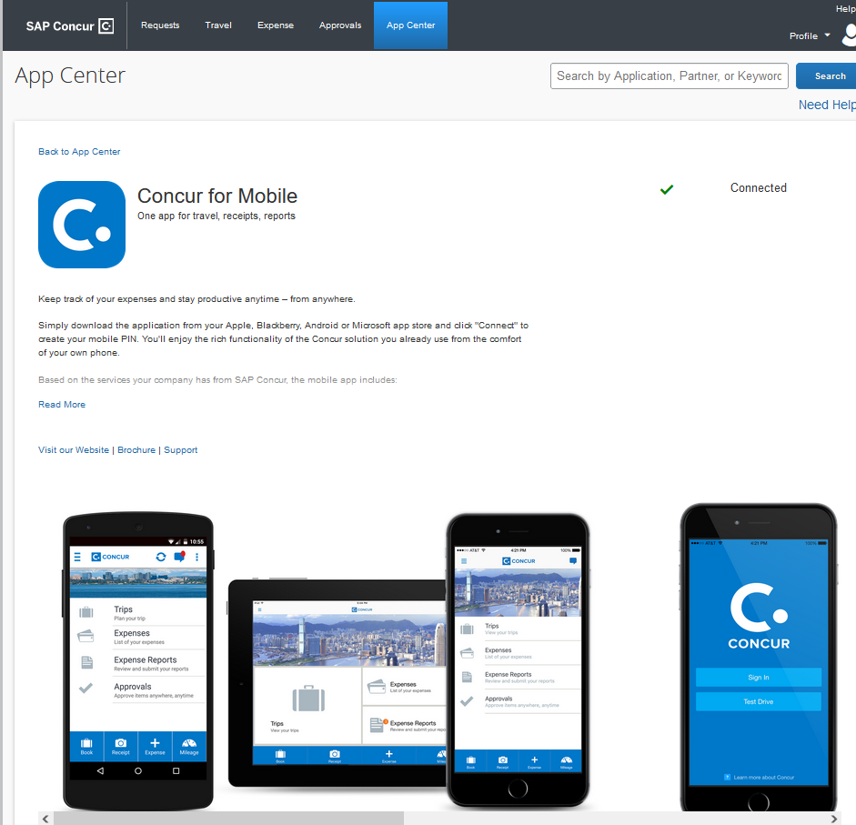
Concur App
Download the SAP Concur mobile app from your device's app store. You can also get a link to download the app from your AggieTravel profile under the Concur Mobile Registration link

Slide 34
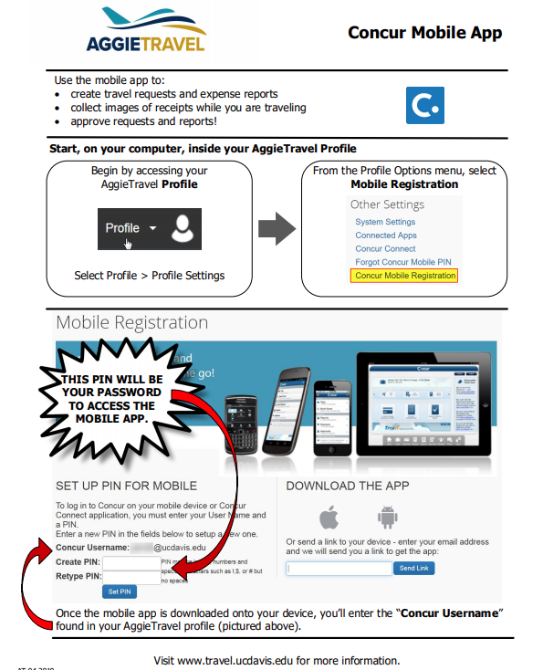
Concur App
https://supplychain.ucdavis.edu/sites/g/files/dgvnsk2181/files/inline-files/Mobile%20Application-v.4-19.pdf
Link for instructions to set up your mobile access in your Aggie Travel profile using a computer before you can login to the app.

Slide 35
RESOURCES

Slide 36
Links to websites:
UCD – New Process Pcard Reconciliation
https://supplychain.ucdavis.edu/pay-purchase/p-card/reconciliation-in-aggietravel
Allowable and Unallowable Expenses
https://supplychain.ucdavis.edu/pay-purchase/p-card/using-card#allowable
Adhoc Routing
https://supplychain.ucdavis.edu/travel-entertainment/aggietravel/expense-reports/ad-hoc-routing
Sales Tax and Use Tax
https://financeandbusiness.ucdavis.edu/systems/kuali/docs/purchasing/pcdo/use-tax

Slide 37
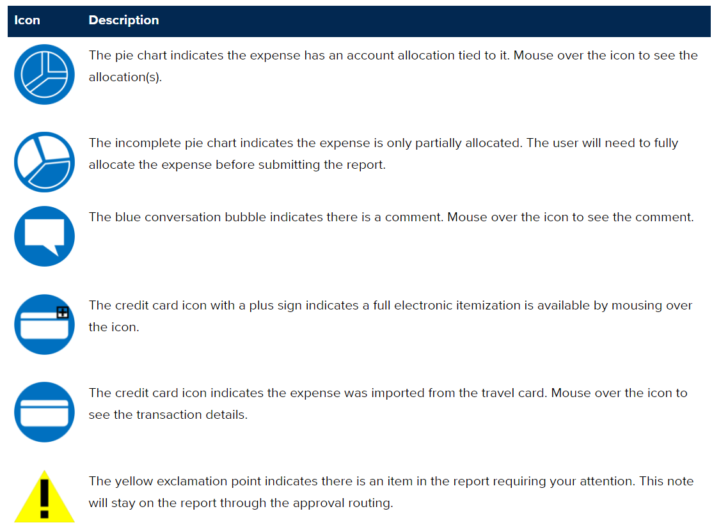
Aggie Travel Icons
https://supplychain.ucdavis.edu/travel-entertainment/aggietravel/help/icons

Slide 38
FAQs
Aggie Travel – Concur Application- will be the system to reconcile both Travel Card expenses and Purchasing card expenses. Separate reports need to be submitted, one cannot combine a travel expense in a Pcard Expense report.
Can expenses be sorted by account? – No. The approver can go to Print/Email section of the expense report and see UCD Detailed Report. This will show all expenses and the allocations. Alternatively, if there are many expenses for one account and a few others for different accounts, the Pcard Holder can submit 2 separate expense reports.
Do we need to be specific on the Business Purpose? Yes, please write a sound purpose describing the items and the benefit they are bringing to the program/research project. If more space if needed, please use the Comments field.
Who will have viewing access to past transactions? A delegate for the Pcard holder has access to past transactions and reports. Everyone that has Decision Support access can search unreconciled Pcard transactions for a cardholder using Report FIS 418.
Adhoc Routing Scenarios A, B and C – If these scenarios do not work, please contact your Business Partner and we will meet with the County Director and Office Manager to assist you finding a routing scenario that will work best for you.

Slide 39
FAQs
Do we still need to adhoc to both the Supervisor and the PI? It depends on the account used. If there are 10 expenses and only one of them is being charged to an award account, yes you need to adhoc that PI. The routing should resemble the same approvals the Pcard holder previously had on the Pcard Detail Form. Since we are eliminating this form, we adhoc the report to get the online approval.
Do Pcards reports route the same as travel reports? No. Aggie Travel reports for travel or entertainment route: Traveler/Submitted – Fiscal Officer – Department Head. Aggie Travel reports for Pcards route: Pcard holder/submitter – Adhoc to local county level approval – fiscal officer.
If the CD is the PI, the report needs to be adhoc routed to the CD only.
Membership and subscriptions are not taxable. Mark the radio button “Tax Exempt” and write on the comments section that memberships and subscription are non taxable in California.
Do we need to calculate tax? No, if the merchant already charged the tax, it will populate the “Merchant Charges tax” field. If the merchant charged tax but it did not upload, please enter the tax amount in the “Tax information” field.
Expense types will be added such as food.
If the PI or CD is on vacation, please send an email to the BOC Team email box with the authorization to another person to approve expenses while on vacation.

Slide 40
FAQs
All expenses charged to PDSL and CEGS accounts need to be adhoc routed to the County Director.
If the Office Manager tracks PDSL funds, please adhoc the report to the Office Manager as well.
Do we need to adhoc to the fiscal officer? No, the report will route to the fiscal officer automatically.
When reports are rejected, is there a place to write what needs to be corrected? Yes, every approver that sends the report back to the user will need to write a comment specifying the changes that need to be done.
When a report is sent back to the user, the adhoc routing should have been saved from the first time it was submitted and will route to all approvers again.
Will Aggie Travel notify the pcardholder or delegates when an expense is in Aggie Travel? Yes the Concur system will send automatic emails and reminder emails to the Pcard holder every time a new expense has uploaded to the system, the same way it currently does for Travel corporate card expenses.
What if the CD is the purchaser? The same way approvals go in the Pcard detail form, the same routing should be adhoc’ed in the system. For CDs that have a Pcard, they will need to adhoc the report to their supervisor.

Slide 41
FAQs
What happens if the delegate or cardholder fails to adhoc to county approver? BOC will return the report back to the Pcard holder and ask to add the adhoc routing.
How long does it take for a Pcard expense to show up in the Aggie Travel system? It depends on the merchant and the bank that processes their credit card purchases. It usually takes at least 1 day but it may take up to a week.
What information does the Concur Mobile App require? It will ask for your email address, a username and a unique PIN number.

Slide 42
Questions? Contact your BPT Team: Team 1: boc-uccepartner1@ucanr.edu Team 2: boc-uccepartner2@ucanr.edu Team 3: boc-uccepartner3@ucanr.edu Team 4: boc-uccepartner4@ucanr.edu Team 5: boc-partner5@ucanr.edu THANK YOU!

