Slide 1
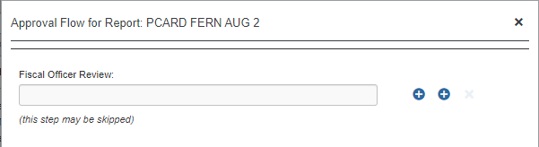
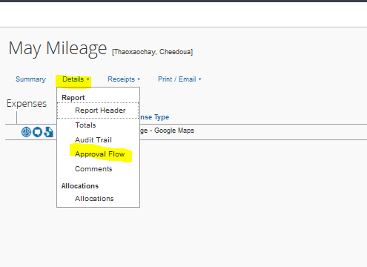
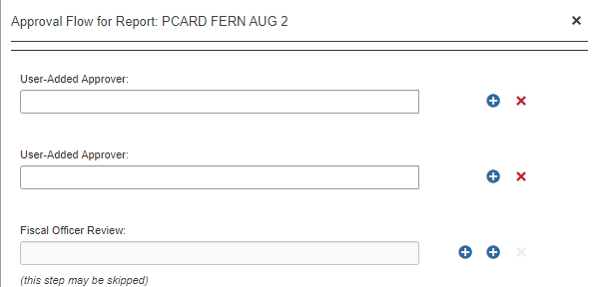

Adhoc to approver
2
1
Add a step before this step
3
From main page of expense report, select Details, and Approval Flow
This screen will be your initial viewing screen, click on the plus sign to the right to add a step before this step– no need to know who the fiscal officer is or add it. The system will do depending on the accounts used.
Add your adhoc approver(s)
Save Workflow
4

