Slide 1

IT’S MY CHOICE…
EAT RIGHT! BE ACTIVE!
A Nutrition Curriculum for Third Grade

Slide 2
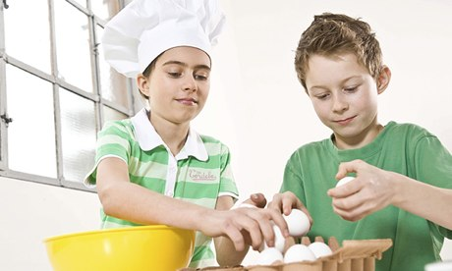
Lesson
4
IT’S MY CHOICE…
VARY THE PROTEIN!
Bilal Cooks Daal
by Aisha Saeed

Slide 3
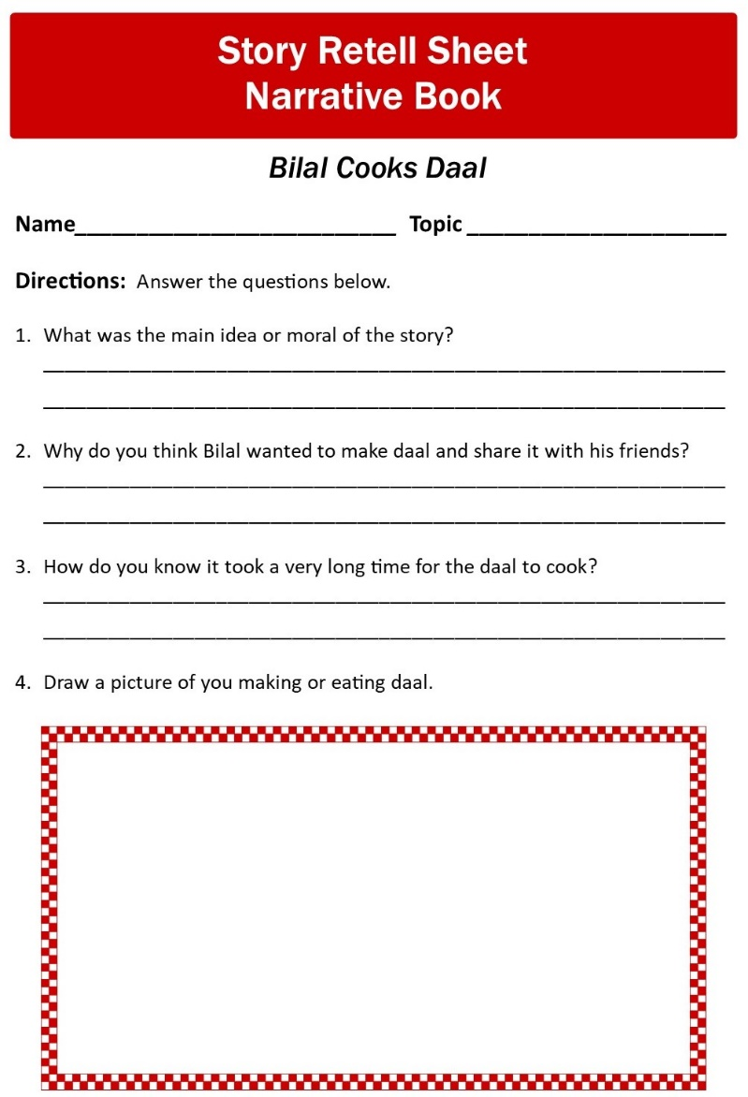
IT’S MY CHOICE…
VARY THE PROTEIN!
Lesson
4

Slide 4
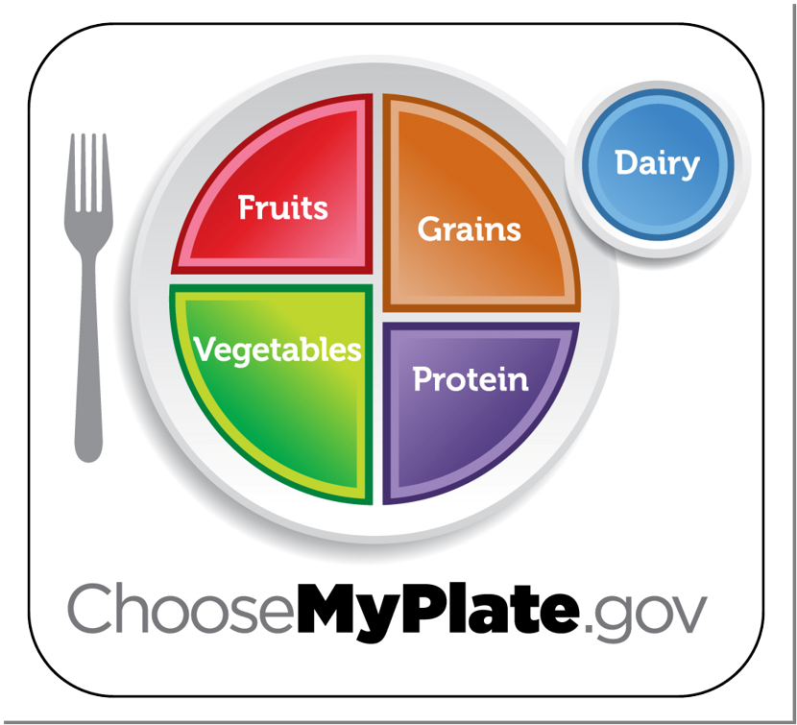







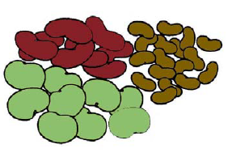


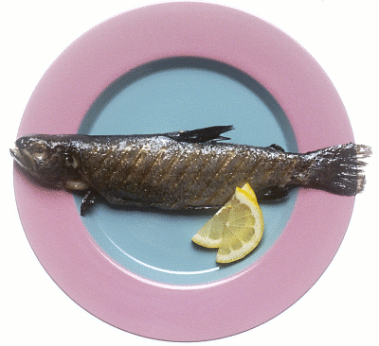
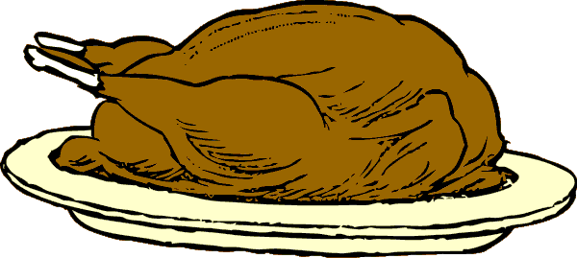
Lesson 4
Protein Sources
It’s My Choice… Vary the Protein!
Essential Nutrient
Plants
Protein
Helps you grow and build muscles, skin, bones, internal organs, and brain.
Things Bilal and His Friends Did With Their Strong Bodies
Animals
Ride a bike
Hopscotch
Play in the pool
Hike through the forest
Skip pebbles in the stream
CHOOSE PROTEIN FOODS FROM PLANTS AND ANIMALS!
CHOOSE SEAFOOD AT LEAST ONCE A WEEK!
CHOOSE NUTS, SEEDS, AND NUT BUTTERS AS SNACKS!

Slide 5


IT’S MY CHOICE…EAT RIGHT! BE ACTIVE!
Credits
Developer:
Sharon K. Junge, University of California Cooperative Extension, Emeritus
Contributor:
Rosemary Carter, University of California Cooperative Extension,
Placer/Nevada Counties
Translation:
Myriam Grajales-Hall, ANR News and Outreach in Spanish
Pilot Testing:
Rosemary Carter, University of California Cooperative Extension,
Placer/Nevada Counties
Interactive PowerPoint Contribution:
Adan Osoria, University of California Cooperative Extension,
Contra Costa County
Layout and Design:
Annette Cosgrove, University of California Cooperative Extension,
Placer/Nevada Counties
©2014 by the Regents of the University of California. All rights reserved. Permission is granted to reproduce the handouts and home activities for workshop sessions. No other part of this publication may be reproduced in whole or in part, or stored in a retrival system or transmitted in any form or by any means, electronic, mechanical, photocopying, recording, or otherwise, without written permission of the author.

