Slide 1

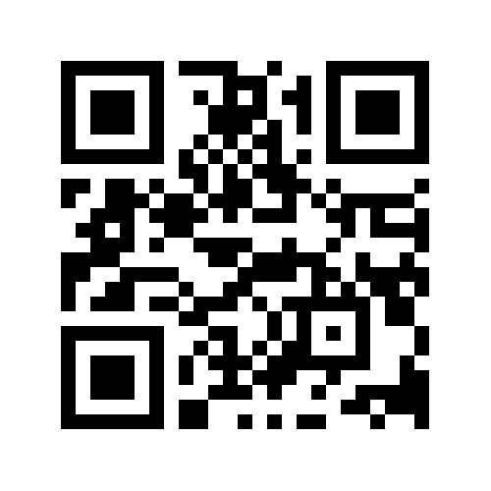
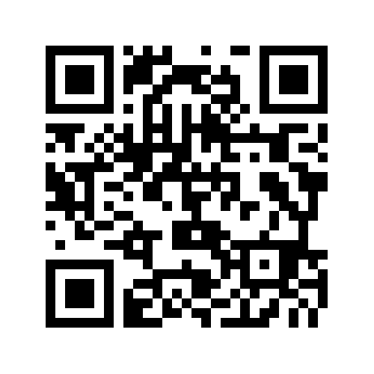
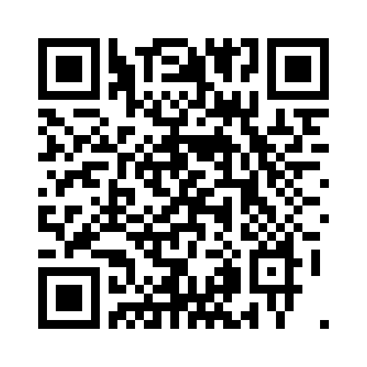
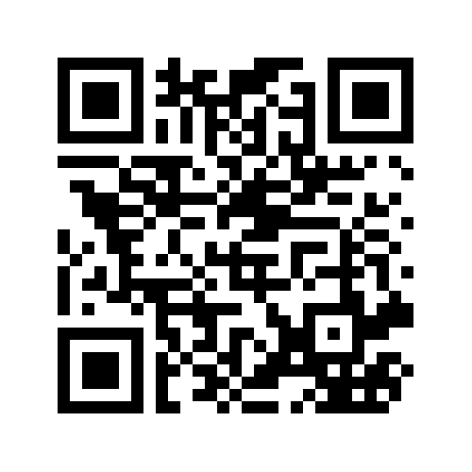
Where Can I Get More Food for My Family?
Food
Bank
CalFresh
Summer Meals
WIC
https://www.cafoodbanks.org/our-members/
https://www.getcalfresh.org/
https://www.cde.ca.gov/ds/sh/sn/summersites22.asp
https://myfamily.wic.ca.gov/
Image by OpenClipart-Vectors from Pixabay
Notes:
REPLACE FOOD BANK LINK WITH LOCAL FOOD BANK
QR Code generator: https://ucanr.edu/portal/urls/

