Slide 1
L1 4-H Epidemiology
Project Orientation
Public Health Process
Notes:
Team Builder: Super hero power - draw or act and share. - 10 minutes

Slide 2
Overview
Zoom/Technology
Ice Breaker
Pre-Evaluation
Group Agreements
Graphic Novel

Slide 3
Pre - Evaluation Survey
https://ucanr.co1.qualtrics.com/jfe/form/SV_8BtaHL8RiUQZUJ8

Slide 4
Group Agreements
Be kind
Be respectful to others opinions
Work together
Support each other
Have fun!
Participate

Slide 5
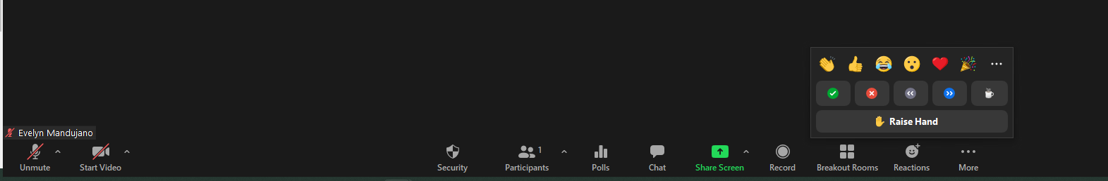
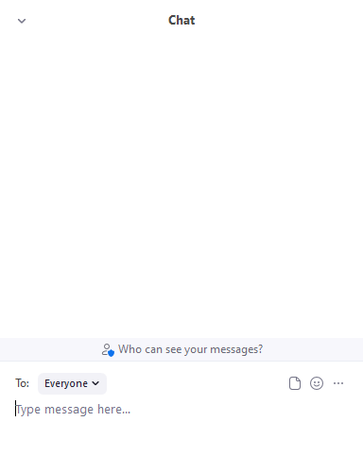
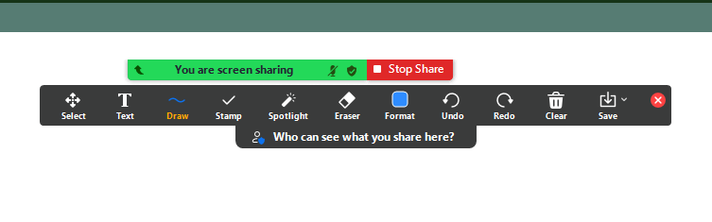
ZOOM
Use your Emojis!
Mute & Unmute Here
Use the Chat to send Messages!

Slide 6
Graphic Novel
Make sure to read before the first lesson!
https://www.cdc.gov/flu/resource-center/freeresources/graphic-novel/junior-detectives-print-web.pdf
Or Google ‘disease detectives operation outbreak CDC’

