Slide 1
Lesson 4 4-H Epidemiology
Project Activity 3
Virus Transmission
Notes:
Team Builder: Super hero power - draw or act and share. - 10 minutes

Slide 2
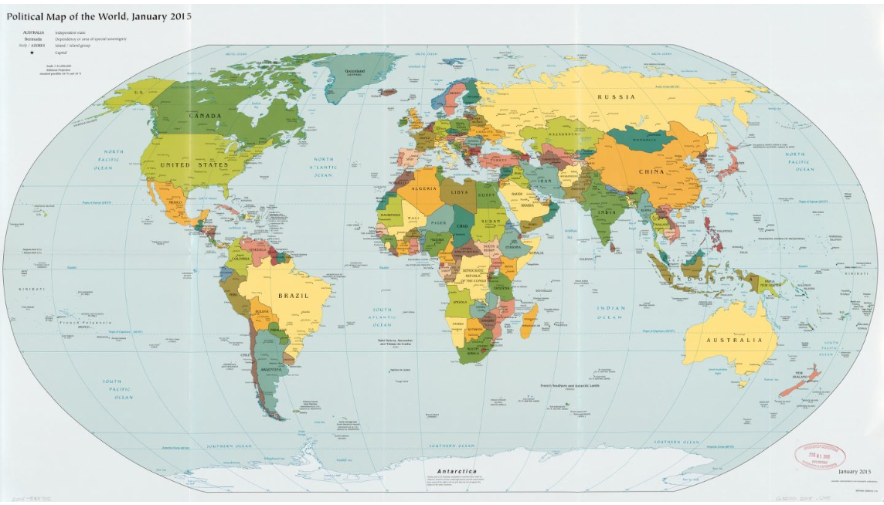

Slide 3
What do you remember about case definition and case classification?

Slide 4
Bird-Bird-Bird
Initial setting = wildlife park
Initial reservoir = Bird-Bird-Bird A domestic duck living in a pond
First host (host A) = Bird-Bird-Bird An winning domestic chicken that was recently purchased and whose coop is located near the pond
Method of transmission to infect the host A = The domestic duck living in the pond waddles up close to the chicken coop and shakes its head releasing influenza virus into the air. Then host A becomes infected as the virus enters through the beak of one of the chickens in the coop.
Host B = Bird-Bird-Bird Host A then transmits the virus to another chicken in the coop through shared food containers.

Slide 5
Activity
Divide into story map outline.
Create story maps and share with the group.

Slide 6
Discussion Questions
How might Hamlet have been infected?
How is COVID-19 transmitted?

Slide 7
Post Activity
Research the story map outline for COVID-19
Animals and COVID-19 | CDC

