Slide 1
Lesson 5 Epidemiology:
Project Activity 2
Spreading and Tracing Disease
Dorina M Espinoza
Anne Iaccopucci
Marcel Horowitz
Notes:
Team Builder: Super hero power - draw or act and share. - 10 minutes

Slide 2

Disease Transmission
How to think like an epidemiologist
Think outside the box
  Opposite Activity

Slide 3
Epidemiology Vocabulary
Draw a line to match the
term to the definition
Vaccination
Pathogens
Immunity
herd immunity
epidemic
pandemic
A disease prevalent over a whole country or the world.
Treatment with a substance used to stimulate the production of antibodies and provide immunity against one or several diseases to produce immunity against a disease; inoculation
If a sufficient proportion of a population is immune to an infectious disease (through vaccination or prior illness), its spread from person to person is unlikely, and even persons not vaccinated (such as newborns and those with chronic illnesses) receive some protection because there are fewer infected persons from whom to catch the disease.
Protection against a disease. Immunity is indicated by the presence of antibodies in the blood and can usually be determined with a laboratory test.
The occurrence of a disease within a specific geographical area or population that is in excess of what is normally expected.
An organism (e.g., certain bacteria, viruses, parasites, and fungi) that causes disease.

Slide 4
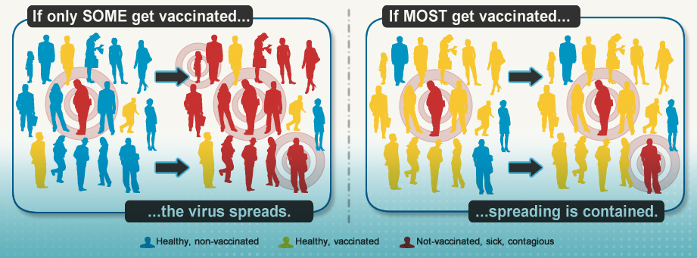
Pass It On Activity

Slide 5
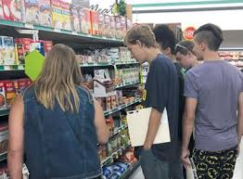



Pass It On Activity
Phase 1: Logging 4 Exchanges with your friends
Table 1. Exchanges 1 - 4 and Sick or Health status of each person.
Your Name: ____Dorina__________________________
Card #: __2_______ Card Code: ___XY___
Exchange | Student Name | Card # | Card Code | Sick (Infected) | Healthy (Not infected)
1 Grocery Store
2 Restaurant
3 School
4 4-H Club Meeting

Slide 6
Figure 1. Disease transmission
X = Vaccinated and Immune
X Y = Vaccinated not Immune
S Z = Not Vaccinated
S = Not Vaccinated, Sick

Slide 7
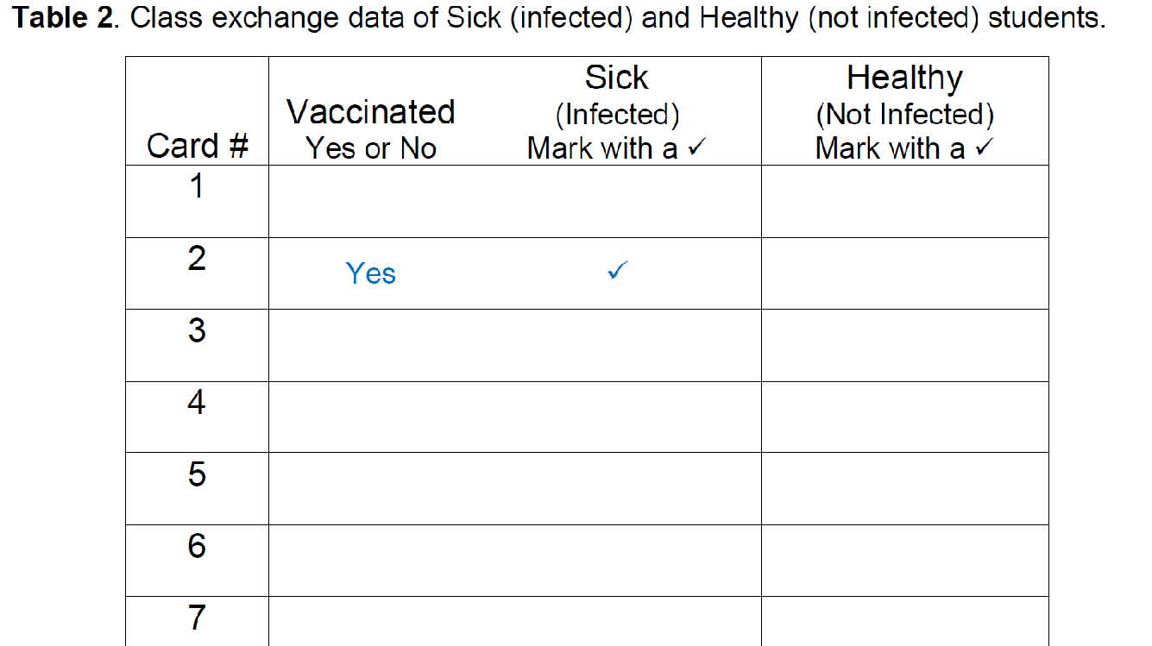
Pass It On Activity
Phase 1: Logging 4 Exchanges with your friends

Slide 8
Case Definition: Case Classification
How to think like an epidemiologist
Know your stuff
  Pathogen
  Immunity
  Herd Immunity
  Outbreak
  Epidemic/Pandemic

Slide 9
Disease Transmission
How to think like an epidemiologist
Which statement is true about pathogens
  Pathogens can never be spread from animal to person
  A type of pathogen is Ben & Jerry’s Cherry Garcia ice cream
  Antibiotics are always used to treat illnesses caused by pathogens
  A micro-organism that can cause disease is a pathogen

Slide 10
Disease Transmission
How to think like an epidemiologist
Which statement is true about immunity
  Once we are immune to a disease we are always immune to that disease
  Superheroes, especially Wonder Woman, are naturally immune to diseases
  Immunity is our bodies way of protecting us against a disease
  Vaccines are not very effective in helping develop our immune system

Slide 11
Disease Transmission
How to think like an epidemiologist
Which statement is true about herd immunity
  Herd immunity is when we have enough white blood cells in our body to fight off a disease
  Cows are often able to develop herd immunity
  When enough people are immune to an infectious disease, herd immunity develops and the spread of the disease (from person to person) is less likely
  When enough people do not get vaccinations, herd immunity develops

Slide 12
Disease Transmission
How to think like an epidemiologist
Which statement is true about outbreak
  Disease outbreaks are investigated by the cruise ship industry
  An outbreak does not occur from food we eat
  Outbreak is a movie about coronavirus
  An outbreak is when there is a sudden appearance of a disease in a specific area or population

Slide 13
Disease Transmission
How to think like an epidemiologist
Which statement is true about epidemics and pandemics
  Epidemics occur across the globe; pandemics occur within a country
  Both epidemics and pandemics describe disease outbreaks that impact very few people
  Epidemics occur within a community, population, or region; pandemics occur worldwide, or over a very wide area

Slide 14
Disease Transmission Activity Debrief
What are your take-aways from this activity?

