Slide 1
Lesson 6: Epidemiology
Have You “Herd”?
Modeling Influenza and Exploring your Community
Dorina M Espinoza
Anne Iaccopucc
Marcel Horowitz

Slide 2
Immunity
How to think like a disease scientist
Decisions, Decisions, Decisions
Learn tools used by disease scientists to make decisions about disease and community health
Investigate your community’s health status, as of today

Slide 3

Immunity
Would you rather…
  To answer the questions, you will be using the “Reactions” button at the bottom of your Zoom screen
    Clap or Thumbs up

Slide 4
Immunity
Would you rather
  …only be able to use a fork or only be able to use a spoon?
    Fork or Spoon

Slide 5
Immunity
Would you rather
  …your only mode of transportation be a donkey or a giraffe?
    Donkey or Giraffe

Slide 6
Immunity
Would you rather
  …not be able to shower for the rest of your life or not be able to clean your teeth?
    Shower or Teeth

Slide 7
Immunity
Would you rather
  …have no phone after 8 pm or complete computer usage monitored by your parents?
    Phone or Computer

Slide 8
Immunity
Would you rather
  …wake up in the middle of an unknown desert or wake up in a rowboat on an unknown body of water?
    Desert or Rowboat

Slide 9
Immunity
Would you rather
  …be unable to move your body every time it rains or not be able to stop moving while the sun is out?
  Move in Rain or Stop in Sun

Slide 10
Immunity
Would you rather
  …only charge your phone once a week or not have a camera on your phone?
    Charge Phone or No Camera Phone

Slide 11
Immunity
Would you rather
  …go through life unable to ask any questions or unable to answer any questions?
  Ask Questions or Answer Questions

Slide 12
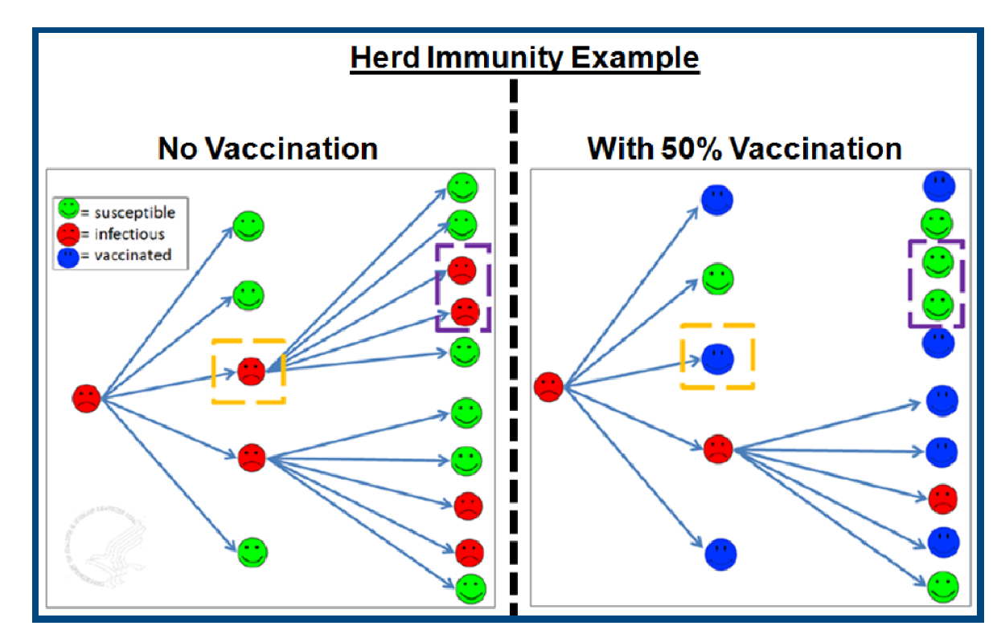
Modeling Influenza’s Spread

Slide 13
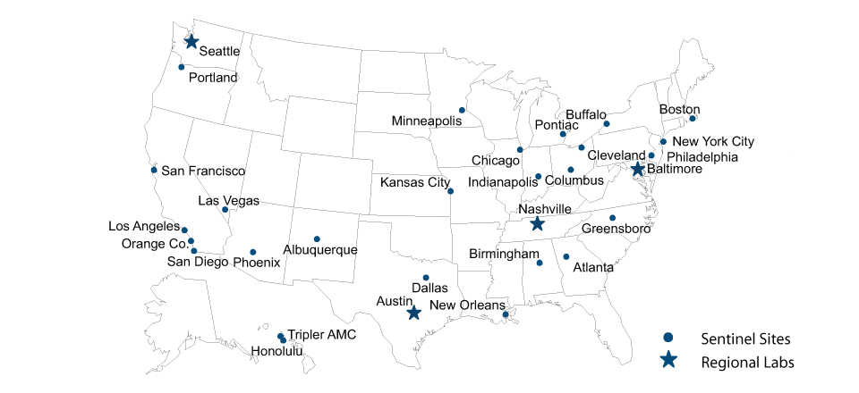
Modeling Influenza’s Spread
In every state in the US, locations (known as sentinel sites) report routine influenza testing results to determine what the typical illness level (i.e., baseline) is for that time of year.
We are going to monitor testing results for one site. We will need clinical laboratory scientist working in a hospital in a sentinel site.

Slide 14
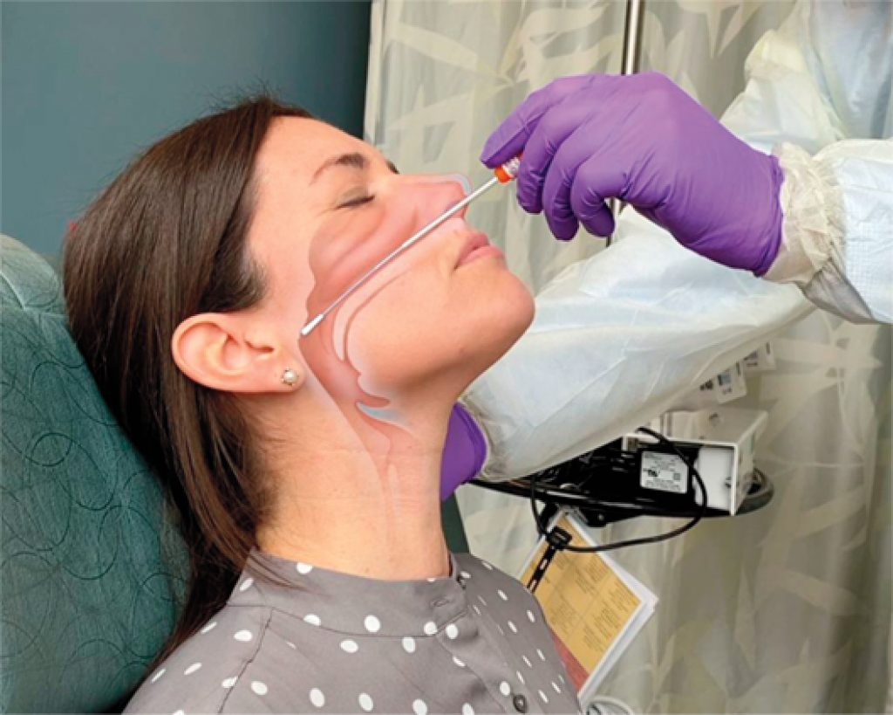
Modeling Influenza’s Spread
The nasopharynx swab procedure will be used.

Slide 15
Modeling Influenza’s Spread
Urban Scenario
The site of the flu outbreak is San Francisco, an urban area with a dense population.
During a 24-hour period, nasopharynx swab samples were taken from hospitalized patients with respiratory infections. To determine if the patients were positive for influenza, the nasopharynx swab test was done.
Lab Results
 | Patient 1 Jesse | Patient 2 D.J. | Patient 3 Stephanie | Patient 4 Joey | Patient 5 Michelle
Test Results (Positive or Negative) | Negative | Positive | Positive | Negative | Negative
Diagnosis (Influenza, Not Influenza) | Not Influenza | Influenza | Influenza | Not Influenza | Not Influenza

Slide 16
Modeling Influenza’s Spread
Urban Scenario
When more than one influenza case (+) occurs in a 24-hour period (above baseline), information is sent to state public health labs and CDC for additional testing and research.
On the basis of your data, should you report influenza to the state public health laboratory and CDC?
The nasopharynx swab is a quick way to check for influenza. On average it has a false-negative rate of 30%–50% (people who have influenza receive a negative result). Explain one way a false--negative test result might occur?

Slide 17
Modeling Influenza’s Spread
Urban Scenario
To determine the ability of a virus to spread a model is used to calculate the reproduction number:
      R₀ = (k) × (d) × (p) R₀ >1 can lead to an epidemic
Avg # People a Sick Person will Infect =
(# contacts in 1-day) x (# days a person stays infectious) x (likelihood of transmission for each contact)

Slide 18
Modeling Influenza’s Spread
To determine the ability of a virus to spread a model is used to calculate the reproduction number:
      R₀ = (k) × (d) × (p) R₀ >1 can lead to an epidemic
Avg # People a Sick Person will Infect =
(# contacts in 1-day) x (# days a person stays infectious) x (likelihood of transmission for each contact)
Urban Scenario
R₀ = (16) × (7) × (0.02)
R₀ =

Slide 19
Modeling Influenza’s Spread
For a community to be protected from an epidemic or pandemic, a specific percentage of the community must be immune to the virus; this is called the herd immunity threshold (Ic).
For example, if the herd immunity threshold is 0.5, that means a total of 50% of the community would need to be vaccinated or develop the immunity to prevent the outbreak from becoming an epidemic or pandemic.
Ic = 1 – 1/ R₀
Urban Scenario
R₀ =
Ic = __% of the San Francisco would need to be vaccinated

Slide 20
Investigating your Community's Health Status
CA COVID-19 Cases Dashboard
  https://public.tableau.com/views/COVID-19CasesDashboard_15931020425010/Cases?:embed=y&:showVizHome=no
Pandemics Explained: Unlocking evidence for better decision making (from Harvard Global Health Institute)
  https://globalepidemics.org/

Slide 21
Investigating your Community's Health Status
CA COVID-19 Cases Dashboard
  https://public.tableau.com/views/COVID-19CasesDashboard_15931020425010/Cases?:embed=y&:showVizHome=no
Select your County
  Look at the Positive Cases Graph
    What do you notice about the graph? (flat, up, down)
  Look at the Case Demographics Chart
    What do you notice about the chart? (similarities, differences)
  Given what you’ve learned, what might help explain the similarities and differences?
  How do these maps compare with the CDC 2019-20 Influenza Season?
  What would you do in your county if you were the Public Health Officer?

Slide 22
Investigating your Community's Health Status
Pandemics Explained: Unlocking evidence for better decision making (from Harvard Global Health Institute)
  https://globalepidemics.org/
  Click on the US Map and Select CA
    Find your County
      What color is your County? What does the color mean?
    Find a County with a color that is different from yours
      Given what you know today, why do you think there is a difference between the two counties?
      What would you do in your county if your were the Public Health Officer?

Slide 23
Investigating your Community's Health Status
Report Back
  Please share on your exploration of the US, CA, and your home County maps and trends
  Please share your thinking on wearing the hat as your county’s Public Health Officer

Slide 24
Next Lesson Preparation
Look Around, What Do You See?
https://ucanr.edu/sites/DiseaseDetectives/files/329187.pdf
Public Service Announcement (PSA) Activity
Gimme Six Feet (Physical Distancing Remix)

