Slide 1
Lesson 7: Disease Detictives
PSA Activities
Dorina M Espinoza
Anne Iaccopucci
Marcel Horowitz

Slide 2

Educational Activity
Fart mind experiment
Zoom Poll!

Slide 3
How we influence people’s behaviors:
    motivate
    change attitudes
    educate
    enforce policy
    influence with peer pressure
    overcome barriers
PSA Examples
Notes:
motivate (will it make you a better person? happier? more helpful? etc...)
change attitudes (can you convince them it is cool? important? kind? financially beneficial? etc...)
educate (what do they need to know? what are they afraid of? etc...)
use emotional stories (what do they really care about? what do they want emotionally or socially? etc...)
influence with peer pressure (how can you convince them everyone else is doing it? etc...)
overcome barriers (can you eliminate the reason they can not/ will not do this behavior?)

Slide 4


Slide 5
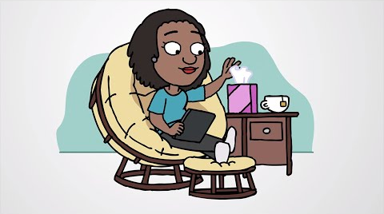
Video
Notes:
What do you want to do?
motivate
change attitudes
educate
enforce policy
influence with peer pressure
overcome barriers

Slide 6
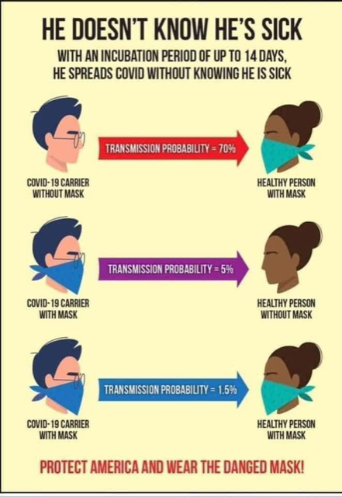
Social Media Post
Notes:
What do you want to do?
motivate
change attitudes
educate
enforce policy
influence with peer pressure
overcome barriers

Slide 7
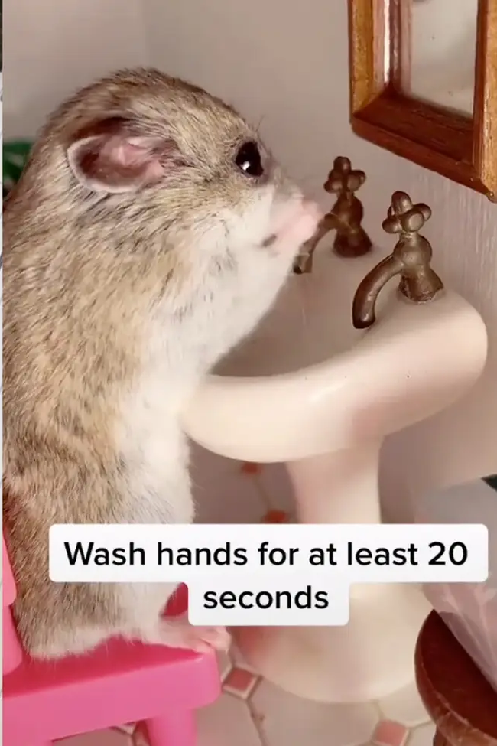
Meme
Notes:
What do you want to do?
motivate
change attitudes
educate
enforce policy
influence with peer pressure
overcome barriers

Slide 8
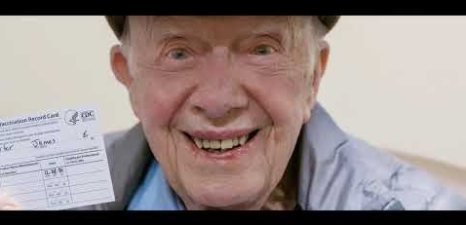
Persuasive Video
Notes:
What do you want to do?
motivate
change attitudes
educate
enforce policy
influence with peer pressure
overcome barriers

Slide 9

Policies- Environment
Notes:
What do you want to do?
motivate
change attitudes
educate
enforce policy
influence with peer pressure
overcome barriers

Slide 10

Song
Notes:
What do you want to do?
motivate
change attitudes
educate
enforce policy
influence with peer pressure
overcome barriers

Slide 11

Educational Video (~2 mins)
Notes:
What do you want to do?
motivate
change attitudes
educate
enforce policy
influence with peer pressure
overcome barriers

Slide 12

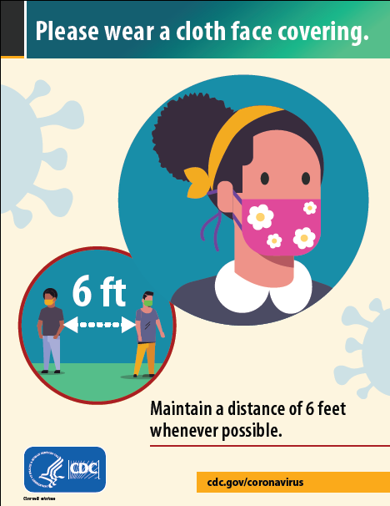
Poster
Notes:
What do you want to do?
motivate
change attitudes
educate
enforce policy
influence with peer pressure
overcome barriers

Slide 13
Positive Activity
How would you rather be told?
People remember what we say!
Don’t go out when you feel sick
Don’t touch contaminated surfaces
Don’t cough into your hand
Don’t shake hands with other people

Slide 14
Group Health Education Project
aka Public Service Announcements (PSA)
https://drive.google.com/file/d/1N2X9BqKC0yA5ZMG1Jm-vRy5fllr0Lh8z/view
EXAMPLES:
https://ucanr.edu/sites/DiseaseDetectives/Health_Education_Materials/

Slide 15
Choose a Message Focus - VACCINES
Get vaccinated
Get boosted
Schedule an appointment to talk to your doctor about your concerns about the Covid-19 vaccine
Get your child vaccinated
Vaccines are free
Talk to several religious leaders about their perspective on getting vaccinated
Talk to your family about the safety and benefits of getting vaccinated
Let others know that citizenship status is not taken when you get vaccinated.

Slide 16
Connections
What connection to 4-H can you make?
What do you want to say about the problem? (e.g., How big is the problem? What is the risk? What is a solution to the problem?)
How are you being kind?

Slide 17
Marketing Approach
motivate
change attitudes
educate
use emotional stories
influence with peer pressure
overcome barriers

Slide 18
Format/ Style
Video - Zoom, Youtube, Phone/ Camera Recording
Song - Upload to Youtube or Any Recording Platform
handout/flyer - Canva, Hand Make a Flyer, Word, Adobe
sign/poster - Canva, Hand Make a Poster, Word, Adobe
Meme - ??
social media banner - Canva, Instagram, Facebook
Educational activity - Create your Own Activity! Share your activity through a video

Slide 19
Ways to Connect
Zoom - https://zoom.us/
Google Hangouts - https://hangouts.google.com/
Skype - https://www.skype.com/en/
Google Docs
Group Chats:
Whats App
Group Me
Poster:
Canva https://www.canva.com/login?redirect=%2Fdesign%2FDAE5I6rWC2E%2FxuuGWUpySnMsG0DkXFxusg%2Fedit

Slide 20
Partners/ Groups (Breakout Groups 1-3)
Choose a Group Leader
Share Contact Information
(Email, Phone Number, Social Media, Etc…)
Select a Time to meet and work on your project
Pick ONE topic/behavior
Pick ONE social marketing approach
Pick ONE style of material
Decide How You Will Divide the Work Between Group Members!

Slide 21
Individually (Break Out Group 2)
Select a Time to work on your project
Pick ONE topic/behavior
Pick ONE social marketing approach
Pick ONE style of material

Slide 22
REMINDERS:
PSA Activity is Due → Next Thursday at our Final Meeting!
Put way for students to submit their PSA here. It can be a link to a Google Folder, an email, or another electronic method of submission.

