Slide 1
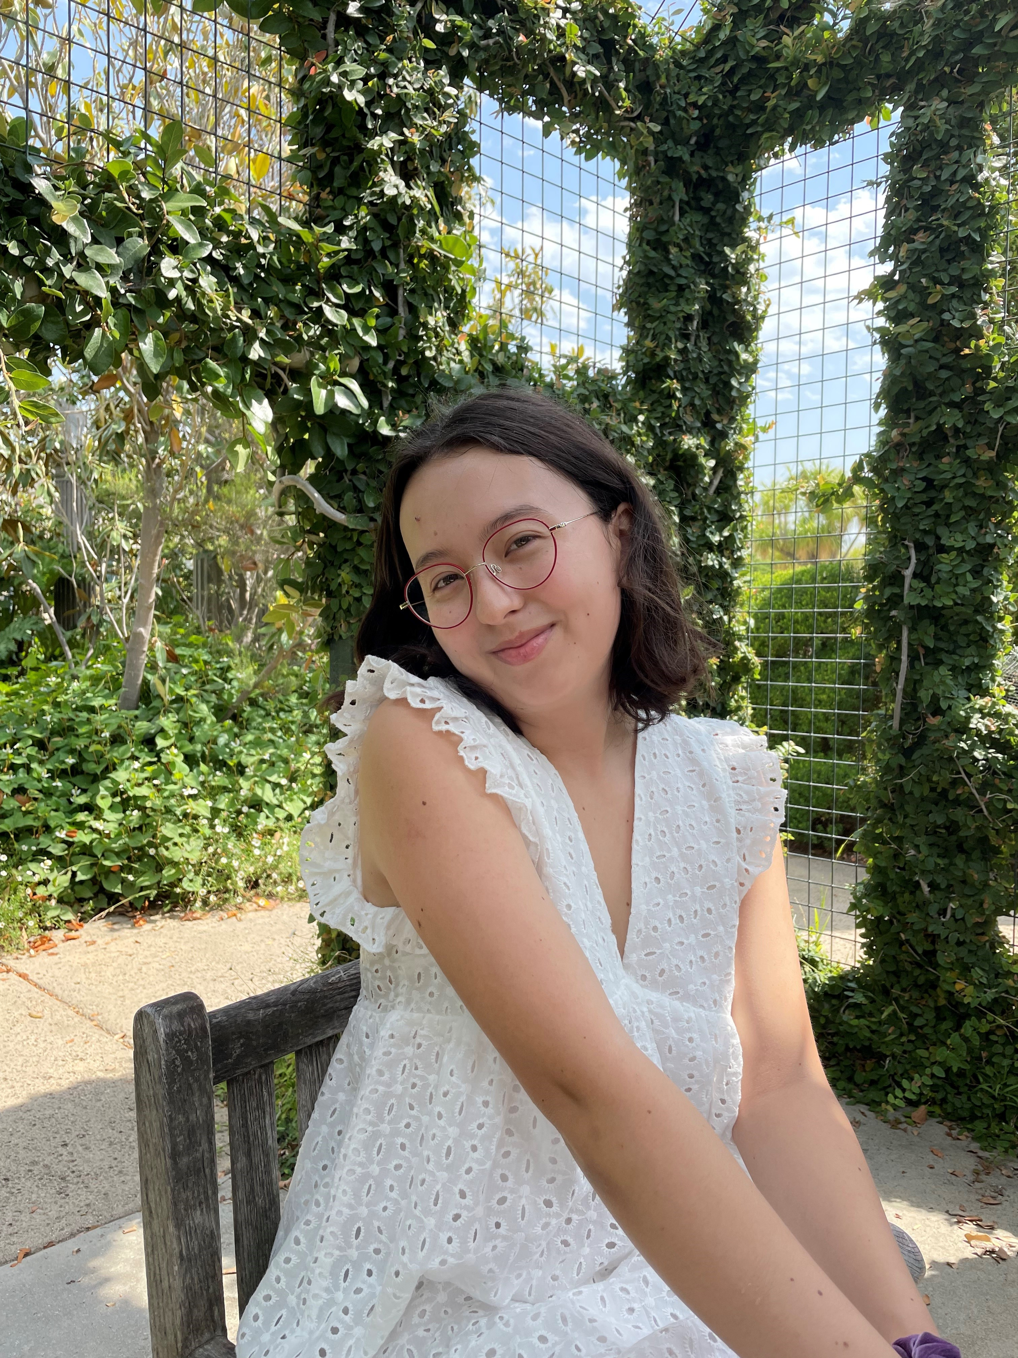
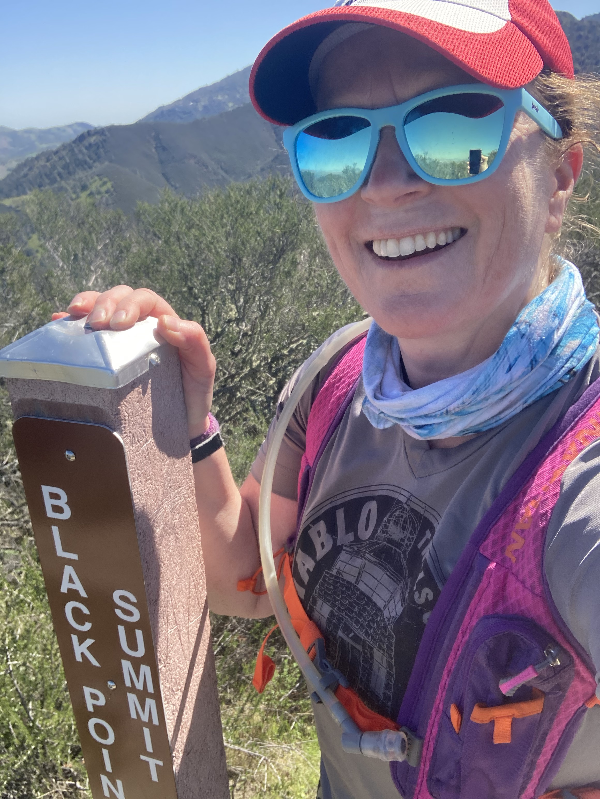
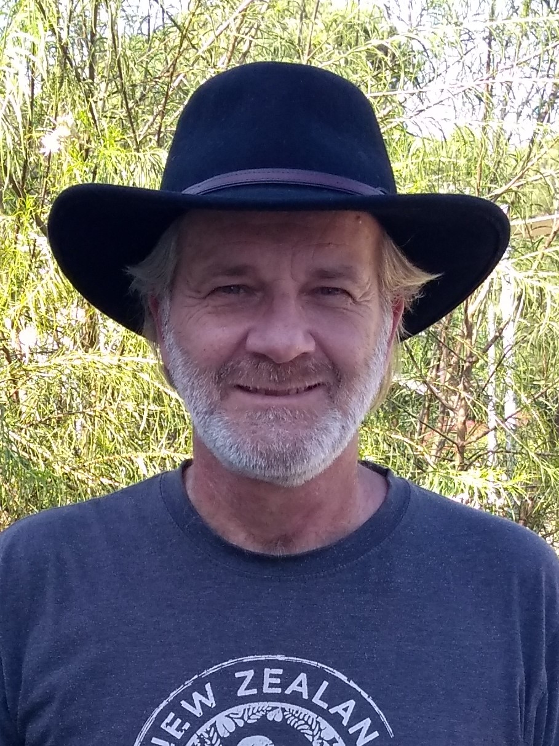
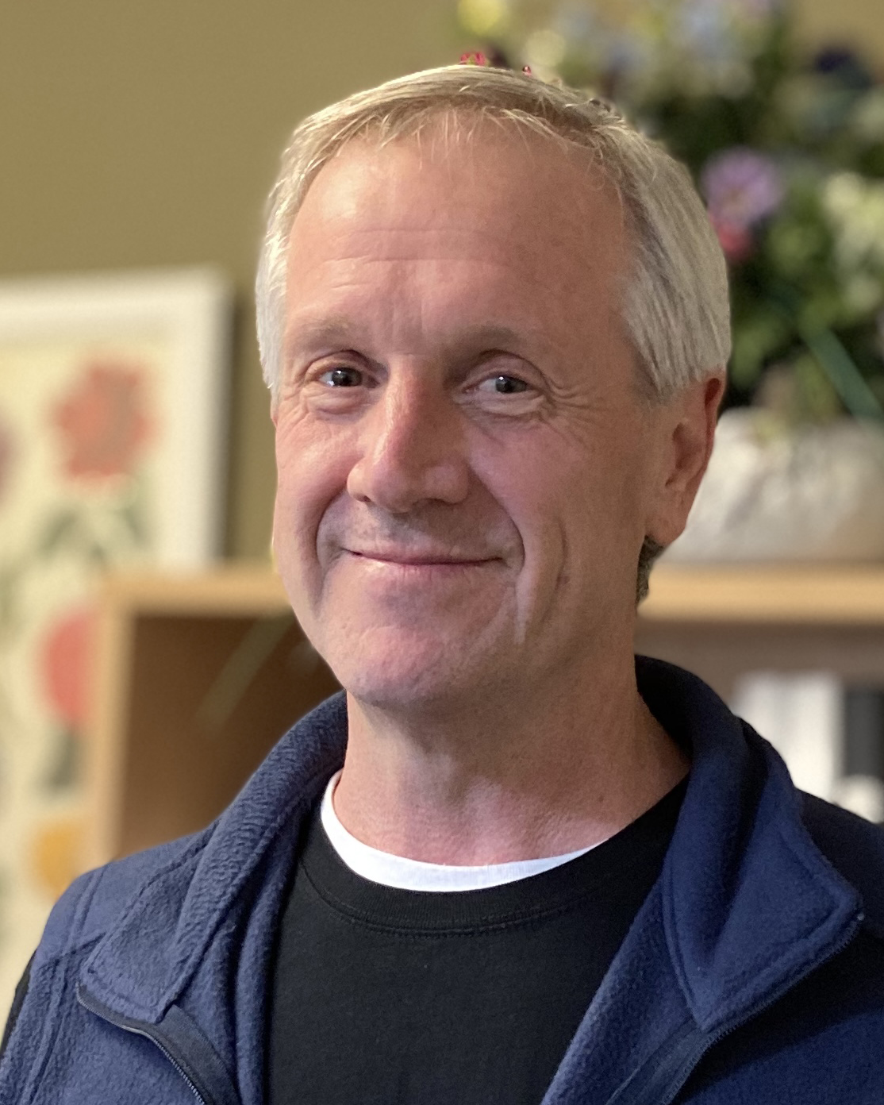
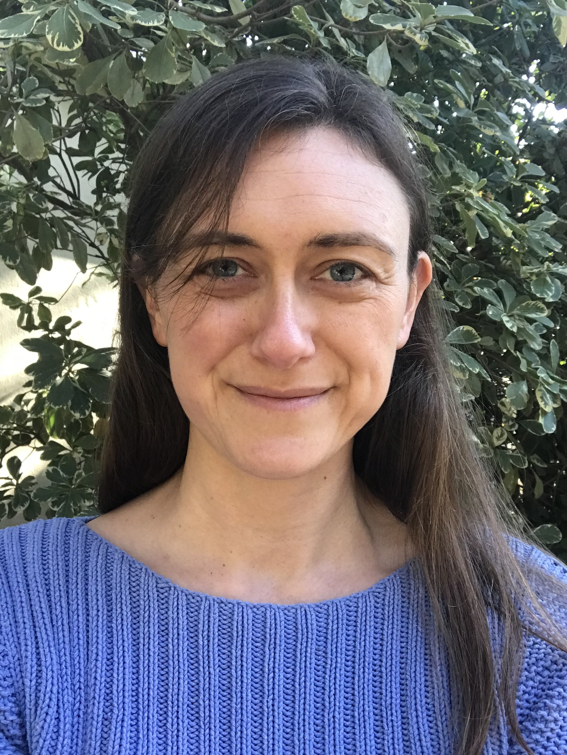
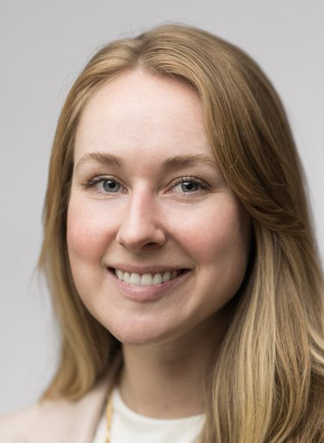
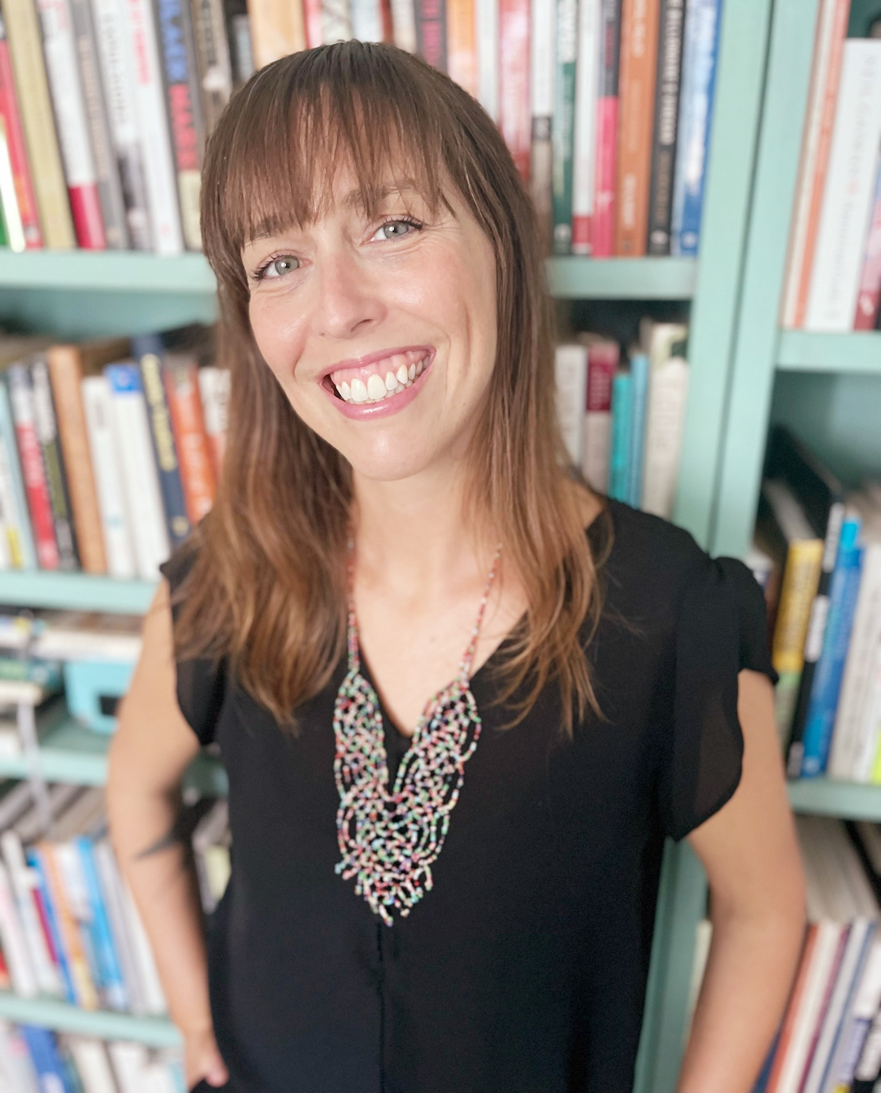
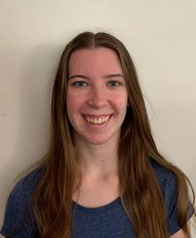

New October Hires: Welcome to UC ANR!
Kassandra A Bacon NUTRITION POLICY INSTITUTE
Jovani Belman-acevedo STATEWIDE IPM PROGRAM
Daisy Beltran ANR CE SPECIALISTS UCM
Namitha Bhat ANR CE SPECIALISTS UCM
Miles Bosarge SOUTH COAST REC
Samantha Rose Conselman STATEWIDE IPM PROGRAM
Yolanda Cruz UCCE SANTA CLARA COUNTY
Kristin Babson Dobbin UCB CNR ENV SCI, POLICY MGMT
Alec Devlin Dompka UCCE HUMBOLDT
Giselle Escobar UCCE CAPITOL CORRIDOR MCP
Maikon Figueredo Lemos KEARNEY REC
Abigail Marie Frolli LINDCOVE REC
Uriel Gonzalez IT SERVICES
Angelina Christine Gutierrez UCCE SAN MATEO COUNTY
Janessa Lee Hartmann UCCE SHASTA COUNTY
Janelle Hernandez BUSINESS OPERATIONS CENTER
Kevin Kamp UCCE CENTRAL SIERRA NEVADA MCP
Peter J Kelly III PROGRAM SUPPORT UNIT
Fatemeh Khodadadi UCR PLANT PATH & MICROBIOLOGY
Denisee Labrada UCCE IMPERIAL COUNTY
Rachel Elizabeth Lee PUBLISHING & PRODUCTION
Lorenzo Levinger UCCE MARIN COUNTY
Karen Looye UCCE SAN MATEO COUNTY
Mariette C Malessy PROGRAM SUPPORT UNIT
Stephanie Alexandra Mar SOUTH COAST REC
Krista Marshall STATEWIDE PROGRAMS
Cynthia Morales UCCE SANTA BARBARA COUNTY
Jennifer Neumann STATEWIDE IPM PROGRAM
Cuong Huu Nguyen UCCE IMPERIAL COUNTY
Adam Michael Novicki HANSEN REC
Claudia Pardo UCCE KERN COUNTY
Michelle Ann Ross UCCE CAPITOL CORRIDOR MCP
Hanah H Shih AG ISSUES CNTR
Kristen Shive UCB CNR ENV SCI, POLICY MGMT
Tyler Smith UCCE SAN DIEGO COUNTY
Joanna P Solins UCCE CAPITOL CORRIDOR MCP
Emma K Tribble STATEWIDE IPM PROGRAM
Itzel Uribe Torres UCCE SANTA CLARA COUNTY
Karyn T Utsumi CALIFORNIA NATURALIST PROGRAM
Joaquin Vega FACILITIES, PLANNING & MGMT
Anna Walden INTERMOUNTAIN REC
Heather Waller BUSINESS OPERATIONS CENTER
Yu-Chen Wang UCCE SANTA CRUZ COUNTY
Miranda Renee Westfall NUTRITION POLICY INSTITUTE
Rhiannon Willingham UCCE SAN DIEGO COUNTY
Brandon Wood BUSINESS OPERATIONS CENTER
Karyn T. Utsumi
Rachel Lee
Adam Novicki
PJ Kelly
Joanna Solins
Kassandra Bacon
Ashley Hooper
Mirjana Knepprath

