Slide 1
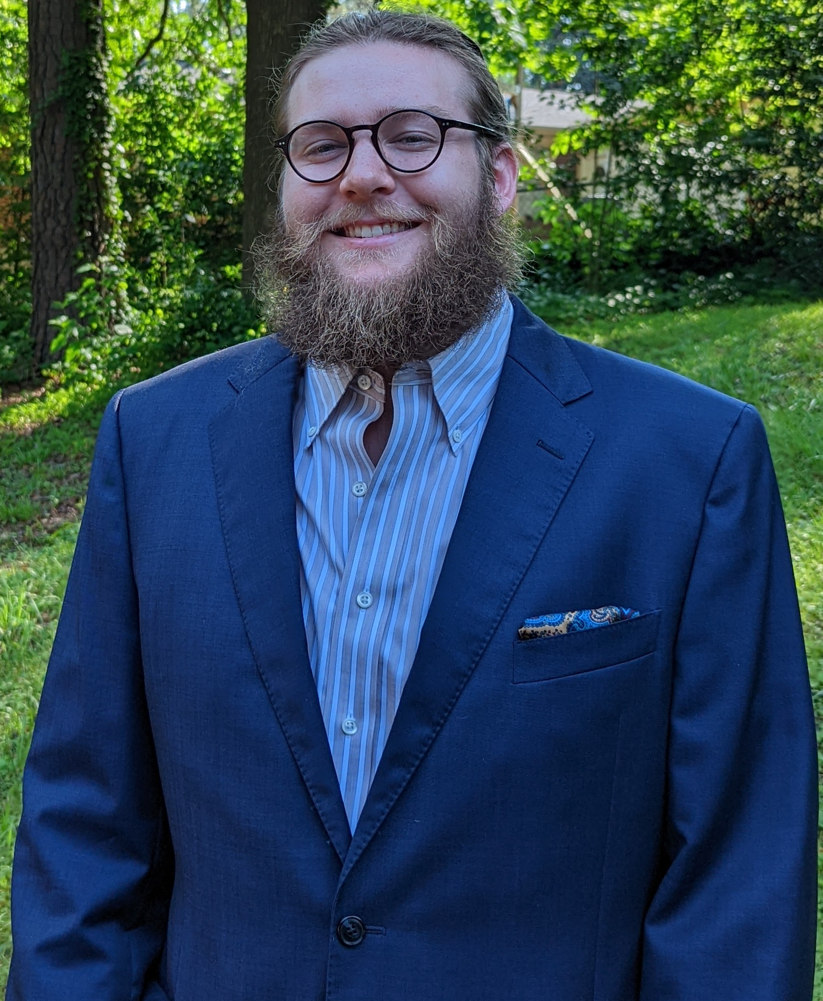
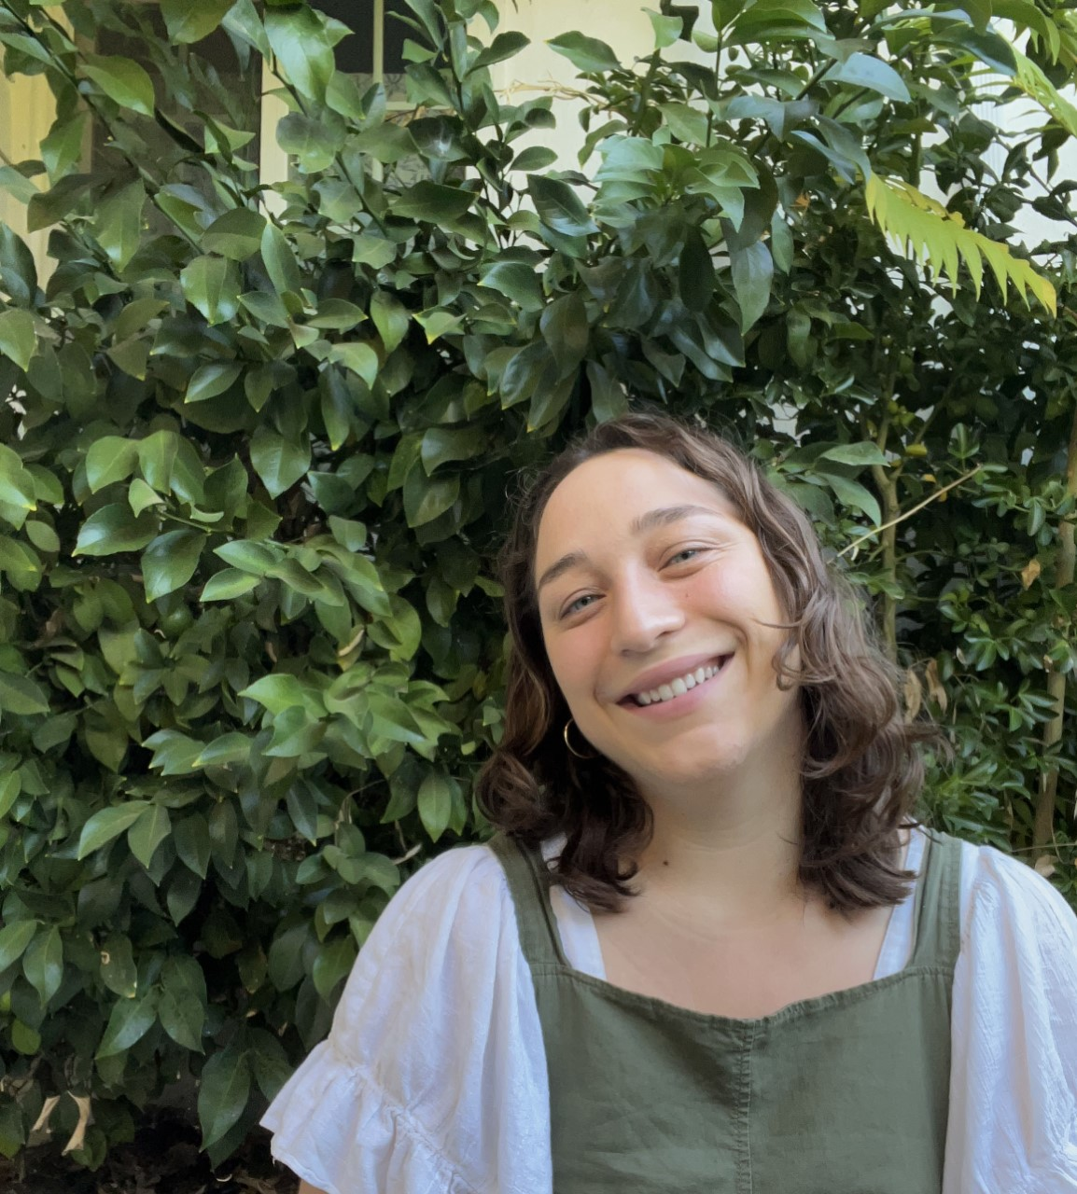
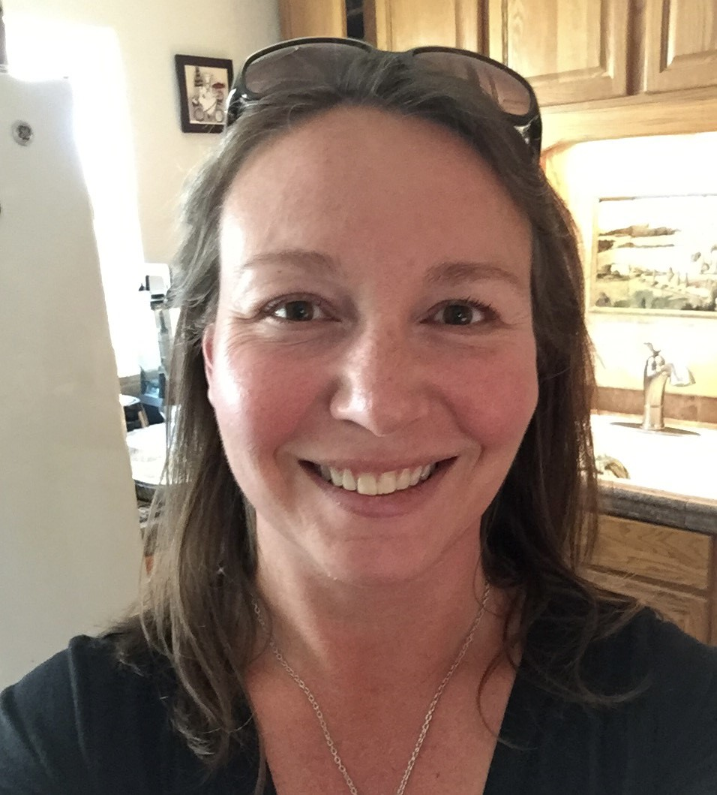
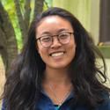
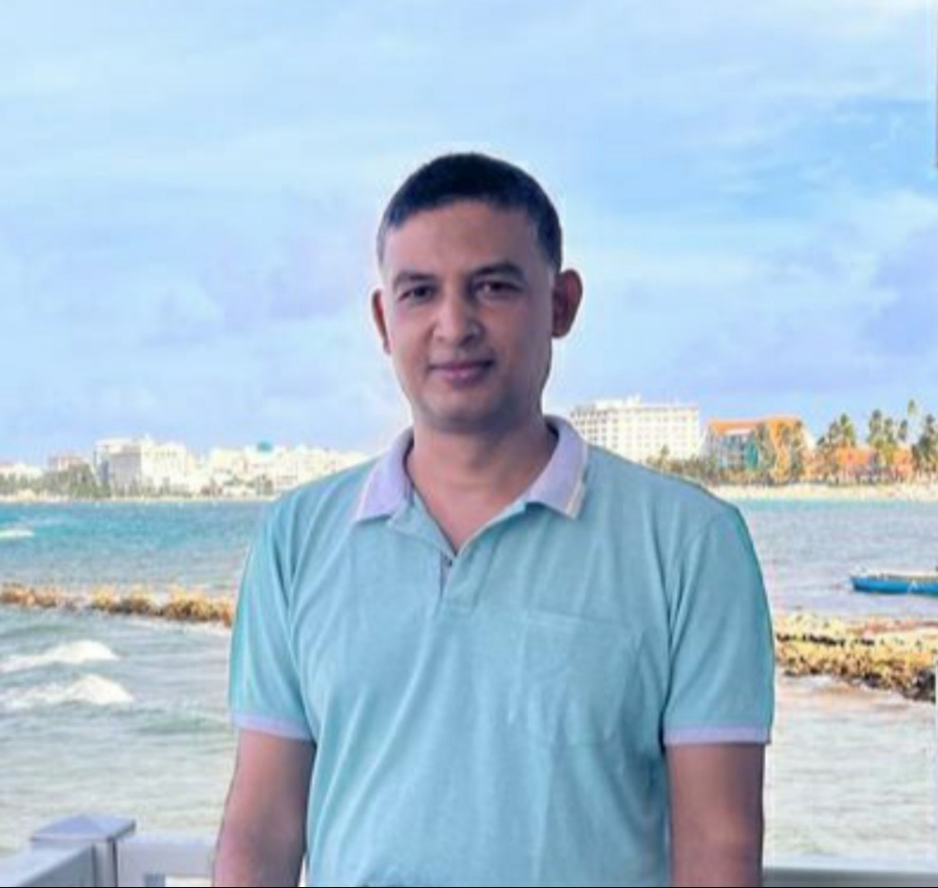

New November Hires: Welcome to UC ANR!
Jovani Belman-Acevedo STATEWIDE IPM PROGRAM ANR Emma Burt UCCE CENTRAL SIERRA NEVADA MCP
Lucie Cahierre VICE PRESIDENT PROGRAMS
Samantha Rose Conselman STATEWIDE IPM PROGRAM
Eve Solana Roxane Dowdell CALIFORNIA STATE 4-H OFFICE
Giselle Escobar UCCE CAPITOL CORRIDOR MCP
Taiyu Guan UCCE SUTTER/YUBA COUNTIES
Janessa Lee Hartmann UCCE SHASTA COUNTY
Prakash Kumar Jha ANR CE SPECIALISTS UCM
Mirjana Knepprath BUSINESS OPERATIONS CENTER
Zubia Mahmood UCCE SANTA CLARA COUNTY
Divyanshu Malik AG ISSUES CNTR
Juliana Martinez Hernandez IMM OFFICE OF HR
Jesus Montejano UCCE MONTEREY COUNTY
Jennifer Neumann STATEWIDE IPM PROGRAM
Cuong Huu Nguyen UCCE IMPERIAL COUNTY
Mikele Olson-Calbert UCCE CONTRA COSTA COUNTY
Skylar Peters SW MSTR GARDENER PROGRAM
Michelle Ann Ross UCCE CAPITOL CORRIDOR MCP
Michael Ryan UCCE CAPITOL CORRIDOR MCP
Mea van Staden UCCE ALAMEDA COUNTY
Anna Walden INTERMOUNTAIN REC
Zubia Mahmood
Alec Devlin Dompka
Emma Burt
Mikele Olsen-Calbert
Stephanie Mar
Prakash Kumar Jha

