Slide 1
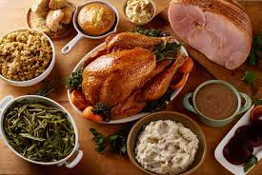
Town Hall
2-3 pm, November 17, 2022
Chat warm-up
Learning about each other
What is your favorite food at the Thanksgiving table?
Agenda
  Welcome
  Leadership Update
  Stories from the Field
  Around UC ANR: Other updates
  Closing

Slide 2
Summary - this slide not shown
Welcome - Pam 2 minutes
Warm up question: Favorite Thanksgiving Food?
Leadership Update (10-15 minutes) (Glenda, Tu, Deanne) Transition
Story from the Field
Shannon Klisch
Donor note (1 minute) (Pam)
Strategic focus (15 Minutes)
In the Media
Other updates
Emily Delk
ANR@Work survey (3 minutes)
New hire list (Pam 1 minute)
Open Enrollment
Winter Faire – Volunteers needed
Close Pam (1 minute)

Slide 3
Objectives: To inform and build unity
Why this meeting?
It’s for all of us!
Comments…. Use “Chat”
“Panelists” or “Everyone”
Questions…. Use “Chat”
Recordings are posted after the meeting on the Town Hall page

Slide 4
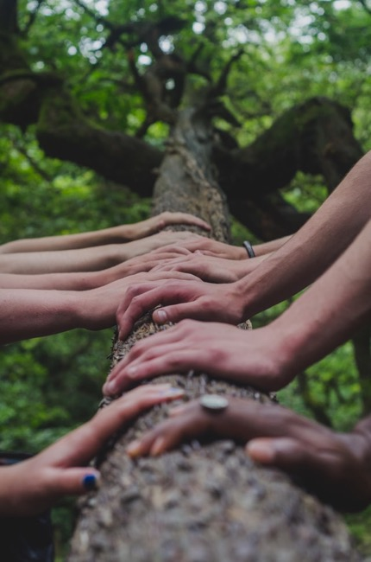
Our Principles of Community
Foster a sense of _________ and emotional safety
Photo by Mark Bell
Notes:
belonging

Slide 5
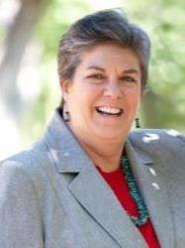
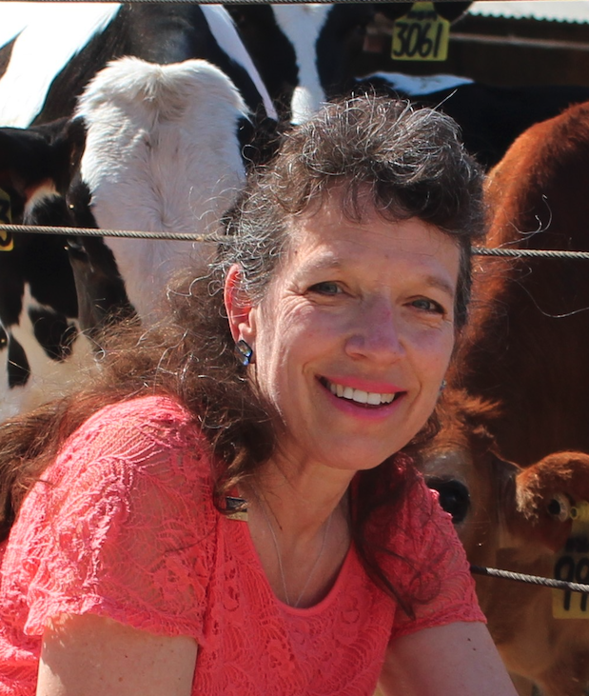
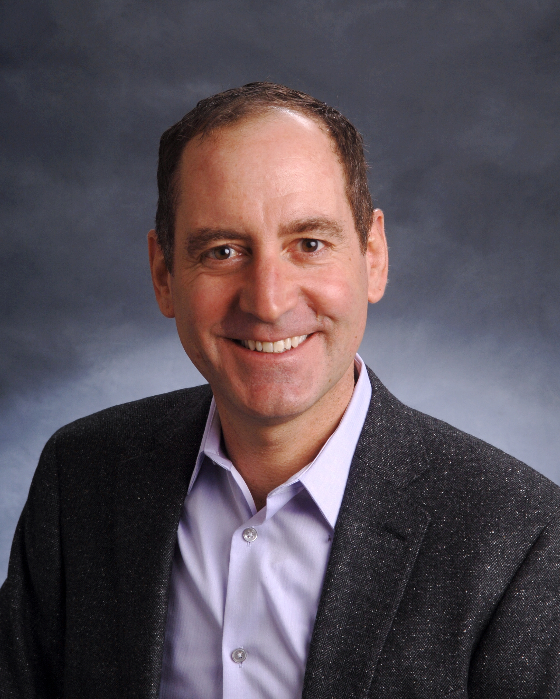
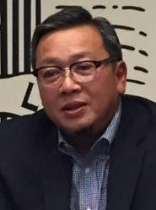
Leadership Update
Vision & News - (10-15 mins)
Notes:
Mark - we have 10-15 min

Slide 6

CalFresh and Market Match Nutrition Incentive Programs at Farmers Markets
Opportunities & Lessons Learned
Presented by Shannon Klisch
Academic Coordinator, PI
UC ANR Collaborators and staff: Rosa Vargas, Mishelle Petit, Kelly Hong, Miguel Diaz, Betsy Plascencia, Melissa Rorabough, Abbi Marrs
11-15-22 UC ANR Town Hall

Slide 7
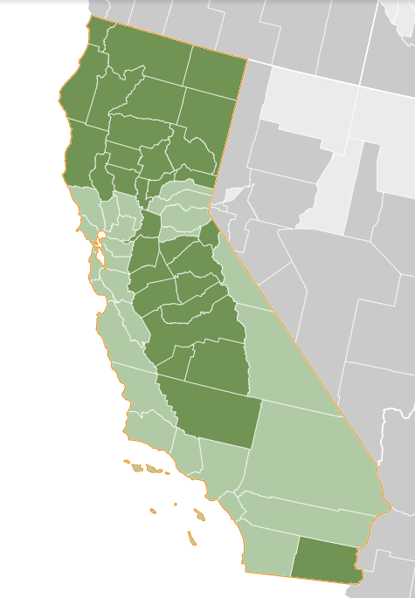
Food insecurity (FI) & food access impact community health
10.2% of Californians are FI (2019) ¹
Nationwide
FI households spend 16% less on food than food secure of similar comp²
94% of very low food secure HH report that they cannot afford to eat balanced meals²
FI is assoc. with adverse health outcomes³
1 Graphic: https://map.feedingamerica.org/county/2019/overall/california
2 Coleman-Jensen, Alisha, Matthew P. Rabbitt, Christian A. Gregory, Anita Singh, September 2022. Household Food Security in the United States in 2021, ERR-309, U.S. Department of Agriculture, Economic Research Service.
3 Gunderson C, Ziliak, JP. Food Insecurity and Health Outcomes. 2015. Health Affairs, vol 34, no. 11. https://doi.org/10.1377/hlthaff.2015.0645
Notes:
Food insecurity is defined by the United States Department of Agriculture as the lack of access, at times, to enough food for an active, healthy life. Food insecurity is associated with numerous adverse social and health outcomes and is increasingly considered a critical public health issue. Key drivers of food insecurity include unemployment, poverty, and income shocks, which can prevent adequate access to food.

Slide 8
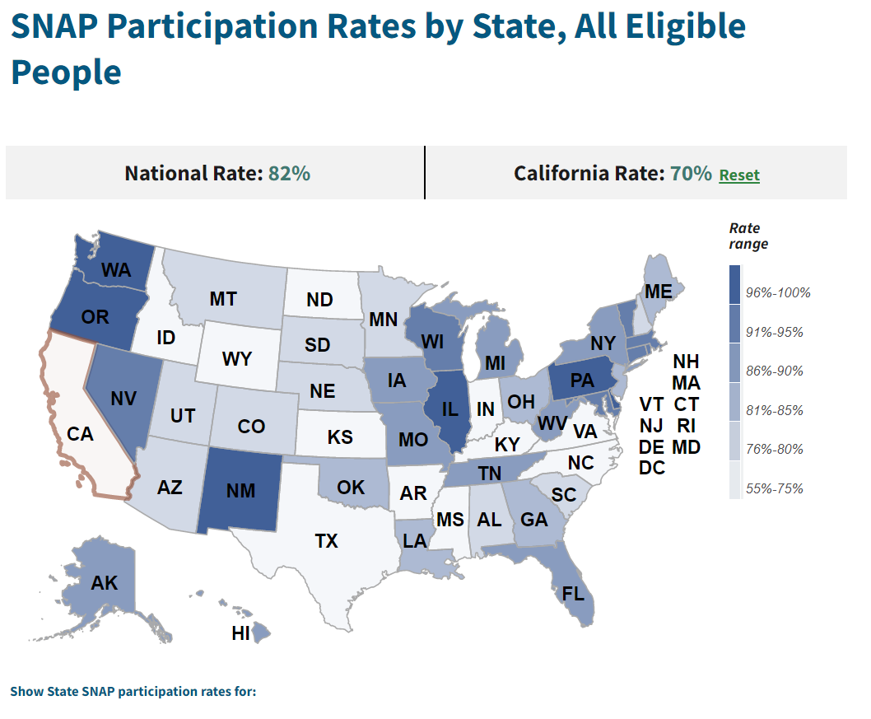
SNAP Participation: US and California
“Too often, people are eligible for federal assistance programs but do not benefit from them.”
White House National Strategy on Hunger, Nutrition and Health
https://www.whitehouse.gov/wp-content/uploads/2022/09/White-House-National-Strategy-on-Hunger-Nutrition-and-Health-FINAL.pdf
Graphic & data source: https://www.fns.usda.gov/usamap#
Notes:
Participation in federal food programs, like SNAP have a positive impact on food security. Although the relationship is complicated.
The Biden-Harris administration has prioritized food security as evidence by their Natl Strategy on Hunger, Nutrition & Health. Access to food assistance programs is specifically called out as a mechanism to relieve food insecurity.
Nationally est that 82% of potentially eligible people participate in SNAP, for Cal it is just 70%

Slide 9
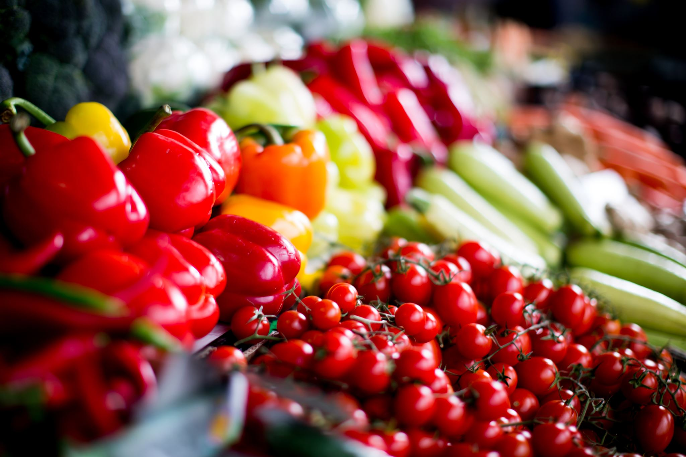
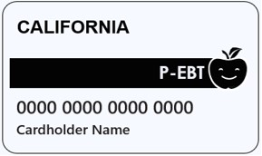

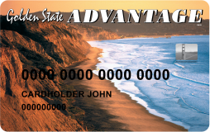
Farmers Markets
# of markets increasing
Healthy, local food
Increase affordability
Lack of awareness
Too $$
Times
Unwelcoming
Increase $$ for local farms & f/v

Slide 10
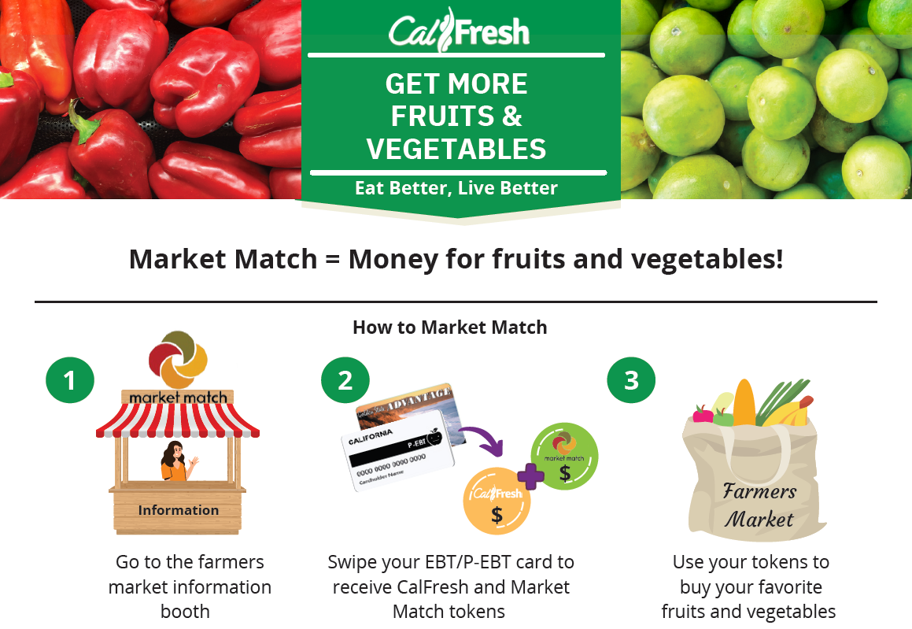
Source: CFHL,UCCE in SLOSB modified from Ecology Center
Notes:
Funded through state, local and federal funds
Administered in CA through the Ecology Center

Slide 11
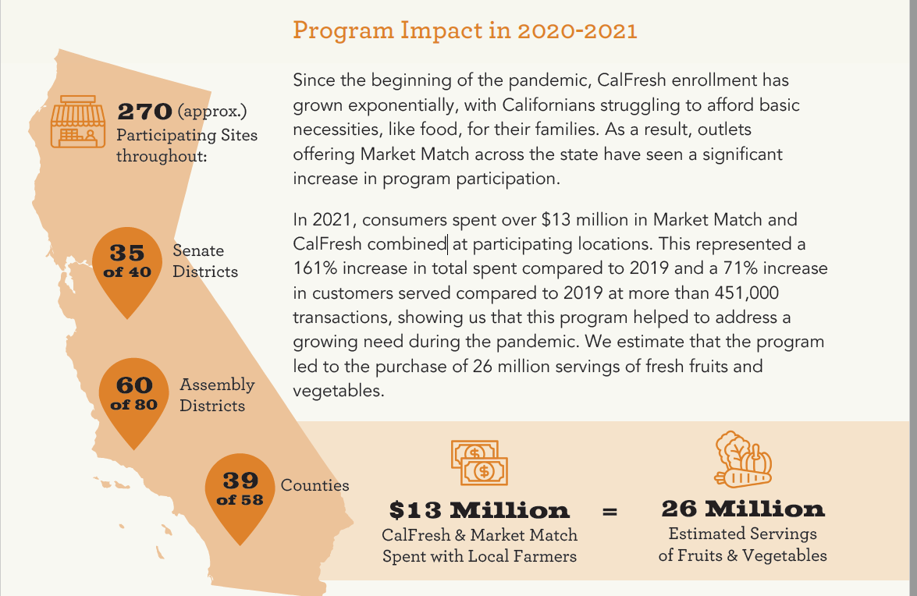
Source: 2022 Market Match Impact Report (Ecology Center)

Slide 12
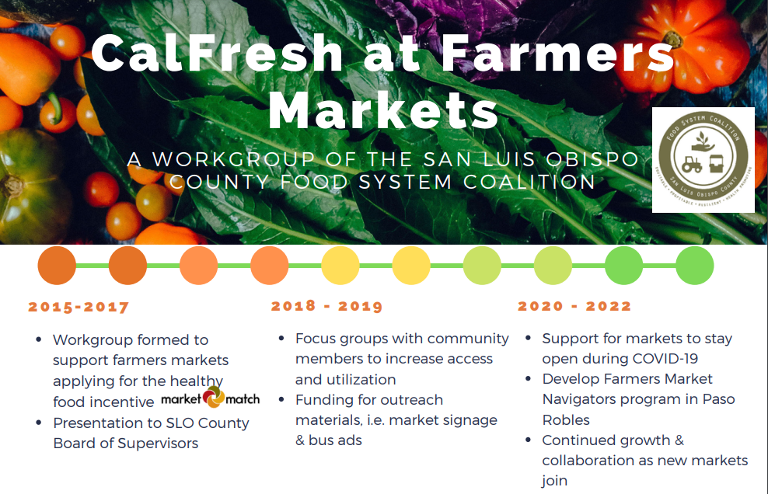

Slide 13
Our mission is to increase the use of CalFresh at Farmers Markets in order to 1) create equitable access to healthy food and 2) support local farms
Work Group Goals:
Increase the number of markets that accept CalFresh
Increase CalFresh $ redeemed
Promote National Farmers Market Week
Advocate for increased local, state and federal support for EBT at Farmers Markets
Provide training and support across market associations

Slide 14
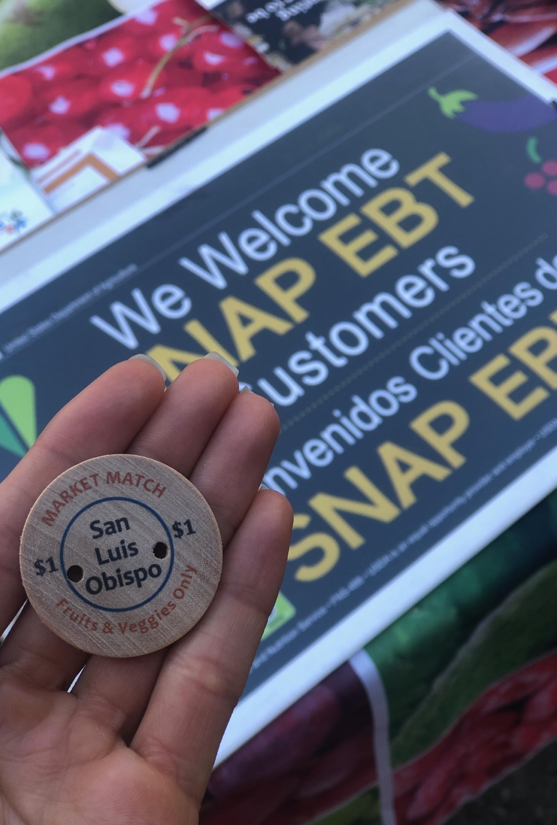
UCCE’s Role
Convene Partners
Provide T/A
Community Assessment
Targeted Education & Outreach
Monitor & Evaluate
Photo: CFHL,UCCE SLO
Notes:
Local efforts & timeline

Slide 15

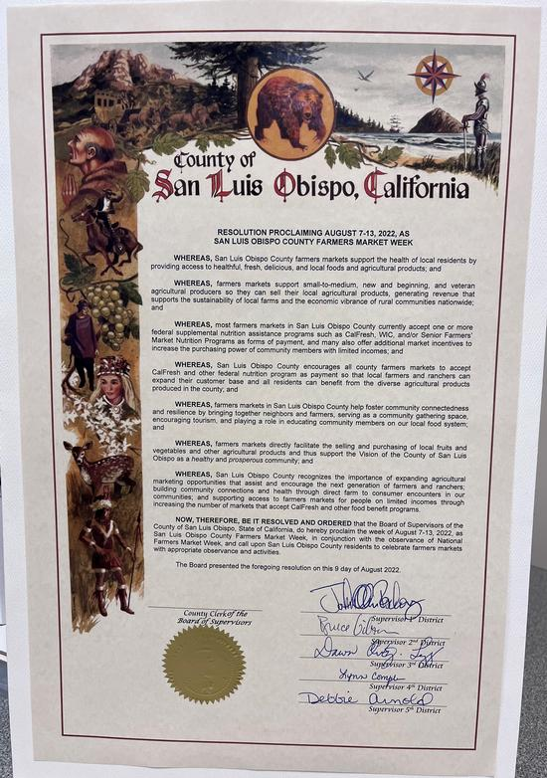
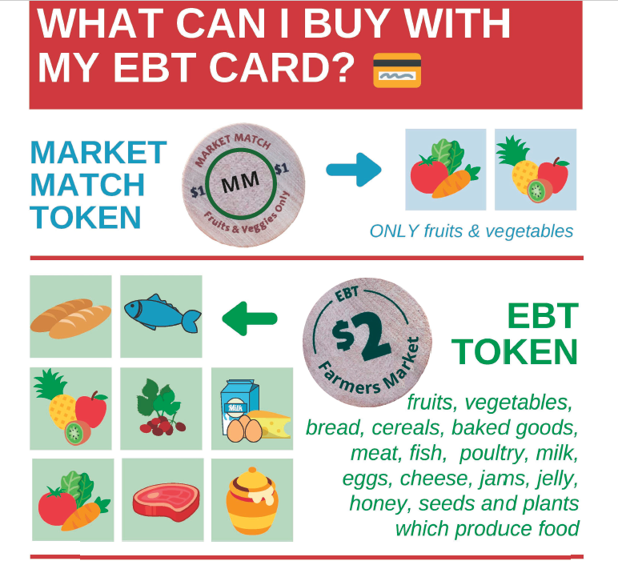
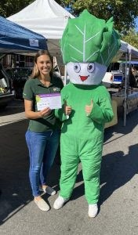
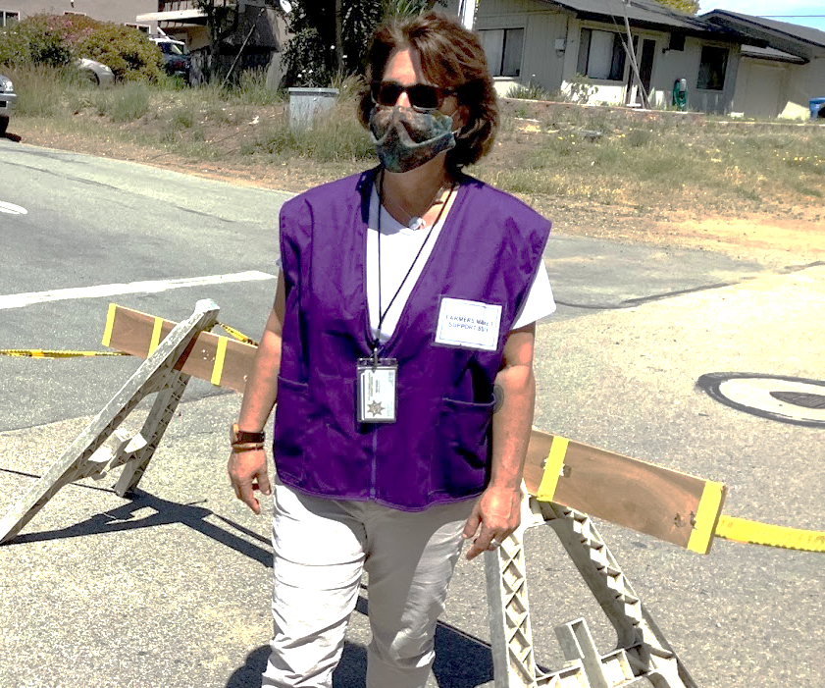
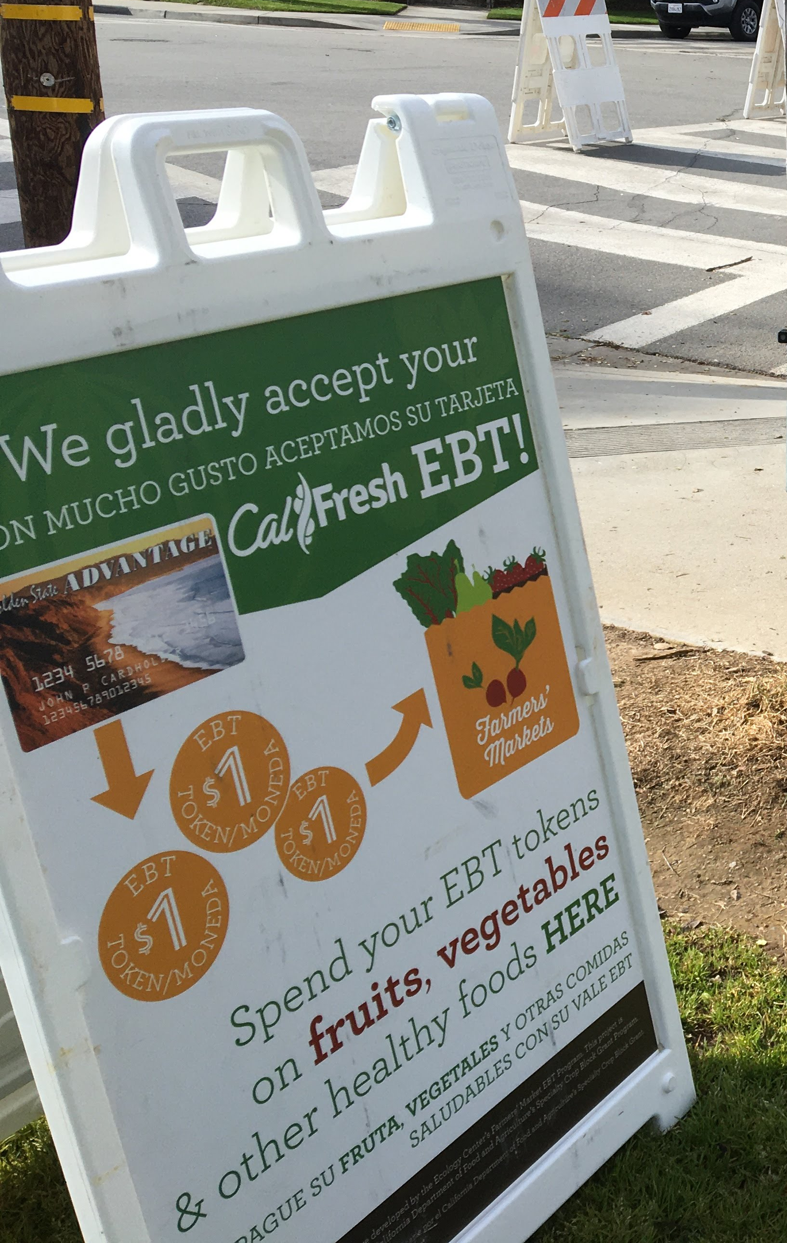
Photo: UCCE SLO
Graphic: CFHL UCCE SLO, Modified from Ecology Center
Photo: UCCE SLO
Photo: SLO Food Bank
Photo: UCCE SLO

Slide 16
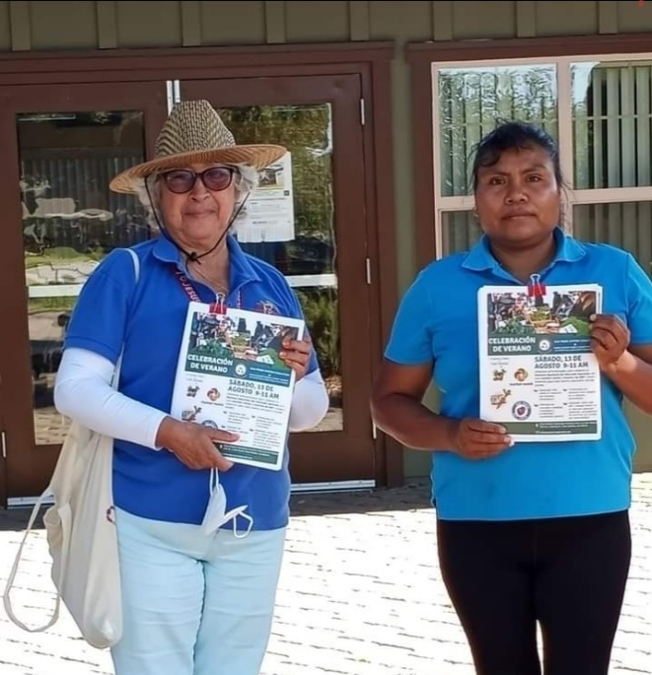
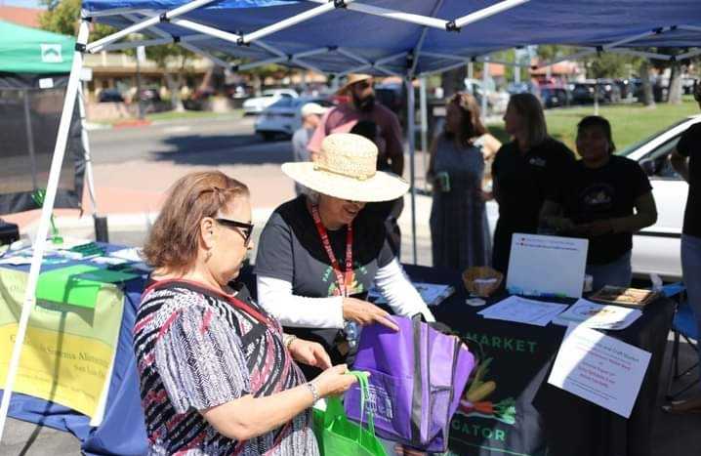
Farmers Market Navigators
“The reason I want to be part of the Farmers Market program is to improve and help people in my community. What I enjoy most is communicating with people about how they can benefit from the organic fruits and vegetables that they sell locally at farmers markets. Also, providing information that can guide them to use the benefits of their cards. Finally, encourage them to visit the farmers market so that in the future Farmer’s Market will have more stalls selling local vegetables and fruits.” – Navigator, Eustolia
Photos: Center for Family Strengthening, Promotores

Slide 17
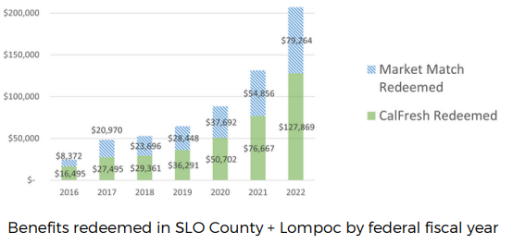
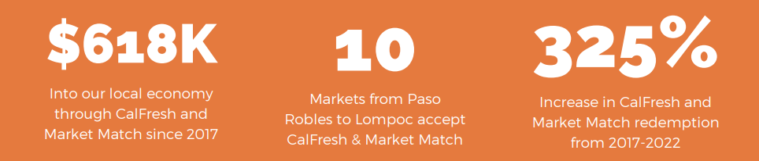
Outcomes
Up from 4 in 2017
Notes:
https://ucanr.edu/sites/SLO/files/374718.pdf
Add data from collaboration tool, grants secured

Slide 18
At markets with Navigators (March-Aug)
165% increase in CF customers
171% increase in CF$ redeemed

Slide 19
Quotes from partners
“This work group really helped our market to be accepted into the Market Match program. I think without the visibility and partnership that this work group provided, we would not have been considered for Market Match. So you all should really feel good about that and thank you.”
– Farmers market manager and work group partner

Slide 20
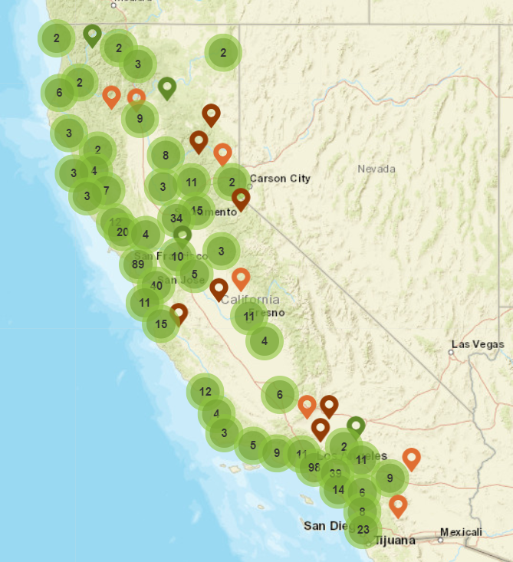
Farmers Market Finder
https://ecologycenter.org/fmfinder/
Notes:
What is CalFresh?
What is Market Match?

Slide 21

Opportunities to support farmers market nutrition incentive programs across CA
Counties with farmers markets with low MM redemption rates compared to # of CF households
Kern
San Bernardino
Orange
San Diego
Madera
Fresno
Riverside
Modoc
Tulare
El Dorado
San Joaquin
Source: Email communication with Ecology Center

Slide 22
Thank you
sklisch@ucanr.edu

Slide 23
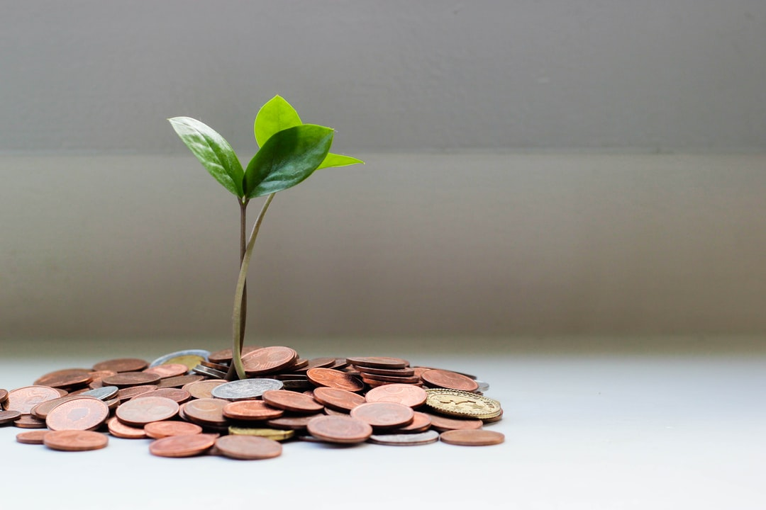
Donor Feedback
People care about what we do
“I am so happy to contribute to this wonderful organization!!”
- Kimberlee K. San Marcos, CA

Slide 24
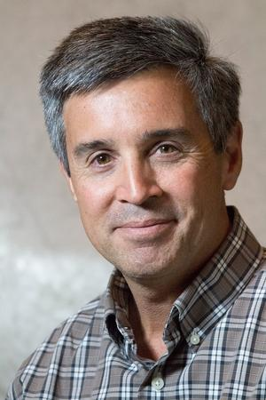

Strategic focus
Greg Ira
Achievements Climate Stewards and California Naturalist have made in workforce development collaborations

Slide 25



UC California Naturalist Program
Engaging new audiences through workforce development (WFD) collaborations
Greg Ira and Sarah-Mae Nelson
17 November 2022

Slide 26
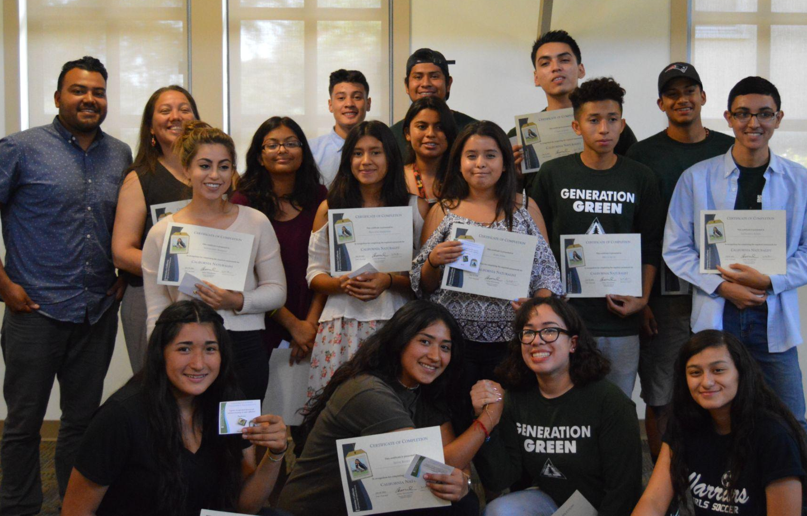
What is Workforce Development (WFD)?
“A wide range of activities, policies and programs to create, sustain and retain a viable workforce that can support current and future business and industry.”
Different perspectives on WFD:
Individual
Community/region
Organization/industry

Slide 27
Our WFD Intervention: Education & Service Courses
Course Elements | California Naturalist | Climate Stewards
40 hours of contact time (including 3 field trips) | ✔ | ✔
Class Participatory Science project | ✔ | ✔
Required text | ✔ | ✔
8 hour capstone project | ✔ | ✔
Field journal | ✔
Online content (e-learning component) |  | ✔
Notes:
40+ hours of contact time (including 3 field trips)
Focus on Climate Change and the California context
Participatory science project
Required text: Climate Stewardship: Taking Collective Action to Protect California
Delivery: Hybrid with asynchronous lessons through Canvas as well as in person meetings
Required: 8 hour capstone project

Slide 28
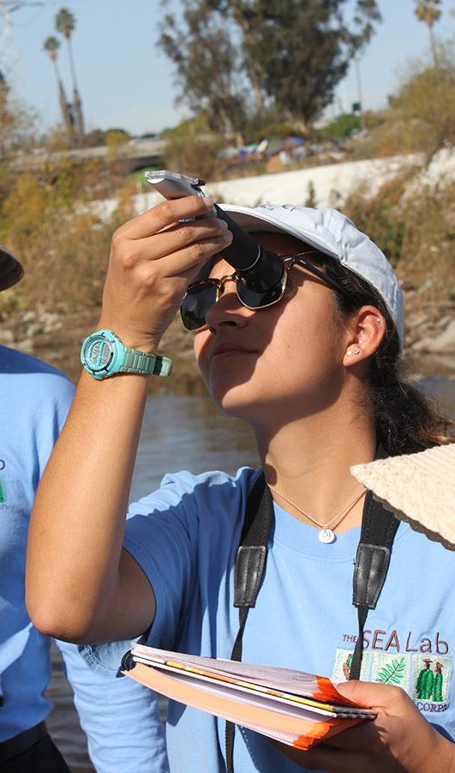
WFD & the CalNat Course
Junior Field Rangers Training. A collaboration with local WFD organizations, CalNat instructors, the National Forest Foundation, and 3 National Forests in SoCal.
Coastal Interpreters Training for LA Conservation Corps members by the USC Sea Grant at the LACC Sea Lab.

Slide 29
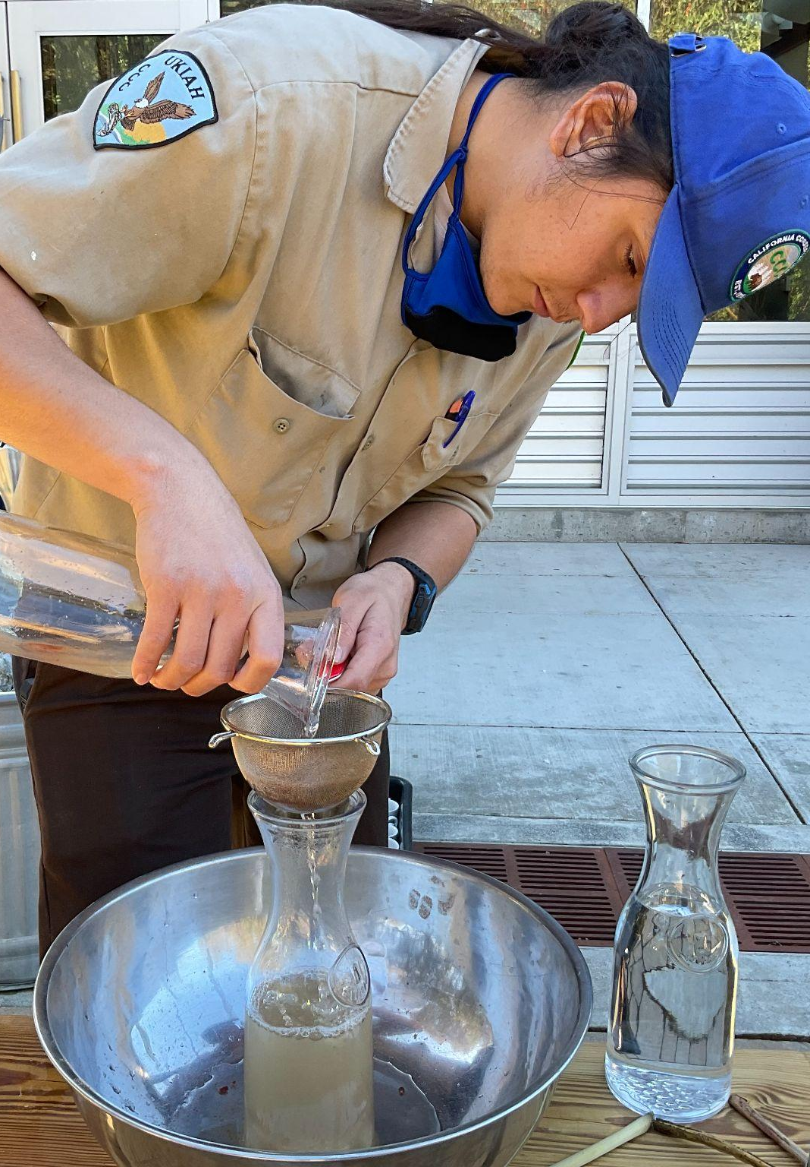
WFD Grants with the CCC
2019 RREA Grant: Pilot CalNat Courses at Hopland REC with the Ukiah CCC Residential Center
2022 Youth Community Access Grant (CNRA): 10 New partnerships with CCC residential centers and adjacent CalNat partners
2022 CA Resilient Careers in Forestry Grant (EDA): Delivering CalNat and Climate Stewards courses with CalNat partners and 5 community colleges for CCC members and community college students

Slide 30
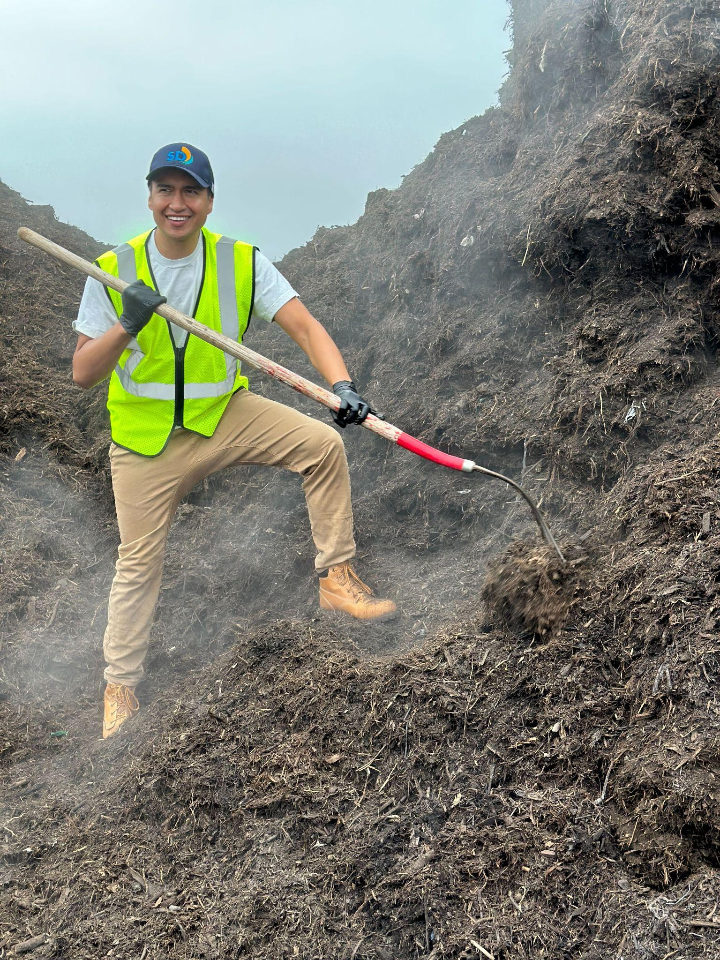
WFD Contracts for Climate Stewards
California Climate Action Corps
(pilot & expansion)
  Fall ‘21 - Proof of Concept 1-hour presentation for 30 Fellows
  Spring ‘22 - Piloted 2 back-to-back courses for 50 Fellows
  Fall ‘22 - Running 4 concurrent courses for 115 Fellows
  Fall ‘23 - Planning to run ~8 concurrent courses for 250 Fellows
Nick Vallejo tests compost temperature while working for the City of San Diego

Slide 31
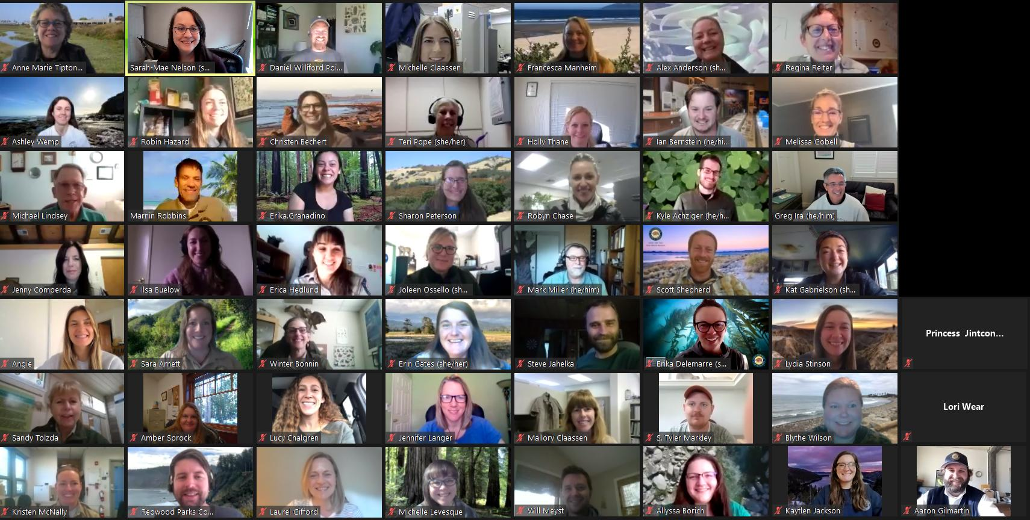
Other WFD efforts using Climate Stewards
California State Parks
  2021 - Pilot Training Course for 54 Parks Staff
  2023 - Planning to offer courses for Parks Staff across the state
CA Association of Environmental & Outdoor Educators (AEOE)
  Fall ‘22 - Climate Certification Module for EE Professional Certification course
CA State Parks Spring ‘21 Class Photo

Slide 32
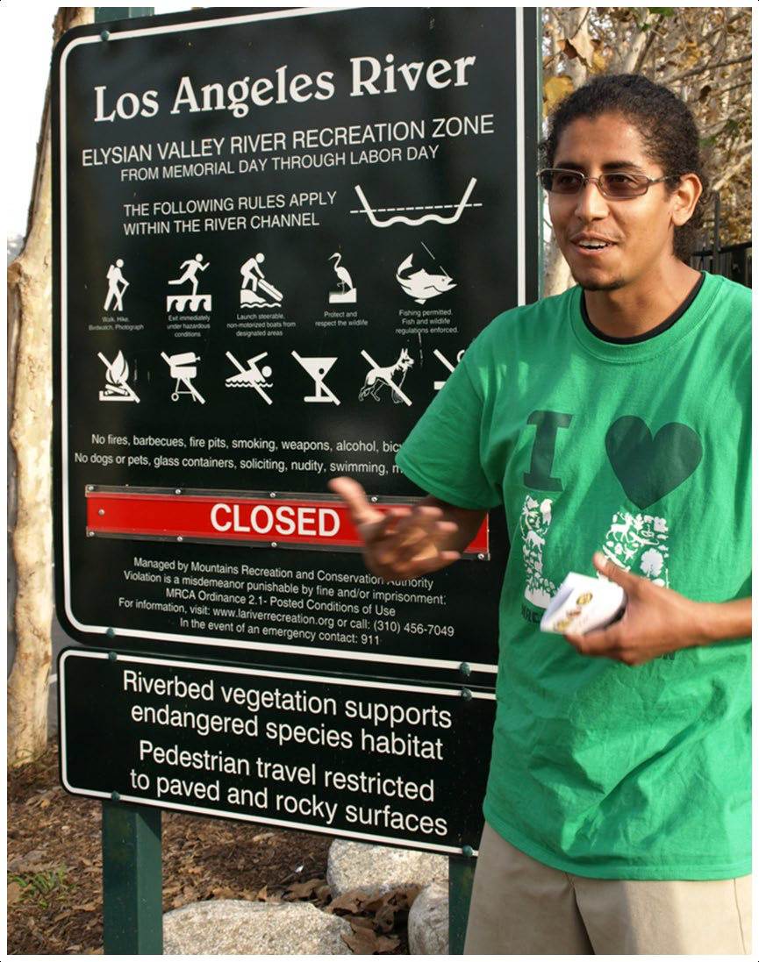
Benefits of Connecting with WFD Efforts
Broaden and diversify program audience
Provide individuals with knowledge, skills and attitudes that support personal, academic, and professional growth
Illuminate academic and professional pathways for young adults
Establish relationships with institutional partners with statewide coverage
Contribute to local and regional community economic development needs
Improve content alignment with employment opportunities and industry trends

Slide 33
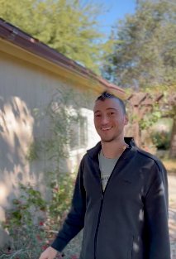
In the Media
Rachel Surls published an article in Civil Eats about the services that urban farms provide communities
Rob York discussed what he learned in the aftermath of the Mosquito Fire at Blodgett Forest with Cap Radio News & about prescribed fire with Mercury News/East Bay Times
Luca Carmignani was interviewed by Farmer Fred about wildfire preparation for Garden Basics podcast
The VINE’s FIRA ag robotics conference was showcased in several trade publications, namely AgNet West, AgAlert and Agri-Pulse
See more https://ucanr.edu/News/UC_ANR_in_the_news
Luca Carmignani
Photo by Mark Bell

Slide 34

#GivingTuesday, a global day of giving that harnesses the collective power of individuals to celebrate generosity worldwide.
#GivingTuesday is held annually on the Tuesday after Thanksgiving (in the U.S.) Kick off the holiday season with us!
Notes:
So…mark your calendars and Save-the-Date: Giving Tuesday on November 29th!
Giving Tuesday is a global movement inspiring millions of donors to give to thousands of non-profits around the globe.
These graphics are used by the global campaign, and you’ll see how we tailor some of these materials to build out our campaign.
ADVANCE SLIDE

Slide 35




START HERE
Get The Scoop eNews
eddelk@ucanr.edu
Campaign-In-A-Box
Register to participate
Notes:
Ok—so where do we start for Giving Tuesday?
1. Be sure you’re signed up to receive “The Scoop” eNews that has reminders, helpful hints, and links to tools you need. Please take a moment to send me an email so I can add your name to this mailing list. All CD’s and Program leadership are already signed up. But if there is anyone else on your team that needs to receive campaign info, please let me know and I’ll be sure they are added to the distribution list.
2. Register for participation in the campaign
WHO?—everyone! All County Extensions/RECs/Programs/Groups are asked to register their participation in Giving Tuesday.
WHY? To improve communication of campaign plans—making sure we get the tools into the people who really need them; and to help cross promote on all UC ANR social media platforms.
HOW? Look for The Scoop eNews in your email—click the link or forward to your campaign lead.
3. Available next week--UC Davis box link, you will find all the “Campaign-in-a-Box” materials.
ADVANCE SLIDE

Slide 36

PRIZE CHALLENGES!
$500 prize to the twenty funds that have the greatest number of unique donors
Donation Challenge
$500 prize to the first ten funds that secure an individual $500+ donation
In-It-To-Win-It Challenge
$500 prize to the ten funds that raise the most on GivingTuesday
Donor Challenge
4-H Match
$50,000 available for a 1:1 match starting at midnight
Notes:
And now, what we’ve all been waiting for…We want to introduce new Prize Challenges! Prize challenges are a fun and exciting way to boost donations on Giving Tuesday! In many cases, all you have to do is make a donation to help your Programs win some of the $20,000 in prizes that are made available from generous donations to the Incentive Fund. Please note that only online donations are counted toward prize challenges.
We want this campaign to be successful for you, so we have developed challenges to help reward efforts that will ultimately bring longer term success!
DONOR CHALLENGE: $10,000 up for grabs!
We'll award a $500 prize to the twenty funds that have the greatest number of unique donors for GivingTuesday.
DONATION CHALLENGE: $5,000 up for grabs!
We'll award a $500 prize to the first ten funds that secure an individual $500+ donation on GivingTuesday!
IN-IT-TO-WIN-IT CHALLENGE: $5,000 up for grabs!
We'll award a $500 prize to the ten funds that raise the most on GivingTuesday!
4-H Match: $50,000 up for grabs!
Donors to the CA 4-H Foundation are offering $50K in a dollar for dollar match starting at midnight until funds are depleted. This is the most ever offered in an incentive pool, so 4-Hers be sure to take advantage!
Challenge rules will be shared in The Scoop—so please look there for additional details. Good luck--and most importantly, have fun!
ADVANCE SLIDE

Slide 37
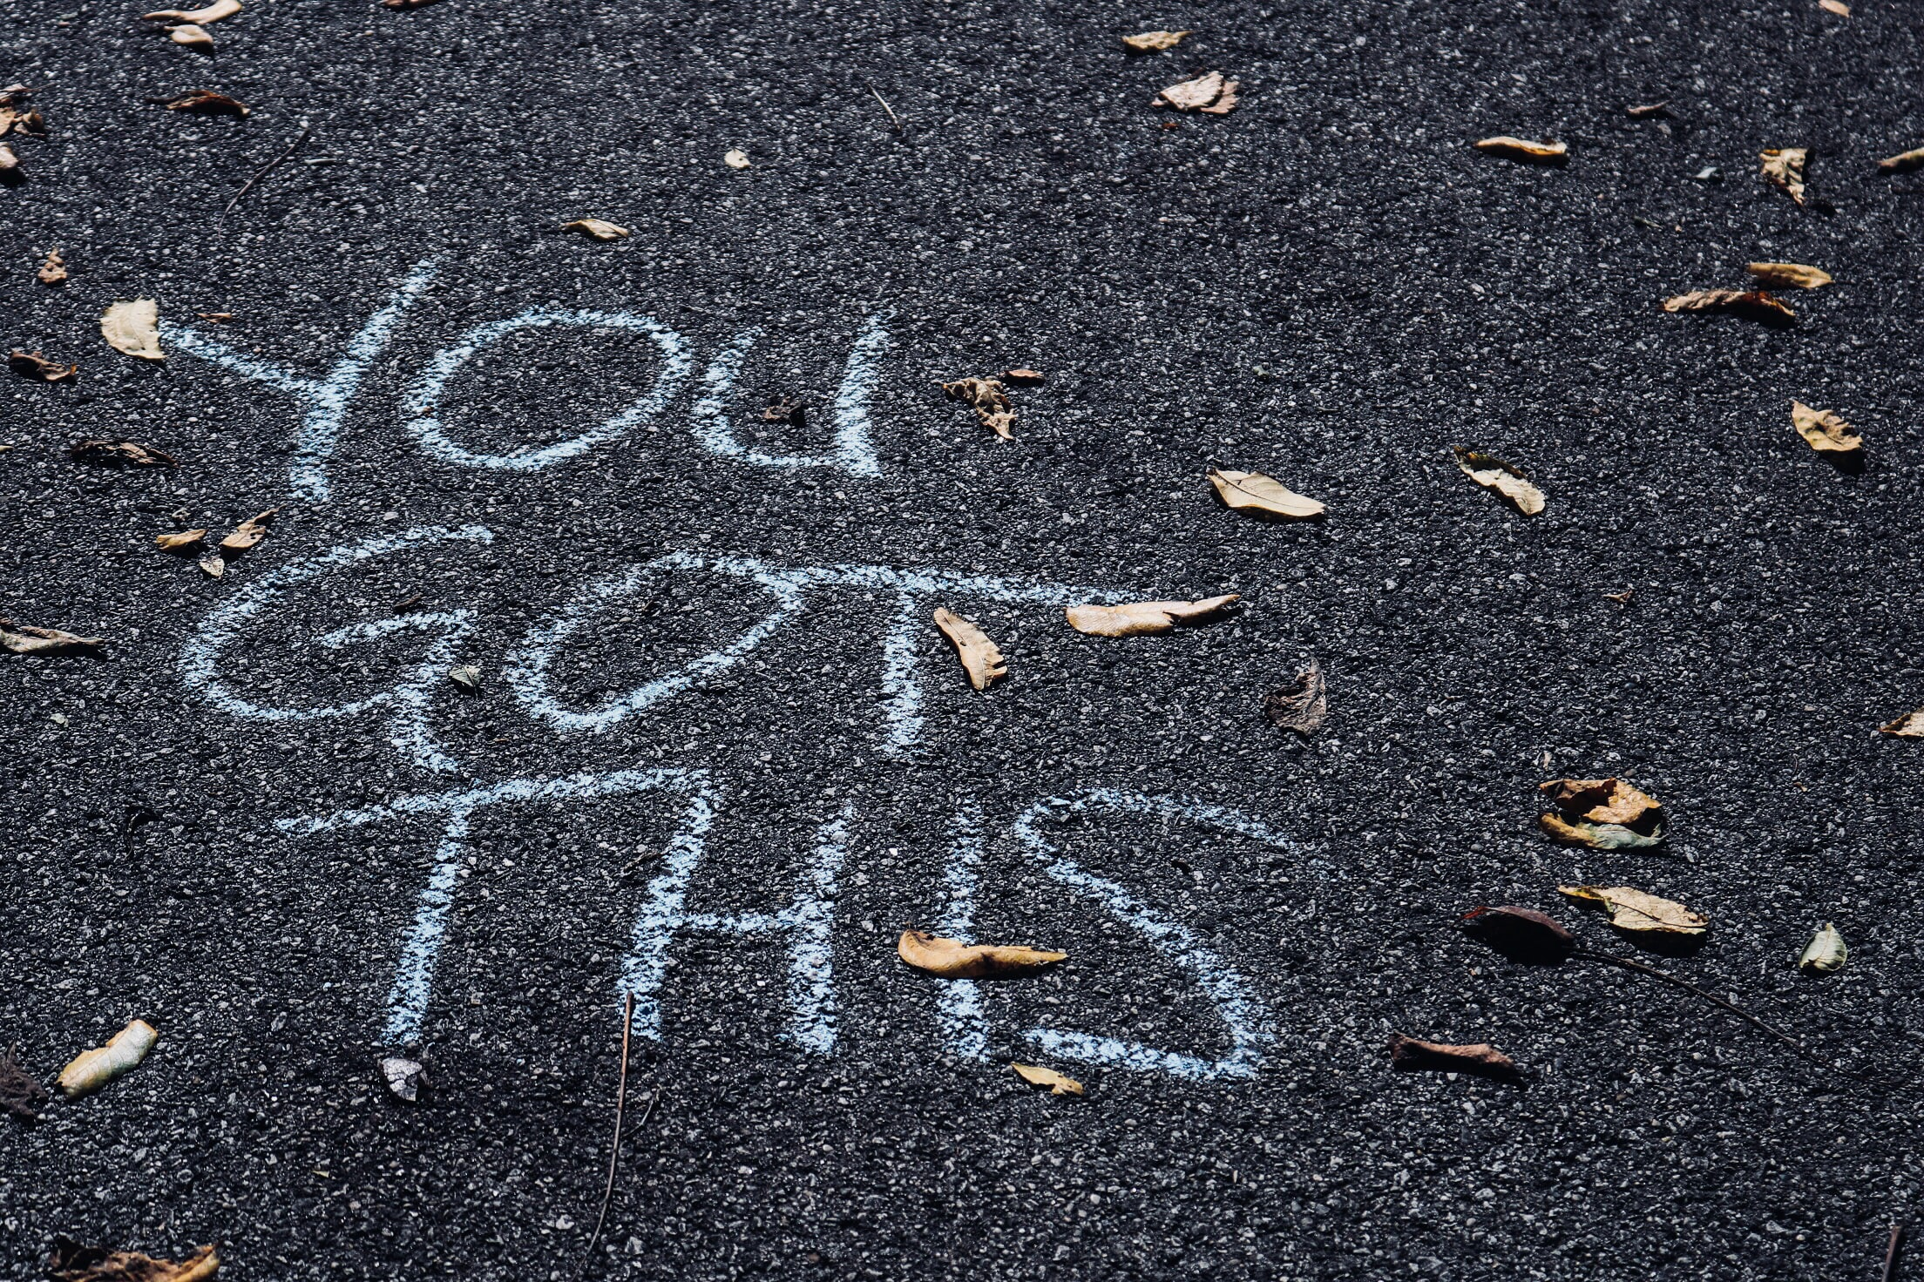
We’re Here to Help
Emily Delk
Dir. of Annual Giving
eddelk@ucanr.edu
916-564-4862
Dora Garay
Social Media Strategist
dgaray@ucanr.edu
510-630-5622
Tina Wikner
Fundraising Systems and Data Administrator
cwikner@ucanr.edu
415-420-5314
Notes:
Thanks again for your time today! We know you’ve got this—and we’re here to help! Contact information is on the screen, so please don’t hesitate to reach out.
Andrea is going to put a link in the Chat for a very short survey to gather your feedback to help us improve our webinars. So thank you in advance for taking a few minutes to share your input!
https://ucdavis.co1.qualtrics.com/jfe/form/SV_20oQcVnhI9kGvpb

Slide 38
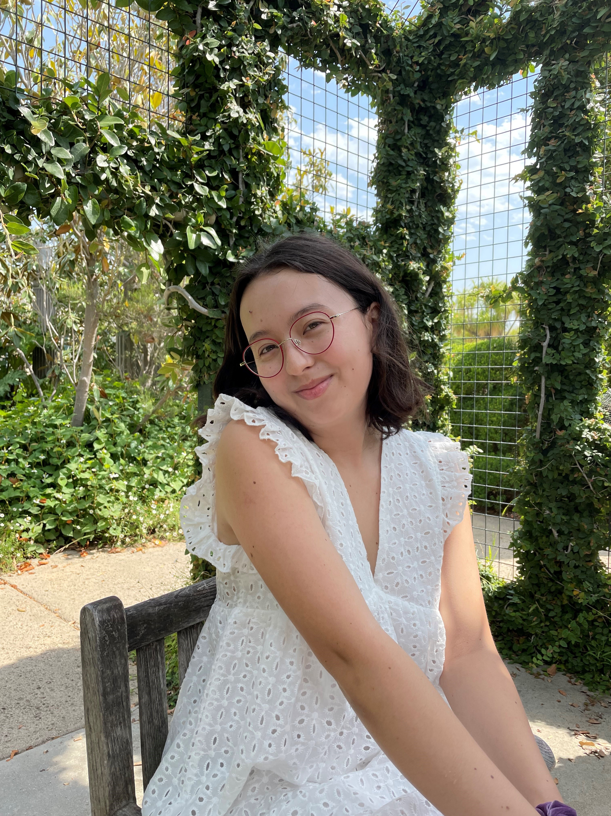
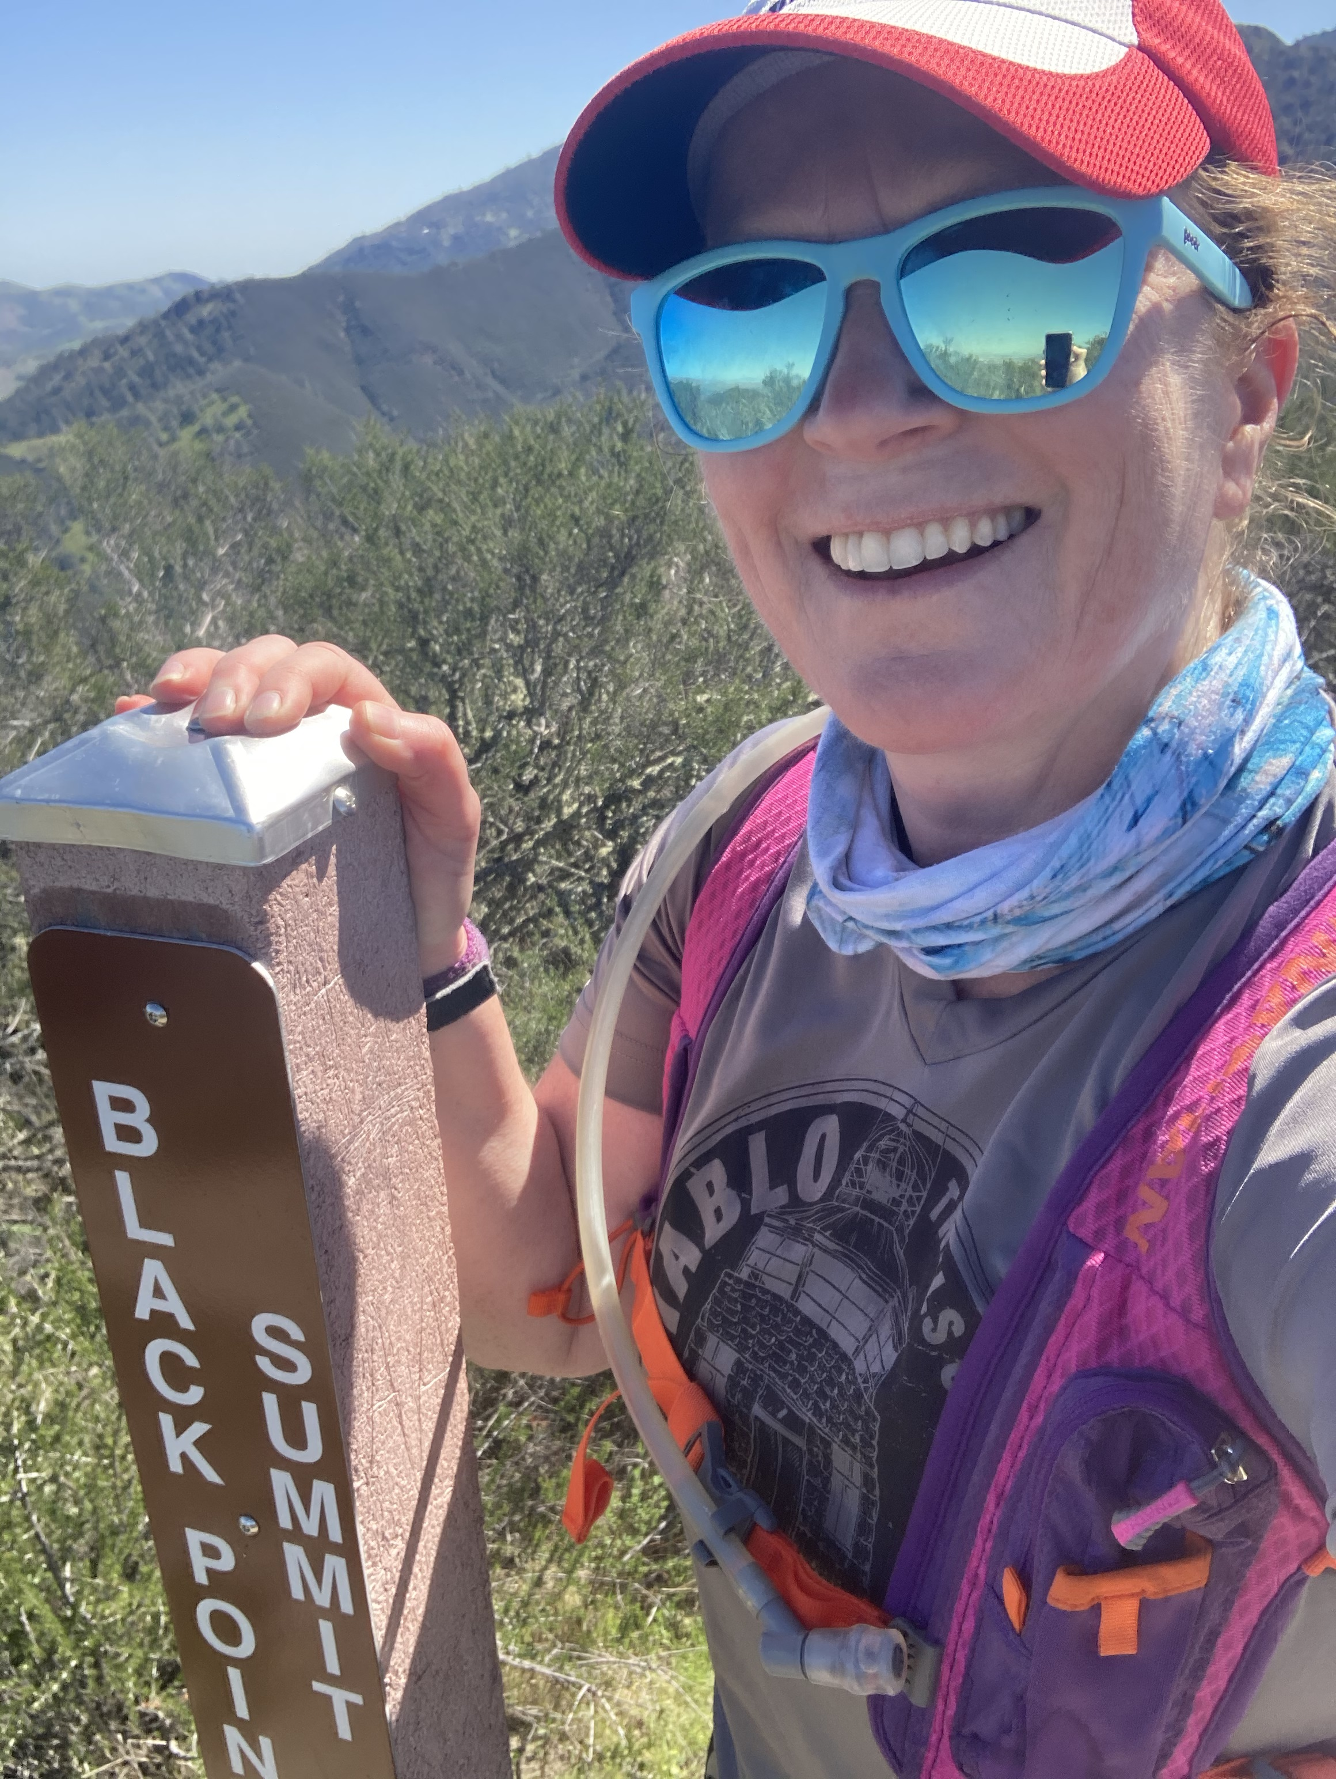
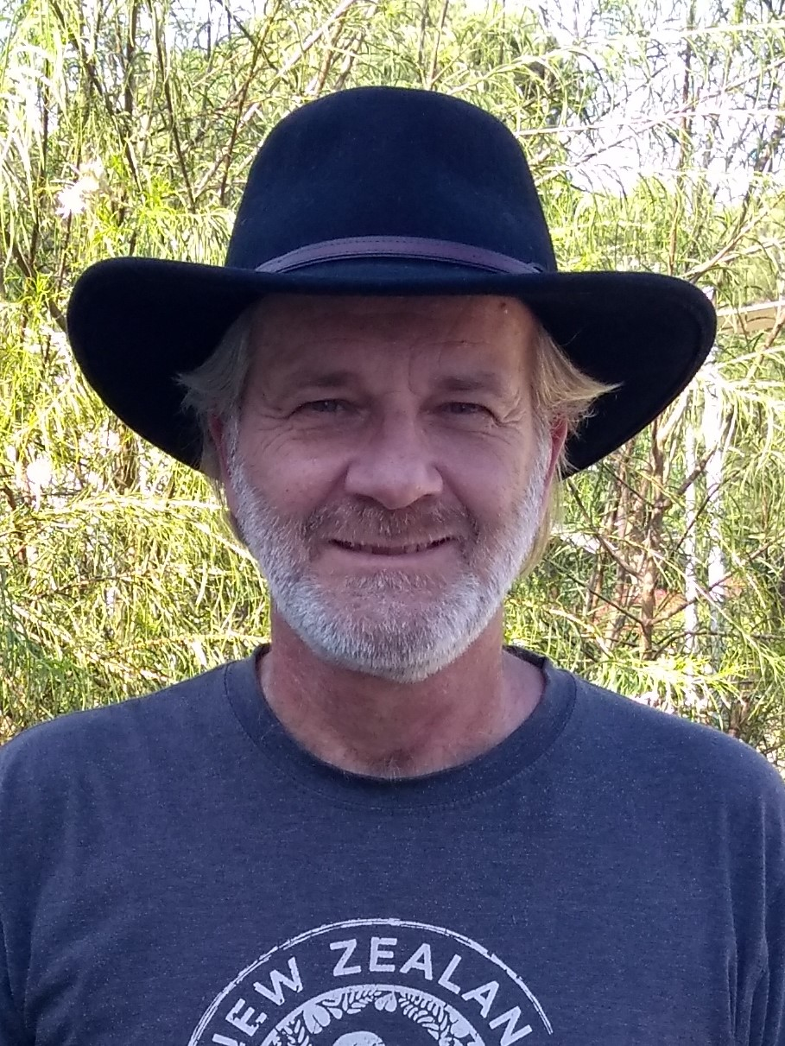
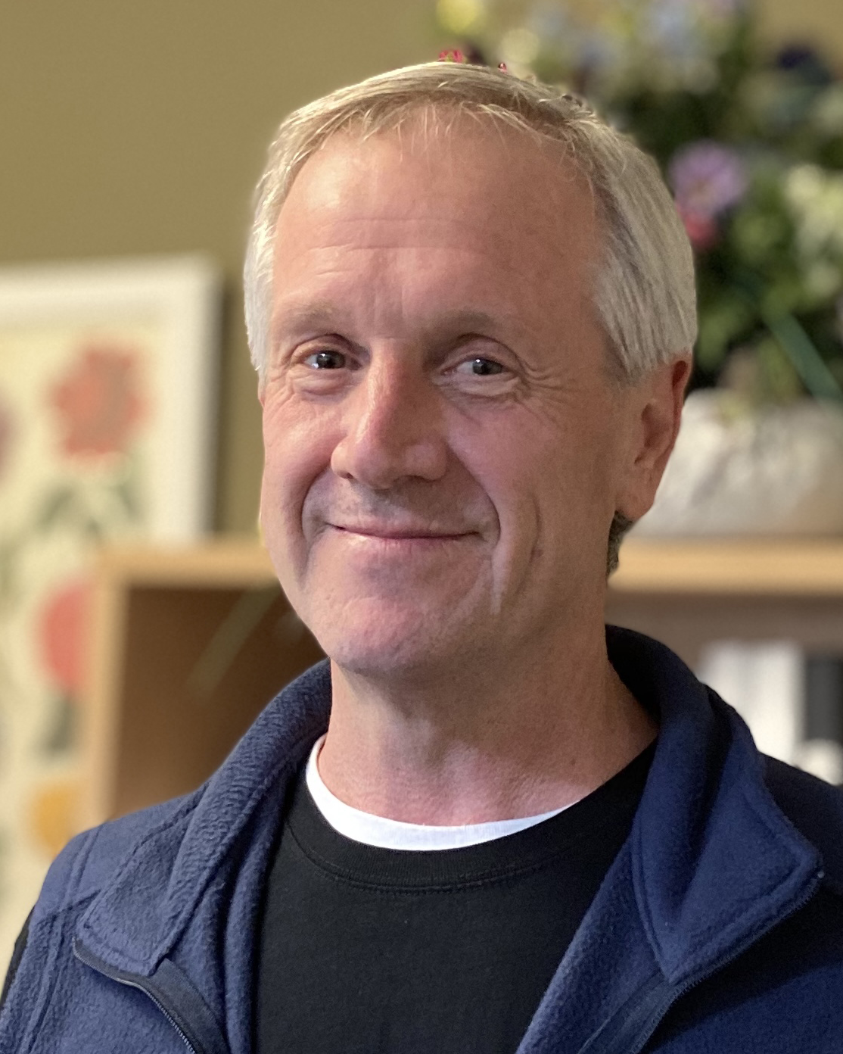
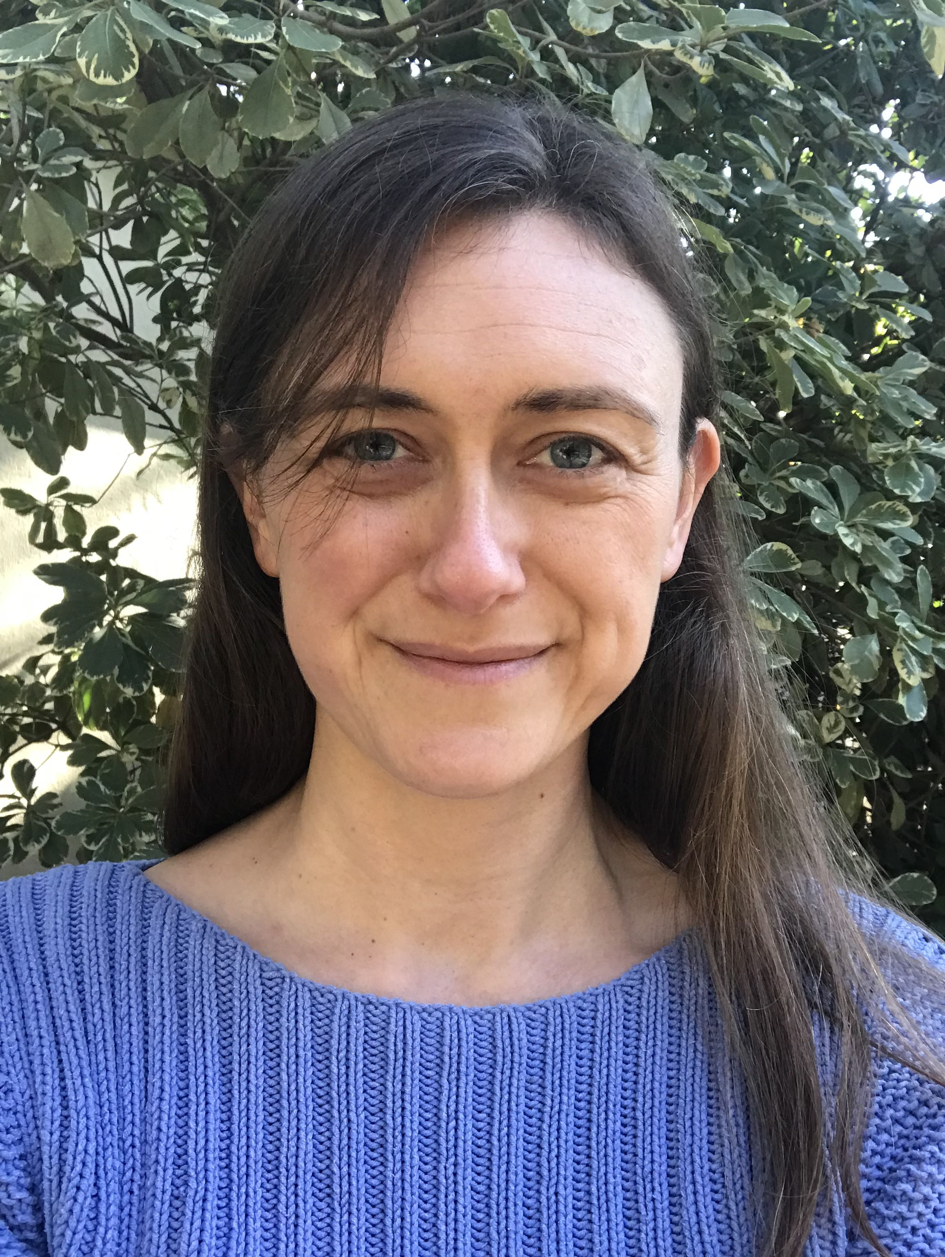
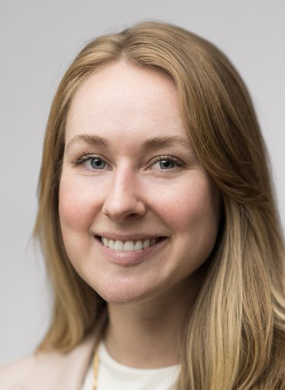
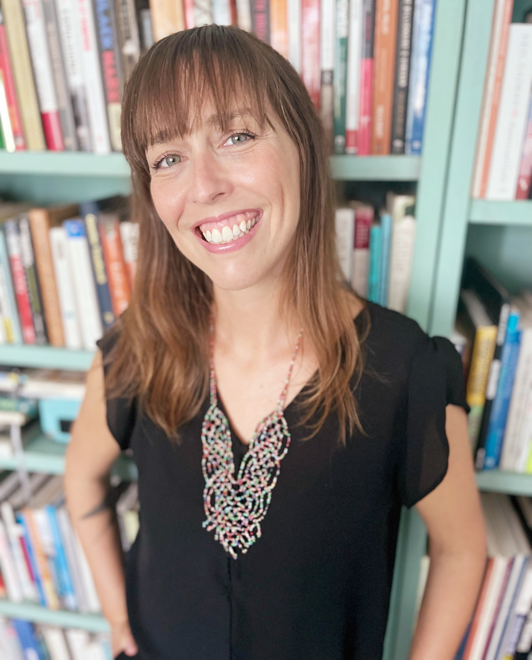
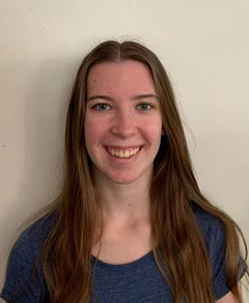
New October Hires: Welcome to UC ANR!
Kassandra A Bacon NUTRITION POLICY INSTITUTE
Jovani Belman-acevedo STATEWIDE IPM PROGRAM
Daisy Beltran ANR CE SPECIALISTS UCM
Namitha Bhat ANR CE SPECIALISTS UCM
Miles Bosarge SOUTH COAST REC
Samantha Rose Conselman STATEWIDE IPM PROGRAM
Yolanda Cruz UCCE SANTA CLARA COUNTY
Kristin Babson Dobbin UCB CNR ENV SCI, POLICY MGMT
Alec Devlin Dompka UCCE HUMBOLDT
Giselle Escobar UCCE CAPITOL CORRIDOR MCP
Maikon Figueredo Lemos KEARNEY REC
Abigail Marie Frolli LINDCOVE REC
Uriel Gonzalez IT SERVICES
Angelina Christine Gutierrez UCCE SAN MATEO COUNTY
Janessa Lee Hartmann UCCE SHASTA COUNTY
Janelle Hernandez BUSINESS OPERATIONS CENTER
Kevin Kamp UCCE CENTRAL SIERRA NEVADA MCP
Peter J Kelly III PROGRAM SUPPORT UNIT
Fatemeh Khodadadi UCR PLANT PATH & MICROBIOLOGY
Denisee Labrada UCCE IMPERIAL COUNTY
Rachel Elizabeth Lee PUBLISHING & PRODUCTION
Lorenzo Levinger UCCE MARIN COUNTY
Karen Looye UCCE SAN MATEO COUNTY
Mariette C Malessy PROGRAM SUPPORT UNIT
Stephanie Alexandra Mar SOUTH COAST REC
Krista Marshall STATEWIDE PROGRAMS
Cynthia Morales UCCE SANTA BARBARA COUNTY
Jennifer Neumann STATEWIDE IPM PROGRAM
Cuong Huu Nguyen UCCE IMPERIAL COUNTY
Adam Michael Novicki HANSEN REC
Claudia Pardo UCCE KERN COUNTY
Michelle Ann Ross UCCE CAPITOL CORRIDOR MCP
Hanah H Shih AG ISSUES CNTR
Kristen Shive UCB CNR ENV SCI, POLICY MGMT
Tyler Smith UCCE SAN DIEGO COUNTY
Joanna P Solins UCCE CAPITOL CORRIDOR MCP
Emma K Tribble STATEWIDE IPM PROGRAM
Itzel Uribe Torres UCCE SANTA CLARA COUNTY
Karyn T Utsumi CALIFORNIA NATURALIST PROGRAM
Joaquin Vega FACILITIES, PLANNING & MGMT
Anna Walden INTERMOUNTAIN REC
Heather Waller BUSINESS OPERATIONS CENTER
Yu-Chen Wang UCCE SANTA CRUZ COUNTY
Miranda Renee Westfall NUTRITION POLICY INSTITUTE
Rhiannon Willingham UCCE SAN DIEGO COUNTY
Brandon Wood BUSINESS OPERATIONS CENTER
Karyn T. Utsumi
Rachel Lee
Adam Novicki
PJ Kelly
Joanna Solins
Kassandra Bacon
Ashley Hooper
Mirjana Knepprath

Slide 39
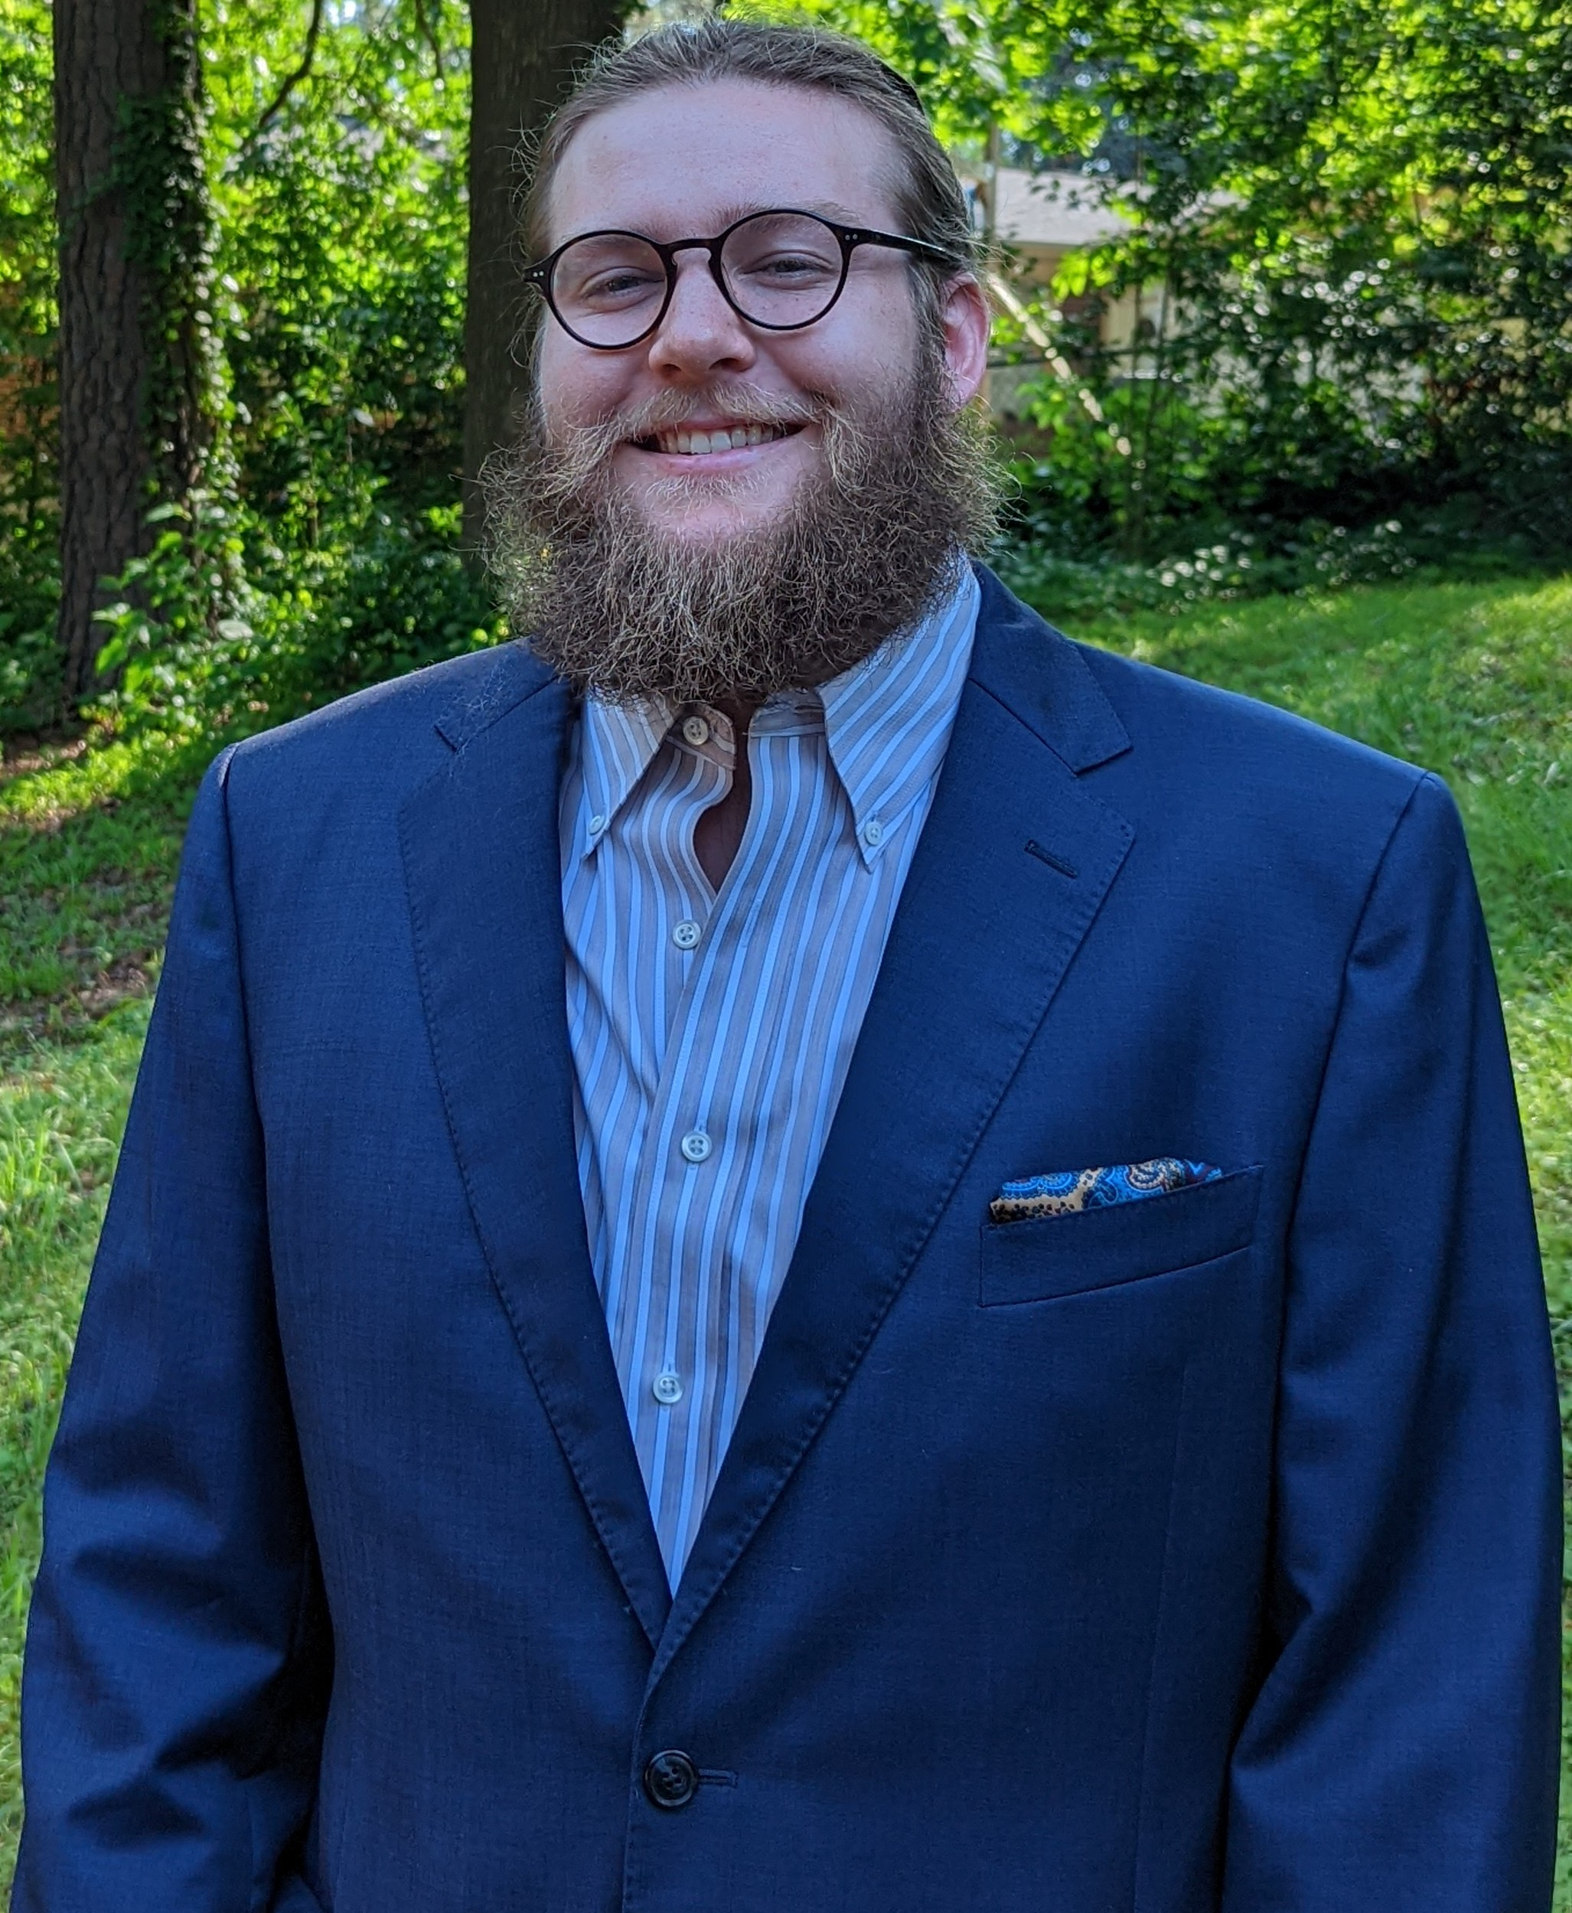
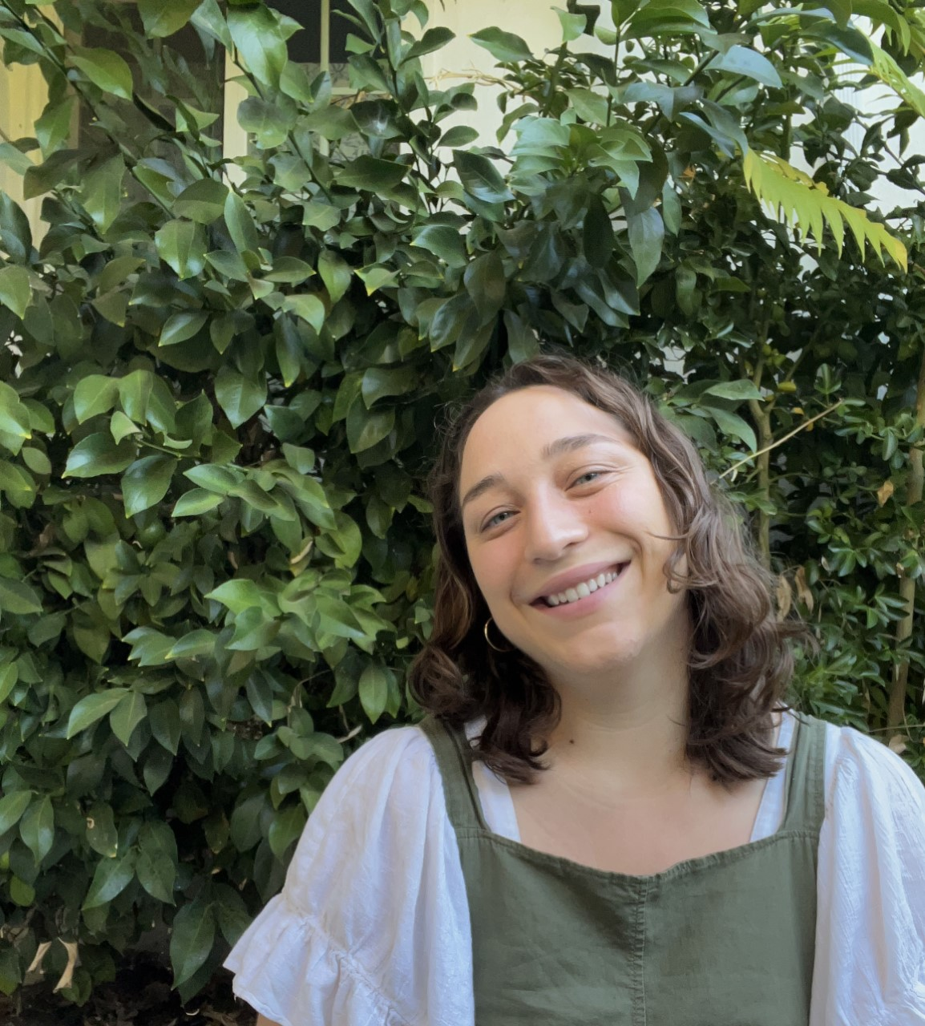
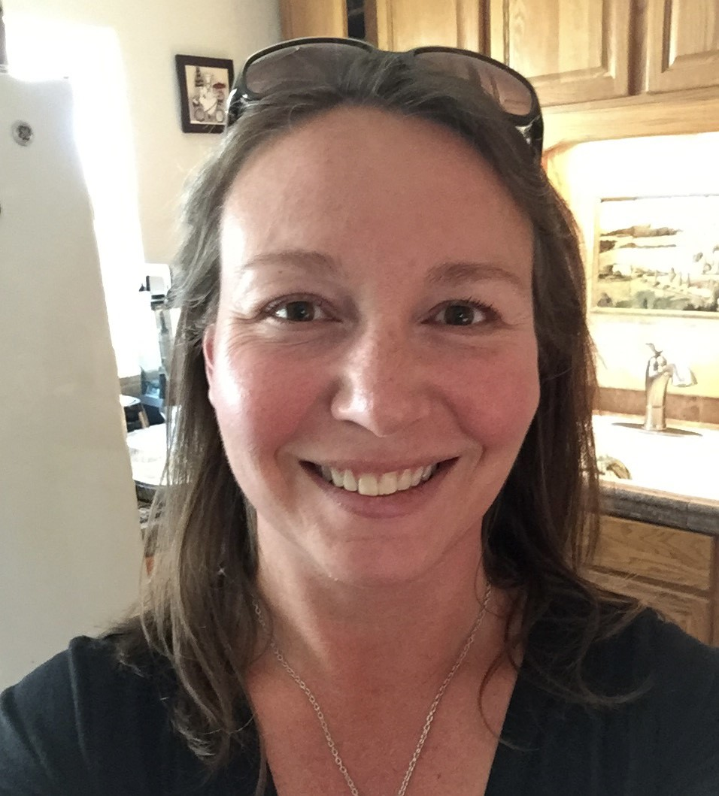
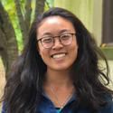
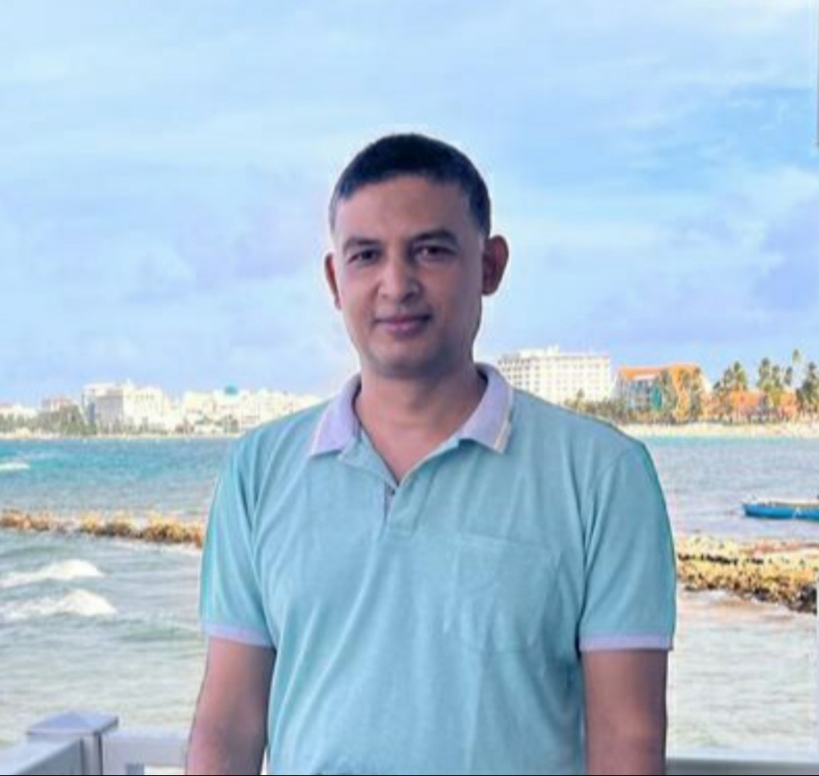
New November Hires: Welcome to UC ANR!
Jovani Belman-Acevedo STATEWIDE IPM PROGRAM ANR Emma Burt UCCE CENTRAL SIERRA NEVADA MCP
Lucie Cahierre VICE PRESIDENT PROGRAMS
Samantha Rose Conselman STATEWIDE IPM PROGRAM
Eve Solana Roxane Dowdell CALIFORNIA STATE 4-H OFFICE
Giselle Escobar UCCE CAPITOL CORRIDOR MCP
Taiyu Guan UCCE SUTTER/YUBA COUNTIES
Janessa Lee Hartmann UCCE SHASTA COUNTY
Prakash Kumar Jha ANR CE SPECIALISTS UCM
Mirjana Knepprath BUSINESS OPERATIONS CENTER
Zubia Mahmood UCCE SANTA CLARA COUNTY
Divyanshu Malik AG ISSUES CNTR
Juliana Martinez Hernandez IMM OFFICE OF HR
Jesus Montejano UCCE MONTEREY COUNTY
Jennifer Neumann STATEWIDE IPM PROGRAM
Cuong Huu Nguyen UCCE IMPERIAL COUNTY
Mikele Olson-Calbert UCCE CONTRA COSTA COUNTY
Skylar Peters SW MSTR GARDENER PROGRAM
Michelle Ann Ross UCCE CAPITOL CORRIDOR MCP
Michael Ryan UCCE CAPITOL CORRIDOR MCP
Mea van Staden UCCE ALAMEDA COUNTY
Anna Walden INTERMOUNTAIN REC
Zubia Mahmood
Alec Devlin Dompka
Emma Burt
Mikele Olsen-Calbert
Stephanie Mar
Prakash Kumar Jha

Slide 40
Closing
❅
❄
❅
❅
❅
❄
Open Enrollment ends tomorrow, Friday, November 18 at 5 PM
Visit https://ucnet.universityofcalifornia.edu/oe to submit your benefits choices.
❅
Winter Fair – Thursday, December 15
UC ANR's Winter Faire will be in place of December's Town Hall.
Volunteers are sought to help us plan for fun activities!
Email anrprogramsupport@ucanr.edu if interested in volunteering.
❅
❅
Thanks to our speakers and to you all!
Recordings of meetings posted at https://ucanr.edu/sites/anrstaff/All_Hands
Stay safe & have a Happy Thanksgiving next week!

