Slide 1
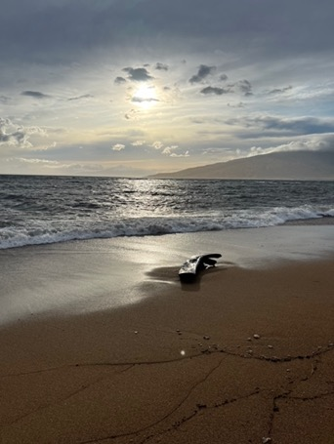
Town Hall
2-3 pm, July 21, 2022
Chat warm up
Learning about each other
What is your favorite summer food?
Agenda
Welcome
Leadership Update
Stories from the Field
Strategic Element
Wellness Break
Around UC ANR: Other updates
Close

Slide 2
Objectives: To inform and build unity
Why this meeting? It’s for all of us.
Comments…. Use “Chat”
“Panelists” or “Everyone”
Questions…. Use “Q&A”
Recordings are posted after the meeting on the Town Hall page

Slide 3
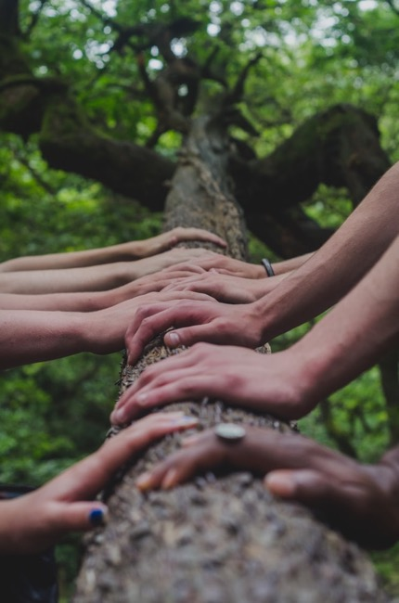
Our Principles of Community
Invest in _________
all members
Photo by Mark Bell
Notes:
all members

Slide 4
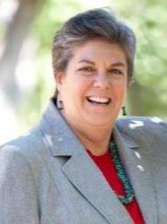
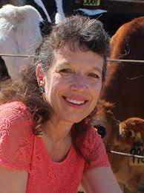
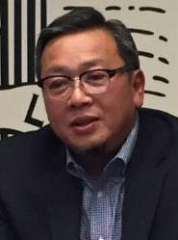
Leadership Update
Leadership Transitions - Kathy Eftekhari
Real Estate Transaction Update - Tu Tran
Legislative UC Budget Update - Anne Megaro
Notes:
2 min. Kathy; 5 min. Tu; 3 min. Anne

Slide 5
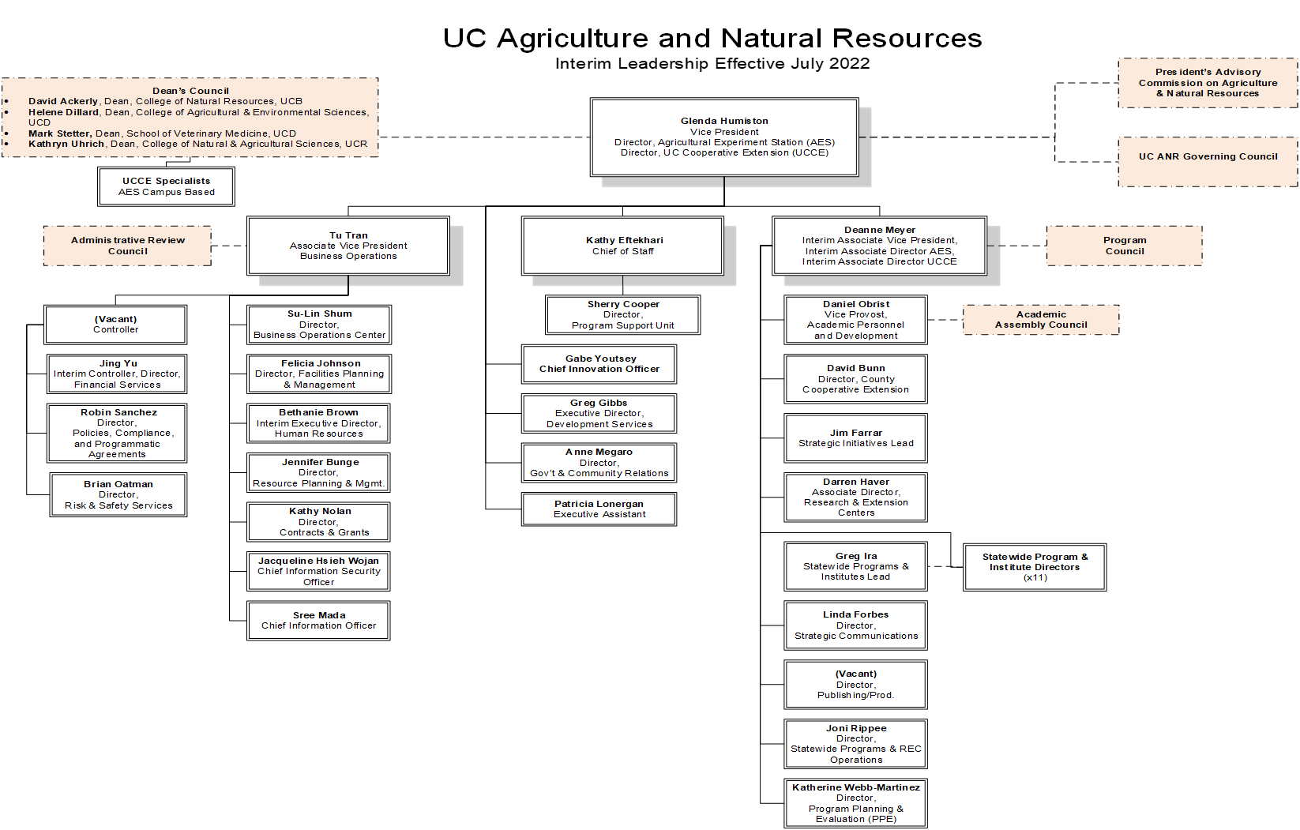

Slide 6
ANR TOWN HALL PRESENTATION
AVP Tu M. Tran
July 19, 2022
Notes:
Jennifer bunge

Slide 7
UC ANR LAND TRANSACTIONS & FACILITY DEVELOPMENTS
Land Transactions & Facility Developments | Updates
Land Transactions:
3031 2nd St Lot sale | Sold 6.6 acres to USDA ARS for $4.3M, potential opportunity for research partnerships Remaining 4 acres retained for future development for UC ANR purposes
UC ANR South Coast REC and UC Irvine North Irvine Staff Housing (NISH) | UC ANR to transfer 40 acres to UC Irvine from the current 200 acres at SCREC UC Irvine plans to provide 1,800 housing units to address staff housing needs Feasibility of increasing density is under consideration
Hansen REC Sale and New Acquisition | Sold Faulkner farm for $3.7M and Saticoy property for $10.5M Acquiring 114 acre Beardsley property for $9.6M, in due diligence period Executed purchase sales agreement, currently working on due diligence
Facility Developments:
South Coast REC – New Educational Building | $7.2M budget, 10,000 gross square feet Planning committee identified, and consultants are conducting site analysis and facility programming review
Desert REC – New Regional Research and Learning Center | $5.4M budget, 7,500 gross square feet Planning committee identified, and consultants are conducting site analysis and facility programming review
Elkus Ranch – Emergency Response Infrastructure | $3M budget to repair and pave roads, upgrade water distribution system, and CEQA effort initiated
Lindcove REC – Citrus Center | Consultants developing building concepts for existing Youth Experiential Lab and new Ray Copeland Citrus Center to accommodate 300 guests

Slide 8
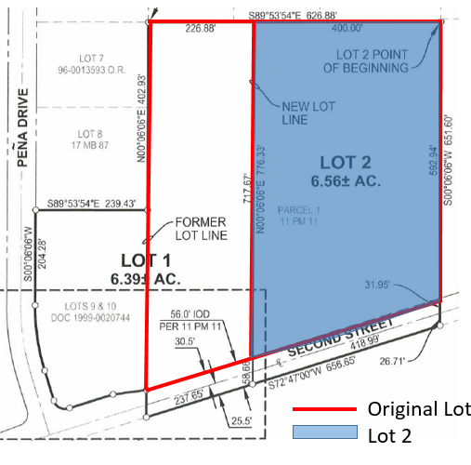
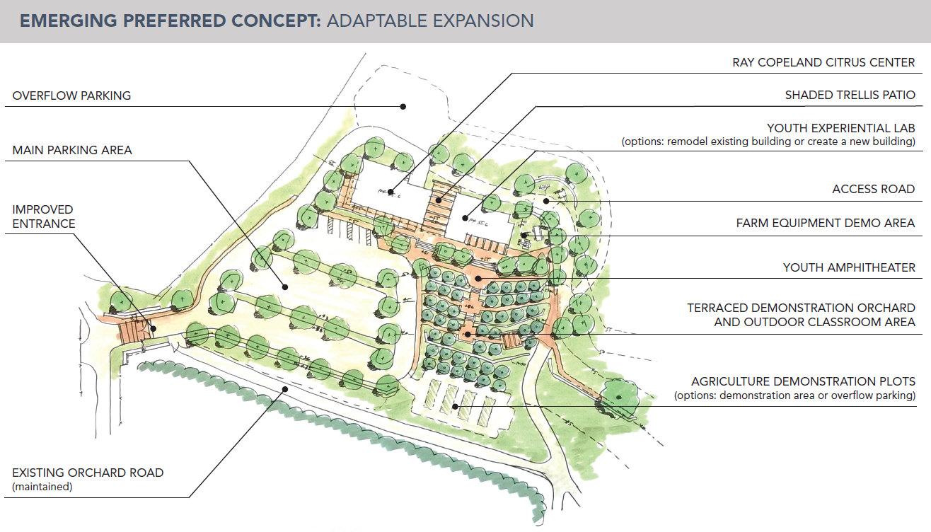
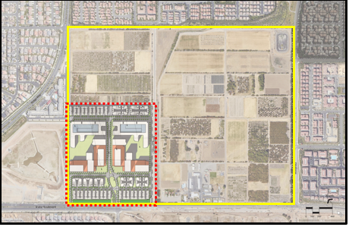
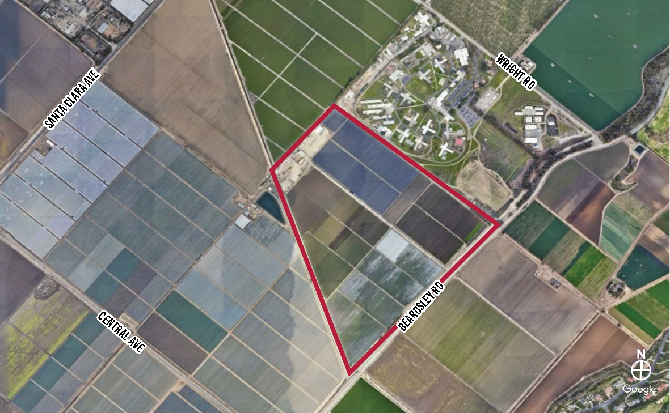
UC ANR LAND TRANSACTIONS & FACILITY DEVELOPMENTS
3031 Second St
Lindcove REC
Southcoast REC and UC Irvine
Beardsley Property

Slide 9
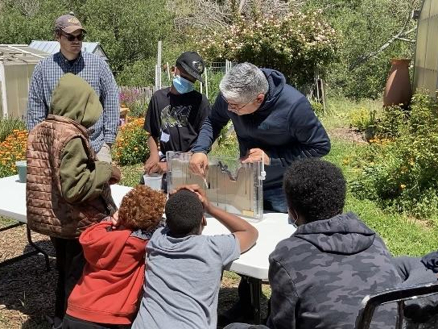
Stories from the field
UC ANR 4-H Water Wizards
4-H Water Wizards is part of a larger UC Davis-led research project to find ways to sustain irrigated agriculture while improving groundwater quantity and quality in the Southwest under a changing climate.
Frank McPherson, Director, Bay Area UCCE
Notes:
5 min.

Slide 10
Our Public Value Statements
Safeguarding abundant and healthy _____ for all Californians.
food
Notes:
food

Slide 11
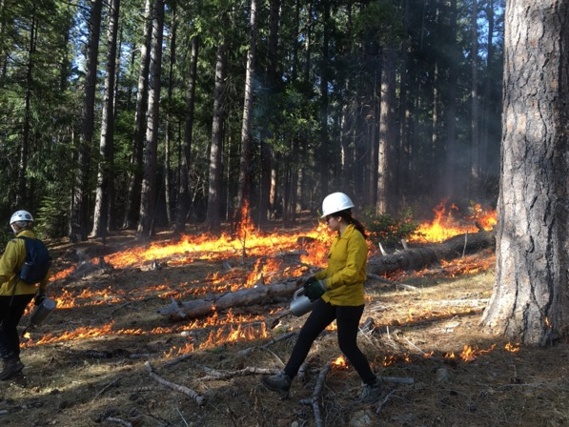
In the Media
Lenya Quinn-Davidson was quoted in an NPR story on prescribed fire
Susie Kocher was quoted in a story on drought and fire in Yahoo and The Los Angeles Times
A story on Latino gardeners that quoted Rachel Surls was picked up by multiple out-of-state outlets
Multiple national outlets ran UC ANR content on drought-tolerant gardening
Photo by Mark Bell

Slide 12

Wellness break. Practicing what we preach.
David Ritz

Slide 13
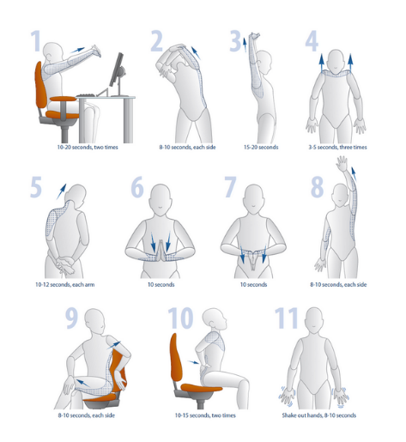
Remember to stretch
10, 2 and 4 stretches
https://safetyservices.ucdavis.edu/units/occupational-health/ergonomics/office-computer/stretches
Notes:
10, 2 and 4 stretches, https://safetyservices.ucdavis.edu/units/occupational-health/ergonomics/office-computer/stretches

Slide 14


Ombuds Office Come with a problem. Leave with a plan.
Lindsey Dunning, Associate Ombuds

Slide 15

Overview and Mission Statement
The Ombuds Office serves UC Davis, UC Davis Health, and UC Agriculture and Natural Resources as an off-the-record resource to develop strategies for navigating complex and costly conflict. The Ombuds Office supports fair and collaborative professional and academic experiences in a diverse and changing world. The mission of the Ombuds Office is to provide a safe place for all members of the UC Davis and UC ANR communities to discover pathways for conflict management and problem solving.

Slide 16



Stages of Conflict Escalation
Battle
No communication
Acting out, sabotage
Anger, fear, depression
Challenge
More people, gossip
Increased intensity, blaming
“Always,” “never”
Irritant
Unreliable, miss deadlines
Lack of recognition for contributions
Arrogant, sarcastic, abrasive

Slide 17
Reach out to us when you experience:
Common Concerns
Conflicts concerning behavior of colleagues or volunteers
Concerns around discrimination, harassment, or abrasive conduct*
Difficult group dynamics
Career/Advancement issues
Complaint processes
Handling difficult behavior
*Off-the-record resource

Slide 18
Guiding Principles
Confidential
Impartial
Informal
Independent
International Ombuds Association Ethical Principles

Slide 19
The Ombuds Office Can Help:
Sort through and untangle problems
Identify underlying needs
Generate options to effectively address issues
Weigh risks, rewards, costs, and benefits
Gain a new, neutral perspective
Learn about possible campus resources and policies
cc: Ren Ran - https://unsplash.com/@renran?utm_source=haikudeck&utm_medium=referral&utm_campaign=api-credit

Slide 20





Ombuds Services
Individual Meetings
Mediation and Group Work
Community-Wide Workshops and Tailored Trainings
Information Sessions
Systemic and Trend Feedback

Slide 21
Conflict Competence Workshops
Getting to the Root of Group Conflict
October 20, 2022, 9am – 11am
June 6, 2023, 10am – 12pm
Conflict Competence for Staff
November 3, 2022, 9am – 12pm
March 16, 2023, 9am – 12pm
From Bystander to Upstander
February 28, 2023, 9am – 11am
Constructive Feedback for Positive Change
December 7, 2022, 9am – 11am
April 12, 2023, 9am – 11am
Conflict Competence for Managers and Supervisors
August 18 & 25, 2022, 8:30am – 12pm
January 26 & February 2, 2023, 8:30am – 12pm
Listening to Be Heard
September 13, 2022, 9am – 11am
May 3, 2023, 9am – 11am
Creative Problem Solving in the Workplace
September 27, 2022, 12pm – 1pm
February 15, 2023, 12pm – 1pm
To register or find additional dates, visit lms.ucdavis.edu.

Slide 22
“Conflict competence is the ability to develop and use cognitive, emotional, and behavioral skills that enhance productive outcomes of conflict while reducing the likelihood of escalation or harm. The results of conflict competence include improved quality of relationships, creative solutions, and lasting agreements for addressing challenges and opportunities in the future. As with all competencies, people can learn ways to improve, change, and develop.”
Mediation Training Institute, Conflict Dynamics Profile, Eckerd College Leadership Development Institute, http://www.conflictdynamics.org/blog/2013/11/conflict-competence/, 2021.

Slide 23
Ombuds Office
Come with a problem. Leave with a plan.
For a phone or Zoom appointment, call:
530.754.7233
For additional information, please visit our website: ombuds.ucdavis.edu
A note about email: To protect confidentiality, the Ombuds does not keep records. The best way to schedule is by phone, but if you choose to email we do not retain the email or respond to content.

Slide 24

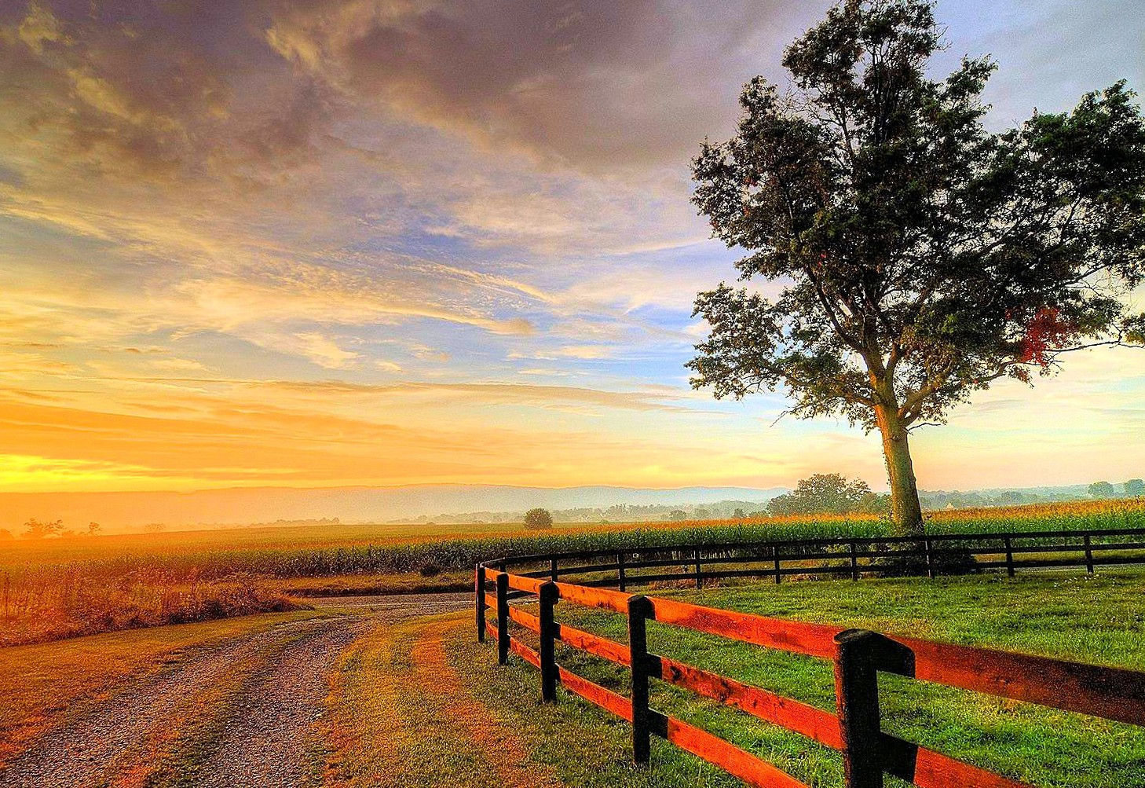
Around UC ANR: Other updates
2022 ANR@work survey
Tina Jordan
To be released week of July 25!
Survey closes at 11:59 PM, Aug. 19
All academics and staff are invited to provide feedback about their experience working at UC ANR.
Chance to win one of forty $75 gift cards!
Look for your unique invitation email - don’t delete it!
Responses are anonymous.
If you have questions about the survey, please contact satsurvey@ucanr.edu.

Slide 25
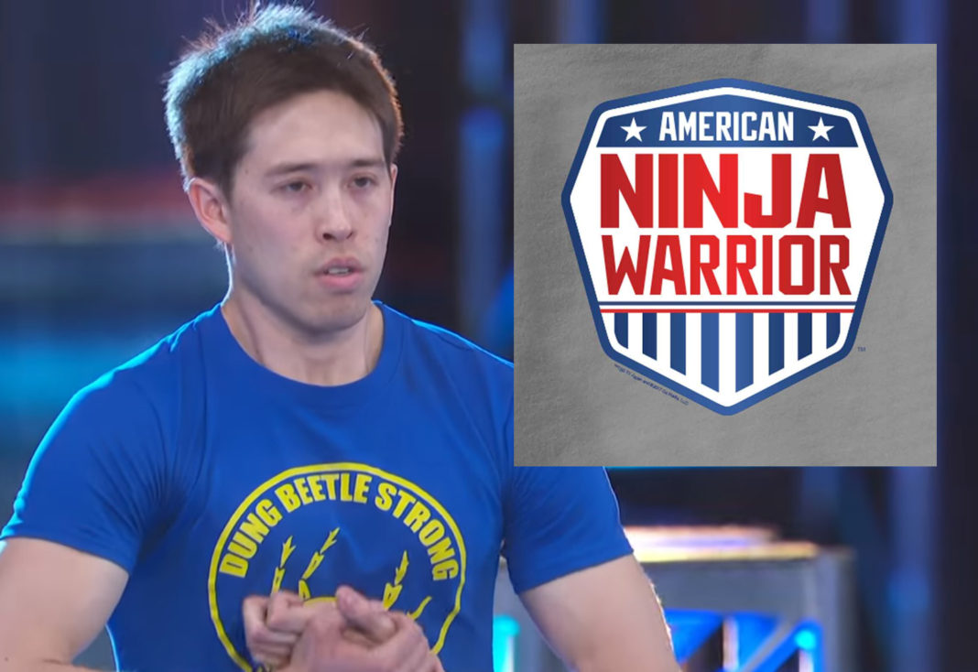
Recent Hires: Welcome to UC ANR
Clarissa Jayde Abarca
Kenneth Abeloe
Omar Abulghanam
Jude Al Abosy
Ingrid Alarcon
Leslie Alfonso
Brian Allen
Victoria Arana
Juan Armendariz
Jackie Atim
Matthew Avila
Kareena Barboza
Serena Brady
Alexander Bush-Chavey
Amber Butland
Gabriela Caceres-Fernandez
Luca Carmignani
Natalie Conrad
Maisie Cousins
Kenna Elliott
Kristen Farrar
Xuewen Feng
Ron Filson
Mariana Garcia
Clebson Goncalves
Benjamin Halleck
Maddy Hamman
Jerry Harris
Joy Hollingsworth
Heather Johnson
Desert REC
UCCE Stanislaus County
UCCE Fresno Madera
Nutrition Policy Institute
UCCE Los Angeles County
UCCE Stanislaus County
UCCE Central Sierra
UCCE Marin County
UCCE Riverside County
UCCE Specialist UC Merced
UCCE Stanislaus County
Statewide Program Operations
Imm Office Of HR
UCCE San Joaquin County
UCCE Fresno Madera
Program Support Unit
South Coast REC
IT Services
UCCE Butte
UCCE Riverside County
Sustainable Ag Research & Education
Statewide IPM Program
UCCE Marin County
UCCE Central Sierra
UCCE Lake County
UCCE Fresno Madera
UCCE Modoc County
UCCE San Luis Obispo County
UCCE Tulare County
UCCE Ventura County
Alexandra Kopatsis
Brian Krall
Anna Lee
Isabel Lizarraga
Andrew Nicholas Lopez
Jose Lopez
Sonia Luna
Breanna Martinico
Jonelle Mason
Jennifer Mendes
Eric Middleton
Heather Moore
Brooke Morris
Sarah Neukrug
Rose Olivas
Irene Padasas
Richard Pulvera
Makelle Pustejovsky
Sara Qaderi
Filiberto Ramirez
Jose Ramirez
Jennifer Ramirez
Cecilia Ramos
Rosemary Renteria
Ana Resendiz
Leslie Rivas Alvarado
Jeannine Roberts
Theresa Rodriguez
Stephany Roldan
Nutrition Policy Institute
Facilities, Planning & Mgmt
Imm Office Of HR
UCCE Monterey County
UCCE Santa Clara County
UCCE Stanislaus County
UCCE Kern County
UCCE Napa County
UCCE Tehama County
California State 4-H Office
UCCE San Diego County
IT Services
UCCE Stanislaus County
Nutrition Policy Institute
UCCE Riverside County
UCCE Tulare County
Nutrition Policy Institute
UCCE Modoc County
UCCE Fresno Madera
Kearney REC
Kearney REC
UCCE Stanislaus County
UCCE Kern County
Business Operations Center
UCCE Imperial County
Nutrition Policy Institute
UCCE Central Sierra
Sierra Foothill REC
UCCE Fresno Madera

Slide 26

Recent Hires: Welcome to UC ANR continued
Nanding Ross
Jonathan Ruiz
Richard Saldate
Lisandro Santiago Cruz
Barb Satink Wolfson
Rachel Shellabarger
Christopher Shogren
Hardeep Singh Khushwinder Singh
Tyler Smith
Saoimanu Sope
Kevin Stapleton
Mat Talton
Jaedyn Tapia
Brenda Thomas Gould
Itzel Uribe Torres
Josefina Vallejo
Kaomine Vang
Elise Vasquez
Carolyn Warne
Diedra Werner Liske
Hope Zabronsky
Cameron Zuber
UCCE Capitol Corridor
UCCE Kings County
UCCE Fresno Madera
UCCE Sonoma County
UCCE San Benito County
California Institute For Water Resources
UCCE Los Angeles County
UCCE Central Sierra
UCCE Fresno Madera
UCCE San Diego County
Strategic Communications
Statewide IPM Program
UCCE Capitol Corridor
South Coast REC
UCCE Los Angeles County
UCCE Santa Clara County
Intermountain REC
Kearney Agricultural Center
UCCE Monterey County
Development Office
UCCE Central Sierra
California Institute For Water Resources
UCCE Merced County

Slide 27
Closing
Stay safe & well
Thanks to our speakers and to you all.
Next Town Hall
September 15
(3rd Thursday @2 pm )
Photo Mark Bell
Notes:
MARK - may have extra time. Wendy manages town hall; anyone from leadership like to share/answer any of the Q&A questions?
Remind that Q&A will be posted
Next town hall date

Slide 28
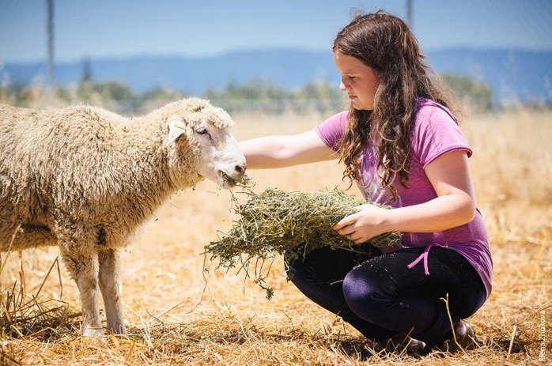

Making connections
10-minute breakout groups
Introduce yourself and your role
What’s one thing you love about your work?
Notes:
Sept 22 breakouts

Slide 29
Summary - this slide not shown
Welcome - Pam 2-3 minutes
Principles of Community question
Leadership Update (10-15 minutes) (Tu, Deanne, Kathy) Transition
Story from the Field
Water Wizards - Frank McPherson (to be confirmed or 3 min. video)
PVS question (1 minute) (Pam)
In the media (1 minute) (Pm)
Donor note (1 minute)
Wellness break (1 minute) (C/- David Ritz)
Strategic focus (10-15 Minutes) Ombuds - Lindsey Dunning
Other updates
ANR@Work survey Tina Jordan
New hire list (1 minute)
Close Pam (1 minute)

Slide 30
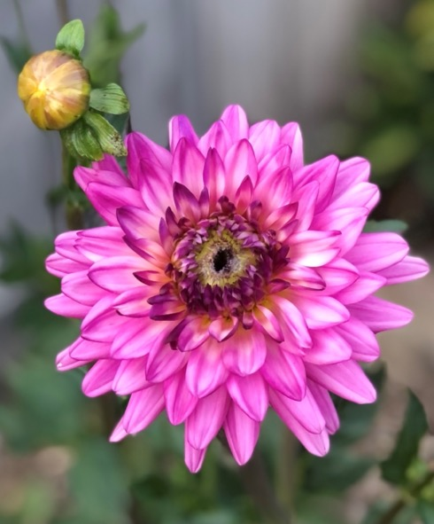
Feedback from supporters
“With my thanks and gratitude to all the fantastic LA County MG's...you have changed my life!”
- Susan M., West Hills, CA
Photo by Emily Delk
Notes:
Pam to invite Greg Gibbs

Slide 31
Our Public Value Statements
Safeguarding abundant and healthy _____ for all Californians.
Photo by Mark Bell
Notes:
food

