Slide 1
Master Gardeners
of Placer County
Helping home gardeners
make informed decisions
by sharing research-based information

Slide 2
Welcome to our Placer Master Gardener Workshop via Zoom
This presentation will be recorded and linked on our website, pcmg.ucanr.org.
Audience participants will be muted and video will be turned off.
Q&A: Send questions in chat window. They will be answered at the end of the presentation.
Windows/Mac: Click ‘Chat’ in the Zoom controls at bottom of screen.
Android Phone: Click ‘More’ at the bottom of the screen, then click on Chat.
iPhone or iPad: Controls appear at the bottom or top of your screen,
click on “…” then on Chat.
Presentation will begin soon.

Slide 3
Welcome to our Placer Master Gardener Workshop via Zoom
This presentation is designed for Placer County gardeners (Sunset zones 14, 9 or 7.)
If you live in a different climate zone, you may need to adapt some of the information provided here. Contact your local Master Gardener program for help.

Slide 4
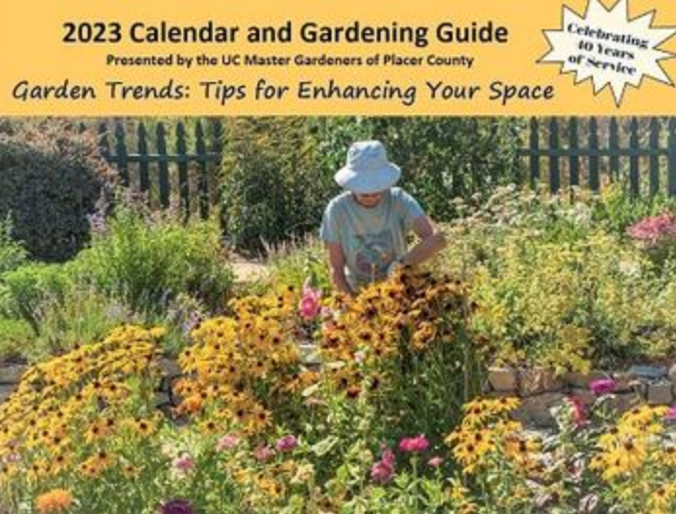
Welcome to our Placer Master Gardener Workshop via Zoom
2023 Calendar & Gardening Guide
The 2023 Calendar and Gardening Guide
introduces the latest garden trends that the
gardener can implement to create a healthy,
sustainable, productive, and rewarding
garden.
Visit us at:
pcmg.ucanr.org/2023_Calendar
for ordering information
a list of vendors
and view the beautiful photos.
Online now!
Calendars go on sale September 6.

