Slide 1
UCPath Roadmap:
UCPath Retrofit Chartfield Order Changes Webinar
Presented by:
Ankith Mamindla & Kim Quach
12/08/2022

Slide 2
Agenda
Record Meeting – Published online
Intro to Retrofit Chartfield Order Changes Project
Project Go Live & Impact Audience
Impacted UCPath Pages
  Only visual changes and values are not changing
Current Chartfield Order vs New Chart Field Order
  Example 1: Funding Entry Page
  Example 2: Process Direct Retro Page
Questions
Additional Impacted Pages

Slide 3



Project Overview
Update UCPath page Chartfield ordering adhering to the new UC Systemwide standard
GOAL
Update UCPath Pages used for CCOA Entry.
OBJECTIVE
Only visual changes to the Chartfield order
CHANGES

Slide 4
Key Dates
Go-Live – Tuesday, Dec 13th
Visual Changes will be effective from December 13th
Cutover
7:30 PM – 9:30 PM on December 12th
  Please note, there would be no system outage. We advise everyone to stay out of the system during this time.
Impacted Modules
  PY & GL
Impacted Audience
  PY & GL Transactors and Inquiry users

Slide 5
Project Purpose and Scope
UC system-wide is implementing a new Common Chart of Accounts (CCoA) structure. As part of the CCoA redesign, all locations have agreed to a single new UC-wide chartfield(CF) order. This order was approved by the UC Controllers.
UCPath will be retrofitted in order to display Chartfields in the new CCoA order. This is being managed as a part of the UCPath Retrofit project.
The change in go-live for the AggieEnterprise has no impact on this project.
In Scope
  Impacts to the display order of Chartfields in UCPath pages
  Applies to both historical and new transactions in UCPath
Out of Scope
  Chartfield order in interfaces, database tables, and reports will not be modified (no technical updates needed)
  Cognos reports 339-Payroll Expense Distribution Report and 391-Funding Entry Report are not changing.

Slide 6
Impacted UCPath Components
The new CCoA order changes will be applied to the below UCPath components (UCPath Pages):
  E-702 Funding Entry Page and Funding Entry Inquiry
  E-713 Direct Retro and DR Inquiry(Salary Cap/ MCOP Worksheets)
  E-712 Budget Distribution Page
  E-084 Manage Accruals Page
  E-716 Work Study Split Setup
  E-063 Benefits Cost Transfers and BCT Inquiry
  E-078 Payroll Request Form
  E-353 Mgr-Admn SS Non-Recurring Flat Dollar Amts

Slide 7
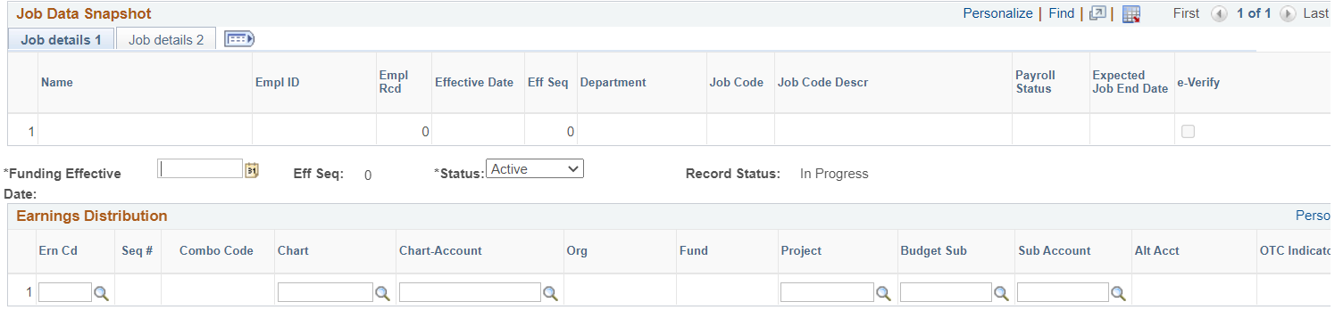
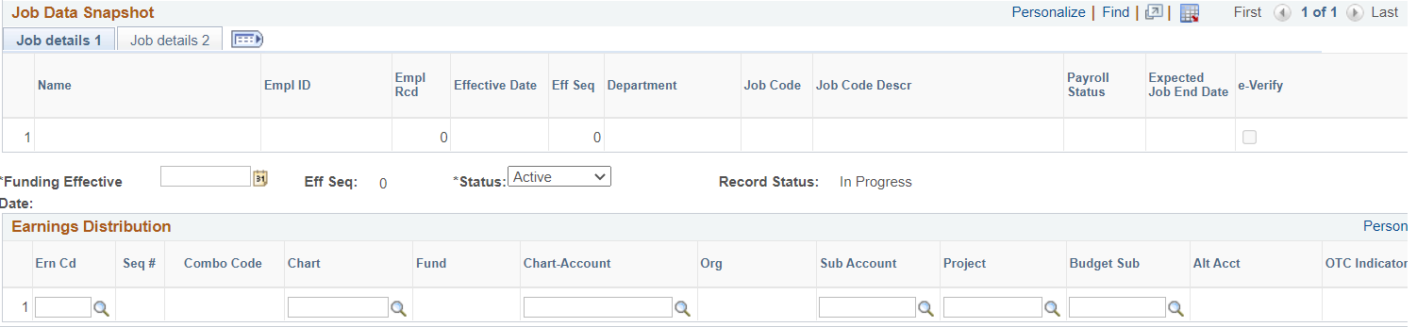
Current UCPath Chartfield Order: Example 1
Old Order
New Order

Slide 8
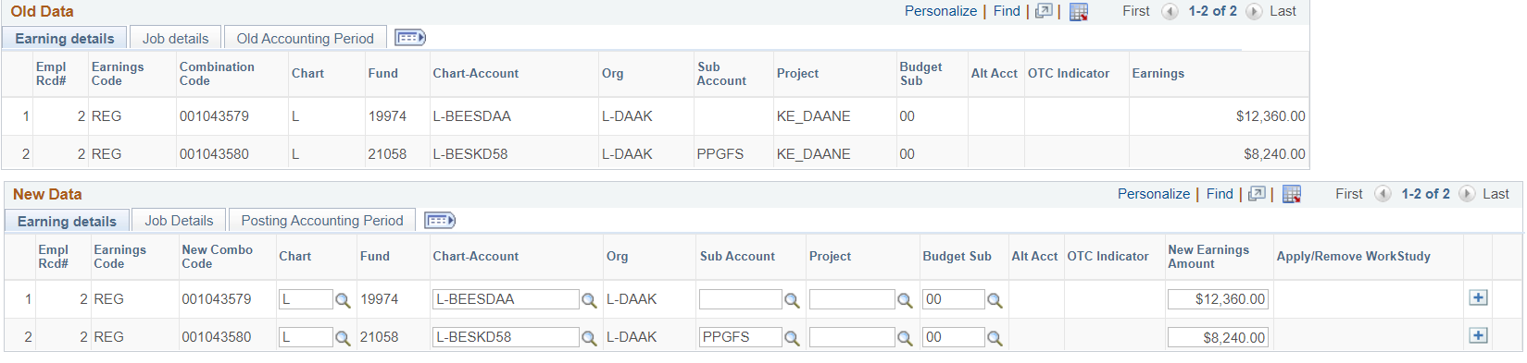
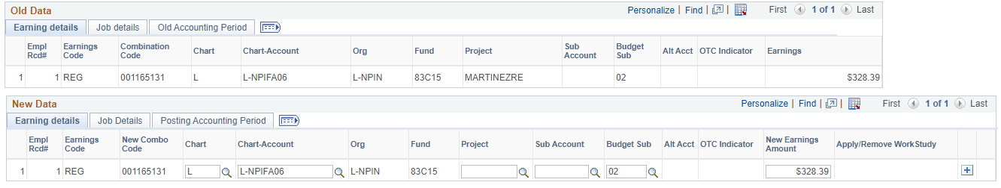
Current UCPath Chartfield Order: Example 2
New Order | Old Order

Slide 9
Questions?

Slide 10
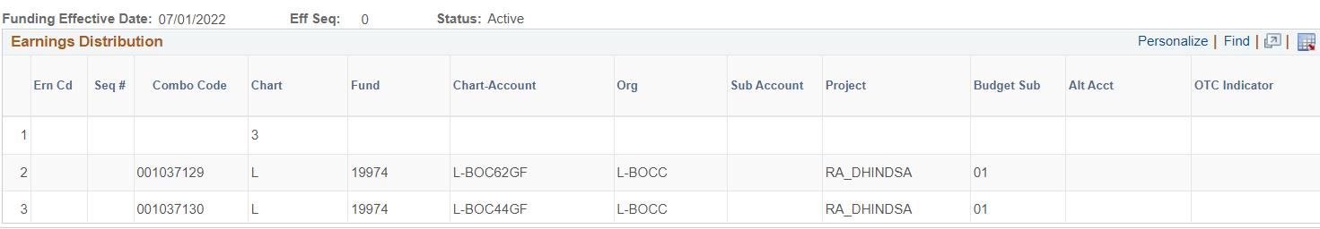
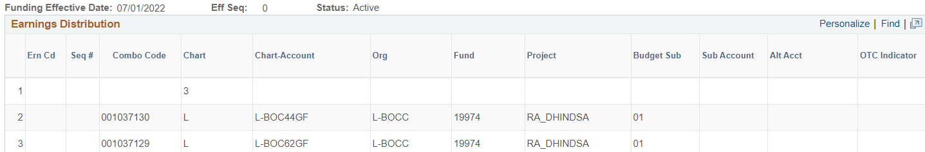
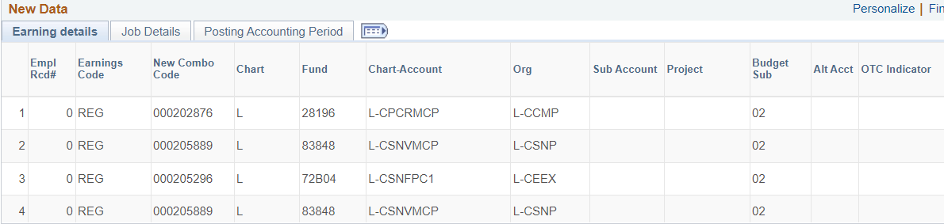
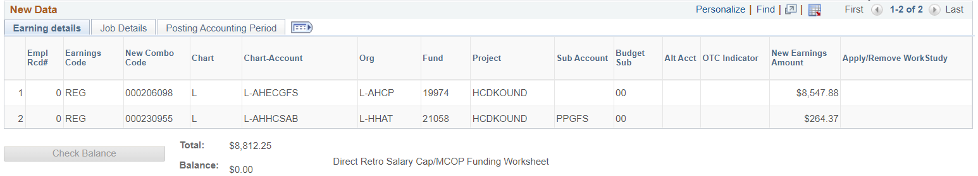
Funding Entry Inquiry & Direct Retro Inquiry
New Order | Old Order

Slide 11
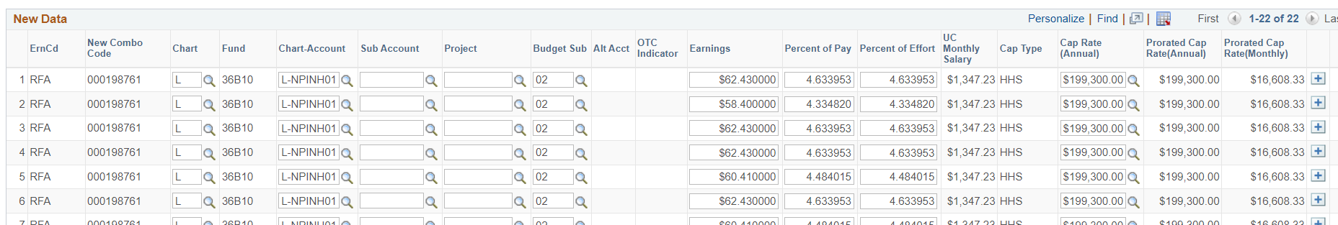
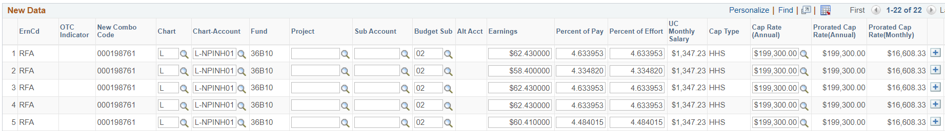
Direct Retro - MCOP
New Order | Old Order

Slide 12
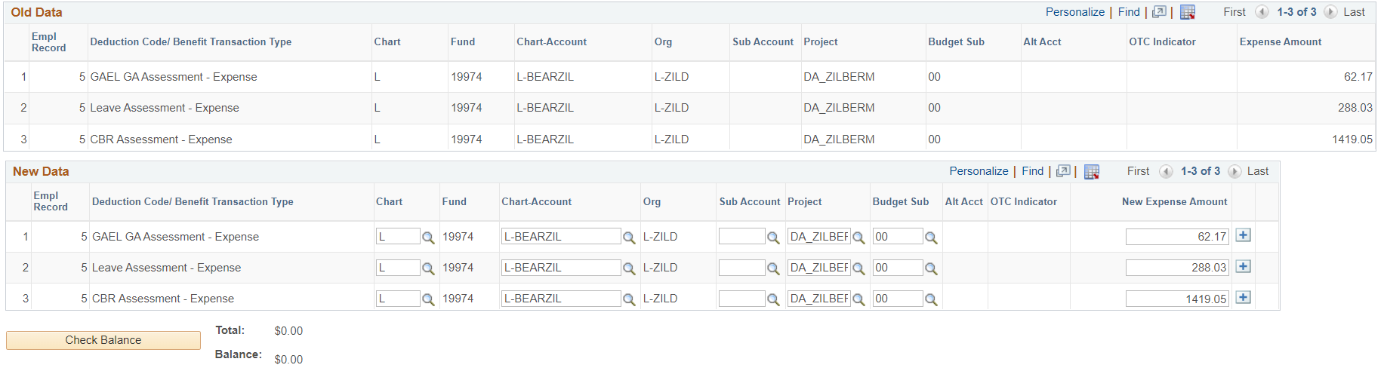
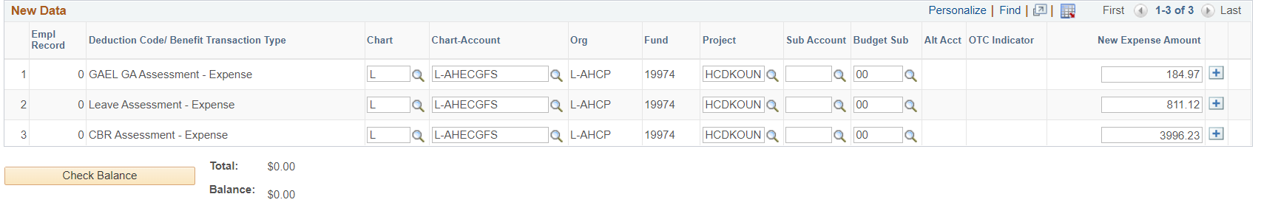
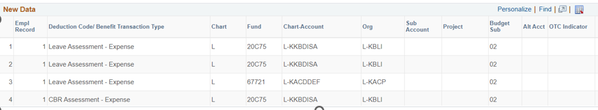
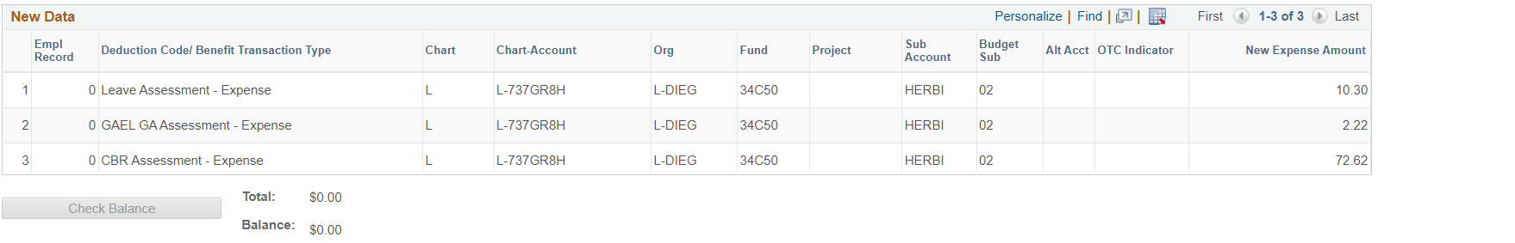
Benefit Cost Transfer (BCT) & BCT Inquiry
New Order | Old Order

Slide 13
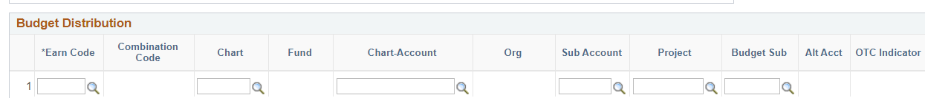

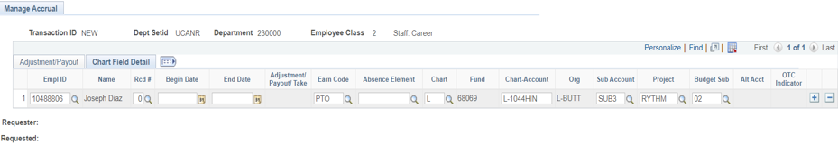
Budget Distribution Page & Manage Accruals
New Order | Old Order

Slide 14
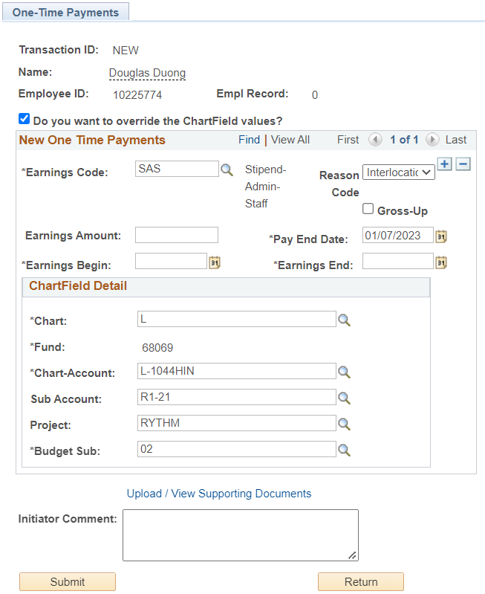
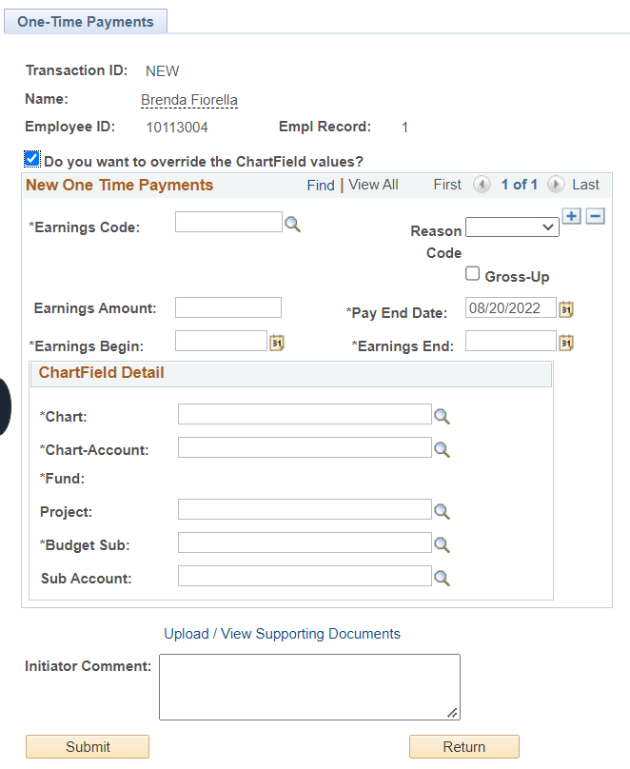
Approve One-Time Payments
New Order | Old Order

