Slide 1
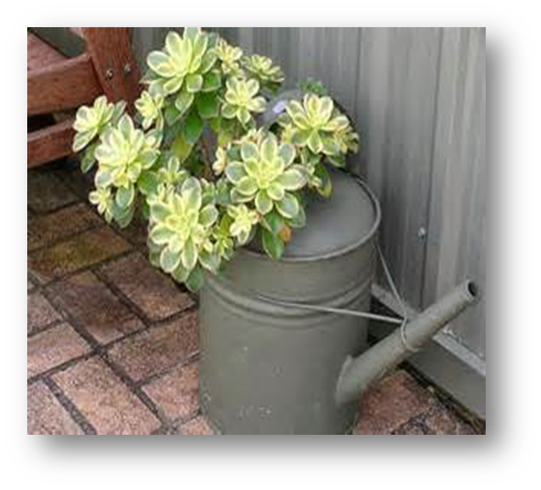
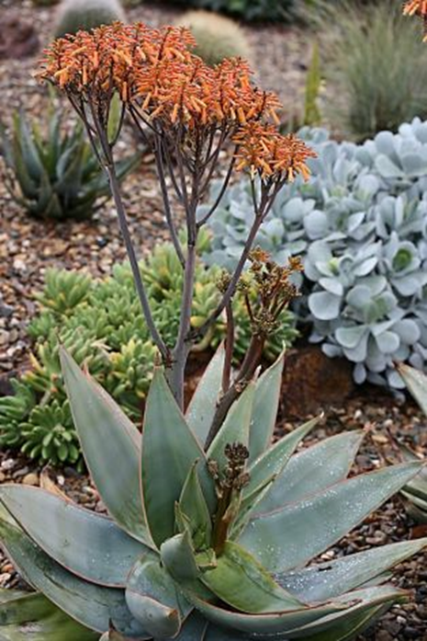
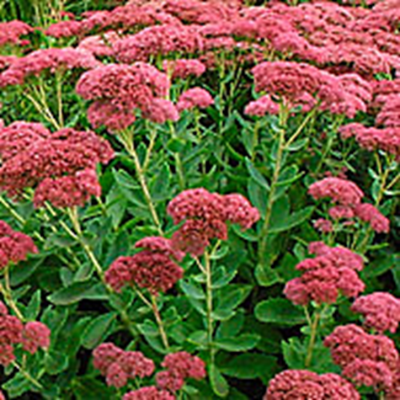
Succulents “The easiest plants you will ever grow!”
Notes:
Created:
Created by: Diane Arnold and Marie Salers
Audience: Garden clubs, 4H workshop on “How to Propagate Succulents”
Publicity: As listed for the Sun City Lincoln Hills Garden Club.
"The amazing diversity and versatility of succulents will be discussed by examining the “Who, What, Why, When and How” of growing succulents. You will learn what succulents “really are”, why you’ll love to grow them, which succulent varieties do well in our area, how to grow and propagate succulents and when to plant and propagate succulents.”
[Aloe Striata, Aeonium Sunburst, Sedum Spectbile (Autumn Joy)]

Slide 2
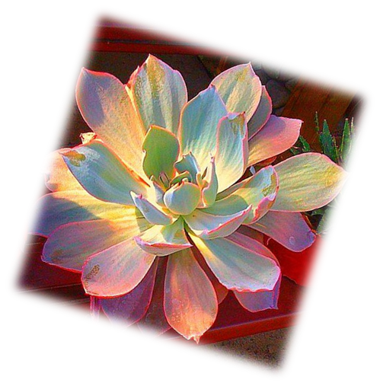
AGENDA
Welcome!
Today’s Agenda
  WHO are Master Gardeners?
  WHO can grow succulents?
  WHAT are succulents?
  WHY grow succulents?
  WHEN to cultivate and propagate.
  HOW to cultivate and propagate.
Questions and Answers
Notes:
Good Afternoon!
“I’m XXX and this is XXX.
“Thank You for having us today as your guest speakers.
Today, as Master Gardeners of Placer County, in next 45 mins, we are going to…
Agenda: See slide # 2
WHO are Master Gardeners?
WHO can grow succulents?
WHAT are succulents?
WHY grow succulents?
WHEN to cultivate and propagate.
HOW to cultivate and propagate.
Questions and Answers
Next Slide: WHO ARE MASTER GARDENERS?
[Aeonium Sunburst]

Slide 3
Who Are Master Gardeners?
Master Gardeners of Placer County
  Extend research-based, sustainable gardening and composting information
  Present accurate, impartial information to home gardeners
  Encourage public to make informed gardening decisions
Notes:
Refer audience to Handouts—pg 1.
Briefly highlight.
Next Slide : “Who are MGs continued”

Slide 4
Who Are Master Gardeners?
Where to find us…
Online, in the Media, and Special Publications
  Hotline: Call (530) 889-7388 or submit your questions online
  Website: pcmg.ucanr.org
  Facebook, Twitter, Instagram
  Gold Country Media monthly column
  Curious Gardener quarterly newsletter and on our website
  Calendar and Gardening Guide
  School and Community garden consulting
Notes:
Refer audience to Handouts—pg. 1.
Briefly highlight.
Next Slide: “Who are MGs continued”

Slide 5
Who Are Master Gardeners?
Where to find us…
Workshops, Fairs and Festivals and Special Events
  Speakers by Request
  Workshops (various venues, check website)
  Farmers’ Markets (seasonal: Auburn, Roseville)
  Fairs and Festivals Booths (varies)
  Garden Faire (April)
  Mother’s Day Garden Tour (May)
Notes:
Refer audience to Handouts—pg 1.
Briefly highlight.
Next Slide: “Who Can Grow Succulents?”

Slide 6
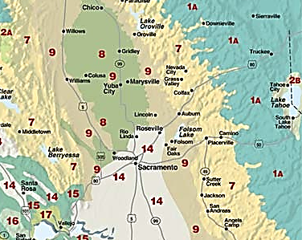
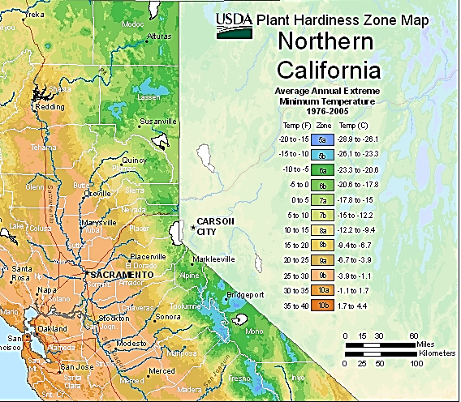
WHO Can Grow Succulents?
All of us in Placer County!
Our Sunset Climate and USDA Plant Hardiness Zones.
Sunset Zones: 1A, 7, 9, 14
USDA: 6a, 6b, 7a, 7b, 8a, 8b, 9a, 9b
Notes:
Our climate accommodates succulents!
Point out zones.
We’ll talk later about specifics on growing succulents later in presentation.
But…good news…if you are willing….succulents are willing!
Next Slide: “What Are Succulents?”
[Sources: Sunset, USDA, Placer Herald/Elaine Applebaum-2009, CA Garden Web]

Slide 7
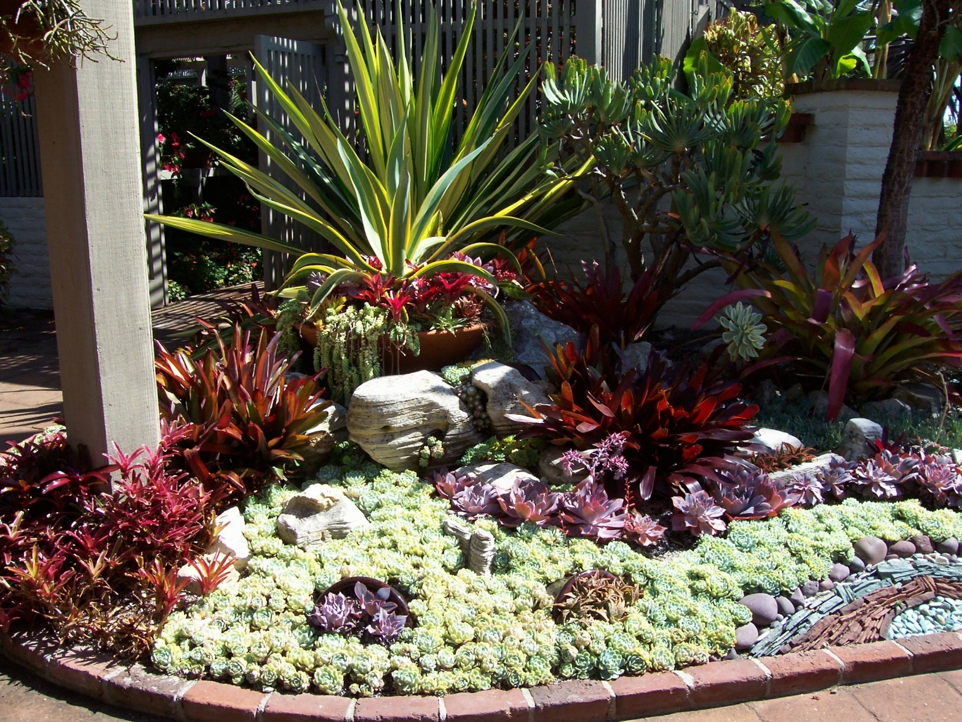
WHAT Are Succulents?
Notes:
Sherman Gardens—Orange County.
Beautiful place to visit and even have a nice lunch.
Next Slide: “Evolutionary Timeline”

Slide 8
Evolutionary Timeline
Succulents
50 million years old!
Evolved to survive changing, dry environment (Xerophytes).
Developed fleshy, water storing tissues in stems, leaves and/or roots.
Mostly native to Northern Europe and Far East. Large concentrations in Southern and Eastern Africa.
Cacti
20 million years old!
Succulents continued to evolve, forming Cactaceae family
Leaves to spines. Stems to succulence. Roots shallow & wide spreading.
Native to Americas and surrounding islands (Galapagos, Caribbean).
Notes:
Succulents are AMAZING Plants!
They are ADAPTERS!!!
Scientists -Succulents 50 million yrs ago
Pretty amazing when you think about it in Geologic time!
Cacti much younger at 20 Million yrs ago!
Succulents: Native to No. Europe & Far East.
Cacti: Most dense/diversity in No. Mexico, So. Tropic of Argentina/Boliva.
Next Slide: “Definition of Succulents”

Slide 9
Definitions
“All cacti are succulents, but not all succulents are cacti!”
Succulents
“Succu” = Latin = Juicy plant
A characteristic across approximately 37⁺ plant families. 10,000 varieties (species)!
A plant’s ability to store water in it’s leaves, stems and roots.
Cacti
Greek word = Prickly plant
A plant family = Cactaceae. 2000 ⁺ varieties (species).
Cacti display succulence. They are succulents w/spines!
Unique only to cacti: Areoles (cushion-like buds).
Notes:
“All cacti are succulents, but not all succulents are cacti”.
SUCCULENTS = “A collective name” for many plants that exhibit succulence.
A Characteristic!
“A plant is a succulent if it stores water in juicy leaves in order to survive dry spells.”
CACTI = “The best known succulents”
A Plant Family!
Distinguishing characteristic = AREOLES (Air-re-ole).
“WHY impt to know diff. btwn S & C?”
Succulents and Cacti can have different needs.
Next Slide: “Succulent Varieties for Placer County”

Slide 10
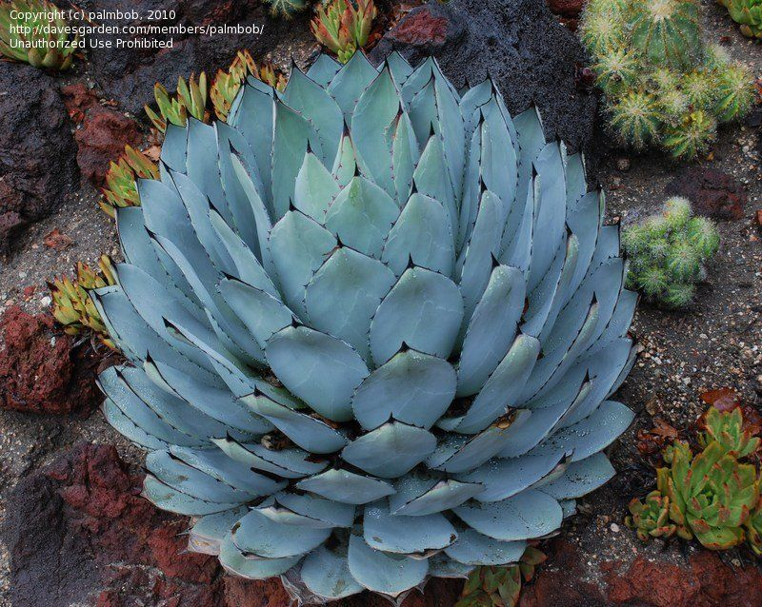
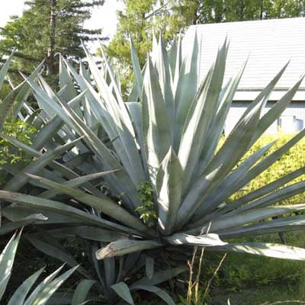
Succulent Varieties for Placer County
(Refer to handouts for list)
Agavaceae (family name)
Agaves
Artichoke agave (A. parryi)
Century plant (A. Americana)*
Miniature century plant (A. toumeyana)
Parry’s agave (A. parryi huachucensis)
Royal agave (A. victoriae-reginiae)
Artichoke agave
Century plant (Agave americana)
*UC Davis Arboretum “All Star”
Notes:
Refer audience to Handouts p. 3.
all varieties in slides are in the handout.
Briefly highlight some of your favorites.
Next Slide: “Varieties continued”

Slide 11
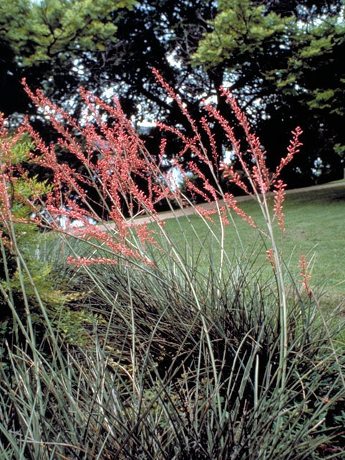
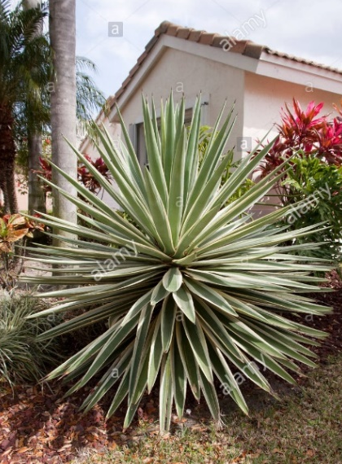
Succulent Varieties for Placer County
Agavaceae (continued)
Yuccas
Coral yucca/Hummingbird yucca*
  (Hesperaloe paryiflora)
Curved leaf/soft leaf (Y. recurvifolia)
Gold edge (Y. filamentosa ‘Variegata’)
Spanish dagger (Y. gloriosa).
Coral yucca*
Spanish dagger
*UC Davis Arboretum “All Star”
Notes:
Refer audience to Handouts p. 3.
all varieties in slides are in the handout.
Briefly highlight some of your favorites.
Next Slide: “Varieties continued”

Slide 12
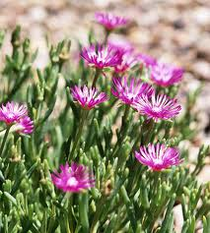
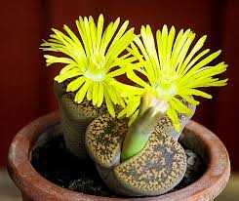
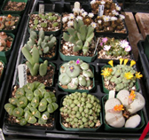
Succulent Varieties for Placer County
Aizoaceae
Ice plants & Lithops
Cooper’s ice plant (Delosperma cooperi )*
Ice plants (Cephalophyllum)
Living stones/ Pebble plants (Lithops).
Cooper’s Ice Plant*
Lithop--flowering
Lithops—different varieties
*UC Davis Arboretum “All Star”
Notes:
Refer audience to Handouts p. 3.
all varieties in slides are in the handout
Briefly highlight some of your favorites.
Next Slide: “Varieties continued”

Slide 13
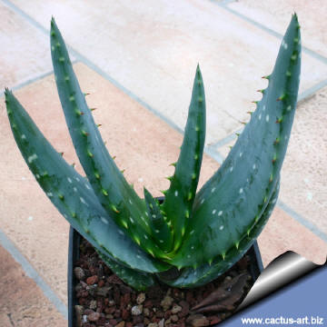
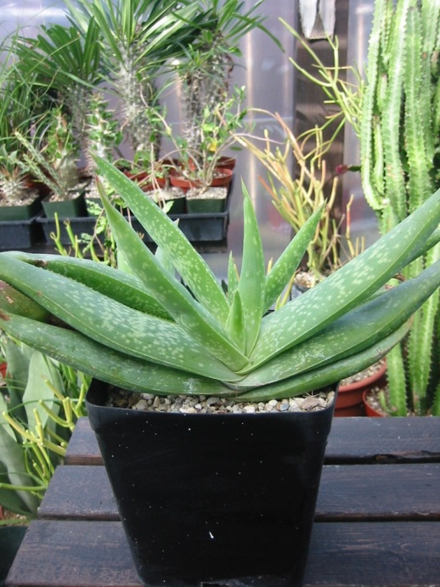
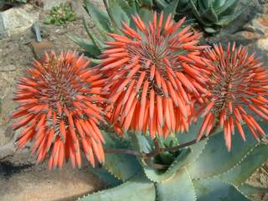
Succulent Varieties for Placer County
Aloaceae
Aloe
Cape speckled aloe (A. microstigma)
Coral aloe (A. striata x saponaria)
Elias Buhr’s aloe (A. buhrii)
Mitre aloe (A. perfoliata)
Cape Speckled Aloe
Mitre Aloe
Elias Buhr Aloe
Notes:
Refer audience to Handouts p. 3.
all varieties in slides are in the handout.
Briefly highlight some of your favorites.
Next Slide:“Varieties continued”

Slide 14
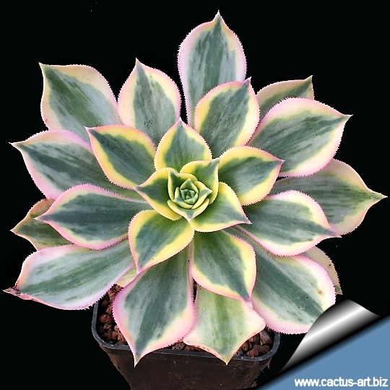
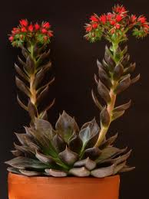
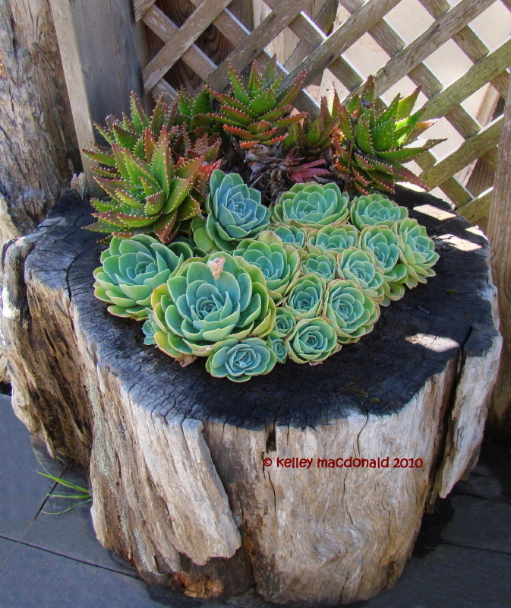
Succulent Varieties for Placer County
Crassulaceae
Crassula
Aoenium
Echeveria
Sunburst
( Aeonium ‘Sunburst’)
E. Impricata (Hens & Chicks)*
E. Black Prince
*UC Davis Arboretum “All Star”
Notes:
Refer audience to Handouts p. 3.
all varieties in slides are in the handout
Briefly highlight some favorites
Next SLIDE: “Varieties continued”

Slide 15
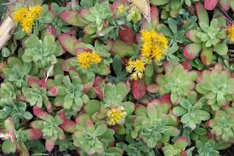
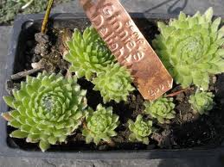
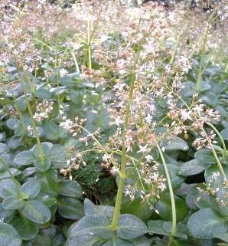
Succulent Varieties for Placer County
Crassulaceae (continued)
Crassula
Sedum (A. buhrii)
Sempervivum (A. perfoliata)
Palmer’s Sedum*
Ginnie’s Delight (Hens & Chicks)
Fairy Crassula
*UC Davis Arboretum “All Star”
Notes:
Refer audience to Handouts p. 3
all varieties in slides are in the handout.
Briefly highlight some of your favorites.
Next Slide: “Varieties continued”

Slide 16
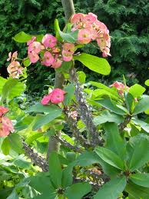
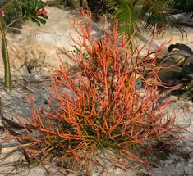
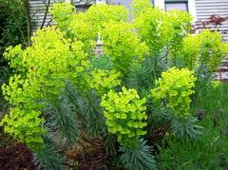
Succulent Varieties for Placer County
Euphorbiaceae
Euphorbias and Spurges
Crown of thorns (E. Milii)
Firesticks (E. tirucalli ‘Rosea’)
Crown of Thorns
(E. Milii)
Firesticks (E. tirucalli ‘Roseae’)
Euphorbia pulcherrima
Notes:
Refer audience to Handouts p. 3.
all varieties in slides are in the handout.
Briefly highlight some of your favorites.
Next Slide: “Why Grow Succulents?”

Slide 17
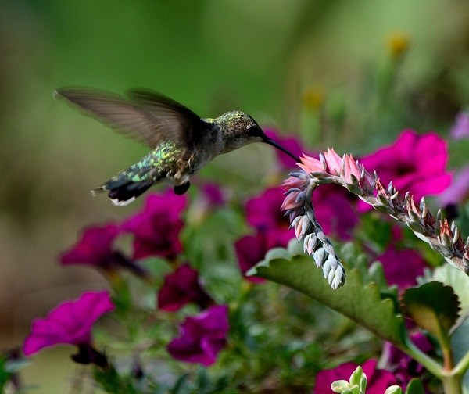
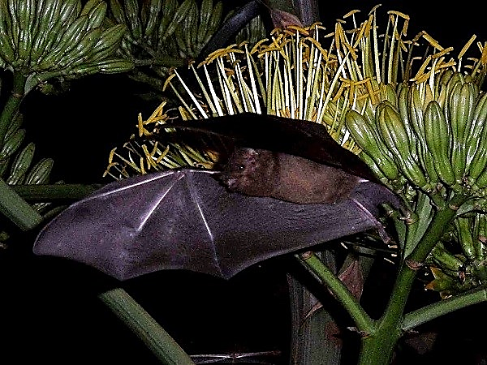
WHY Grow Succulents?
  Drought tolerant.
  Trendy and popular.
  Low maintenance.
  Source for pollinators.
  Large number of varieties.
  Versatile growing options.
  Other Uses >>>>>>
Echeveria & Hummingbird
Agave & Bat!
Notes:
Briefly review.
Note: There are no bats in P. Co. that are pollinators (?).
Next Slide: “Why” continued

Slide 18
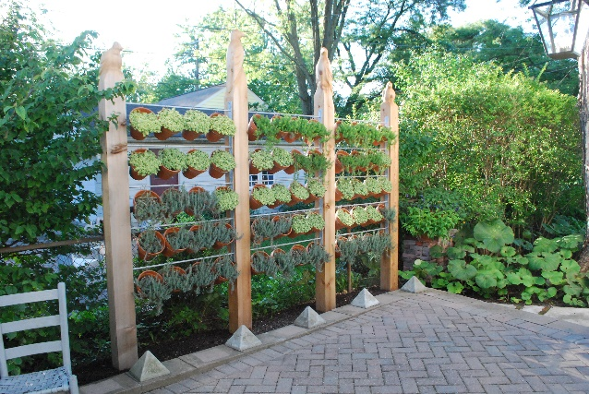
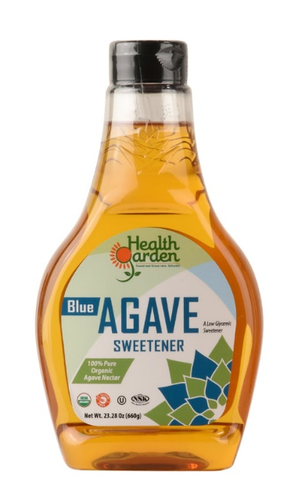
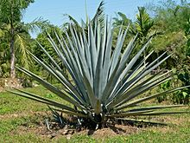
WHY Grow Succulents? (continued)
Horticultural
  Used indoor & outdoor, ornamental gardens, ‘live’ fence.
  Agave: rope, bio-fuel.
  Food
  Agave sweetener, liquors
  Agave tequilana (Blue agave) for Tequila.
Notes:
Briefly highlight.
[Note: If questions arise about the use of Aloe Vera for medicinal use or as a food, we are all aware that some uses have been around for a very long time but MGs are not authorized to discuss these topics.]
Next Slide: Cochineal Insect

Slide 19
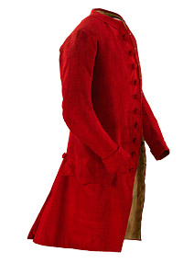
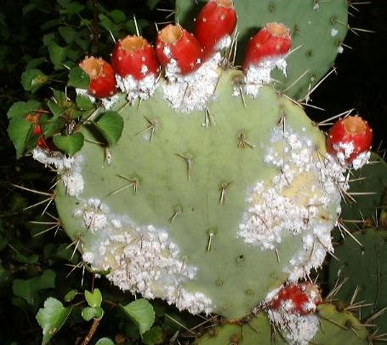
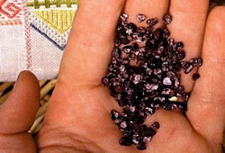
WHY Grow Succulents? (continued)
Other
  Cochineal insect on Prickly Pear cactus
    Cochineal Red dye for Aztecs royal red robes & European Royals.
Notes:
Although this insect grows on a Cactus—pretty interesting use of an insect and how used.
Next Slide: “Creative Ways to Grow Succulents”—pictures.

Slide 20
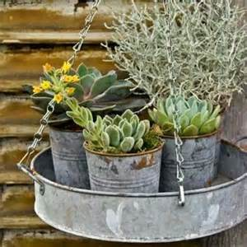
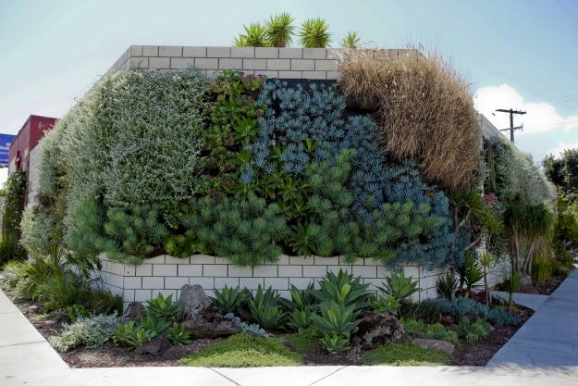
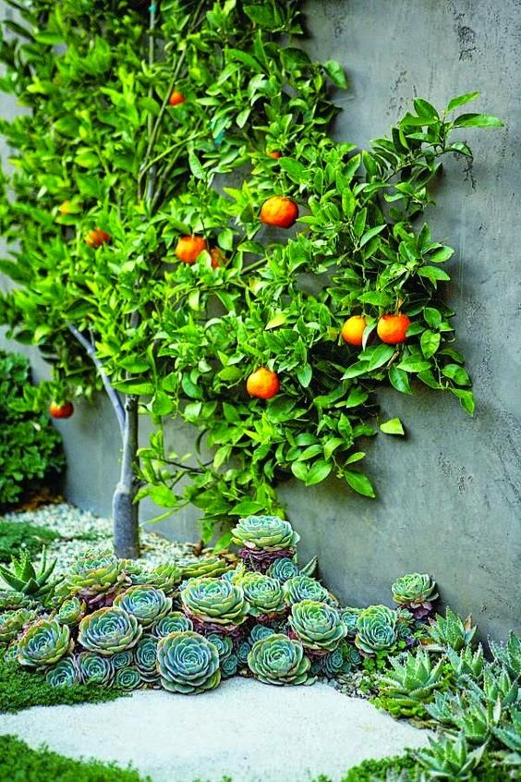
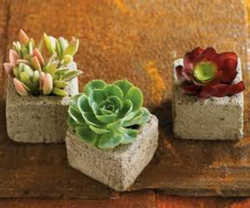
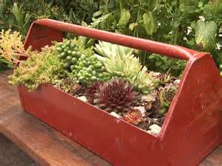
Creative Ways to Grow Succulents
Notes:
Briefly highlight.
Upper right slide: Smog wall in Los Angeles.
Next Slide: “Creative Ways to Grow Succulents”—pictures—cont.

Slide 21
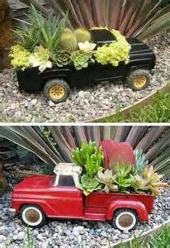
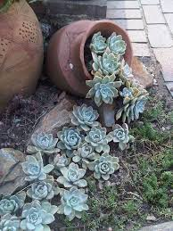
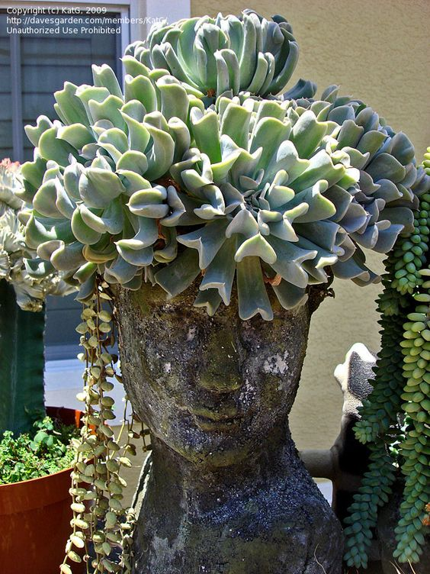
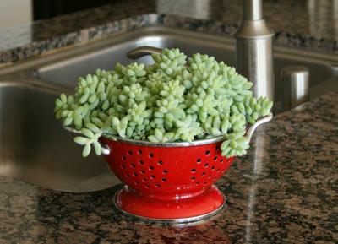
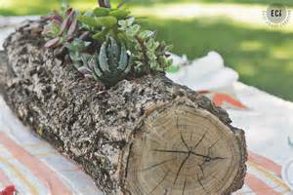
Creative Ways to Grow Succulents
Notes:
Briefly highlight .
Next SLIDE: “Creative Ways to Grow Succulents”—pictures—cont.

Slide 22
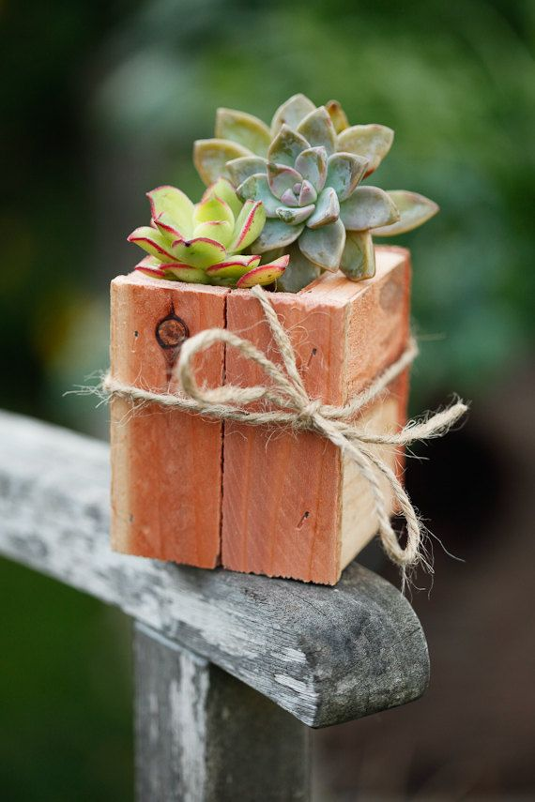
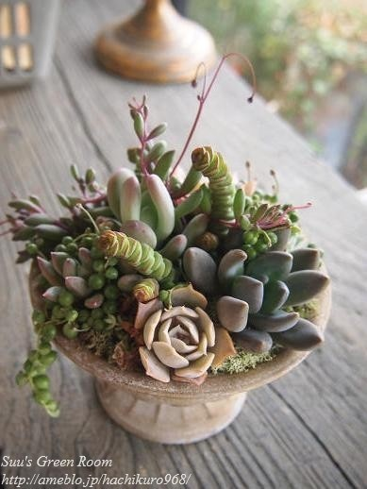
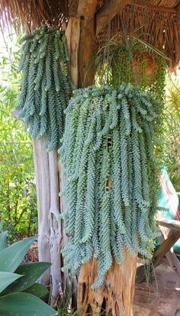
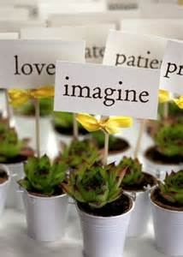
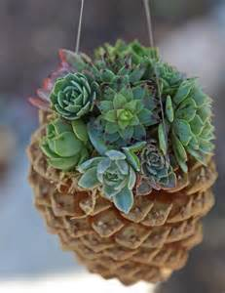
Creative Ways to Grow Succulents
Notes:
Briefly highlight.
Next Slide: “When to Grow and Cultivate Succulents”

Slide 23

WHEN to Cultivate & Propagate Succulents
It all depends on the succulent!
Growth cycle is in response to temperature and water.
Know your succulent! “Summer or Winter grower.”
Indoor succulents: Repot anytime (every 2-3 years). Minimize propagating during dormancy.
Outdoor succulents: Plant or propagate generally in Spring and Fall—not during dormant season.
Notes:
Most important item: Know growing habits of your succulent! And
If outdoor plant….
Next Slide: “When to Cultivate & Propagate” continued

Slide 24
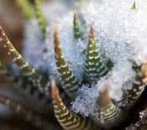
WHEN to Cultivate & Propagate Succulents
Dormancy cycle in response to cooler temperature and lower moisture.
Determine if “Summer grower” or “Winter grower”.
Summer grower = Winter dormancy
(May-Aug) (Nov-Feb)
  Agave, Echeveria, Euphorbia, Lithops…
Know the “particulars” of your succulent.
Notes:
Summer Grower or Winter Grower?
Refer audience to Handout p.3: Lists under left hand column (WG/SD or SG/WD).
Next Slide: “When to Cultivate & Propagate” cont.
[Aloe}

Slide 25

WHEN to… (continued)
Winter growers = Summer dormancy
(Nov-Feb) (May-Aug)
  Aeonium, Aloe, Bulbine, Crassula, Hawthoria, Kalanchoe, Sedum…
Know the “particulars” of your succulent.
Ask others.
Cape balsam
Notes:
Winter Grower.
Refer audience to Handout p.3: Lists under left hand column (WG/SD or SG/WD).
Next Slide: “HOW to Cultivate & Propagate” cont.

Slide 26



How to Cultivate Succulents
We Will Discuss How To:
  Grow
  Propagate
  Manage pests & problems
Mealy bug
Notes:
We will cover 3 areas:…How to Grow, Propagate, Manage Pests/Problems.
Next Slide: The “Six Elements to Consider in Cultivating Succulents”

Slide 27

How to Cultivate Succulents:
Six Elements to Consider
“Choosing right plant for the right place!”
Planting mix or well draining soil.
Temperature requirements.
Lighting conditions.
Watering requirements.
Fertilizing needs.
Notes:
We will explain each element in more detail.
Next Slide:
“Choose right plant for the right place” and
Planting mix/type of soil.

Slide 28

How to Cultivate Succulents:
Six Elements
“Choose right plant for the right place!”
  Your gardening zone (USDA & Sunset).
  Tender or “cold hardy” succulent?
  Consider microclimates.
Planting mix or soil:
  Use cactus/succulent mix.
  Need good draining amended soil or mix.
  Avoid “soggy” or “heavy” mix or soil.
  Slightly acidic (pH 5.5—6.5).
  Mulch top of mix/soil with volcanic rock, perlite or similar (not wood mulch).
Notes:
Explain.
Next Slide:
Consider the TEMPERATURE requirements of plant.

Slide 29

How to cultivate…
Temperature
  Check individual succulent requirements.
  High temperatures okay, but…
    Some varieties don’t tolerate direct sun.
    Avoid scorching (too close to window glass).
    Provide good air circulation.
  Cooler temperatures—usually 40º minimum.
  Cover if frost expected or move to protected area:
    Frost kills.
  Protect from wind.
  Maximize microclimates.
Notes:
Explain.
Next Slide: #4 Lighting requirements of succulents.

Slide 30

How to cultivate…
Lighting
  Greatly influences plant growth and flower development.
  Bright light generally okay.
  Provide proper sun exposure:
    Southern, SW or SE facing slope.
    Some exceptions: Christmas, Easter and Thanksgiving cacti…
Notes:
Explain.
Next Slide: #5 Watering requirements of succulent .

Slide 31

How to cultivate…
Watering
  Overwatering = # 1 cause of succulents dying!!!
  Water thoroughly only when needed,
  when almost dry.
  Minimal watering during dormant season:
    Begin withholding water in fall.
    Dormancy varies with succulent variety—know your succulents! (see handout “Succulent Varieties for Placer Co.”).
    Exceptions: Christmas, Easter and Thanksgiving cacti…
Notes:
Explain.
Next Slide: #6 Fertilizing requirements of succulent

Slide 32

How to cultivate…
Fertilizing
  Fertilize during growing season
    Usually spring and summer.
    Mid-summer, many succulents “resting.
    Know your succulents’ growing season.
  Use ¼ to ½ strength of a balanced fertilizer (10_{Nitrogen} 10_{Phosphorous} 10_{K Potassium}).
  Foliar fertilizers not recommended!!!
Notes:
Explain.
Next Slide: How to Propagate

Slide 33

How to Propagate Succulents
Three Easy Methods:
  Seed germination.
  Cuttings: leaves and stems.
  Division: offsets and roots.
Always Remember…
  Choose best propagation method for succulent variety.
  Sterilize tools and other equipment.
  Avoid using very young plants.
  Determine when your succulent is growing or dormant (see handout “Succulent Varieties for Placer Co.”, pg. 3).
Stem cuttings, offsets, offset tubers and division all from one plant!
Notes:
Refer participants to pg. 3—lots of good information to refer. All on one page.
Next Slide: “HOW to…” Always Remember—cont.
[Snake plant]

Slide 34


How to Propagate
Always Remember—continued
  Propagate beginning of active growth period (often early spring, up to June).
  Keep out of direct sunlight.
  Provide good air circulation.
  Patience! Rooting time varies depending on succulent variety:
    can take weeks to months to see any roots
    often the “mother” leaf will begin to wither.
  Transplant.
Notes:
Explain.
Next Slide: “Seed Germination”
[Echeveria]

Slide 35



How to Propagate
Seed Germination
  Mostly used for cacti.
  Need time and patience.
  Seeds from retail or collect your own.
  Usually sown in April for germination in late spring.
Notes:
Seed germination: takes a lot of patience and time.
Can take 2-3 mos. to germinate & a lot can go wrong in that time.
Mostly commercial nurseries use seeds.
Next Slide: “Cuttings—LEAF”

Slide 36





How to Propagate
Cuttings: Leaf
  “Cleanly” pull or cut healthy leaf away from plant.
  Lightly dust cut end of leaf with rooting hormone/fungicide.
  Allow leaf to form callus (1-2 days to 1 week).
or
Notes:
Demonstration
Note:
The METHODS are different, but the process after you cut the LEAF or STEM is pretty much the same;
Clean cut, callus, good succulent mix, etc.
Rooting hormone = hedging your bets for less disease.
Next SLIDE: “Cuttings-LEAF”—cont.

Slide 37





How to Propagate
Cuttings: Leaf (continued)
  Lay callused leaf in pot or seed tray with succulent mix.
  Lightly “firm in” callused end.
  Label, water and allow pot/tray to drain completely. Keep slightly moist.
  Transplant when ready.
or
Notes:
Demonstration
Continue explaining bullets and process.
Want to plant many cuttings as some will not make it.
Next Slide: “Cuttings-STEM”

Slide 38



How to Propagate
Cuttings: Stem
  Choose a healthy, sturdy stem (too long = wilt, flop over).
  Use a sharp knife to cut straight across, just above a shoot or bud.
    Cut at stem segment for Christmas, Easter Cactus, etc.
  Trim stem to 2-4” in length.
or
Notes:
Demonstration
Note:
The METHODS are different, but the process after you cut the LEAF or STEM is pretty much the same;
Clean cut, callus, good succulent mix, etc.
You can use both the lower and upper part of the stem.
Next Slide: “Cuttings—STEM” cont.

Slide 39



How to Propagate
Cuttings: Stem (continued)
  Strip off lower leaves of stem.
  Allow to callus.
  Top succulent mix w/small, clean ground lava or perlite.
  Gently push cutting in slightly moistened succulent mix.
  Be patient while roots develop!
Nodes = Potential New Roots
Notes:
Demonstration
Continue explaining.
Patience is your friend until new roots develop.
Next Slide: “Division—CLUMPING OFFSET”

Slide 40




How to Propagate
Division—Clumping Offsets (Pups)
    Dig up succulent or remove from pot.
    Pull, tease or cut away offsets from base of plant.
Notes:
Demonstration
You can get so many new plants with this fun method! So rewarding.
Note the root system of the lower right plant.
Next SLIDE: “Division—CLUMPING OFFSET”
[Century plant/Agave]

Slide 41


How to Propagate
Division—Clumping Offsets (Pups) (continued)
    Each offset should have:
      its own vigorous roots
      at least one growing point, shoot.
    Allow to callus.
  Top succulent mix w/small, clean ground lava or perlite.
  Gently place offset in slightly moistened succulent mix.
  Lightly water after 2-3 days to avoid root rot.
Notes:
Demonstration
Process sound familiar? Similar to leaf and stem cuttings!
Note nice/healthy roots!
Next Slide: “Division—ROOTSTOCK”

Slide 42



How to Propagate
Division—Rootstock
    During dormant season, dig up or remove parent plant from ground or pot.
    Use a sharp knife to cut rootstock or tubers into sections.
    Each section should have:
        its own vigorous roots
        at least one growing point/shoot
    Remove any damaged, old or woody part of section.
Cape balsam
Notes:
Demonstration
Example: Cape Balsam.
Dormant season the best, but if take new plants inside/greenhouse with Cape Balsam, anytime of year.
Next Slide: “Division—ROOTSTOCK”—cont.

Slide 43



How to Propagate
Division—Rootstock (continued)
    Allow to callus.
    Replant into succulent mix.
    Lightly water after 2-3 days.
Notes:
Demonstration
Example: Cape Balsam—cont.
Next Slide: “Division—ROOTSTOCK” of Jade plant
Can use as an alternative instead of Cape Balsam example.

Slide 44



How to Propagate
Division—Rootstock
    During dormant season, dig up or remove parent plant from ground or pot.
    Use a sharp knife to cut rootstock or tubers into sections.
    Each section should have:
        its own vigorous roots
        at least one growing point/shoot
    Remove any damaged, old or woody part of section.
Jade plant
Notes:
Demonstration (Can use as an alternative instead of Cape Balsam example)
Example: Jade plant.
See previous slides on Cape Balsam.
Next Slide: “Division—ROOTSTOCK” of Jade plant

Slide 45



How to Propagate
Division—Rootstock (continued)
    Allow to callus.
    Replant into succulent mix.
    Lightly water after 2-3 days.
Notes:
Demonstration continued.
Example: Jade plant-continued.
Next Slide: “How to Manage Pests & Problems”

Slide 46




How to Manage Pests & Problems
Pests/Animals
    Aphids
    Birds
    Deer
    Gophers & Rodents
    Mealy bugs
    Rabbits & Squirrels
    Scale insects
    Snail/Slugs
    Red Spider mites
    Thrips
    Worms/Caterpillars
Aphids
Mealy bugs on Agave plant
Red Spider Mites
Snail damage on Hawthoria
Notes:
Refer audience to Handout p. 4.
Highlight a few you are most familiar.
Most pest/problems due to OVERWATERING!
In your handouts, p.4, “overwatering” is mentioned at least 5x’s!!!
Next Slide: “How to Manage….” cont.

Slide 47



How to Manage Pests & Problems
Environmental
    Cold damage
    Etiolation
    Mechanical/Physical
    Over-watering
    Phototoxicity (chemical w/direct hot sun)
    Pot bound
    Scorch damage
    Under-watering
Over-watering
Etiolation
Scorched
Under-watering
Notes:
Handout p. 4—continued
Highlight a few you are most familiar.
OVERWATERING & Under watering.
Next Slide: “Environmental Considerations”

Slide 48



How to Manage Pests & Problems
Fungus and Other
    Fungus:
      Anthracnose
      Black sooty mold
      Black spot
      Grey mold
      Fusarium wilt
      Powdery mildew
      Root (Black stem) & Crown rot
    Some environmental problems can be misdiagnosed as a disease.
      Too much sun, over/under watering, physical damage, etc.
Black spot—Jade plant
Powdery mildew-Crassula
Root rot (Black stem rot)
Notes:
Handout p. 4—continued.
Highlight a few you are most familiar.
Next Slide: “Wrap-Up”

Slide 49


Wrap-Up
Discussed the Versatile World of Succulents!
Who: Placer County is just perfect for succulents!
What: Succulents are juicy!
Why: Easy, diverse and beautiful.
When: Summer and winter growers.
How: Cultivate and propagate.
Questions/Comments
Thank You!
Notes:
Briefly review.
Q & A.
EVALUATIONS.
Thank You!
Next Slide: Thank you
[Aloe polyphylla]

Slide 50
Thank You!
Any Questions?
Master Gardener Hotline: (530) 889-7388
Master Gardener Website: pcmg.ucanr.org
Evaluations, please!
Notes:
Please take a minute to complete the short evaluations. Your feedback is appreciated.

