Slide 1

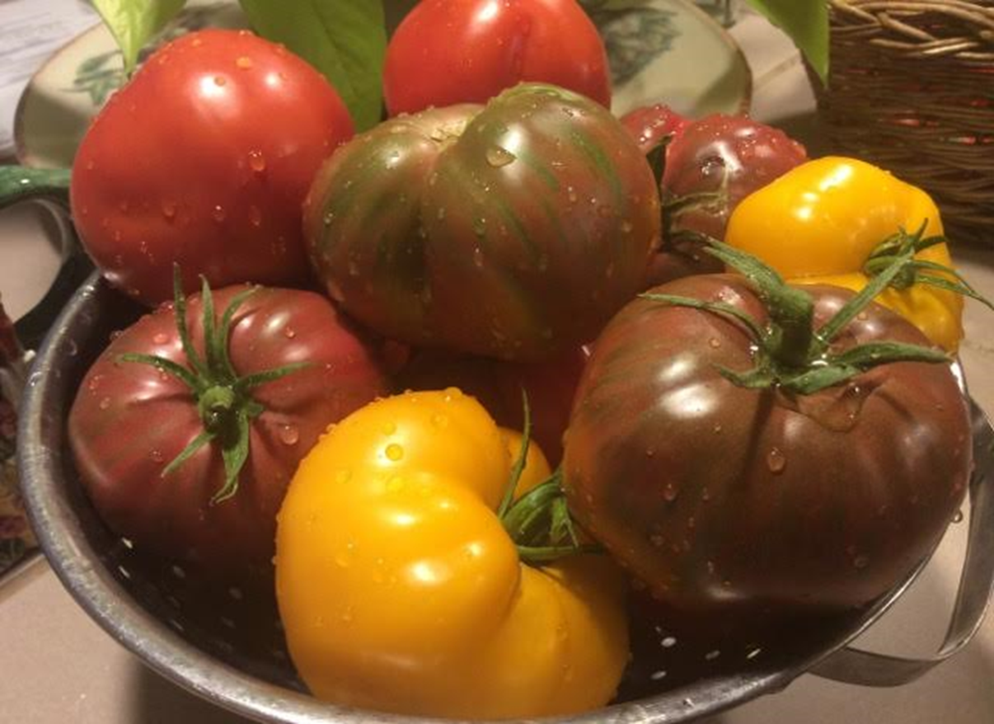
Total Tomato Talk
Presented by Master Gardeners of Placer County
Notes:
Created: 03/01/2025
Created by: Kim Evans
Audience: Home Gardeners
Publicity: This class is dedicated to one of our summer favorites, the tomato!
Learn about planting, growing, and caring for this delicious staple as well as how to control problems before they happen.
Let us help you grow the ultimate tomato – firm and juicy, sweet, and tangy.
Update History:
Updated on 11/18/2020 by David Warman.
David Warman, updated for Zoom presentation on 2/13/2021. Photo by D. Warman.
David Warman, 2/18/2023, updated title for RUEC presentation.
Barbara Villareal, March 2024, presented at RUEC.

Slide 2

Who Are Master Gardeners?
Master Gardeners of Placer County
  Extend research-based, sustainable gardening and composting information through various educational outreach methods.
  Present accurate, impartial information to home gardeners
  Encourage the public to make informed gardening decisions in regard to plant choices, soil fertility, pest management, irrigation practices, and more.
  Placer County Master Gardener Program began in 1983.

Slide 3

Who Are Master Gardeners?
Where to find us…
Online, in the Media, and Special Publications
  Hotline: Call (530) 889-7388 or submit your questions online
  Website: pcmg.ucanr.edu
  Facebook, Instagram, X, YouTube
  Gold Country Media monthly column
  Curious Gardener quarterly newsletter on our website
  Gardening Guide and Calendar

Slide 4
Who Are Master Gardeners?
Where to find us…
Workshops, Fairs and Festivals, and Special Events
  Speakers by Request
  Workshops (various venues, check website)
  Farmers’ Markets (seasonal: Auburn, Lincoln, Roseville)
  Fairs and Festivals Booths (varies)
  Garden Faire (April)
  Mother’s Day Garden Tour (May)

Slide 5
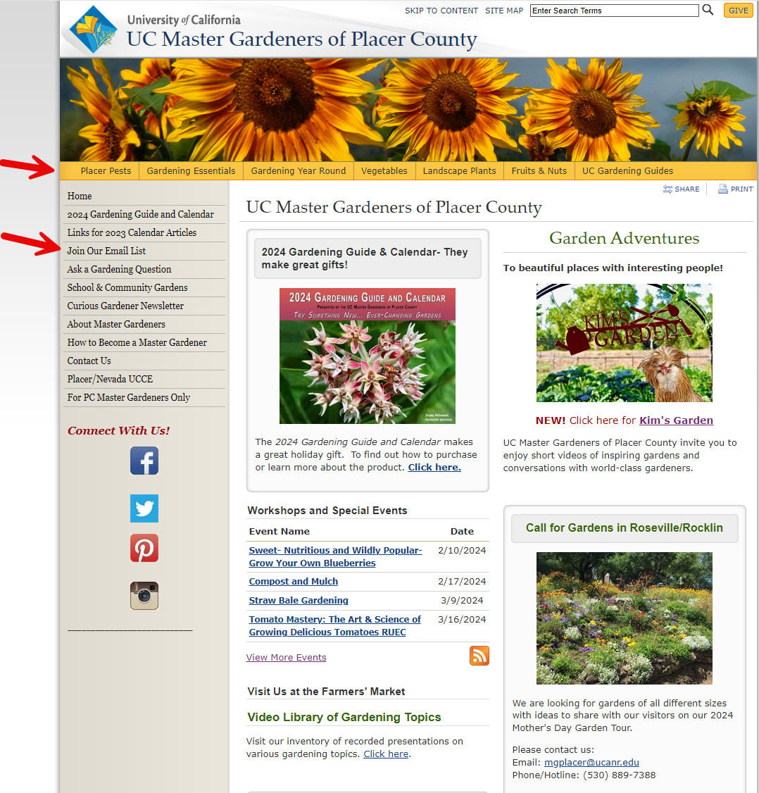
pcmg.ucanr.edu
Notes:
Yellow Menu are drop downs to more information.
Join Our Email List for subscription to our quarterly Curious Gardener Newsletter.

Slide 6
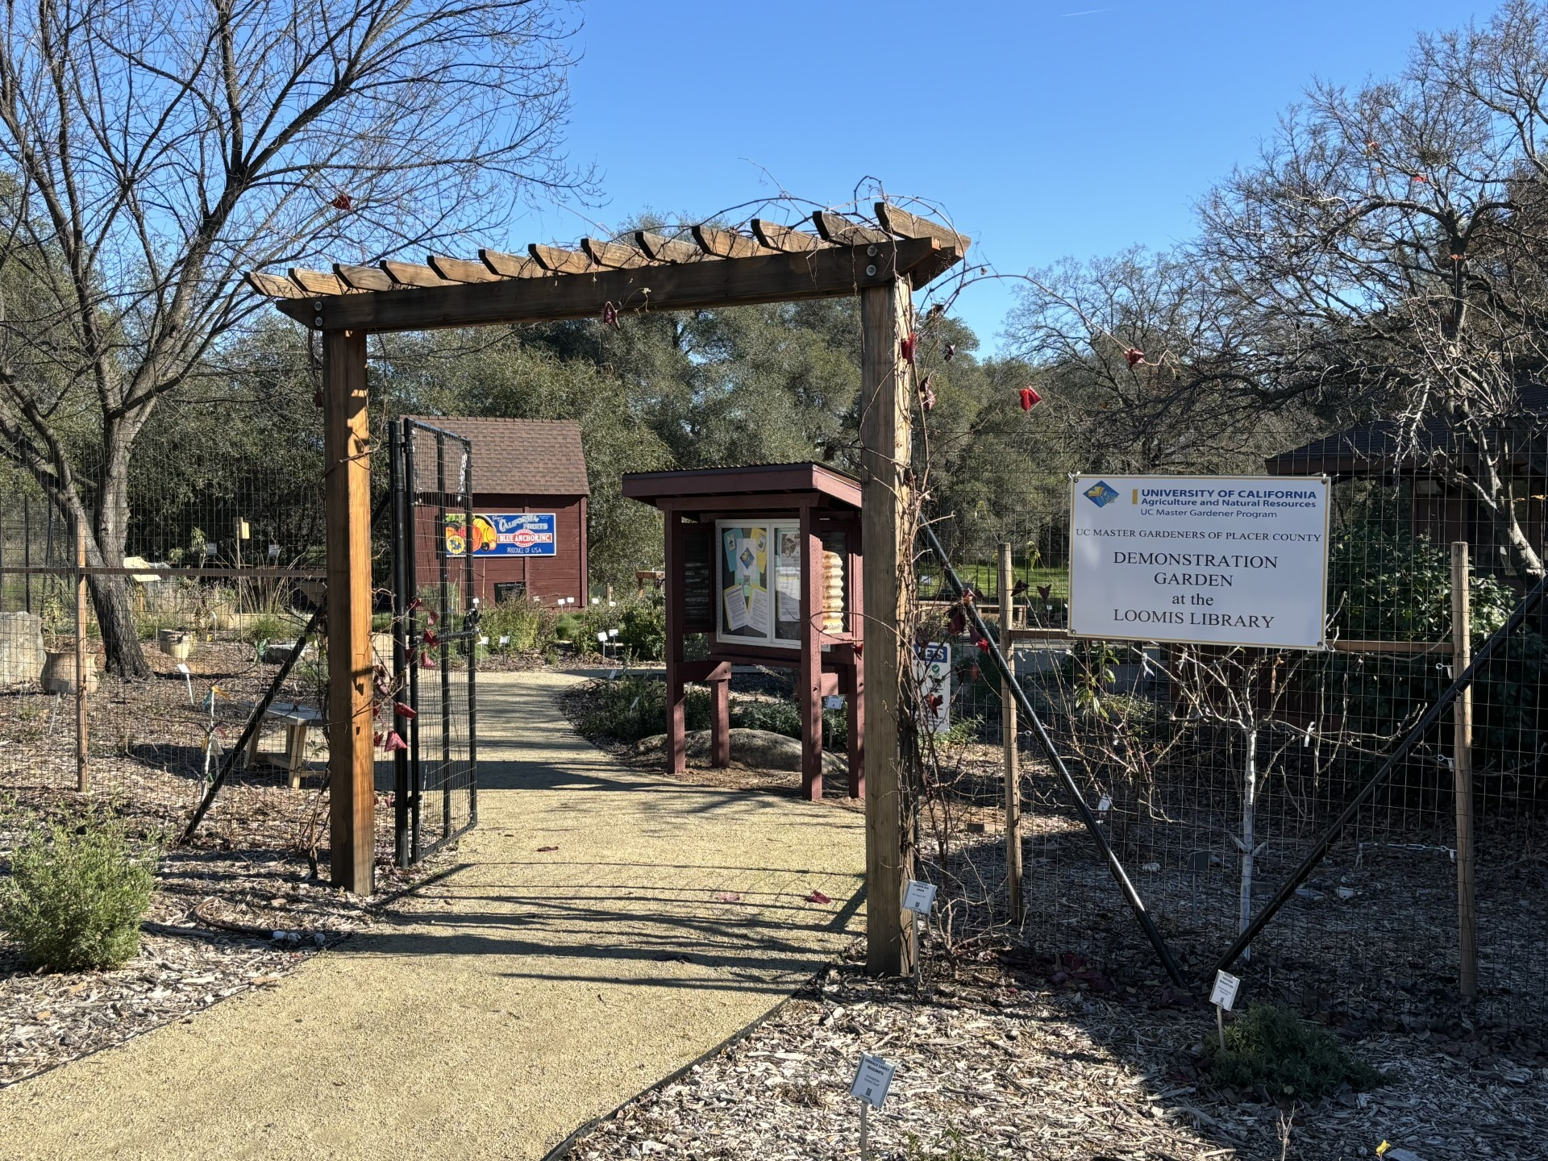
2025 2nd Saturday
Open Garden Dates
February 8
March 8
April 12
May 10
June 14
July 12
August 9
September 13
October 11
November 8
Master Gardeners on site between
10:00 am – 12:00 pm
6050 Library Dr., Loomis
Photo by K. Evans
Notes:
Add in any seasonal slides.

Slide 7
Agenda
Tomato facts
Picking your Plant
Sow seed watch it grow
Prepare space
Tomato Support
Fertilizing /pruning
Watering
Harvest
Pests & Disease
Conclusion
Notes:
Agenda

Slide 8
Tomato Facts
Nightshade Family of Plants: Solanaceae (Peppers, Potato, Eggplant)
Originally thought to be poisonous.
Botanical fruit although many consider it a vegetable.
Tomatoes are the official state vegetable of New Jersey
Tomato juice is the official Beverage of Ohio
China is the largest producer 68 M T
US is number 4 with 10 M T
Notes:
Tomatoes in the Home Garden: https://ucanr.edu/sites/ucmgplacer/files/158610.pdf
Pub Number 31-159

Slide 9
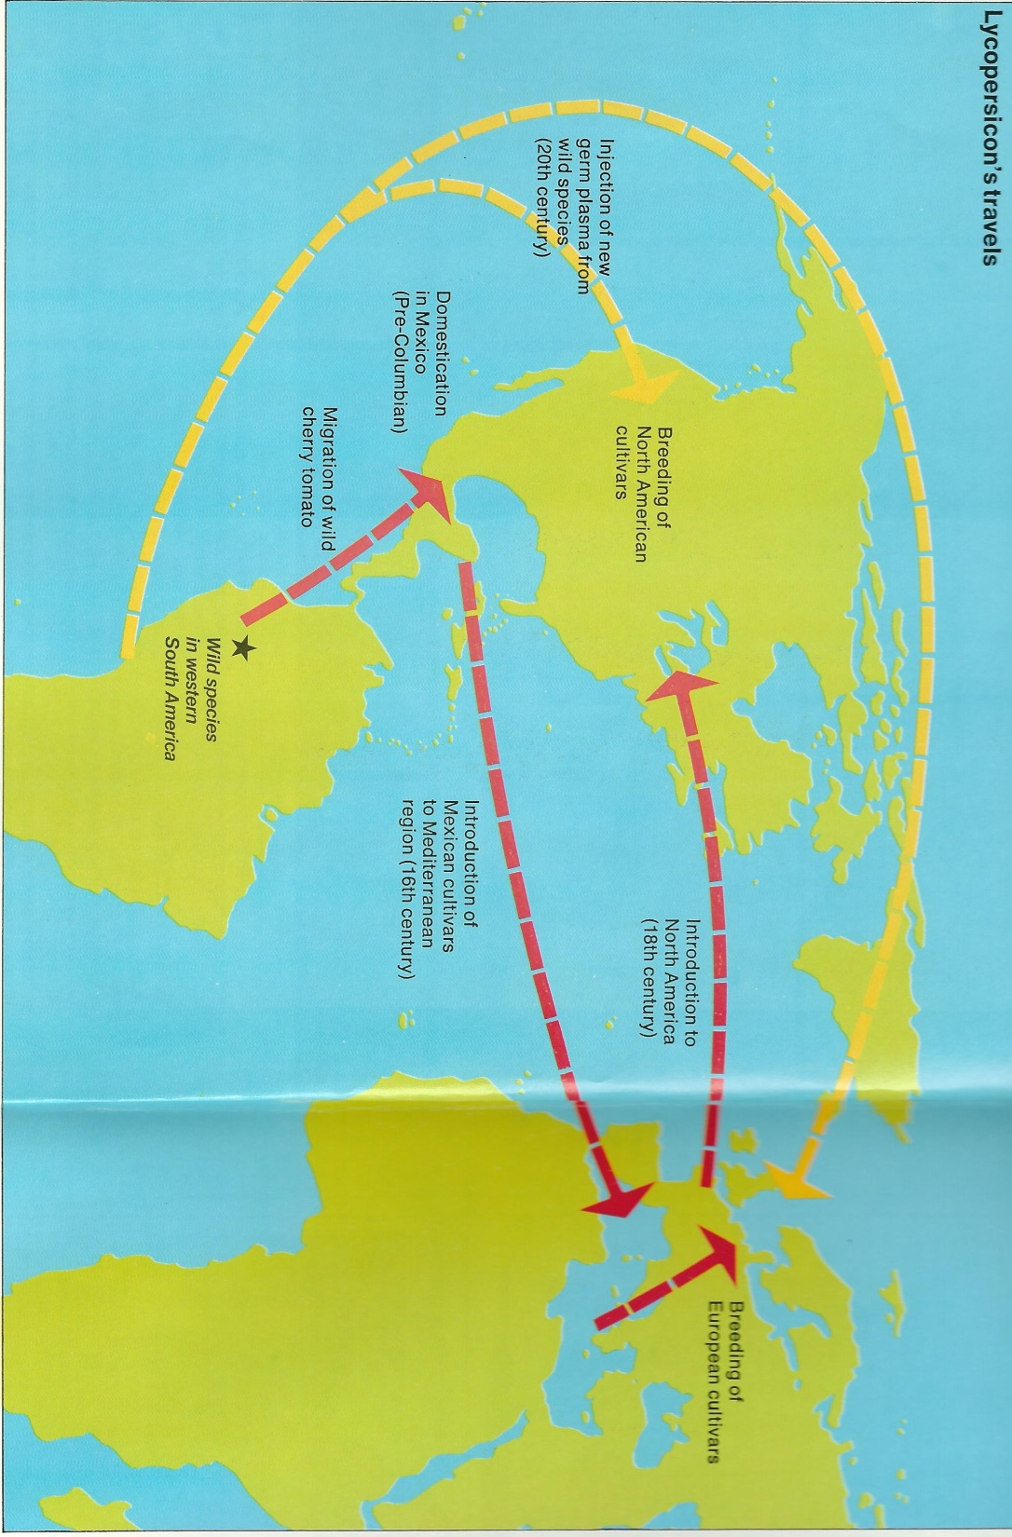

Tomato – The World Traveler
Notes:
See Nevada County MG YouTube and Publication 31-159
The tomato is a native to South America and confined to a narrow coastal region in the northwestern corner of the continent from Ecuador to northern Chile.
- In the 16th and 17th centuries, early seafaring explorers brought the domesticated tomato back to European populations, where it was received with mixed emotions.
- Many potential plant propagators that had previous knowledge of the nightshade family were familiar with their toxicity, making tomatoes slow to catch on.
- Today, the tomato is not only the most popular garden vegetable in the U.S. but is cultivated in nearly every country around the planet with a sufficient growing season.
- Some experts believe it is the single most important horticultural crop on the global scale.

Slide 10
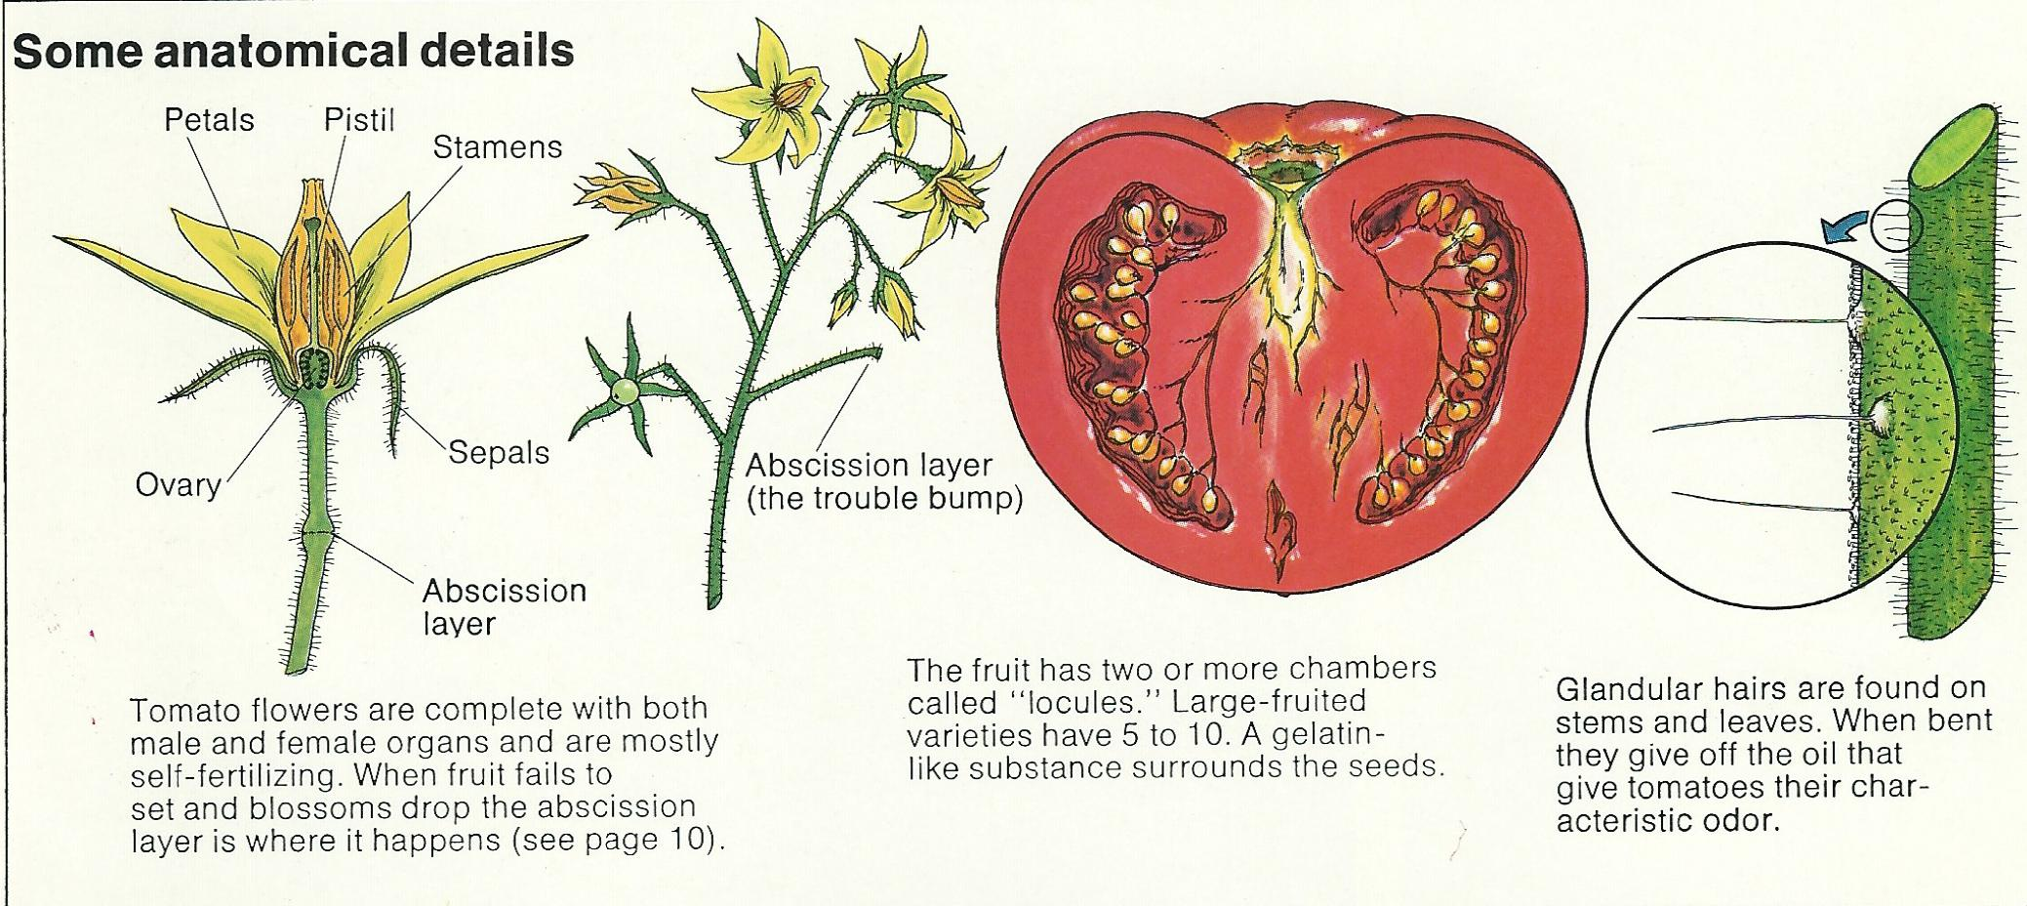
Anatomy of a Tomato
Notes:
Flower has both male (stamen) & female (pistil) parts.
Wind or shaking the flower will fertilize the flower for fruit to set.
(NOTE: Point out seeds in cross section of tomato picture, later discuss seed saving.)
Glandular hairs on stems give off a characteristic odor.
Photo: Nevada County MG presentation

Slide 11

Heirloom vs. Hybrid
What’s Going On?
Heirloom
  Introduced more than 50 years ago
  Must have a history of its own
Hybrid
  Cross-pollinated with human intervention
  Not true to type
  Bred for specific improvements
Notes:
Let’s talk about different types of tomatoes.
Heirloom are grown for:
- better taste
- less than perfect bright red uniform shape
- seeds have been collected by families and passed down
Hybrid:
- developed after WWII for mechanical harvesting with a thicker skin that holds up during shipping to market
- developed for resistance to diseases and pests
Source: https://sacmg.ucanr.edu/What_are_Heirloom_Tomatoes/

Slide 12
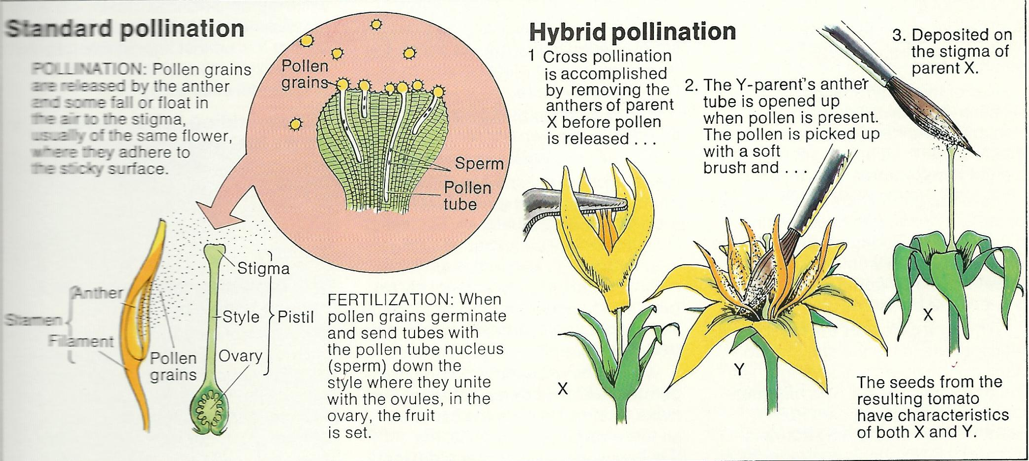
Standard vs. Hybrid Pollination
Notes:
Standard: pollination happens naturally by falling to the stigma in the air
Hybrid: pollination needs more mechanical intervention

Slide 13
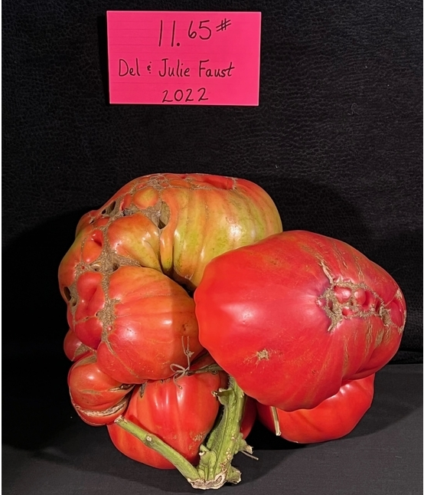
World Record Tomato
Notes:
Grown by Del & Julie Faust in Stillwater, Minnesota in October 2022. Possibly Beefsteak variety.
https://www.guinnessworldrecords.com/world-records/heaviest-tomato

Slide 14
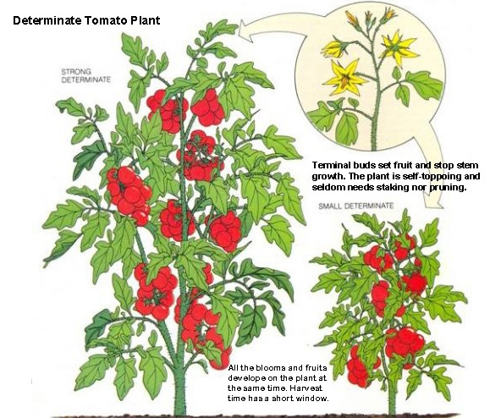
Determinate (Bush)
Notes:
- Determinate grows to a certain size and produces tomatoes all at once.
- Harvest time is short, good choice for canning.
- Also good for containers.
- Variety examples: Rutgers, Roma Celebrity.
https://ucanr.edu/blogs/blogcore/postdetail.cfm?postnum=16937

Slide 15
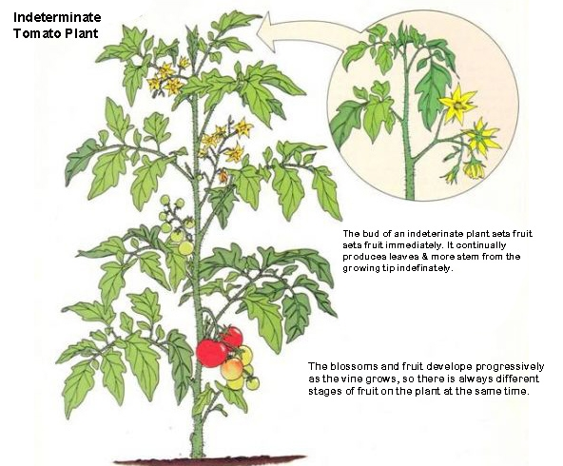
Indeterminate (Climbing)
Notes:
- Indeterminate continues to grow all season long until killed by frost.
- Vining because they continue to flower and bear fruit over the season.
- At my house will continue through November.
https://ucanr.edu/blogs/blogcore/postdetail.cfm?postnum=16937

Slide 16


Picking the right plant for you
Purpose Slice / Canning
Seed or plant choice
    Heirloom or Hybrid
    Disease resistant
Seed company - over 10,000 varieties / Location
Store limited choices
Grow time / Season length
Notes:
NOTE what are you doing with them
Can Roma san Marzano, amish paste. Brandywine
Slice beefsteak ace earygirl
For following slides: https://ucanr.edu/sites/ucmgplacer/files/171555.pdf

Slide 17
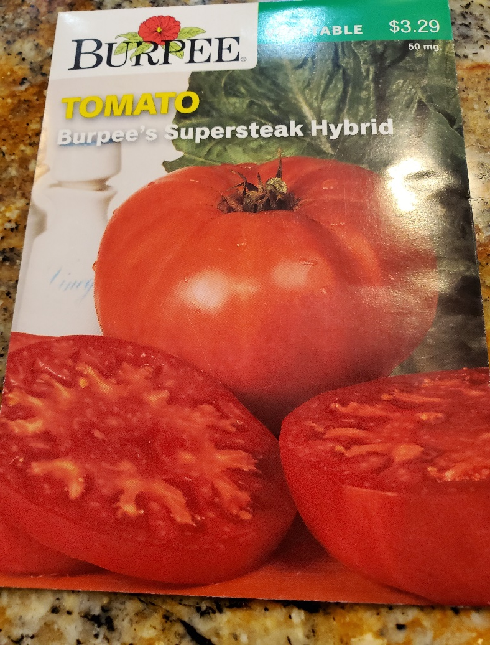
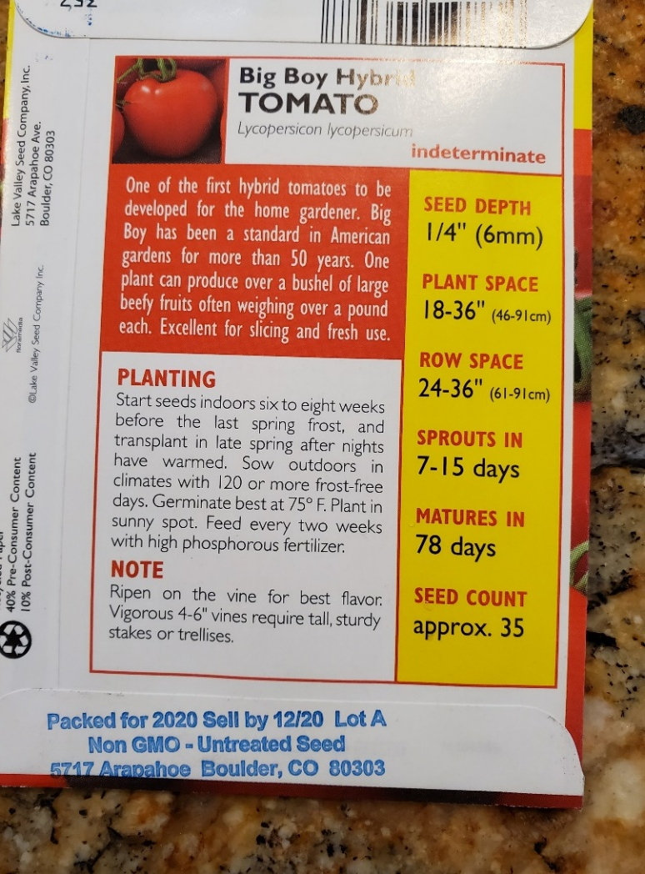
Starting your plants from seed
*Read Your Seed Packet*
Notes:
Photo: D. Warman

Slide 18
Work Backward from Anticipated Planting Date
Proposed Planting Date – May 1
Start Seeds six to eight weeks prior to May
Start seeds – first two weeks of March
Last Frost date – Month of March for our areas
Start Seeds | Interval | Planting Date
March 2 - 16 | 6 – 8 weeks | April 27 – May 11
Notes:
https://anrcatalog.ucanr.edu/pdf/8159.pdf
Make sure before planting, your typical frost date has past.

Slide 19
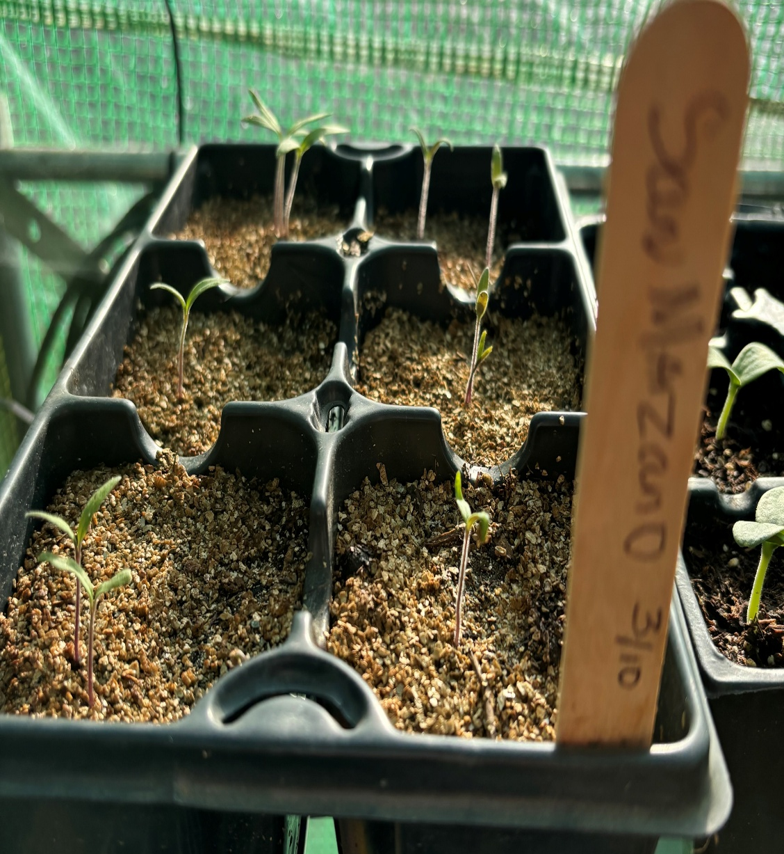
Sowing the Seed
Soil
    Seed Starter mix / Sterilized
    Potting soil / larger pieces
    moisture
Container
    6 cell less water /choose best one / pot up
    2”, 3” 4”
    Fill and tap down
Seed depth
  ¼ inch / lightly cover/ Water in

Slide 20

NO LIGHT NEEDED
Tomato seeds do not need light to germinate,
But they do require proper warmth, moisture, and oxygen. The ideal temperature for germination is around 70°F to 85°F (21°C to 29°C) soil temperature. Heating Mats are very helpful.

Slide 21
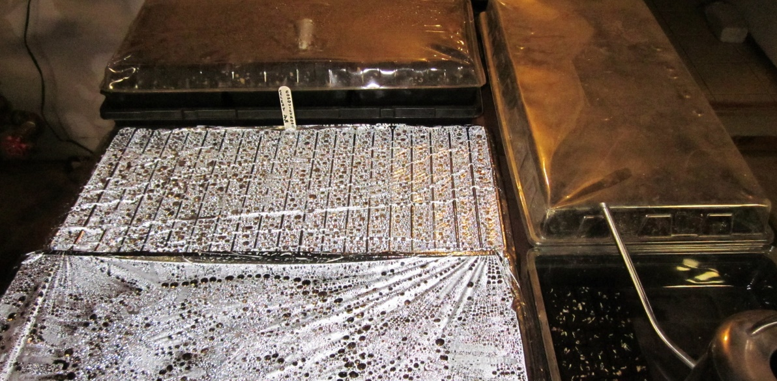
Cover to Retain Moisture
Notes:
Cover with plastic to retain moisture
Photo by D. Warman.

Slide 22
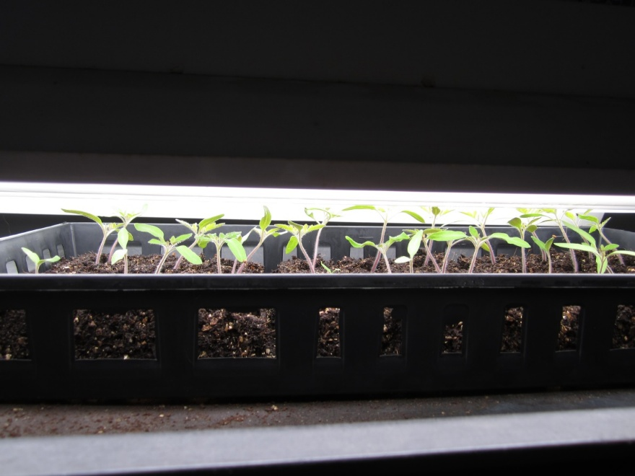
They have sprouted
Remove dome to prevent damping off / remove from heat mat
Provide light 12 hours/day if possible to keep from getting leggy
Maintain proper moisture

Slide 23
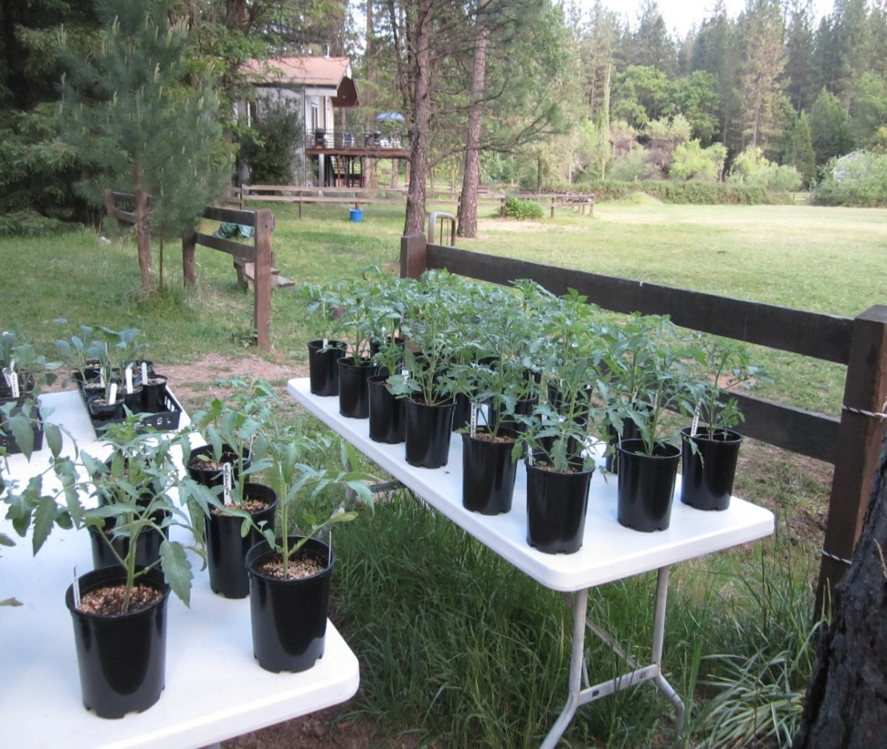
4-6 weeks of growth
Harden off
Start Slowly: for the first day set outside in shady but not to windy area.
Increase sun exposure gradually
Finally leave outside when the forecast is to be above 50 degrees F overnight.
Do this for about a week

Slide 24
Prepare Planting Space For Transplant
IN GROUND
CONTAINER
Choose your Container at least 5 gallon, with holes
Add Soil Medium
Add Organic Matter
Add your Fertilizer, may need to add every few weeks Liquid is good
Prepare water system. Needs more water than in ground
Remove weeds
Add organic matter
  aged animal manure, compost,
Add appropriate organic or chemical fertilizer
Water System- Drip works very well
Notes:
Test soil: either through a lab or inexpensive test kit you can find at any nursery. Lab will be most accurate; test kit will provide approximate nutrient content.
https://ucanr.edu/sites/ucmgplacer/files/166281.pdf
https://ucanr.edu/blogs/CCMGBlog/blogfiles/38756.pdf

Slide 25
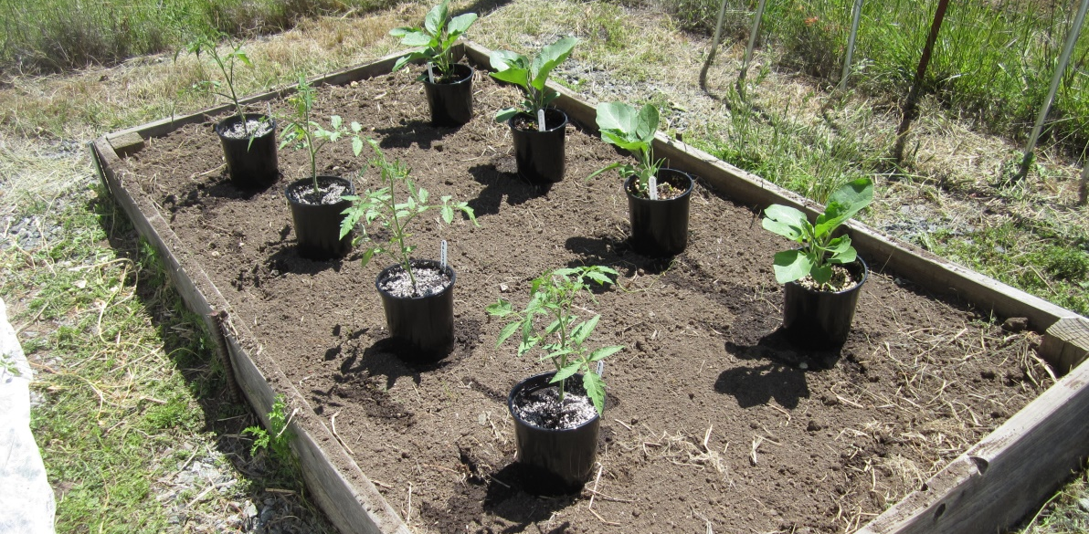
Spacing
Notes:
Plant tomatoes 3 to 4 feet apart for unslaked and 1 1/2 to 2 feet if staking.
Photo by D. Warman.

Slide 26
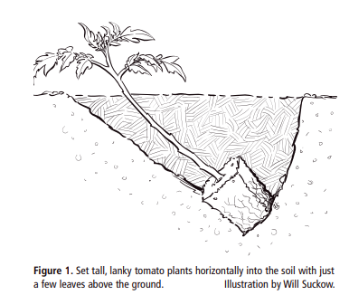
Deep Planting
Notes:
Transplants should be about 6 to 8 inches, tall, hardened-off, stocky and with healthy green leaves.
Water 2 hours before planting in the afternoon to minimize water loss during cooler overnight hours.
Pinch off lower leaves so when buried, roots will form.
Set plant into soil horizontally with few sets of top leaves showing. This will give the plant a solid foundation.
Growing Tomatoes in the Home Garden, https://anrcatalog.ucanr.edu/pdf/8159.pdf

Slide 27
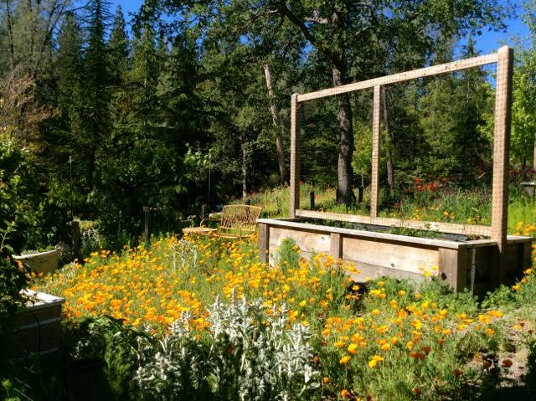
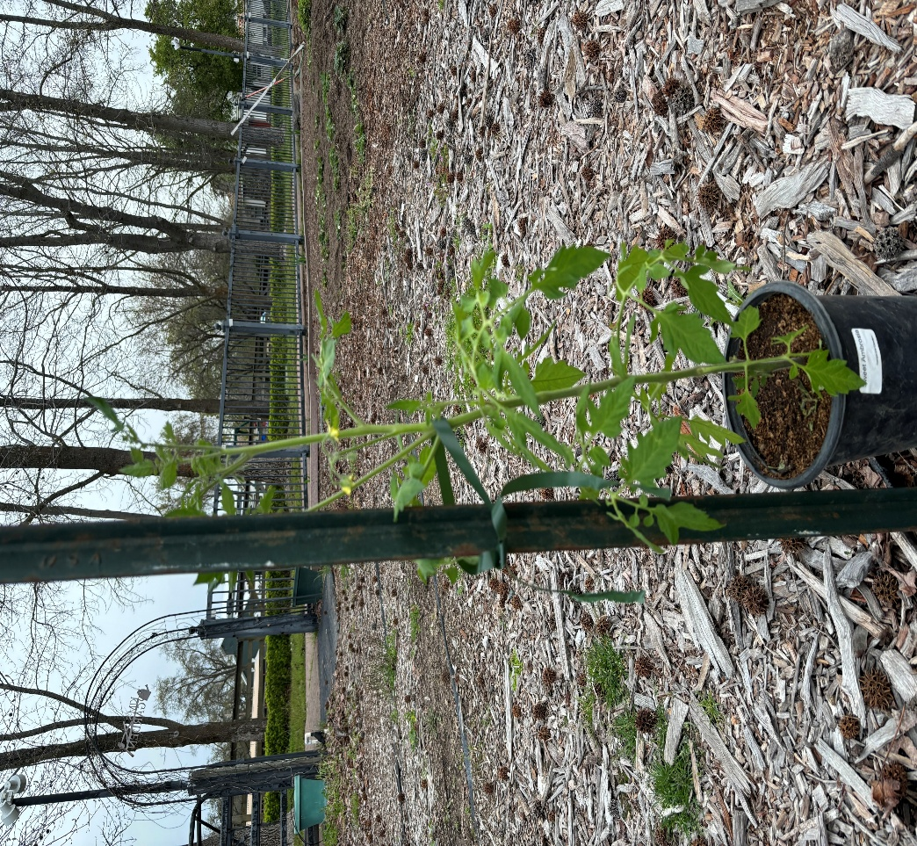
TOMATO SUPPORTS
trellis
Poll
Notes:
Various support structures.
Photo by D. Warman.

Slide 28
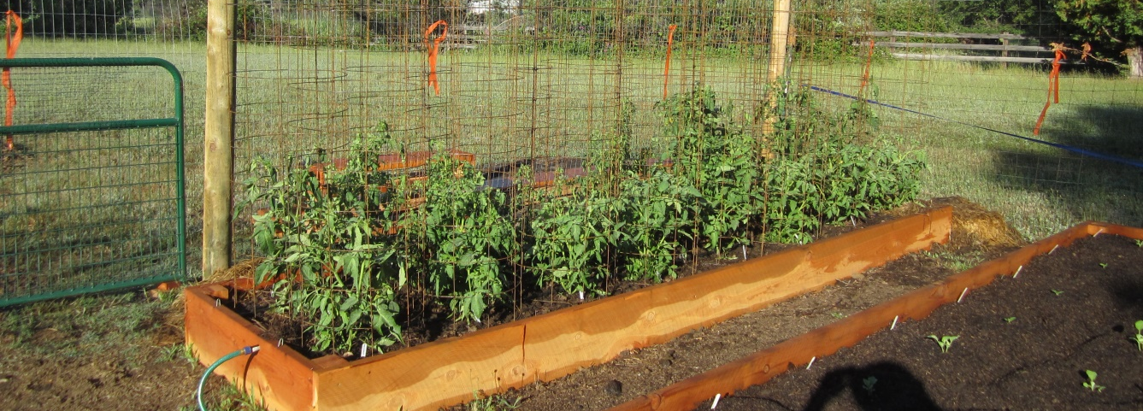
Support - Cage
Notes:
Various support structures.
Photo by D. Warman.

Slide 29
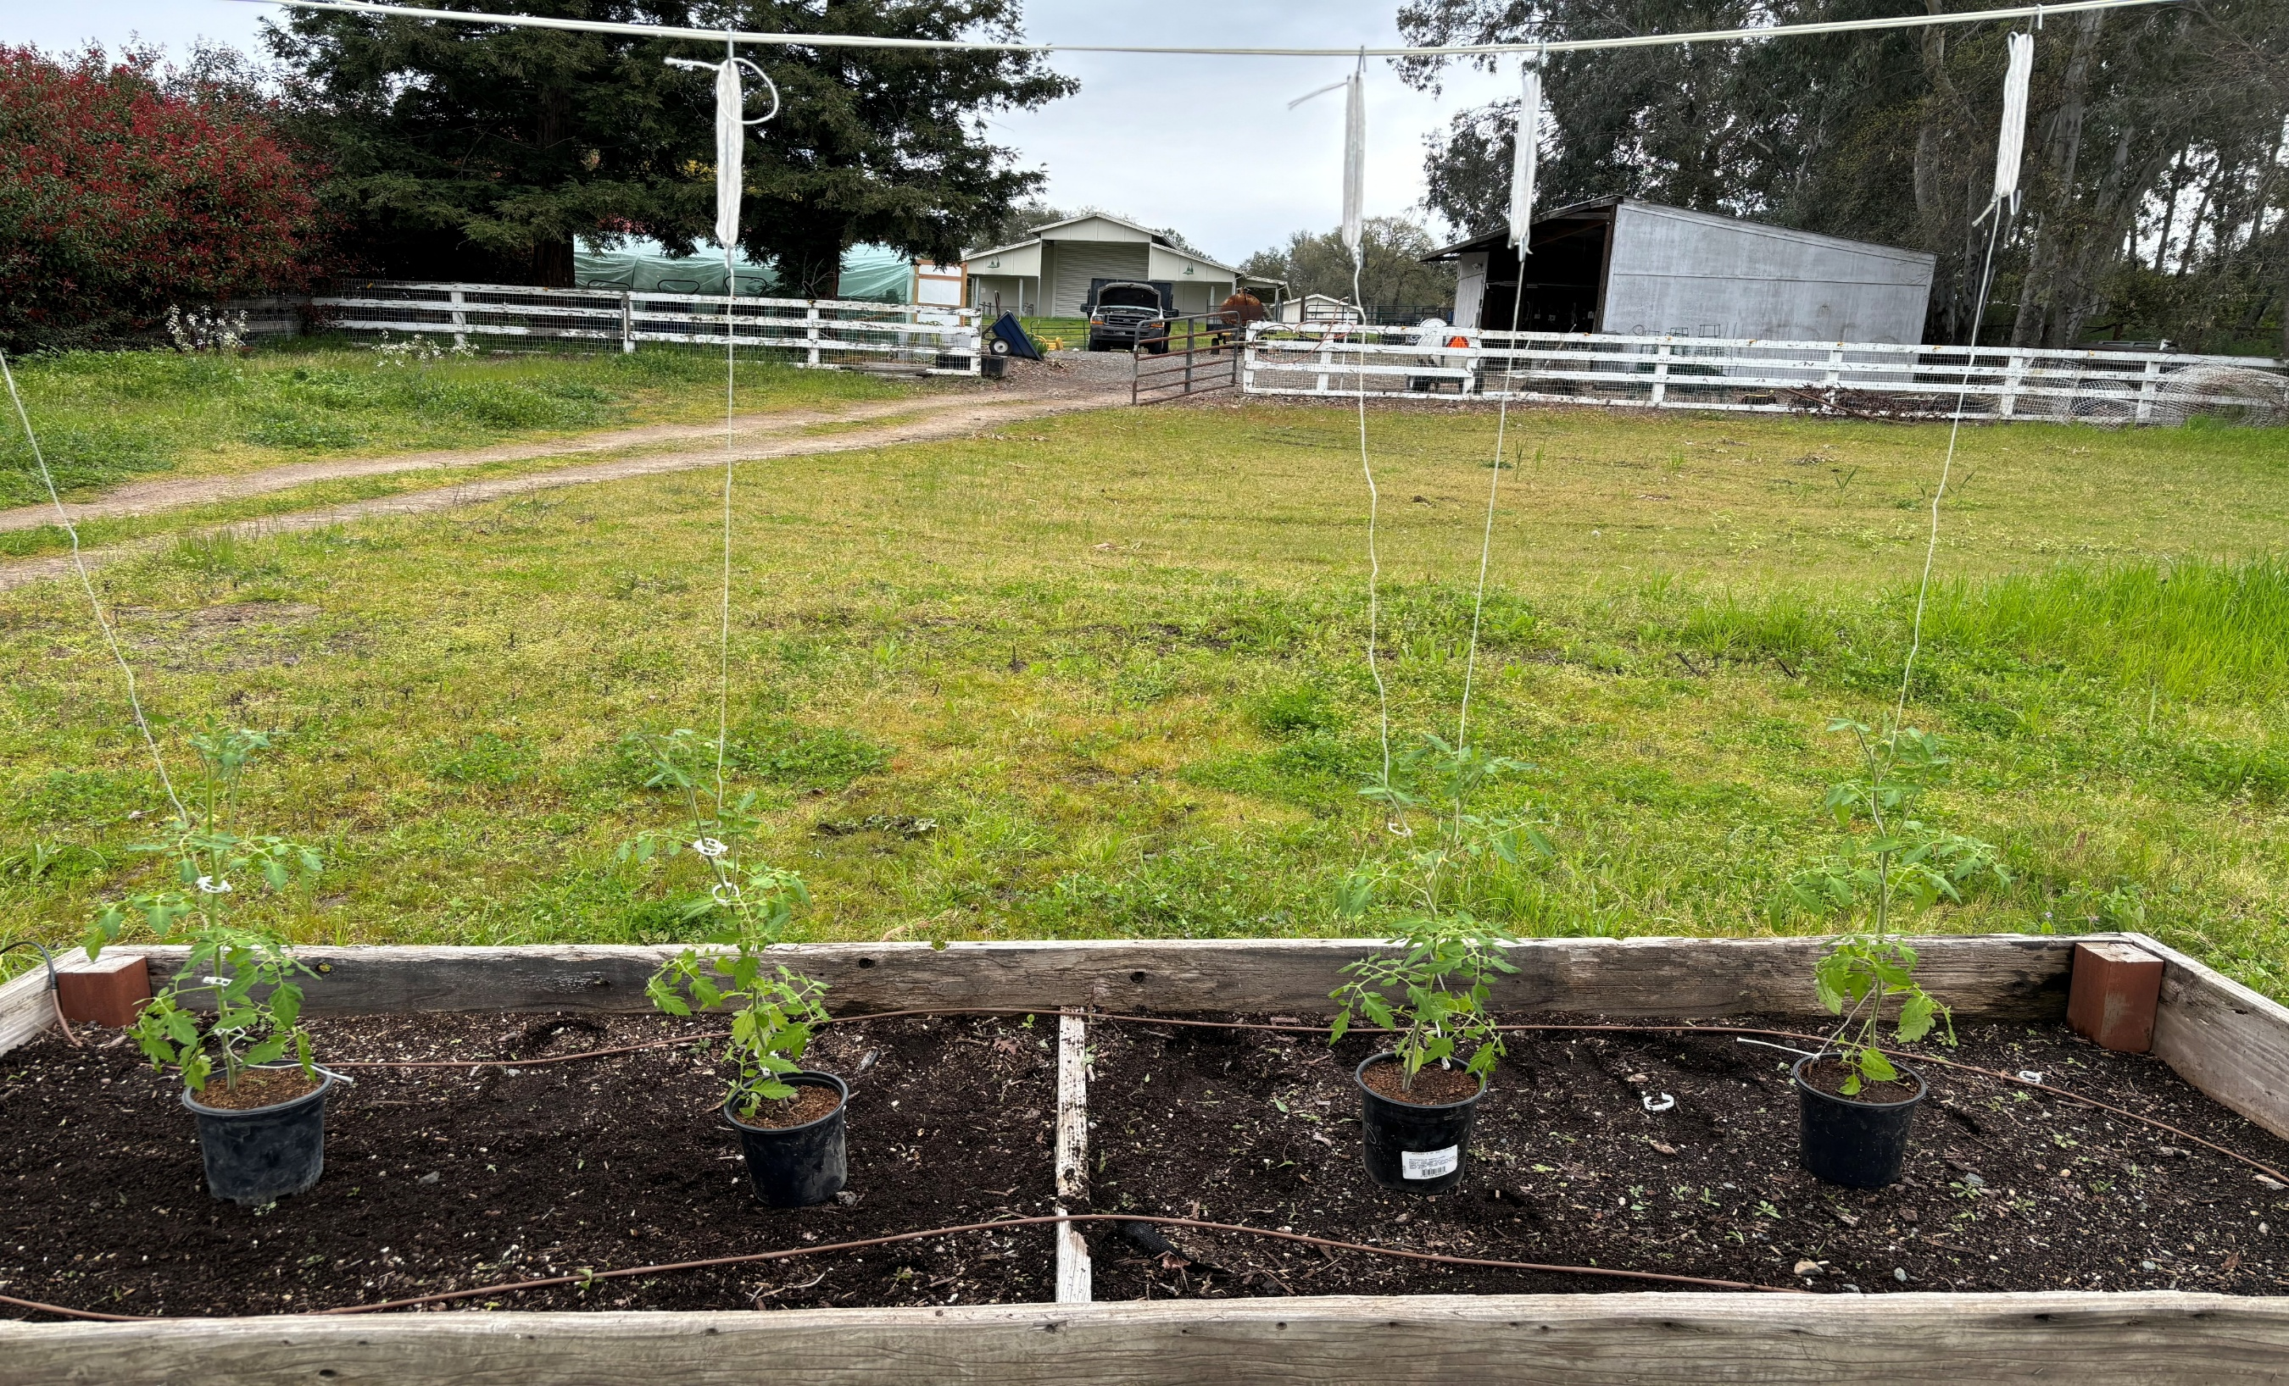
Support – Tie up
Notes:
Various support structures.
Photo by D. Warman.

Slide 30
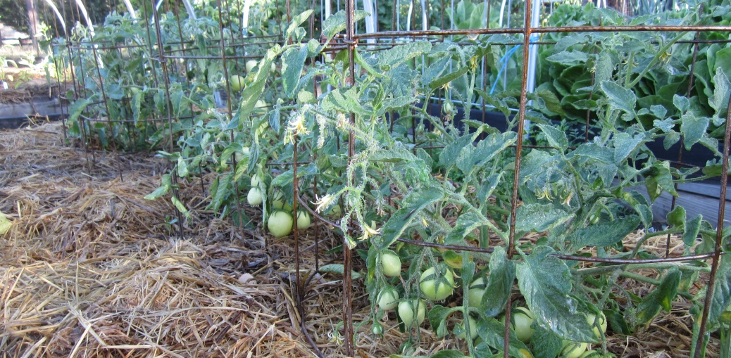
Mulch
Notes:
A layer of mulch 3 to 4 inches deep (compost or straw) will help:
- reduce soil moisture fluctuations
- moderate soil temperature
- discourage weeds
Photo by D. Warman.

Slide 31
Maintenance
Watering
Fertilizing
Pruning
Notes:
See: https://ipm.ucanr.edu/home-and-landscape/tomato/cultural-tips/index.html?src=307-pageViewHLS#:~:text=Pruning%20tomato,-Pruning%20is%20not&text=Plants%20with%20two%20or%20more,the%20others%20as%20they%20develop.

Slide 32
Fertilizing
Organic | Inorganic
Manures , Compost & Fish Emulsion | Chemical
Continues to improve the soil. | Can generate waste (salts) and damage the soil.
Add around plant lightly work in soil | 1 – 2 lbs./100-foot row
Nitrogen (N) + promotes foliage green color Phosphorus (P) + root growth, blooms, sets fruit and seed development Potassium (K) regulates water nutrients and carbohydrates in plant tissue, helps to prevent disease. | 10-30-20 at peak of blooming Container gardening needs more fertilization can’t pick up from ground. Raised bed gardening losses nutrients from faster water loss. In ground mother nature can’t keep up with the plant using the nutrients.
Notes:
Every time you take something away from the soil, you must give something back. Otherwise, you are literally stunting growth.
https://ipm.ucanr.edu/home-and-landscape/tomato/cultural-tips/index.html?src=307-pageViewHLS#:~:text=Pruning%20tomato,-Pruning%20is%20not&text=Plants%20with%20two%20or%20more,the%20others%20as%20they%20develop

Slide 33
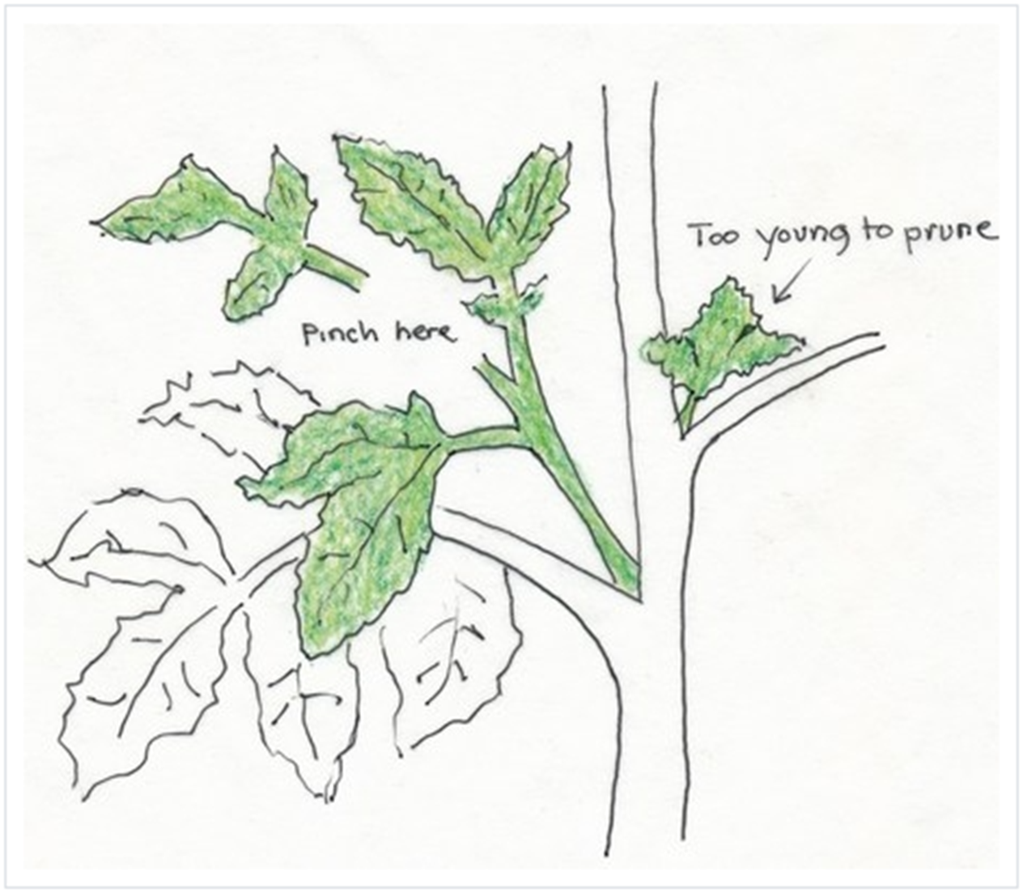
Pruning: The Secret to Bigger & Tastier Tomatoes
Two or more stems produce more tomatoes
Removing suckers after two leaves develop
Pinch above them
Notes:
https://ucanr.edu/News/?routeName=newsstory&postnum=57078

Slide 34

Watering
Deep moisture will keep your plants healthy and help protect from Disease
Avoid wetting the foliage or fruit.
Drip systems are encouraged
Saves time
Saves water
Gets water exactly where you need it
Notes:
https://ipm.ucanr.edu/home-and-landscape/tomato/cultural-tips/index.html?src=307-pageViewHLS#:~:text=Pruning%20tomato,-Pruning%20is%20not&text=Plants%20with%20two%20or%20more,the%20others%20as%20they%20develop

Slide 35
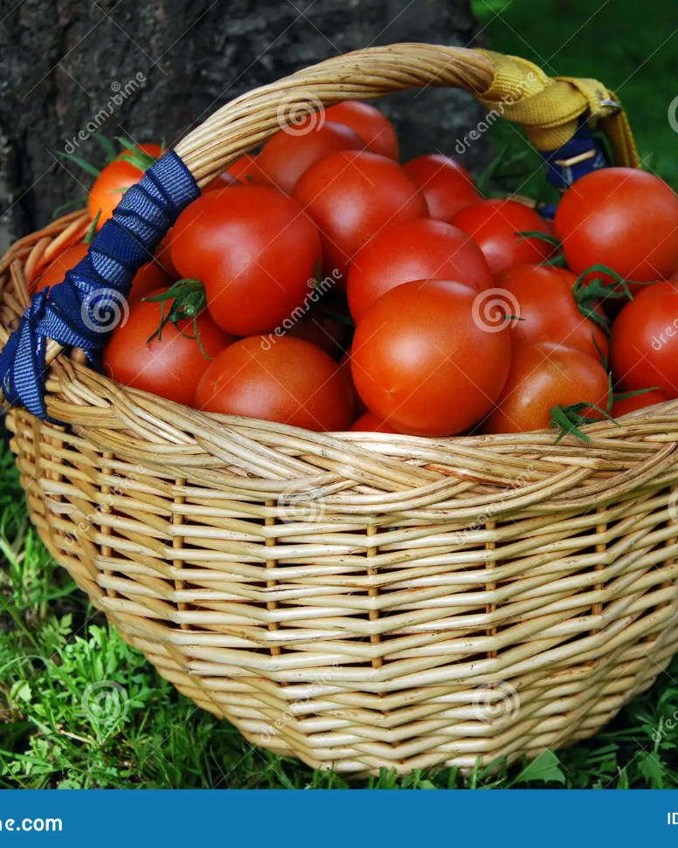
Harvest
Make sure you harvest regularly. This will help prevent rotting fruit that attract unwanted insects that cause disease.
Use shears to remove
Pinch off at knuckle
Eat and enjoy
Notes:
Photo by dream time

Slide 36
Other Considerations
PH of soil
Tomatoes prefer PH from 6.0-7.0 7 is neutral >7 is acidic <7 is alkaline
Location and orientation of bed
East/west with at least 6-8 hours of sun
Avoid cold micro-climates
Crop rotation
3-year rotation is good
Don’t follow plants from the same family (eggplant, peppers, potatoes)
Notes:
PH – use your soil tester mention in previous slide.
Location/orientation – raised bed should get equal amounts of sun
Crop rotation – enhances soil fertility and prevent insect and disease pests isolating pests from food source

Slide 37
Pests and Problems
Vertebrate Pests
Insects
Diseases

Slide 38
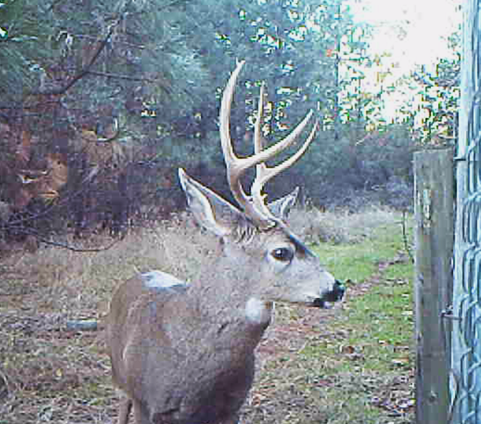
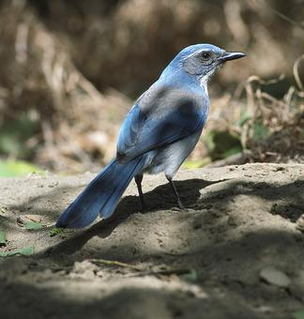
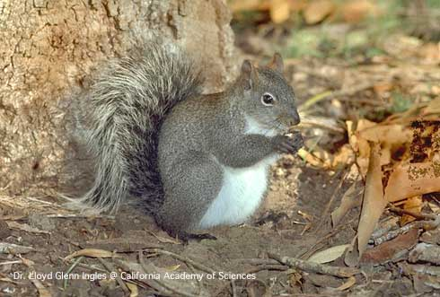
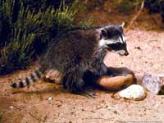
Vertebrate Pests
Notes:
We have a separate presentation on Vertebrate Pests on our YouTube channel called From Bambi to Thumper Zoom Workshop: An Integrated Strategy for the Management of Vertebrate Pests.
Photos from: https://ipm.ucanr.edu

Slide 39
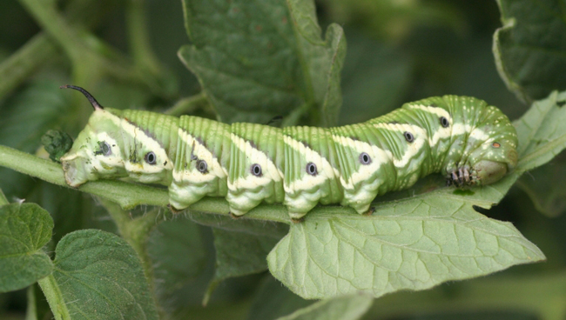
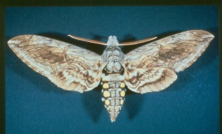
INSECTS
The Dreaded Hornworm!
Tomato and tobacco hornworms feed only on solanaceous plants
Five-spotted hawk moth
Notes:
https://ipm.ucanr.edu/agriculture/tomato/hornworms/
Feed on blossoms, leaves and fruit.
Photos from IPM.ucanr.edu
urbantomato,.ca

Slide 40
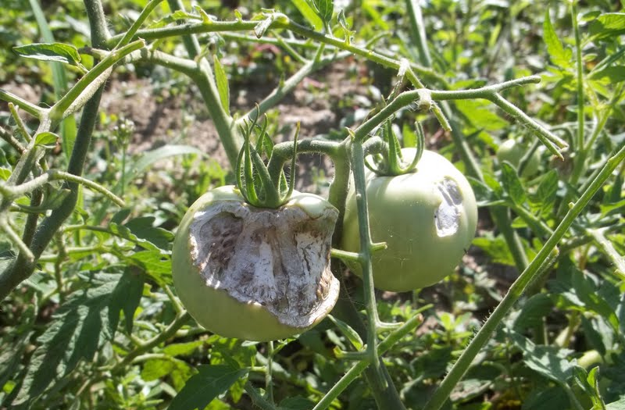
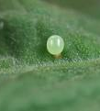
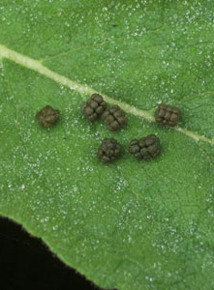
Signs of Invasion
Top picture: damage by the hornworm
Bottom left: egg of hornworm
Bottom right: Droppings of the hornworm
Notes:
Hornworm eggs and poop. You’ll probably see the poop before you see the eggs.
Photos from IPM.ucanr.edu

Slide 41
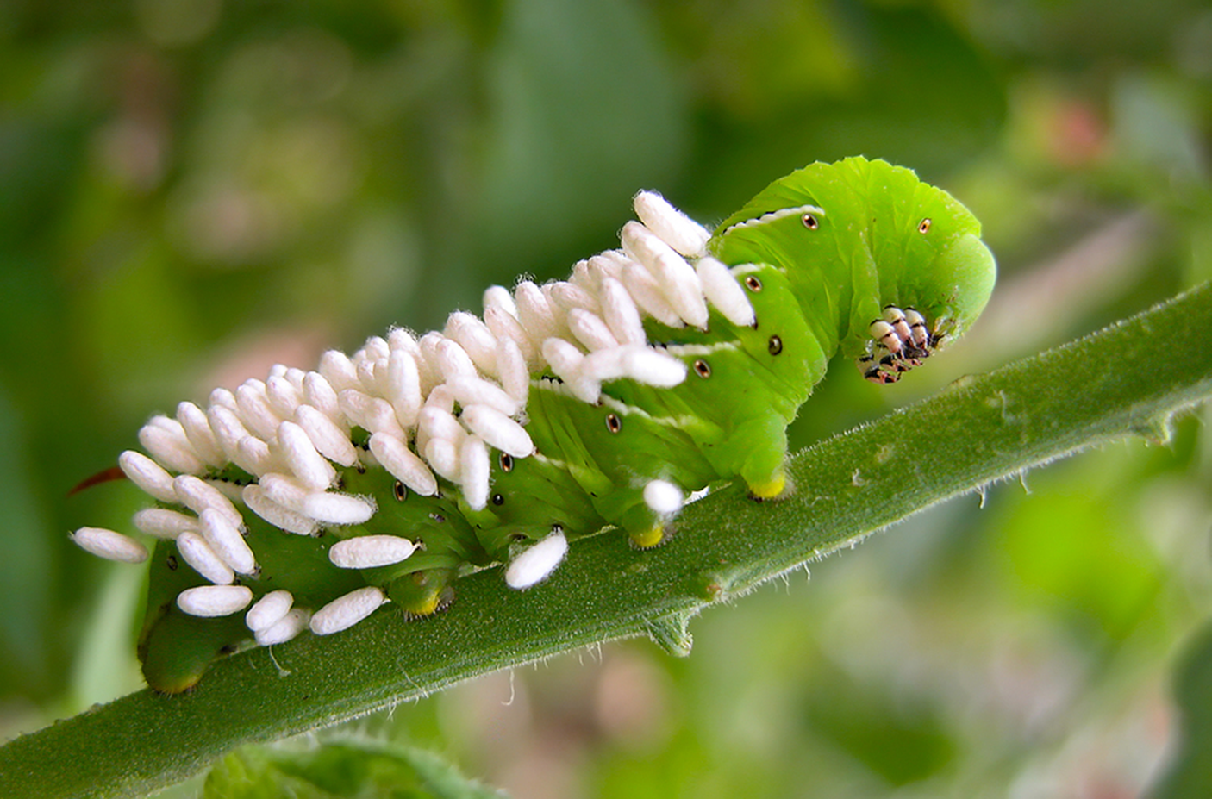
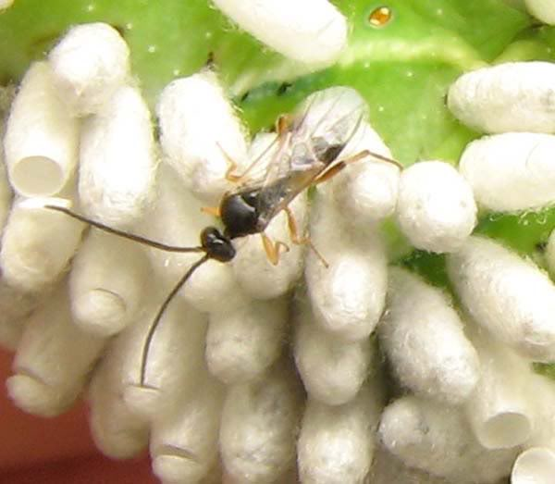
We Have Allies!
The Brachonid Wasp
Natural control of hornworms can also occur. Insects such as lady beetles, green lacewings
Notes:
Brachonid Wasp lays their eggs on the hornworm and the eggs begin to devour the hornworm. If you see this in your garden, leave it be. The wasp is a great thing to have in your yard. Otherwise, hand pick off the hornworm and dispose in garbage.
Photos from IPM.ucanr.edu

Slide 42
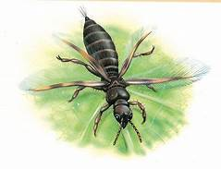
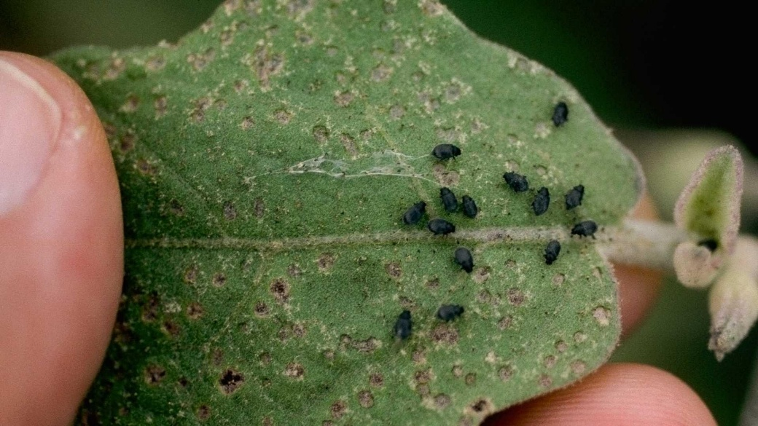
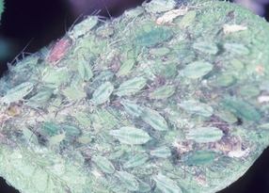
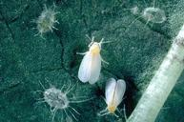
Less common pests
Flea Beetle
thrips
White flies
Potato aphids
Notes:
Home and Garden Information Center
Photos from IPM.ucanr.edu

Slide 43
Pest/Control
Insect Pest | Natural, Less Toxic Insecticide
Potato Aphid | Insecticidal Soap Pyrethrin Neem Oil Extract
Flea Beetle & Thrips | Insecticidal Soap Pyrethrin Neem Oil Extract
Whitefly | Insecticidal Soap Neem Oil Extract
Tomato Fruit Worms & Hornworms | Bacillus Thuringiensis (B.t.) Spinosad Pyrethrin Neem Oil Extract
Notes:
Neem Oil Extract seems to be the common less toxic insecticide.
https://ipm.ucanr.edu/agriculture/tomato/

Slide 44
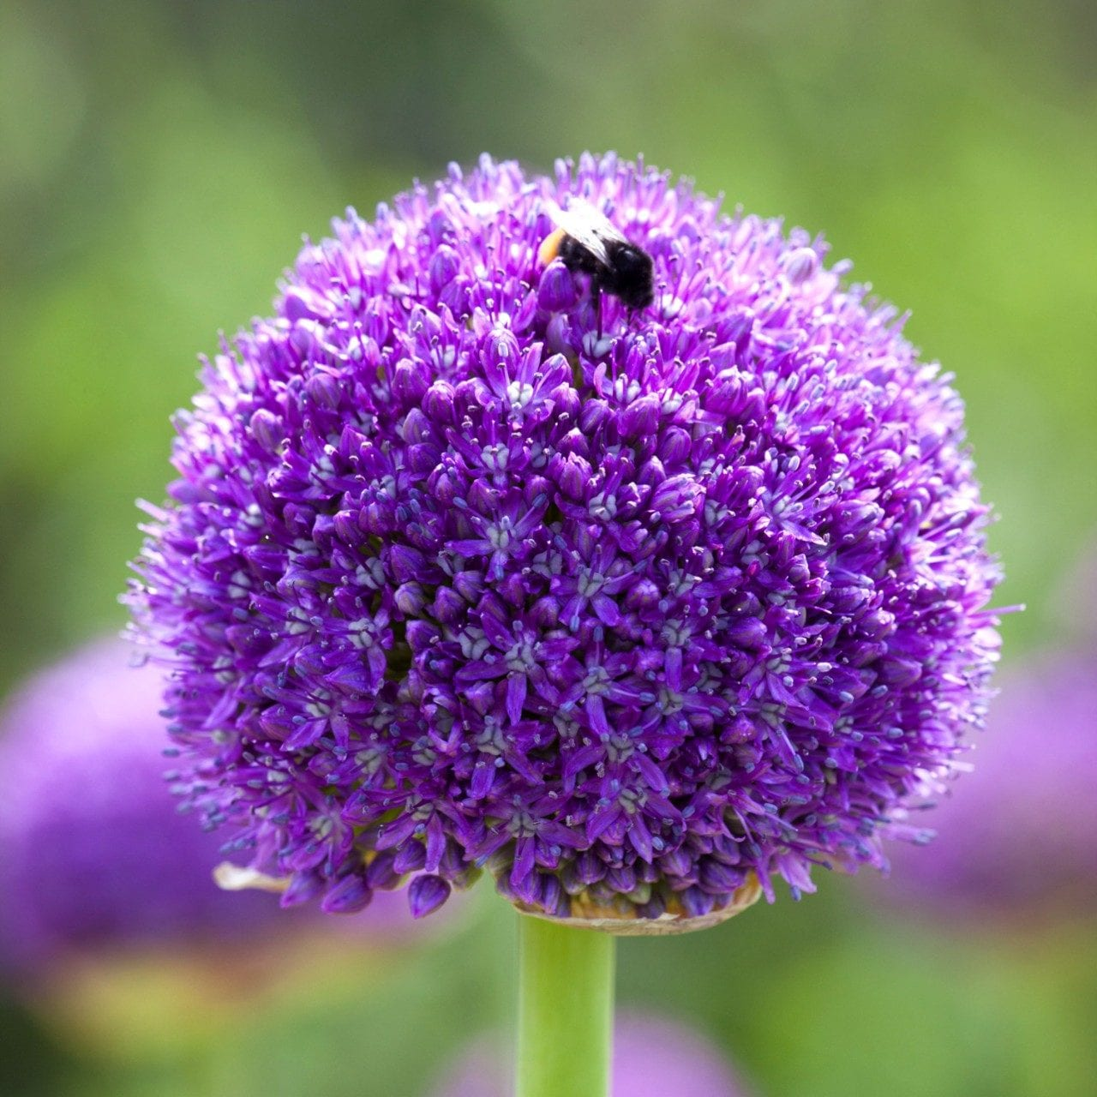
Companion Planting
Companion planting: can be described as establishing two or more plant species in close proximity for some cultural benefit (such as pest control or higher yield). The concept embraces a number of strategies that increase the biodiversity of agroecosystems (Cunningham, 1998)
Alliums, Asparagus, Basil, Carrot, Cucumber Marigold, Nasturtium, Nettles, Parsley, Rosemary
Not Pole Beans

Slide 45
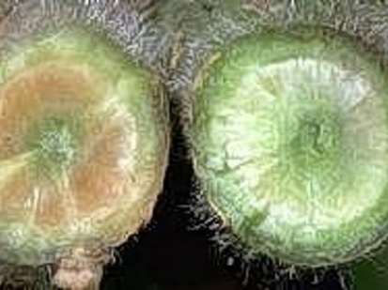
Tomato Diseases
Verticillium and Fusarium Wilt
Tobacco Mosaic Virus
Damping Off
Powdery Mildew
Blossom End Rot
Sunscald
Notes:
Common tomato diseases. See next slide for photos.
Picture from contra costa master gardener
Almost eliminated by resistant variety

Slide 46
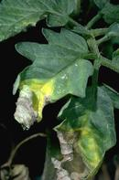
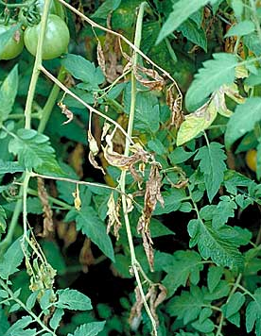
Soil-Borne Fungi Disease
VERTICILLIUM WILT
FUSARIUM WILT
Fungi spreads into the vessels and blocks the water flow to foliage
PURCHASE RESISTANT VARIETIES OR MAKE SURE TO KEEP YOUR SOIL HEALTHY.,
Notes:
Verticillium or Fusarium wilt, seldom kills tomato plants, but reduces their vigor and yield.
https://ipm.ucanr.edu/agriculture/tomato/verticillium-wilt/
https://ipm.ucanr.edu/agriculture/tomato/fusarium-wilt/
https://ipm.ucanr.edu/agriculture/tomato/tobacco-mosaic/

Slide 47
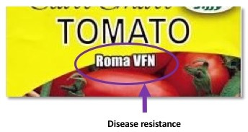
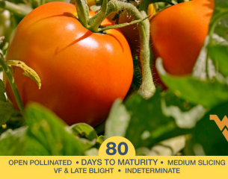
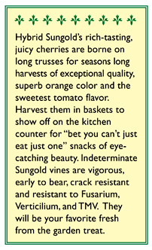

Notes:
Check your seeds packets that are resistant to Fusarium, Verticillium and Tobacco Mosaic Virus (TMV).

Slide 48
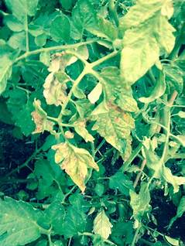
Tobacco Mosaic Virus
Discovered 1900 devastated crops
The viruses infect the plant by entering microscopic wounds in the plant cells
Spreads by direct contact
Clean all tools / crop rotation / debris
Buy resistant varieties

Slide 49
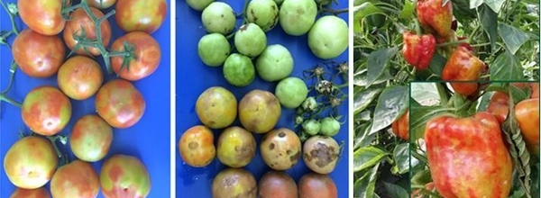
tobacco mosaic virus
Notes:
Picture from Moorman, G.W. 2015. Tobacco Mosaic Virus (TMV). PennState Extension.

Slide 50
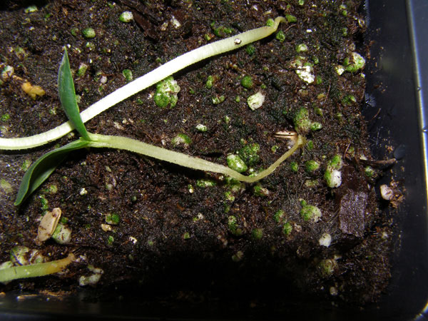
Damping Off
It is caused by a fungus or mold that thrive in cool, wet conditions
Seedlings fail to emerge from the soil
Seedling stems become water soaked and thin, almost thread like, where infected.
Young leaves wilt and turn green-gray to brown.
Fluffy white cobweb-like growth on infected plant parts under high humidity.
Notes:
Constricted or damaged stems when seedlings.
Photo: D. Warman

Slide 51
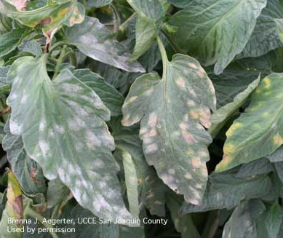
Powdery Mildew
BEST TO PREVENT RATHER THAN CURE.
Have good air circulation / pruning
Plant in full sun
Keep leaves dry
Buy resistant varieties
The disease occurs primarily on foliage, looks like your plant is covered in flour. Leads to reduced photosynthetic activity, premature leaf drop, and reduced fruit size and yield.
Notes:
Prevent watering overhead.
https://ipm.ucanr.edu/agriculture/tomato/powdery-mildew-on-field-grown-tomatoes/

Slide 52

Blossom End Rot
Blossom end rot results from a low level of calcium in the fruit and water balance problem in the plant.
Calcium is transported by the water
Consistent watering
Keep soil moist but not saturated
Notes:
Consistent watering should avoid this. Use a timer for regulated watering.
https://ipm.ucanr.edu/PMG/GARDEN/VEGES/ENVIRON/blossomendrot.html#:~:text=Blossom%20end%20rot%20results%20from,dries%20out%20nor%20remains%20saturated.

Slide 53



Sunscald
Sunscald is when the tomato is burned by the sun.
It can occur on green or on riper tomato
You can prevent sun scald by giving your plants artificial shade.
Any type of shade you can provide is good
Shade cloth is probably the best 40%
Umbrellas work just as well
Notes:
Sunburn caused by overexposed to direct sunlight.
Prevent this by having enough foliage over the fruit or use a shade cloth especially during those very hot days.
https://ipm.ucanr.edu/PMG/GARDEN/VEGES/ENVIRON/tomsunscald.html
Tomato Picture by g johnson
Shade picture by celtic agrarian

Slide 54


Shade Cloth Examples
Provide partial shade during most intense sun part of the day.
30 - 40% shade cloth is good.
Need structure to withstand windy days.
PVC table like structure
PVC hoop like structure
Notes:
https://ucanr.edu/blogs/blogcore/postdetail.cfm?postnum=55005
Photos: Master Gardener Program of Contra Costa

Slide 55

Shade / Pest Cover
Notes:
Deep planting in raised bed.
Photo by D. Warman.

Slide 56



Tomato Cracking
NOT A DISEASE
Cause: Uneven watering skin can’t keep up with the water intake. Harvest to late
Solution: Regular water schedule. Harvest regularly

Slide 57
Last years Question
Why is my tomato plant not producing tomatoes?
Lack of Pollination
To much water
Insufficient Light .
Lack of proper nutrients p/k
High heat
Notes:
Slide 33

Slide 58
GARDENING IS GREAT!!!!
DON’T BE AFRAID TO TRY ANYTHING
HAVE FUN
ENJOY THE FRUITS OF YOUR LABOR

Slide 59
Resources
Tomatoes in the Home Garden, Publication Number 31-159
https://ucanr.edu/sites/ucmgplacer/files/158610.pdf
Growing Tomatoes in the Home Garden, Publication 8159
https://anrcatalog.ucanr.edu/pdf/8159.pdf
Harvesting Seeds From the Garden
https://anrcatalog.ucanr.edu/pdf/8159.pdf
UC IPM Cultural Tips for Growing Tomato
https://ipm.ucanr.edu/home-and-landscape/tomato/cultural-tips/index.html?src=307-pageViewHLS
Author: Russell Groves, UW-Madison Entomology
info@extension.wisc.edu
Author: Cynthia Nations
https://ucanr.edu/blogs/blogcore/postdetail.cfm?postnum=53468
Notes:
This needs updating after going through links in slides.

Slide 60
Thank You!
Any Questions?
Master Gardener Hotline: (530) 889-7388
Master Gardener Website: pcmg.ucanr.edu
Evaluations, please!

