Slide 1
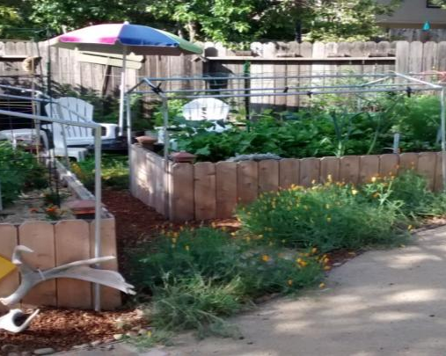
SUMMER GARDENING 2021
Notes:
Created: May 1, 2021
Created by: Kathy Netto of Placer County Master Gardener(s) who created this originally
Audience: Home Gardeners
Publicity: The sun is shining; your garden is planted, and you can almost taste the fruit of your labor. But are you getting the most from your garden? Join Master Gardeners as they discuss frequently asked questions about pest management, fertilizing, and caring for your garden during the heat of summer. These tips will truly help your garden grow.
Update History: for each update to the presentation include date, name of updater, explanation of update
(were additional slides added, were web links updated, etc.)

Slide 2
Who Are Master Gardeners?
Master Gardeners of Placer County
  Extend research-based, sustainable gardening and composting information
  Present accurate, impartial information to home gardeners
  Encourage public to make informed gardening decisions

Slide 3
Who Are Master Gardeners?
Where to find us…
Online, in the Media, and Special Publications
  Hotline: Call (530) 889-7388 or submit your questions online
  Website: pcmg.ucanr.org
  Facebook, Twitter, Instagram
  Gold Country Media monthly column
  Curious Gardener quarterly newsletter on our website
  Gardening Guide and Calendar

Slide 4
Who Are Master Gardeners?
Where to find us…
Workshops, Fairs and Festivals, and Special Events
  Speakers by Request
  Workshops (various venues, check website)
  Farmers’ Markets (seasonal: Auburn, Roseville)
  Fairs and Festivals Booths (varies)
  Garden Faire (April)
  Mother’s Day Garden Tour (May)

Slide 5
DISCUSSION TOPICS
  What’s Eating My Garden?
  Protecting Plants in Extreme Heat
  How Much Should I Water
  Fertilizers and Soil Amendments
  Fruit Tree Care

Slide 6
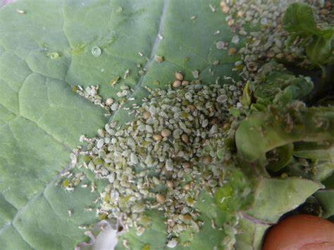
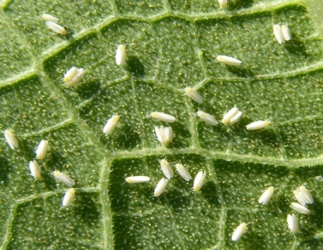
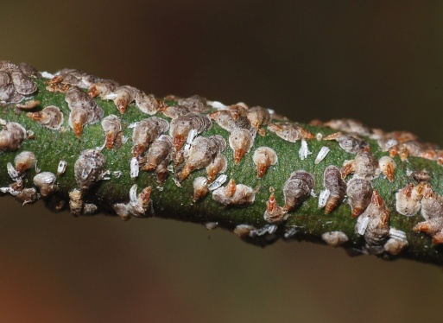
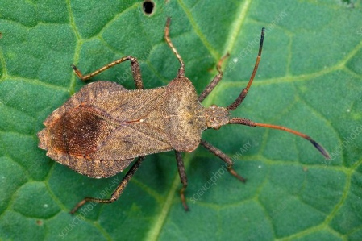
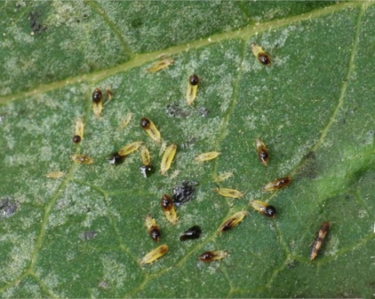
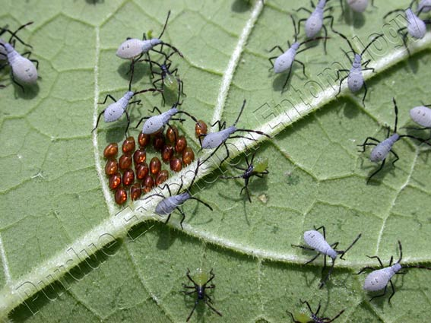
COMMON GARDEN PESTS: Sucking insects
Aphids Whiteflies Scale
Squash bugs
Adult
Nymphs
Thrips
Notes:
Sucking insects suck plant juices and can cause mottled and stippled leaves. They can produce a sticky honey dew sap that can attract ants and cause sooty mildew. Generally they are fairly simple to control with a sharp blast of water, sticky traps or hand picking. If you do develop an infestation there are a number of commercial control methods (See IPM website)
Chewing Insects cause more damage to plants because they can strip the leaves or eat the whole plant. These pests can be controlled by using barriers, hand picking, traps or bait.

Slide 7
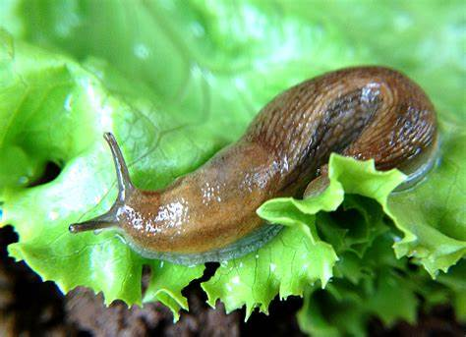
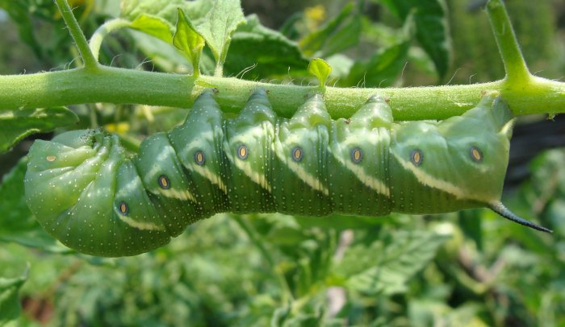
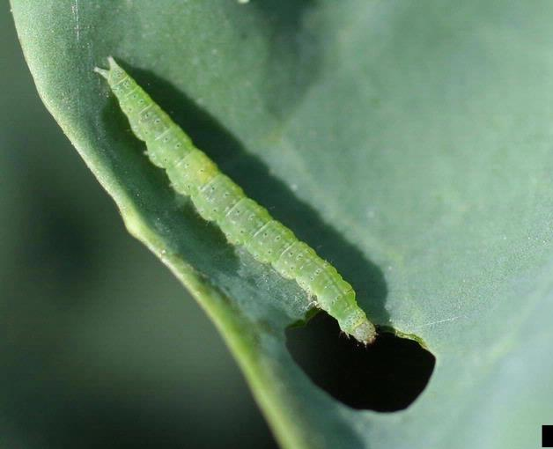
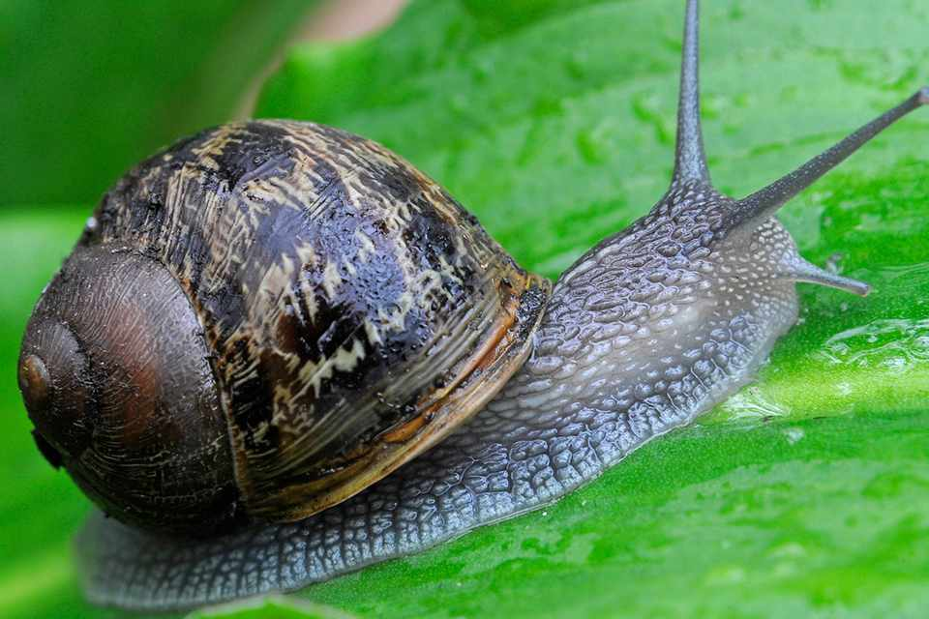
Chewing Pests
Slug Tomato Hornworm
Snail Cabbage moth larva
Notes:
Chewing Insects cause more damage to plants because they can strip the leaves or eat the whole plant. These pests can be controlled by using barriers, hand picking, traps or bait.
Butterfly and moth larva can be controlled by hand picking and if you have chickens they make a tasty treat.

Slide 8
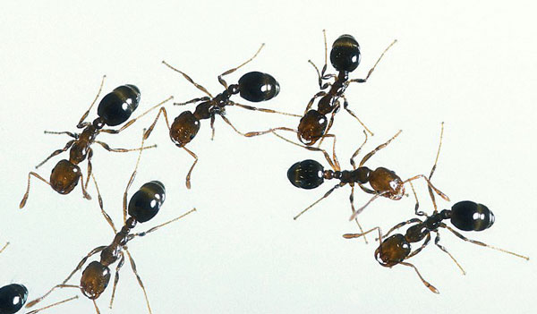
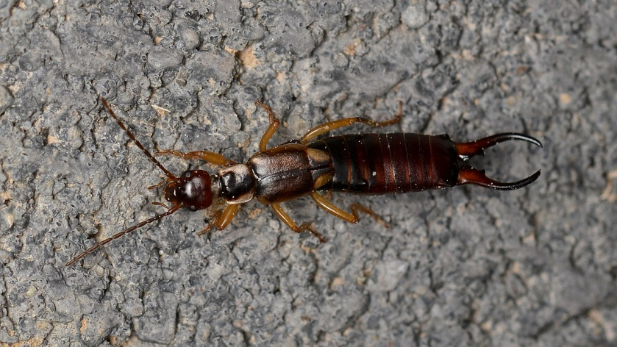
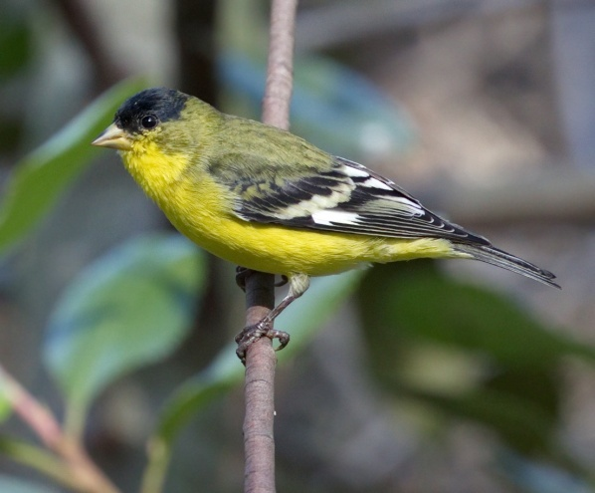
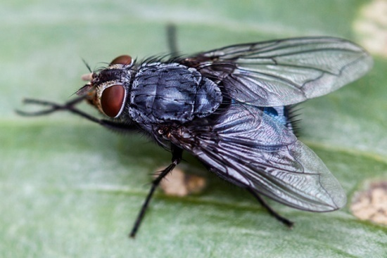
Nuisance pests
Earwigs Ants
Flies
Birds
Notes:
Some pests are just nuisances and can be easily controlled with cultural practices. Some easy controls are: cleaning up after pets, burying food scraps in the compost bin, not leaving pet food out and making sure to pick up fruit that has fallen. This year it seems like the ants are taking over so I’m using ant bait stakes to control them. By controlling ants you can help yourself to control aphids. Ants farm aphids for the honey dew that they produce.
Good cultural practices can also help to control rats, mice and raccoons. If there isn’t a food source, generally these guys move on.
Yes, even those cute birds can be a nuisance in the garden. The love ripe fruit and the tender green of just sprouted vegetables.

Slide 9
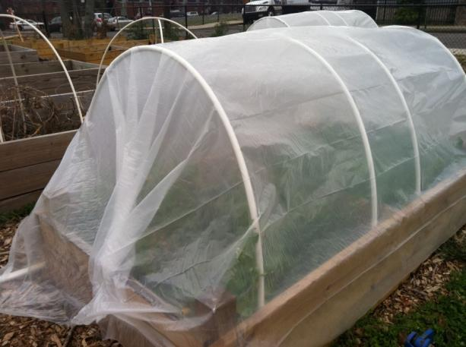
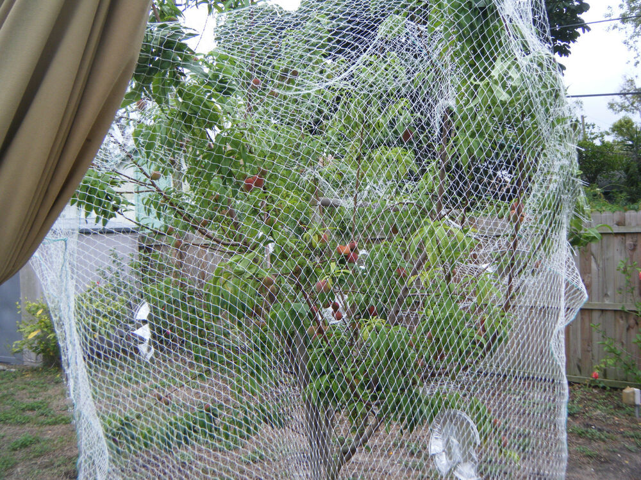
An ounce of prevention……
Use bird netting or shiny
objects to discourage birds
Use bug netting or row cover
to protect plants

Slide 10
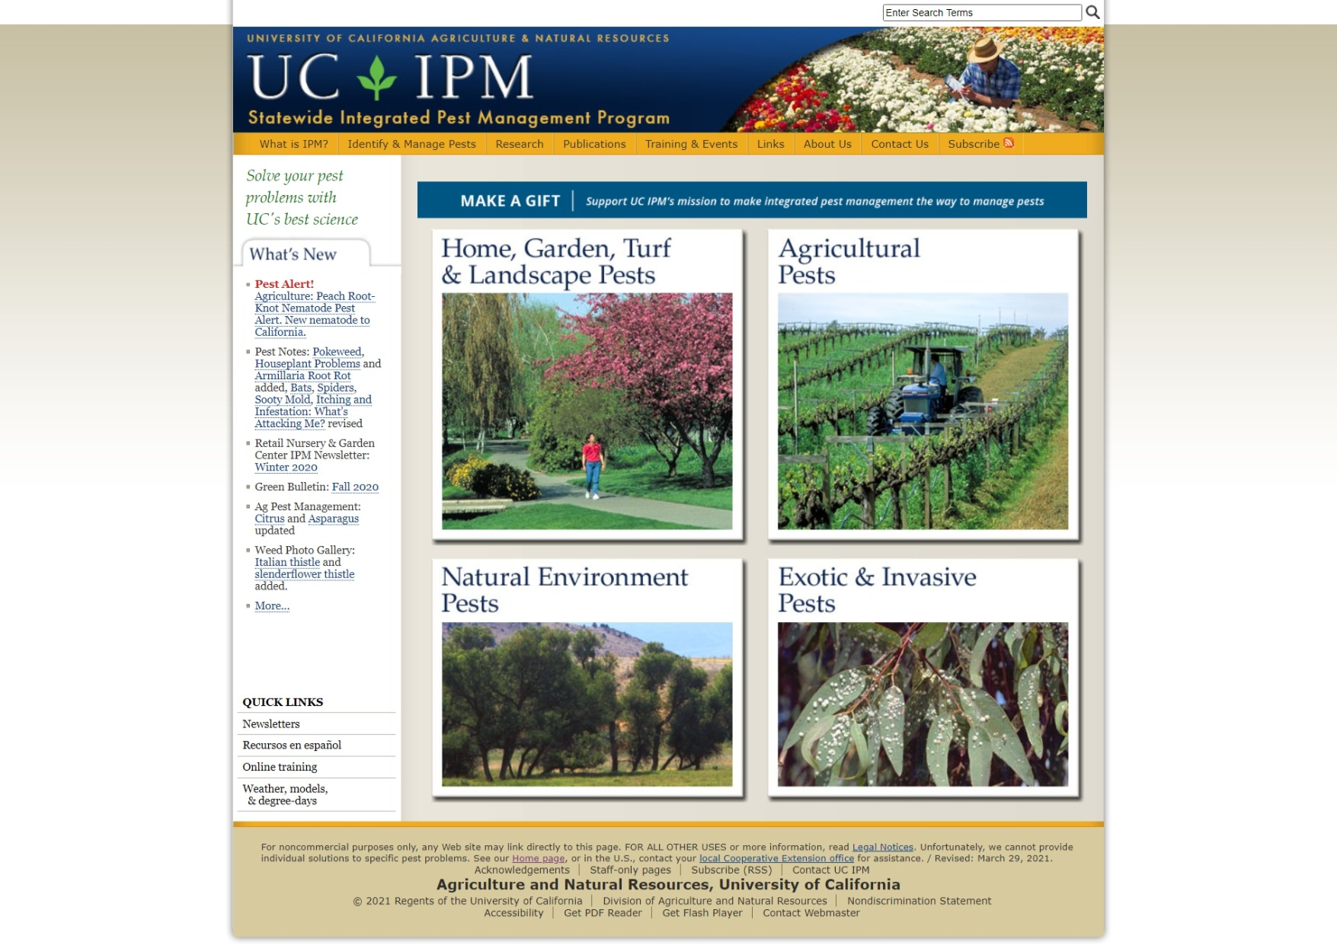
Your guide to managing pests
Select this box
Notes:
This web site will provide research based information for your pest questions

Slide 11
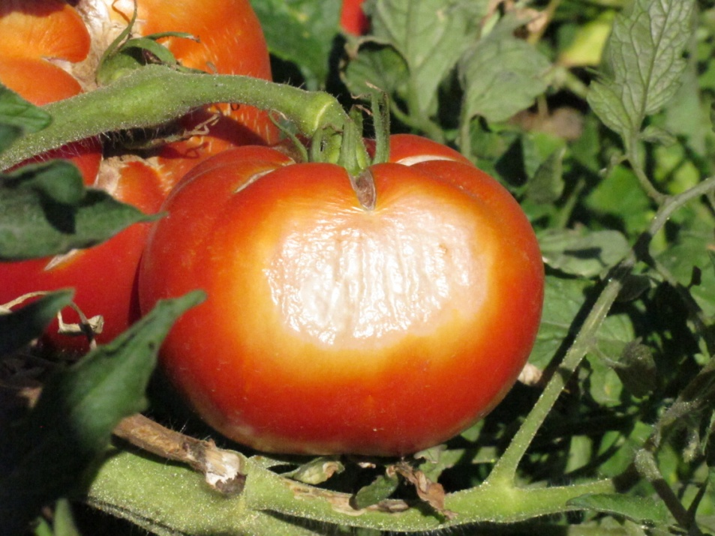
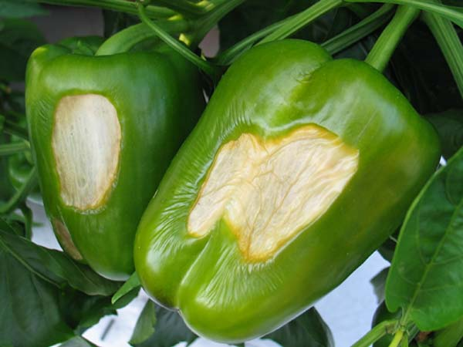
Gardening In Extreme Heat
Examples of sun scald on tomatoes and peppers
Notes:
As you know our summers here can get quite hot for days on end and that heat can effect our plants. The intense afternoon sun can cause sun burn on your vegetables when temperatures get over 100 for several days tomato plants can drop their flowers.

Slide 12
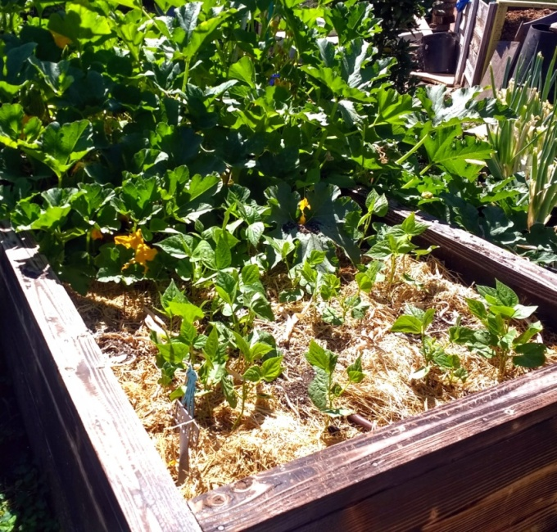
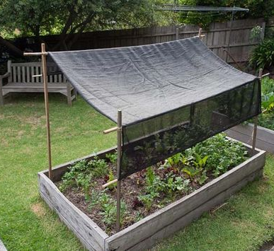
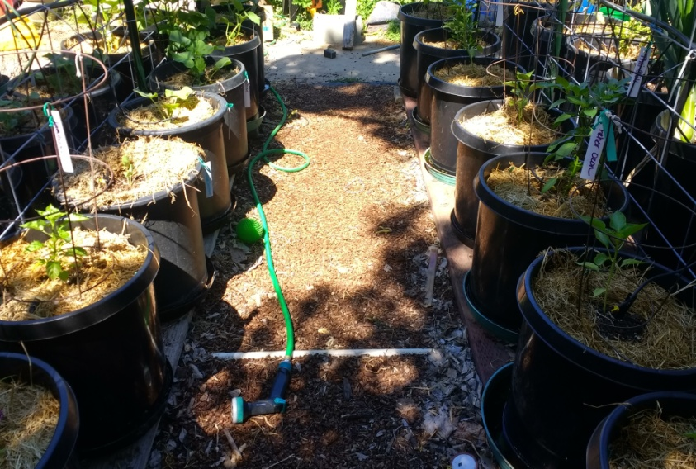
Simple tips to beat the heat
Use shade cloth or burlap
for protection
Use mulch around plants
Water early
Harvest early
Notes:
There are a few simple things you can do to help your garden survive the dog days of summer. Using shade cloth or burlap to block some of the intense rays may help to prevent sun scald. Using 2-3” of mulch around plants can help save water and help keep the roots cool. This is important especially when gardening in containers because they can dry out quickly. Watering in the early morning or late evening helps to prevent evaporation. Harvesting in the early morning is when the fruit is freshest and it puts less stress on the plants.

Slide 13
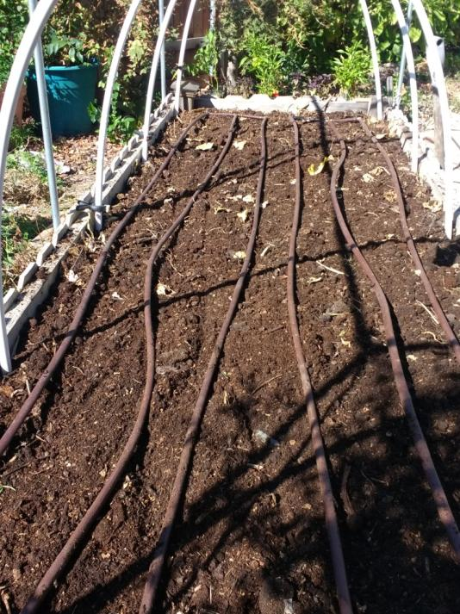
Water Wise
Water early & deeply
Use drip, inline or hand water
Check irrigation regularly
Mulch, mulch, mulch
Notes:
Watering your raised bed is easy.
You can use in-line emitters like what is shown in this bed or emitters to individual plants. Both work well to put the water at the soil level thus reducing water loss to evaporation. The inline and soaker products come in both ¼” and ½” sizes depending on your bed size
Drip will help keep the water off the foliage of the plants, reducing the risk of fungal disease.
Hand watering is also an option but it takes time and it means dragging the hose around.
Our winters are often mild and can be dry so we do need to irrigate those winter crops in between rain storms.

Slide 14
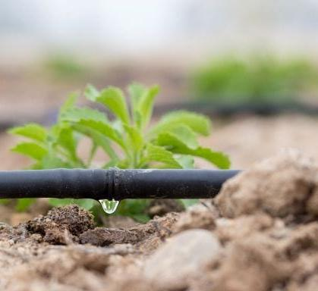
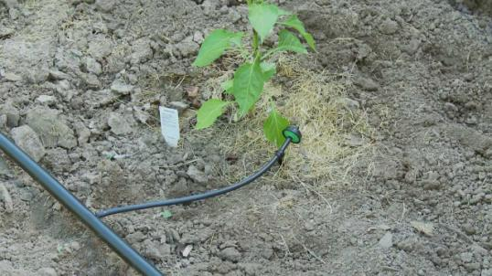
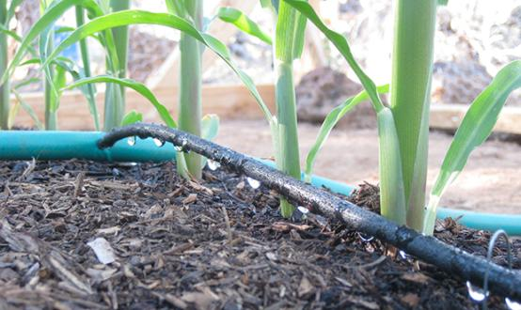
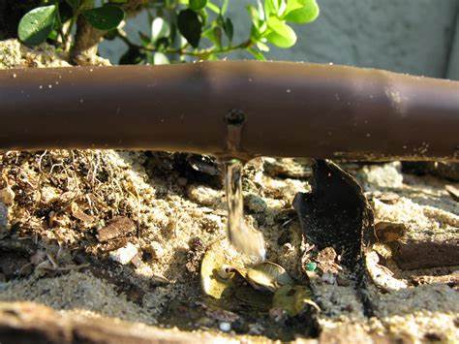
Examples of drip irrigation
¼” in line emitter drip
Drip emitter with ¼” line
½” in line emitter drip
¼” soaker line
Notes:
Which style you choose is up to you.
The inline emitters are made to put out a measured amount of water in gallons per hour. The product package will tell you how much water you will get. Make sure to stagger the emitters in the raised bed for the best coverage
Individual emitters also put out a measured amount of water. They often come color coded based on their gallons per hour. This method will allow you to customize the watering for the needs of your plants.
The soaker hose is a soft spongy line that has microscopic holes that allow the water to ooze out

Slide 15
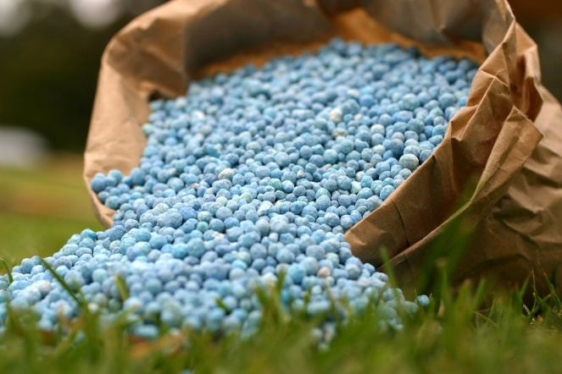
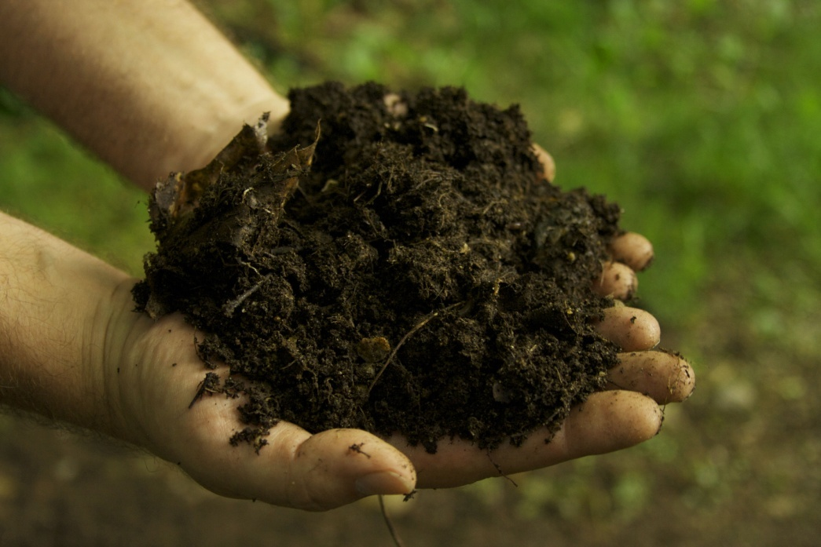
Fertilizers and Amendments
Apply early morning or late evening
Don’t apply to stressed plants
Follow all directions
Follow all directions
Follow all directions
Notes:
Whether you use an organic fertilizer or a synthetic always follow all the directions. Improper use can lead to damaged plants or cause pollution from run off.
If your plants are looking stressed avoid applying fertilizer until you have brought them out of the stressed condition.
Mix fertilizers into the soil so that it can get to the roots and the plant can use it.
Using compost to feed plants is always a great option – it improves the soil structure, helps to retain moisture and it can be readily used by the plants.

Slide 16
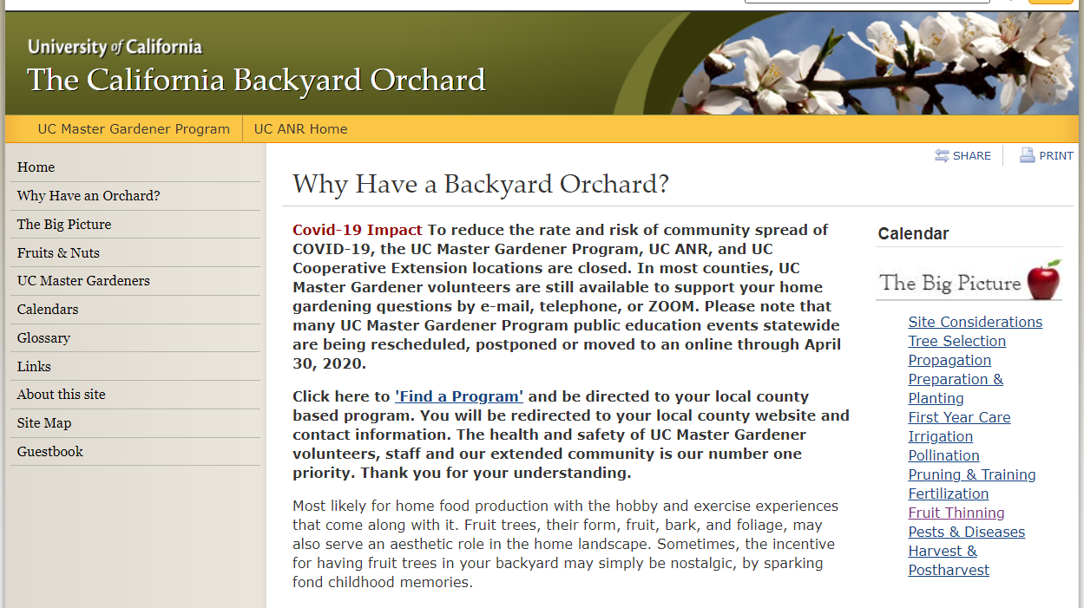
Fruit tree care
Deep water
Thin fruit
Remove fruit from young trees
Harvest fruit in the morning
Keep dropped fruit cleaned up
Notes:
Fruit trees benefit from being watered long and deep. You want the water to go down deep in the soil to encourage the roots to develop down in the soil. How much and how often will depend on your soil type and the size of the fruit tree. Water thoroughly, but not frequently. Visit the California Backyard Orchard website for more information on irrigating fruit trees.
Thinning fruit from trees will allow fruits to mature to a proper size and will encourage quality fruit.
Remove fruit from immature fruit trees. Allow the tree to develop an adequate root system.
Harvest fruit early in the morning for best flavor. When harvesting use clippers or gently twist the fruit off the branch.
Keep fruit that has dropped from the tree picked up. Keeping a tidy area around trees will discourage unwanted pests and reduce the chance of your tree getting a disease.

Slide 17
Resources
http://homeorchard.ucanr.edu
https://ipm.ucanr.edu
https://cagardenweb.ucanr.edu
https://anrcatalog.ucdavis.edu/pdf/8048.pdf
The California Backyard Orchard
State Wide IPM Program
The California Garden Web
Fruit Trees: Planting and Care of Young Trees

Slide 18
Thank You!
Any Questions?
Master Gardener Hotline: (530) 889-7388
Rot Line: (530) 889-7399
Master Gardener Website: pcmg.ucanr.org
Evaluations, please!

