Slide 1
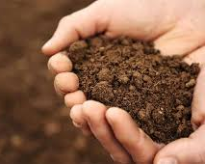
It’s Not Just Dirt!
“To be a successful farmer
one must first know
the nature of the soil.”
- Xenophon, Oeconomicus
400 B.C.
Notes:
Created: developed 1/19
Created by: Peggy Beltramo Presented at Loomis Seed Library workshop
Audience: Vegetable Gardeners, general soil interest
Publicity: What is soil? It's not just dirt. Learn what makes up healthy soil and what lurks beneath. Information will be presented about how to manage and care for your soil.
Update History: N/A
*Note: Remember to resubmit any new information to SIM for approval

Slide 2
Who Are Master Gardeners?
Master Gardeners of Placer County
Extend research-based, sustainable gardening and composting information
Present accurate, impartial information to home gardeners
Encourage public to make informed gardening decisions

Slide 3
Who Are Master Gardeners?
Where to find us…
Online, in the Media, and Special Publications
Hotline: Call (530) 889-7388 or submit your questions online
Website: pcmg.ucanr.org
Facebook, Twitter, Instagram
Gold Country Media monthly column
Curious Gardener quarterly newsletter; email and on website
Gardening Guide and Calendar

Slide 4
Who Are Master Gardeners?
Where to find us…
Workshops, Fairs and Festivals and Special Events
Speakers by Request
Workshops (various venues, check website)
Farmers’ Markets (seasonal: Auburn, Roseville)
Fairs and Festivals Booths (varies)
Garden Faire (April)
Mother’s Day Garden Tour (May)

Slide 5
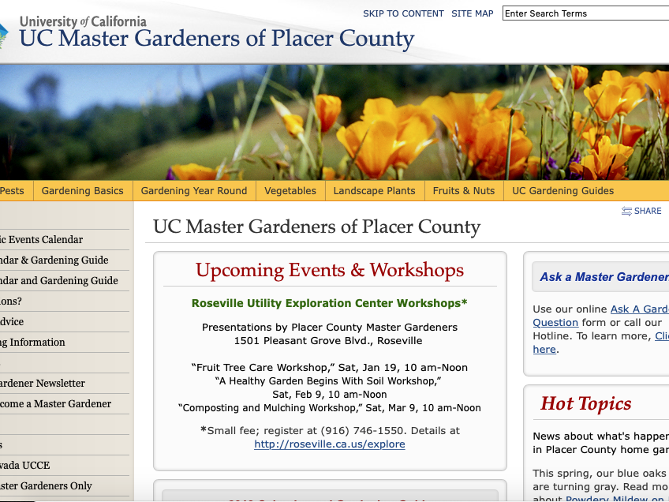
pcmg.ucanr.org

Slide 6

It’s Not Just Dirt!
Let’s Look at Your Handouts…

Slide 7
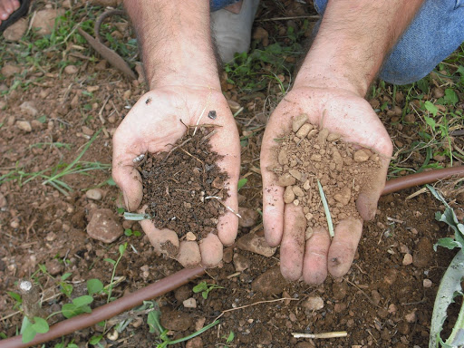
Soil or Dirt?
Notes:
https://askmax.countrymax.com/lawn_and_gardenDetail.php?Soil-Vs.-Dirt-What-is...
Mar 29, 2011 - Soil contains microorganisms, decaying organic matter, earthworms and other insects. Soil is a living environment. The earthworms and insects aerate the soil and add to the organic matter of the soil through their waste and when their bodies decay. Soil on the left, dirt on the right...you can see the difference!

Slide 8
Agenda
Soil Basics
Soil Fertility
Soil Food Web
Compost
Mulch

Slide 9
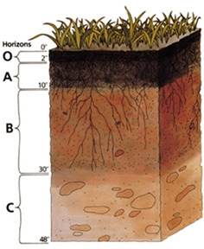
Typical Soil Profile
O = Plant Matter
A = Topsoil
B = Subsoil
C = Parent Material
Notes:
https://ucanr.edu/blogs/blogcore/postdetail.cfm?postnum=17084
Soil Horizons
Soil is made up of distinct layers, called horizons. Each layer has its own characteristics that make it different from all of the other layers. These characteristics play a very important role in what the soil is used for and why it is important.
O HORIZON- This is the top layer of soil that is made up of living and decomposed materials like leaves, plants, and bugs. This layer is very thin and is usually pretty dark.
A HORIZON- This is the layer that we call “topsoil” and it is located just below the O Horizon. This layer is made up of minerals and decomposed organic matter and it is also very dark in color. This is the layer that many plants roots grow in.
B HORIZON- This is the layer that we call “subsoil” and it is located just below the A Horizon. This layer has clay and mineral deposits and less organic materials than the layers above it. This layer is also lighter in color than the layers above it.
C HORIZON- This is the layer that we call “regolith” and it is located just below the B Horizon. This layer is made up of slightly unbroken rock and only a little bit of organic material is found here. Plant roots are not found in this layer.
Question for Audience: How far do roots penetrate the soil?

Slide 10
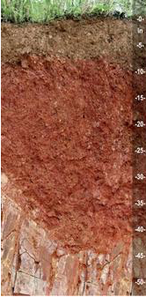
Actual Soil Profile
Notes:
https://content.ces.ncsu.edu/extension-gardener-handbook/1-soils-and-plant-nutrients

Slide 11
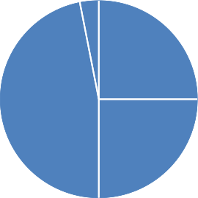
Soil Components
Organic matter
Air
Solid
Sand
Silt
Clay
Pore
Space
Water
Notes:
45% solids
5% organic
50% pore space with room for air and water—in healthy soil

Slide 12
Soil Components
Organic matter
Air
Solid
Sand
Silt
Clay
Pore
Space
Water
Let’s start here
Notes:
Let’s start here!

Slide 13
Soil Components
Soil Texture
Sand
Silt
Clay
Cannot be substantially changed
Notes:
The relative proportions of sand, silt, and clay determine a soil’s textural class. Soil texture is a permanent feature, not easily changed by human activity.
Adding organic matter is a more economically feasible alternative for improving soil. Adding organic matter does not change a soil’s texture—the percentage of sand, silt, and clay in the soil—but adding organic matter will alter soil structure by increasing the pore space and improving drainage. Gardeners can be successful with any soil texture, as long as they know the attributes and limitations of that soil.

Slide 14
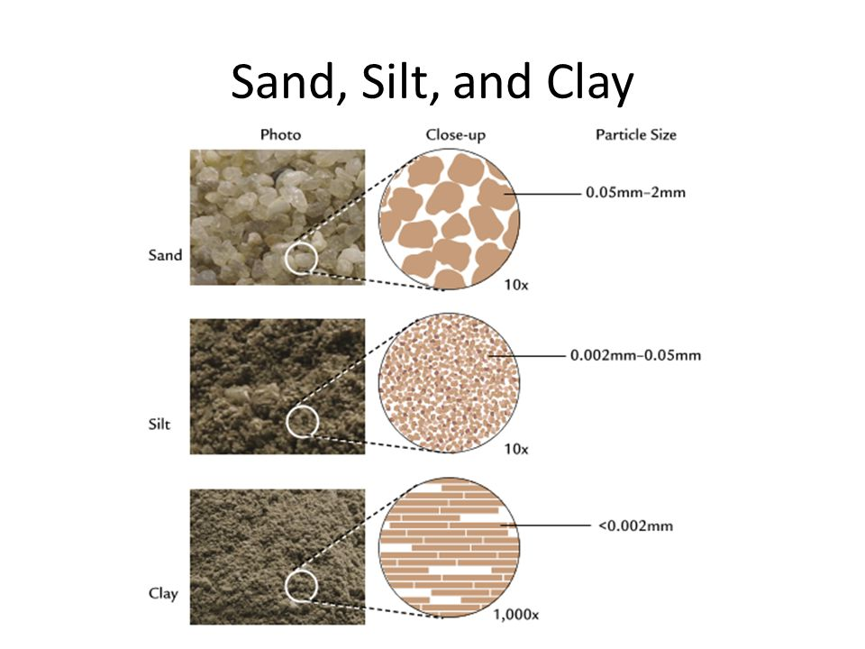

Soil Components
Notes:
Note: magnification of sand and silt is 10x. Clay magnification is 1,000x!

Slide 15
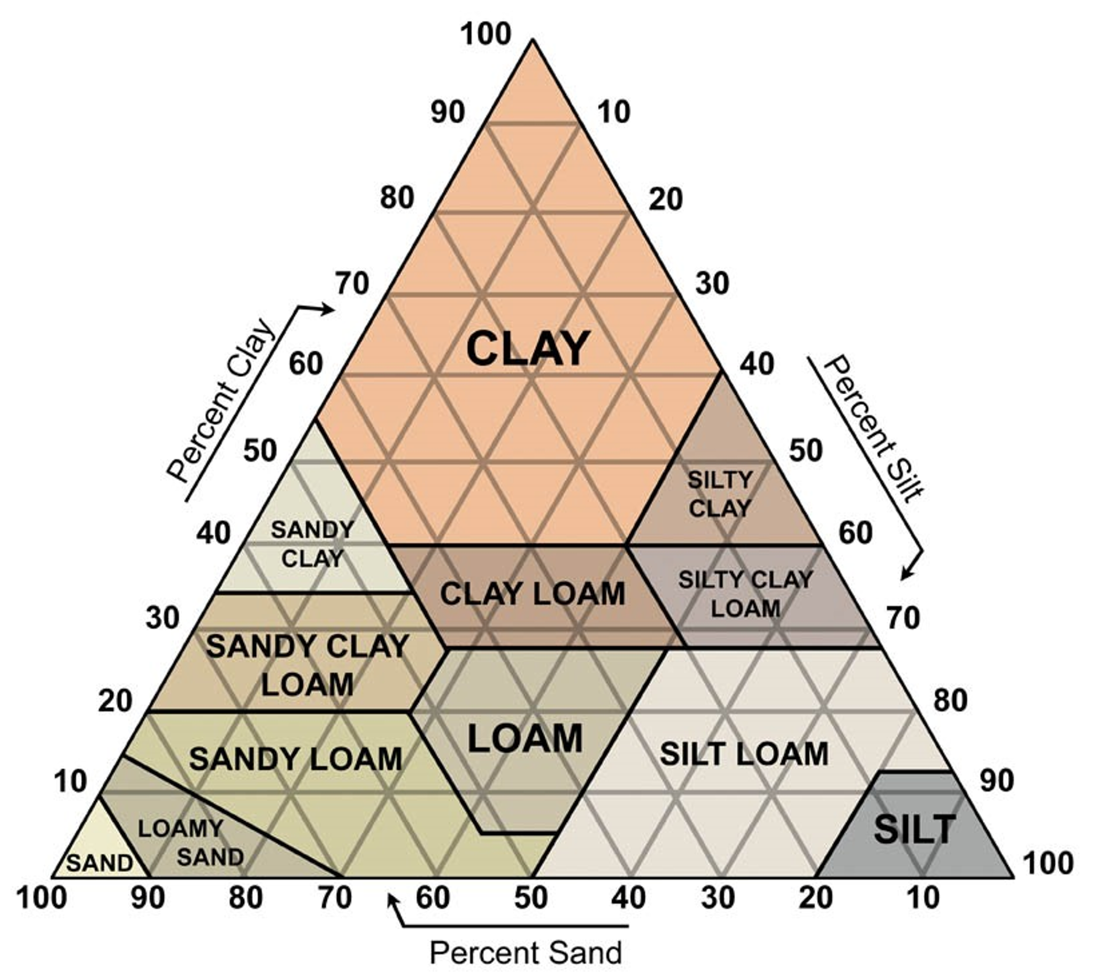
What Soil Do You Have?

Slide 16
Soil Triangle
Typical clay soil.
Can you change it?
Notes:
Add organic matter NOT sand
https://extension.oregonstate.edu/news/theres-no-break-people-who-garden-clay
"Clay soils are highly structured at the atomic level, much as crystals are," said Brewer. "No amount of sand can be added to a clay soil to change its texture. The large sand particles tend to provide a surface onto which the tiny clay particles adhere. The result can be a more difficult soil to manage than the original clay.”

Slide 17
Soil Triangle
To effect this change,
you need to add
100 TONS of sand!!
It is STILL clay soil!
Notes:
https://content.ces.ncsu.edu/extension-gardener-handbook/1-soils-and-plant-nutrients
Change 1 acre of clay by 10% takes more than 100 tons of sand! tandem dump truck!
Clay soils
Higher nutrient-holding capacity.
Higher available water-holding capacity.
BUT Finely textured soils exhibit properties
that are somewhat difficult to manage or overcome.
Often too sticky when wet and too hard when dry to cultivate.

Slide 18
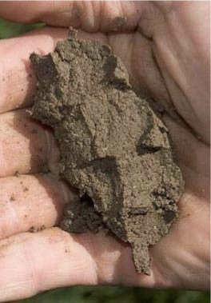
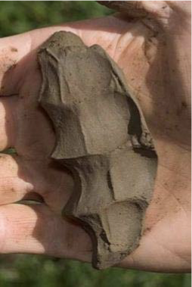
Physical Characteristics of Soil
Sandy Loam
Clay Loam
✓Texture
Notes:
Sandy or Coarsely Textured Soils
Low in organic matter content and native fertility.
Rapidly permeable and do not hold soil moisture.
Nutrient leaching is a concern, so proper fertilization is a must. Apply smaller amounts of nutrients, and apply them more frequently.
Low in cation exchange and buffer capacities.
Well-suited for road foundations and building sites.
Feel gritty.
Loamy or Medium-Textured Soils
Contains more organic matter.
Permit slower movement of water and are better able to retain moisture and nutrients.
Are generally more fertile.
Have higher cation exchange and buffer capacities.
Feel crumbly.
Clayey or Finely Textured Soils
Higher nutrient-holding capacity.
Higher available water-holding capacity.
Finely textured soils exhibit properties that are somewhat difficult to manage or overcome.
Often too sticky when wet and too hard when dry to cultivate.
May have shrink-and-swell characteristics that affect construction uses.
Feel slippery.

Slide 19
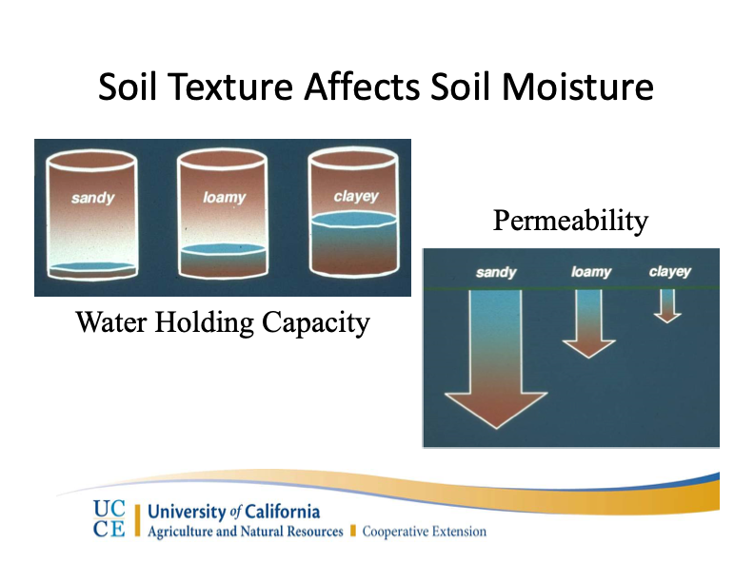

Slide 20
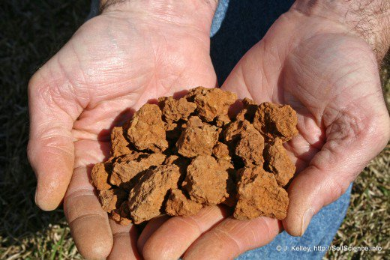
Can you
Change Soil Texture?

Slide 21
Can you
Change Soil Texture?
WRONG QUESTION…

Slide 22
Can you
IMPROVE Soil Texture?
YES!
Add organic matter!
More about this, coming up

Slide 23
Soil Components
Organic matter
Air
Solid
Sand
Silt
Clay
Pore
Space
Water
We started here
Notes:
45% solids
5% organic
50% pore space with room for air and water—in healthy soil

Slide 24
Soil Components
Organic matter
Air
Solid
Sand
Silt
Clay
Pore
Space
Water
Now let’s look here
Notes:
45% solids
5% organic
50% pore space with room for air and water—in healthy soil

Slide 25
Soil Texture vs. Structure
Remember!
Texture
Percent sand/silt/clay
Cannot be substantially changed
Notes:
texture = ingredients in granola: oats, nuts/seeds, fruits,

Slide 26
Soil Texture vs. Structure
Structure
Arrangement of particles
Into aggregates, clods, crusts, pans, etc.
Can be changed for better or worse
Notes:
texture = ingredients in granola: oats, nuts, fruits, seeds
baked with liquid = aggregates = structure
http://marinmg.ucanr.edu/files/237707.pdf
Another important element of soil is its structure, or how the particles are held together - how they clump together into crumbs or clods. A loose structure provides lot of pore spaces for good drainage and root growth. Structure is particularly important in clay soils since unstructured or weakly structured clay drains poorly, is sticky and difficult to work, and contains little air. Organic material is the main contributor to good structure, increasing pore space in the soil and separating some of the sticky substances that can bind clay particles together.

Slide 27
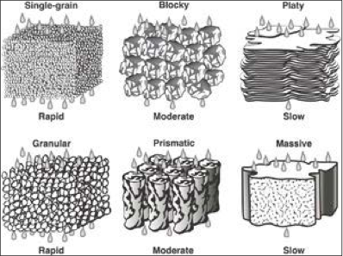
Soil Aggregates
Notes:
The structure influences air and water movement through soil or “PORE SPACE”
YOU CAN IMPROVE Your Soil Structure!!
https://ucanr.edu/sites/glennmg/files/278231.pdf
Your Soil Structure: How can you improve it?
• Avoid compaction of planted areas – reduced tillage, permanent paths, mulch
• Add organic matter to the soil – compost!!
• Grow cover crops!
• Proper watering and fertilization
• Build and Nurture Soil Food Web

Slide 28
Soil Components
Soil pH
“potential Hydrogen”
Is your soil acidic or alkaline?
Notes:
The pH of a garden soil is a measure of its relative acidity or alkalinity. Soil pH is important because it influences numerous chemical reactions that occur in the soil, including the availability of the 17 nutrient elements essential for plant growth and development. The soil pH is a function of the hydrogen ion (H+) concentration in the soil. The pH scale consists of 14 divisions from 1 to 14, with the value of 7 being neutral, 1 being most acidic, and 14 being most alkaline or basic. Like the scale for measuring earthquakes, the pH scale is logarithmic, not linear. A pH of 5.0 is 10 times more acidic than a pH of 6.0 and 100 times more acidic than a pH of 7.0. A pH of 7.0 means that alkalinity and acidity are equally balanced in the soil.

Slide 29
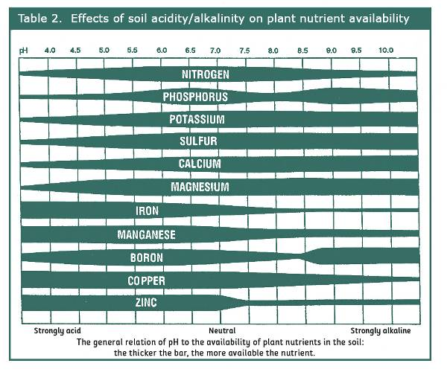
Agenda
Notes:
https://ucanr.edu/sites/gardenweb/Vegetables/?uid=26&ds=462&close=yes
pH nutrients
Why are soil pH, acidity, and alkalinity levels important? A: Most crops do best when the pH is slightly acidic to neutral (pH of 5.5 to 7.5). Soils in California typically range from pH 5 to 8.5, but a pH near neutral or slightly higher (alkaline) is most common. Measuring soil pH is done most easily with the soil test kits sold at garden centers. They are relatively cheap and reliable.

Slide 30
Agenda
Typical California Range
Notes:
https://ucanr.edu/sites/gardenweb/Vegetables/?uid=26&ds=462&close=yes
pH nutrients
Soils in California typically range from pH 5 to 8.5, but a pH near neutral or slightly higher (alkaline) is most common.

Slide 31
Agenda
Most common California pH
Notes:
https://ucanr.edu/sites/gardenweb/Vegetables/?uid=26&ds=462&close=yes
Soils in California typically range from pH 5 to 8.5, but a pH near neutral or slightly higher (alkaline) is most common.

Slide 32
Best pH for plants
Notes:
https://ucanr.edu/sites/gardenweb/Vegetables/?uid=26&ds=462&close=yes
Why are soil pH, acidity, and alkalinity levels important? A: Most crops do best when the pH is slightly acidic to neutral (pH of 5.5 to 7.5).
Note widest part of band of each element.
how to correct
soil test gives corrective

Slide 33
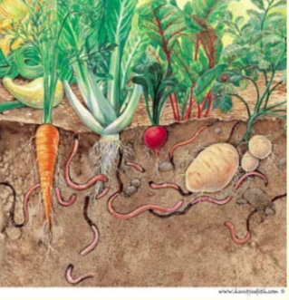
Who Lives in Your Soil?

Slide 34
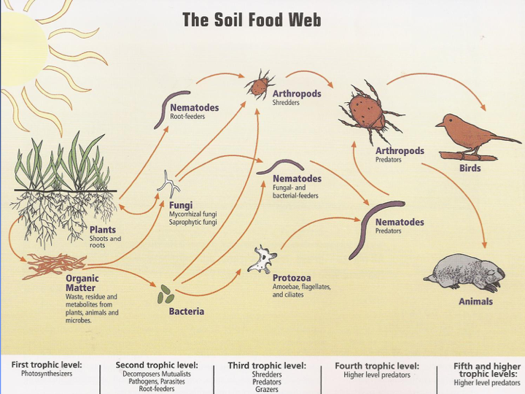
Soil Food Web
Notes:
Soil food wed glossary https://www.nrcs.usda.gov/Internet/FSE_MEDIA/nrcs142p2_050130.jpg
https://ucanr.edu/sites/EDC_Master_Gardeners/files/168442.pdf

Slide 35
Organism Types
bacteria
fungi
protozoa
nematodes
arthropods
earthworms
Notes:
Though you never see them, ninety percent of all organisms on the seven continents live underground. In addition to bacteria and fungi, the soil is also filled with protozoa, nematodes, mites, and microarthropods. There can be 10,000 to 50,000 species in less than a teaspoon of soil. In that same teaspoon of soil, there are more microbes than there are people on the earth.
https://www.theatlantic.com/health/archive/2013/06/healthy-soil-microbes-healthy-people/276710/

Slide 36
Soil Organisms
What do they do?
Decompose organic matter
Modify soil structure
• Redistribute minerals and nutrients
•Nutrient reservoirs – “fertilizer bags”
(Think poop and carcasses)
Notes:
Soil Organisms – What do they do??
Decompose organic matter
Modify soil structure
Redistribute minerals and nutrients
Nutrient reservoirs – “fertilizer bags”
(Think poop and carcasses)

Slide 37
Soil Organisms
What do they do?
• Sequester carbon
Degrade pollutants, pesticides
Biological regulation of pest species
LOOK!
Notes:
Soil Organisms – What do they do??
• Sequester carbon
Degrade pollutants, pesticides
Biological regulation of pest species

Slide 38
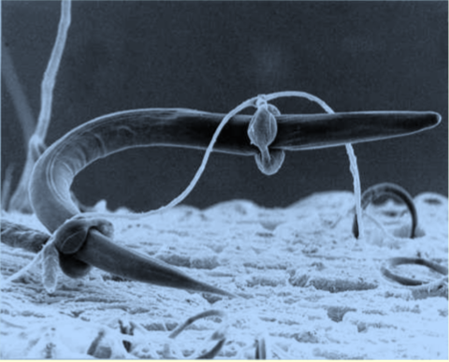
Nematode captured by the constricting rings of the predatory fungus Arthrobotrys anchonia.
Notes:
Nematode captured by the constricting rings of the predatory fungus Arthrobotrys anchonia.

Slide 39
Mycorrhizae
(“Fungus‐Roots”)
Symbiotic relationship
Fungi colonize plant roots
Fungi–receive sugars
Plants get phosphorus & water
Notes:
Mutualists – the mycorrhizal fungi – colonize plant roots. In exchange for carbon from the plant, mycorrhizal fungi help solubolize phosphorus and bring soil nutrients (phosphorus, nitrogen, micronutrients, and perhaps water) to the plant.
https://www.nrcs.usda.gov/wps/portal/nrcs/detailfull/soils/health/biology/?cid=nrcs142p2_053864

Slide 40
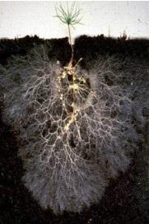
Mycorrhizal Fungi
WHY?
Increase plants’
resistance to drought
Help roots explore
up to 20x
the volume of soil

Slide 41
Add Mycorrhizal Inoculants?
Not so fast!
• Plants utilize fungi selectively
• Research shows that the wrong fungi,
or wrong combination, can impair plant growth
• Adding purchased is not wise: – Often dead in the bag
or may not be the correct species
• Adding fungi has unknown effects on the growth
of that plant, the soil organisms in your area, etc.
Notes:
Marketing mycorrhizae
http://pcmg.ucanr.org/newsletters/Curious_Gardener_Newsletters76595.pdf
This link is on your handout!

Slide 42
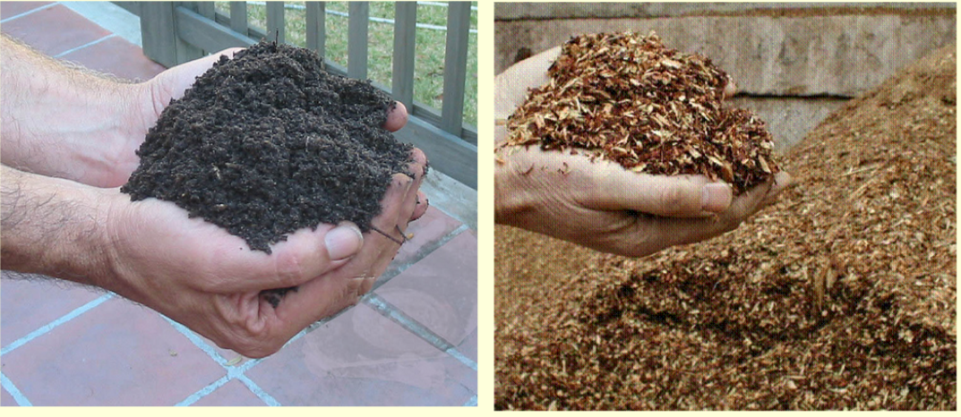
Compost vs. Mulch
Compost feeds the soil
Mulch protects the soil

Slide 43
Compost vs. Mulch
● Compost = Rotted organic matter
Made from plant material and/or manure
—Usually incorporated into the soil
Mulch = Organic or inorganic material
—spread on the soil surface
Notes:
https://ucanr.edu/sites/glennmg/files/278231.pdf
Mulch = Organic or inorganic material spread on the soil surface
Compost = Rotted organic matter made from plant material and/or manure
»Thermophilic decomposition (heat) »Finished compost is not hot »Usually incorporated into the soil
COMPOST = FEED THE SOIL MULCH = PROTECT THE SOIL

Slide 44
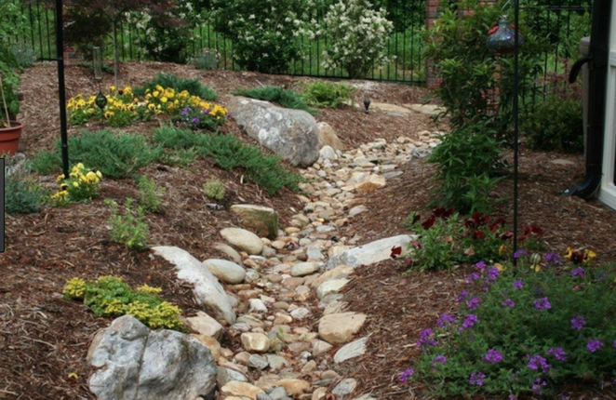
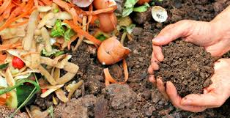
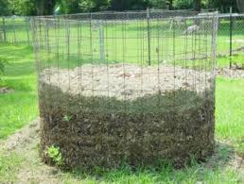
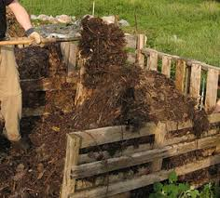
Compost—What is It?
Learn more!
Take a composting class
Learn more!
Take a composting class
Notes:
Compost is defined as the product resulting from the controlled biological decomposition of organic material1. Compost production involves heat generation through microbial activity (mostly aerobic) that can eliminate pathogens and other harmful bacteria, as well as stabilize the product such that it is appropriate for application in agricultural soils. Composting is a process that can be applied to various raw organic materials including yard trimmings, kitchen scraps, and manure, to name a few. The materials used to produce compost (referred to as feedstocks), as well as the composting procedure and length of maturation determine the quality of the compost2.
https://ucanr.edu/sites/Nutrient_Management_Solutions/stateofscience/Compost/

Slide 45
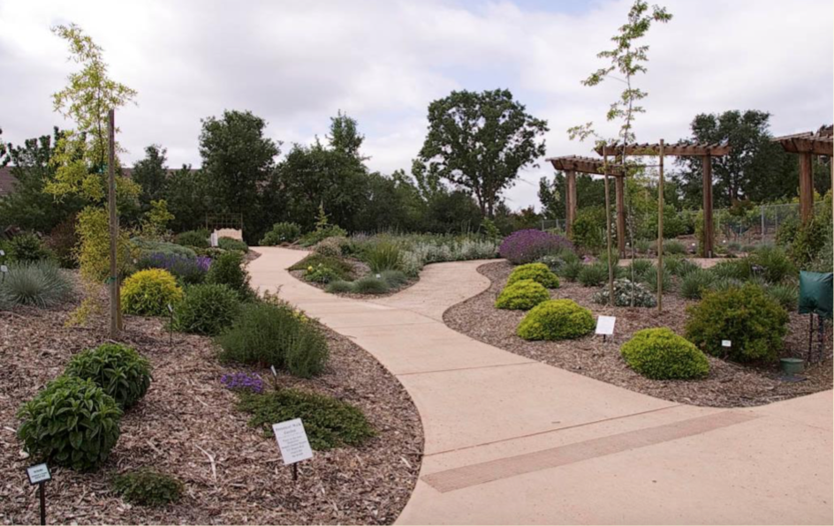
Mulch
Notes:
Sacramento Master Gardener Fair Oaks Horticulture Center
Demonstration Garden
web: fair oaks horticulture center

Slide 46
Potential Benefits of Mulch
● Reduces weeds & erosion
● Insulates roots from temp. extremes
Conserves soil moisture
Notes:
Potential Benefits of Mulch
● Reduces weeds & erosion
● Insulates roots from temp. extremes
● Conserves soil moisture→↑ root growth ● Increases microbial activity
● Increases water penetration
● Improves plant establishment
● Improves Soil Structure over time

Slide 47
Potential Benefits of Mulch
Improves root growth
Increases microbial activity
● Increases water penetration
● Improves plant establishment
● Improves Soil Structure over time
Notes:
Potential Benefits of Mulch
● Reduces weeds & erosion
● Insulates roots from temp. extremes
● Conserves soil moisture→↑ root growth ● Increases microbial activity
● Increases water penetration
● Improves plant establishment
● Improves Soil Structure over time

Slide 48
Potential Problems with Mulch
May prolong saturation in heavy soils
– Favors root and crown rot
May host plant diseases, insects,
and nuisance fungi
● Some wood chips are poor quality
may even be treated or dyed
● Can’t see soil moisture
Notes:
Potential Problems with Mulch
● May prolong saturation in heavy soils – Favors root and crown rot
● May host plant diseases, insects, and nuisance fungi
● Some wood chips poor quality
● Can’t see soil moisture
● Time consuming to spread

Slide 49
Mulch Basics—Wood Chips
● Softwood mulches (pine, cypress, etc.)
last longest – less microbial feeding
Keep mulch 6-12 in. away
from the base of trees & shrubs
Application rate: Generally 2-4 in. deep
● Keep mulch on top of soil
to prevent N nitrogen tie-up
Has little effect on soil pH
Notes:
Mulch Basics (Wood Chips)
● Softwood mulches (pine, cypress, etc.) last longest – less microbial feeding
● Keep mulch 6-12 in. away from the base of trees & shrubs when soil wet, poorly drained
● Application rate: Generally 2-4 in. deep – Fine = <2 in. Coarse = 4-6 in.
Keep mulch on top of soil to prevent N tie-up Avoid mulch in planting holes
Soil pH – little effect (pine needles acidic)

Slide 50
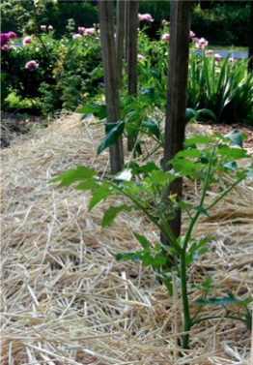
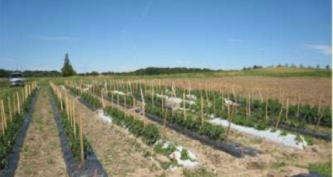
Other Types of Mulch
● Straw
Pine needles
Oak leaves
Plastic
● Gravel
Notes:
Mulch Basics Other Types of Mulches
● Straw
Pine needles
Oak leaves
Plastic
● Gravel

Slide 51
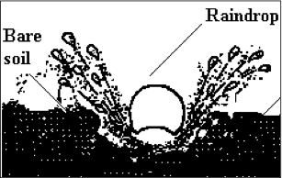
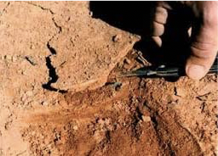
Crust Forms on Unprotected Soil

Slide 52
Healthy Soil Tips
Treat your soil right!
Avoid disturbing the soil
Avoid compaction
need pore space for air & water
Keep roots in the soil—
happy mycorrhizal fungi
Keep soil surface covered
Compost—feed the soil!
Notes:
Avoid Compaction – need pore space
Don’t Cultivate when wet, esp. clay
Don’t Over-cultivate, walk on fresh beds or overuse heavy equipment.
Good Soil Tilth: Nutrient, water and air holding ability and workability is achieved by incorporating organic matter.

Slide 53
Soil or Dirt?
Now what do you think?
Notes:
https://askmax.countrymax.com/lawn_and_gardenDetail.php?Soil-Vs.-Dirt-What-is...
Mar 29, 2011 - Soil contains microorganisms, decaying organic matter, earthworms and other insects. Soil is a living environment. The earthworms and insects aerate the soil and add to the organic matter of the soil through their waste and when their bodies decay. Soil on the left, dirt on the right...you can see the difference!

Slide 54
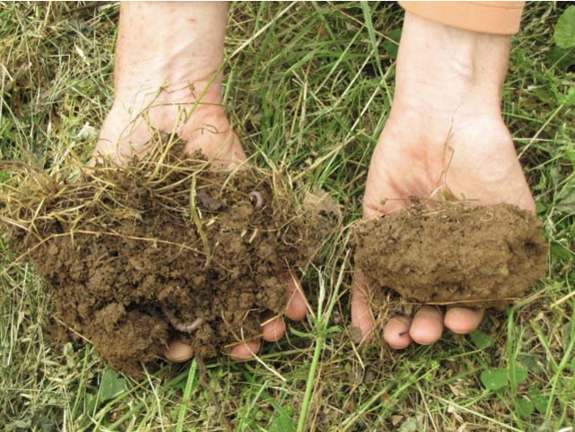
One Last Question…
No-till or Till?
Notes:
http://sonomamg.ucanr.edu/Food_Gardening/Additional_KG_Articles/No-Till_Food_Gardening/
What are the advantages of minimum soil disturbance besides the reduced physical effort that I was trying to achieve?
• By applying compost and fertilizers to the top of the soil, we are providing nutrition close to where biological activity and aeration is best.
• Tilling brings up weed seeds.
• No-till doesn’t disturb earthworms, fungi and other macro- and microorganisms.
• Undug soil is better able to maintain humus—meaning improved plant nutrition, disease resistance, soil aeration and water holding capability.
• Undug soil retains (vs. releases) carbon dioxide and, by adding compost, the soil’s carbon absorption ability is increased.
• There is better water retention. Increased levels of soil aggregations allow for higher water infiltration and greater soil water storage capacity. The untilled soil is able to build up a system of pores that move water up, down and sideways resulting in more efficient use of water. Also, there is a reduced likelihood that elements will enter the atmosphere as greenhouse gases or be leached to groundwater.
• Living roots can be kept in the soil.
• Plant growth (production) is boosted as the result of healthy soil life, improved irrigation, etc.

Slide 55
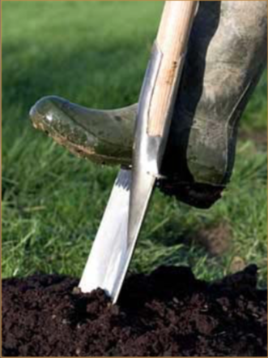
Thank You!
Any Questions?
Evaluations, please!
Master Gardener Hotline: (530) 889-7388
Master Gardener Website: pcmg.ucanr.org

Slide 56
Following slides include
additional topics for inclusion

Slide 57
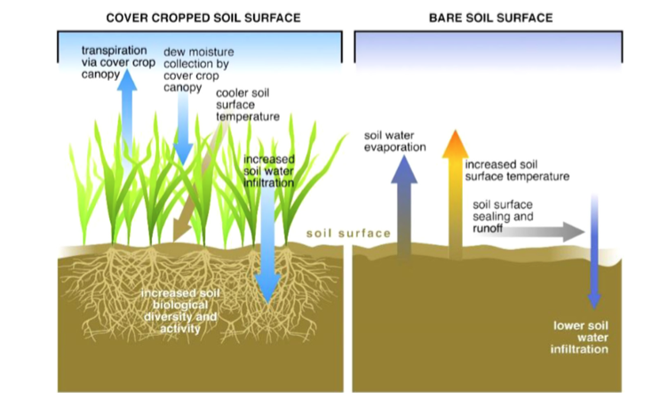
Cover Crop Benefits
Notes:
https://ucanr.edu/blogs/blogcore/postdetail.cfm?postnum=27687
Cover crops (also known as green manures) are plants primarily grown for the benefit of the soil rather than for crop yield. With autumn only a few months away, now's a good time to think about planting cool-season cover crop seed mixes for your farm or garden.
Why grow cover crops? The benefits of cover cropping include reduced soil erosion, adding organic matter, nutrients, and mycorrhizae to the soil, and weed and nematode suppression. Cover crops also increase nutrient retention and water infiltration. And some, such as radish, break into compacted soil layers, making it easier for the following crop's roots to develop more fully. Flowering cover crops on farms also increase beneficial insects, including bees and natural enemies, that provide pollination and pest control services in crop production.
Cover crops provide biomass underground AND dig in or compost tops at harvest (50% bloom for legumes—nitrogen fixing)

Slide 58
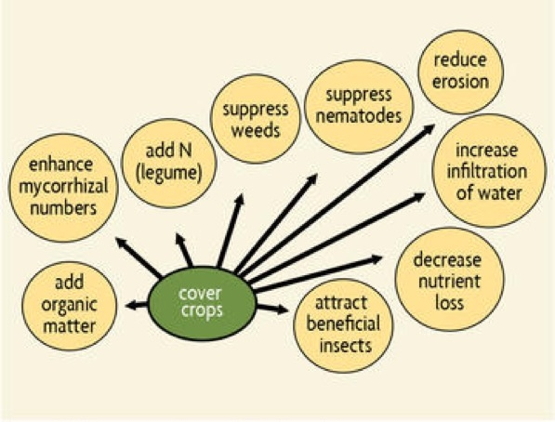

Cover Crop Benefits
SARE.org
Notes:
https://ucanr.edu/blogs/blogcore/postdetail.cfm?postnum=27687
Cover crops (also known as green manures) are plants primarily grown for the benefit of the soil rather than for crop yield. With autumn only a few months away, now's a good time to think about planting cool-season cover crop seed mixes for your farm or garden.
Why grow cover crops? The benefits of cover cropping include reduced soil erosion, adding organic matter, nutrients, and mycorrhizae to the soil, and weed and nematode suppression. Cover crops also increase nutrient retention and water infiltration. And some, such as radish, break into compacted soil layers, making it easier for the following crop's roots to develop more fully. Flowering cover crops on farms also increase beneficial insects, including bees and natural enemies, that provide pollination and pest control services in crop production.
Cover crops provide biomass underground AND dig in or compost tops at harvest (50% bloom for legumes—nitrogen fixing)

Slide 59
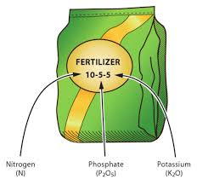
Fertilization
Notes:
fertilizer NPK
$$=not what you should do.
Sellers will tell you what they have to sell, not whether your plants NEED it or not.
Many people confuse plant nutrition with fertilization. Plant nutrition refers to the needs of the plant and how a plant uses the basic chemical elements. Fertilization is the term used when these elements are supplied to the soil as amendments. Adding fertilizer during unfavorable growing conditions will not enhance plant growth and may actually harm or kill plants.
To complete their life cycle, plants need 17 essential nutrients, each in varying amounts (Table 1–3). Of these nutrients, three are found in air and water: carbon (C), hydrogen (H), and oxygen (O). Combined, C, H, and O account for about 94% of a plant’s weight. The other 6% of a plant’s weight includes the remaining 14 nutrients, all of which must come from the soil. Of these, nitrogen (N), phosphorus (P), and potassium (K), the primary macronutrients, are the most needed. Magnesium (Mg), calcium (Ca), and sulfur (S), the secondary macronutrients, are next in the amount needed. The eight other elements—boron, chlorine, copper, iron, manganese, molybdenum, nickel, and zinc—are called micronutrients because they are needed in much smaller amounts than the macronutrients.
https://content.ces.ncsu.edu/extension-gardener-handbook/1-soils-and-plant-nutrients#section_heading_7242

Slide 60
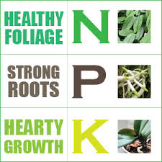
Fertilization
Notes:
https://content.ces.ncsu.edu/extension-gardener-handbook/1-soils-and-plant-nutrients#section_heading_7242
Many people confuse plant nutrition with fertilization. Plant nutrition refers to the needs of the plant and how a plant uses the basic chemical elements. Fertilization is the term used when these elements are supplied to the soil as amendments. Adding fertilizer during unfavorable growing conditions will not enhance plant growth and may actually harm or kill plants.
To complete their life cycle, plants need 17 essential nutrients, each in varying amounts (Table 1–3). Of these nutrients, three are found in air and water: carbon (C), hydrogen (H), and oxygen (O). Combined, C, H, and O account for about 94% of a plant’s weight. The other 6% of a plant’s weight includes the remaining 14 nutrients, all of which must come from the soil. Of these, nitrogen (N), phosphorus (P), and potassium (K), the primary macronutrients, are the most needed. Magnesium (Mg), calcium (Ca), and sulfur (S), the secondary macronutrients, are next in the amount needed. The eight other elements—boron, chlorine, copper, iron, manganese, molybdenum, nickel, and zinc—are called micronutrients because they are needed in much smaller amounts than the macronutrients.

Slide 61
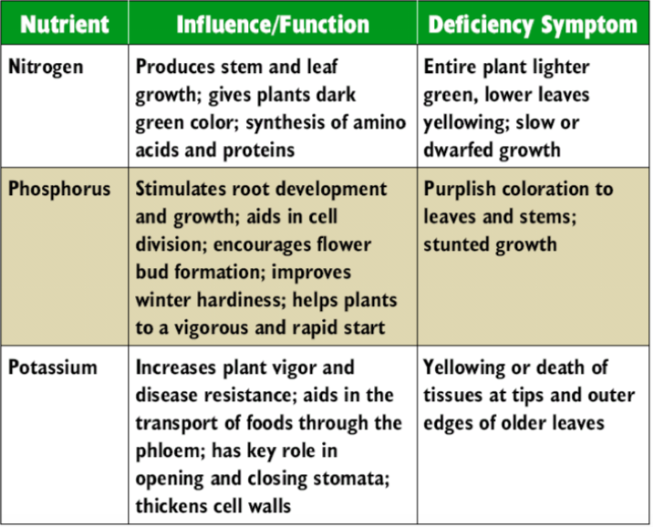
Primary Macronutrients
Notes:
https://afghanag.ucdavis.edu/educational-materials/files/field-crops/ed-field-afg-purdue-unitb-lesson4-nutrient.pdf
Plants need 17 essential nutrients. Three are found in air and water: carbon (C), hydrogen (H), and oxygen (O). Combined, C, H, and O account for about 94% of a plant’s weight.
The other 6% of a plant’s weight includes the remaining 14 nutrients, all of which must come from the soil. Of these, nitrogen (N), phosphorus (P), and potassium (K), the primary macronutrients, are the most needed.

Slide 62
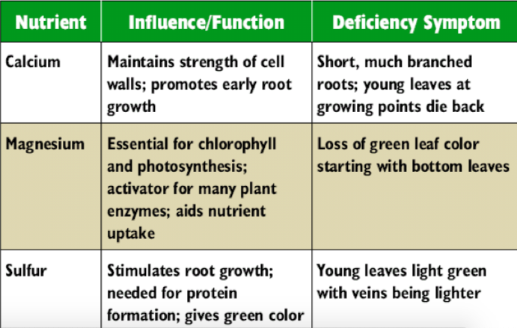
Secondary Macronutrients
Notes:
Magnesium (Mg), calcium (Ca), and sulfur (S), the secondary macronutrients, are next in the amount needed.

Slide 63
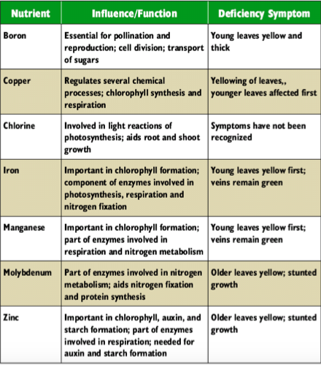
Micronutrients
Notes:
The eight other elements—boron, chlorine, copper, iron, manganese, molybdenum, nickel, and zinc—are called micronutrients because they are needed in much smaller amounts than the macronutrients.

Slide 64
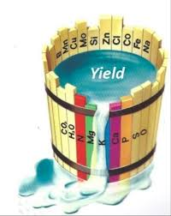
Liebig’s Law of the Minimum
Growth is limited
by the
scarcest nutrient
Notes:
Liebig’s Law
Growth limited by scarcest nutrient!
The concept of limiting factors is based on Liebig's Law of the Minimum, which states that growth is controlled not by the total amount of resources available, but by the scarcest

Slide 65
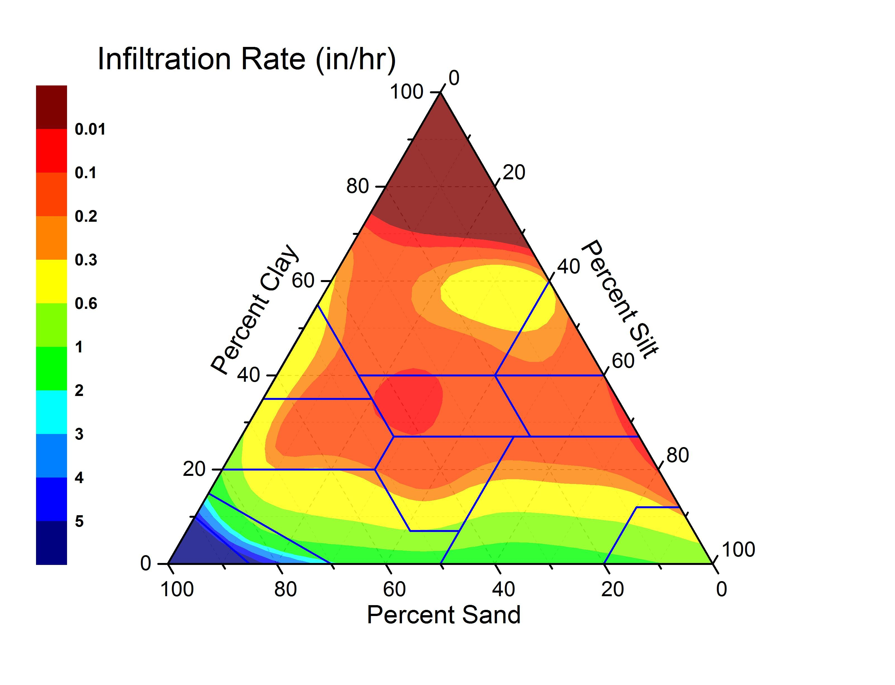
Water Infiltration Rate
Notes:
Water infiltration in inches per hour

Slide 66

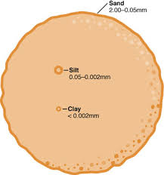
Soil Components
Relative size of particles
Notes:
clay particle = 1.5 mm = pinhead
silt particle = 37.5 mm = (1.5 in.) = golf ball
sand particle = 1500mm = sand (59 in.) NEARLY 5 feet!

Slide 67
Soil Components
Not Really!
Relative size of particles
Notes:
clay particle = 1.5 mm = pinhead
silt particle = 37.5 mm = (1.5 in.) = golf ball
sand particle = 1500mm = sand (59 in.) NEARLY 5 feet!
clay .002 mm pinhead 2500 clay particles
silt .05 mm golf ball 750 silt particles
sand 2mm hula hoop 750 sand particles

Slide 68
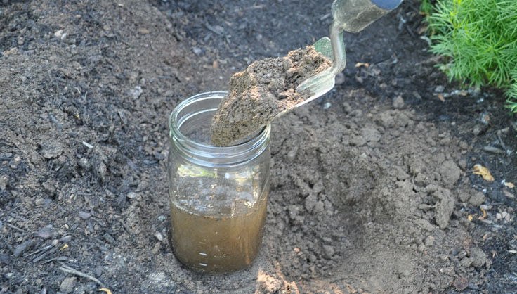
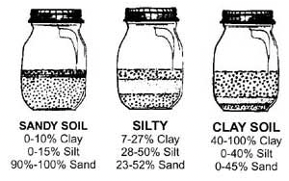
Soil Jar Test
Notes:
https://ucanr.edu/sites/UrbanAg/files/263165.pdf
soil l jar test
SERPENTINE SOILS http://pcmg.ucanr.org/files/166284.pdf

Slide 69
More info for MGs
Notes:
Soil Basics
Ingels: https://ucanr.edu/sites/sacmg/Soil_Amendments/
https://ucanr.edu/sites/gardenweb/Vegetables/?uid=26&ds=462&close=yes
pH nutrients
https://content.ces.ncsu.edu/extension-gardener-handbook/1-soils-and-plant-nutrients

