Slide 1
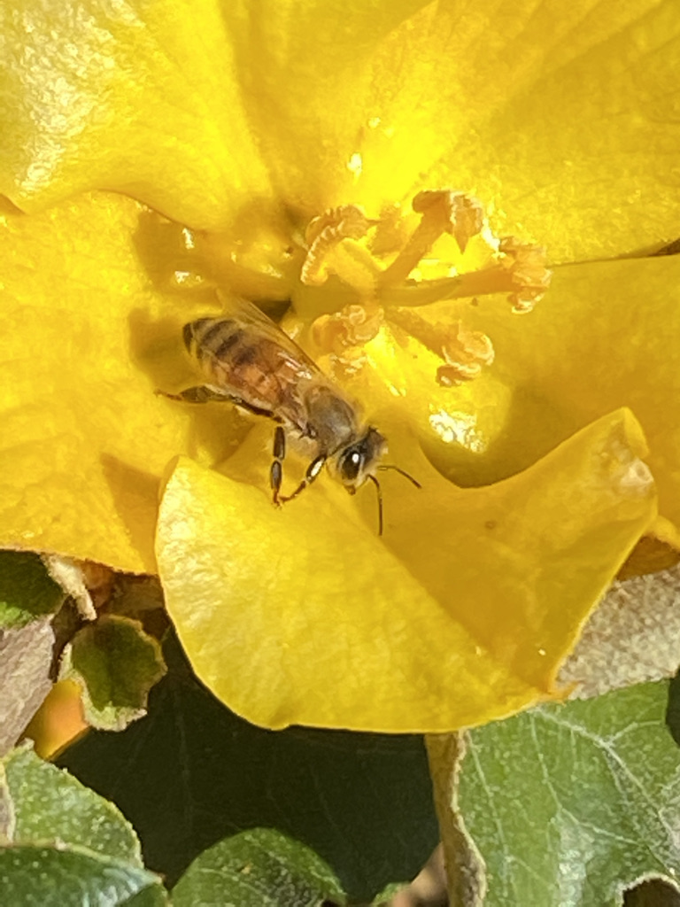
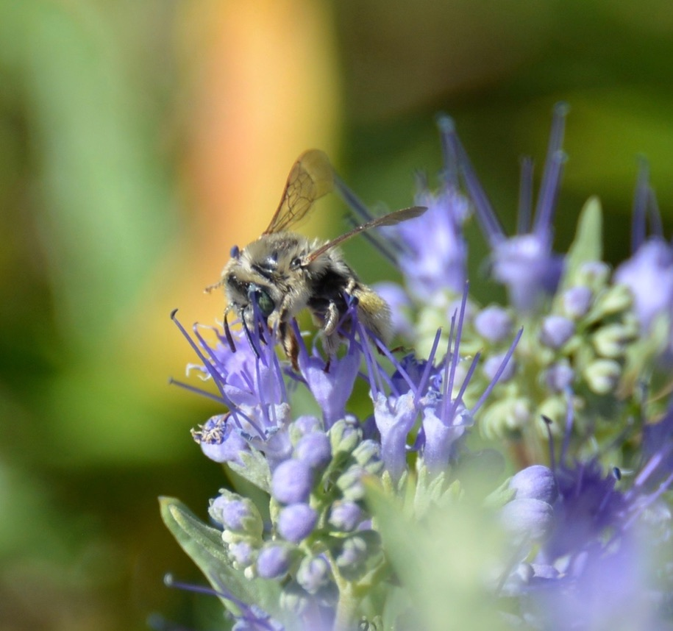
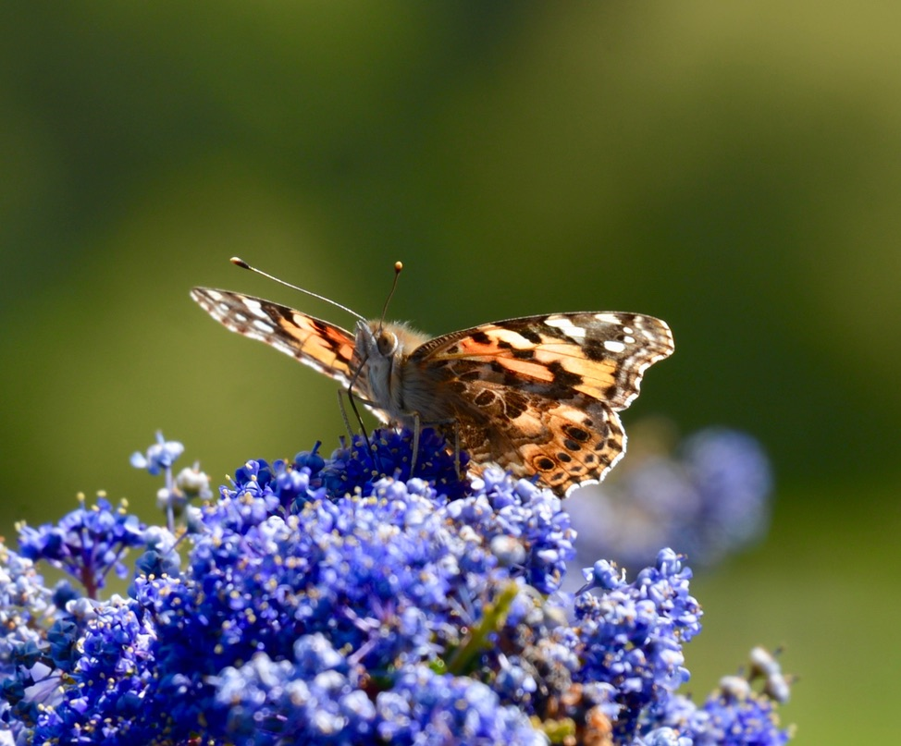
Plant It and They Will Come: Planning for Pollinators
Notes:
Created: date presentation developed (May 2021)/approved.
Created by: Tece Markel
Audience: Public Workshop
Publicity: Learn how to attract and support bees, butterflies and other pollinators by choosing a palette of plants that provides a living landscape which offers nourishment and nesting places for these creatures that enliven our gardens, as well as providing pollination services for us. It’s a win-win for humans and pollinators!
Update History: for each update to the presentation include date, name of updater, explanation of update
(were additional slides added, were web links updated, etc.)

Slide 2
Who Are Master Gardeners?
Master Gardeners of Placer County
Extend research-based, sustainable gardening and composting information
Present accurate, impartial information to home gardeners
Encourage public to make informed gardening decisions

Slide 3
Who Are Master Gardeners?
Where to find us…
Online, in the Media, and Special Publications
Hotline: Call (530) 889-7388 or submit your questions online
Website: pcmg.ucanr.org
Facebook, Twitter, Instagram
Gold Country Media monthly column
Curious Gardener quarterly newsletter on our website
Gardening Guide and Calendar

Slide 4
Who Are Master Gardeners?
Where to find us…
Workshops, Fairs and Festivals, and Special Events
Speakers by Request
Workshops (various venues, check website)
Farmers’ Markets (seasonal: Auburn, Roseville)
Fairs and Festivals Booths (varies)
Garden Faire (April)
Mother’s Day Garden Tour (May)

Slide 5
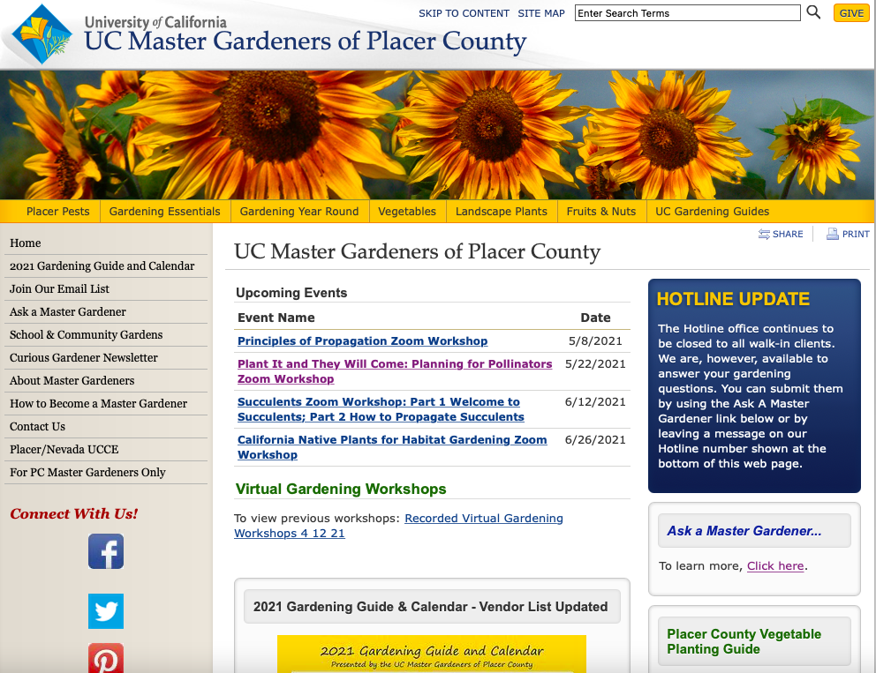

Slide 6
Agenda
Who are Pollinators?
Why do we need Pollinators?
What is Pollinator Habitat?
How Can I Attract Pollinators?
PLANTS! PLANTS! PLANTS!
6￼
Notes:
Who are the Pollinators? Right now, think of all the pollinators you can. I will reveal who they are momentarily. Read the rest as printed.

Slide 7
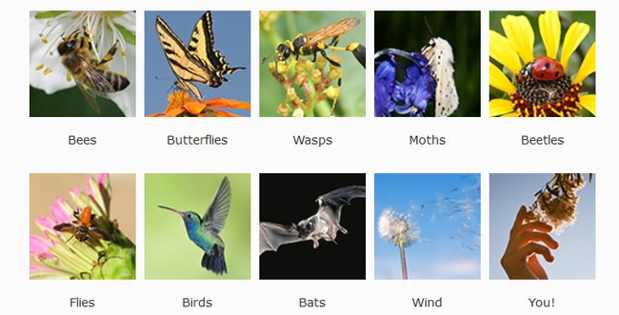
Who Are the Pollinators?
Notes:
POLLINATORS:
bees; butterflies; wasps; moths; beetles; flies; birds; bats; wind; humans
To get animals to help, plants provide:
• food (pollen, nectar) • scents/perfume • oils
• nest materials
Bats do not pollinate here locally but they do in the desert. Wind accounts for 13% of pollination. Think of allergy season and wind driven pollen like that from oak ,pine, olives and grapes.

Slide 8
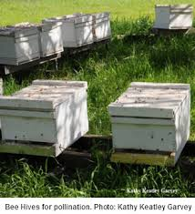
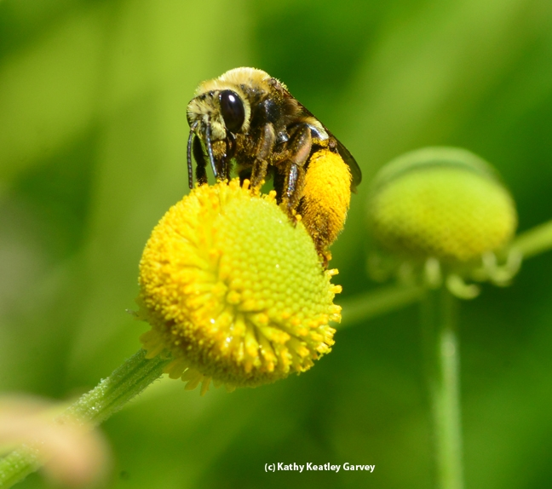
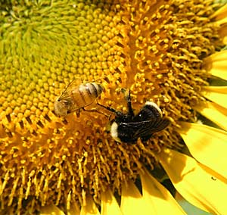
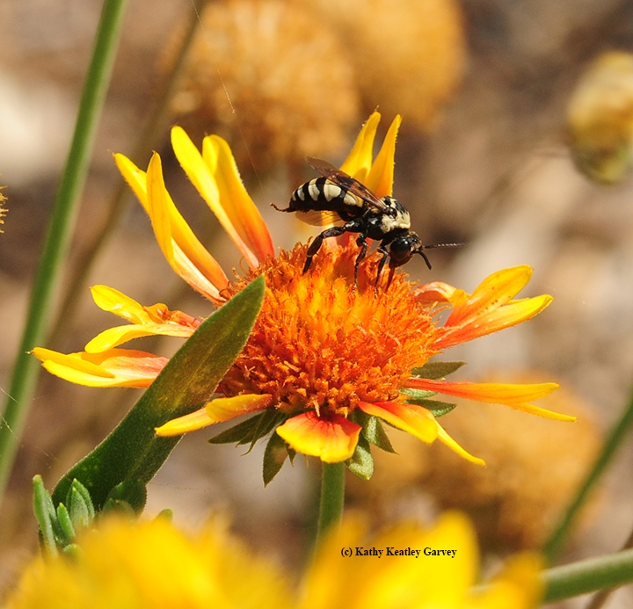
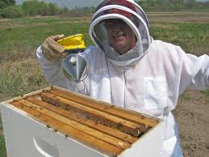
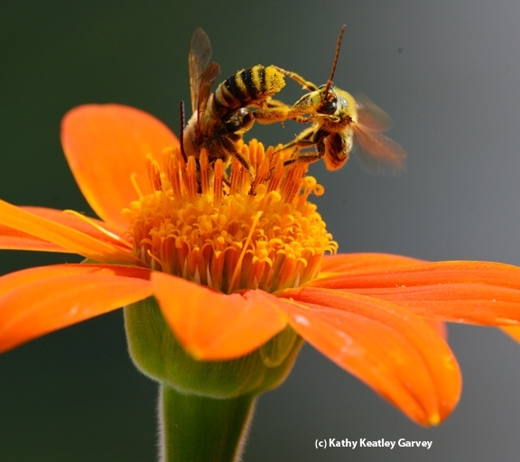
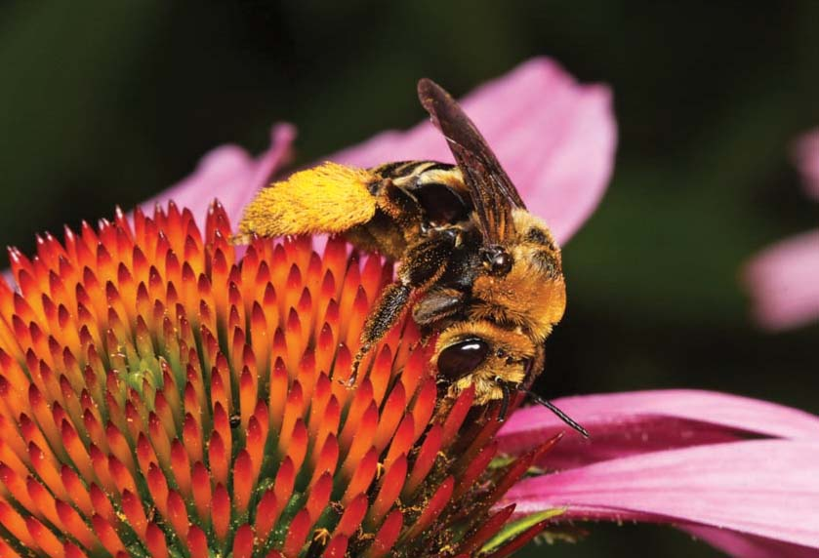
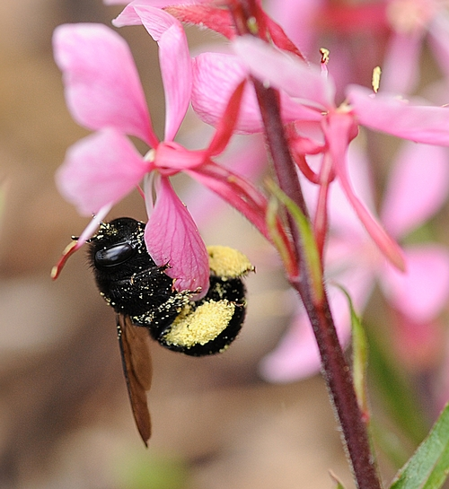
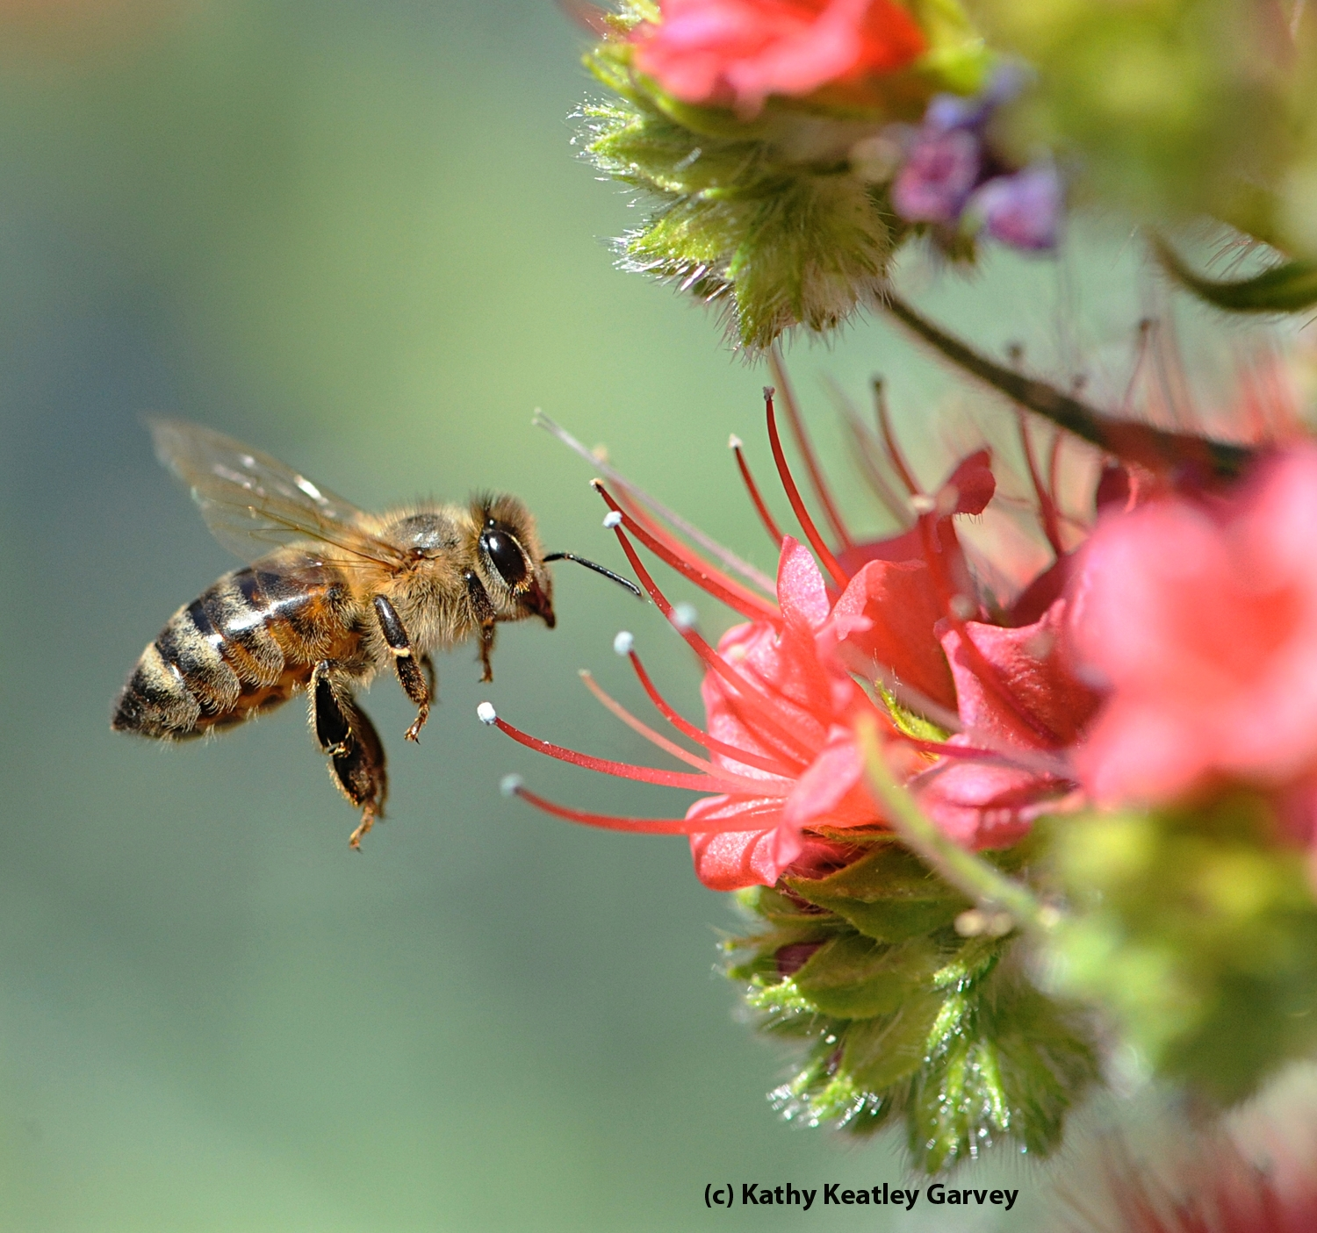
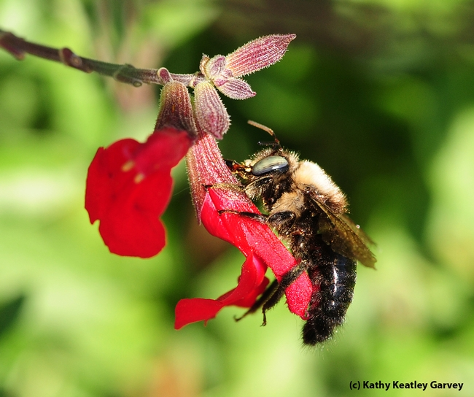
Honeybees and All the Other Guys!
The Other Guys
Honey Bees
Notes:
Bee hives; bee keeper; honey bee on Echium wildpretti (Tower of Jewels)
1 Honeybee and bumblebee on sunflower;
2 longhorn bee on Helenium (sneezeweed)
4 bumblebee on Salvia (sage);
5 female solitary bee (Svasta obliqua expurgata) on purple coneflower (Echinacea pupurea)
6 bee fight on Tithonia (Mexican sunflower)
Most folks are familiar with honeybees but may be surprised to learn that they are European imports brought by the early settlers to our country. People have heard of the difficulties bees are experiencing with Colony Collapse Disorder.
On the right side, we see the Other Guys. These are native bees which also provide pollinator services and are often very specialized in their work and sometimes are more efficient than honeybees.

Slide 9
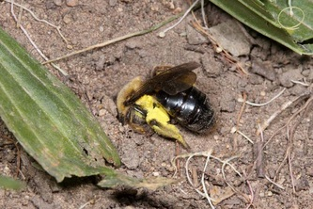
Who Are the Pollinators?
1600 native bee species in California
75% solitary—ground/cavity nesters
10 % social—bumblebees
15% cuckoo—lay eggs in other bees’ chambers
Notes:
Andrenidae Mining Bees tickle bees: Sabin Elementary, Portland, Oregon http://www.sabinpta.com/tickle-bee
mining bees in schoolyard. Students observe and protect their friends.
In CA, we have 1600 native bee species. It is estimated that they provide 35-38% of pollination services required by CA crops.

Slide 10
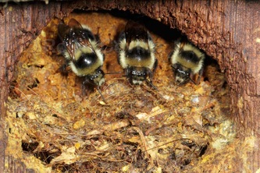
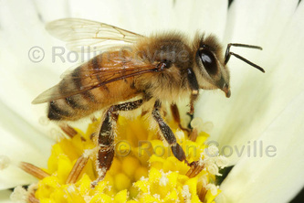
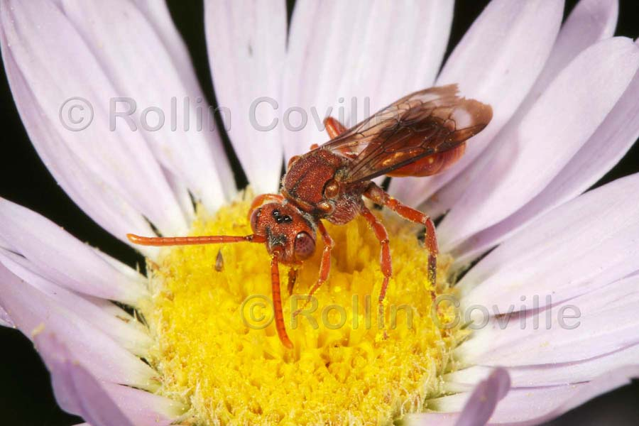
Who Are the Pollinators?
Bumblebees
Carpenter bee
Honeybee
Digger bees
Cuckoo bee
Notes:
bee groups ppt http://ucanr.edu/sites/2017MGConference/files/271017.pdf
Ground nesters
Leave some bare soil, not all mulched.
Sweat bees will land on you and drink your sweat for the salt content.

Slide 11
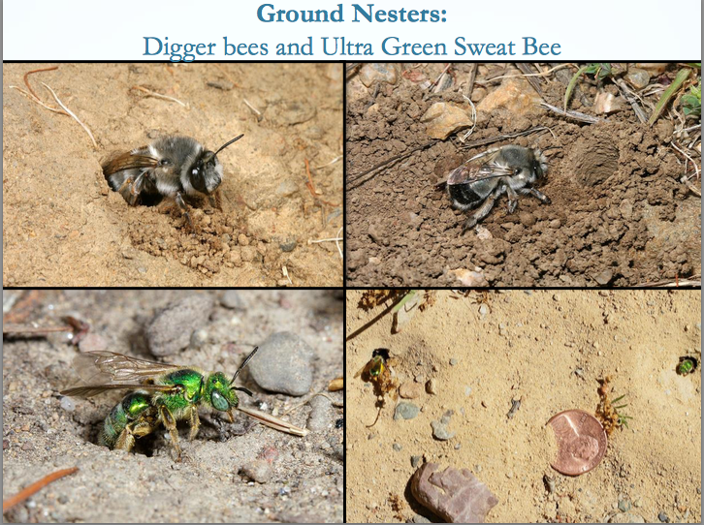
Who Are the Pollinators?
Gordon Frankie
Notes:
bee groups ppt http://ucanr.edu/sites/2017MGConference/files/271017.pdf
Ground nesters
Leave some bare soil, not all mulched.
Sweat bees will land on you and drink your sweat for the salt content.
Ground nesting bees make up 70%of CA bees. They usually need direct access to the soil surface to excavate and access their nests. They may use abandoned nests undr grass or under piles of grass clippings or leaves.

Slide 12
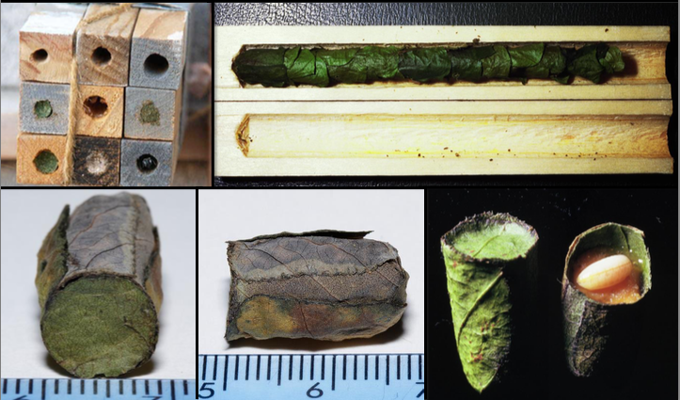
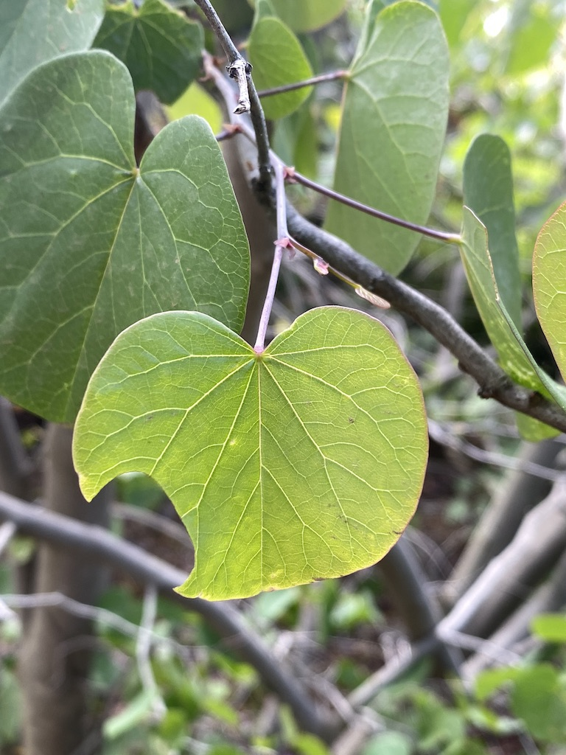
Who Are the Pollinators?
Gordon Frankie
Leaf-cutter bees
Notes:
Leaf-cutter bees
Use redbud leaves, rose leaves, petals
Cause scalloped edges, no danger to plants.
Approximately 30% of native bees are tunnel or cavity nesters. These bees may use abandoned beetle tunnels in stumps or tree snags. A few chew the soft pithy centers of some plant stems.
This leafcutter bee cuts a perfect circle form a soft leaf like this redbud leaf. Count yourself fortunate if you see these cutouts as then you know a leafcutter bee has chosen your yard to raise her young. She cuts the leaf to line an available tube, collects pollen and nectar, mixes it, then lays a single egg on it. She then caps off that cell with another leaf piece and continues to fill more chambers. She caps it off and her job is done.

Slide 13
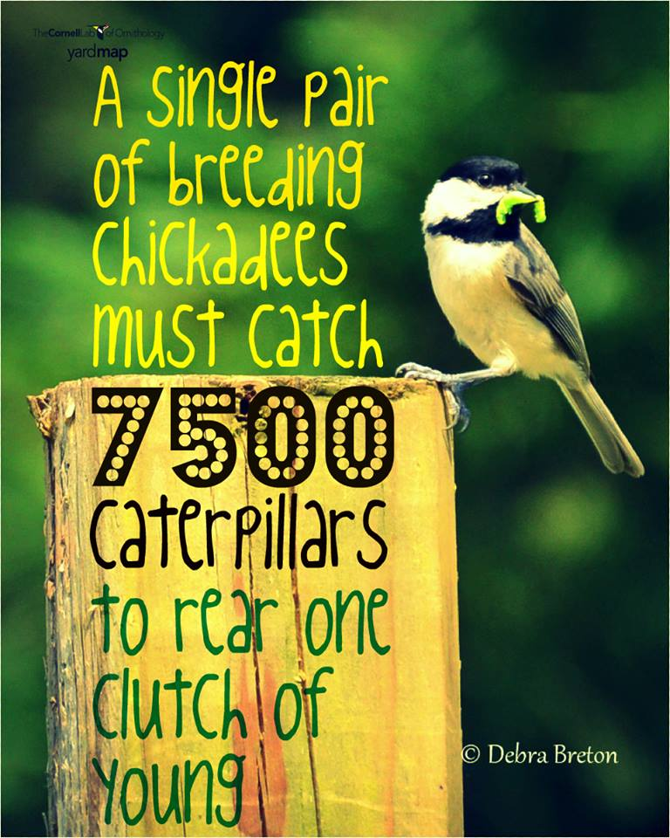
Why Do We Need Pollinators?
Notes:
A single pair of breeding chickadees must find 6,000 to 9,000 caterpillars to rear one clutch of young, according to Doug Tallamy, a professor of entomology and wildlife ecology at the University of Delaware.
Caterpillars are the preferred choice of birds raising their young. Caterpillars make perfect baby food as they are “like soft bags filled with food”, according to Doug.. It would take 200 aphids to equal one medium-sized caterpillar.
Doug Tallamy writes in his book, BRINGING NATURE HOME: HOW NATIVE PLANTS SUSTAIN WILDLIFE ON OUR GARDENS:
“Our nearly universal animosity toward insects is understandable, but seriously misplaced. Of the 9 million or so insect species on earth, a mere 1% interact with human in negative ways. The other 99% of the insect species pollinate plants, return nutrients tied up in dead plants and animals to the soil, keep populations of insect herbivores in check, aerate and enrich the soil, and as I keep stressing, provide food either directly or indirectly for most other animals.”
https://nestwatch.org/connect/news/caterpillar-its-whats-for-dinner/

Slide 14
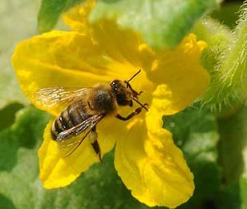

Why Do We Need Pollinators?
Pollinate 75% to 90%
of all flowering plants
180,000 plant species
1,200 crops
Responsible for 1 of every 3
bites of food
A tiny fly is responsible
for all of the world’s chocolate!
Squash bee Kathy Keatley Garvey
Chocolate midge
Notes:
Pollinators provide pollination services for 75% of agricultural crops and 90% of flowering perennials.
75% crops, 90% perennials.
Every bite of chocolate we eat starts off as seeds in pods that grow on Theobroma cacao, a tree whose name translates to "cacao, food of the gods." Enter chocolate midges—without the midges, there would be no chocolate! (Seen in US? Yes—National Park in American Samoa)
https://www.nps.gov/articles/chocolate-midge.htm

Slide 15
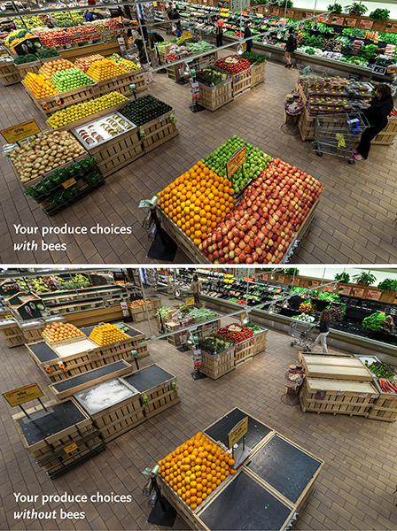
Why Do We Need Pollinators?
Notes:
https://media.wholefoodsmarket.com/news/bees
June 14, 2013
The before-and-after photo (above) is shocking – as are the statistics. Whole Foods Market’s produce team pulled from shelves 237 of 453 products – 52 percent of the normal product mix in the department. Among the removed products were some of the most popular produce items:
Apples, Onions, Avocados, Carrots, Mangos, Lemons, Limes, Honeydew, Cantaloupe, Zucchini, Summer squash, Eggplant, Cucumbers, Celery, Green onions, Cauliflower, Leeks, Bok choy, Kale, Broccoli, Broccoli rabe, Mustard greens
These 2 pictures were photographed at a Whole Foods Market in 2013. The first shows a typical produce department. The second photo was taken after the produce team pulled the fruit and veggies that depend on bees for pollination. That meant that 237 out of 453 products were removed.

Slide 16
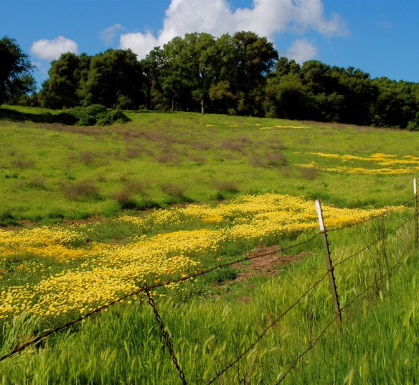
Small Fenced yards are unappealing to species
that live in wide-open fields and meadows.
Notes:
Let’s think like a pollinator. This photo looks wild and weedy but there is lot going on here that is beneficial. Large swaths of flowers attract pollinators. Those oak trees are food for many varieties of moths and caterpillars.
Those grasses may be larval host food for moths and butterflies too. They also provide overwintering site for insects. Notice the layers. There is bare soil for ground nesting bees. There trees with upper and midstory layers for shelter.

Slide 17
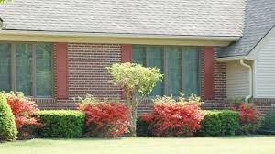
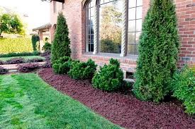
No food
or shelter here.
Notes:
A high diversity of plants are needed to attract a diversity of pollinators. If we look at these two yards, there aren’t many flowers OR diversity. The lawn does not provide shelter or food.
In fact, there may have been pesticides and herbicides being used here which could be harmful to pollinators.

Slide 18
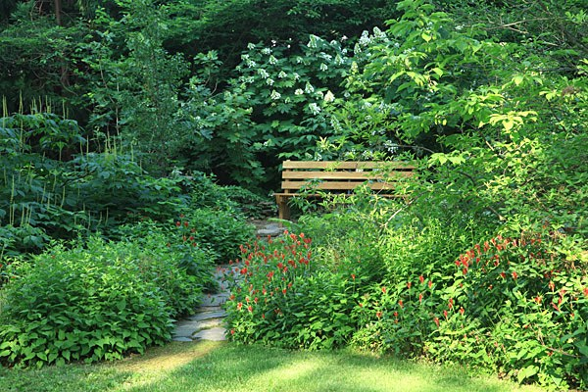
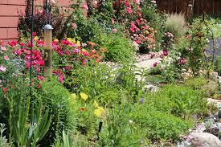
But you CAN
Create a garden
attractive to humans
AND
Provide habitat to attract pollinators
Notes:
Compare the previous photos to these and notice the huge variety of plants with various flower types, the layers where pollinators could mate and raise their young and find safe hiding places to rest.

Slide 19

Provide a Healthy Habitat
Food
Adult food
Food for Young
Notes:
varies by type of pollinator
nectar for adults (flight fuel). Provides carbohydrates
nectar/pollen to feed offspring. Pollen provides protein
OR
“host” plant
A healthy habitat needs to include food for adult pollinators. Nectar provides carbohydrates for flight fuel. Pollen provides protein, vitamins, minerals and fats. Both pollen and nectar are needed to feed bee offspring.
Plants also provide food for young in the form of larval host plants for caterpillars of moths and butterflies.

Slide 20
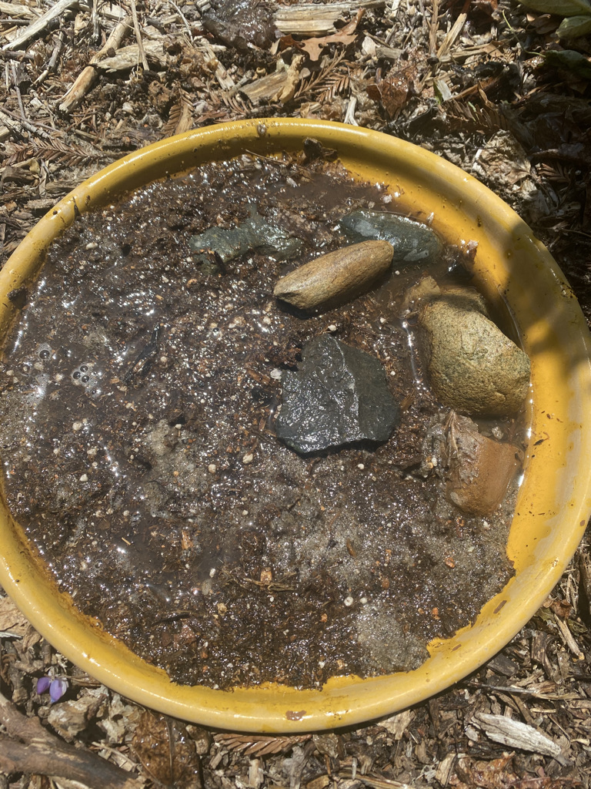
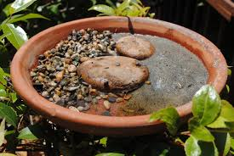
Provide a Healthy Habitat
Water
Shallow
or with
landing spots
Puddling dish
Not clean water!
Notes:
http://ucanr.edu/blogs/blogcore/postdetail.cfm?postnum=26345
dirty water resources
shallow, safe landing, corks, saucer w/ stones, “noodles” in pool
Also wet sand, and wet mud
Pollen and nectar that constitute a bee’s diet don’t contain much moisture, so bees must have a water source. Bees need shallow safe landing spots near water to prevent drowning. Add gravel and larger rocks for this. In larger birdbaths, water should only be several inches deep. You may provide floating pieces of cork as rescue islands. Some folks leave Styrofoam “pool noodles” in their swimming pools for bee rescue.
Butterflies prefer wet sand or mud for “puddling” which offers minerals especially important for healthy reproduction. FYI, “dirty water” refers to water containing nutrients, so it’s okay to let leaves and algae sit in your bee water source. Minerals leach from them into the water. Change the water every 3-4 days to keep mosquitos from breeding in it.

Slide 21
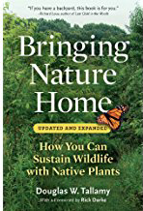
Provide a Healthy Habitat
Shelter
Perching sites to
defend territory
watch for females
Layers of trees and shrubs for windbreaks and shade
Think 4-D
Notes:
Plant in Layers
canopy, understory, shrubs, herbaceous plants, groundcovers
“THINK 3-D,” says Doug Tallamy, co-author of The Living Landscape, “and in fact, maybe think 4-D, since by designing your landscape in all three dimensions, layering plants into complex communities, you’ll add the ‘D’ of diversity, too.”
“4 D” The fourth dimension is diversity
multiples of height, width, breadth, = DIVERSITY
Also provides shelter from predators and from hot or cold weather

Slide 22
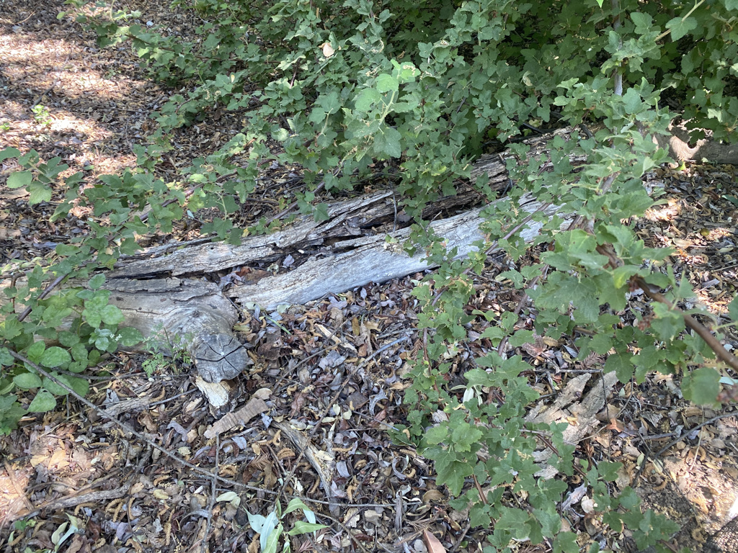
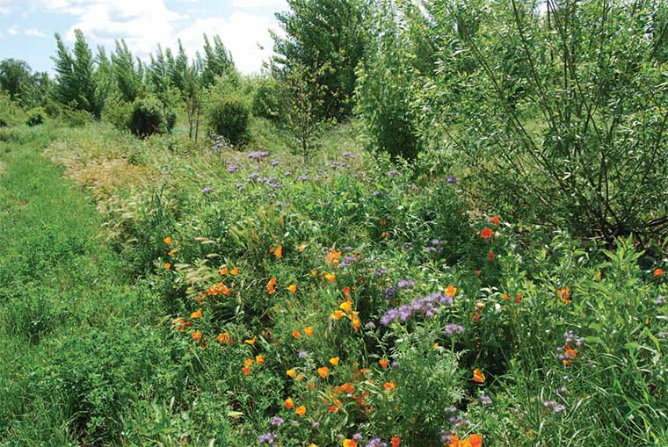
Provide a Healthy Habitat
Space
Leave a portion
of your yard
or property
“wild.”
Notes:
Provide nesting sites:
pupation sites (shrubs)
hollow stems, bare soil, 70% bees are ground nesters, leaf litter, brush piles, hotels
A New Vision Consider leaving a portion of your yard or property “wild”
“It’s important to not be too neat. Small clumps of grass or weeds or debris left under shrubs can protect the bumble bee queen as she overwinters in her nest below. Garden visitors will see that we leave some weed growth on the garden edges to provide this type of habitat.”
Wild areas—NOT weeds
Another important aspect is to retain snags (dead tree branches), shrubs with hollow stems and bare ground.
Walt Disney quote:
'What do you mean we can't get rid of those weeds in time? Then go over there and put some fancy signs with Latin names in front of them’—Walt Disney.

Slide 23
How Can I Attract Pollinators?
A wide selection of plants
Many sources of food
Long bloom season
Year-round food source
“Drone view.”
Large masses of
a single color/plant.
Notes:
A wide selection of plants provides
many sources of food
Long bloom season to provide a year-round food source
“Drone view.” Large masses of a single color/plant.
Some moths are night flyers
Local bats—not pollinators; insectivores
As few as 10 carefully chosen plant species will provide a good foundation. Grouping the same plants together will attract a greater number of pollinators.(Attracting Native Pollinators, Xerces.org, p. 102,Gordon Frankie, UC Berkeley Bee Lab)
The size of the pollinators, the length of their tongues and the accessibility of nectar and pollen determines the flower preferences of pollinators.

Slide 24
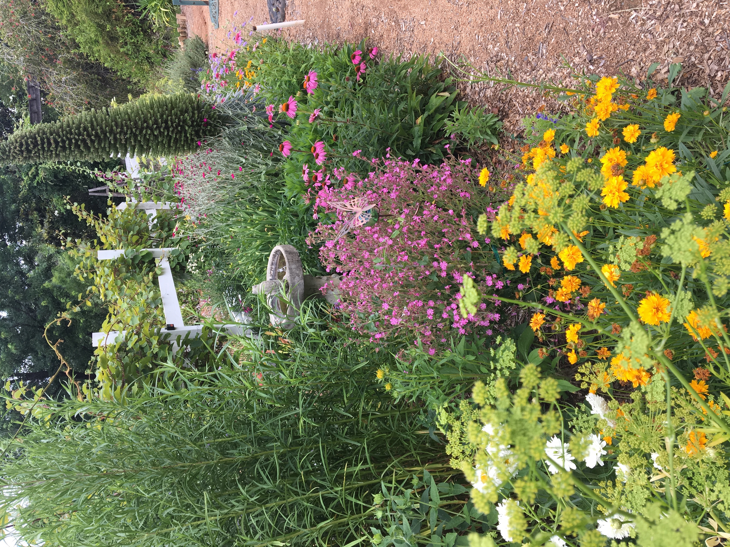
Use Flower Shapes and Colors to Attract Diverse Pollinators
Notes:
Including a variety of plants with different flower sizes, shapes and colors, as well as plant heights, will support the greatest number and diversity of pollinators.
Flowers often have contrasting color marks – lines, patterns or freckles – that serve as guides to where the bee should go in the flower. These are called nectar guides.
Let me describe a few flower shapes. I will be labeling the plants with common names but later you may check the resource list that accompanies this presentation on our PCMG website for a listing of the botanical names which will help when purchasing plants. You may also view this talk again via our YouTube channel.

Slide 25
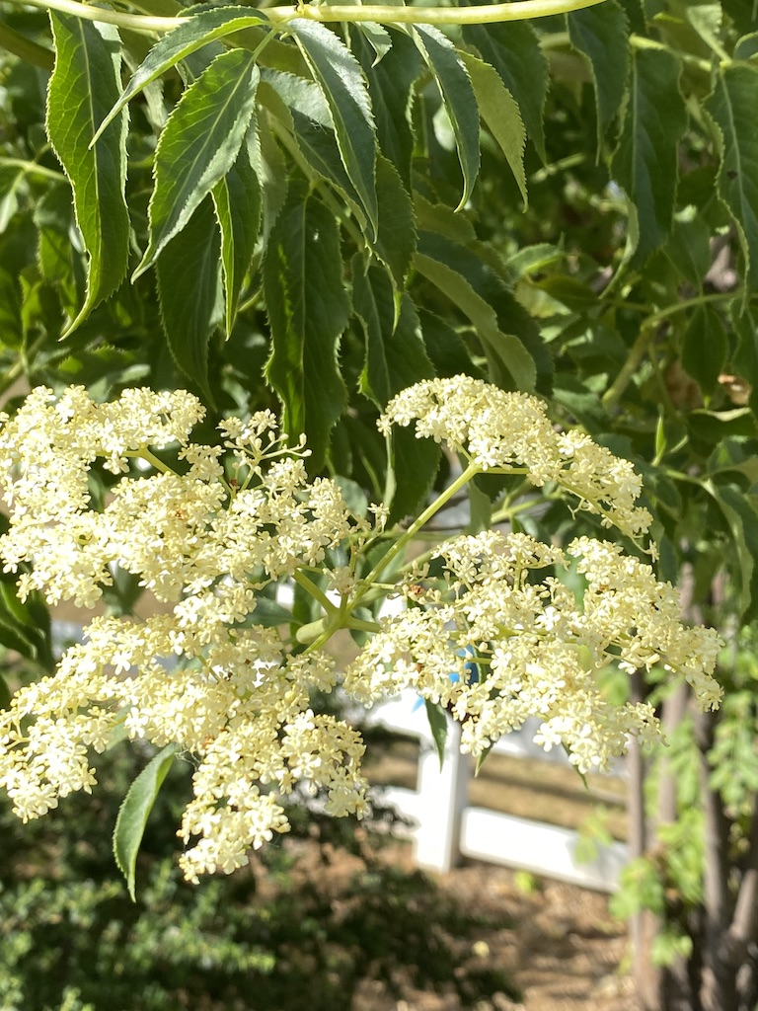
Umbel Type Flowers
Short flower stalks, ending in tiny flowers
These are umbels
Think ”umbrella”
Blue elderberry
Notes:
If you see a flower that has a number of short flower stalks which spread from a common point, ending in tiny flowers, it is known as an umbel. This is characteristic of the celery, carrot or parsley family.

Slide 26
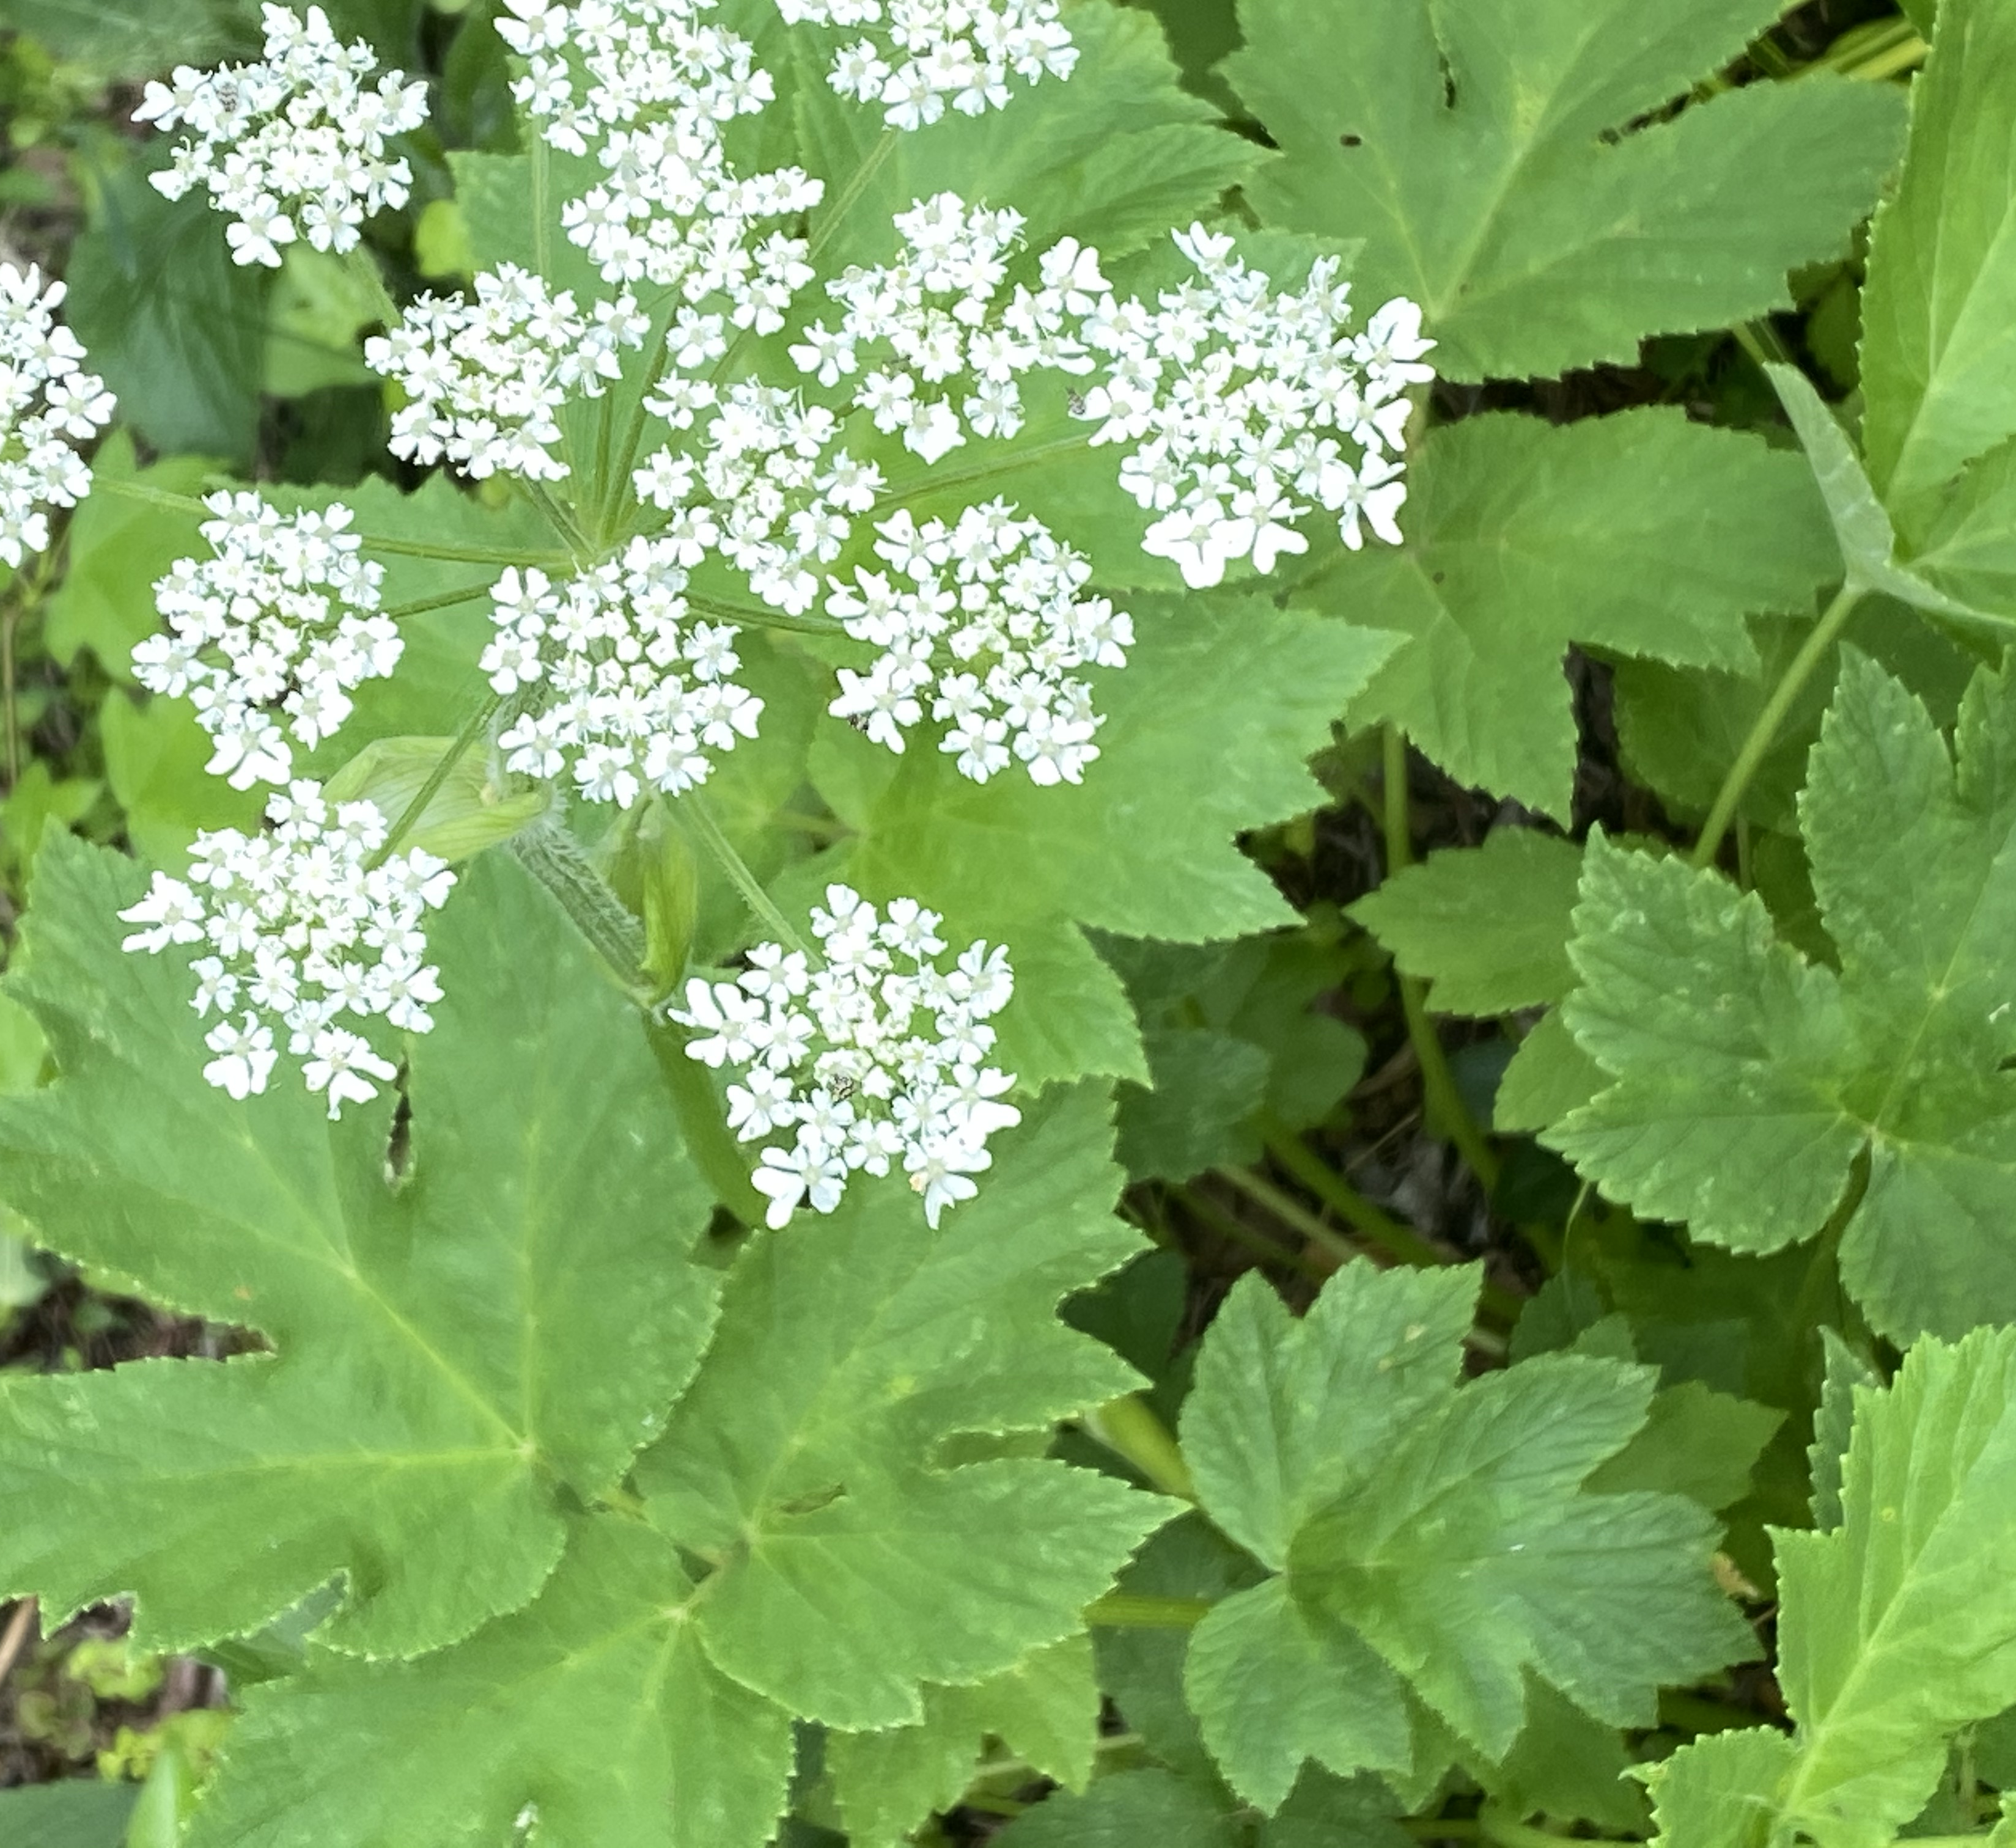
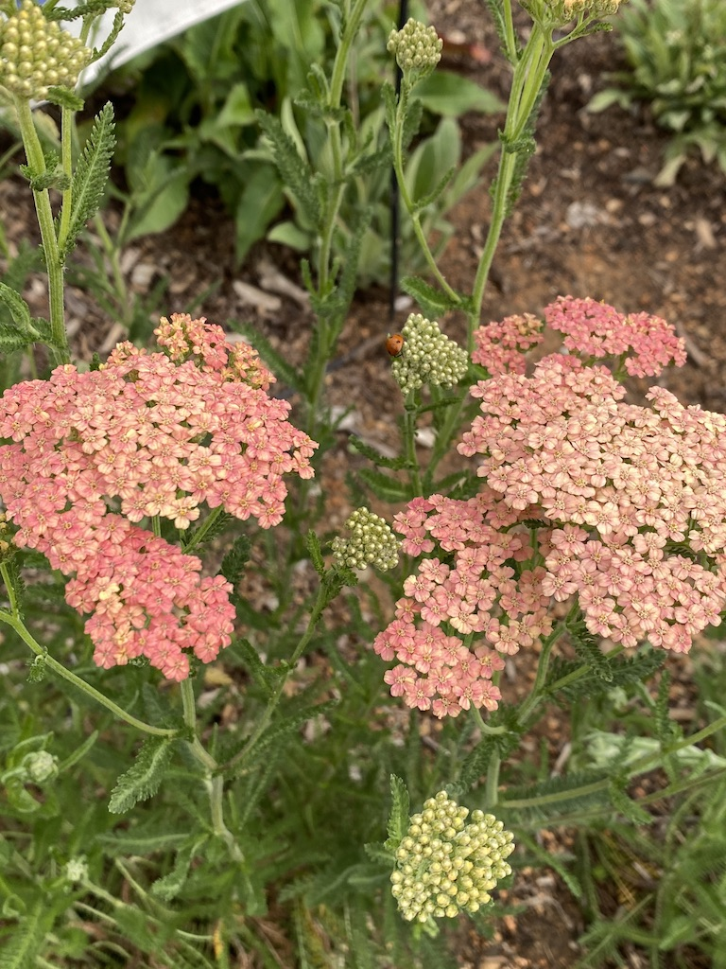
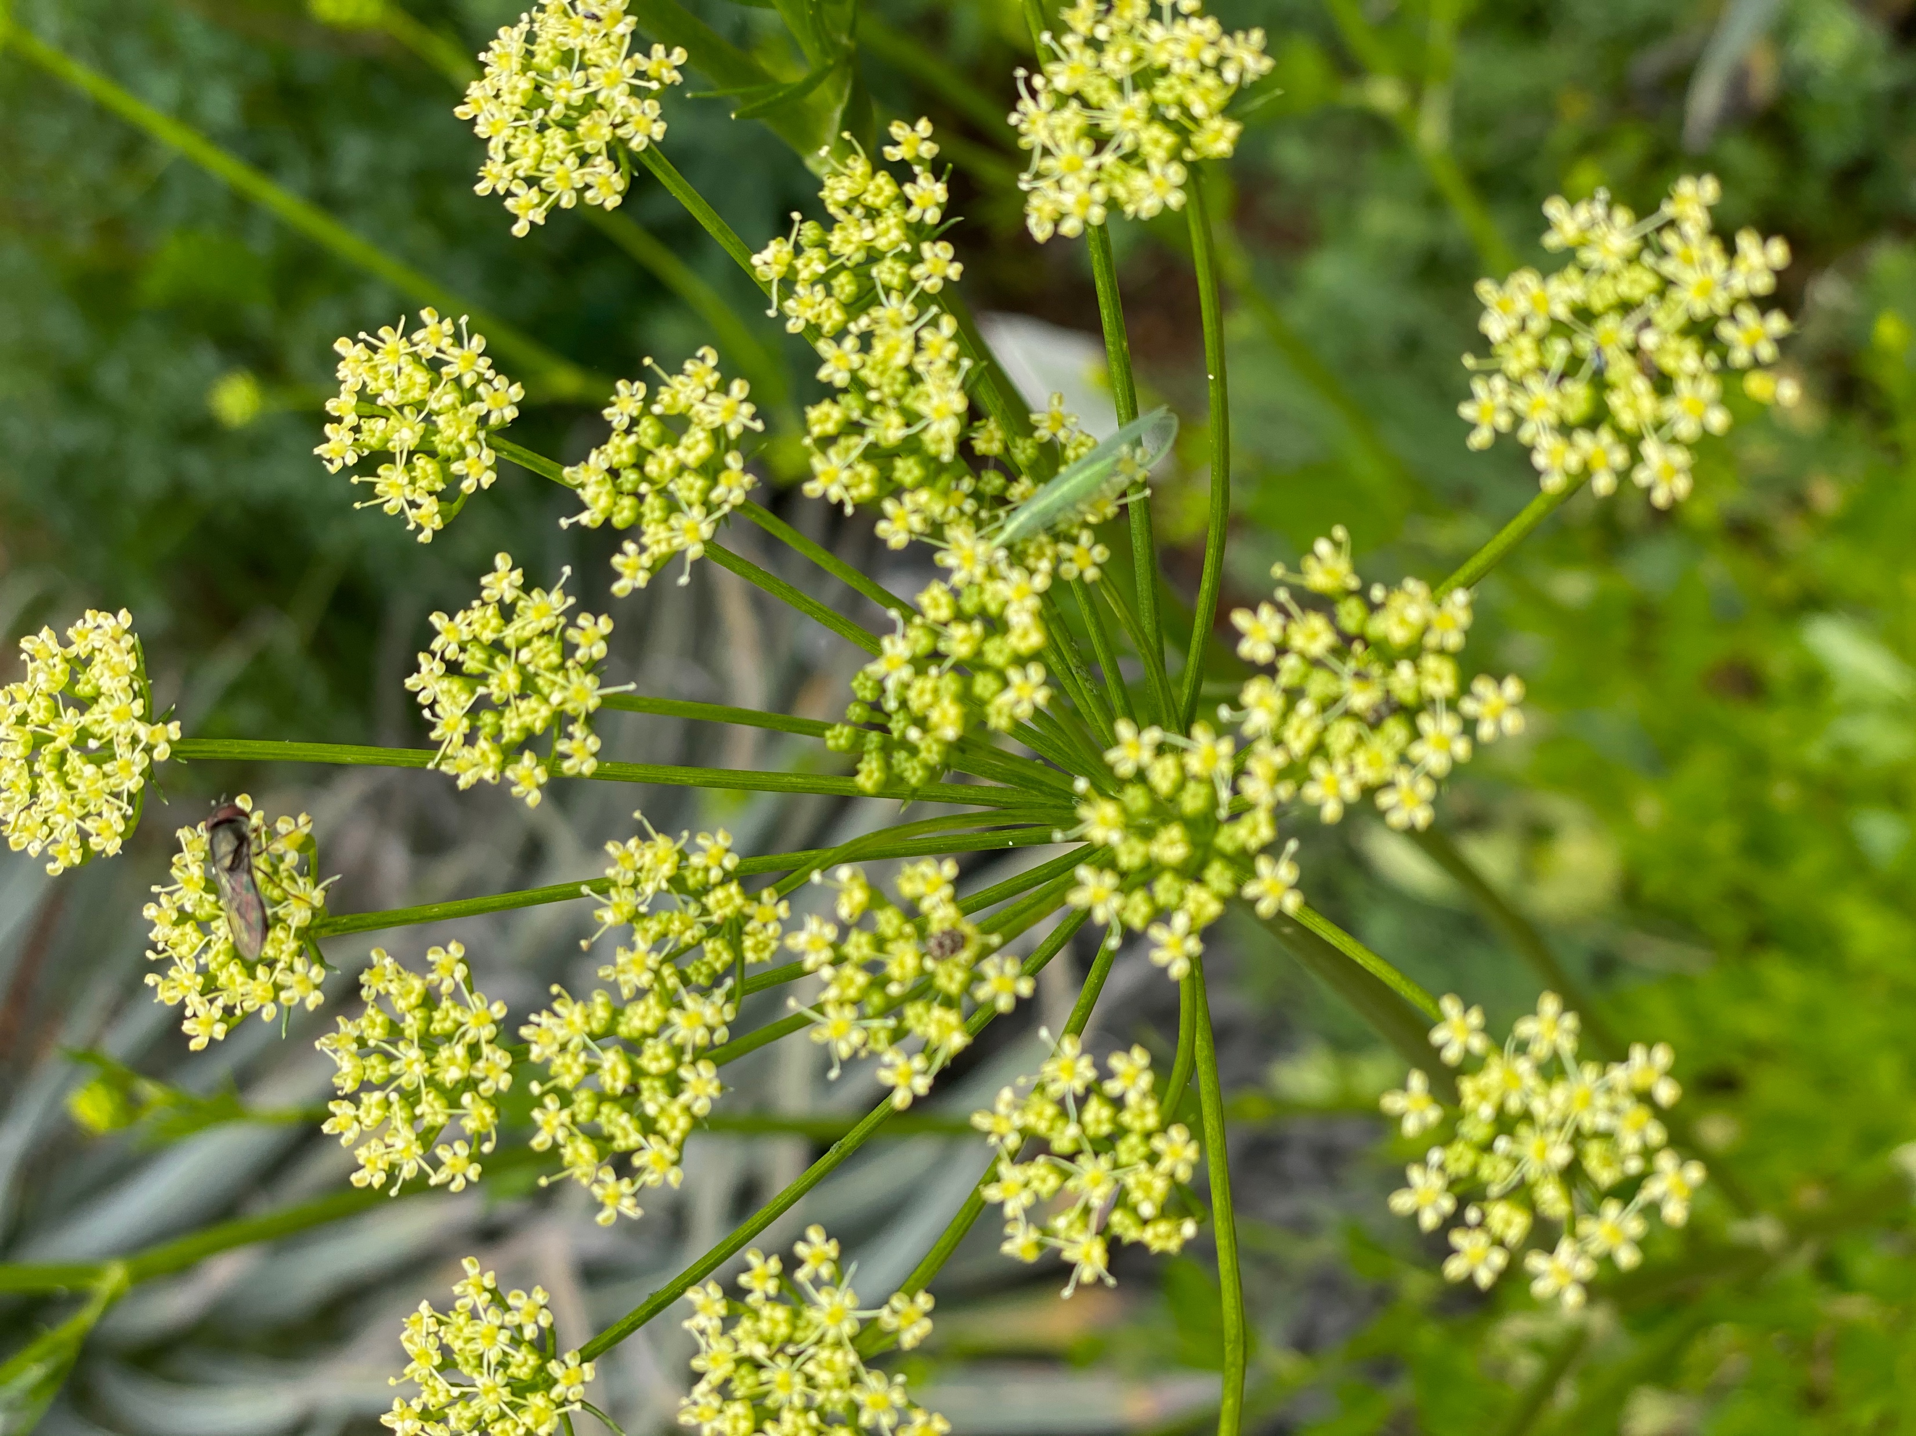
Umbel Type Flowers
Elderberry
Cow parsnip
Parsley
Yarrow
Notes:
These plants with umbel style flowers offer convenient landing pads for pollinators.

Slide 27
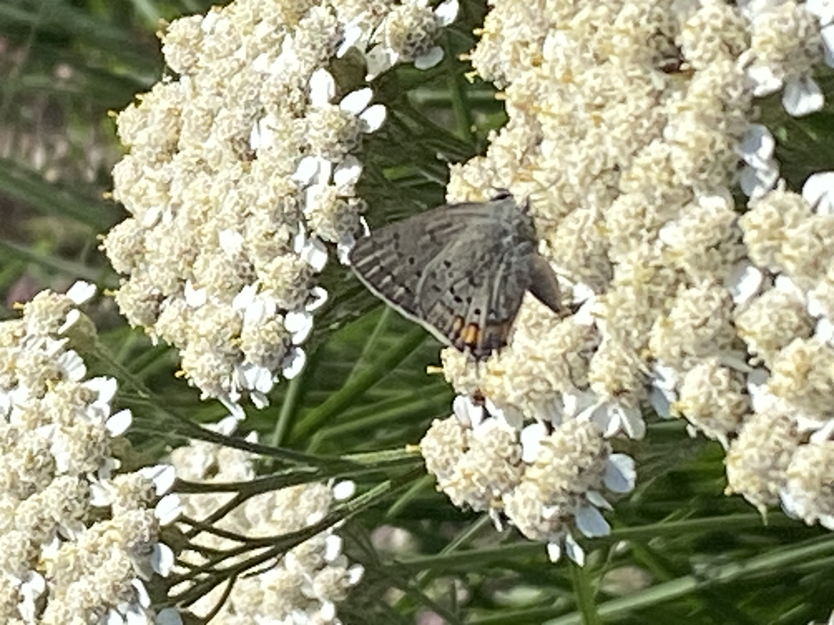
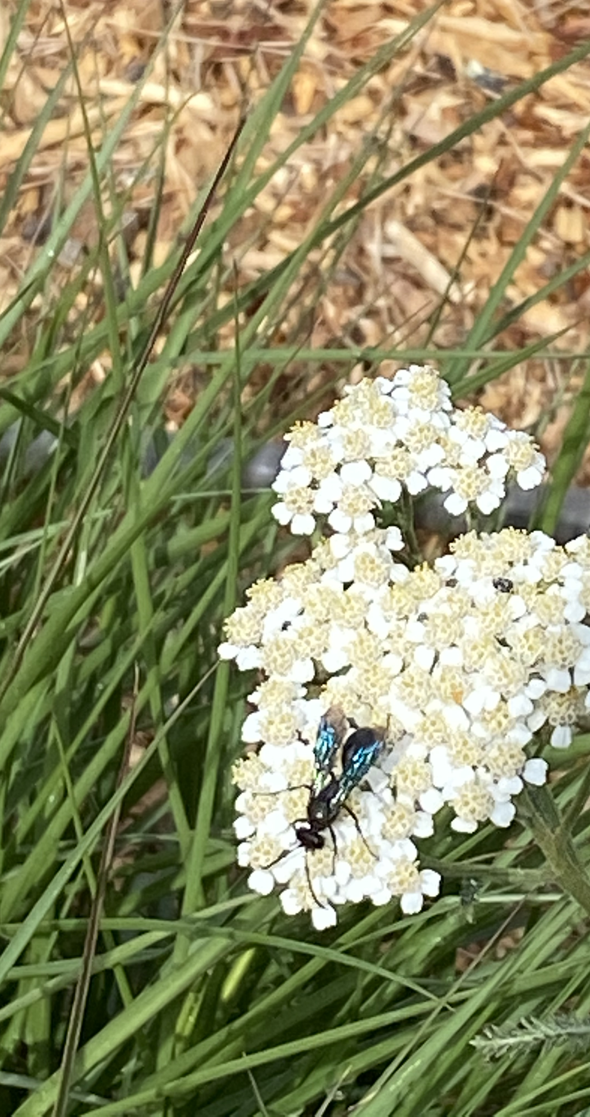
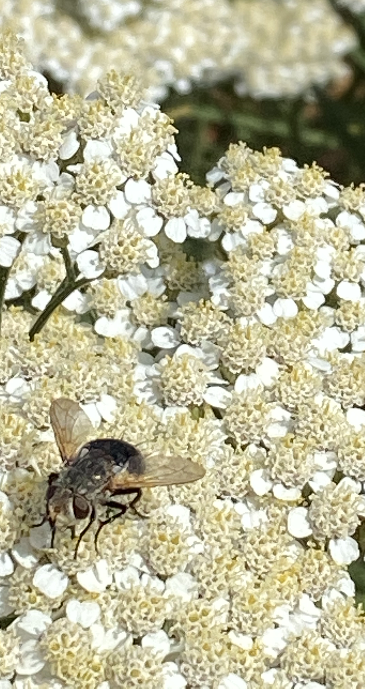
C
Common Yarrow
Notes:
This CA native plant, Achillea millefolium, is visited by a wide variety of pollinators: here are an Eastern Tailed Blue butterfly, Blue Mud dauber, a Drone fly and a yellow jacket.

Slide 28
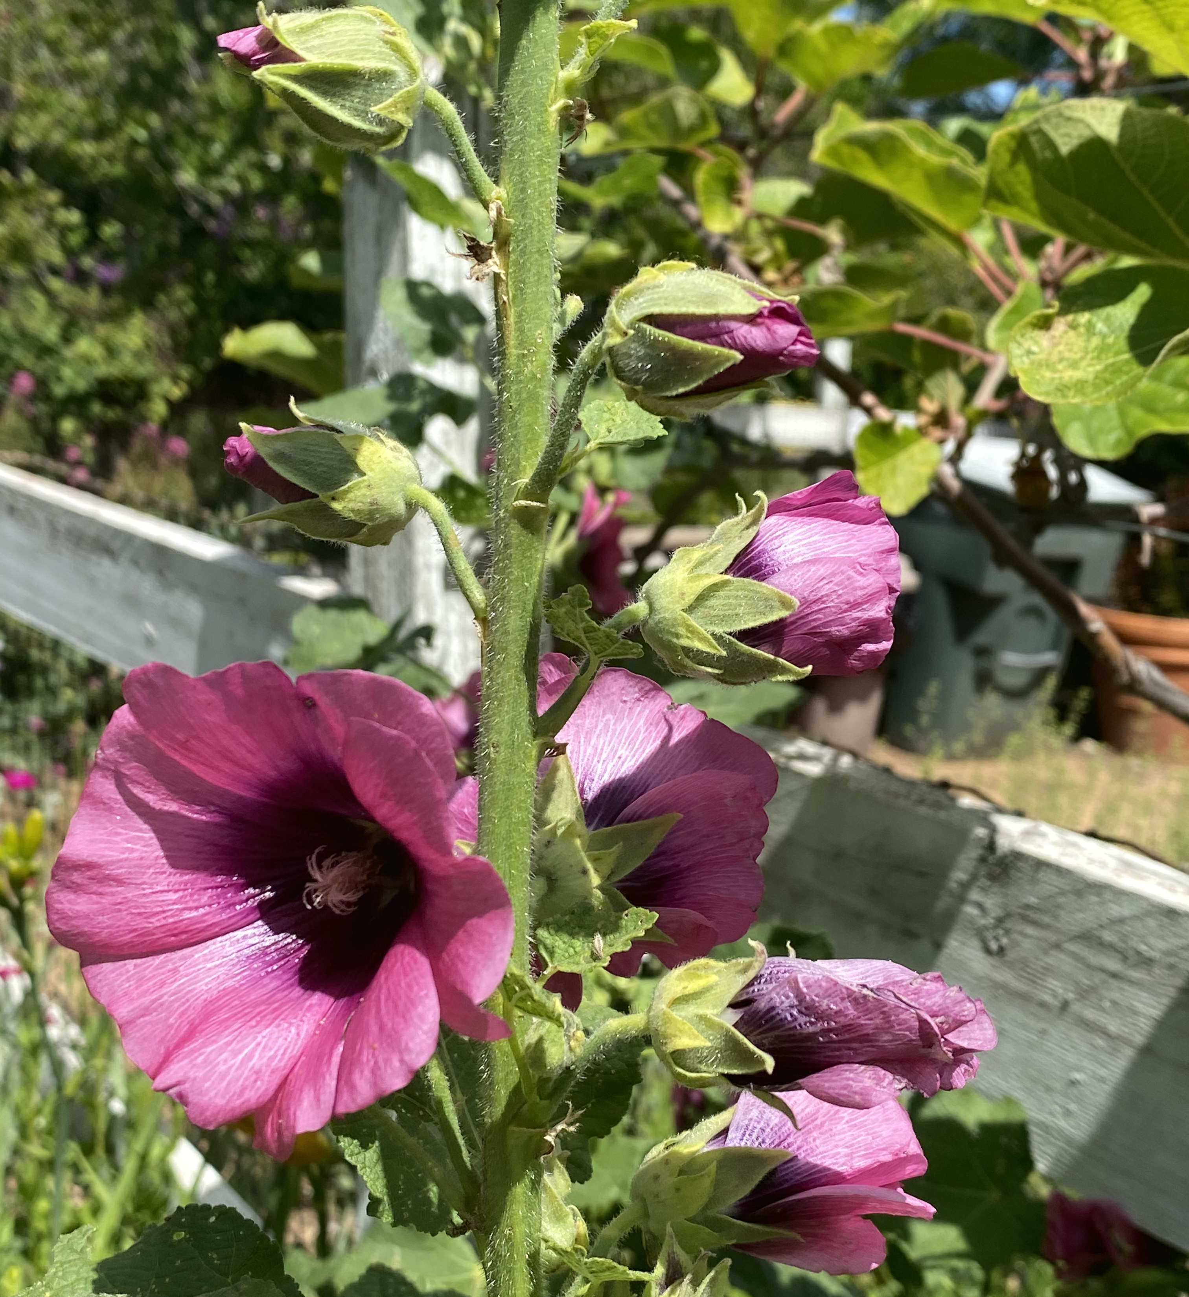
Open Cup-shaped Flowers
Usually have a ring of copious pollen
Used by honeybees, bumblebees and other solitary bees
Mostly offer only pollen
Hollyhock
Notes:
Open cup-shaped flowers are easy for all bees to access. These flowers usually have a large ring of anthers in the center and you can watch bees practically swimming around the center and picking up the pollen. These flowers only offer pollen as a reward, which means that they are primarily visited by bees.

Slide 29
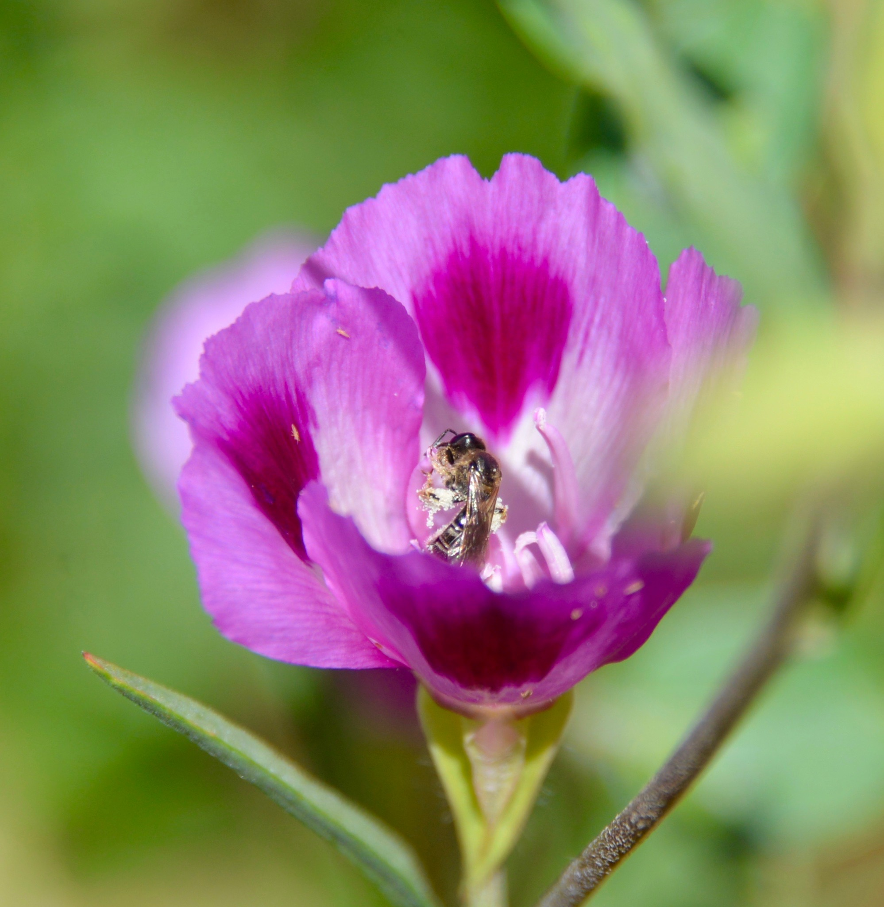
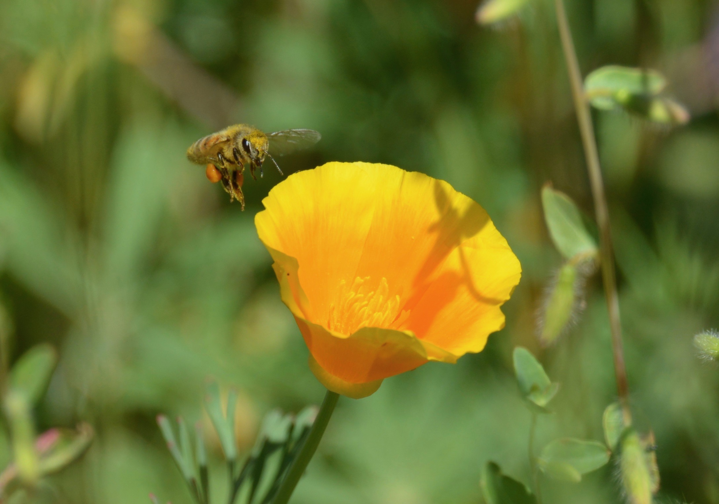
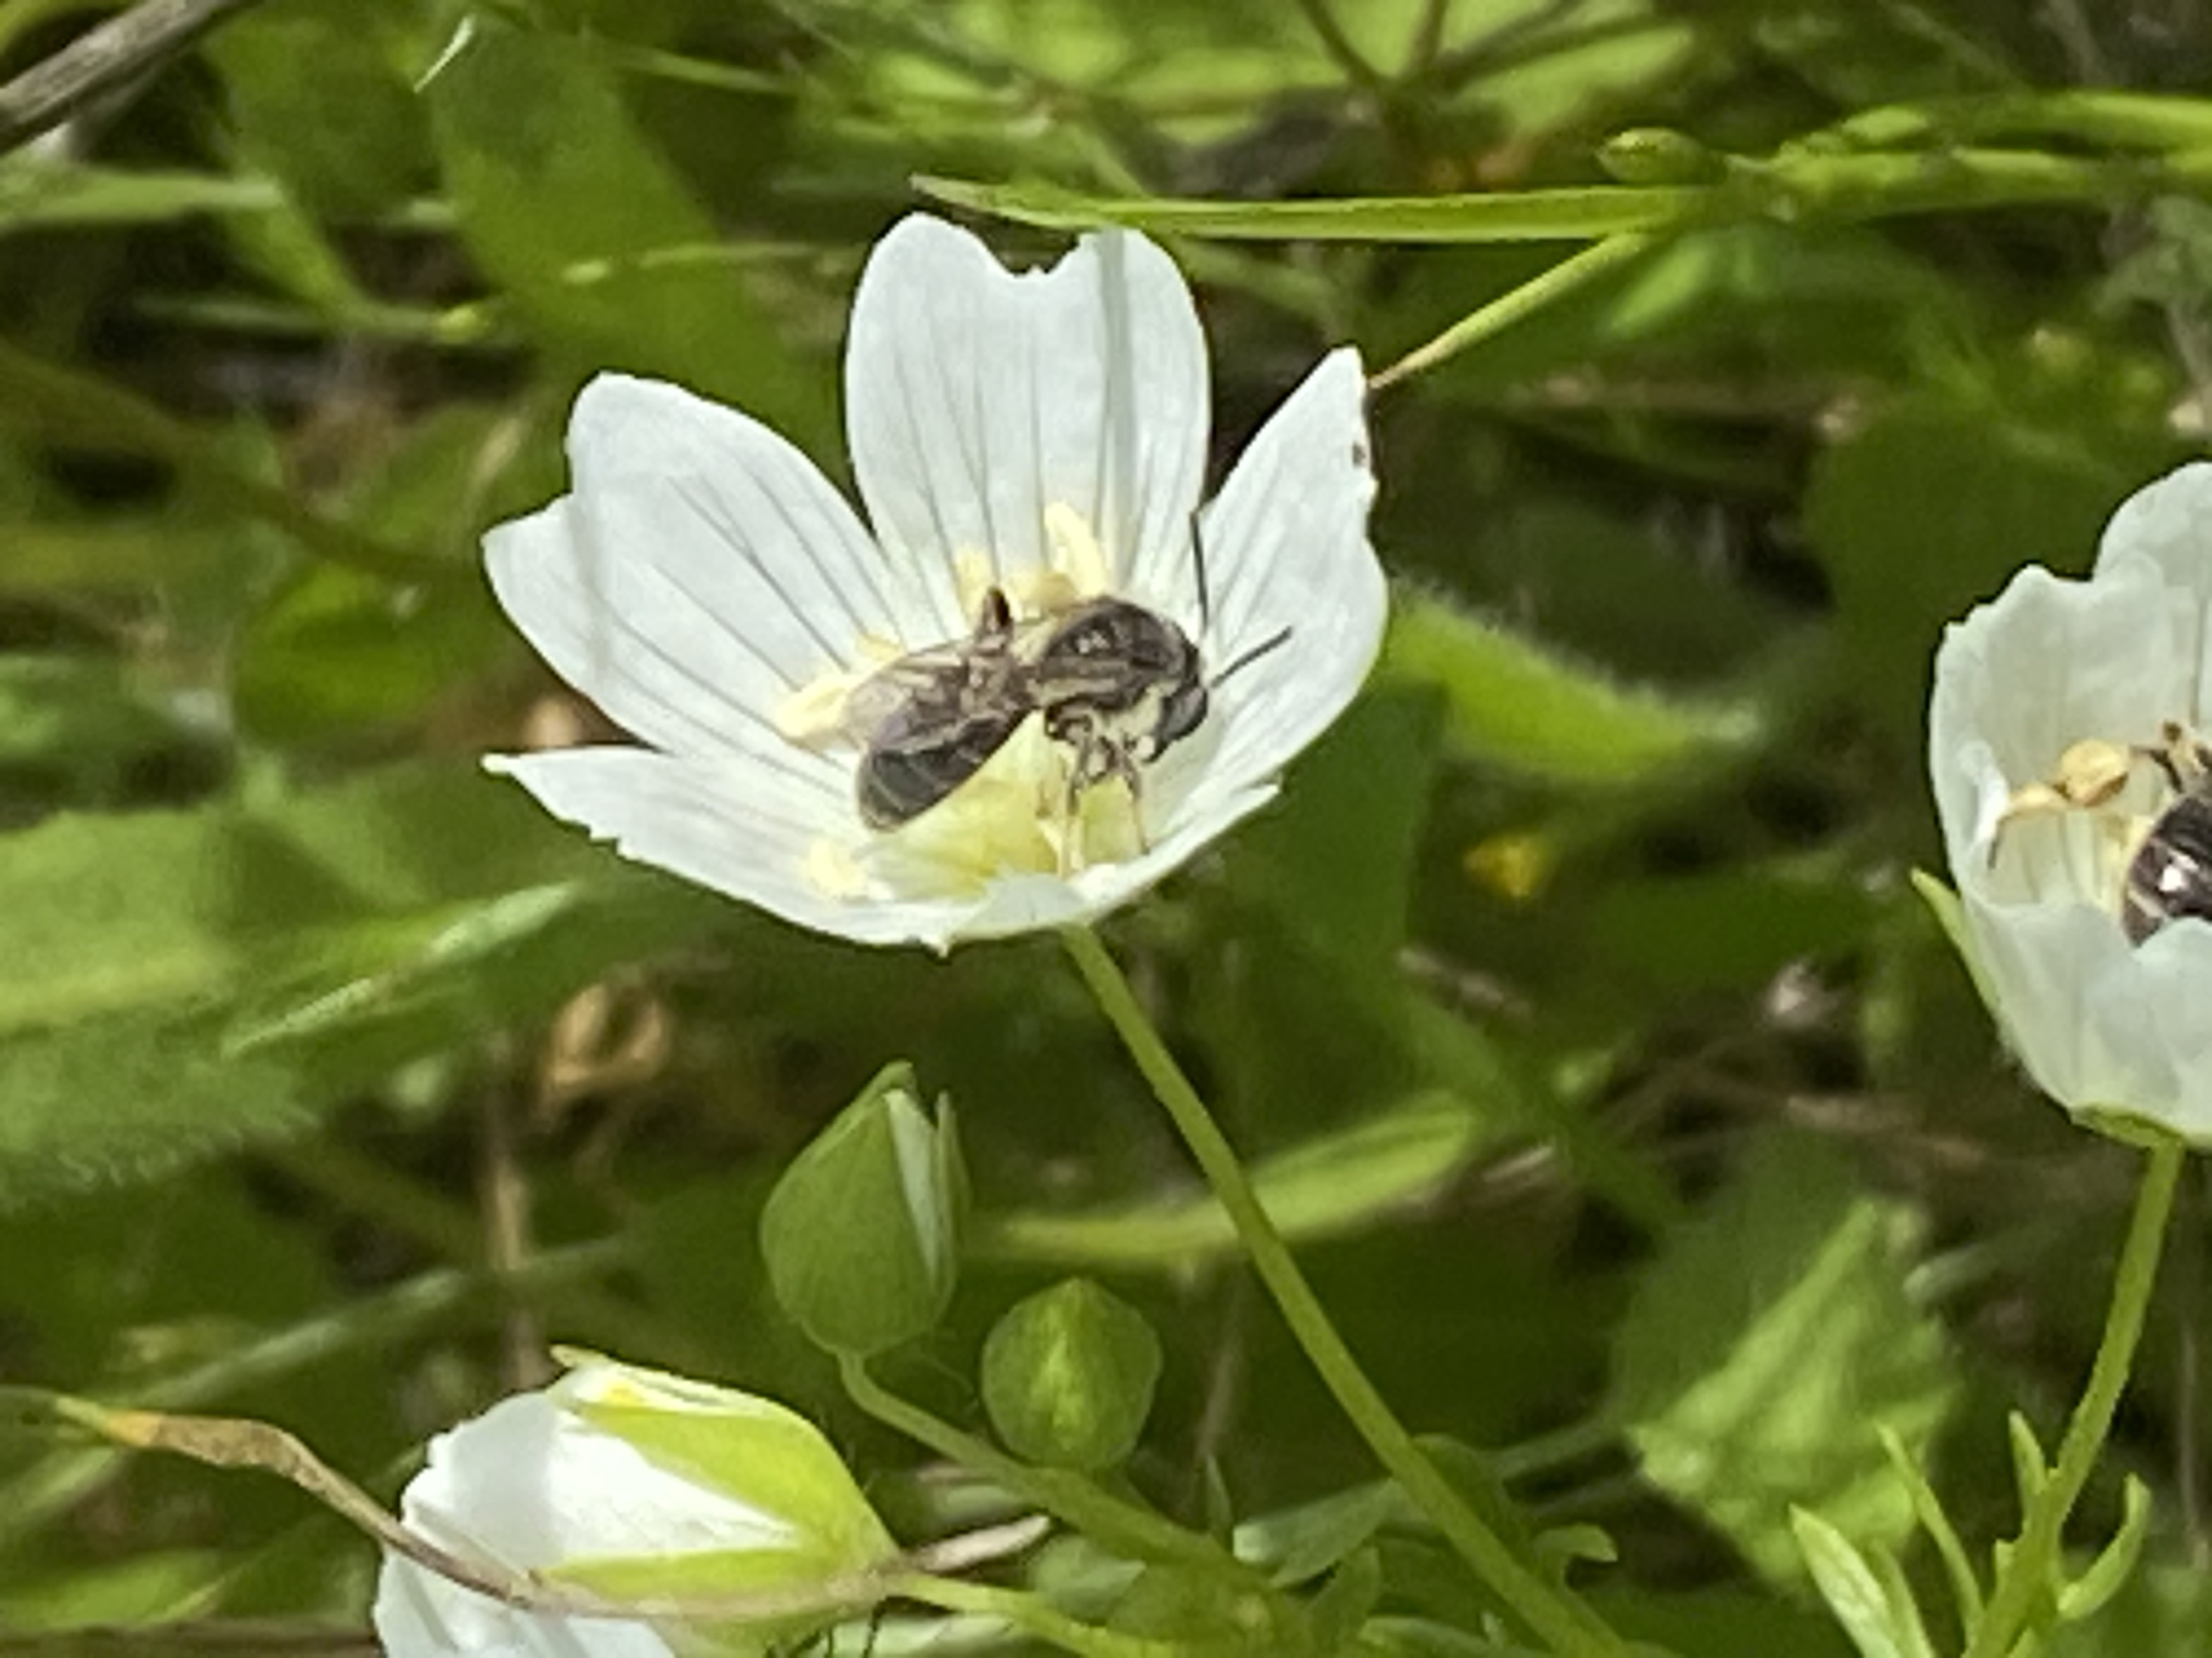
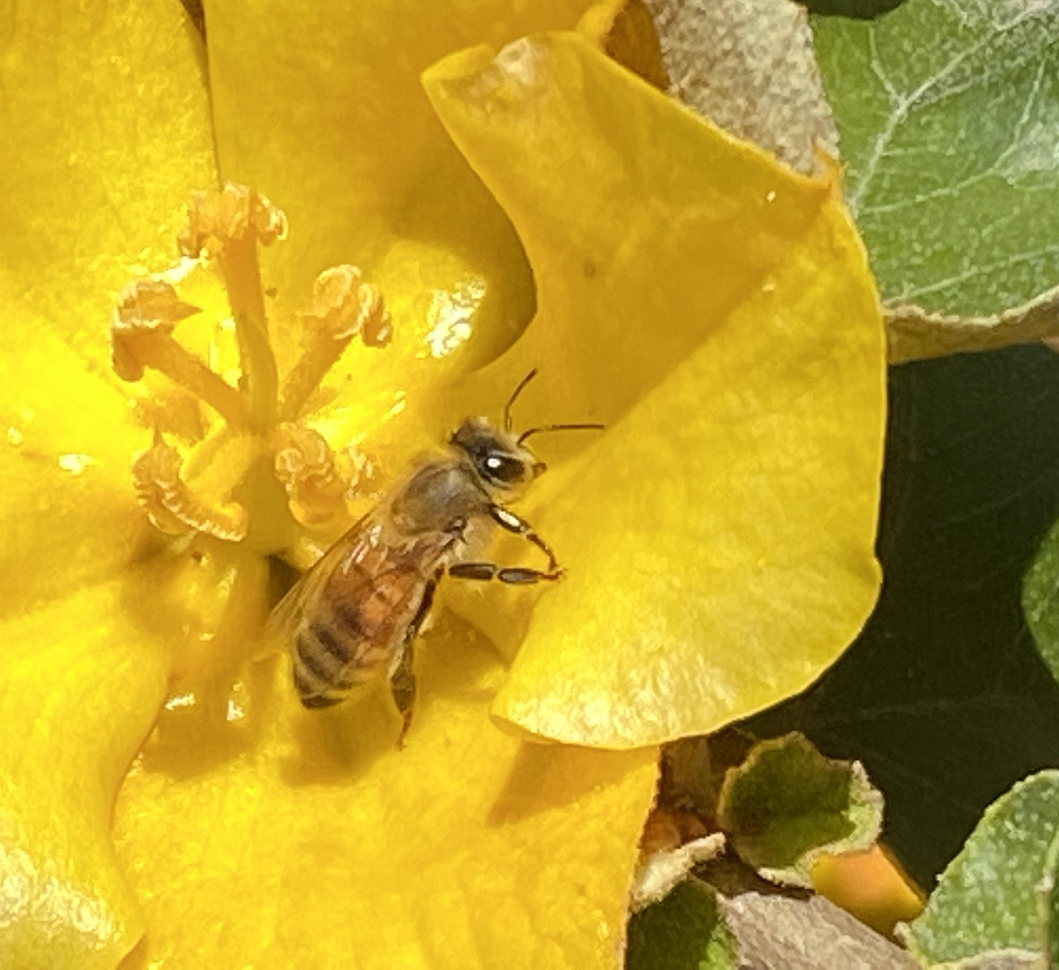
Open Cup-shaped Flowers
CA poppy
Photo Tora Rocha
Clarkia
Photo Tora Rocha
Meadowfoam
Hollyhock
Notes:
Here we have a grouping of CA native flowers. Notice the nectar guides on the Meadowfoam flowers.

Slide 30
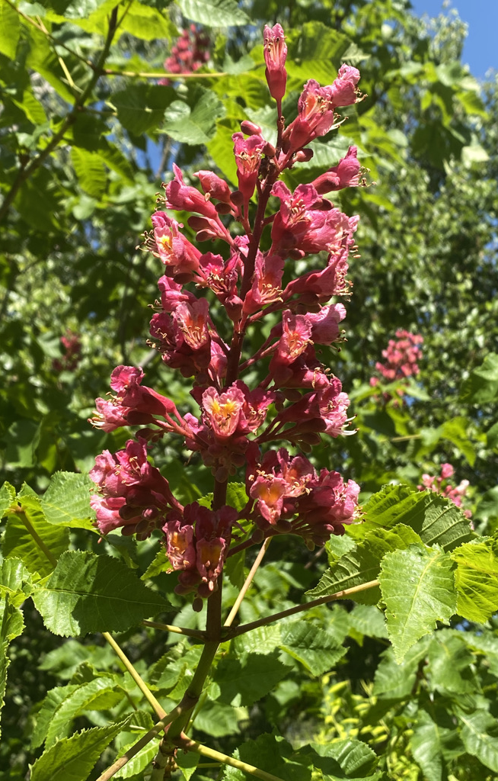
Tubular Flowers
Nectar found at the bottom of the tube
Visited by butterflies and moths with long tongues
Bees may also pollinate them
Length and width of tube determines visitors
Horse chestnut
Notes:
Usually nectar is found at the bottom of these tubes. The length and width of the tube can limit which pollinator species can access the nectar. Many of these flowers are visited by moths and butterflies which have very long tongues.

Slide 31
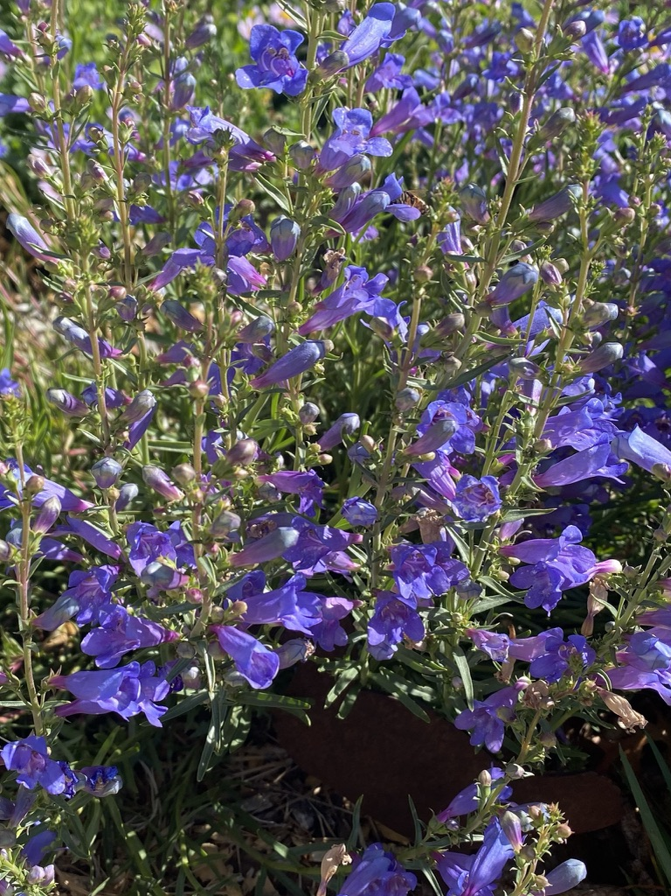


Tubular
Flowers
Foothill Penstemon
Cape fuchsia
Firecracker penstemon
Notes:
Hummingbirds are frequent visitors also.

Slide 32


Odd Bee-havior?
Bumblebee robbing nectar
Honeybee Cuckoo
Notes:
Nectar robbing is used to access nectar when a bee with a short tongue visits a flower with a long corolla. It has strong mandibles (mouth parts) so it can instead bite a hole in the base of a flower. The downside is that the flower does not get pollinated by that bee.

Slide 33

Lipped Flowers
Landing platform
Typically visited by bumblebees
Often in the pea and sage families of flowers
Lupine
Notes:
More complicated shapes, like a pea or lupine, limit which bees can access the nectar or pollen in that plant. These flowers often require heavier, larger bees like bumblebees for pollination. These large bees are strong enough or heavy enough to push open the flower.

Slide 34



Redbud
Golden lupine
Toadflax
Lupine
Photo Tora Rocha
Photo Tora Rocha
Notes:
These plants have flowers with lobes that act as a landing platform, called a lip, where a bee can land to enter the flower. The pollen is hidden in the upper part of the flower, called the keel. When the bee pushes its way into the flower to reach the nectar while standing on the lobe, the stigma and stamen pop out of the keel and pick up any pollen on the bee’s back and places their own pollen on the center of the thorax of the bee. When the bee moves to the next flower, the process repeats and pollination happens.

Slide 35


Composite Type Flowers
Daisy like flowers
Actually hundreds of tiny florets packed together.
Prairie coneflower
Coneflower
Notes:
Flowers with a central disk like sunflowers are favorites of many pollinators. When you look at one of these flowers, you are actually looking at tens or hundreds of flowers. The center “disk” part of the flower is made up of tiny flowers, each with its own nectar and pollen. The outer flowers, which are petals, are called ray flowers and function as attraction.

Slide 36



Mexican sunflower
Seaside daisy
Great Valley gumweed
Notes:
Here, the seaside daisy and the gumweed flowers are the CA native flower examples.

Slide 37

Bunched Flowers
Small flowers make up a compound inflorescence
Lots of nectar and pollen in a small area
Attract butterflies, bees and hoverflies
Toyon
Notes:
Many small flowers make up a compound inflorescence .Having lots of flowers combined into a single head provides a lot of nectar and pollen resources in a small area. Pollinators can visit lots of flowers in a concentrated area without expending as much energy traveling between plants.
. Painted lady butterfly on toyon

Slide 38




CA lilac
Pincushion flower
Butterfly bush
Tall verbena
Hollyleaf cherry
Photo Tora Rocha
Notes:
. Within a simple inflorescence, individual flowers can open slowly over time, allowing for more visitors and ideally more pollination.
On the upper left, a honeybee visits a Dark Star Ceanothus. Other flowers shown here are Pincushion flower, a native Hollyleaf cherry in bloom and a butterfly nectaring on Tall verbena.

Slide 39

Larval Host Plants
Where adults lay eggs
Food for caterpillars
Caterpillars cause damage
Holes in leaves
Plant may be eaten down for the season
Notes:
Many species of wildflowers, grasses, shrubs and tress are butterfly hosts. Caterpillars of some species will eat only a single species of plant while others will eat a wider range of plants. Often, butterflies and moths have specialized relationships with native larval host plants.

Slide 40





Monarchs need Milkweed
Photos Tora Rocha
Notes:
For the many butterflies that are host-plant specific, such as Monarchs with their milkweeds, the availability of these host plants is critical to their survival.
The first photo shows a blooming Showy Milkweed plant (being visited by bees). The upper middle photo illustrates the tiny size of a fairly young Monarch caterpillar, followed by a much larger caterpillar. On the bottom row on the farthest left is a newly pupated jade green individual next to the dark pupa that is very close to ‘ECLOSING” or emerging as an adult. That is an adult female Monarch on the far right.

Slide 41



Anise Swallowtail
Notes:
Most butterflies lay their eggs directly on host plants so that after hatching, caterpillars do not have to travel far to begin feeding.
Here is an Anise swallowtail egg on the ferny leaves of fennel, followed by a photo of the caterpillar and the adult butterfly.

Slide 42





Pipevine Swallowtail
Notes:
Leaves are the primary source of caterpillar food, but they will also sometimes eat stems, flowers and immature fruit.
These photos illustrate the life cycle of the Pipevine Swallowtail butterfly. The California Dutchman’s pipevine is the larval host plant. From the upper left, you see the flower which resembles an old fashion pipe, then eggs on a leaf, some of which have already hatched. On the bottom row we have the caterpillar , then a pupa attached to a stem and finally the adult Pipevine Swallowtail nectaring on the native Verbena lilacina “de la mina”.

Slide 43


How Can I Attract Pollinators?
Hummingbirds
Attracted by bright colors
Red, yellow, orange, blue
Tubular flower shape
Hover to drink nectar
Notes:
In our area, we have year round hummingbird residents in the form of Anna’s hummingbirds. It is possible, with careful planning, to have something blooming for them all year long. Early bloomers include willows, manzanitas, ceanothus and Ribes, which are currants and gooseberries.

Slide 44



Hummingbirds
Hummingbird Mint
Manzanita
Mexican Sunflower
Notes:
Later in spring, hummers will feed at California buckeye, various sages, and penstemons. In summer, they are quite attracted to Mexican sunflower, known as Tithonia, even though it doesn’t have tubular flowers. Late summer and fall bring California fuchsia which is a hummingbird magnet. Many hyssops (also known as hummingbird mint) continue to bloom for a long period.

Slide 45




Herbs
Fennel
Culinary sage
Borage
Chamomile
Notes:
Many culinary herbs are pollinator friendly. They are good additions to edible gardens as they attract pollinators where they are needed.

Slide 46



Chives
Rue
Rosemary
Notes:
Let some of the herbs flower so that pollinators have pollen and nectar. Rosemary is a prolific bloomer.

Slide 47
Plants! Plants! Plants!
Plant for year-round bloom
Plant in the sun.
Patchwork Quilt
Patchwork Quilt
Notes:
Let’s think of our gardens as Patchwork Quits. Let’s consider sequential flowering times and make it a goal to have flowers blooming in every season. Most bees exhibit floral constancy, which means they visit only one or a very few types of flowers each time they go out foraging. The ideal patch size is 4 x 4’. A garden area design that features dense plantings ensures a robust food supply for pollinators and will create a full and colorful garden.
Most bees and butterflies prefer to fly in the sun, so concentrate your flower plantings there.

Slide 48
Plants! Plants! Plants!
Photo PlantRight
Photo: UC Davis
Sage
Salvia ‘Bee’s Bliss’
Goldenrod
Solidago ‘Cascade Creek’
California Natives
Patchwork Quilt
Notes:
Salvia ‘Bee’s Bliss’ is a low-growing wide-spreading native sage that is attractive to pollinators.
Goldenrod is a late summer/early fall native bloomer that is especially attractive to migrating Monarchs.

Slide 49


Plants! Plants! Plants!
Spring Bloom
Summer Bloom
Fall Bloom
© 2013 John Doyen
Las Pilitas Nursery
Las Pilitas Nursery
Silver Bush Lupine
Eaton’s Penstemon
California aster
Winter Bloom
California Natives
Photo credit:CountryMouse13
Coyote Brush
Patchwork Quilt
Photo credit:CountryMouse13
Coyote Bush
Baccharus pilularis ‘Pigeon Point’
Notes:
Since native bees are seasonal, the plant palette chosen should reflect the changing seasons of both bees and plants. With few exceptions, most bee species are only active for a short time each year. Several plants should be blooming in each season to provide pollen and nectar to visiting bees. The main activity period for bees is February to October, so select bloom times that overlap.

Slide 50



Plants! Plants! Plants!
ANNUALS ARE IMPORTANT!
California poppy
Lacy Tansy
Tidy Tips
Bug Squad Blog
Photos by
Kathy Keatley Garvey
Patchwork Quilt
Notes:
Lacy Tansy Phacelia tanacetifolia,
California poppy Eschscholzia californica
Common tidytips Layia platyglossa
Annual plants keep the garden dynamic with changing colors and flower types throughout the year. Sow seeds for spring blooming annuals like these three here in the late fall in order to take advantage of winter rains.

Slide 51


One of the Best Pollinator Plants
Mexican Sunflower
Tithonia rotundifolia
Blooms spring to fall
Attracts many pollinators
Also butterflies
Even hummingbirds
#TithoniaInEveryGarden
Notes:
"Tithonia in every garden" or hashtag it: #TithoniaInEveryGarden.
You can't go wrong with Mexican sunflower or Tithonia, which anchors many pollinator gardens in California from early spring through fall. It is visited by many species of butterflies and bees. Hummingbirds love it too.
In addition to monarchs, we've seen Gulf Fritillaries, Western tiger swallowtails, mourning cloaks, pipevine swallowtails, skippers, buckeyes, acmon blues, painted ladies and other butterflies sipping nectar from Tithonia. That's not to mention the other pollinators drawn to the colorful orange flower. Among them: bumble bees, carpenter bees, sunflower bees, leafcutter bees, blue orchard bees, sweat bees, syrphid flies or hover flies, and hummingbirds
http://www.ucanr.org/blogs/blogcore/postdetail.cfm?postnum=22079

Slide 52

Plants! Plants! Plants!
Hedgerows provide shelter and food.
Patchwork Quilt
Notes:
Hedgerows can benefit pollinators in cropland, as well as large properties with space for large plantings.
A hedgerow is a mixture of trees and/or flowering shrubs that typically includes an understory of grasses and nectar flowers. The plants are allowed to flower and reach their mature size. Hedgerows have enormous wildlife value: they offer dense cover and a diversity of seasonal food sources.

Slide 53


Avoid Pesticides
Neonicotinoids are Insecticides
Are absorbed into plant tissues
including the pollen and nectar.
May remain in plant up to 2 years!
Insects are killed or disrupted
when they eat those plants.
Neonicotinoids kill pollinators.
Ask at your nursery!
Patchwork Quilt
Notes:
Neonicotinoids are commonly used insecticides which are highly water soluble, allowing the growing plants to absorb and transport the chemical to all plant tissues, from roots to pollen. Pollinators may consume contaminated plant products like leaves, pollen and nectar and be killed if they consume a high enough dose of the chemical. The use of neonics and other pesticides is common in nurseries, and plants are often not labeled as treated when sold. Please talk to the store manger to find out if their plants have ever been treated.

Slide 54
Avoid Pesticides
Bt
Bt is a bacterium
Infects the gut of caterpillars
Does not affect humans or beneficial insects.
Bt container label
Controls worms and caterpillars on fruits,
vegetables, ornamentals and shade trees.
Kills tomato hornworms, tent caterpillars, gypsy moths
and others listed.
PS: Bt kills all caterpillars NOT just the ones on the label!!!
Bt is nonsystemic. It can be washed off.
Length of efficacy is 1 to 4 days.
Patchwork Quilt
Notes:
Bt (which is Bacillus thuringiensis) kills ALL leaf feeding moth and butterfly caterpillars that feed on sprayed foliage.
LBAM Light brown apple moth is treated for in 13 counties.
https://www.cdfa.ca.gov/plant/PDEP/target_pest_disease_profiles/LBAM_PestProfile.html
bT http://pmep.cce.cornell.edu/profiles/extoxnet/24d-captan/bt-ext.html

Slide 55





Book Resources
Patchwork Quilt
Notes:
Attracting Native Pollinators. 2011 by The Xerces Society and Dr. Marla Spivak
The Bee Friendly Garden. 2016 by Kate Frey and Gretchen LeBuhn
California Bees and Blooms. 2014 by Gordon Frankie, et al.
The California Wildlife Habitat Garden. Aug 8, 2012 by Nancy Bauer
Bringing Nature Home. 2007 by Douglas Tallamy
Check out these book resources for great info and plant lists. Many other resources are included on the “Plant It and They Will Come/Planning for Pollinators” Resource Sheet.

Slide 56

Notes:
If you are not familiar with Calscape, it is the California Native Plant Society’s database about California native plants local to your area. Let’s look at it briefly. I typed in my zipcode to see which plants are native to my location,

Slide 57

Notes:
I clicked on the butterfly tab at the far upper right, with my zipcode still in place.). It tells me that 110 butterflies and moths are native here.

Slide 58

Notes:
I chose a butterfly, the Western Tiger Swallowtail, to see which plants are confirmed host plants.

Slide 59

Notes:
I chose to look at the Hollyleaf Cherry. Plant photos are shown from foliage to flowers and fruit. Under the photos , in green print, it lists 45 nurseries that carry this plant for sale.

Slide 60

Notes:
Scrolling down, we see other butterflies and moths that use this plant. Then we see landscaping information, such as light exposure, soil and water needs, etc.

Slide 61


Pollinator Planting Basics
Provide abundance
Plant in masses of a single species (4’ x 4’)
Long bloom season
Leave bare soil for ground nesting bees
Leave snags and logs for cavity nesters
Notes:
To conclude, to have a successful pollinator garden, we should aim to provide abundance by planting in masses of a single species. Plan for a long bloom season. Leave some non-mulched bare soil for ground nesting bees. Leaves snags and logs for cavity nesters.

Slide 62

Pollinator Planting Basics
Provide a diversity of blooms types
Include plants with overlapping bloom times
Diversity of blooms will attract a variety of pollinators and other insects
Notes:
Read slide

Slide 63

Time to Start Planning!

Slide 64


Thank You!
Any Questions?
Master Gardener Hotline: (530) 889-7388
Master Gardener Website: pcmg.ucanr.org
Button willow
Cephalanthus occidentalis

