Slide 1
Vertebrate Pests Around the Garden and Home
Developed by UC IPM for UC Master Gardeners
Notes:
Created: 5/18/2008
Created by: Roger Baldwin of UCANR
Audience: Description of intended audience
Publicity: Text that could be published on calendar, Facebook, newsletter to attract an audience
Update History: Updated with placer introduction and ending slides 3/21/2021 by B. Villareal
Today we’re going to talk about animals (or vertebrate pests) that could be eating the fruits and vegetables in your garden.

Slide 2
Who Are Master Gardeners?
Master Gardeners of Placer County
  Extend research-based, sustainable gardening and composting information
  Present accurate, impartial information to home gardeners
  Encourage public to make informed gardening decisions
2

Slide 3
Who Are Master Gardeners?
Where to find us…
Online, in the Media, and Special Publications
  Hotline: Call (530) 889-7388 or submit your questions online
  Website: pcmg.ucanr.org
  Facebook, Twitter, Instagram
  Gold Country Media monthly column
  Curious Gardener quarterly newsletter on our website
  Gardening Guide and Calendar
3

Slide 4
Who Are Master Gardeners?
Where to find us…
Workshops, Fairs and Festivals and Special Events
  Speakers by Request
  Workshops (various venues, check website)
  Farmers’ Markets (seasonal: Auburn, Roseville)
  Fairs and Festivals Booths (varies)
  Garden Faire (April)
  Mother’s Day Garden Tour (May)
4

Slide 5
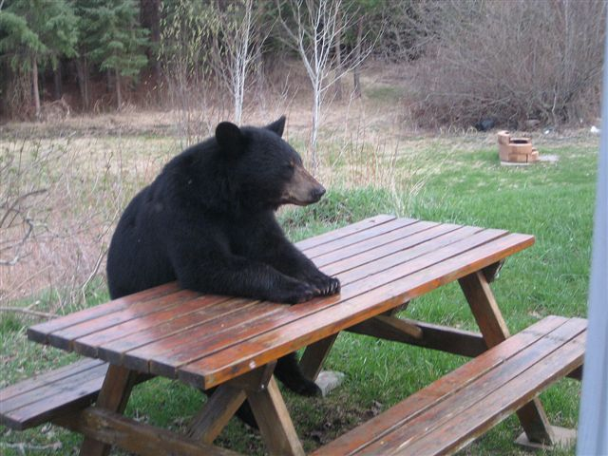
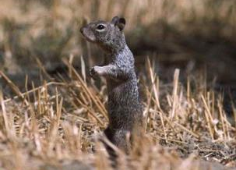
What Are Vertebrate Pests?
Nonhuman species of vertebrate animals that are currently troublesome locally, or over a wide area, to one or more persons, either by being a health hazard, a general nuisance, or by destroying food, fiber, or natural resources.
Photo: unknown
Photo: UC IPM
Notes:
Let’s start with a textbook definition of what a vertebrate pest actually is as shown on the slide.
This means that a vertebrate pest can be something as small as a ground squirrel or as large as a black bear hanging out in your backyard. Remember, these species are not inherently pests. They’re only considered pests when they start to cause problems.
Different kinds of pests can cause damage in different ways. Today, we’re going to focus on the vertebrate pests that cause damage in your gardens, and the pests that will eat your fruits and vegetables. We’re going to try to help you figure out what might be eating the things you’re growing.

Slide 6
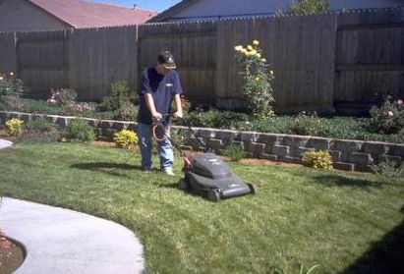
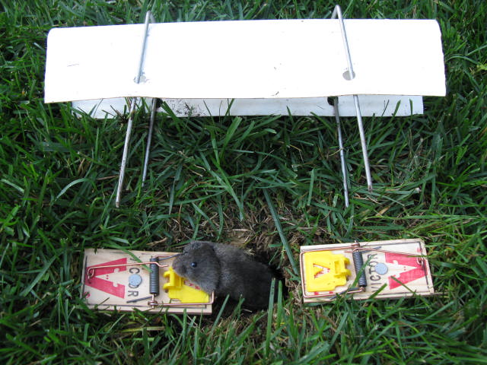
Current Control Strategies
Currently, we focus on an integrated approach that utilizes a number of strategies and tools to control vertebrate pests
Photo: UC IPM
Photo courtesy of Steven Albano
Notes:
When managing vertebrate pests, we want to use integrated pest management, or IPM, and use a wide range of practices and multiple strategies. These may include mechanical and physical control, cultural control. We may use all of these different practices, or we might just use one. It depends on what type of pest you have.
The most important thing in deciding what practices you need to use is pest identification. If you don’t know what it is, you can’t do anything about it. You can’t set a trap because you might catch something you don’t want. You cant put out a toxicant because, again, you might expose something you don’t want to. You have to know what you have before you can do any management.
With this example of moles, if you mow regularly and reduce vegetation, you’re less likely to have damage from this pest. Once you’ve reduce the population, you can use trapping to remove the remaining population. Using these two strategies is an example of an integrated approach to controlling vertebrate pests.

Slide 7
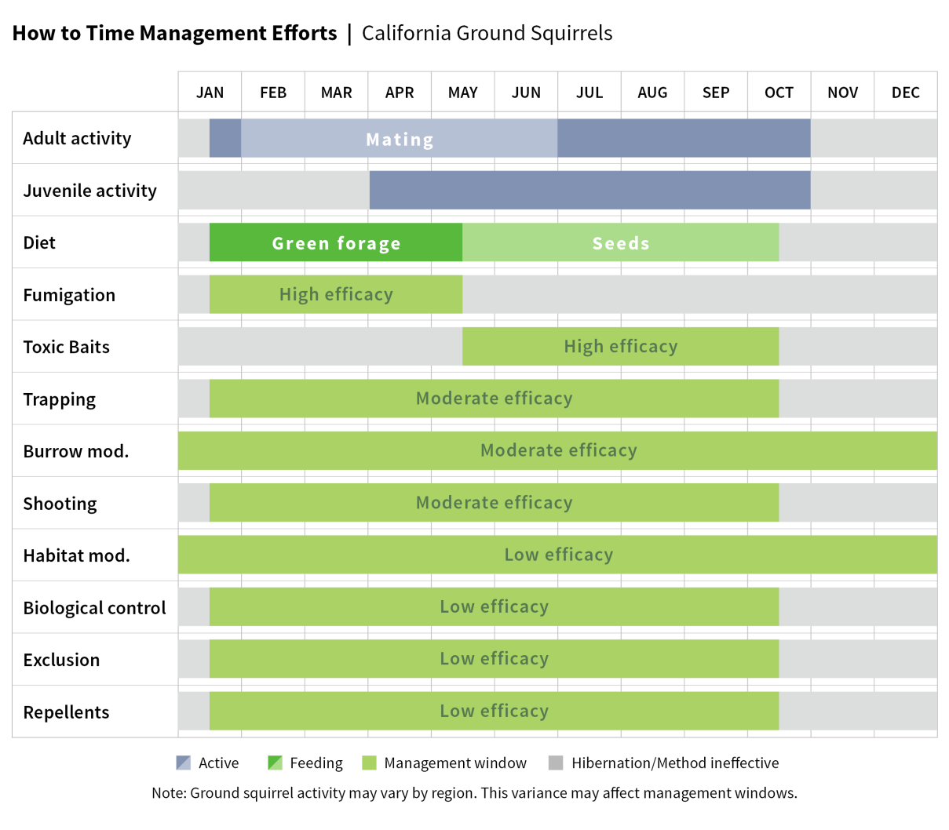
Importance of Biology/Ecology
Understanding the biology and ecology of vertebrate pests will guide management decisions.
Example:
  ground squirrels
Chart from Ground Squirrel BMP website http://www.groundsquirrelbmp.com/
Notes:
It’s very important to understand the biology and ecology of pests because they can really direct you to which tool or set of tools you should use to manage pests.
Here’s an example with ground squirrels. If you look at the top two lines on this chart, it shows the activity of juveniles and adults. They’re not active year round. So if you’re trying to manage ground squirrels, its best not to do it when they’re hibernating. It’s not shown on this graph, but ground squirrels also estivate, meaning they are not active during some of the hottest parts of the year.
If you look at the third line, it shows what ground squirrels eat. So in the first half of the year, ground squirrels eat green material and in the second half of the year, they eat seeds.
If you look at the next two lines, which both have high efficacy, fumigation and toxic baits, they only work at certain times of the year. Why might fumigation be more effective at the beginning of the year? (when the ground is wet, fumigants work much better)
Why does toxic bait work so well in the second half of the year? (that’s when they’re foraging for seeds, baits are often covered in seeds and rolled oats)
So you can see why it’s important to know and understand the biology and ecology of the pest so you can select management tools that will work successfully.

Slide 8
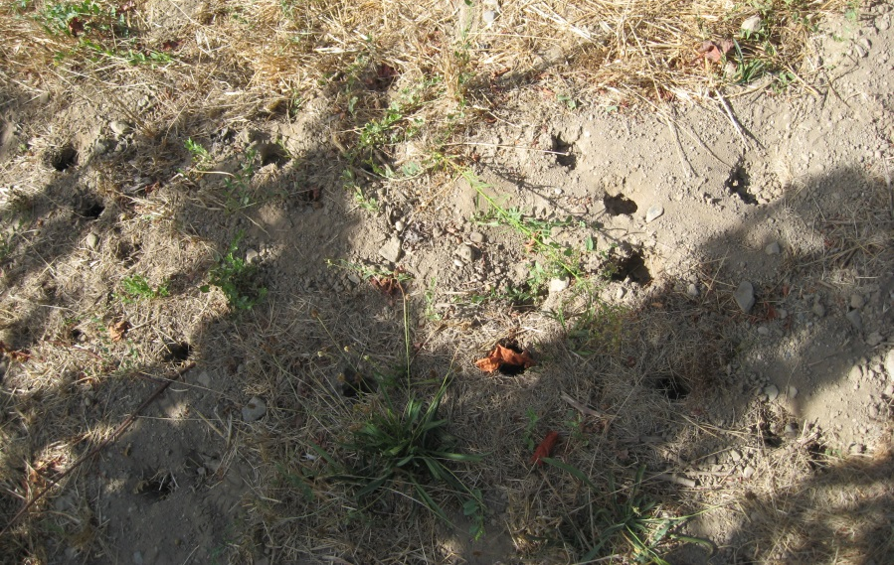
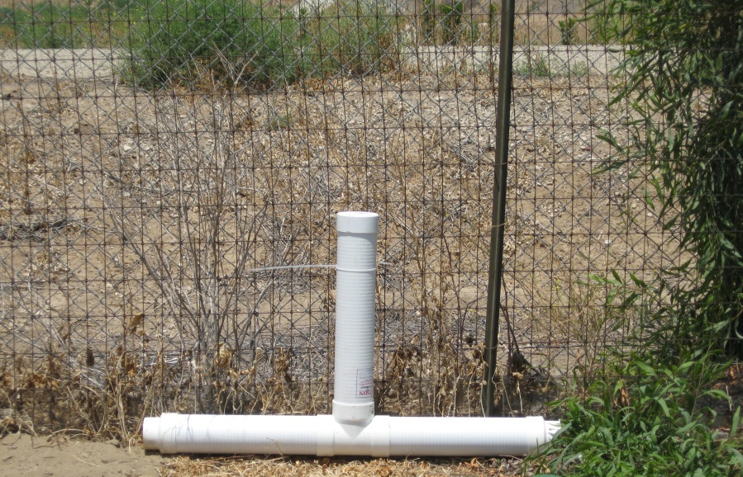
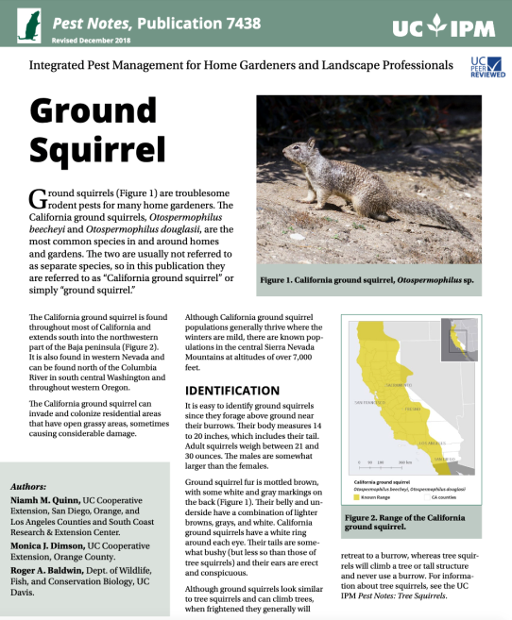
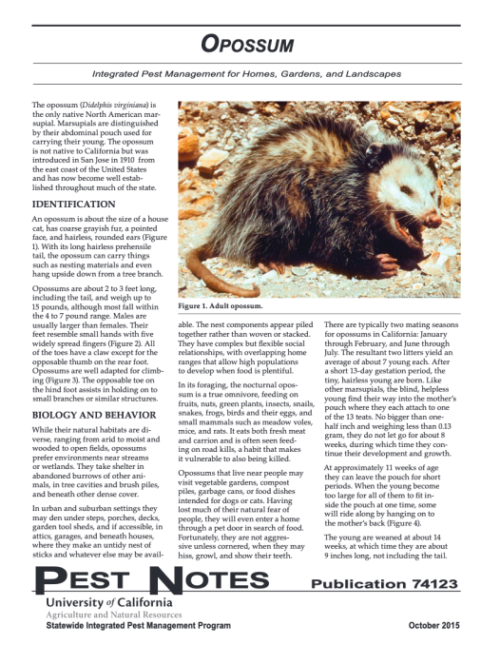
Management Strategy
Identify the vertebrate pest species.
UC IPM Pest Notes
Assess options for managing this species.
Photos: Roger Baldwin
Notes:
The number one thing in your management strategy is to know what pest you have. Once you know what it is, then you can assess management options. Some traps you set above ground, while others you set below ground. Some bait stations are above ground, like this ground squirrel bait station in the bottom picture, while others are below ground.
The UC IPM Pest Notes series for vertebrate pests will guide you through identifying the animal and finding appropriate management tools.
Once you know what you have, you can assess the different strategies that are available, and what make sense for your situation. There are several things you want to consider. What’s the cost? How practical is it? Do you need to be a certified applicator to use a particular material? Or can any homeowner or resident use this strategy? If you’re in a more rural environment, are there any protected species that may be affected by your management strategy?

Slide 9
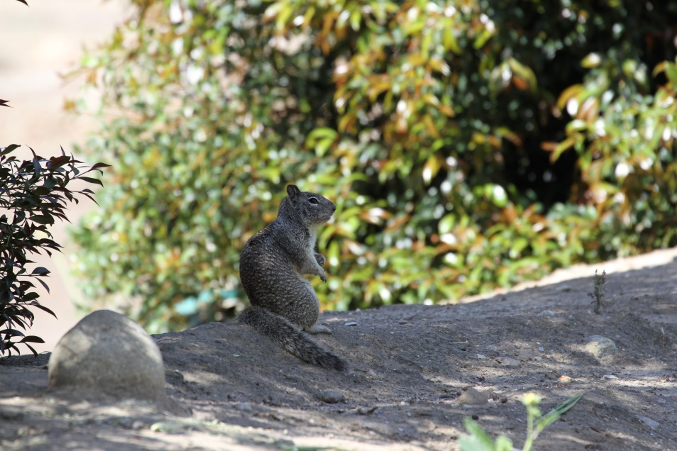
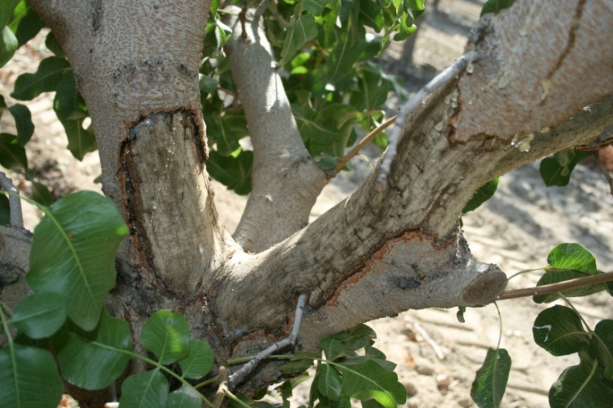
Species Identification – Ground Squirrels
Gray-brown fur with semi-bushy tail
Are social
Damage
  girdling of trees
  consumption of forbs and grasses
  chewing of irrigation lines
  abundant burrow openings
Photo: UC IPM
Photo: David Haviland
Notes:
We’re going to go through a few different animals you may encounter around gardens and homes.
Ground squirrels are rodents that are typically considered pests. They’re gray and brown in color, sometimes with a speckled or mottled appearance. They have a saddle on the back of their shoulders that’s a creamy color and they have a whiteish circle around their eye. Other squirrel species (like tree squirrels) do not have these characteristics.
Ground squirrels are social, which means they have family groups and are typically found together instead of solitary.
Ground squirrels are one of the major vertebrate pests in California, in agriculture and landscapes. They can girdle trees, consume forbs and grasses, they like to chew on irrigation lines. They burrow in the ground and by moving that much soil, they can contribute to significant soil erosion.
If their burrow networks are near buildings or on hillsides, sometimes when it rains you’ll get water rushing through their burrow channels which can destabilize soil and potentially cause a huge amount of erosion.

Slide 10
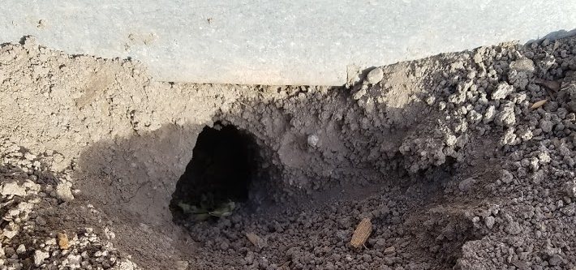
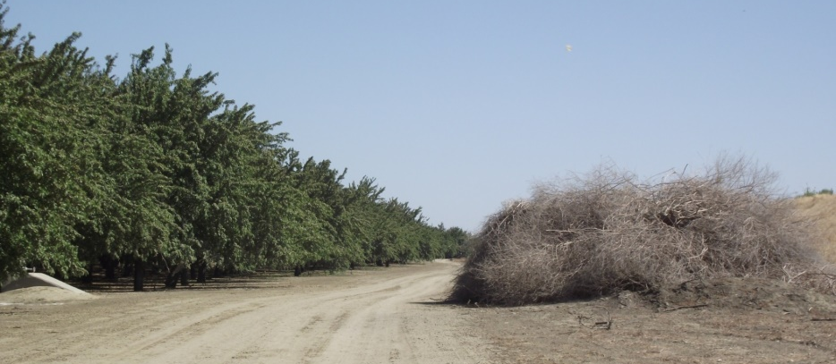
Species Identification – Ground Squirrels
Squirrels are active throughout the day and are frequently visible.
They prefer to burrow next to buildings, on field edges, and alongside fencerows and roadsides.
Photo: Niamh Quinn
Photo: Roger Baldwin
Notes:
Ground squirrels typically have multiple burrow openings. We see ground squirrels commonly during the day because that’s the time they are active.
Sometimes squirrels will burrow under buildings. Typically they prefer to burrow, den, or next in open areas because they can see predators coming.
If you receive a call on the help line about something eating something, one of the questions you can ask is, “Have you seen any squirrels?” Because ground squirrels are active during the day (diurnal), we can see them and they’re fairly easy to identify.
Ground squirrels, like other pest species (skunks, racoons, rodents), will often use brush, wood piles or pruning piles for harborage. So getting rid of those kinds of piles will help reduce vertebrate pests ability to establish in your yard.

Slide 11
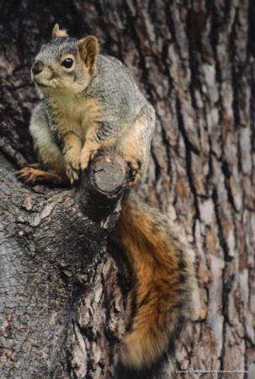
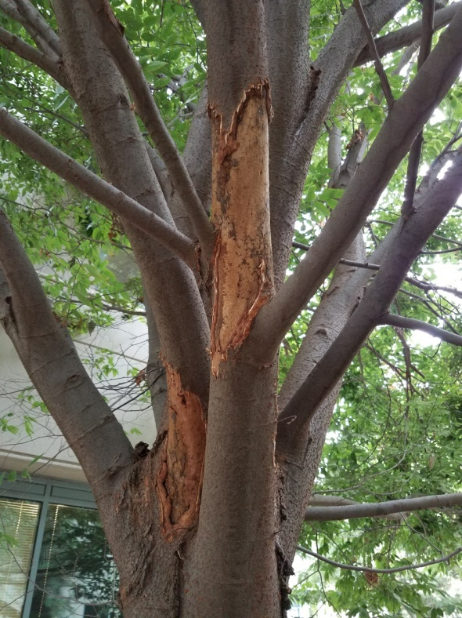
Species Identification – Tree Squirrels
Eastern fox squirrel causes the most damage.
Are diurnal.
Will consume fruits and nuts, dig holes in lawns, chew on cables, and nest in buildings.
Photo: UC IPM
Photo: R Baldwin
Notes:
In particular, the squirrels that are orange and eat lots of fruits and nuts are the Eastern fox squirrel. There’s also the Eastern gray squirrel. Both of these are non-native to California. Depending on where you are throughout the state, you may encounter one or the other or both. They are a major pest in California. They are invasive and spreading quickly. Like ground squirrels, they are also diurnal which means they are active during the day.

Slide 12
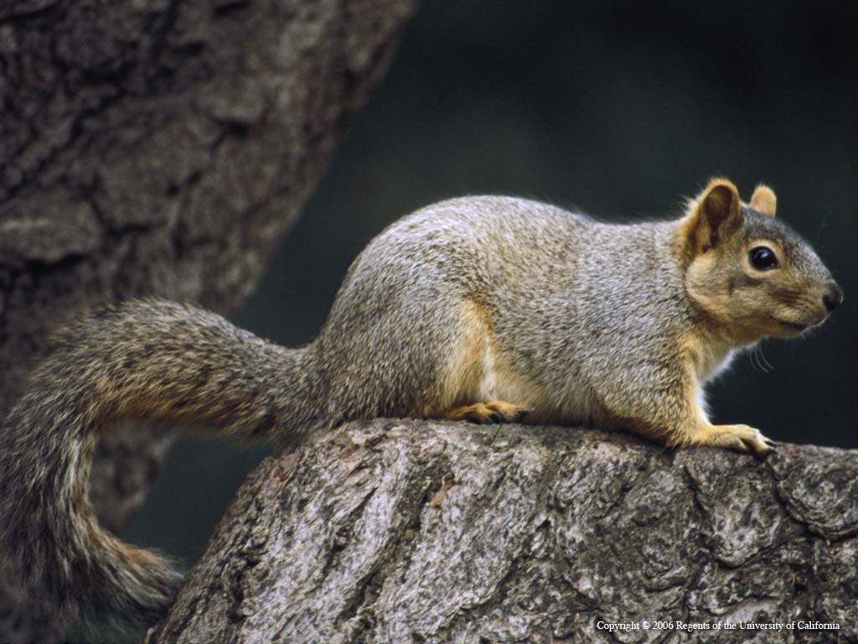
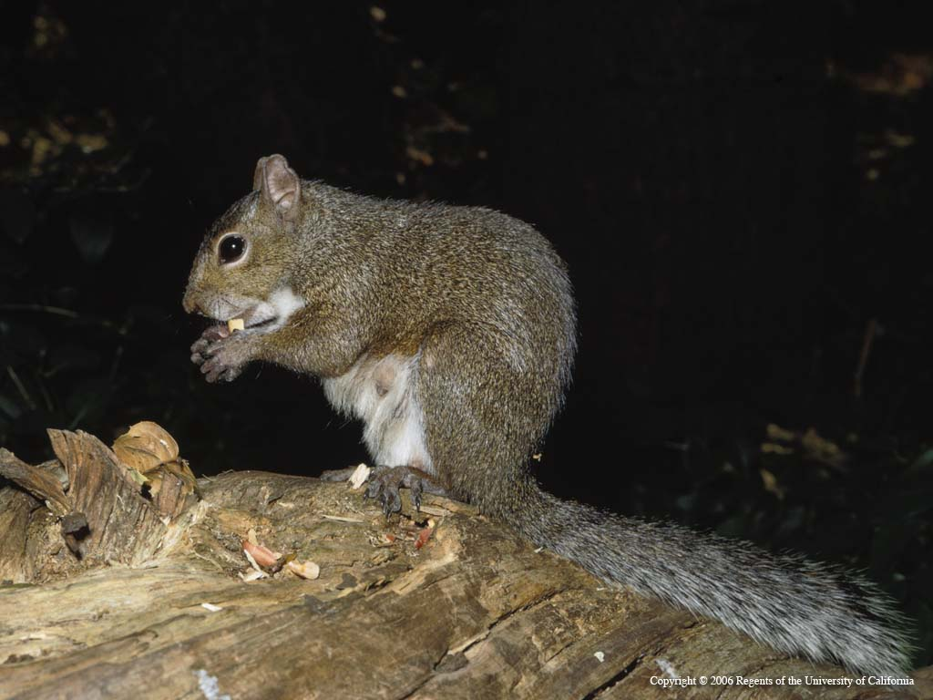
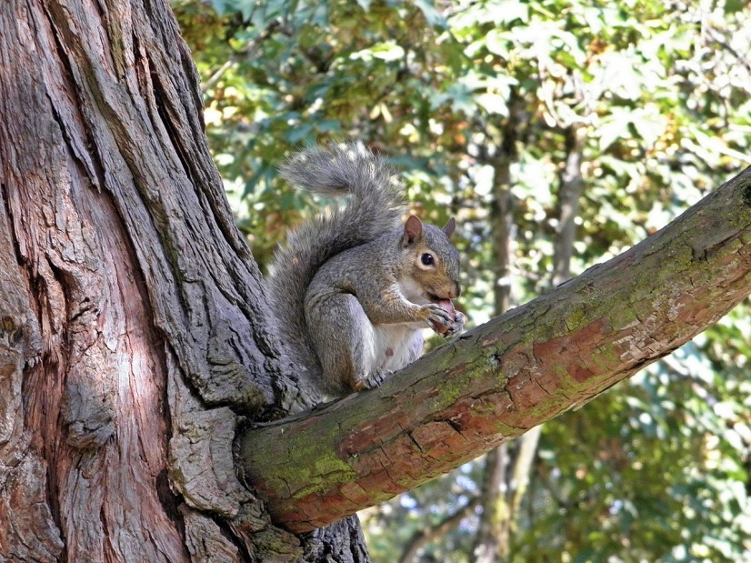
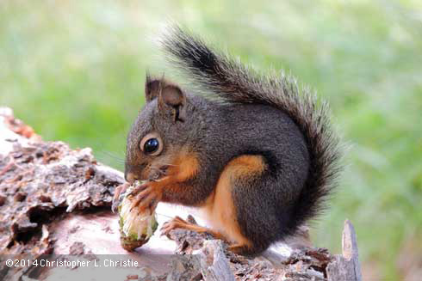
Species Identification – Tree Squirrels
Eastern fox (Photo: UC IPM)
Eastern gray (Photo: Jerry P. Clark)
Western gray (Photo: UC IPM)
Douglas squirrel (Photo: Christopher Christie)
Notes:
There are four different kinds of tree squirrels throughout California. Not all these squirrels are in all areas in California yet, especially the non-native ones. But they are expanding their range and if you don’t have them now, you will likely see them soon.
Upper left: Eastern fox squirrel (also called red fox squirrel)
Upper right is the Eastern gray squirrel
Bottom right is the native Douglas squirrel
Bottom left is native Western gray squirrel
The native Western Gray squirrel typically doesn’t cause too much damage. Management for these species is quite different. For eastern fox squirrels, there are not many restrictions for their management. For Eastern gray, western fox, or even the douglas squirrel, they require a permit to trap from CA Fish and Wildlife because they’re considered a game species.

Slide 13
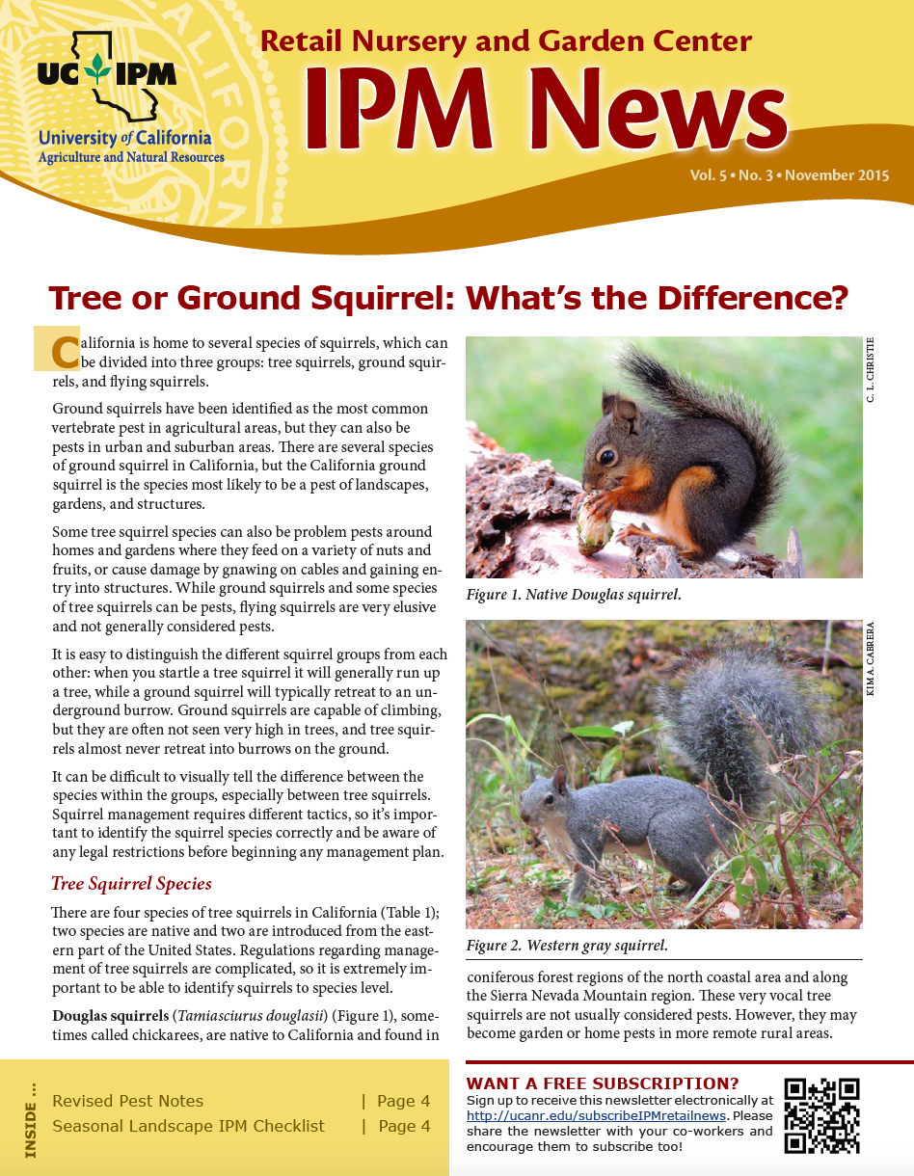
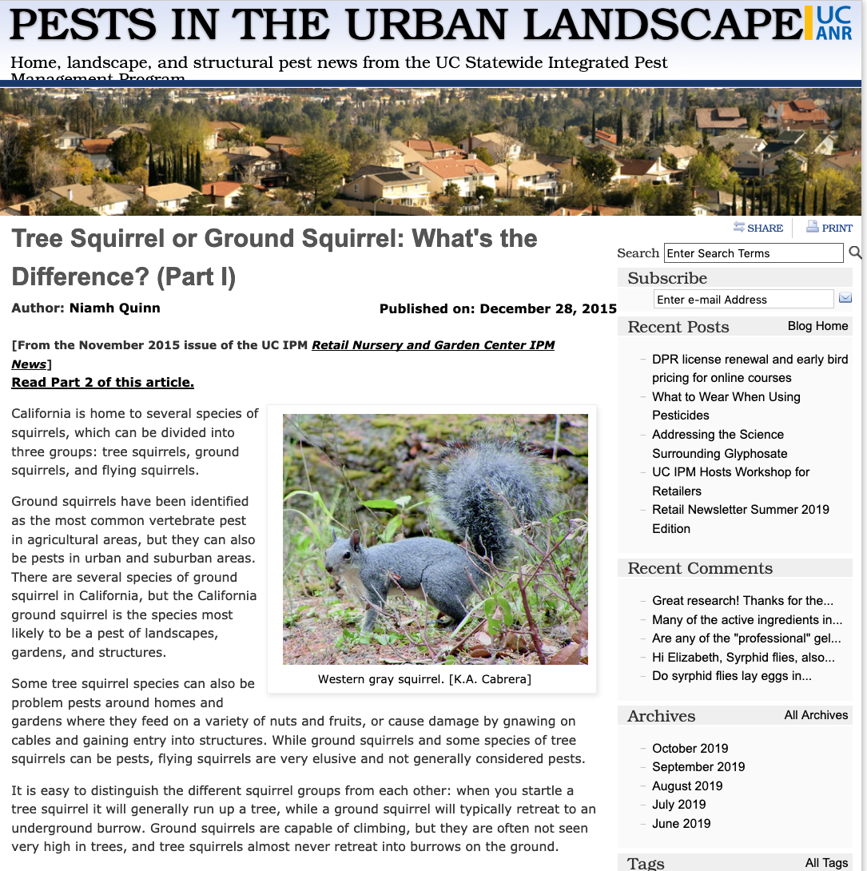
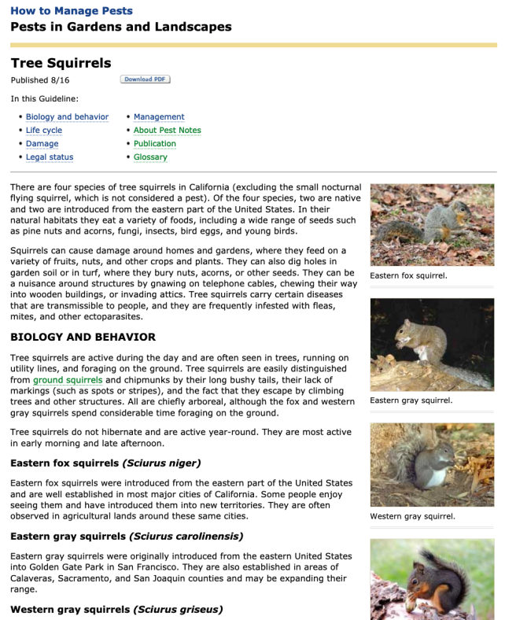
Species Identification – Tree Squirrels
Search online for
“UC IPM tree squirrel blog”
Eastern fox (Photo: UC IPM)
Eastern gray (Photo: Jerry P. Clark)
Western gray (Photo: UC IPM)
Douglas squirrel (Photo: Christopher Christie)
Notes:
Managing tree squirrels is complicated and there are legal restrictions depending on where you live in the state. We don’t have time today to go over the specifics, but here is a good article on identifying tree squirrels and these management restrictions on the UC IPM urban and community blog. The blog post is based on an article first written for the UC IPM newsletter, Retail Nursery and Garden Center IPM News.
The easiest way to find the blog is to search for the terms “UC IPM tree squirrel blog”. The Tree Squirrels Pest Notes has similar information that will help in identifying and understanding these pests.

Slide 14
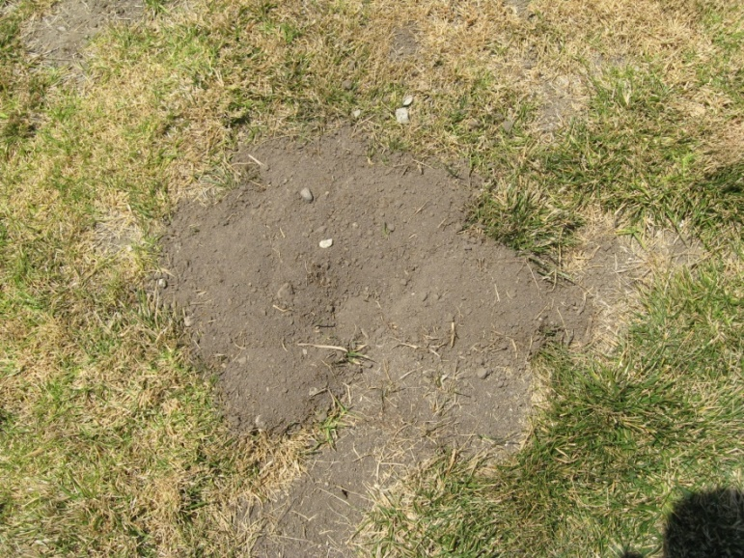
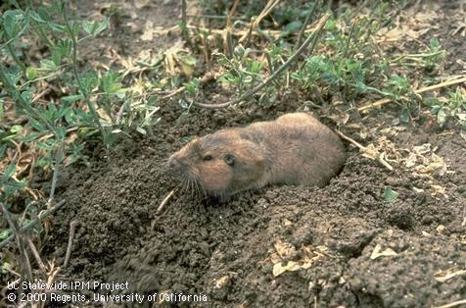
Species Identification – Pocket Gophers
Burrowing rodent about 6-8 in long; rarely seen above ground.
Gopher mounds are plugged and often fan-shaped.
Photo: R Baldwin
Photo: UC IPM
Notes:
Pocket gophers are a very common pest as well. There are two pockets on their cheeks where they keep their vegetation that they rip up underground and bring them back to their nests.
You will rarely see gophers because they prefer to stay below ground. However, you will often see their mounds. They tend to be fan shaped with a plug in the middle. The reason they’re fan shaped is because gophers move soil at a 45 degree angle out of their burrow so the soil falls around on one side.

Slide 15
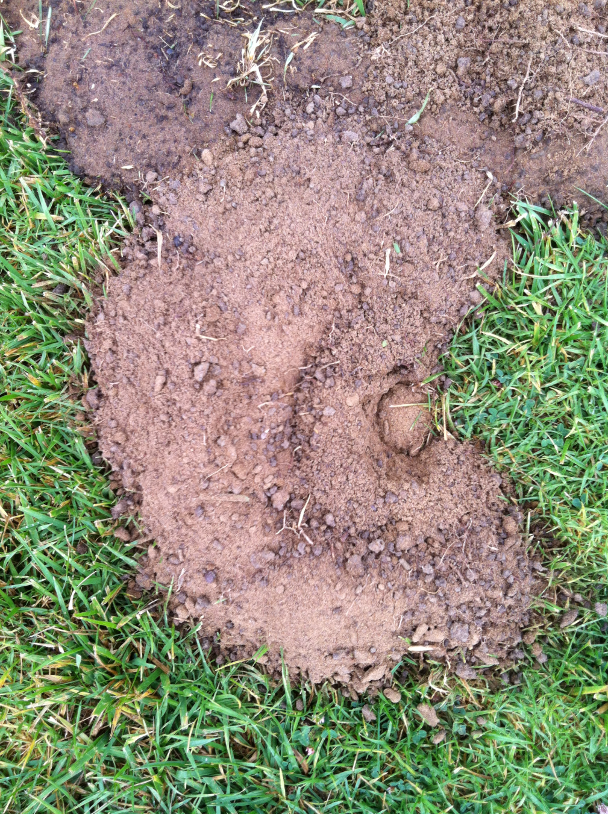
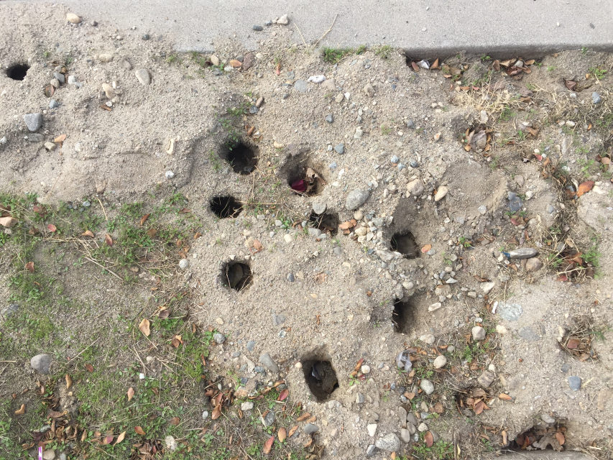
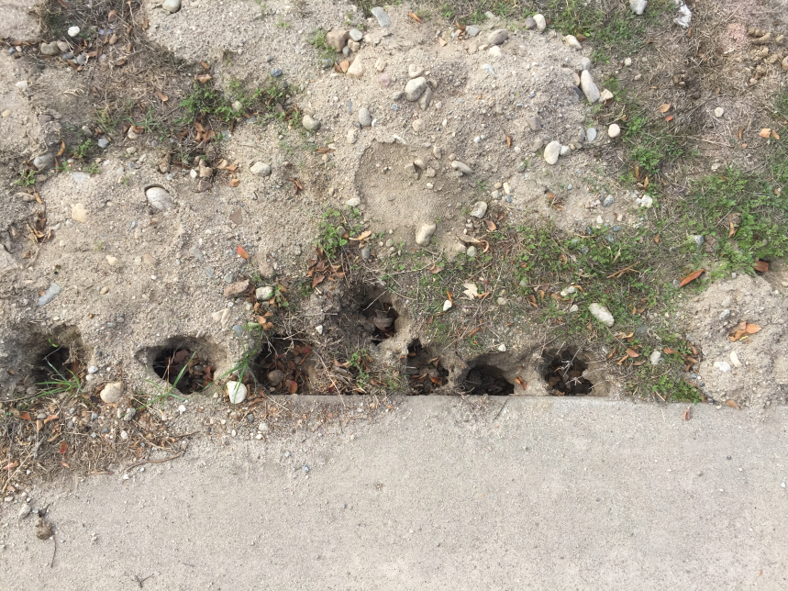
Photos by Niamh Quinn
Notes:
Gopher mounds may not always have that characteristic fan shape. Depending on the soil and how long the mound has been there, they may look different.
The mounds on the right are near the beach, the soil was sandy and it was windy so the mounds were not well preserved. Sometimes when you get photos, they’re not going to be the best quality, or most illustrative so it’s good to know what generally gopher mounds look like but it’s also important to familiarize yourself with the wide variety of what they can look like.

Slide 16
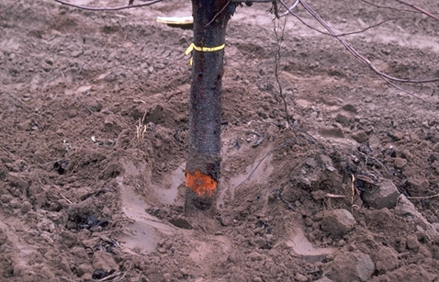
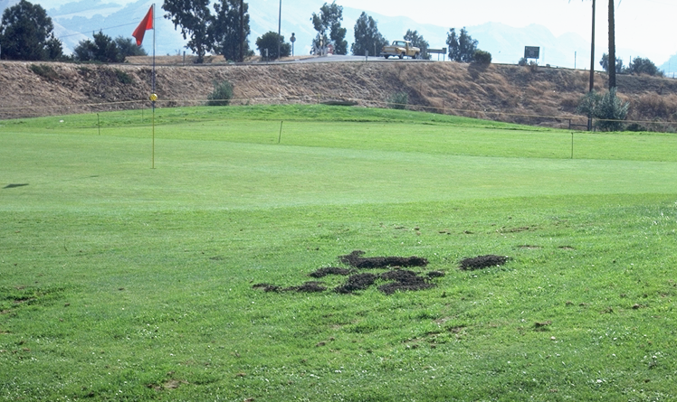
Species Identification – Pocket Gophers
They feed on taproots weakening and/or killing plants.
Then can girdle trees, particularly below ground.
Mounds can also kill plants and can create weed seed-beds.
Notes:
Gophers feed underground, they can weaken the plant or take it out completely. They’ll girdle trees and vines but because it happens below ground, you may not see the damage until it is too late.
They can also move so much soil that it compromises the structure of the ground and a tree can topple over as well. Mounds can also be tripping hazards.

Slide 17
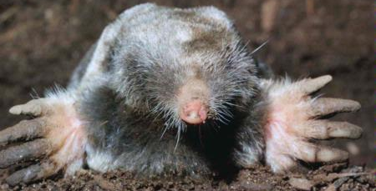
Species Identification – Moles
Are burrowing mammals with a pointed snout and broad feet that eat worms and insects.
As such, moles cause less damage to gardens than gophers, though linear ridges and mole mounds do cause damage.
Photo: UC IPM
Notes:
Moles have different fur than most other animals, it grows up rather than at an angle so they’re often softer than other furry vertebrates. Moles are also burrowing mammals but they are NOT rodents. It doesn’t cause a lot of damage to fruits and vegetables typically. They prefer to eat worms and grubs.
Their mounds cause some of the same concerns as gophers such as tripping hazards, soil erosion, etc.

Slide 18
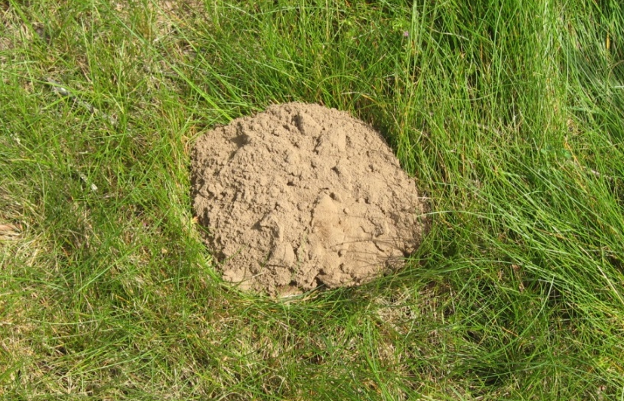
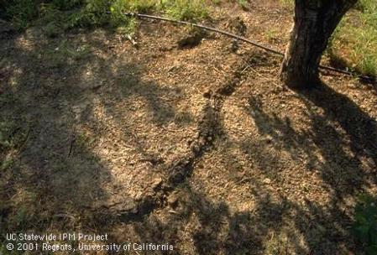
Species Identification – Moles
Mounds are volcano shaped with the plug in the center of the mound.
Can also be identified from raised earth indicating underground tunnels
Photo: R Baldwin
Photo: UC IPM
Notes:
Moles typically don’t do a lot of damage in vegetable gardens but they can cause damage to lawns and crack turf. They burrow very close to the ground and tunnel near the surface. This tends to be where there’s more moisture, and more of the things that moles like to eat like grubs. These raised ridges of soil are indicative of moles, they’re the only critter that make these kinds of tunnels. The absence of these raised ridges, however, doesn’t mean you don’t have moles. But if you see them, it’s very likely you have moles.
Moles can be very difficult to control. You’ll sometimes see their mounds, which are very round, unlike pocket gopher mounds. There are no plugs visible typically. They’re round because moles move soil up at a 90 degree angle, so the soil fall evenly around their hole.

Slide 19
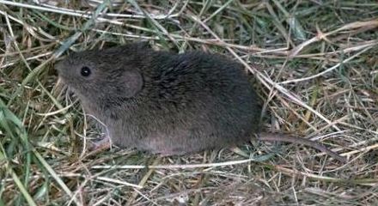
Species Identification – Meadow Voles
Have dark grayish brown fur and are 4 to 6 inches in length.
Populations tend to cycle, exhibiting irruptive growth patterns.
Photo: UC IPM
Notes:
Does anyone have meadow voles? And not to be confused with moles! They’re different, and you do need to know which one you have to manage. So if you’re on the helpline, do clarify if they have moles or voles.
Typically you’ll find them near areas with lots of grass. They’re quite small mammals, about 4 to 6 inches in length. They’re larger than a mouse but smaller than most rats.
Their population cycles are interesting, there are some years where you won’t see many of them. Then a few years later, there will be tons of them.

Slide 20
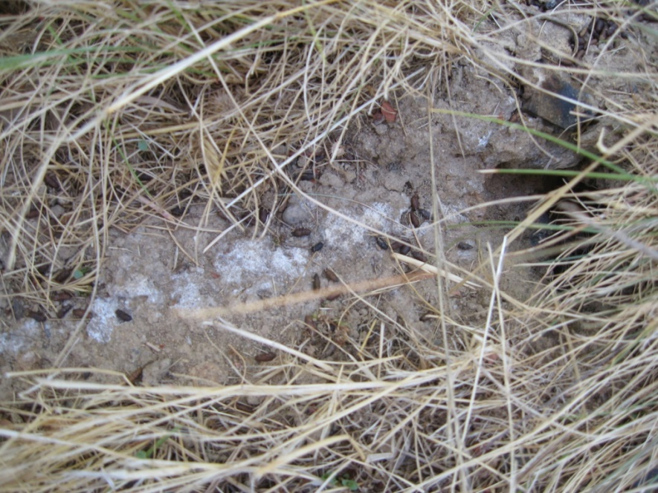
Species Identification – Meadow Voles
Dig shallow burrows and leave well-worn trails. Fecal pellets are often present,
Primary damage caused by girdling of stems, consumption of vegetation, and gnawing of cables, pipes, etc.
Photo: UC IPM
Photo: R Baldwin
Notes:
Voles like areas where there’s a lot of vegetation. Their holes look a bit like gopher holes, but they have short runways that go into their tunnels. They can girdle stems, they consume a lot of vegetation. Most of their damage is above ground but they can do damage underground to cables, irrigation, etc.

Slide 21
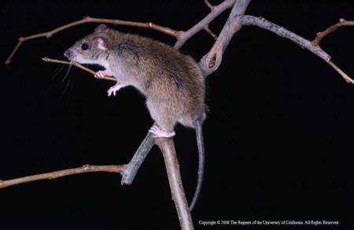
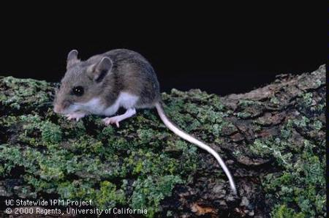
Species Identification – Other Rodents
Norway rats, roof rats, house mouse, deer mouse.
Primarily commensal rodents.
Can be difficult to control in some outdoor settings.
Photos: UC IPM
Notes:
California has rats and other rodents throughout the state, they’re really everywhere. There are a few different species of rats. Norway rats and roof rats tend to be the primary commensal rat species, living in and around human dwellings.
Rats can be difficult to control because they tend to be neophobic. Does anyone know what neophobic means? They’re afraid of new things. So they don’t like new traps. The other thing that makes them hard to control is their reproductive output which makes rodents a really challenging problem.
For commensal rodents, there are things in and around your house that you can use, there are certain tools available to you.
The deer mouse is a native species. We don’t typically find them in our houses, but you will sometimes find them in sheds and in more rural areas near natural areas.

Slide 22
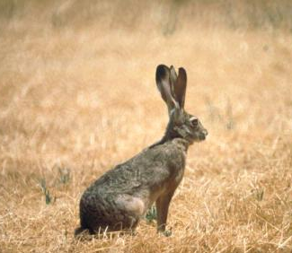
Species Identification – Hares & Rabbits
Jackrabbits are hares, but they are the most common rabbit-like pest in agricultural settings.
Are larger and have longer ears than cottontails.
Damage caused through foraging on stems and leaves of plants
Photo: UC IPM
Notes:
Jackrabbits are not rabbits. They’re hares, primarily they’re an agricultural and rural pest species. They have huge ears that are nearly half the size of their bodies. They tend to do damage on the stems and leaves of plants, not as much the fruits and vegetables themselves.

Slide 23
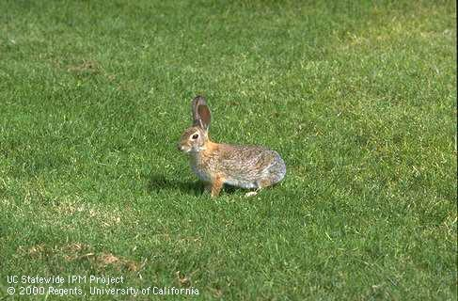
Species Identification – Hares & Rabbits
Cottontails are true rabbits.
They are smaller and have shorter ears.
Typically a bigger pest than jackrabbits in urban settings.
Photo: UC IPM
Notes:
Cottontails are much smaller than jackrabbits. Their ears are substantial but much shorter than jackrabbits. The damage they cause is similar to jackrabbits, with damage to stems and leaves of plants. They’re more of a problem in urban areas with landscapes, nurseries, etc.

Slide 24
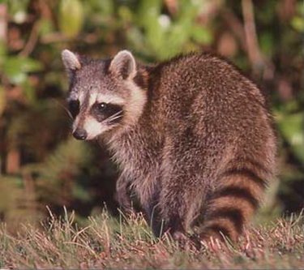
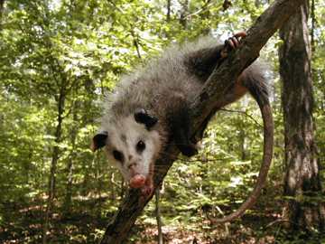
Species Identification – Raccoon and Opossum
Will eat fruits and vegetables.
Can get into garbage and pet foods.
Potentially transmit diseases.
Photo: unknown
Photo: Brian Carver
Notes:
These species are found in urban areas. They will get into your fruits and vegetables. Raccoons and opossums can carry diseases like salmonella that can be harmful to pets and humans.
If you feed your pets outside, which you shouldn’t, be sure that the food containers are sealed otherwise you will attract these vertebrate pests.

Slide 25
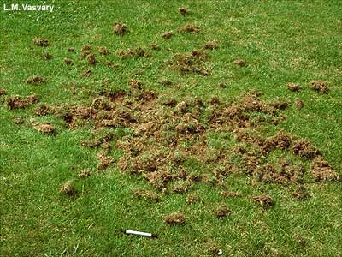
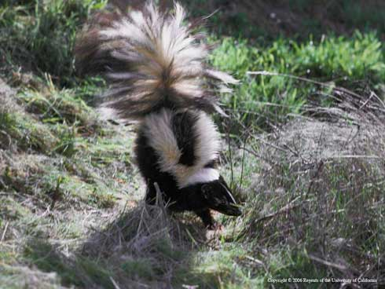
Species Identification – Skunks
Will dig holes looking for grubs and insects
Will spray
Will eat pet foods
Can transmit diseases
Photos: UC IPM
Notes:
Most of the times, skunks are after grubs and insects. They do more damage on turf as opposed to your vegetable gardens while they look for food.
What disease are we most concerned about with skunks? Rabies! There aren’t a lot of instances of rabies in California. You’re more likely to get rabies from a feral cat scratch or a bat, but skunks can transmit the disease.

Slide 26
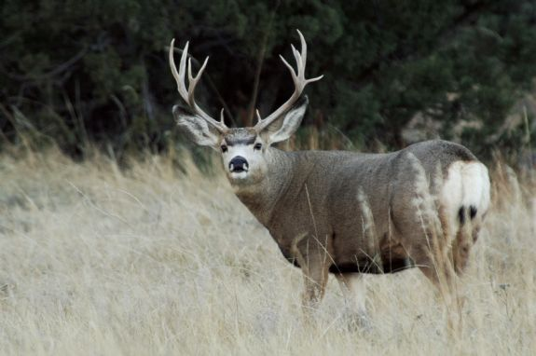
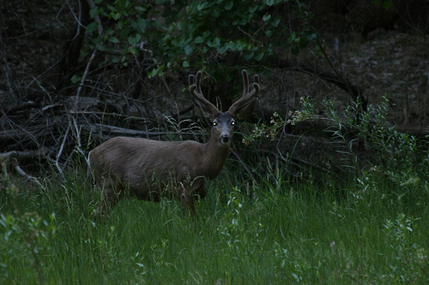
Species Identification – Deer
Can cause significant damage to gardens and landscaping, especially when in close proximity to forested and riparian areas.
Most damage will occur during dawn, dusk, and at night, so identification of footprints and scat may be needed to determine deer were the cause of damage.
Photos: unknown
Notes:
Deer pests may not be present in all regions of California, but they are pests in certain areas. They’re pretty distinctive. They can be pests in urban areas that are really close to natural resources areas. They don’t have to physically be in your yard, they can simply eat alongside your yard.
Mostly, they will do damage at dawn and dusk. So it’s important to consider when you’re looking for damage. Their poop is fairly easy to identify and their footprints are very distinctive as well.

Slide 27
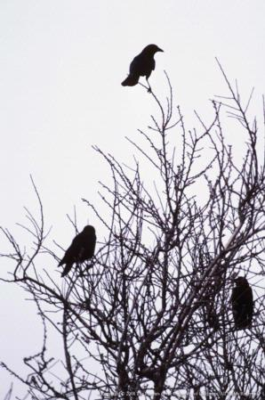
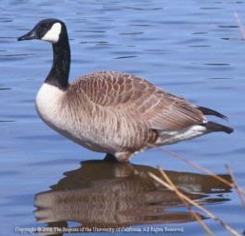
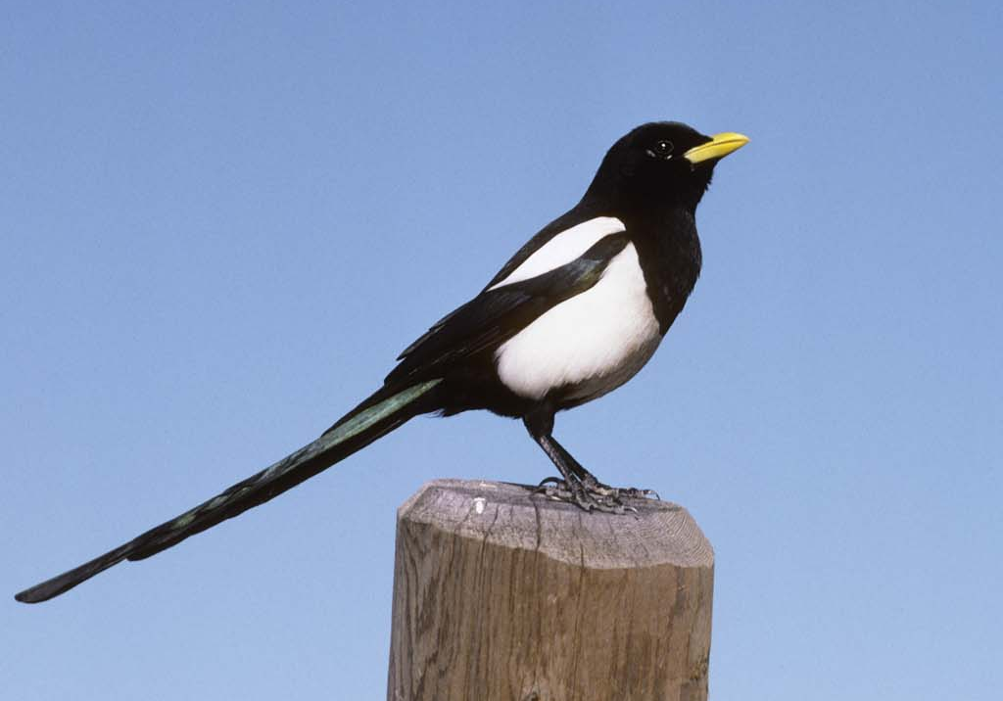
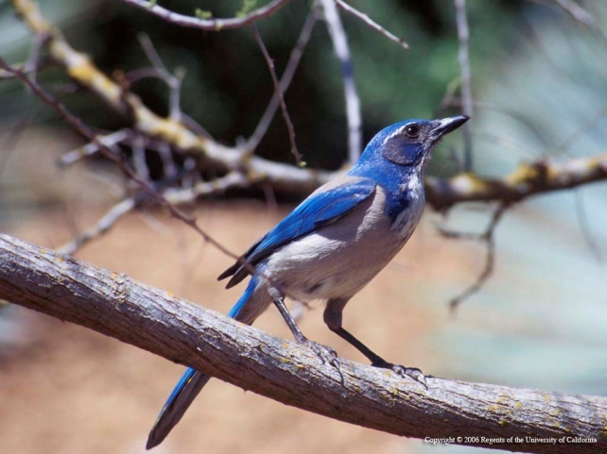
Species Identification – Birds
Birds can be pests in vegetable gardens.
These include ducks, geese, crows, magpies, starlings, house finches and scrub jays.
UC IPM
Notes:
Birds can be urban pests as well. They’ll often eat fruits and vegetables. Starlings and house finches can be very common in urban areas so they’re often some of the pests you may encounter. They also carry diseases that can be transmitted to humans.

Slide 28
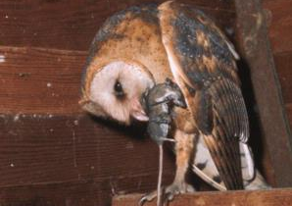
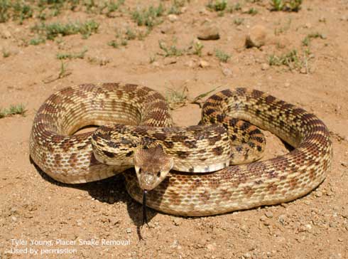




IPM for Vertebrate Pests
Biological control– natural predators
Cultural control– Modify habitat
Physical control– exclusion, trapping, frightening
Chemical control– repellents, rodenticides
Tyler Young
R Baldwin
UC IPM
Notes:
There are a lot of options for vertebrate pest control. We always recommend an integrated management approach.
Biological control of certain species can be challenging. For example, with rodents, they reproduce so quickly, that it’s not always possible to control the population through biological control only.
Cultural controls like habitat modification can be effective like removing brush piles and vegetation management for boles.
Some of our physical controls like exclusion and trapping work well. Raised flower beds, fencing to keep rabbits out, tree protectors to reduce damage from girdling. Frightening devices are not effect all across the board, some of the work well, some of them don’t. And it depends on what you’re trying to manage. Trapping can be a very effective tool as well and you don’t need any special permits for them.
Repellents and rodenticides can be effective chemical control. Sometimes repellents don’t work, it just depends on what kind. As for rodenticides, they’re not all the same and they don’t have the same impacts. Burrow fumigants can also be used for underground burrowing pests.
For the last two management methods, physical and chemical controls, it’s extremely important that you know exactly what pest you have before you use these controls.

Slide 29
What Control Options are Available?
 | Habitat modification | Baiting | Burrow fumigation | Trapping | Exclusion | Repellent | Frightening | Shooting
Pocket gopher | X | X | X | X | X
Ground squirrel | X | X | X | X |  |  |  | X
Meadow vole | X | X |  | X | X
Hares & rabbits | X | X |  | X | X | X |  | X
Tree squirrels | X |  |  | X |  |  |  | X
Deer |  |  |  |  | X | X |  | X
Birds | X |  |  | X | X | X | X | X
Notes:
There are different options available for different types of pests. If you have squirrels, you need to know if you have tree squirrels or ground squirrels. As you can see, the control options are different for tree squirrels and ground squirrels.
Not every tool is effective for all species. And not every species has the same set of tools to use to manage. It’s important to keep this in mind because you can’t always recommend the same thing. There’s no magic answer. You have to know what management option is effective for what pest you have. Again, identification of the pest is extremely important.
You can legally shoot things in California, just not everything. As long as they are not game species unless you have a game license, and as long as your city or area allows it.

Slide 30


Control Options—Trapping
Body-gripping traps, box-type squeeze traps, snap traps, and pincer traps are common kill traps.
Wire cage traps are common live traps.
Live traps require euthanization of the animal.
Photo: R Baldwin
Notes:
There are many different types of traps that can be used for different vertebrate pests. These are species dependent, and it’s important to know what you have so you. know how to set them. There are many different traps and they all work a little differently.
When you’re trapping, it is important to consider live vs kill traps depending on what you need. Kill traps kill the target animal, the benefit is that if you are trying to remove an animal, the trap has done it for you. The downside, is that the trap does not discriminate so it can kill nontarget species. If you are worried about nontarget species, life traps won’t harm them.
Wire cage live traps are very common. However, you must release the animal where you caught it or euthanize it appropriately. It is illegal in California to translocate wildlife or bring it somewhere else. And it’s a terrible wildlife practice. Some of these pests carry diseases and parasites and if you move a pest somewhere else, you can spread these diseases and parasites to new populations. So don’t translocate animal pests!
Two techniques are recommended as the most humane ways of euthanizing: shooting (which is not usually legal in urban areas) or gassing in a carbon dioxide chamber.
People are not always comfortable with either of these options, so hiring a professional may be an option to take care of vertebrate pests.

Slide 31
Developed by the University of California Statewide Integrated Pest Management Program (UC IPM)
For information about managing vertebrate pests and other pests of homes, gardens, landscape, and turf, visit the UC IPM website
ipm.ucanr.edu
Special thanks to UC’s experts in human-wildlife interactions Dr. Roger Baldwin and Dr. Niamh Quinn
Notes:
For information about managing vertebrate pests and other pests of homes, gardens, landscape, and turf, visit the UC IPM website at ipm.ucanr.edu
Thank you!

Slide 32
Thank You!
Any Questions?
Master Gardener Hotline: (530) 889-7388
Rot Line: (530) 889-7399
Master Gardener Website: pcmg.ucanr.org
Evaluations, please!
32

