Slide 1
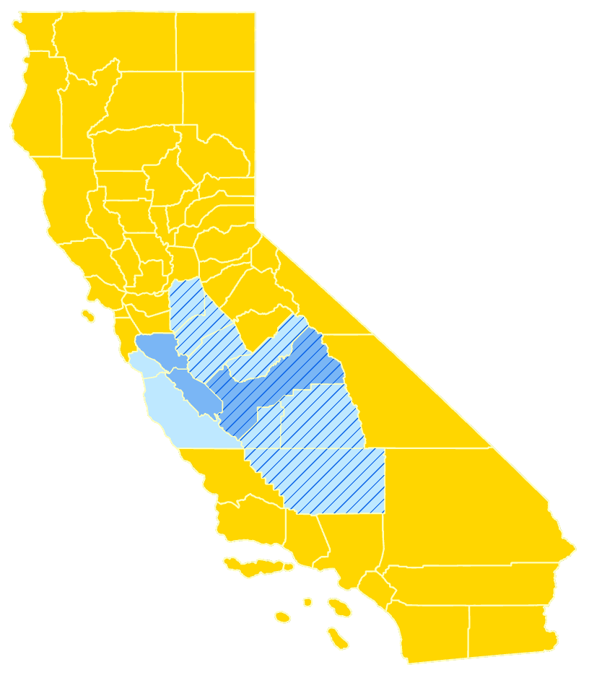
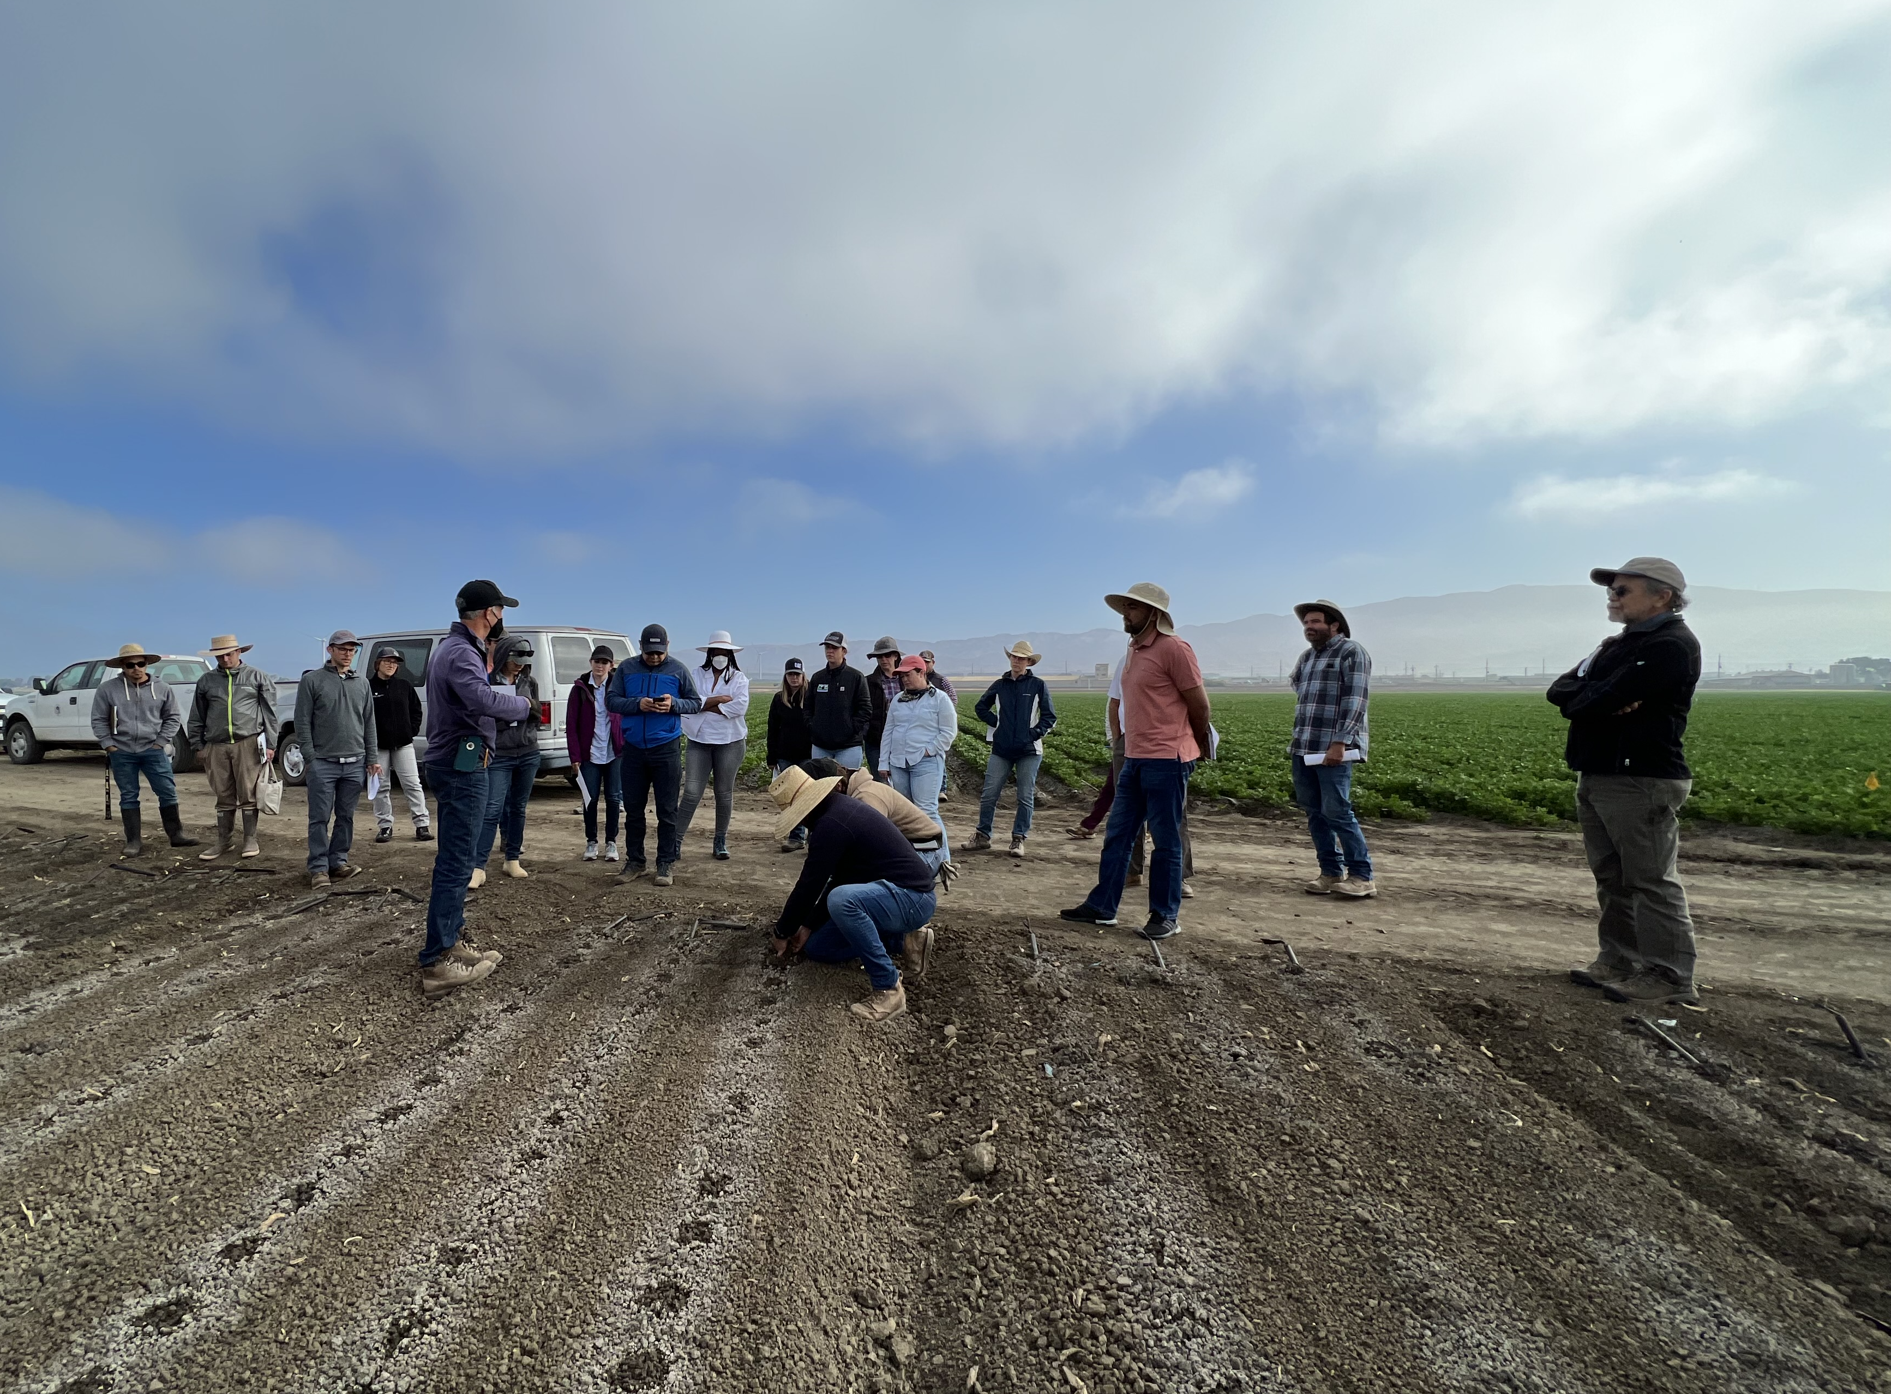





UCANR-CDFA Nitrogen and Irrigation Initiative (NII)
Objective
Improve nitrogen and irrigation management in California by closing the information access and training gap. UCANR advisors and specialists will work with Staff Research Associates (SRAs) to deliver educational content, training, and consultations to growers and their consultants in the San Joaquin Valley and Central Coast.
Outreach
Educational Resources
Continue to develop printed materials, videos, blogs, infographics to share with growers who can then relate and apply such practices to their specific operation.
On-Farm Trials
Coordinate on-farm demonstrations to promote locally appropriate best irrigation and nitrogen management practices to conserve resources and improve irrigation and nitrogen use efficiency.
Training Events
Conduct outreach activities (e.g., webinars, workshops, field days, trainings, one-on-one field visits) to increase knowledge and skills of enhanced nitrogen and irrigation practices and emphasize how practices increase on-farm efficiency.
Grower Consultations
UCANR academics and SRAs will conduct individualized on-farm grower consultations to make recommendations and assist with implementation of recommended practices.
Funding
Three grants collectively fund the initiative, and they are often referenced using acronyms: Fertilizer Industry Advisory Board (FIAB), Specialty Crop Block Grant (SCBG), and Conservation Innovation Grant (CIG).
San Joaquin
Stanislaus
Merced
Madera
Santa Cruz
Santa
Clara
Fresno*
San Benito
Monterey
Tulare
Kings
Kern
= FIAB
= SCBG + FIAB
= CIG
*Fresno is the only county included in all three grants
Image: In-field training on irrigation system evaluation and improved management practices.
Impact Analysis
Surveys will gather data from outreach and farm visit activities. UC Davis social science researchers will assess the effectiveness and impact of our efforts in the San Joaquin Valley.
Activities
Contacts
County Advisors
Monterey/Santa Cruz: Michael Cahn, mdcahn@ucanr.edu
Santa Clara/San Benito: Aparna Gazula, agazula@ucanr.edu
Madera/Merced: Phoebe Gordon, pegordon@ucanr.edu
Fresno/Kings: Mae Culumber, cmculumber@ucanr.edu
Kern/Kings: Mohammad Yaghmour, mayaghmour@ucanr.edu
Staff Contacts
Stanislaus/San Joaquin:
Jacqueline Vasquez Mendoza jvasquezmendoza@ucanr.edu
Fresno/Tulare/Kings: Brady Holder beholder@ucanr.edu
Programmatic Contacts
Mark Cady mark.cady@cdfa.ca.gov
Khaled Bali kmbali@ucanr.edu
Sam Sandoval samsandoval@ucdavis.edu
Rachel Shellabarger rmshellabarger@ucanr.edu
Activity | Tulare, Kings, Kern, Merced, Madera, Stanislaus, San Joaquin, Monterrey, Santa Cruz |  |  | Fresno (FR), San Benito (SB), and Santa Clara (SC)
 | 2022 | 2023 | 2024 | 2022 | 2023 | 2024
Training workshops | X | X | X | X | X | X
On-farm trials | X | X | X | X | X | X
Field meetings/workshops for on-farm trials | X | X | X | X | X | X
Outreach webinars for specialty crop growers |  |  |  | FR, SB or SC | FR, SB or SC | FR, SB or SC
Outreach workshops for specialty crop growers |  |  |  |  | FR, SB or SC | FR, SB or SC

